Slide 1
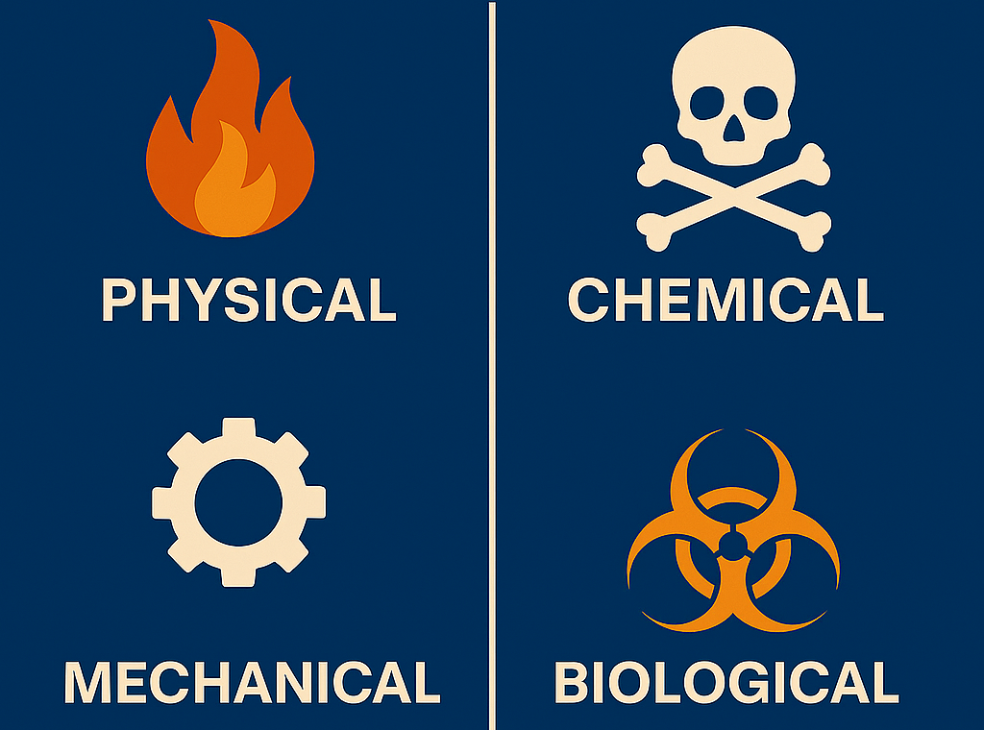
Democratic and Popular Republic of Algeria
Ministry of Higher Education and Scientific Research
University Center of Abdelhafid Boussouf - Mila
Institute of Sciences & Technology
Department of Process Engineering
HSE in Industrial Installations – UED2.1
Week II:
CLASSIFICATION OF HAZARDS

Slide 2
Learning Outcomes
By the end of this session, students will be able to:
Identify main types of hazards.
Differentiate physical, chemical, and biological hazards.
Provide industrial examples for each category.
Recognize combined hazard scenarios.

Slide 3
1. Why classification of hazards?
Classifying hazards means putting them into clear groups. This helps us:
Understand risk better – gives clear structure of risk assessment.
Choose the right controls – each hazard needs its own safety method.
Set priorities – focus first on the most dangerous hazard.
Follow the law – supports compliance with safety rules and inspections.
By classifying hazards, we make safety work more organized, effective, and easier to manage.

Slide 4
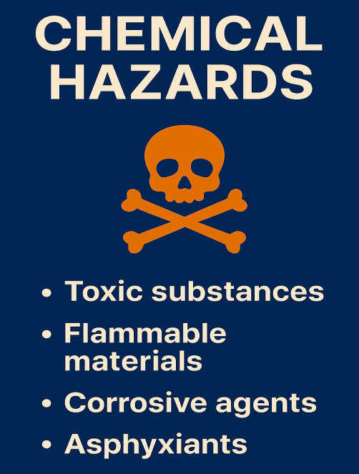
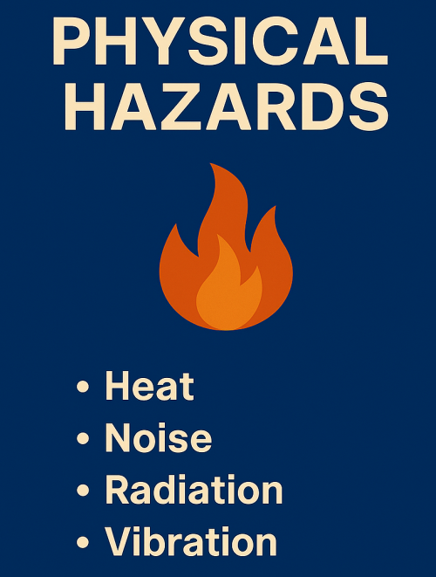


II. Types of Hazards

Slide 5


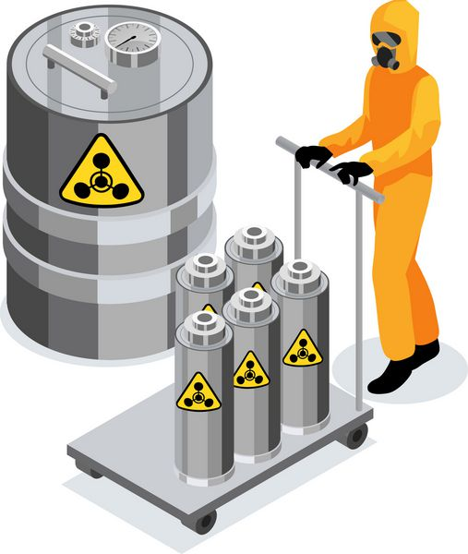


II.1- Physical Hazards
Physical hazards are environmental factors or conditions—such as noise, heat, radiation, or vibration—that can cause harm to a person without necessarily touching them.
Excessive noise → hearing loss, fatigue.
Vibration → musculoskeletal disorders.
Radiation (ionizing & non-ionizing).
Temperature extremes (heat, cold).
Pressure (steam, compressed gases).
Example: Boiler operating at 20 bar → explosion risk.

Slide 6
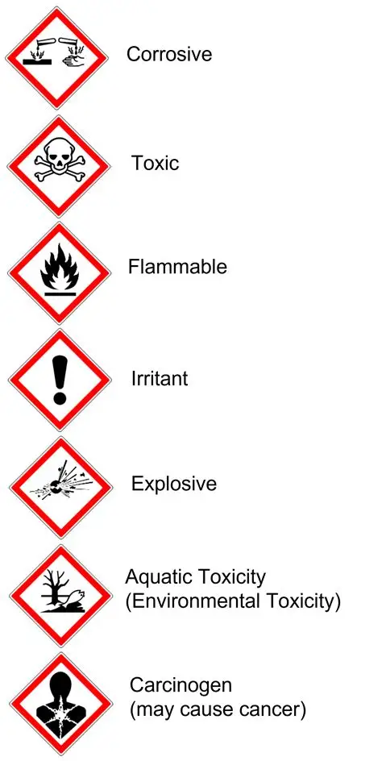
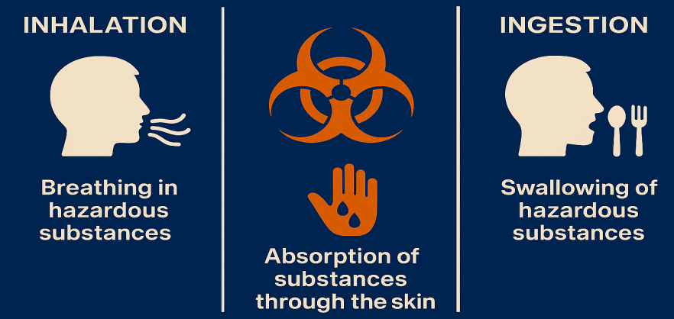
II.2- Chemical Hazards
Chemical hazards are risks arising from the intrinsic properties of substances (toxicity, flammability, corrosivity, reactivity, etc.) that can harm health, safety, or the environment.
Toxic substances: benzene, chlorine.
Flammable substances: solvents, hydrocarbons.
Explosives: ammonium nitrate.
Corrosives: sulfuric acid, sodium hydroxide.
Reactive chemicals: peroxides, unstable intermediates.
Routes of Exposure: Inhalation, skin contact, ingestion.

Slide 7

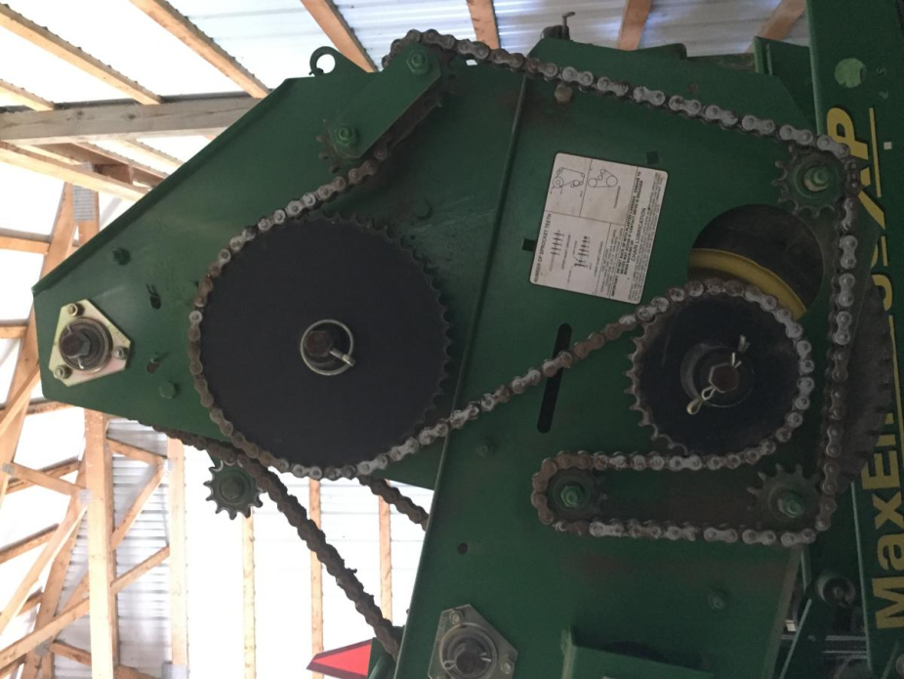

II.3- Mechanical Hazards
A mechanical hazard is any danger that comes from machines or moving parts.
Rotating parts: shafts, belts, pulleys.
Cutting/crushing hazards: presses, rollers.
Falling objects: crane operations, poor stacking.
Slips, trips, falls: wet/uneven surfaces.

Slide 8
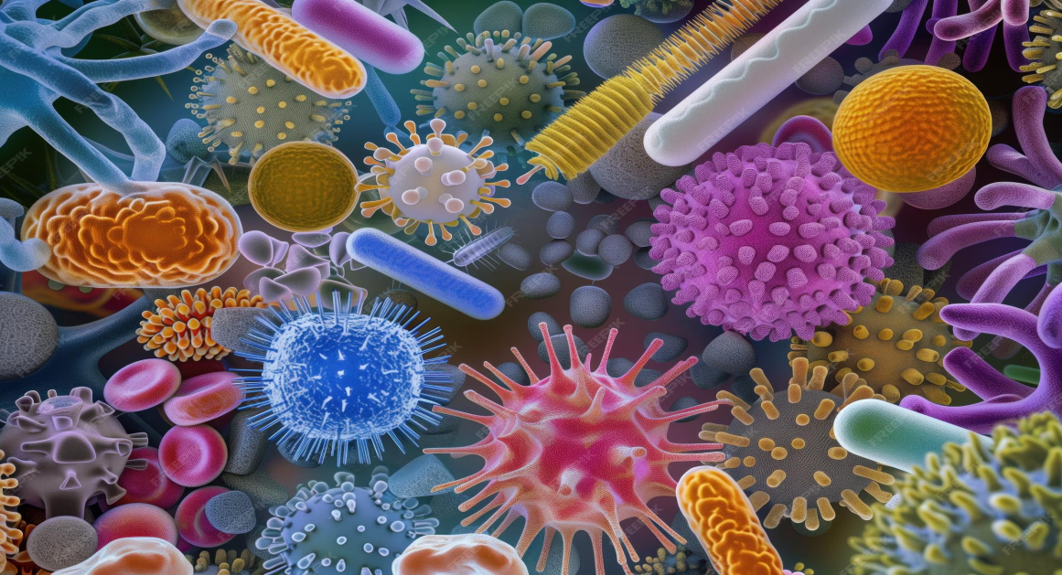
II.4- Biological Hazards
A biological hazard (or biohazard) is a risk of harm caused by living things or substances that come from them.
They can make people sick or infected.
Microorganisms: bacteria, viruses, fungi.
Biological toxins: mycotoxins.
Allergenic dusts: grain dust, organic powders.

Slide 9

II.5- Combined Hazards
Sometimes different hazards happen together and make the risk more dangerous.
Examples:
Chemical + Physical: Flammable solvent near heat → fire or explosion.
Mechanical + Biological: In food industry, machines + germs → injury and contamination.

Slide 10
III. Summary
Hazards classified into 4 main categories.
Physical: energy-related.
Chemical: toxic, flammable, corrosive.
Mechanical: equipment/machinery.
Biological: microorganisms, toxins.
Combined hazards increase risk severity.

Slide 11
IV. Next Session
Week 3: Accident Indicators
Thank you for your attention!
See you next class.

