Slide 1
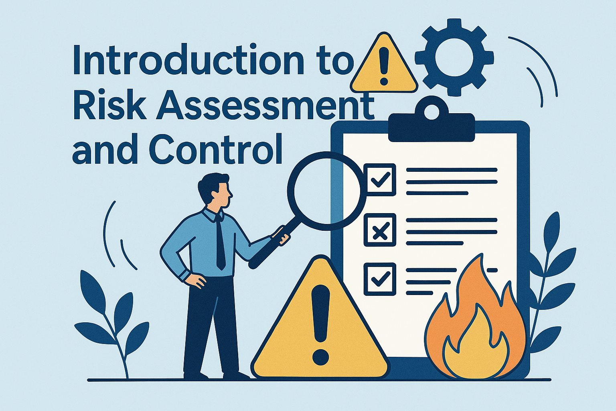
Democratic and Popular Republic of Algeria
Ministry of Higher Education and Scientific Research
University Center of Abdelhafid Boussouf - Mila
Institute of Sciences & Technology
Department of Process Engineering
HSE in Industrial Installations – UED2.1
Week 1:

Slide 2
Learning Outcomes
By the end of this session, students will be able to:
Define hazard and risk.
Differentiate hazard vs. risk.
Identify HSE stakeholders.
Understand the role of HSE in process industries.

Slide 3
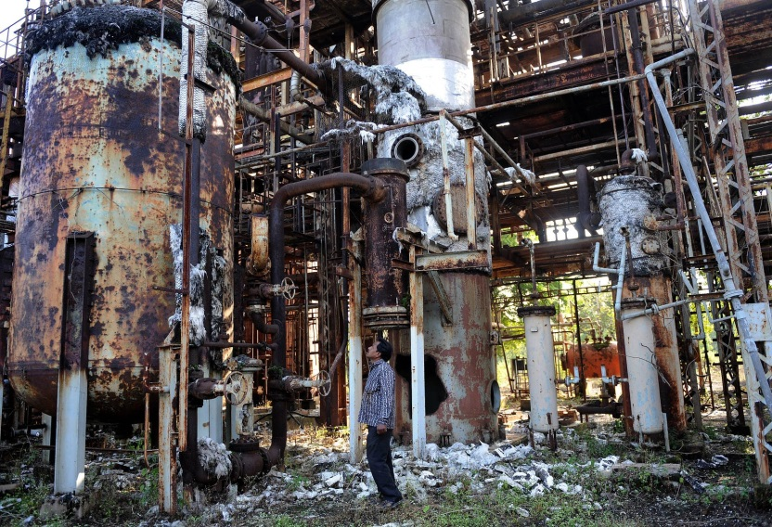
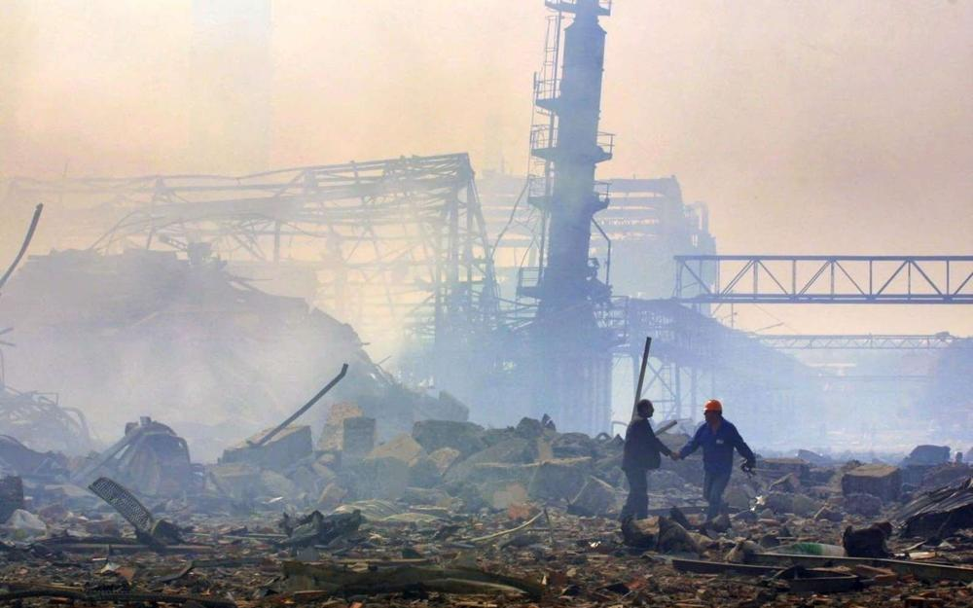
1. Importance of HSE
Bhopal Gas Disaster (India, 1984).
AZF Toulouse (France, 2001)
Prevent accidents, protect life and environment.
Ensure sustainable industrial operations.
Maintain legal and regulatory compliance.
Improve productivity and corporate reputation.
Importance of HSE

Slide 4
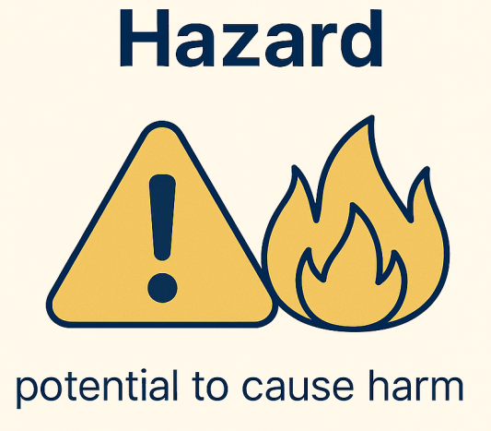


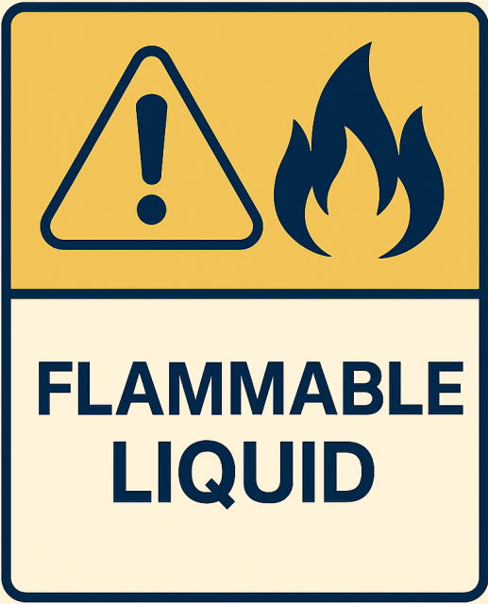
II. Key Concepts: Hazard
Hazard is
Inherent property of material or situation.
EXAMPLES:

Slide 5
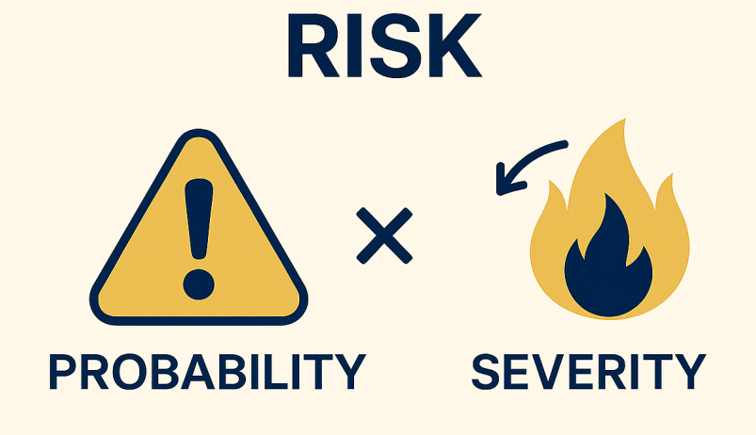
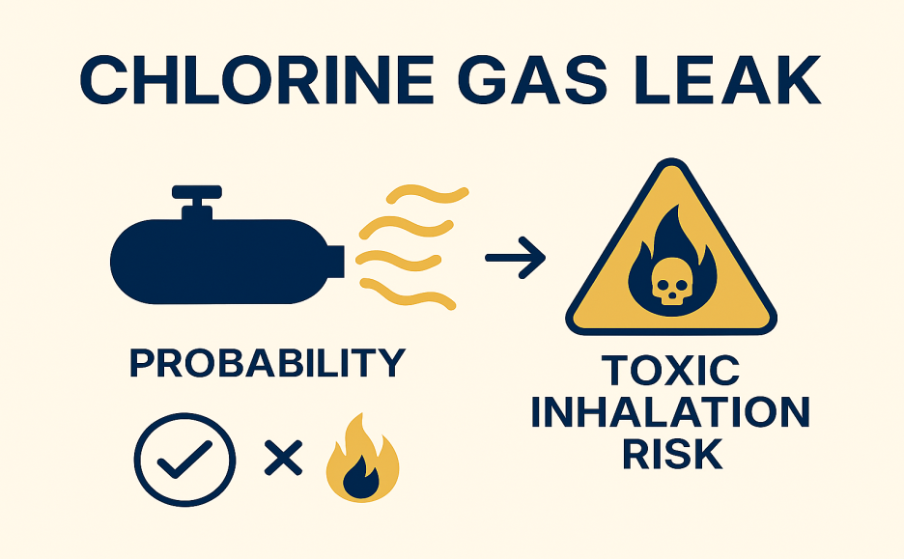
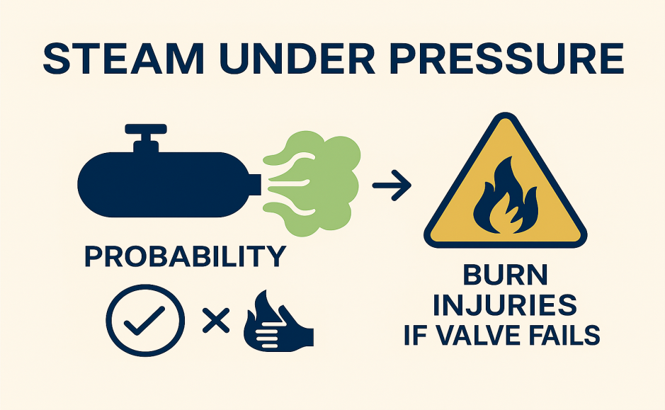
II. Key Concepts: Risk
risk is
the exposure to hazard.
Likelihood that hazard causes harm.
Likelihood = Probability.
Harm : measured by its severity (gravity).
EXAMPLES:
Chlorine gas leak → Toxic inhalation risk.
Steam under pressure → Burn injuries if valve fails.

Slide 6
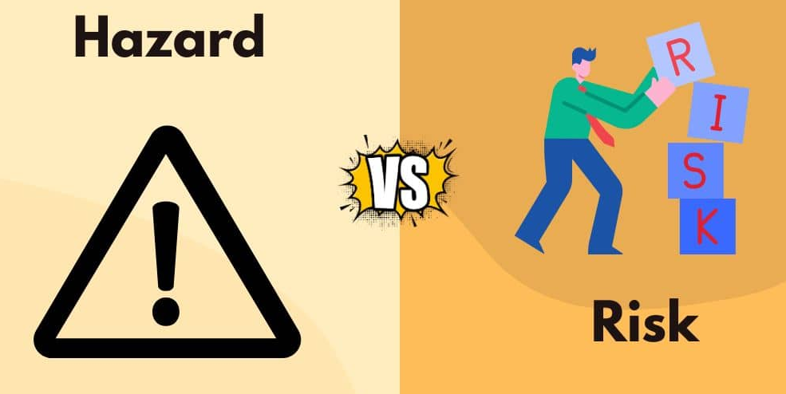
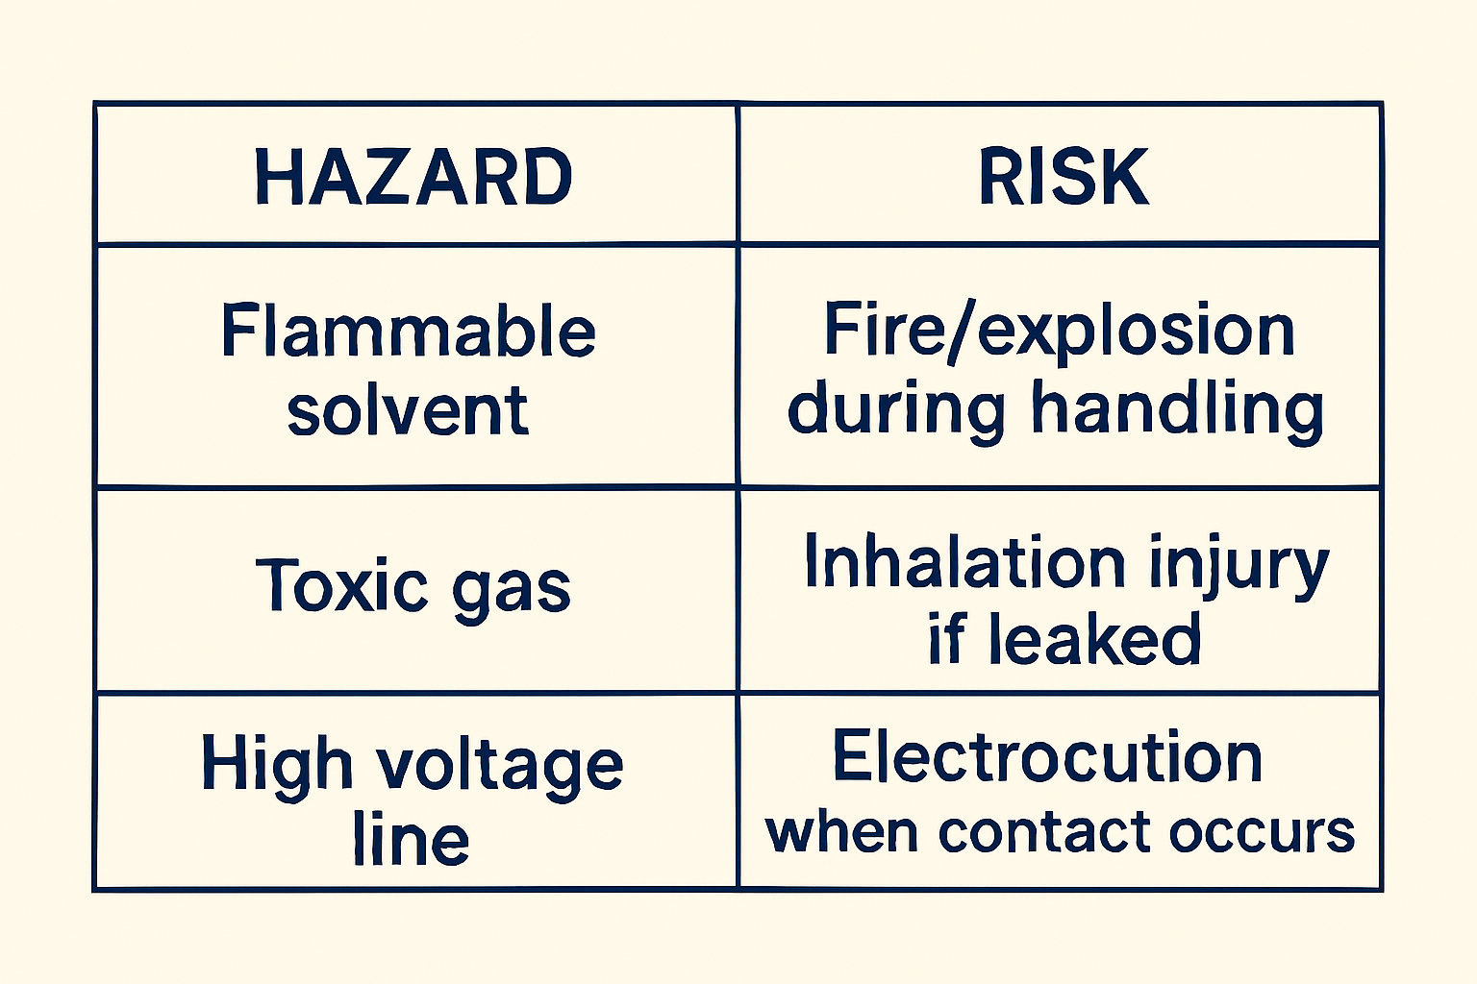
III. Hazard vs. Risk

Slide 7
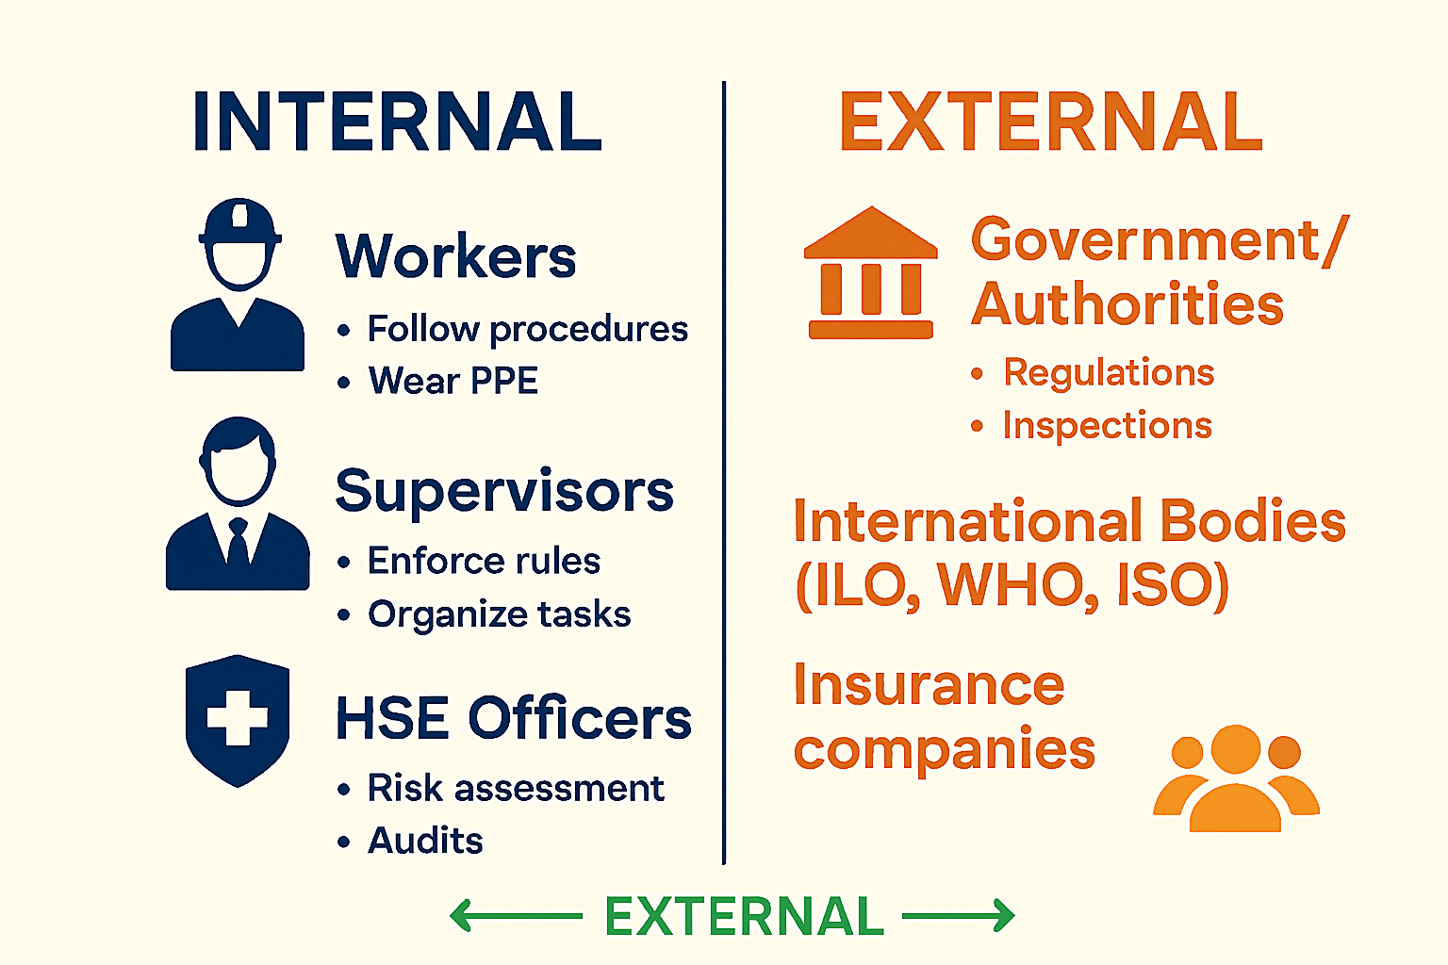
VI. Stakeholders in Prevention
Stakeholders
are all the individuals, groups, or organizations that have an interest in, are affected by, or can influence safety and prevention measures.
Stakeholders can be divided into:

Slide 8
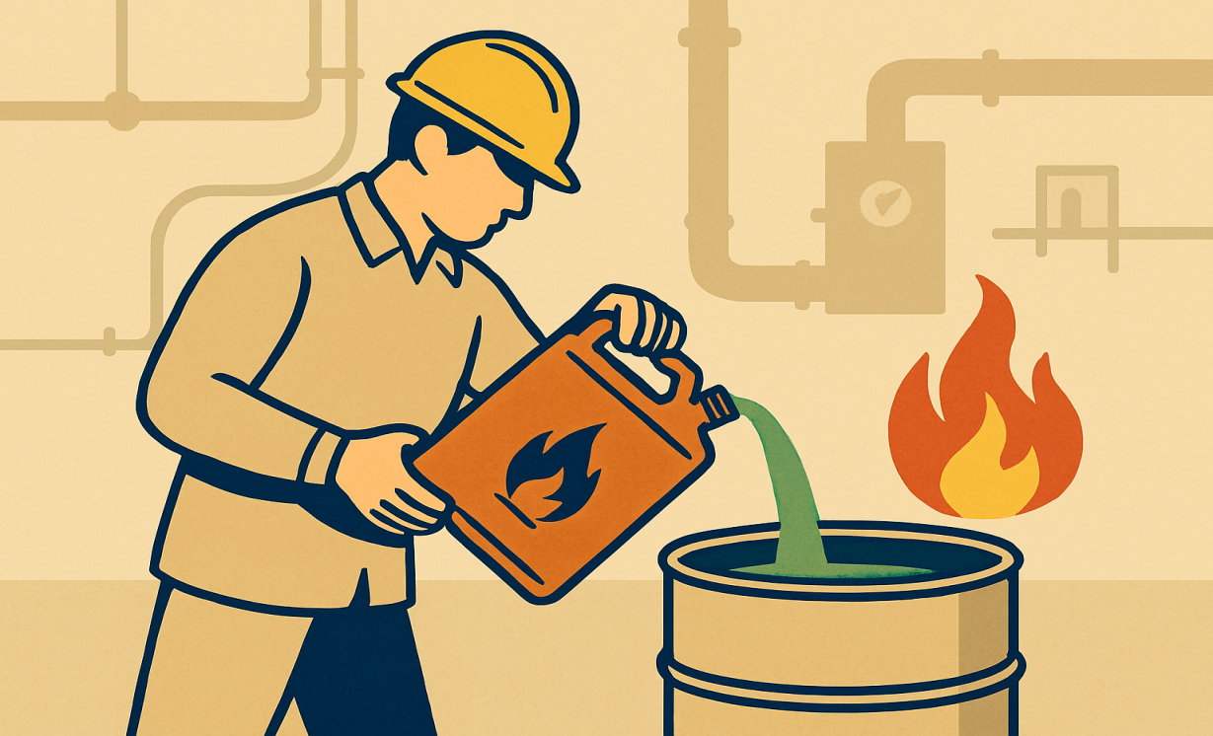
V. Case Study
Scenario: Worker transfers flammable solvent without PPE near ignition source.
Hazard: Flammable solvent.
Risk: Fire/explosion.
Stakeholders: Worker, Supervisor, HSE officer.
Preventive Measures:
- PPE usage.
- Training.
- No ignition sources.
- Ventilation & monitoring.

Slide 9
IV. Summary
HSE is essential for industry and society.
Hazard = potential danger.
Risk = probability × severity.
Many stakeholders share responsibility.
Prevention requires strong safety culture.

Slide 10
IIIX. Next Session
Week 2: Classification of Hazards
Thank you for your attention!
See you next class.

