Slide 1




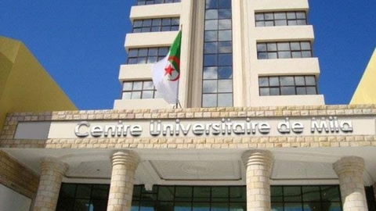

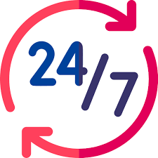
Author's presentation
Instructor: Dr. KADJOUDJ Nadia
Rank: Associate Professor, Class "B"
Department: Biological and Agricultural Sciences
Institution: A. BOUSSOUF University Center, Mila, 43000, Algeria
Contact: kadj.nadia@centre-univ-mila.dz
Availability : I am available in the Department of Biological and Agricultural Sciences on Mondays and Wednesdays, from 9:30 AM to 3:00 PM.

Slide 2

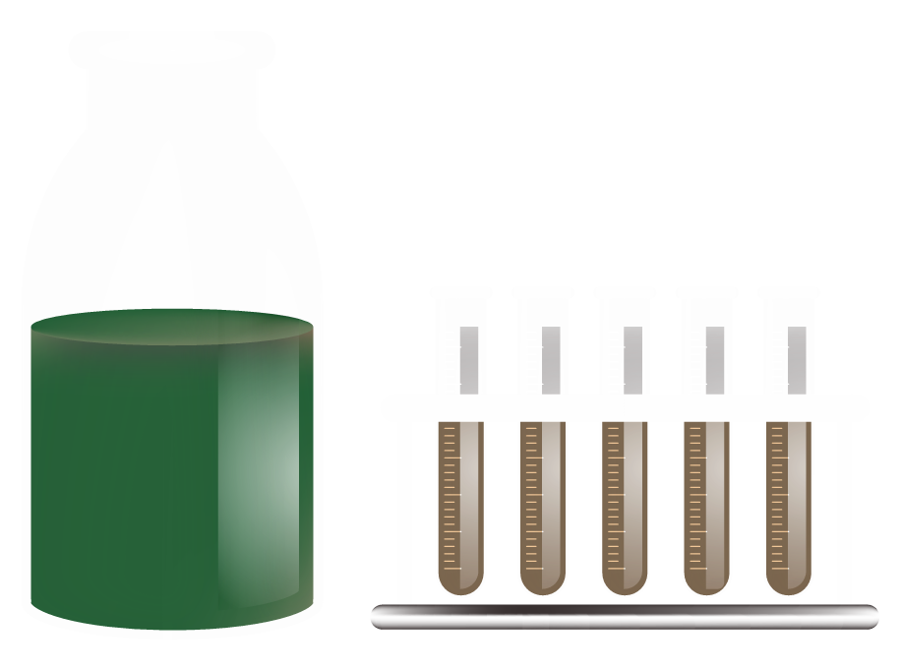
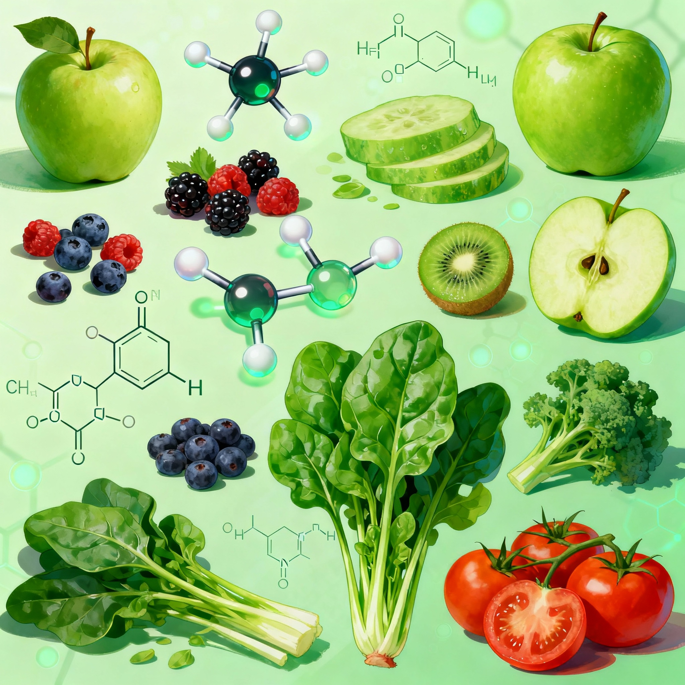
Subject Taught
Subject: Food Biochemistry
Teaching Unit: Fundamental
Credits: 06
Coefficient: 03
Target Audience: Agronomy
Time Allocation: Lectures 03h00, Tutorials (TD) and Practical Work, 01h30 hours/week
Duration: 14 weeks

Slide 3
Course Objectives
To understand the major constituents of food and their technological and functional properties.
To acquire knowledge of the main biochemical changes of these constituents during technological processing and storage.

Slide 4
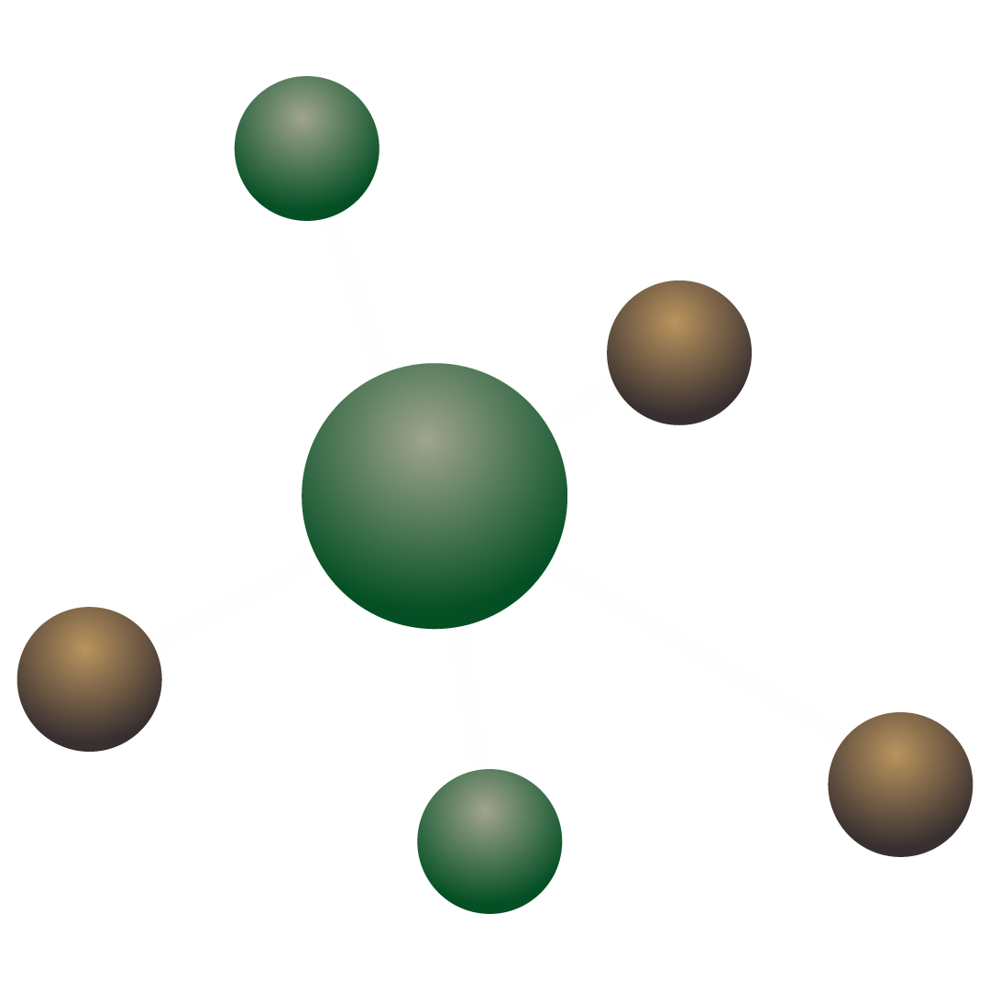
Recommended Prerequisites
General Biochemistry
Organic Chemistry
Physics and Thermodynamics

Slide 5
Assessment Method:
The final grade will be based on a written exam (60%) and a practical project (40%)."

Slide 6
Table of contents
I
III
II
IV
V
VI
Introduction
Water in Food
Lipids or Fats
Proteins in Food
1.1. Importance and Structure of Water
1.2. Physical Properties
1.3. Water Activity
1.4. Behavior of Water in Solutions
1.5. Adsorption Isotherms
1.6. Hysteresis Phenomena of Isotherms
2.1. Physical Properties of Proteins
2.2. Extraction of Food Proteins
2.3. Egg Proteins: Properties and Applications
2.4. Functional Properties of Milk Proteins and Their Enhancement
2.5. Protein Ingredients
3.1. Physicochemical Properties of Lipids
3.2. Functional Properties of Fats
3.3. Nutritional Requirements for Fats
3.4. Preservation and Deterioration of Fats
Carbohydrates in Food
Food Systems
Food Spoilage
4.1. Cellulose and Its Derivatives
4.2. Starch
4.3. Functional Properties of Native and Modified Starches
4.4. Amylolytic Enzymes and Their Applications
4.5. Dietary Fibers
5.1. General Aspects
5.2. Plant-Based Food Systems
5.3. Animal-Based Food Systems
5.4. Non-Conventional Food Systems (N.C.F.S.)
Food Deterioration
Conclusion

Slide 7
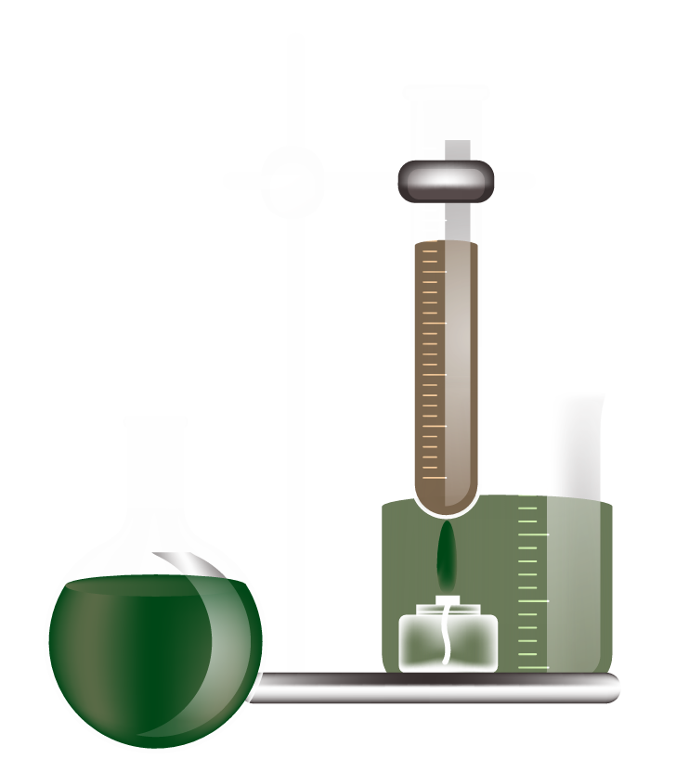

Introduction

Slide 8
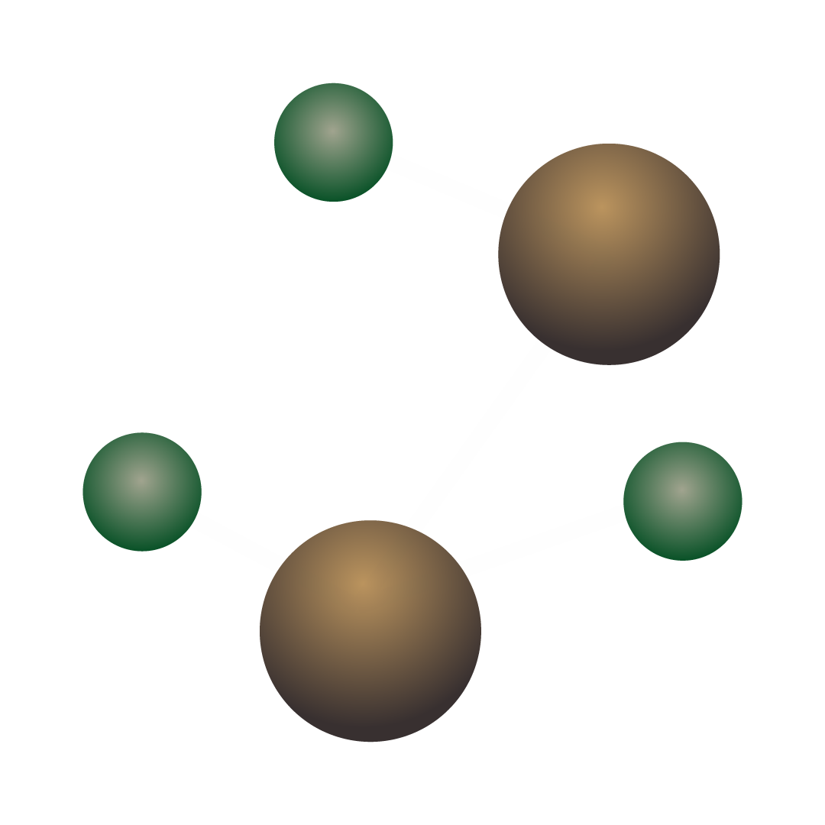
Introduction to food biochemistry
Food Biochemistry stands as a pivotal discipline at the intersection of nutritional science, chemistry, and food technology. It moves beyond the foundational principles of general biochemistry to focus specifically on the composition, properties, and transformations of the biological molecules that constitute our food. This module is designed to provide a comprehensive understanding of the major constituents in food—water, proteins, lipids, and carbohydrates—and their critical roles in determining the nutritional value, sensory quality, safety, and shelf-life of food products.

Slide 9
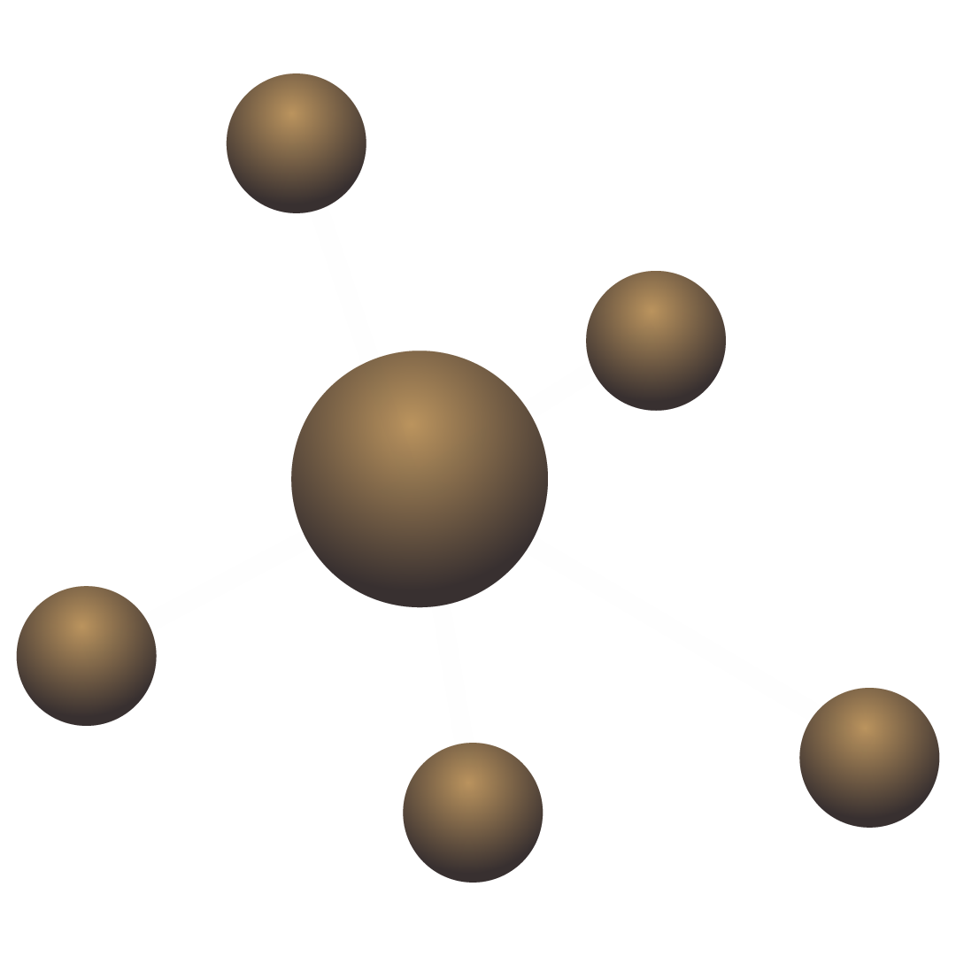
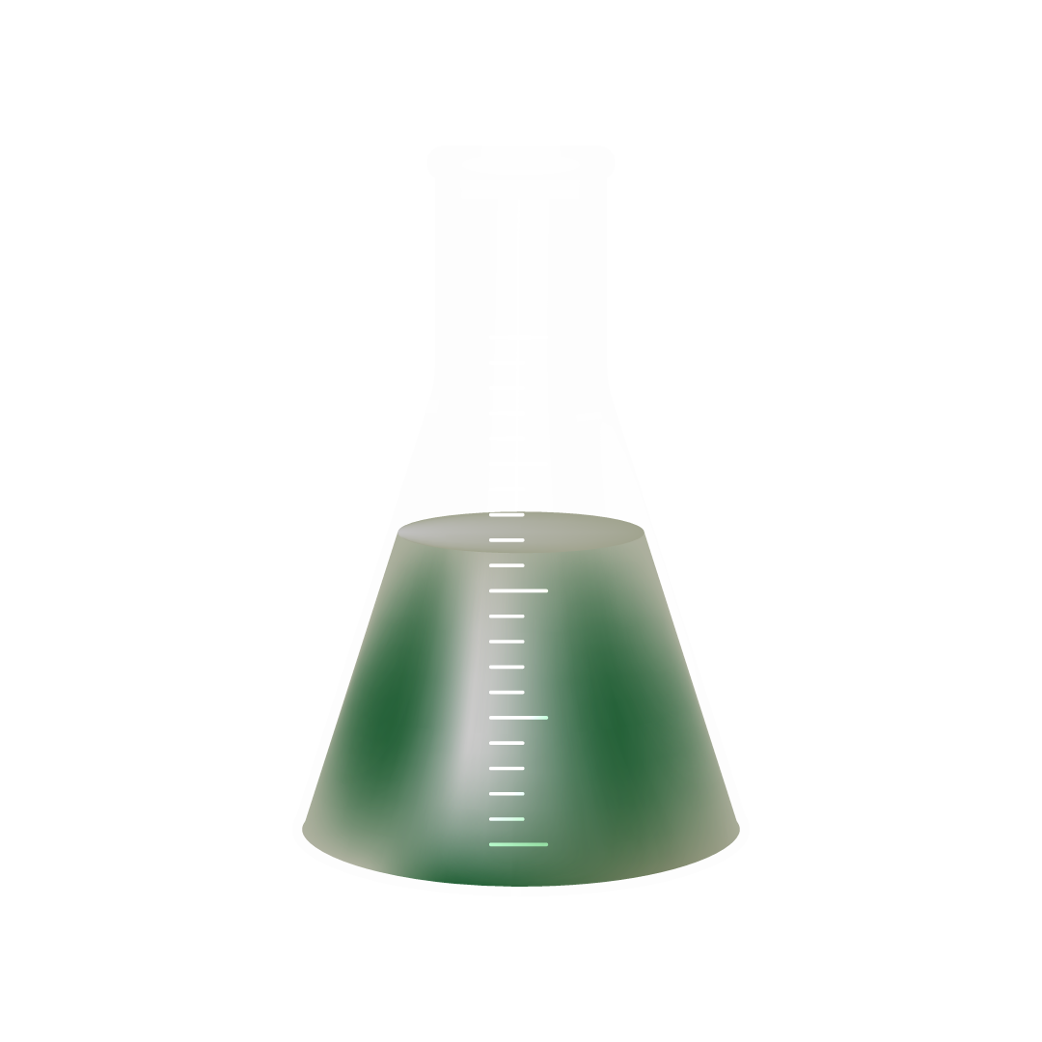
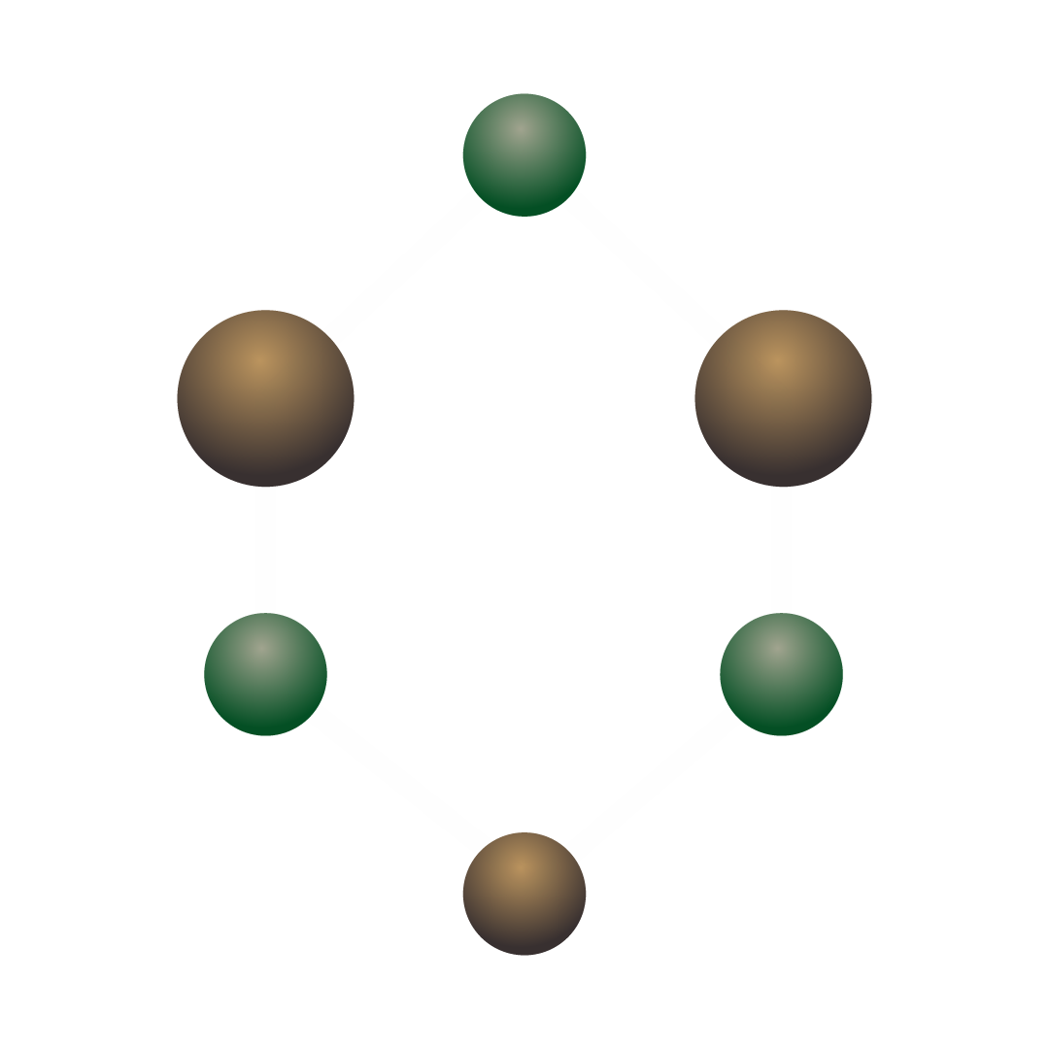
Introduction to food biochemistry
Food Biochemistry represents the cornerstone of modern food science, providing the fundamental principles to understand the complex interplay between the molecular composition of food and its macroscopic properties, technological functionality, and nutritional impact. This advanced module delves beyond the static composition of food to dynamically investigate the biochemical metamorphosis that constituents undergo during processing, storage, and digestion. In an era of global challenges, including the need for sustainable food systems and the rise of precision nutrition, a deep biochemical understanding is paramount for innovation in food design, waste reduction, and enhancing food security (McClements, 2019).

Slide 10
Type of biomolecules
Carbohydrates
Proteins
The most diverse class of food biopolymers
The versatile workhorses of food systems
Lipids
Water
Both their nutritional essence and their role as textural and flavor mediators
The most ubiquitous yet critical component
Food Systems
Food spoilage and deterioration

Slide 11

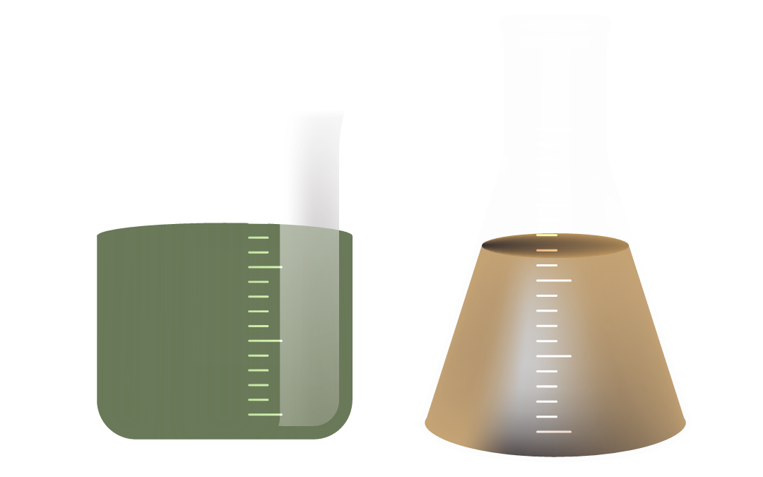
Chapter one:
Water in food

Slide 12
— General information
"Water is life's matter and matrix, mother and medium. There is no life without water" (Albert Szent-Györgyi, Nobel prize in Physiology or Medicine, 1937).
Water is essential for life on Earth. From regulating our body temperature to dissolving vital nutrients, water’s unique properties are at the heart of countless biological processes. In this session, we’ll explore the molecular structure of water, dive into hydrogen bonding and water interactions, and discuss how these factors shape water’s distinct properties and crucial roles in living systems.

Slide 13
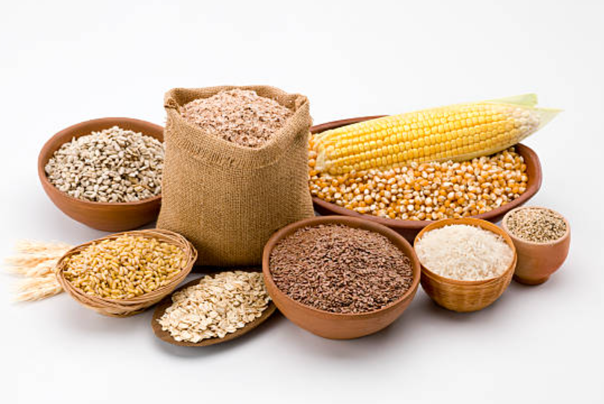
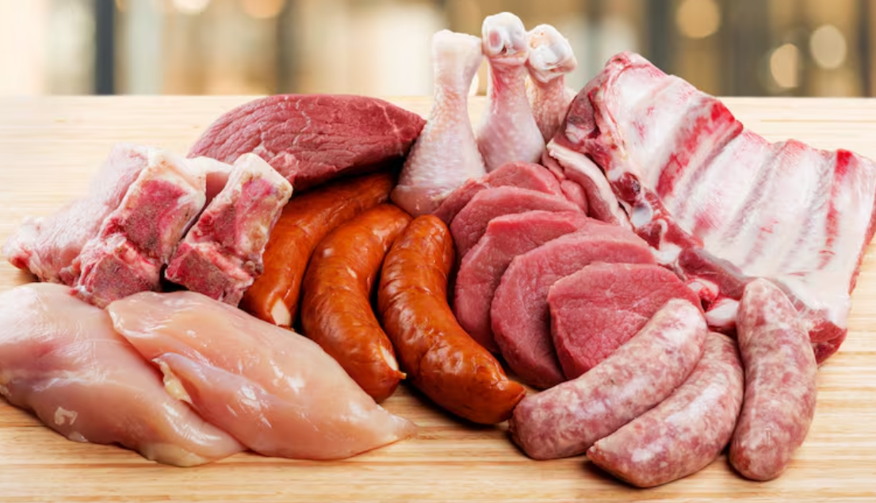
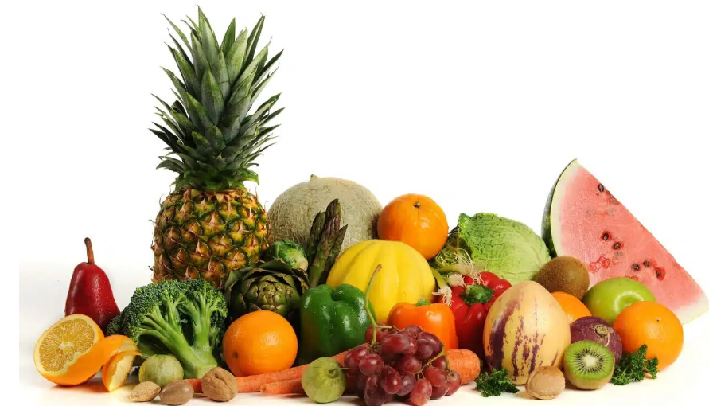
— General information
The water content in food products is highly variable
90-95%
10-20%
60-75%

Slide 14
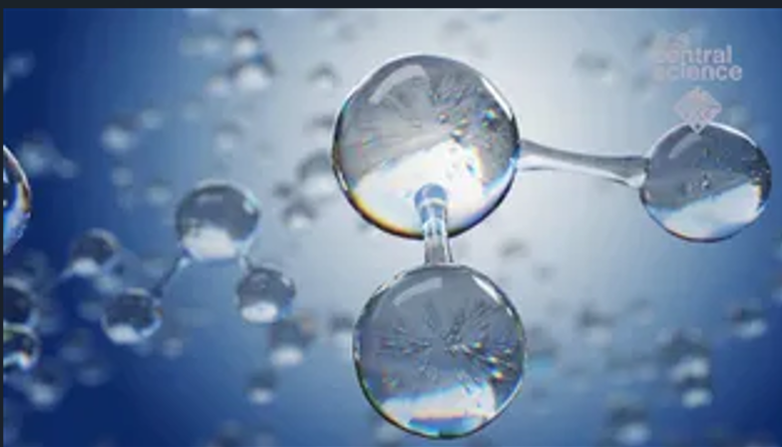
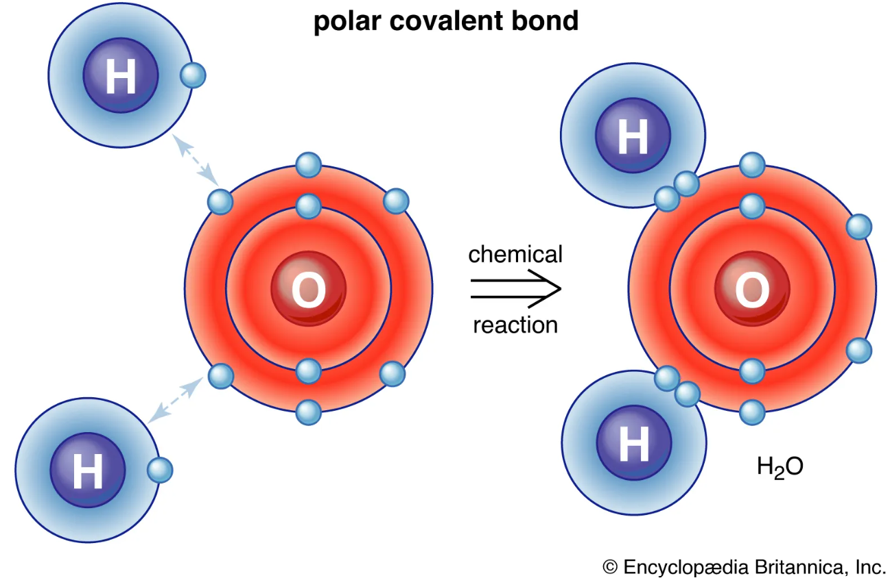
— Structure of Water
A water molecule is made up of two hydrogen atoms and one oxygen atom.

Slide 15

— Structure of Water

Slide 16
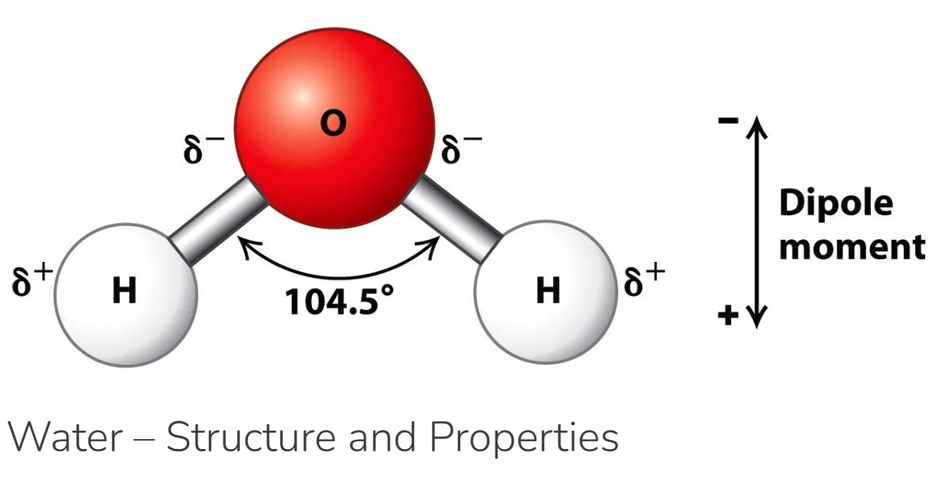
— Structure of Water
The water molecule is not linear but bent in a special way. The two hydrogen atoms are bound to the oxygen atom at an angle of 104.5°.

Slide 17
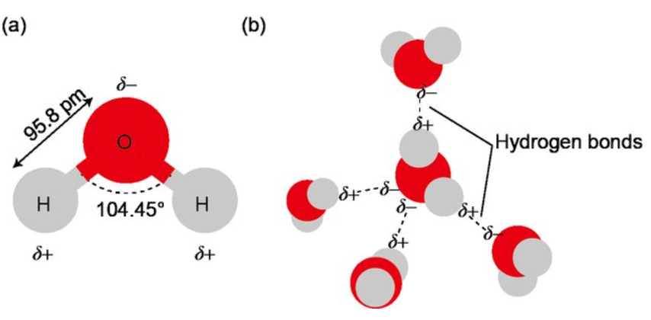
— Structure of Water
The OH distance (bond length) is 95.7 picometres (9.57 × 10⁻¹¹ metres,). Because an oxygen atom has a greater electronegativity than a hydrogen atom, the OH bonds in the water molecule are polar, with the oxygen bearing a partial negative charge (δ−) and the hydrogens having a partial positive charge (δ+).
Figure : Schematics of the atomic structure of water molecule and the hydrogen bonds between water molecules. (a) Atomic structure and charge distribution of water molecule; (b) hydrogen bonds between water molecules (color online).

Slide 18
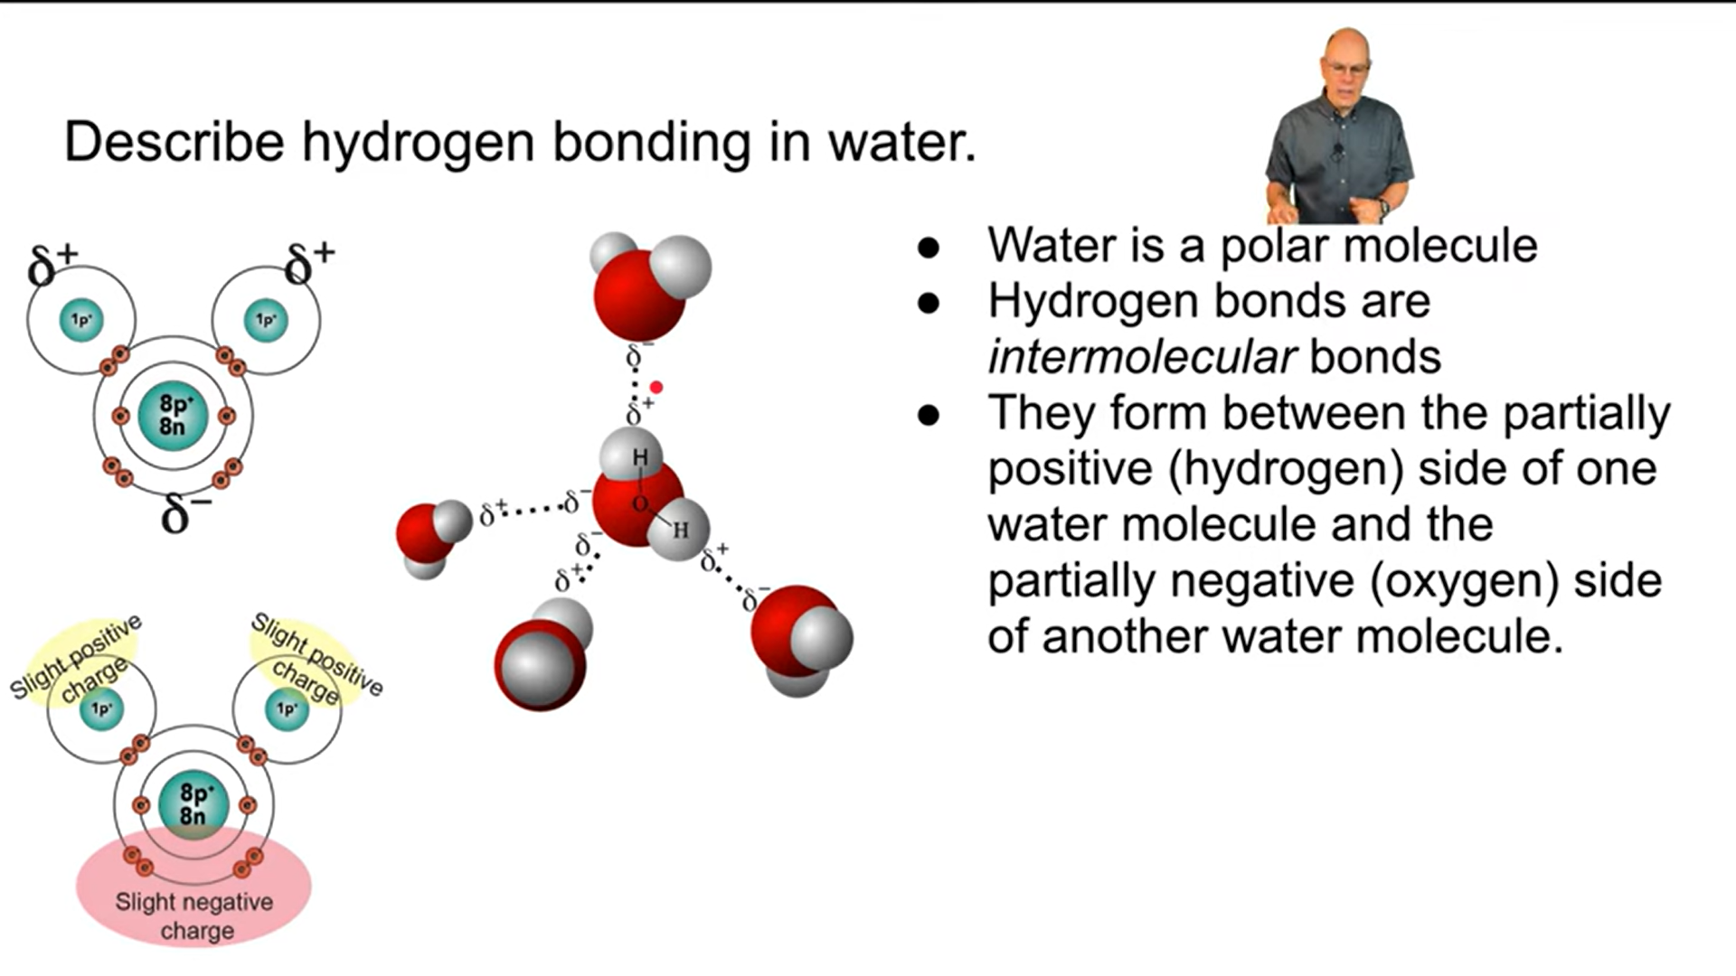
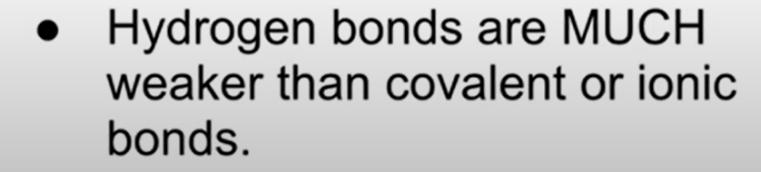

Slide 19
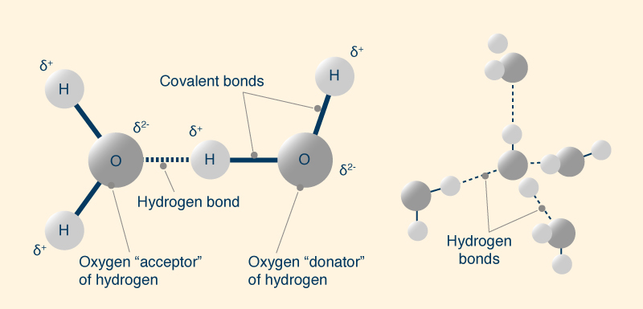
Covalent bonds & Hydrogen bonds

Slide 20
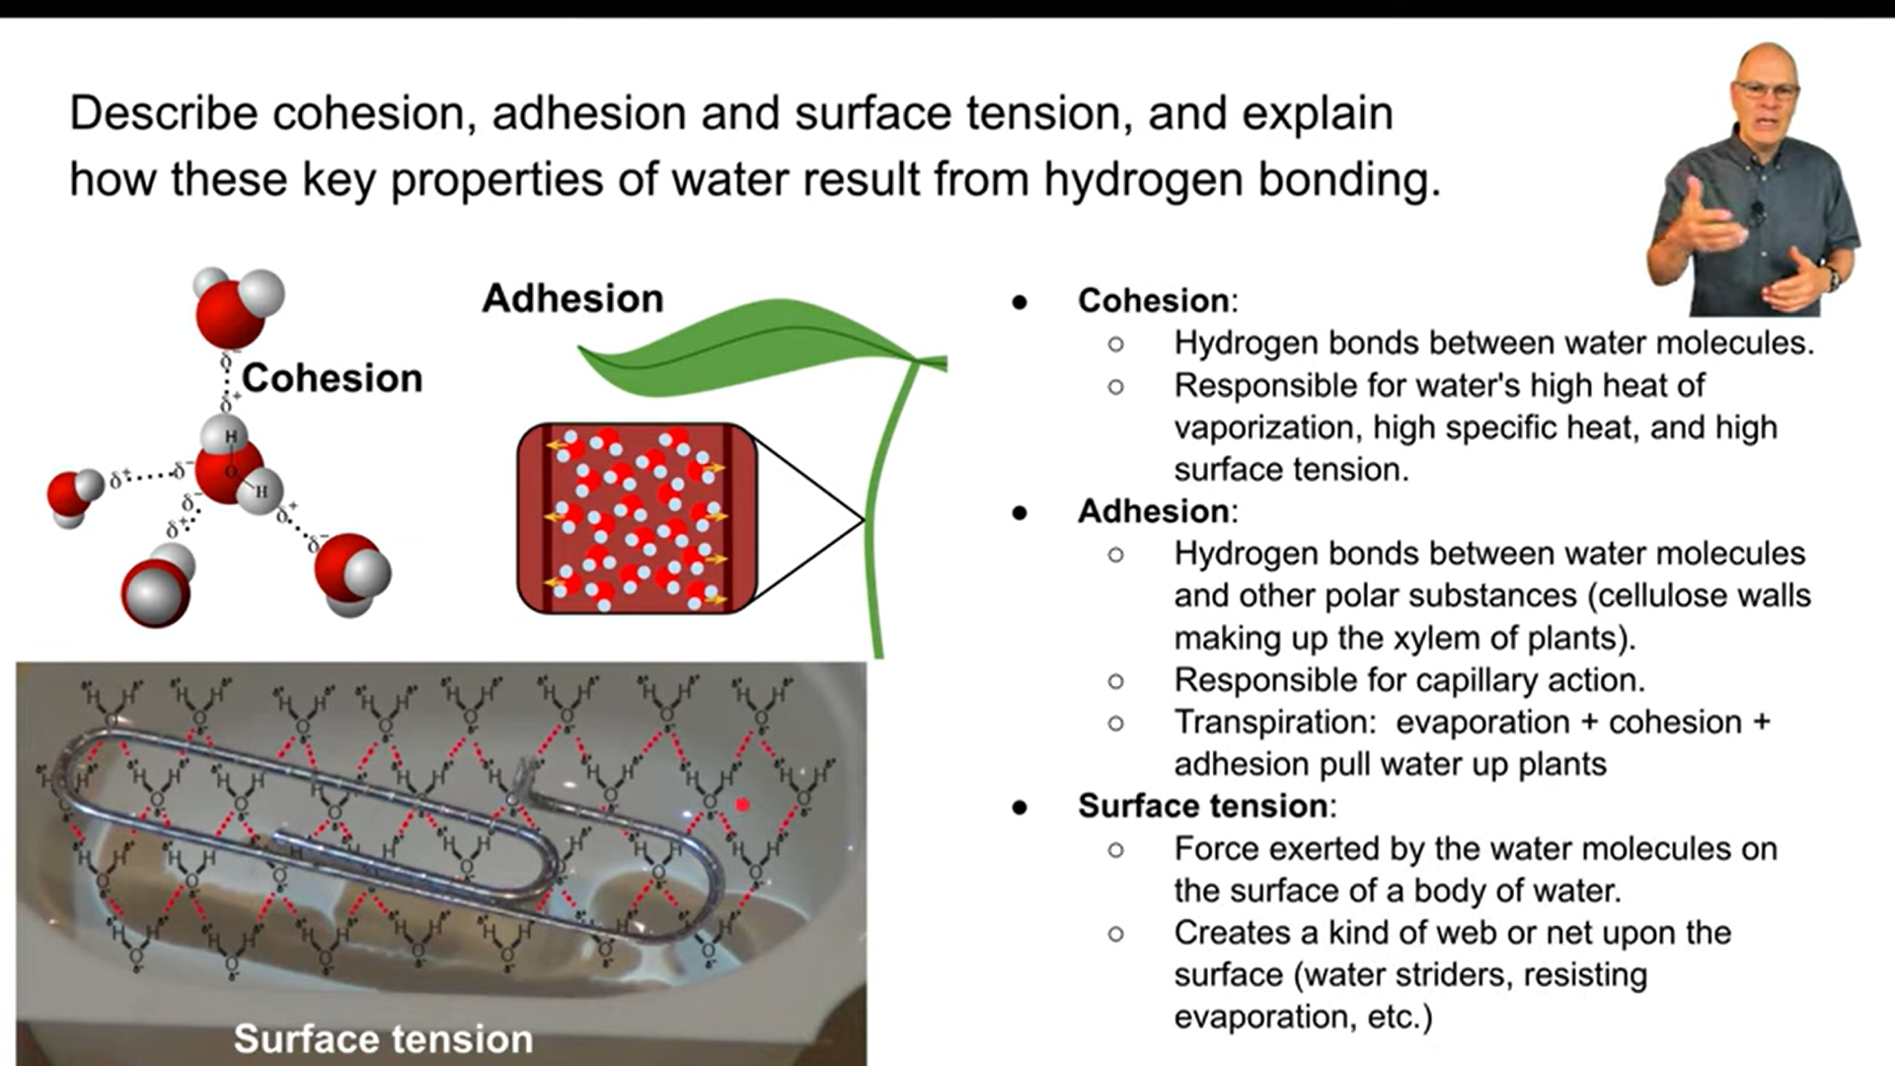
— Behaviour and physical properties

Slide 21
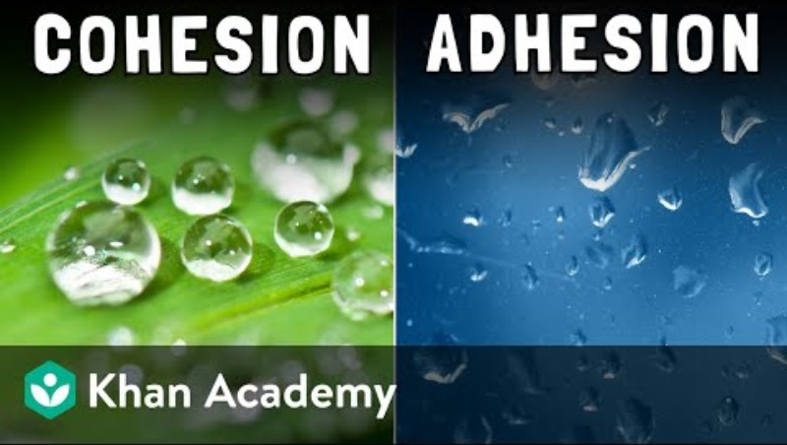

Slide 22

— Behaviour and physical properties

Slide 23


Slide 24
— Behaviour and physical properties
In the vapor state, the water molecule is a monomer.
In the solid state (ice), water molecules are linked to each other by hydrogen bonds, leading to the formation of a polymer with a crystalline structure;
At temperatures < -183°C, all possible hydrogen bonds would be engaged.
At 0°C, only about 50% of them would be engaged.
At 100°C, a certain number would exist.
In the liquid state, various agents can influence this structure in different ways;
Electrolytes like Na+, K+, and Cl-, which are highly hydrated in solution, decrease the number of hydrogen bonds between water molecules, while hydrocarbons and non-polar groups tend to increase them.
In turn, water affects other properties, such as:
The structure of molecules (proteins),
Diffusion,
The reactivity of substances in solution.

Slide 25
— Behaviour and physical properties
He physical properties of water include the following key characteristics:
Water is a colorless, tasteless, and odorless liquid at ambient temperature and pressure.
It has a molecular formula H2O, with a bent molecular shape and a bond angle of about 104.5°.
Water molecules are polar due to the difference in electronegativity between oxygen and hydrogen, resulting in partial positive charges on hydrogen atoms and partial negative charge on oxygen.
This polarity leads to hydrogen bonding between water molecules, causing unique properties such as high melting (0 °C) and boiling points (100 °C) compared to other similar molecules.
Water has a high specific heat capacity, enabling it to absorb and release large amounts of heat with little temperature change.

Slide 26
— Behaviour and physical properties
It has high surface tension and cohesion due to hydrogen bonding, making water molecules stick together and allowing phenomena like water droplet formation and capillary action.
Water is less dense as a solid (ice) than as a liquid, which is unusual; ice floats on water.
Its density at 4 °C is about 1.000 g/cm³, and at 25 °C is about 0.997 g/cm³.
Water is transparent in the visible spectrum, allowing aquatic life to survive and light to penetrate water bodies.
Water occurs naturally in all three phases (solid, liquid, gas) on Earth.
These properties arise mainly from the molecule's polarity and the hydrogen bonding network among water molecules.

Slide 27
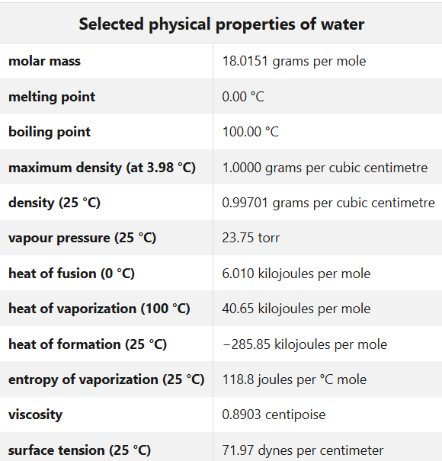
— Behaviour and physical properties

Slide 28
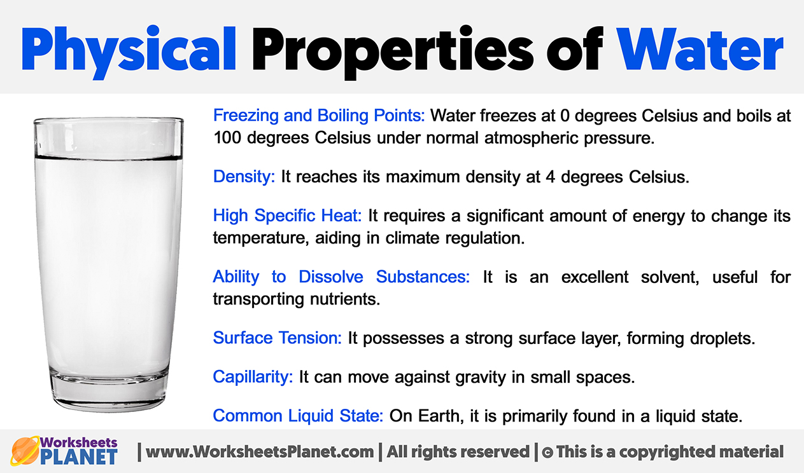

Slide 29
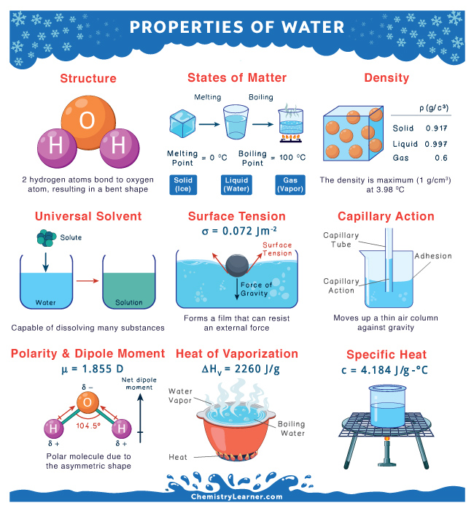
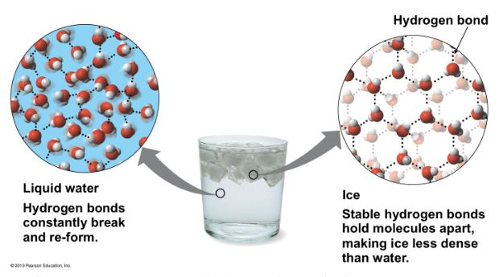
Lquide & Solid water (Ice)

Slide 30
— Behavior of water in food products
Food scientists classify water in foods into three main categories:
Bound water: The tightly held moisture
Imbibed water: The absorbed moisture
Free water: The available water
Each type behaves differently and serves unique functions within food systems.
Notes:
Water might seem like a simple component in foods, but its presence and behavior are far more complex than what meets the eye. The water in your morning bowl of oatmeal, the juiciness of a ripe mango, or the crispness of a biscuit—all represent different forms of water that significantly impact food quality, safety, and shelf life. Understanding these different types of water in foods goes beyond basic nutrition; it’s a fundamental concept that helps explain why foods spoil, how preservation methods work, and why texture changes during storage.

Slide 31
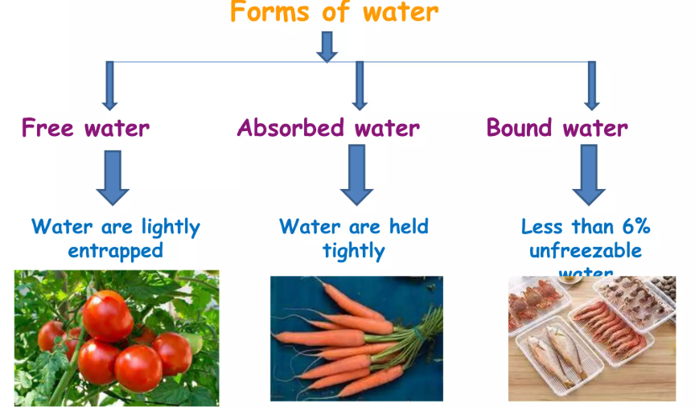

Slide 32
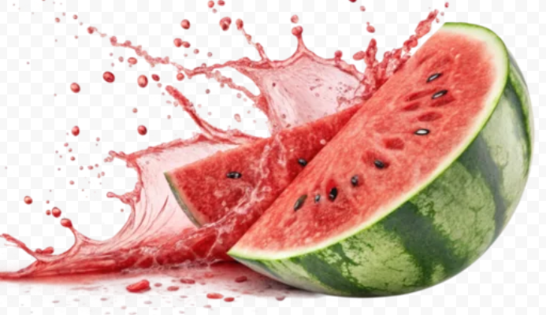
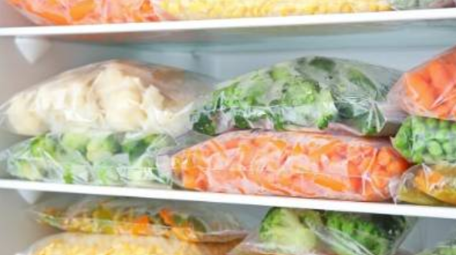
— Behavior of water in food products
— Free water: The available water
Free water, also called available water, is the most abundant form of water in most foods. This is water that moves reely within the food matrix and isn’t attached to any food components.
Think of the water that drips from a freshly cut watermelon or the moisture that accumulates when you thaw frozen vegetables that’s predominantly free water.

Slide 33
— Behavior of water in food products
— Free water: The available water
Free water functions as a solvent for various nutrients, facilitating biochemical reactions essential for flavor development. However, it also has a downside: it provides the perfect environment for microbial growth, making foods with high free water content more susceptible to spoilage.
Free water has properties similar to pure water: it freezes at approximately 0°C, evaporates readily during drying, and can be easily removed through physical methods like pressing or draining. In food science, this type of water is often associated with a food’s water activity (aw), a critical parameter used to predict food stability and safety.

Slide 34
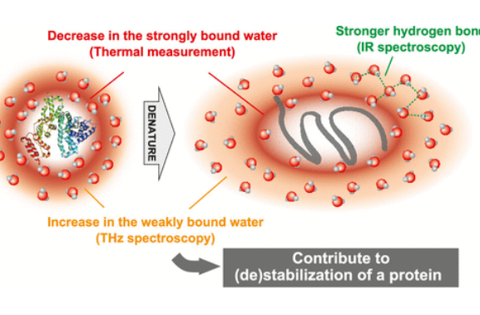
— Behavior of water in food products
— Bound water: The tightly held moisture
Bound water is chemically or physically attached to food components like proteins, carbohydrates, and minerals through hydrogen bonding or other molecular interactions. This type of water is not available for microbial use and behaves quite differently from free water.
Bound water doesn’t freeze at 0°C, often requiring temperatures as low as -40°C to solidify. It’s also resistant to evaporation during conventional drying processes, which explains why even completely dried foods still contain some moisture typically about 5-10% by weight.

Slide 35
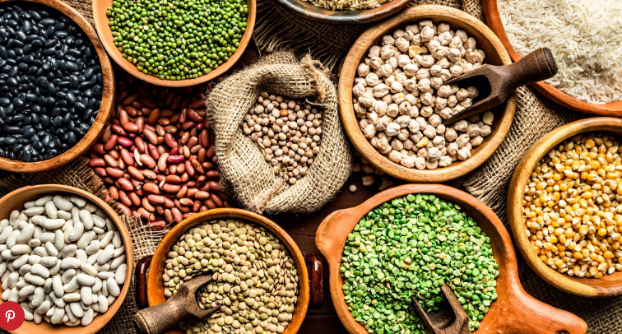
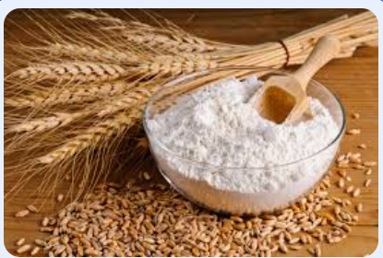
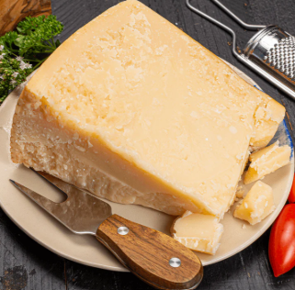
— Behavior of water in food products
— Bound water: The tightly held moisture
The strong attraction between bound water and food molecules means this water cannot serve as a solvent for biochemical reactions or support microbial growth. Foods with higher proportions of bound water tend to have longer shelf lives even without preservatives.
Common examples include:
Dried legumes: Even when completely dry to the touch, beans and lentils retain bound water molecules attached to their starch and protein components.
Wheat flour: Contains about 14% moisture, much of which is bound water associated with starch granules and gluten proteins.
Hard cheese: Despite their firm texture, aged cheeses like Parmesan still contain bound water molecules integrated with the protein matrix.

Slide 36
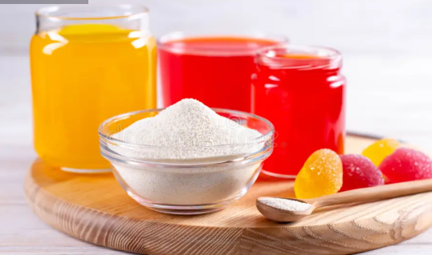
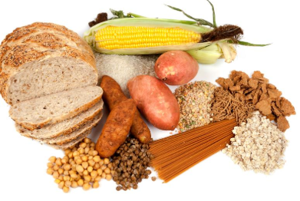
— Behavior of water in food products
— Imbibed water: The absorbed moisture
Hydrocolloids like pectin, agar, and starches have an exceptional capacity to imbibe water, which explains their widespread use as thickening and gelling agents in food processing. When these substances absorb water, they swell significantly while maintaining their structural integrity, creating the characteristic texture of products like jams, puddings, and gravy.

Slide 37
— How water content affects food properties
The distribution and proportion of these three types of water significantly influence a food’s characteristics and behavior during processing, storage, and consumption.
Texture and mouthfeel
Water content is perhaps the most critical determinant of food texture. Consider these examples:
Crispness: Foods like potato chips and biscuits are crisp because they contain minimal free water, with most moisture existing as bound water. Even slight absorption of atmospheric moisture can transform these products from crisp to soggy.
Juiciness: The satisfying juiciness of ripe fruits and properly cooked meats comes from free water released during chewing.
Creaminess: Dairy products like yogurt and ice cream owe their smooth, creamy texture to water imbibed by proteins and stabilizers, creating fine ice crystals or protein networks that provide a pleasing mouthfeel.

Slide 38
— How water content affects food properties
When cooking rice, the transformation from hard, dry grains to soft, fluffy kernels demonstrates how imbibed water dramatically alters texture. The starch granules absorb water, swell, and create the characteristic softness we expect in properly cooked rice.

Slide 39
— How water content affects food properties
Shelf life and stability
The free water content of foods directly correlates with microbial stability. Bacteria typically require water activity (aw) above 0.91 to grow, while most yeasts and molds can survive at aw values as low as 0.80 and 0.70, respectively. This explains why fruits with high free water content spoil quickly, while dried fruits can last months without refrigeration.
Food preservation methods often target the reduction or immobilization of free water:
Dehydration: Removes free water, leaving primarily bound water behind.
Freezing: Converts free water into ice, making it unavailable for microbial growth.
Salt and sugar addition: Creates a hypertonic environment that ties up free water, effectively reducing water activity.
Smoking: Traditional smoking not only adds antimicrobial compounds but also removes surface moisture from foods like fish and meat.

Slide 40
— How water content affects food properties
Flavor perception and delivery
Water serves as the primary solvent for flavor compounds in foods. Free water dissolves water-soluble flavors and carries them to taste receptors, explaining why dried foods often have muted flavors until rehydrated. This is particularly evident in spices the aromatic compounds in whole spices remain trapped until moisture helps release them during cooking.
The distribution between free and bound water also affects flavor intensity. Foods with higher bound water proportions typically have more concentrated flavors because the flavor compounds are less diluted. This is one reason why reducing sauces intensifies their taste profile.

Slide 41
Measuring water in foods
Food scientists and processors use several methods to assess water content and distribution in foods:
Total moisture content | Water activity (aw)
The most basic measurement is total moisture content, usually determined by drying a food sample at a specific temperature until it reaches constant weight. This method, however, doesn’t distinguish between different types of water and may not completely remove all bound water. | Water activity measures the ratio of water vapor pressure of a food to that of pure water at the same temperature. It essentially quantifies the amount of free water available for microbial growth and biochemical reactions. While water content tells you how much water is present, water activity tells you how much of that water is available to participate in reactions.
For most fresh fruits and vegetables, total moisture content ranges from 80-95%, while cereals and grains typically contain 10-14% moisture. Processed meats like sausages contain intermediate moisture levels, usually between 45-55%. | The aw scale ranges from 0 (bone dry) to 1.0 (pure water). Foods with similar moisture contents can have dramatically different water activities depending on how much of their water is bound versus free:
Notes:
Water activity” or “the activity of water” (typically abbreviated as “aw”) is a critical parameter in food science that influences microbial growth and chemical reactions (including enzymatic processes) in food products. Unlike moisture content, which measures the total amount of water in a product, water activity quantifies the availability of water for microbial and chemical processes.

Slide 42
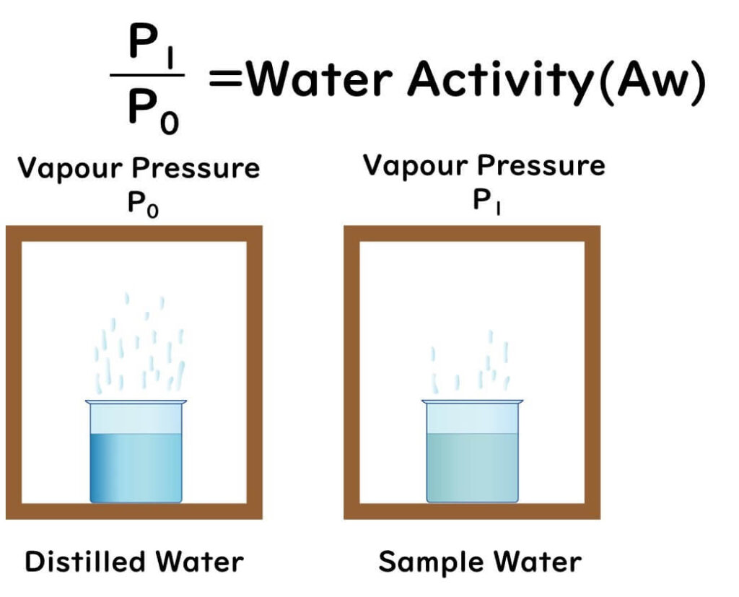
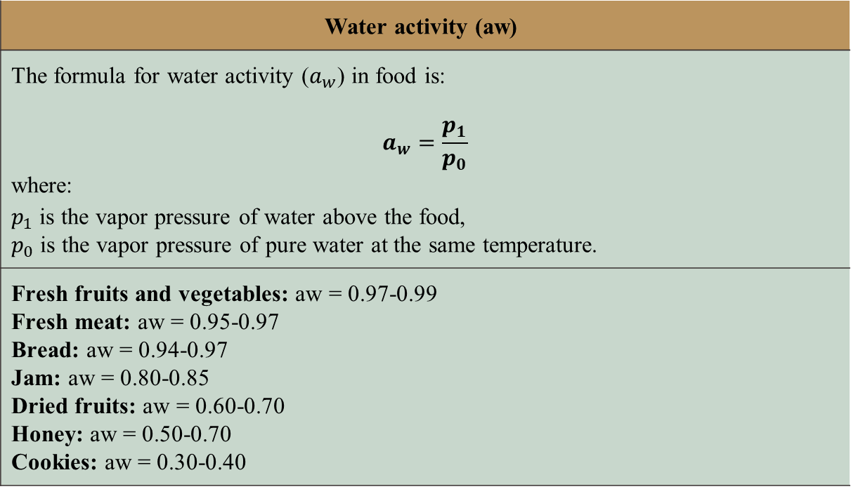
Measuring water in foods
Food scientists and processors use several methods to assess water content and distribution in foods:
Water activity (aw)
The formula for water activity ($a_{w}$) in food is: $$a_{w}=\frac{p_{1}}{p_{0}}$$ where: $p_{1}$is the vapor pressure of water above the food, $p_{0}$ is the vapor pressure of pure water at the same temperature.
Fresh fruits and vegetables: aw = 0.97-0.99 Fresh meat: aw = 0.95-0.97 Bread: aw = 0.94-0.97 Jam: aw = 0.80-0.85 Dried fruits: aw = 0.60-0.70 Honey: aw = 0.50-0.70 Cookies: aw = 0.30-0.40

Slide 43
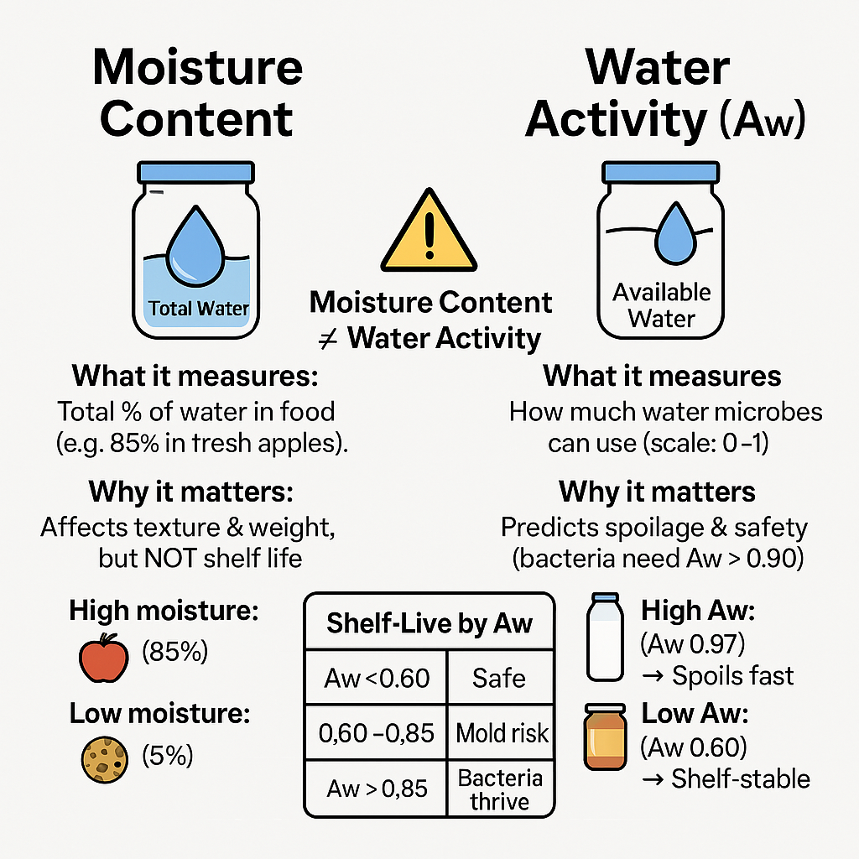
Measuring water in foods

Slide 44

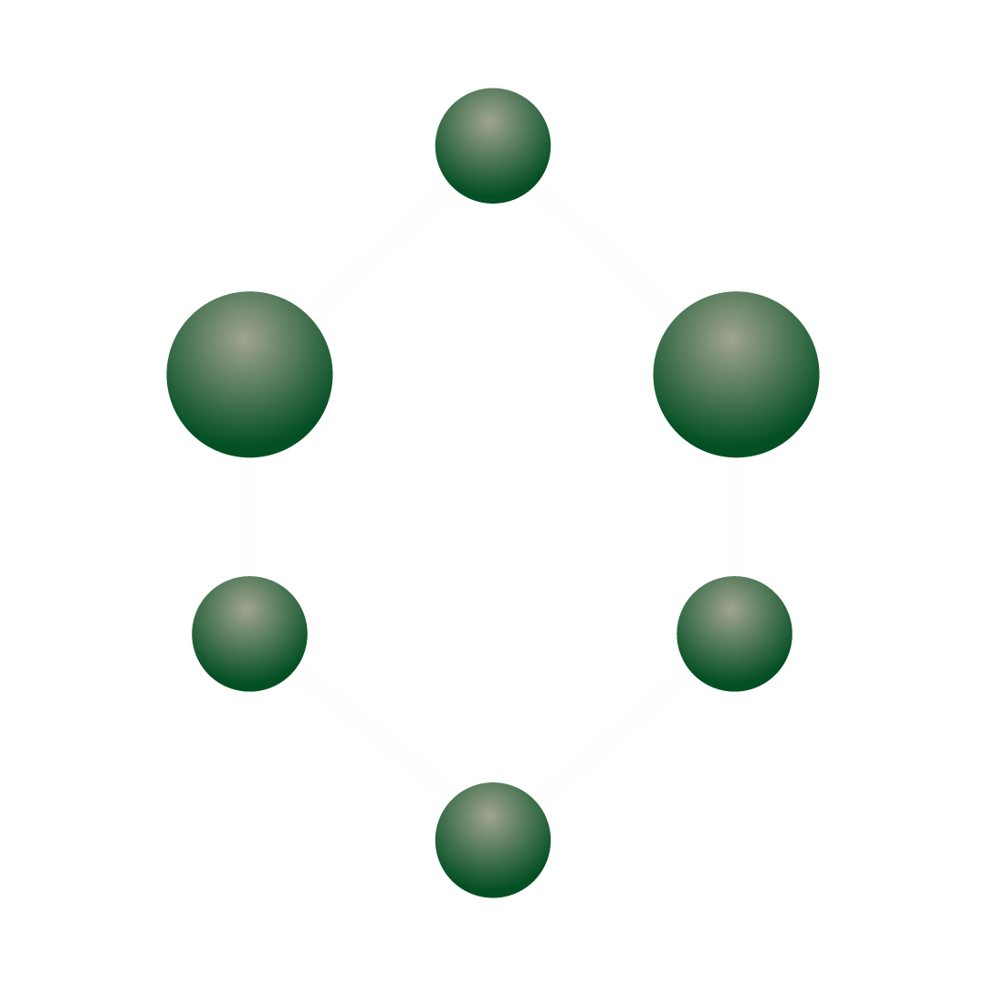
Conclusion
Water in foods is far more complex than just moisture content. The distribution between free, bound, and imbibed water fundamentally determines a food’s characteristics, from its texture and flavor to its safety and stability. For food science students, understanding these water types provides a foundation for explaining countless phenomena in food systems—from why bread goes stale to why pickles remain safe without refrigeration.
As our understanding of food-water interactions continues to evolve, so too will our ability to create better food products: safer, more nutritious, longer-lasting, and with improved sensory qualities. This knowledge bridges the gap between traditional food wisdom and modern food technology, creating opportunities for innovation while respecting the fundamental principles that govern all food systems.
What do you think? How might understanding the different types of water in foods help you make better decisions about food storage in your own kitchen? Have you noticed texture changes in foods that could be explained by shifts in water distribution?

Slide 45
— Adsorption Isotherm

Slide 46
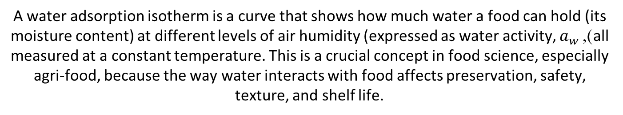
— What Is an Adsorption Isotherm?
A water adsorption isotherm is a curve that shows how much water a food can hold (its moisture content) at different levels of air humidity (expressed as water activity, $a_{w}$), all measured at a constant temperature. This is a crucial concept in food science, especially agri-food, because the way water interacts with food affects preservation, safety, texture, and shelf life.
Absorption vs. Adsorption
Let’s clarify the difference between absorption and adsorption,
Absorption | Adsorption
Water (or another substance) enters inside the bulk of the material or cell. | Water (or another substance) attaches only to the surface of a material.
Exp: a sponge soaking up water: the liquid goes deep inside. | Exp: dew forming on a leaf: the water stays on the outside.

Slide 47
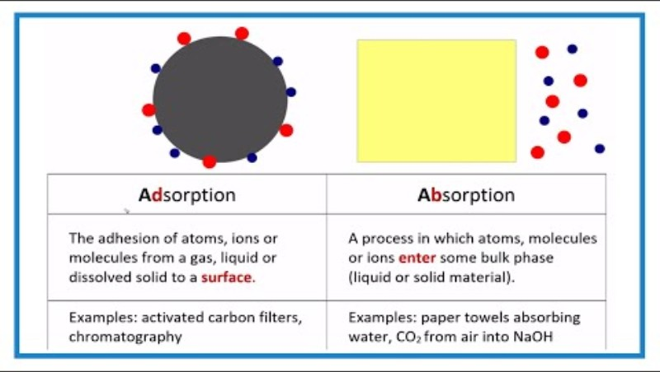
— Adsorption Isotherms

Slide 48
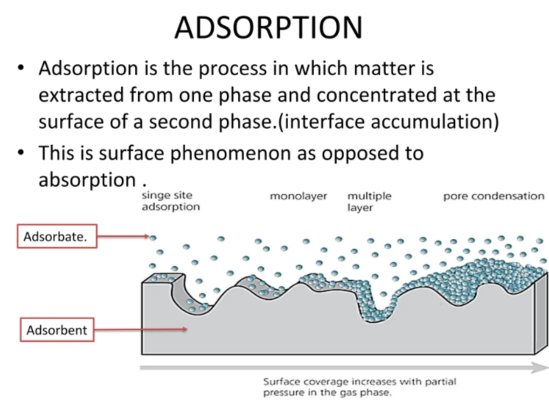
Notes:
Absorption is the process in which matter is extracted from one phase and concentrated at the surface of a second phase

Slide 49
— Examples in Agrifood
Absorption | Adsorption
Seeds soaking in water before planting: Seeds take in water into their cells to start germination. | Powdered milk in humid air: Water vapor from the air sticks to the surface of the milk powder grains without entering the internal structure.
Fresh vegetables: When vegetables are rehydrated or cooked, water moves inside their tissues. | Drying grains or fruits: The first water to leave during drying is the one sticking to the surface that’s adsorbed water.

Slide 50
— Why Does This Matter?
Absorption | Adsorption
changes the whole material and can increase weight or volume significantly. | controls processes like caking, spoilage, powder stability — only a thin outer layer matters.
 | In food preservation, most quality changes (like spoilage or caking in powders) are mainly due to adsorbed water, studied with isotherms.

Slide 51
— Sorption, Absorption and Desorption Isotherm
During the storage of foods, moisture exchange between foods and the environment continues until the establishment of an equilibrium. The moisture exchange may occur when food is losing moisture to its environment, e.g., desorption, or when it is gaining moisture from the moist surroundings, e.g., adsorption. A sorption isotherm at a constant temperature describes the relationship between food and its environment.

Slide 52
— Sorption, Absorption and Desorption Isotherm

Slide 53
— Sorption, Absorption and Desorption Isotherm
Absorption Isotherm and Desorption Isotherm
This is the curve that represents the equilibrium between the amount of water retained by the food as a function of humidity at a given temperature. In other words, it is the partial pressure of water vapor exerted by the water in the food.
The adsorption-desorption isotherm is the relationship between water activity and water content, providing an interesting approach to understanding the behavior of water in foodstuffs . This approach involves establishing the water content curve as a function of water activity

Slide 54
— Sorption, Absorption and Desorption Isotherm
Water adsorption and desorption isotherm
The water content (X) in a food product depends mainly on its water content (X) and its temperature. The curve representing, for a given temperature, the X of a product as a function of the value of the or the HRE is called:
Adsorption isotherm, if it has been determined experimentally starting with a dry product.
Desorption isotherm, if it has been determined experimentally starting with a water-saturated product.
The adsorption-desorption isotherm curve can be graphically represented by plotting:
Along the x-axis: either the αw
Along the y-axis: the product's water content expressed in g of water per 100 g of dry matter (% DM)
The two curves are generally different because drying a product (from αw = 1 to < 0.6) results in irreversible changes in structure and porosity.

Slide 55
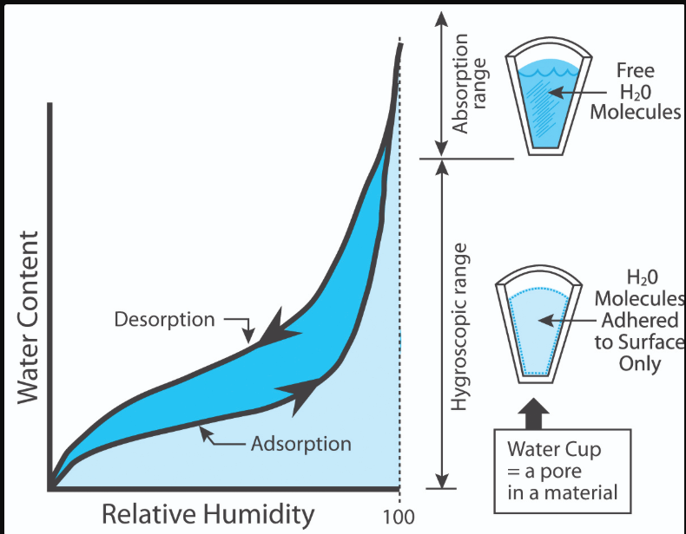
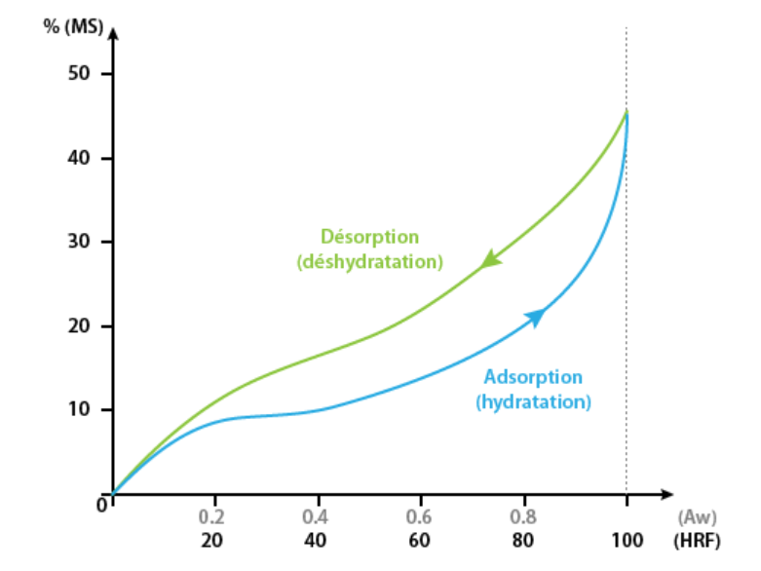
— Sorption, Absorption and Desorption Isotherm

Slide 56
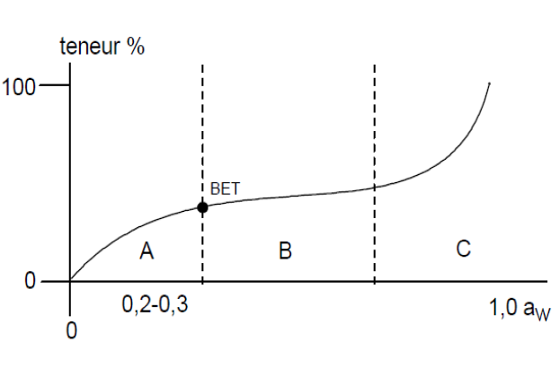
— Sorption, Absorption and Desorption Isotherm

Slide 57
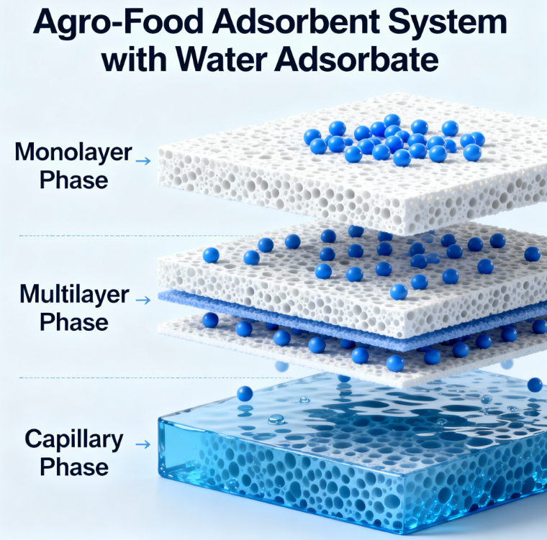
— Sorption, Absorption
and Desorption Isotherm

Slide 58
— Sorption, Absorption and Desorption Isotherm
Generally, the curve is S-shaped, more or less pronounced, with two inflection points that allow three zones to be more or less clearly delineated. Theoretical approaches (models) have made it possible to calculate part of the curve (zone A, work by Brunauer, Emmett, and Teller, the first inflection point sometimes referred to as the "BET point" from the initials of the three authors).
In the three defined zones, water has distinct properties:
Zone A: Aw at the upper limit: in the order of 0.2 - 0.3 (BET point, precisely)
Strongly bound water (adsorption energy: 1-15 kcal/mole H2O)
A practically monomolecular layer (associations by H bonds with polar organic constituents of
foodstuffs (proteins, carbohydrates), water of crystallization of mineral constituents
Non-freezable water, water not available as a solvent or reactive transport medium
(biological processes) in defatted foodstuffs whose contents generally range
between 3-11% .

Slide 59
— Sorption, Absorption and Desorption Isotherm
Zone B: Loosely bound water
Successive layers on the basic monomolecular layer of water fill the pores. Water availability depends on pore size (competitive effect of capillarity) . This water is:
- Freezable;
- Available as a reagent and solvent;
Not available as a transport medium.
Zone C: Free Water
Water is available for all functions. The majority of water contained in fresh foods (fruits, vegetables, meats) is retained in tissues as long as they have not been damaged, responsible for mechanical (freezing and thawing) and microbiological alterations of cell walls . The shape of the curves is determined by the more or less hygroscopic properties of the foods. The desorption or adsorption isotherm should, in theory, follow the same path, but experimental data show that this is not always the case (particularly for fruits and vegetables).

Slide 60
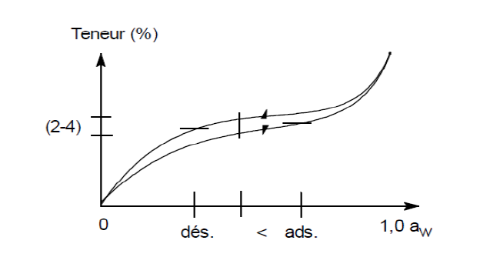
— Hysteresis Phenomena of Isotherms
Generally speaking, adsorption-desorption isotherms exhibit the dynamic property of hysteresis: the adsorption curve is shifted relative to the desorption curve . The shift is such that the relationship Aw (adsorption) > Aw (desorption) at equal water content is always satisfied.
In practice, for the same activity value Aw, the H2O content in desorption can be 2-4 g/100 g higher than that in adsorption (potato starch)
Figure : Hysteresis curve of isotherms
Notes:
Hysteresis of isotherms is the difference between the adsorption and desorption curves of a material, meaning that at the same relative humidity, the amount of substance adsorbed is different from the amount desorbed. This phenomenon is observed in porous materials and is commonly seen with water vapor in hygroscopic substances like foods, but also in other gas-solid systems. Causes include the physical changes in the material's pore structure during the process, such as capillary condensation in pores of different shapes and sizes.

Slide 61
— Hysteresis Phenomena of Isotherms
Hysteresis in the context of adsorption and desorption isotherms refers to the phenomenon where the amount of water retained by a material (food, soil, powder, etc.) at a given relative humidity depends on whether the material is gaining or losing water:
- During adsorption (when the material takes up water from a dry state), the moisture content increases along a certain curve.
- During desorption (when the material loses water from a wet state), the moisture content decreases, but along a different curve.
- The difference between these two curves at the same relative humidity is called hysteresis.

Slide 62
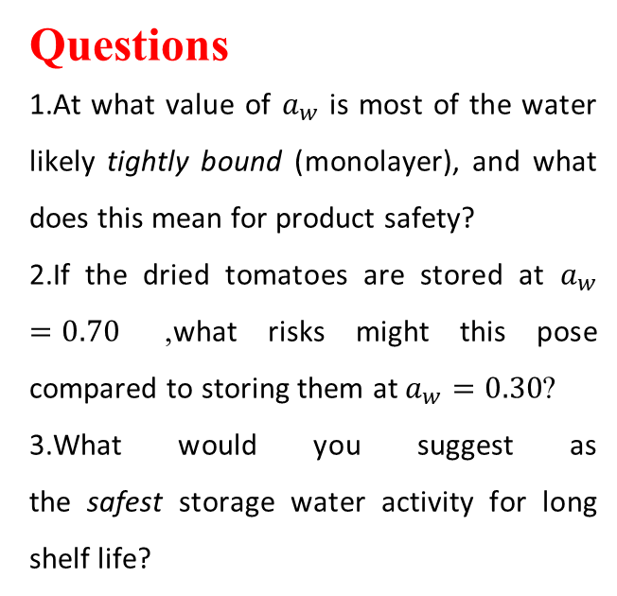
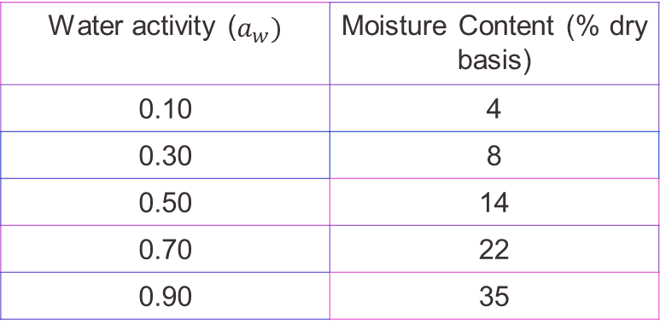
Example
A food technologist is developing a dried tomato product. The water adsorption isotherm at 25°C for this tomato has the following simplified values:
Questions
At what value of $a_{w}$ is most of the water likely tightly bound (monolayer), and what does this mean for product safety?
If the dried tomatoes are stored at $a_{w}=0.70$, what risks might this pose compared to storing them at $a_{w}=0.30$?
What would you suggest as the safest storage water activity for long shelf life?
Water activity ($a_{w})$ | Moisture Content (% dry basis)
0.10 | 4
0.30 | 8
0.50 | 14
0.70 | 22
0.90 | 35

Slide 63

Solution Walkthrough
1. Monolayer point and safety:
Looking at the table, the lowest water content corresponds to the lowest water activity ($a_{w}=0.10$, moisture = 4%).
At $a_{w}$ below 0.30, water is mainly monolayer (tightly bound), so spoilage reactions and microbial growth are very limited. This means better product safety and stability.
2. Risk at higher $a_{w}$:
At $a_{w}=0.70$, moisture is 22%, while at $a_{w}=0.30$, it is only 8%.
Higher $a_{w}$ allows more water to be available for microbes and chemical changes! At $a_{w}=0.70$, there is risk of mold growth and faster spoilage; at $a_{w}=0.30$, much lower risk.
3. Suggested storage $a_{w}$:
To maximize shelf life, keep $a_{w}$ at or below 0.30.
Why? This keeps most of the water in the monolayer or low multilayer state, minimizing spoilage processes.

Slide 64
— Water Activity and Food Modifications

Slide 65

— Water activity and food modifications
The importance of water activity for the stability of foodstuffs during processing and storage is illustrated in the figure below:
Horizontal axis (x): water activity (aw), from 0 (no free water) to 1 (pure water).
Left vertical axis: moisture content of the food.
Right vertical axis: relative reaction rate.

Slide 66
— Water activity and food modifications
Region I (aw < 0.25)
Water is very tightly bound → little available.
Microorganisms are inactive.
Lipid oxidation possible (rancidity).
Region II (0.25 < aw < 0.75)
Water becomes more available.
Enzymatic reactions may occur.
Beginning of browning (Maillard reaction).
Maximum food stability in this zone.
Region III (aw > 0.75)
A lot of free water.
Strong microbial activity (bacteria, yeasts, molds).
Chemical reactions are rapid.
Rapid food deterioration.

Slide 67
— Water activity and food modifications
To delve deeper, let's focus on the reactions influenced by water activity in food.
Region I (aw < 0.25): The Domain of Oxidation
State of water: The water is so tightly bound that it acts as part of the molecular structure. It is not available.
Microbial growth: None. Microbes (bacteria, yeast, mold) absolutely need free water for their vital functions. Here, they are dormant or die.
Enzymatic reactions: Very slow or stopped. Enzymes, which are biological catalysts, need water to move and react with their substrates. Without free water, they are "frozen" in place.

Slide 68
— Water activity and food modifications
Detailed explanation of Lipid oxidation (Rancidity):
Why is this the dominant reaction here? Fat oxidation is a reaction that does not require water in an aqueous phase. It is primarily triggered by oxygen (O₂) in the air.
Mechanism: When the aw is very low, the dry surface of the food directly exposes fat molecules to oxygen. Free radicals (produced by light, heat, or metals) attack the chains of unsaturated fatty acids, initiating a chain reaction that produces aldehydes, ketones, and carboxylic acids – responsible for the bad odors and flavors of rancidity.

Slide 69
— Water activity and food modifications
Region II (0.25 < aw < 0.75): The zone of maximum stability
State of water: The water is partially bound. A significant amount of free water becomes available to act as a solvent and reaction medium.
Microbial growth: Most bacteria still cannot grow (their minimum aw is generally > 0.85). However, some molds and yeasts can begin to grow slowly above 0.6-0.7.
Enzymatic Reactions: free water acts as a solvent and a carrier. It allows enzymes and their substrates (e.g., starch, proteins) to move, meet, and react.
Example: The enzymatic hydrolysis of pectins in ripe fruits, or the activity of proteases in meat that tenderizes it.

Slide 70
— Water activity and food modifications
Non-Enzymatic Browning (Maillard Reaction):
This is the reaction between amino acids (proteins) and reducing sugars. It is responsible for roasted aromas, in bread, coffee, roasted meat, and the brown color.
Why do we care about this reaction?
Because it's the soul of cooking! This reaction is primarily responsible for:
The color of the golden crust of bread.
The aroma of roasted coffee and grilled meat.
The flavor of biscuits, french fries, and baked potatoes.
The color and taste of caramelized onions.

Slide 71
— Water activity and food modifications
Why does it peak in this zone?
The Maillard reaction needs a little water for the reactants to move, but too much water dilutes the reactants and slows down the reaction. The optimal zone is often between 0.4 and 0.7, where molecular mobility is good without excessive dilution.

Slide 72
— Water activity and food modifications
Region III (aw > 0.75): The Domain of Rapid Spoilage
State of Water: Free water is abundant. Foods are typically "wet" (fruits, vegetables, meat, milk).
Microbial Growth: Explosive. This is the main cause of spoilage. Almost all bacteria (e.g., E. coli, Salmonella), yeasts, and molds can grow freely. Water is essential for the transport of nutrients, the elimination of waste, and all the internal metabolic reactions of microbes.

Slide 73
— Water activity and food modifications
Detailed explanation of reactions:
All reactions accelerate: The abundance of free water allows for rapid diffusion of reactants.
Hydrolysis: Hydrolysis reactions (breaking molecules with water) become very important. For example, the hydrolysis of sugars (sucrose splitting into glucose and fructose) or the degradation of water-soluble vitamins (like vitamin C).
Maximum Enzymatic Activity: Enzymes from microbes and those naturally present in the food work at their maximum speed, leading to softening, changes in texture, and the production of spoilage compounds.

Slide 74
— Water activity and food modifications
Aw (Water Activity) | Examples | What Happens (Reactions/Risks)
< 0.3 | Biscuits, cereal, powdered milk | No microbes, rancidity (fat oxidation possible)
0.3 - 0.7 | Raisins, chocolate, dry-cured ham | Maillard, good shelf life, few microbes
> 0.7 | Bread, meat, yogurt, apples | Microbial growth, enzymatic reactions, spoilage

Slide 75

— Water activity and food
modifications
<0.25
> 0.75
(0.25 < aw < 0.75)

Slide 76
— Synthesis and Application
The graph shows that the optimal stability zone for many dry or dehydrated foods (crackers, cereals, pasta, spices) is in region II (aw ~ 0.3 – 0.6). In this zone, the three main scourges – microbes, enzymes, and oxidation – are simultaneously minimized.
This is why food preservation technologies often aim to lower aw:
Dehydration/Drying: Removes water.
Freezing: Turns free water into ice (unavailable).
Salting/Sugaring: "Binds" water with salt or sugar, reducing the free aw.
By understanding these mechanisms, we can better formulate, package, and store foods to preserve their quality, safety, and shelf life.

Slide 77

— Water activity and food modifications

Slide 78


Conclusion
In summary, water activity (aₑ) is a fundamental critical control point in food science and
technology. It is not the total water content, but the availability of that water, which dictates the stability and safety of a food product.
The relationship between aw and food deterioration is defined by three key zones:
At low aw (<0.25), lipid oxidation is the primary concern.
In the intermediate aw range (0.25 - 0.75), enzymatic reactions and non-enzymatic browning peak, but this is also the zone of maximum stability for many dry foods.
At high aw (>0.75), microbial growth becomes the dominant cause of rapid spoilage.
Therefore, controlling water activity through methods like drying, salting, sugaring, or freezingis an essential strategy for extending shelf life, ensuring food safety, and maintaining desired food quality. Mastering aₑ allows producers to predict and control the chemical and microbial destiny of their products.

