Slide 1
UNIVERSITY CENTER OF MILA
INSTITUTE OF SCIENCE AND TECHNOLOGY
DEPARTMENT OF CIVIL AND HYDRAULIC ENGINEERING
Seismic Engineering
Génie parasismique (Master2 G.C)
Chapter 07: Ductility Concept and Structural Design Provisions

Responsible: Dr. GUETTICHE ABDELHEQ

Academic Year 2023- 2024

Slide 2
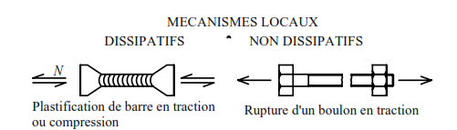
Introduction: reinforced concrete or steel:
Observations made after earthquakes highlight numerous total collapses of reinforced concrete buildings (the Boumerdes earthquake is an example), while damage to steel buildings is non-existent or limited to a few areas of the frame, particularly the connections. Several reasons justify this reality.
Steel structures are the subject of a project and assembly carried out almost necessarily by qualified persons. Many reinforced concrete buildings in the world are built practically without plans or based on approximate plans drawn up by poorly trained people.
Steel structures make use of manufactured products and the products used correspond to the characteristics considered in the frame design calculations. Reinforced concrete is, in many countries, a material whose quality is less controlled; quality control of the concrete material, control of the compliance of the plans with the seismic standard, control of the position of the reinforcements are often lacking or imperfect.
There are numerous possible local dissipative mechanisms in steel structure.

Slide 3
-In reinforced concrete, there is only one possible dissipative mechanism, plastic bending in reasonably unconfined elements. Any adverse event preventing the formation of this plastic bending mechanism leads to local brittle failure often causing total collapse of the structure. Thus, in the example of a moment frame where the plastic moments of the beams would be too high (following an excessive beam height, for example), the cyclic shear of the reinforced concrete leads to rapid failure of the frame nodes and complete collapse.
2. Ductility of structures:
The principle of ductility is based on the fact that during a given earthquake, the displacements obtained when the structure yields are of the same order as those obtained by elastic analysis. This is done by limiting the reduction of design forces and by implementing dissipative zones with specific constructive provisions.
The dissipative zones are called identified fuse zones, which protect the rest of the structure from excessive seismic stresses. This effect results in a reduction of seismic loads by the behavior factor R (from 2 to 5 for reinforced concrete structures and from 2 to 6 for steel structures).

Slide 4
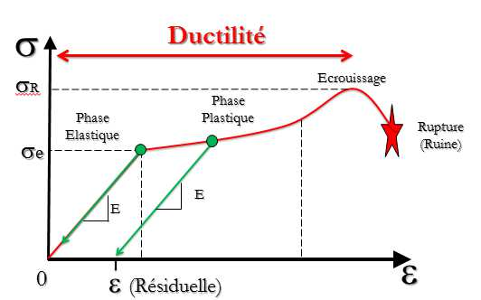
In return for this design, the "survival" of the building must be guaranteed at least until the fuses come into action. This is capacity design.
The development of plastic hinges should occur, outside of the nodes, preferably in horizontal elements (beams, lintels) rather than vertical elements (columns, walls) so as not to compromise the load path of vertical forces or the stability of the structure and/or its load-bearing elements.
As for the load-bearing elements that do not participate in bracing, they must be able to retain their load-bearing capacity under the effect of imposed deformations..

Slide 5
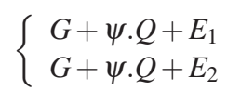
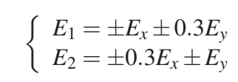
3. Verification of safety:
3.1 Combinations of Actions:In the context of the limit states design principle, seismic action is considered an accidental action due to its short duration of application. Seismic action is characterized by three components acting simultaneously:
Two horizontal components, Ex and Ey, acting along two orthogonal directions in the plane of the structure.
One vertical component, Ez, acting along the vertical axis of the structure
3.1.1Horizontal Components of Seismic Action
The components of seismic action, Ex and Ey, acting along the two horizontal directions, are assumed to be independent but represented by the same response spectrum. The seismic actions used for the design of structures are combined with permanent and variable actions through Equations (5.1) and (5.2):
ψ:The accompanying coefficient (ψ) depends on the nature and duration of the imposed load and is provided in Table (4.2).

Slide 6
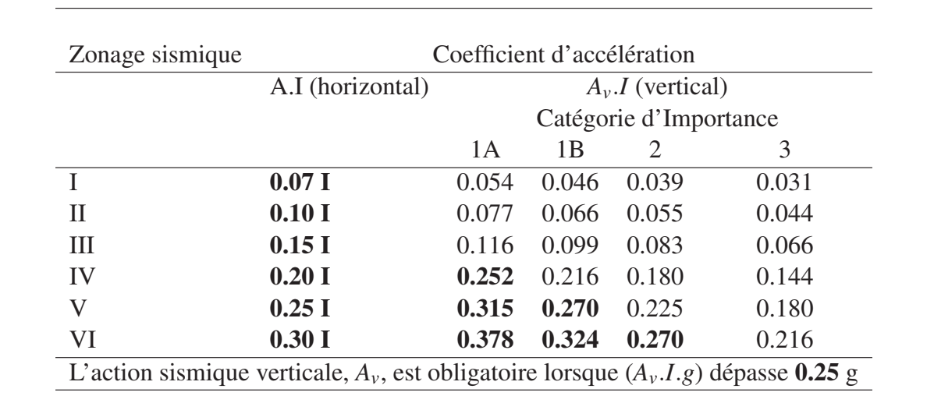
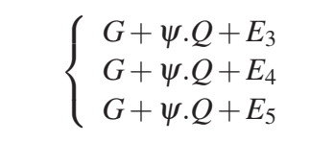
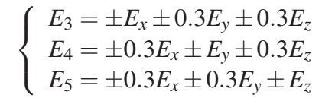
3.1.2 Vertical Components of Seismic Action:The effects of the vertical component of seismic action, as defined in § 3.3.2, must be considered if the value of the product (Av.I.g) exceeds (0.25g) in the following cases:
Horizontal or nearly horizontal structural elements with a span of 15 m or more;
Horizontal or nearly horizontal cantilever elements longer than 2.00 m;
Horizontally or nearly horizontally prestressed elements;
Beams supporting columns;
Structures on seismic isolators.
For the Vertical Component, the Following
Action Combinations Must be Used:
où: E3, E4 et E5 représentent la combinaison des composantes, horizontales (Ex, Ey) et la
composante verticale (Ez), définies par :

Slide 7

Commentary: The analysis used to determine the effects of the vertical component of seismic action can be carried out based on a partial model of the structure, including the elements where the vertical component is assumed to act, while accounting for the stiffness of adjacent elements. It is necessary to consider the effects of the vertical component only for the specific elements involved and the supporting or infrastructural elements directly associated with them.
4. Verification of strength:The following strength condition must be satisfied for all structural elements, their assemblies as well as critical nonstructural elements:
Sd: design acting stress resulting from the combinations, possibly including 2nd order effects.
Rd: design strength of the element, calculated based on the properties of the constituent material
4.1. Verification of ductility: The minimum ductility requirements are deemed to be met if all the constructive provisions relating to the material and structural elements are satisfied.
4.2 Verification of overall equilibrium: This equilibrium condition pertains to the overall stability of the building or structure, subjected to overturning and/or sliding effects caused by the forces resulting from combinations of actions. Each building must be checked for stability against overturning at the foundation level. The overturning moment at the foundation level is equal to the sum of the lateral forces at each level, multiplied by the height of each force from the foundation level.The safety factor against overturning must be at least 1.3. The stabilizing moment must be determined based on the

Slide 8
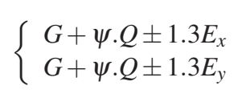
vertical loads considered for calculating the lateral seismic force.
The weights of the foundation and the soil above it are added to these vertical loads.
The stabilizing moment must be calculated at the bottom level of the foundation, relative to its extreme edge. For sliding stability, when its verification is required, the safety factor to be considered must be at least 1.25.
4.3.Justification Regarding the Resistance of Floors: The capacity of the floors must allow for the transmission of the effects of design seismic forces to the vertical bracing elements (cf. § 6.1.2).The diaphragms, in the horizontal planes, must be capable of transmitting the effects of seismic action to the various bracing elements they are connected to, with sufficient overstrength. This condition is satisfied if the effects of seismic action in the diaphragm, obtained from the analysis, are multiplied by an overstrength factor of 1.3, according to the following load combination:
This load combination is used for the calculation and justification of reinforced concrete diaphragms in structures with the following characteristics:
Irregular or complex shapes in plan, with notches or projections.
Large or irregular openings in the diaphragm.
Irregular distribution of masses and/or stiffness (e.g., in cases of projections or setbacks).
Basement with partial perimeter walls or walls present in only part of the ground floor.

Slide 9
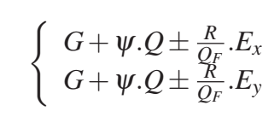
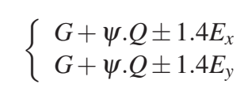
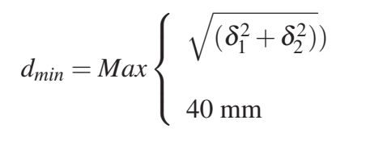
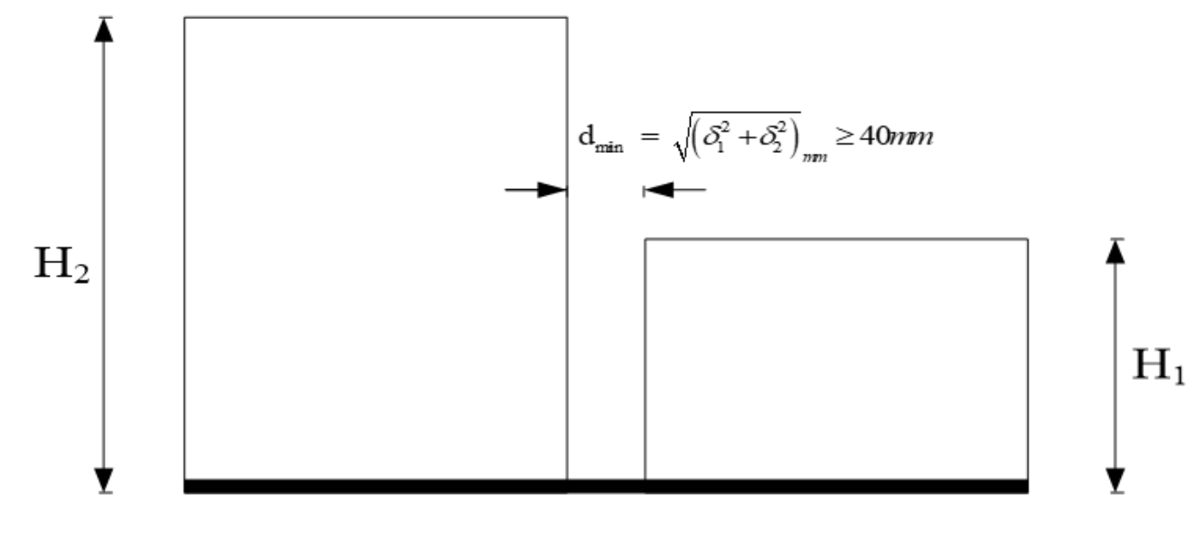
4.4 Verification of foundation stability: For the verification of foundation stability, reference should be made to the prescriptions and/or requirements of Chapter X and the load combinations, see Eqns. (5.7) & (5.8):
For the foundations of individual vertical elements (walls or columns), the following load combination is used:
For foundations shared by multiple vertical elements (foundation beams, strip footings, rafts, etc.), the following load combination is used:
Verification of seismic joint width: Two adjacent blocks must be separated by seismic joints whose minimum width dmin satisfies the following condition:
δ1 and δ2: maximum displacements of the two blocks, calculated according to the formula below at the level of the lowest block including the components due to torsion and possibly those due to foundation rotation:
δek : displacement due to seismic forces Fi
(including torsional effect)
R: behavior factor (page 38 of RPA)

Slide 10
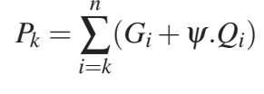
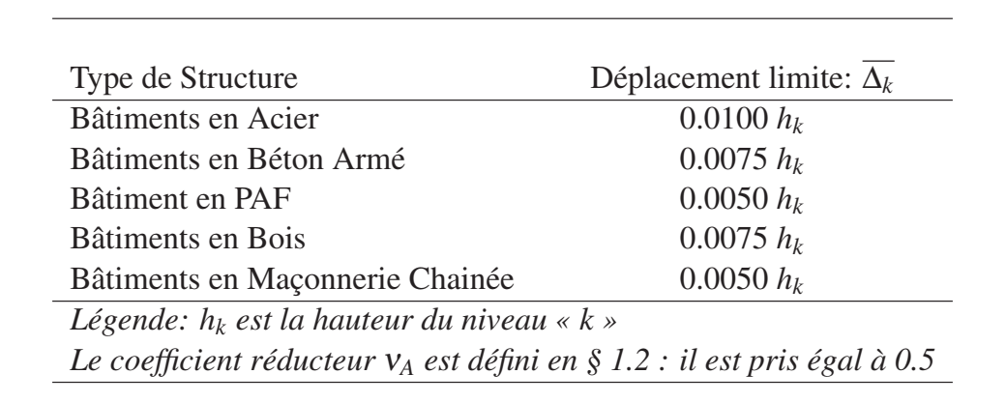


4.6. Verification the P-Δ effect:Second order effects (or P-Δ effects) can be neglected for buildings if the following condition is satisfied at all levels: $θ= \frac{P_{K}× ∆_{K}}{V_{K}× h_{k} } ≤ 0.10$
$where:Δk is defined as:$ $Δ_{k}=δ_{k}−δ_{k−1}$
Pk: total weight of the structure and the associated live loads above level 'k' (see § 4.2.3):
- If 0.10 < θk,≤ 0.20, the P-Δ effects can be taken into account approximately by amplifying the effects of the seismic action calculated using a first order elastic analysis by the factor 1/(1-θk)
- If θk > 0.20, the structure is potentially unstable and must be redesigned.
4.7, Verification of deformations:The relative lateral displacements of a story with respect to the story below, as calculated according to § 4.5.2 (see Eqn. (5.11)), reduced based on the importance group through the reduction coefficient ν, must not exceed the limits, $\overline{Δ}$k​, given in Table (5.2) and Eqn. (5.12), i.e.:

