Slide 1
The Age of Enlightenment (1685-1815)
- The Enlightenment definition and history
- Culture and Society in an Age of Enlightenment
- Religion and the Churches

Slide 2
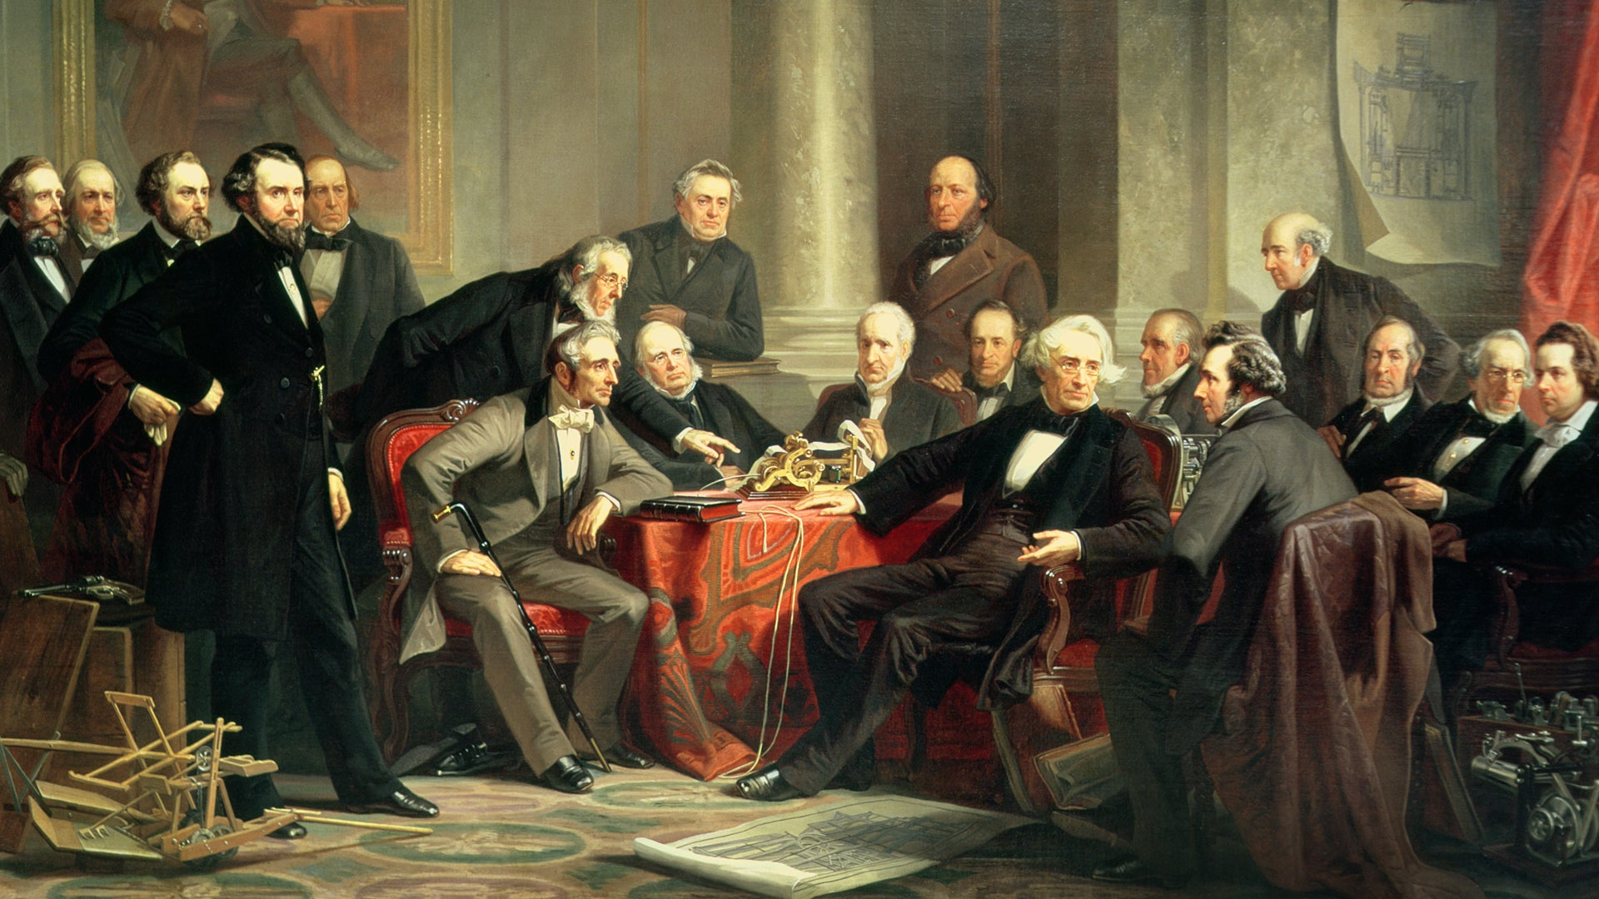
1- The Enlightenment definition and history

Slide 3
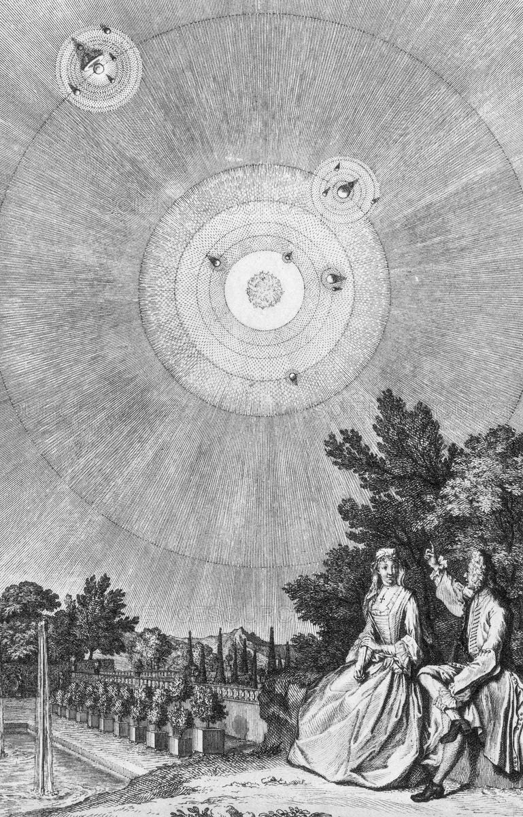
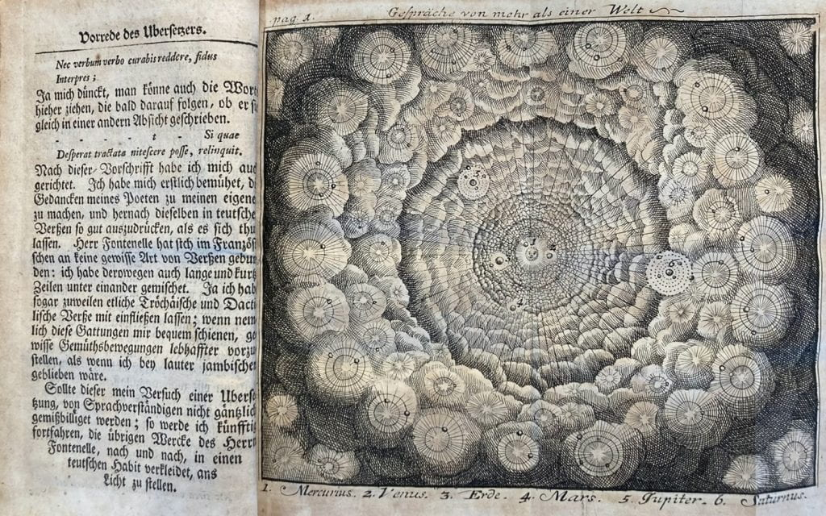
A- Paths to Enlightenment

Slide 4
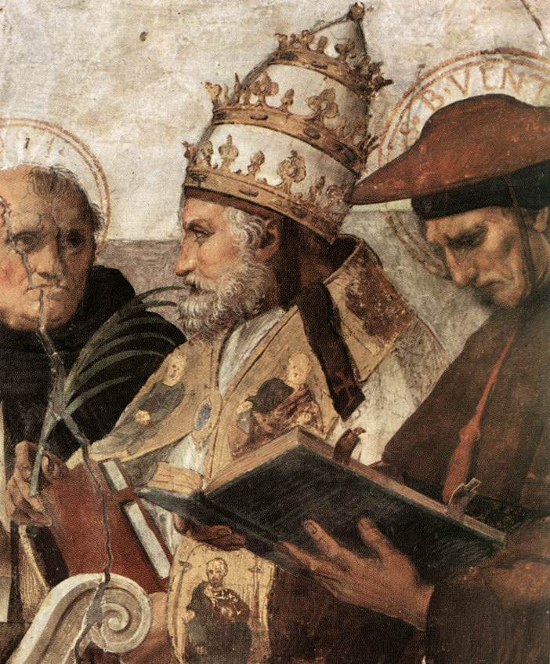

B- New Skepticism

Slide 5


C- Diderot and the encyclopaedia

Slide 6
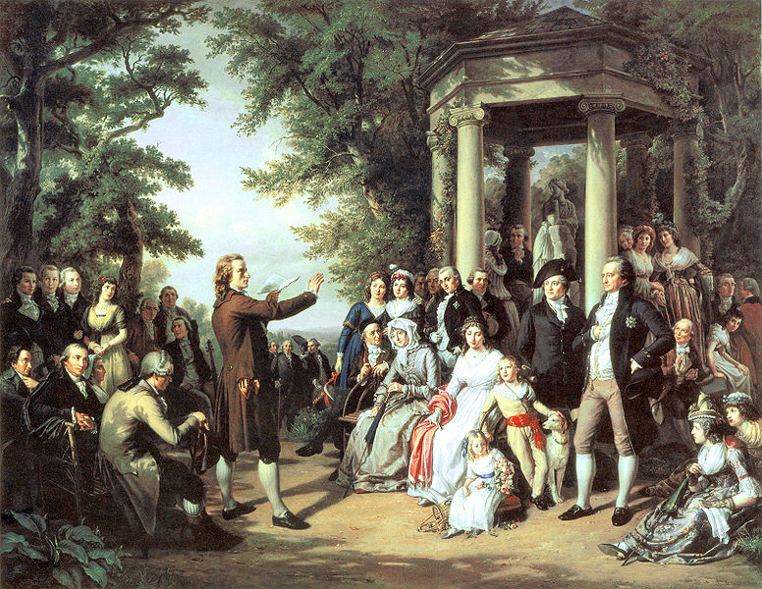
2-Culture and Society in an Age of Enlightenment

Slide 7


A-Education and universities

Slide 8
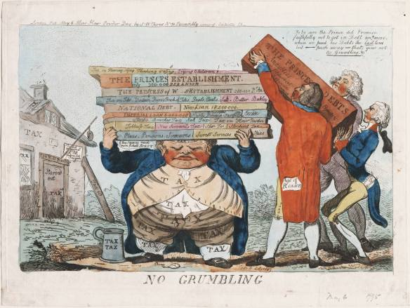
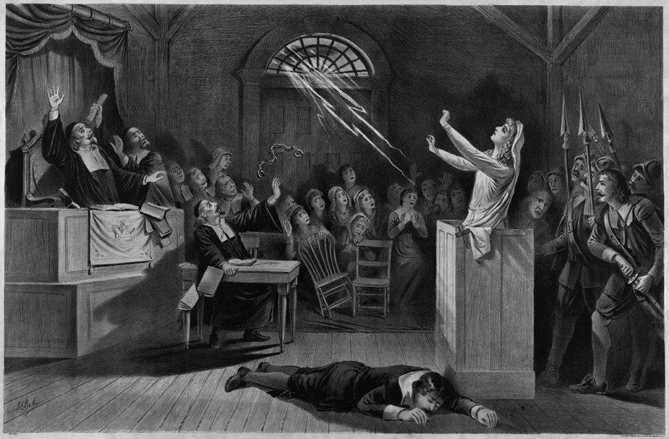
B-Crime and Punishment

Slide 9
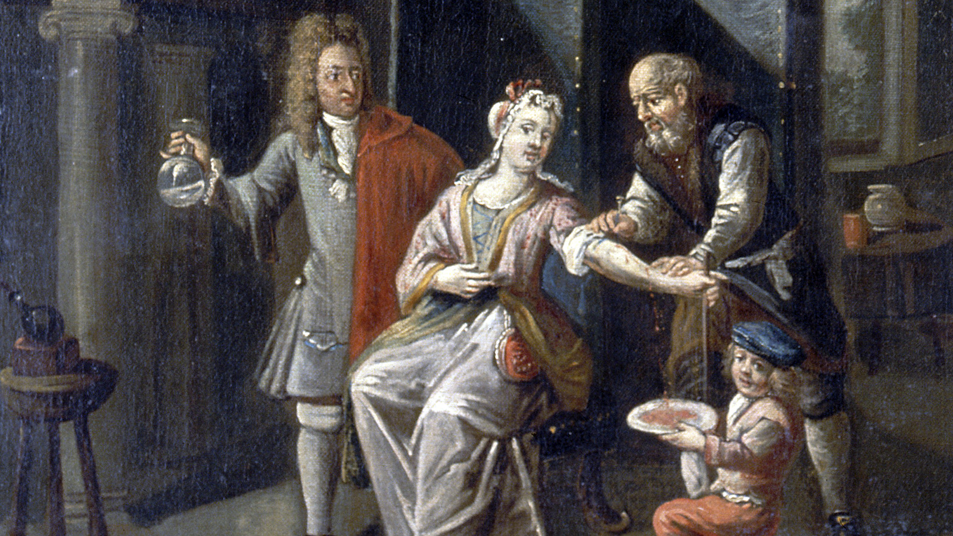
C-The world of Medicine

Slide 10
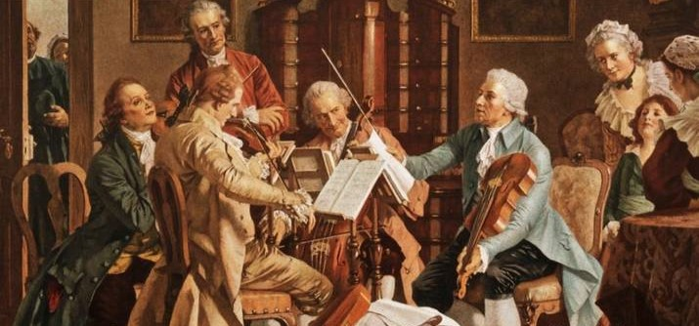
D-Innovations in Art, Music, and Literature

Slide 11
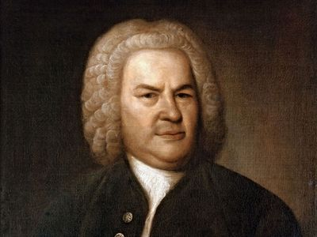

E-The Development of Music

Slide 12


F-The Development of the Novel

Slide 13

G-The Writing of History

Slide 14
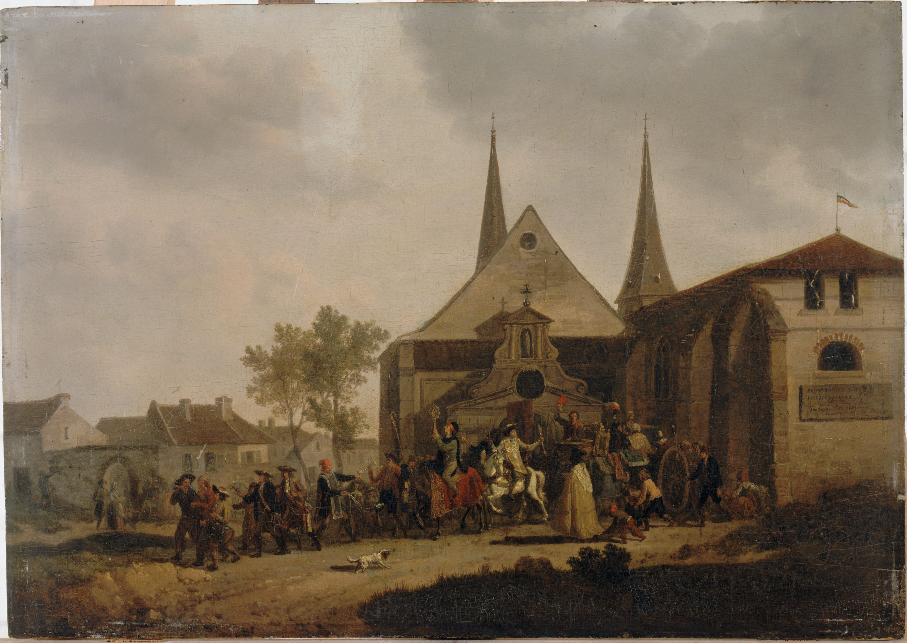
3- Religion and the Churches

Slide 15
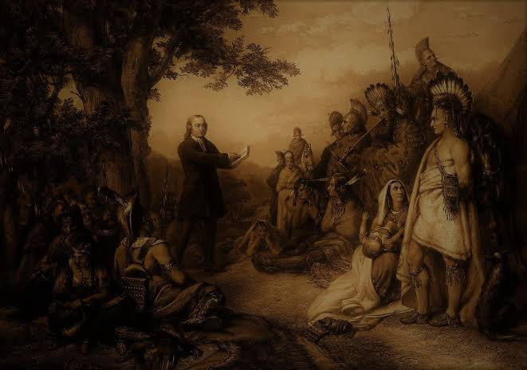
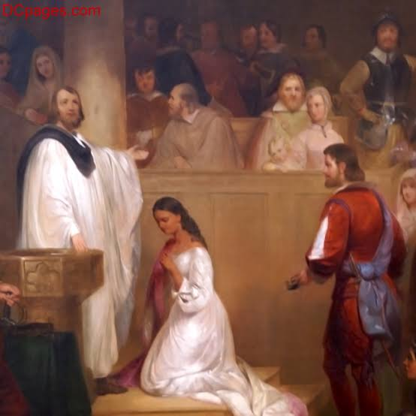
A-The Institutional church

Slide 16
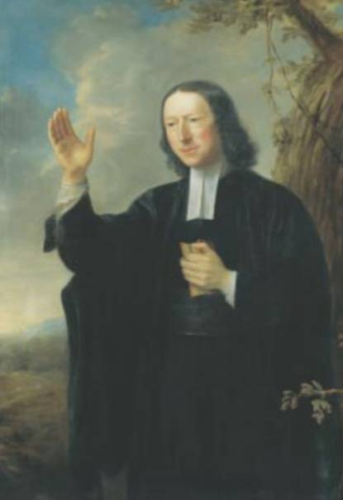
B-Religion

