Slide 1
UNIVERSITY CENTER OF MILA
INSTITUTE OF SCIENCE AND TECHNOLOGY
DEPARTMENT OF CIVIL AND HYDRAULIC ENGINEERING
Seismic Engineering
Génie parasismique (Master2 G.C)
Chapter 5: Equivalent Static Method
« See RPA 99-V2024 (Pages: 74- 77) »

Responsible: Dr. GUETTICHE ABDELHEQ

Academic Year 2024- 2025

Slide 2
Calculation methods in RPA V.2024:The calculation of seismic forces can be conducted using three methods:
Equivalent static method, response spectrum modal analysis method, and time-history dynamic analysis method.
2. Principle of the equivalent static method (per Art 4.2.1):
The actual dynamic forces that develop in the structure are replaced by a system of fictitious static forces whose effects are considered equivalent to those of the seismic action.
The static forces are applied successively in the two main horizontal directions of the structure.
3. Assumptions of the method (per Art. 4.2.2):
The building model to be used, in each of the two calculation directions, is a planar one with masses concentrated at the center of gravity of the floors and only one degree of freedom, in horizontal translation at each level, provided that the bracing systems in both (2) directions can be decoupled.
The lateral stiffness of the bracing system elements is calculated based on uncracked sections for reinforced concrete or masonry structures
Only the fundamental vibration mode of the structure is considered in calculating the total seismic force.
.

Slide 3
4. Conditions for applying the equivalent static method:
The equivalent static method can be used under the following conditions:
If building satisfy the regularity conditions( in plan and in elevation):
HT <= 65 m in zones I, II and III
HT <= 32 m in zones IV, V and VI
b) If building has an irregular configuration:
The studied building or block has an irregular configuration while respecting, in addition to the height conditions , the following supplementary conditions:
 | Importance group
ZONE | 1A | 1B | 2 | 3
I-II | (*) | (*) | (*) | (*)
III-IV | ≤ 3 levels&≤11m | ≤ 5 levels&≤17m | ≤ 7 levels&≤23m | (*)
V-VI | ≤ 2 levels&≤8m | ≤ 3 levels&≤11m | ≤ 5 levels&≤17m | ≤ 5 levels&≤17m
Nota:(*) It means that there is no limitation on the number of floors or height.

Slide 4

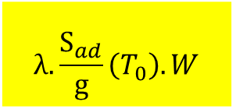
5. Calculation of the total seismic force:
The total seismic force, V, applied at the base of the structure, must be calculated successively in two orthogonal horizontal directions, according to Equation:
ad/g (T0): The ordinate of the design spectrum (see § 3.3.3) ;
T0: Fundamental vibration period of the building for the translational movement in the considered direction (see § 4.2.4);
$$λ=\left\{\begin{aligned}0.85 if :T_{0} ≤{(2T}_{2})\text{and} \text{if} \text{the} \text{building} \text{has} \text{more} \text{than} \text{2 }\text{floors}\text{.} \\ 1\text{otherwise}\end{aligned}\right.$$
Commentary: The coefficient λ reflects the fact that, in buildings with at least 3 floors and degrees of freedom for translation in each horizontal direction, the effective modal mass of the first (fundamental) mode is, on average, 15% less than the total mass of the building.
W: Total seismic weight of the building. It is equal to the sum of the weights Wi, calculated at each level “i": $W=\sum_{i=1}^{n}{W_{i}} with W_{i}=W_{Gi}+ψW_{Qi}$
W_{Gi} : weight due to the dead loads and loads of the eventual fixed equipment attached to the
structure., W_{Qi} : live loads
ψ: weighting coefficient, depending on the nature and the duration of the live load, given in table 4.5.
$$λ.\frac{S_{ad}}{g}\left(T_{0}\right).W$$

Slide 5

5.1. Fundamental period of the structure T: Can be estimated from empirical formulas or calculated using analytical or numerical methods: Temp=${ C}_{t } h_{n}^{3/4}$
hn: height measured in meters from the basis of the structure to the top of the last level (n).
Ct: coefficient, function of the lateral force resisting system and of the type of infill
Case | Type d’ouvrage | ψ
1 | Residential buildings, offices, or similar | 0.20
2 | Buildings temporarily accommodating the public:
2a | Exhibition halls, sports venues, places of worship, meeting rooms with standing areas | 0.30
2b | Classrooms, restaurants, dormitories, meeting rooms with seating areas | 0.40
3 | Warehouses, hangars | 0.50
4 | Archives, libraries, reservoirs, and similar structures | 1.00
5 | Other premises not mentioned above | 0.60
Case | Bracing System | Ct
1 | Reinforced concrete space frames without masonry infill | 0.075
2 | Steel space frames without masonry infill | 0.085
3 | Reinforced concrete or steel frame structures with masonry infill | 0.05
4 | Other types of structures | 0.05

Slide 6


The value of T0 can be calculated using the Rayleigh formula or a simplified version of this formula:
$$T_{cal}=2π\sqrt{\frac{\sum{\left(W_{i}.{δ_{i}}^{2}\right) }}{g.\sum_{i}^{n}{f_{i}δ_{i}}}}$$
fi [unit: S.I.]: system of horizontal forces, distributed according to the formulas for the vertical distribution of V.
g [unit: S.I.]: acceleration due to gravity.
δi [unit: m]: horizontal deflections caused by the forces fi, calculated from a linear elastic model of the structure that takes into account all elements contributing to its stiffness.
Wi [unit: S.I.]: weight calculated at each level (i).
: Simplified version of the Rayleigh formula: $T_{cal}=2\sqrt{δ_{N}}$
In article (4.2.4 P76) RPA 2024 requires that periods calculated from numerical methods must not exceed those from empirical formulas by more than 30%.
Case | Period to be used
$$T_{cal}<1.3T_{emp}$$ | $$T_{0}=T_{cal}$$
$$T_{cal}≥1.3T_{emp}$$ | $$T_{0}=T_{emp}$$

Slide 7
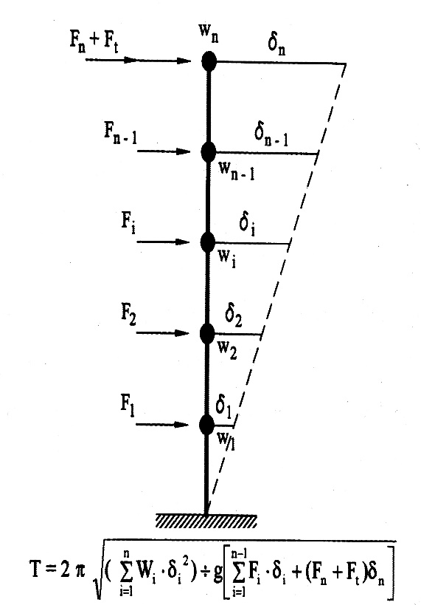
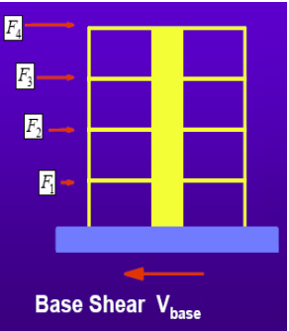
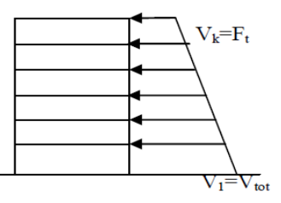


6. Distribution of the resultant seismic forces along the height
The resulting seismic base shear V must be distributed along the height of the structure according to the following formulas:$V=F_{t}+\sum{F_{i}}$
Fi: horizontal force at level i
Ft: force at top of structure to account for influence of higher vibration modes
The force Ft from the base shear is applied at the top of the building under the following conditions:$\left\{\begin{aligned}F_{t}=0,07×T×V T>0,7s \\ F_{t}=0 T≤0,7S\end{aligned}\right.$
The remainder (V-Ft) is distributed to each level by:
$$F_{i}=\frac{(V−F_{t})W_{i}h_{i}}{\sum_{j=1}^{n}{W_{j}}h_{j}}$$
Fi: horizontal force at level i
hi,i: height of floor at level i
Wi,j: Mass at level i
7. Horizontal distribution of seismic forces
The shear force at level k:
$$V_{k}=F_{t}+\sum_{i=k}^{n}{F_{i}}$$

