Slide 1
3, Centrifuge

Slide 2
Centrifuge
Definition
A centrifuge is a laboratory instrument for the density-based separation of fluids, gas, or liquid. Centrifuges are used in daily life as well as in science and medical research. Cells, subcellular organelles, viruses, proteins, and nucleic acids can all be purified with it.²

Slide 3
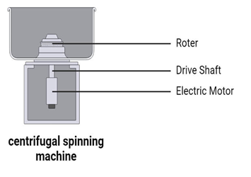
Parts of a Centrifuge
1, Electric Motors: créâtes the spin.
2, Rotor assembly: A drive shaft and a rotor comprise the rotor assembly. There are mainly three types of rotors:

Slide 4
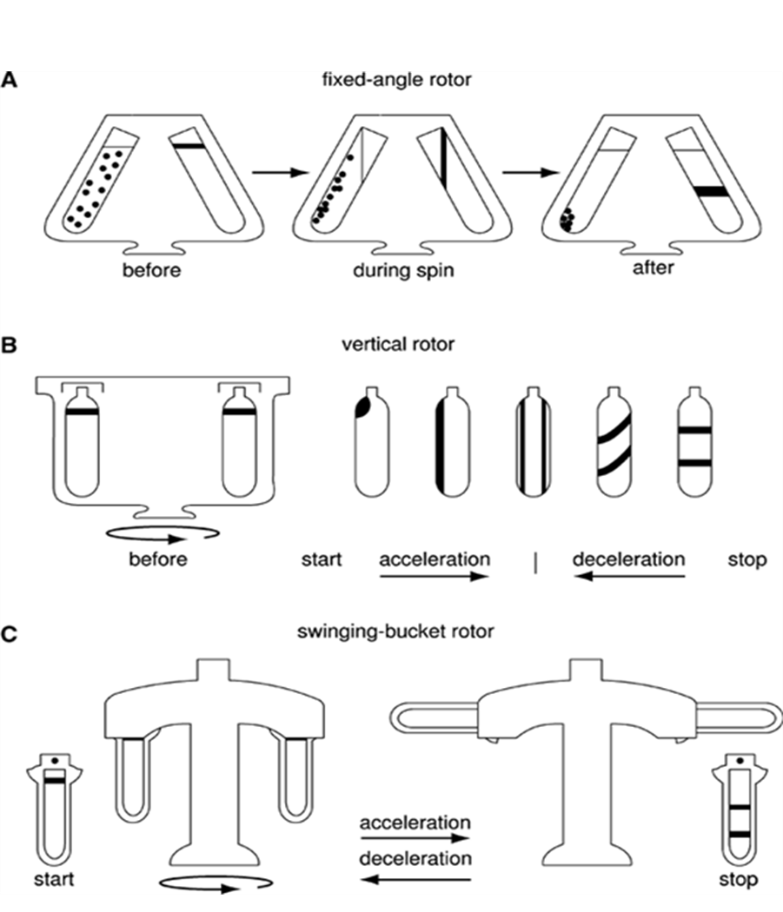
A, Fixed angle rotors: These rotors hold the tubes at an angle of 14 to 40° to the vertical such that particles travel a short distance while moving radially outwards and are used in differential centrifugation. The sedimentation takes place at the walls of the tubes at an angle since the sedimentation direction is the same as the direction of centrifugal force. The pellets (cluster of sediments) later settle at the corner of the base and the wall surface after colliding with the wall surface.

Slide 5
B, Swinging bucket/ Horizontal rotors: These rotors, along with the centrifuge tubes, swing out to a horizontal position during the time of acceleration such that particles travel a longer distance, thereby facilitating easier separation of supernatant from the pellet. These types of motors are employed in density gradient centrifugation.

Slide 6
C, Vertical rotors: These hold the tubes vertically, i.e., parallel to the motor axis, and the particles move shorter distances with shorter periods for separation. It is used for isopycnic and density gradient separation; however, it is not considered useful for pelleting because the pellets are spread out along the entire outer wall of the tube by centrifugal force.

Slide 7
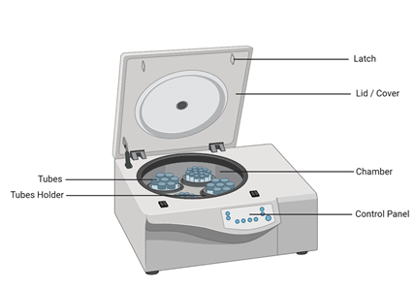
3) Containers: Several types of containers, such as test tubes, blood bags, cuvettes, centrifuge tubes, etc., are held in the rotors such that the sample rotates along as the rotor rotates.
4) Control Panel: It serves the purpose of controlling different parameters such as temperature, rotational speed
5) Latch: When a tube breaks, or there are other issues with the centrifuge while running, the latch keeps the lid closed.
6) Lid: The centrifuge will only spin if the lid is closed and locked to prevent mishaps.

Slide 8
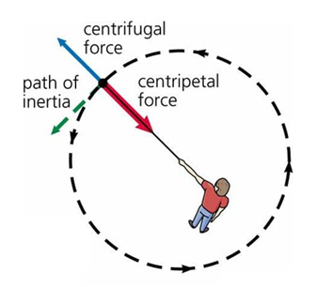
Principle of Centrifugation
Many principles govern the mechanics of centrifugation, but the primary is centrifugal force.
Centrifugal force is an outward push experienced during high-speed rotation, acting radially from the center of rotation and causing the movement and sedimentation of particles suspended in a sample. The principle of the centrifugation technique is to separate the particles suspended in liquid media under the influence of a centrifugal field.

Slide 9
Principle of Centrifugation
Sedimentation is a phenomenon where suspended material settles out of the fluids by gravity. The suspended material can be particles such as clay or powder
The particles having size more than 5 micrometres are separated by simple filtration process while the particles having size 5 micrometre or less do not sediment under gravity. The central force is useful to separate those particles.

Slide 10
Principle of Centrifugation
Centrifugal Force and Sedimentation Caused by centrifugal force
sedimentation is the process by which denser particles settle at the bottom of a sample tube inside a centrifuge. The sedimentation rate is determined by the particles’ size, shape, and density, with heavier and more dense particles moving faster. Differential sedimentation depends on the varied sedimentation rates of particles through a fluid.
Sedimentation Rate and Pellet Formation During rapid centrifugation, particles will sediment into a pellet at the base of the tube or container. This pellet is composed of heavy and dense particles suspended in the sample and can be easily separated for direct analysis after centrifugation.

Slide 11
Principle of Centrifugation
Other Factors Involved in Centrifugation Another principle at work during centrifugation is:
1) buoyancy: which is influenced by the medium in which the particles are suspended. 2) Speed and time of centrifugation are also crucial factors to consider in experimental design, as increasing centrifugation’s duration and speed increases the extent of separation.
3) The rotors’ size and tubes can also impact efficiency and performance.

Slide 12
Centrifugation Techniques
There are two types of centrifugation techniques:
Preparatory centrifugation deals with the isolation and purification of components such as tissue, cells, subcellular structure, membrane vesicles, and other particles of biochemical interest.
analytical centrifugation is carried out to characterize purified biomolecules.

Slide 13
1) preparatory centrifugation
Based on suspension, preparative centrifugation is divided into two different types:
Differential Centrifugation
It separates particles based on shape, size, and density. A suspension of particles with varying densities or sizes will sediment at varying speeds, with the larger and denser particles sedimenting more quickly. Following a series of rising centrifugal force cycles on a suspension of cells, a series of pellets containing cells with a decreasing sedimentation rate will result.
Differential centrifugation utilizes multiple rounds of centrifugation at progressively higher speeds to separate components based on size and density.

Slide 14
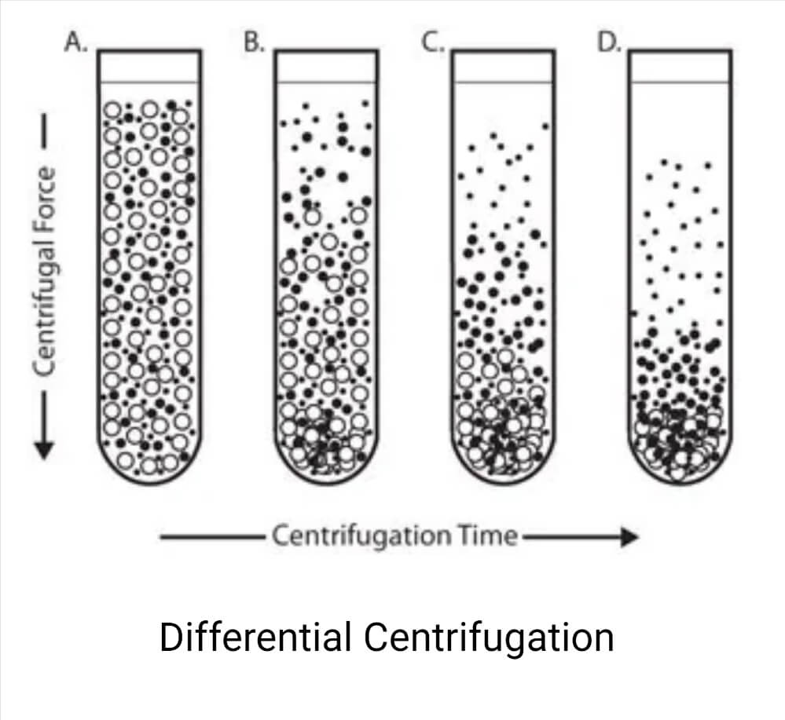
EX:
1- low-speed: whole cells, nuclei, and cell membranes to pellet,
2- medium speed: The pellet that forms during this step is composed of organelles and the consequent supernatant contains the remaining small particles, proteins, and nucleic acids.
3- highest speed. This ensures the separation of small ribosomal and viral particles along with proteins and nucleic acids.
After centrifugation, the tubes from each step of the process can be divided into several fractions, each containing particles with similar densities for further analysis and processing.

Slide 15
B, Density Gradient Centrifugation
Density-gradient centrifugation is an essential tool that allows for separating and defining the relative density of particles in a sample using a gradient of known density. A density gradient is created within a centrifuge vessel by layering solutions by known density. Compound CsCl is commonly used in this application to prepare a gradient.
The sample of unknown density is loaded onto the density gradient and centrifuged at a high speed until the particles migrate to their equilibrium positions. These positions align with the density of the particles themselves. This technique is especially useful in separating DNA, RNA, proteins, and nucleic acids, as buoyant density plays an important role in their response to the gradient.

Slide 16
liquid density gradients
  1) CsCl for DNA banding and isolation of plasmids, nucleoproteins, and viruses;
  2) NaBr and NaI for fractionation of lipoprotein;
  3) Per coll, Ficoll, Metrizamide, Dextran for separation of whole cells and sucrose solution for the separation of DNase, RNase and Protease.
The two subtypes of density gradient centrifugation are:
  1, rate-zonal centrifugation
  2, isopycnic centrifugation

Slide 17
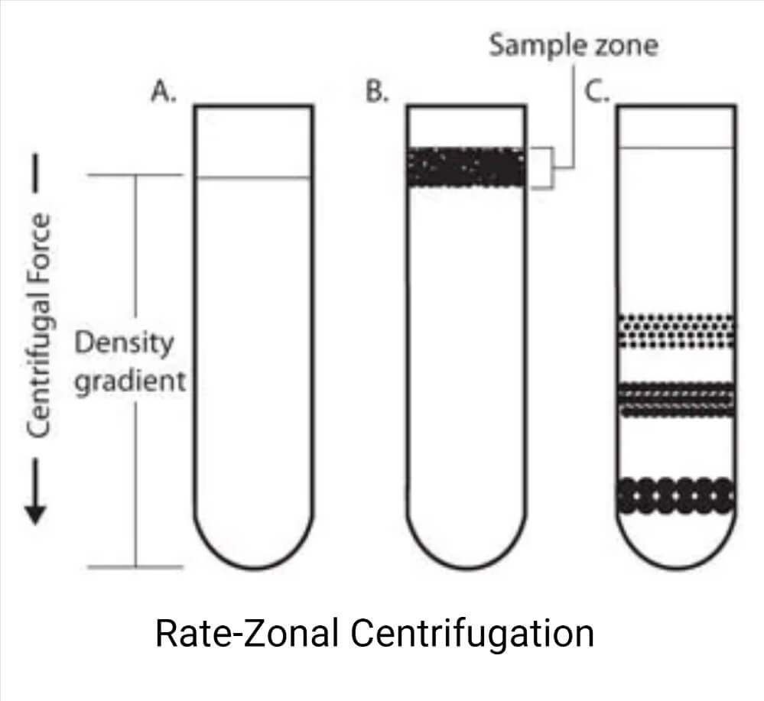
b.1. Rate-zonal centrifugation
On top of a density gradient, the sample is overlaid as a small zone. Depending on their mass, particles travel under centrifugal force at various speeds. Size and mass are the main determinants of how quickly particles settle. As the band of particles descends through the density medium, zones with particles of comparable size develop as the faster sedimenting particles pass the slower ones.

Slide 18
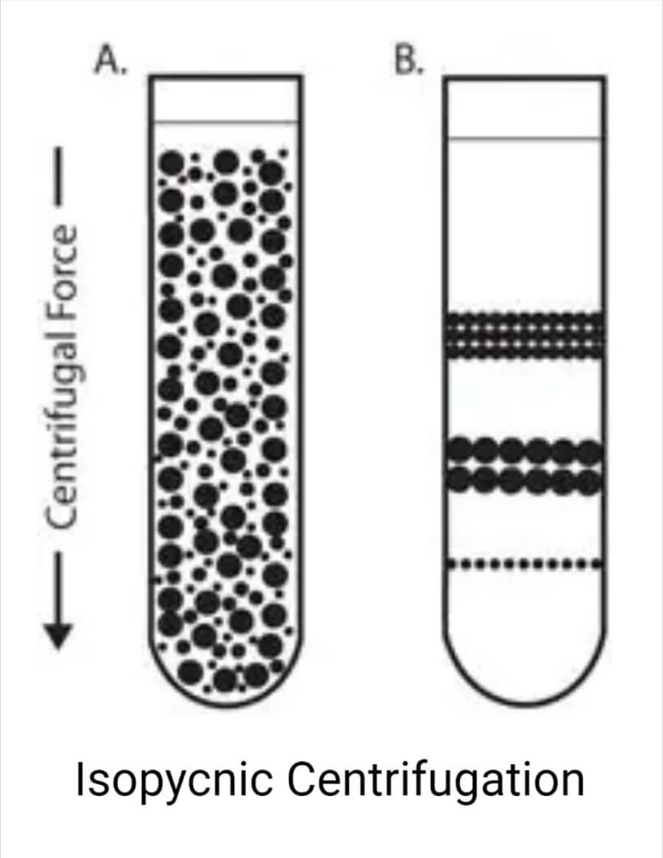
b.2. Isopycnic centrifugation
Particles are separated exclusively based on their density in an isopycnic separation, also known as buoyant or equilibrium separation. It is necessary for the gradient medium to have a higher density than the particles that need to be separated.
Particles migrate under the influence of centrifugal force from a uniformly mixed sample and density gradient until their densities are equal to those of the surrounding medium. After centrifugation, particles of a certain density settle until their density equals that of the gradient media

Slide 19
2, Analytical Centrifugation
Analytical Centrifugation It aims to collect information to characterize the spun sample (sedimentation velocity, viscosity, concentration, etc.), determine the relative molecular weight of the solutes, purity of biomolecules, detect conformational changes of protein structure, etc.
A, Ultracentrifugation
Ultracentrifugation provides maximum separation power and precision using high rotation speed and specialized rotors. Commonly used to separate macromolecules and subcell components, there are two main types of ultracentrifugation:
Analytical ultracentrifugation
Preparative ultracentrifugation

Slide 20
    A,1, Analytical Ultracentrifugation
This is a technique used to study the hydrodynamic properties of small molecules, such as DNA. Analytical ultracentrifugation involves subjecting samples to high speeds and monitoring the reactions based on sedimentation velocity and equilibrium factors.
    A,2, Preparative Ultracentrifugation
Ideal for large-scale research, preparative ultracentrifugation purifies small molecules like DNA and proteins at high speed using unique rotors. This high-speed ultracentrifugation results in a pellet of dense particles.

Slide 21
  B, Counterflow Centrifugation
centrifugation is a specialized technique that allows for the continuous separation of components based on density. Counterflow centrifugation differs from conventional centrifugation by sample and separation medium introduction and collection. In counterflow centrifugation, the sample and medium are introduced to opposing ends of the rotor and flow in opposite directions. The flow causes the components to separate based on density.
The sample is introduced to the rotor through a feeding tube and mixed with a separation medium to create a density gradient. The buffer or separation medium, generally composed of sucrose, is fed through the other end of the rotor. As the two products flow opposite each other, the particles migrate through the separation medium according to buoyant density. Heavier particles will move more quickly against the current, while lighter particles are swept up in the current. This design allows for the continuous flow of separation. The sample and medium will collect at their opposite ends for separate collection.

Slide 22
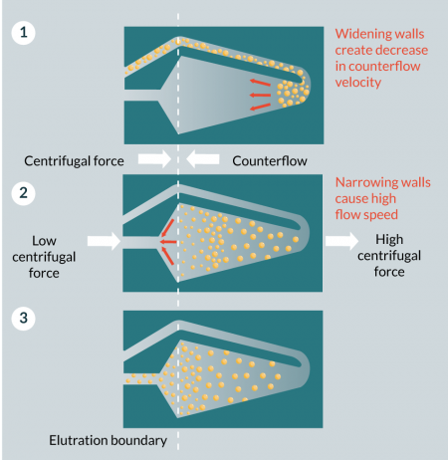
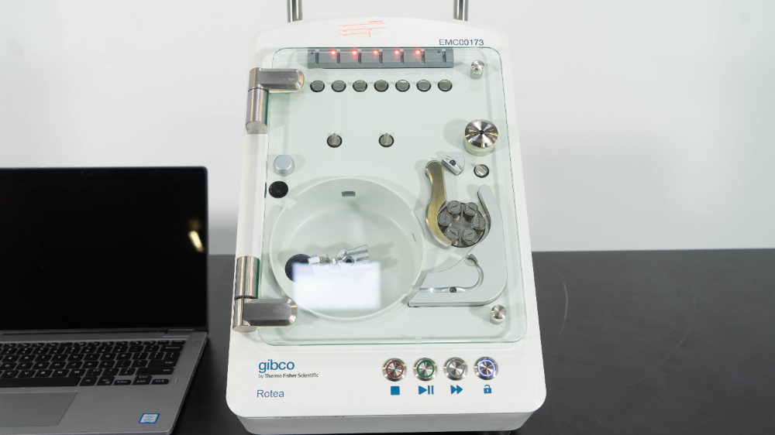

Slide 23
5. Centrifuge Operating Procedure
  Check the centrifuge to ensure it operates properly.
  choosing the proper centrifuge tubes or containers .
  Fill the preferred liquid in the tubes.
  Check that the centrifuge tubes are balanced. weigh each tube separately on a scale to confirm that their weights are equal. Avoid balancing solely on volume! This is especially true for solutions containing various sample types or varied sample concentrations.
  Screw the centrifuge tubes’ lids on firmly.
  Before inserting the centrifuge tubes, ensure their exteriors are dry and clean.

Slide 24
Shut the lid. Ensure that the lid fits tightly.
Configure the run time and speed.
Turn the centrifuge off and remove the sample as soon as you hear an odd noise or feel strong shaking.
After the centrifuge has finished its cycle, wait until it has stopped rotating before opening the cover.
Mechanical failure and harm might result from prematurely stopping the equipment.
Samples can be taken out of the centrifuge once it has stopped spinning.

