Slide 1
UNIVERSITY CENTER OF MILA
INSTITUTE OF SCIENCE AND TECHNOLOGY
DEPARTMENT OF CIVIL AND HYDRAULIC ENGINEERING
Seismic Engineering
Génie parasismique (Master2 G.C)
Chapter 4: Classification Criteria

Responsible: Dr. GUETTICHE ABDELHEQ

Academic Year 2024- 2025

Slide 2
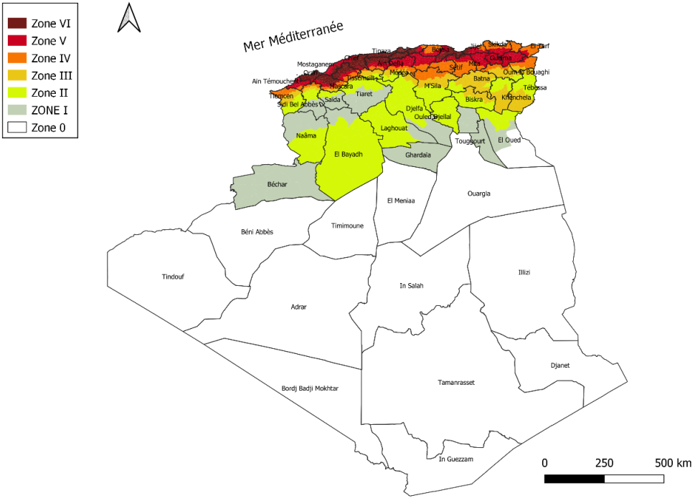
Chapitre 04: Voir RPA 99/2003 (Pages: 11 - 23)
1.Seismic zone classification: The Algerian territory is divided into Seven (7) zones of increasing seismicity as follows:
Zone 0: Negligible seismicity
Zone I: Low seismicity
Zone II: Low to Moderate seismicity
and III: Moderate seismicity
Zone IV: Moderate to High seismicity
Zone V& VI: High seismicity
2,Classification of structures according to their importance (usage group):
Any structure that falls under the scope of application of these rules must be classified into one of the following four (4) groups:
Group 1A | Vital facilities: Safety, Hospitals, defense, Strategic
Group 1B | Facilities of great importance: Schools, Places of worship, Large mosques
Group 2 | Ordinary facilities: Residential, Offices (< 48 m or <300 people), Parking garages
Group 3 | Facilities of low importance: Agricultural sheds, Temporary constructions

Slide 3
3,Site classification:The sites are classified into five (05) categories based on the mechanical properties of the soils that constitute them (see Table 3.1)
4. Note on Soil Types:
The shear wave velocity value for rock should be measured on site or estimated in the case of slightly weathered rock.
(a) The site cannot be classified as Class A if there is more than 3 m of soil between the rock surface and the bottom level of shallow foundations.
Soft or highly weathered rocks may be classified as Class B if Vs is not measured.
Soft clay (Class D) is defined by a plasticity index Ip > 20, moisture content Wn > 40%, undrained shear strength Cu < 25 kPa, and shear wave velocity Vs < 180 m/s
Catégorie | Description | qc30 (M Pa) (c) | N30 (coups) (d) | Cu30 (kPa) (e) | Rc30 (MPa) (f) | Pl30 (Mpa) (g) | Ep30 (MPa) (g) | VS30 (m/s) (h)
S1 | ROCK (a) | / | / | / | >10 | >5 | >100 | >800
S2 | Firm | >15 | >50 | >100 | 0.4-10 | 2-5 | 20-100 | 360-800
S3 | Loose | 1.5-15 | 15-50 | 50-100 | 0.1-0.4 | 1-2 | 5-20 | 180-360
S4 | Very Loose or Presence of at least 3 m of soft clay (b) | < 1.5 | <15 | <50 | < 0.1 | <1 | <5 | <180
S_{S} | site requiring in-depth investigations | / | / | / | / | / | / | /
Notes:
Weathered = متاكل

Slide 4
5. Classification of bracing systems:
The bracing systems included in these rules are classified into the following categories:
A) Reinforced concrete structures:
1.a: Framed Structure.
A structural system in which resistance to vertical and lateral loads is primarily provided by spatial frames, and where the shear resistance at the base of the building exceeds 65% of the shear resistance of the entire structural system. For this category, infill elements must not impede the deformations of the frames (detached partitions or light partitions whose connections do not hinder the movement of the frames).Table (3.11.RPA2024) specifies the maximum number of stories as well as the maximum height for this type of system.
Seismic zone | I&II | III | IV | V &VI
Maximum N°of stories | 5 | 4 | 3 | 3
Maximum N° of height | 17 | 14 | 11 | 11

Slide 5
2Mixed Bracing System, Equivalent to a Frame:
Mixed structural system in which the transfer of vertical and horizontal loads is jointly provided by the spatial frame and shear walls. The shear resistance of the frame at the base of the building ranges between 50% and 65% of the shear resistance of the entire structural system.For this category, infill elements must not impede the deformations of the frames.Table (3.12 RPA2024) specifies the maximum number of stories as well as the maximum height for this type of system.
Framed System and Mixed System Equivalent to a Frame, with Rigid Masonry Infill
Framed systems and mixed systems equivalent to frames, with non-structural rigid masonry infill interacting with the structure. Table (3.13) specifies the maximum number of stories as well as the maximum height for this type of system.
Seismic zone | I&II | III | IV | V &VI
Maximum N°of stories | 7 | 6 | 5 | 5
Maximum N° of height | 23 | 20 | 17 | 17
Seismic zone | I&II | III | IV | V &VI
Maximum N°of stories | 5 | 4 | 3 | 2
Maximum N° of height | 17 | 14 | 11 | 8

Slide 6
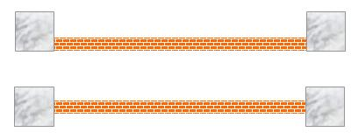

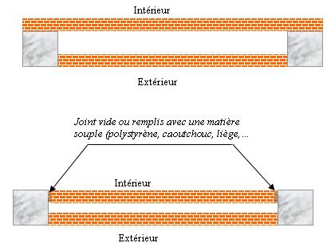
Comment: The infill elements of the structure consist of masonry walls made of small units inserted into the beam-column framework, with a thickness (excluding plaster) not exceeding 10 cm.
Exceptions are made for peripheral infills or separations between two (2) dwellings or two (2) units on the same level, where a second wall of 5 cm on the interior side is tolerated.
This second wall may have a thickness of 10 cm provided it is not inserted into the frames, in order not to exacerbate interaction phenomena. They should be arranged in the plan as symmetrically as possible relative to the center of mass of each floor, so as not to worsen any potential asymmetry of the reinforced concrete bracing system of the floor.

Slide 7

4 Mixed Bracing System Equivalent to Shear Walls :A mixed structural system in which the transfer of vertical and horizontal loads is jointly provided by the spatial frame and shear walls. The shear resistance of the walls at the base of the building ranges between 50% and 65% of the total shear resistance of the entire structural system.
5. Bracing System Composed of Shear Walls: A structural system in which resistance to vertical as well as lateral loads is primarily provided by vertical structural shear walls, and where the shear resistance at the base of the building exceeds 65% of the total shear resistance of the entire structural system. For this bracing system, buildings are limited in height to 48 meters.
6.Framed Core System or Core-Effect System: A mixed bracing system or shear wall system whose torsional rigidity does not reach a minimum threshold value and whose torsional radii, 𝑟𝑥 and 𝑟𝑦 , are less than the radius of gyration, 𝑙𝑠​ , of the floor slab;
Comment 1: Bracing systems (1), (2), (3), (4), (5), and (6) that do not exhibit a minimum torsional rigidity defined by expression (3.17) in both orthogonal horizontal directions are classified as core systems or core-effect systems.

Slide 8
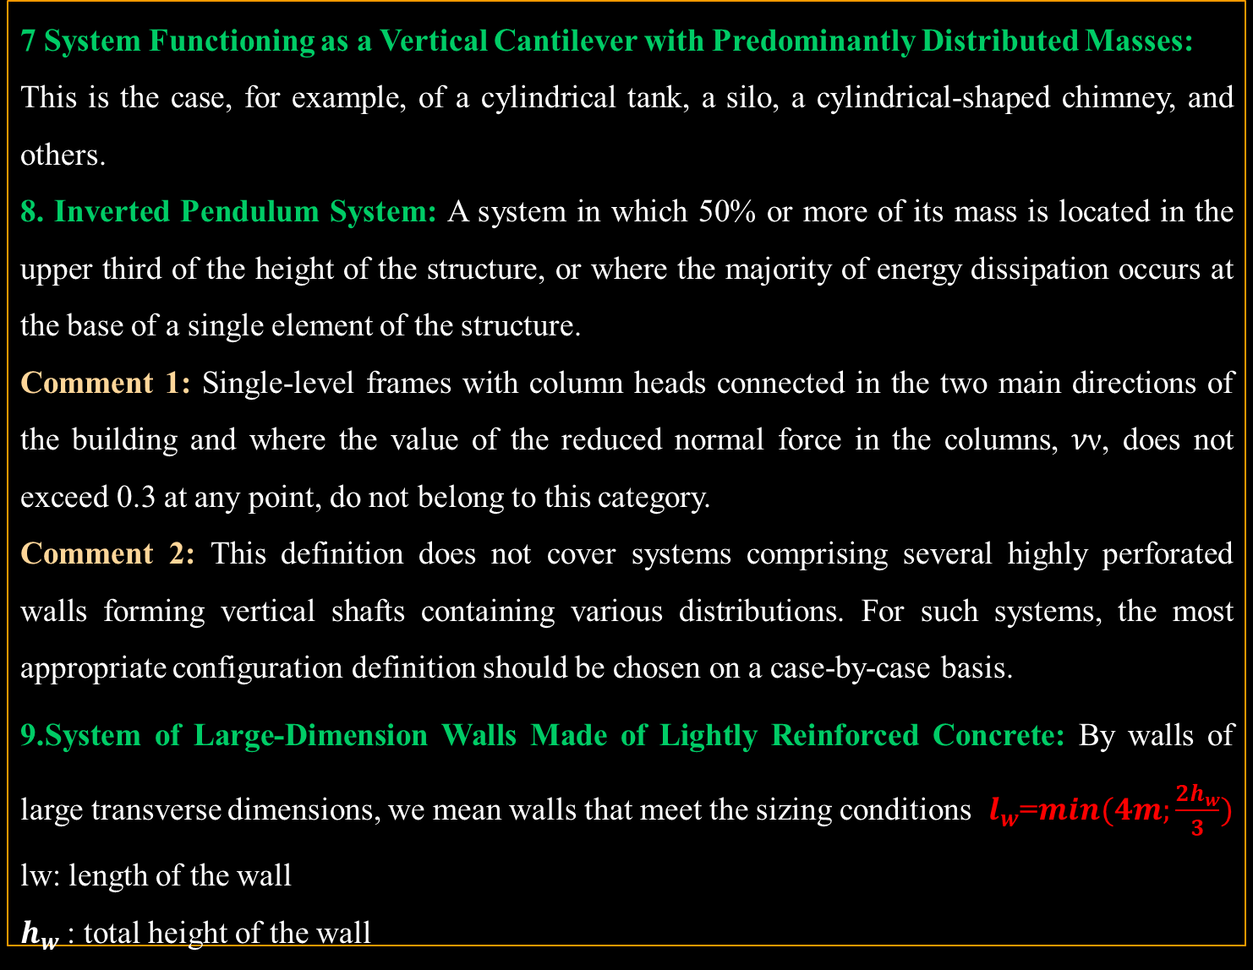
7 System Functioning as a Vertical Cantilever with Predominantly Distributed Masses:
This is the case, for example, of a cylindrical tank, a silo, a cylindrical-shaped chimney, and others.
8. Inverted Pendulum System: A system in which 50% or more of its mass is located in the upper third of the height of the structure, or where the majority of energy dissipation occurs at the base of a single element of the structure.
Comment 1: Single-level frames with column heads connected in the two main directions of the building and where the value of the reduced normal force in the columns, 𝜈ν, does not exceed 0.3 at any point, do not belong to this category.
Comment 2: This definition does not cover systems comprising several highly perforated walls forming vertical shafts containing various distributions. For such systems, the most appropriate configuration definition should be chosen on a case-by-case basis.
9.System of Large-Dimension Walls Made of Lightly Reinforced Concrete: By walls of large transverse dimensions, we mean walls that meet the sizing conditions $l_{w}$=$min(4m;\frac{2h_{w}}{3})$
lw​: length of the wall
$h_{w}$: total height of the wall

Slide 9
B) Steel structures:
10 Frame Structures without Infill or with Isolated Infill: These are frames composed of high-ductility moment-resisting frames. They resist horizontal forces essentially through bending. The dissipative zones are primarily located in plastic hinges near the beam-column joints.
11 Frame Structures with Rigid Masonry Infill: These are frames composed of medium-ductility moment-resisting frames due to the presence of rigid masonry infill. The dissipative zones are primarily located in plastic hinges near the beam-column joints. The height of buildings using this type of frame must be limited to 5 stories or 17 meters.
12 Frames with Concentrically Braced Bays: In these frames, resistance to horizontal forces is primarily provided by members subjected to axial forces. The dissipative zones are primarily located in the tension diagonals. These frames are classified into the following two categories:
(12a): X-shaped Concentrically Braced Bays, in which resistance to horizontal forces is provided solely by the tension diagonals, with the compressed diagonals being neglected.
(12b): V-shaped Concentrically Braced Bays, where resistance to horizontal forces can only be ensured by the joint participation of both tension and compression diagonals; the intersection point is located on a horizontal member that must be continuous. K-shaped Concentrically Braced Bays are not permitted unless specific convincing justifications are provided. The height of buildings using frames with concentrically braced bays must be limited to 10 stories or 32 meters.

Slide 10
13 Moment-Resisting Frames with Concentrically Braced Bays:
In these frames, resistance to horizontal forces is provided both by moment-resisting frames and by braced bays acting in the same plane. These frames are classified into the following two categories:
(13a): X-shaped Concentrically Braced Bays, in which resistance to horizontal forces is provided solely by the tension diagonals, with the compression diagonals being neglected.
(13b): V-shaped Concentrically Braced Bays, in which resistance to horizontal forces can only be ensured by the joint participation of both tension and compression diagonals; the intersection point of these diagonals is located on a horizontal member that must be continuous.
K-shaped Concentrically Braced Bays are not permitted unless specific convincing justifications are provided.
14.Inverted Pendulum System:
This category of structural system with a low degree of redundancy mainly concerns conventional single-story frames with a rigid beam, and slender tube-type structures where the resisting elements are essentially columns located at the periphery of the structure. These particular structures result in dissipative behavior localized only at the ends of the columns.

Slide 11
C) Structures Incorporating Cold-Formed Steel Sections (CFS)
15 Bracing System with Cold-Formed Steel Panel Walls
This is a bracing system composed of panels with steel sheet plates capable of resisting all lateral forces. Table (3.14) specifies the maximum number of stories as well as the maximum height for this type of system.
16 Bracing System with Cold-Formed Steel Tension Diagonals
Stability and lateral resistance are provided by a system of diagonals working in tension only. Table (3.15) specifies the maximum number of stories as well as the maximum height for this type of system.
Seismic zone | I&II | III | IV | V &VI
Maximum N°of stories | 5 | 5 | 4 | 3
Maximum N° of height | 17 | 17 | 14 | 11
Seismic zone | I&II | III | IV | V &VI
Maximum N°of stories | 3 | 3 | 2 | 2
Maximum N° of height | 11 | 11 | 8 | 8

Slide 12
D) Masonry Structures
Ordinary load-bearing masonry constructions are prohibited in seismic zones; only confined load-bearing masonry is permitted there.
17 Confined Load-Bearing Masonry Structures
This system concerns load-bearing structures made of rubble masonry or small manufactured units and featuring reinforced concrete tie-beams installed after the masonry work is completed. These structures resist both vertical and horizontal loads simultaneously. Table (3.16) specifies the maximum number of stories as well as the maximum height for this type of system.
16 Bracing System with Cold-Formed Steel Tension Diagonals
E) Timber Structures
In seismic zones, timber constructions incorporating systems 18, 19, 20, and 21, described below, are limited to 2 stories or 8 meters in height.(see page 65 RPA2024).
Seismic zone | I&II | III | IV | V &VI
Maximum N°of stories | 5 | 4 | 3 | 2
Maximum N° of height | 17 | 14 | 11 | 8

Slide 13
F) Other Structures
See systems 22, 23, 24,25, and 26, described in page 66 (RPA 2024 )
6. Global behavior coefficient R:
Its unique value is given by Table (3.17) depending on the bracing system. For the design of the bracing, a single value of the behavior factor, 𝑅R, must be used for each principal direction.
The value of 𝑅 for different structural systems takes into account their energy dissipation capacity with respect to seismic action and is determined based on the nature of the constituent materials, the type of construction, the possibilities for force redistribution within the structure, and the deformation capacities of elements in the post-elastic range.
This behavior factor, 𝑅, is adjusted by the quality factor, 𝑄𝐹 (see Eqn. (3.23) and Table (3.18)), which accounts for the degree of regularity and redundancy of the bracing system during the sizing calculation phase. This also assumes that the quality and execution rules specific to each material and system, as well as the construction provisions in Chapters VII to IX and Appendices E and F, are strictly adhered to.

