Slide 1
The spectrophotometer

Slide 2
Definition of spectrophotometer
The spectrophotometer is a vital instrument used to measure the intensity of light absorbed by a sample. This measurement helps determine the concentration of solutes in a solution.
2, Biotechnology Applications: Used in DNA, RNA, and protein quantification.

Slide 3
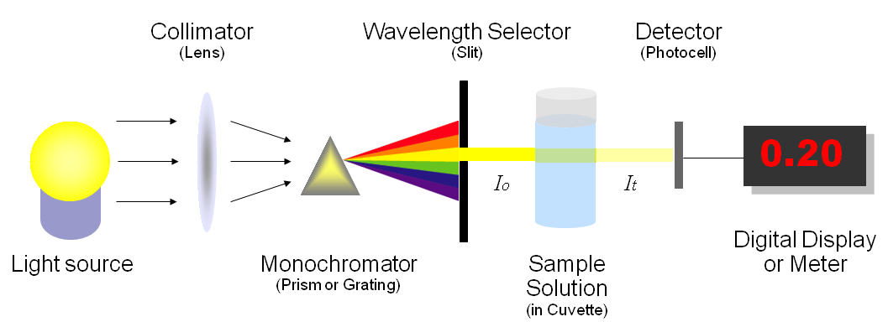
3, Spectrophotomètre Instrumentation
The basic spectrophotometer instrument consists of a light source, a digital display, a monochromator, a wavelength sector to transmit a selected wavelength, a collimator for straight light beam transmission, photoelectric detector and a cuvette to place a sample.
A spectrophotometer is made up of two instruments:
Spectrometer: is to produce light of any wavelength
Photometer: is to measure the intensity of light

Slide 4
We can see that the amount of absorber is related to the concentration of the solution and the thickness of the cell.
Transmittance T = I/I₀
transmittance = T%
Absorbance A = -log T
A= log (I/I₀) = log (I₀/I)
We then obtain the relationship known as Beer-Lambert's law:
A = ε l C
ε = the molar extinction coefficient (L.mol-1.cm-1) or molar absorptivity (or absorption coefficient); this is a characteristic of the substance studied at a given wavelength.
C = concentration and l = cuvette length

Slide 5

3. Excitation of electrons
When a wavelength is applied to a solution, electrons absorb energy and go from the ground state to the excited state. To return to the ground state they emit a wavelength, which is detected and gives a spectrum called the absorption spectrum. It shows the absorbance in relation to the wavelength.

Slide 6
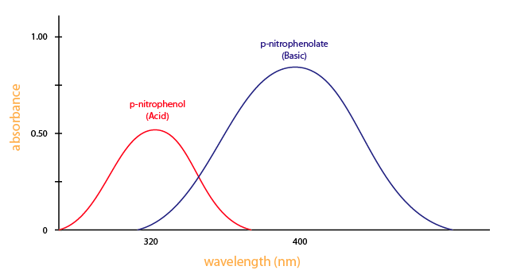
You need a spectrometer to produce a variety of wavelengths because different compounds absorb best at different wavelengths. For example, p-nitrophenol (acid form) has the maximum absorbance at approximately 320 nm and p-nitrophenolate (basic form) absorb best at 400nm, as shown in Figure 4

Slide 7
Use a spectrophotometer
To determine the absorbance of the coloured species, it is necessary to first perform a "blank", i.e. record the intensity of the light the intensity of the light passing through a cuvette containing solvent (without the chemical species whose absorbance is to be measured).
Quartz cells are required for UV measurements as plastic and glass absorb this radiation. because plastic and glass absorb this radiation. Water also absorbs UV radiation, so a UV-transparent solvent such as cyclohexane or dichloromethane

Slide 8
  4,1, Installation of tanks
Fill one cuvette with the solution to be analysed; fill another identical cuvette with the solvent of the solution to be analysed: this is the "blank" cuvette.
Do not touch the entrance and exit surfaces of the light beam with your fingers; they must be perfectly clean.
Insert the cuvette with the clean side perpendicular to the light beam.

Slide 9
  4,2, Computer-interfaced spectrophotometer
4.2.1. Recording an absorption spectrum Go to “spectrum” mode and select absorbance display.
➊ set the acquisition parameters:
the wavelength range to be scanned; if no information is available, choose from 400 nm to 800 nm ;
the “step”; in general, choose 1 nm.
➋ Start acquisition; the software asks you to insert the blank” cell. Insert the blank cell and click on OK.
The computer records the intensity of transmitted light for each wavelength in the selected range.
➌ Replace the “white” cuvette with the cuvette containing the solution studied. Click on OK.
The computer records the intensity of transmitted light for each wavelength, calculates the absorbance and then displays the absorption spectrum.

Slide 10
4,2.2 Recording absorbance at a given wavelength
Set to “absorbance measurement” mode.
➊ set the measurement wavelength.
➋ Repeat steps ➋ and ➌ of 4.2.1.
  Spectrophotometer not interfaced to computer
➊ set the measurement wavelength.
➋ Insert “blank” cell. Press “zero absorbance” button.
➌ Insert the cell containing the solution to be studied. Read the absorbance displayed.
➍ To plot a spectrum, repeat the above three steps for each wavelength studied.

Slide 11
5, Good practices of use of the spectrophotometer
Perform the calibration of the spectrophotometer, each time the analysis of a group of samples is carried out.
Keep the lid of the sample holder closed during the measurement process, to ensure an adequate reading.
Avoid reusing disposable cuvettes.
Use only quartz cuvettes, to perform analyzes below 310 nm.
Avoid the use of plastic buckets, if organic solvents are used.
Use high quality silicate borosilicate glassware to prepare the standards. Avoid the use of sodium-sodium-glassware whenever possible, because prolonged contact with standards can permeate it and, consequently, produce erroneous results.
Carefully clean the glass cuvettes after use. Discard those that present scratches on the polished surface.

Slide 12
Use high quality reagents as much as possible. Low quality reagents can cause contamination even at very low concentrations. The diluents used – water or solvents – must be free of impurities.
Verify that the samples or standards have not been degassed inside the cuvettes.
Take into account, when trying to use new procedures, that not all substances comply with Beer’s law. Carry out linearity tests on the range of concentrations to be used.

Slide 13
6, the maintenance of a spectrophotometer
Externally clean the spectrophotometer, including controls, screens or measuring meters. This can be done with a piece of fine fabric – similar to the texture of handkerchiefs – moistened with distilled water.
Inspect and clean the power cord.
Verify that the lamp is clean and in good condition. If it does not work, install a new one, with the same specifications as the original one. In modern spectrophotometers, lamp status is automatically detected by software that controls the status and operation of the instrument, making it easy to determine when the lamp needs to be changed. Replace the bulb and adjust the bulb afterwards following the procedure recommended by the manufacturer.
Check the protection fuse. Before opening the fuse housing, check that the spectrophotometer is off and that its contacts are clean and in good condition.

Slide 14
Place the computer in the operational configuration.
Operate the ignition switch to allow operation for five (5) minutes.
Perform a leakage current test in the ON and OFF positions.
Calibrate the front panel of the spectrophotometer according to the manufacturer’s instructions.
Measure the sensitivity of the equipment.
Conduct a test following Beer’s law.
Return the spectrophotometer to the initial setting, if calibration has been successfully performed.

