Slide 1
Biotechnologie instrumentation and maintenance

Slide 2
Subject : Biotechnology instrumentation and maintenance
UED1
crédits: 2
coefficient: 2
TD: 1.30h, cours: 1.30h / par semaine
modalités d'évaluation: TD: 1 interrogation + la présentation et la participation + des exposes ; cours: contrôle

Slide 3
GENERAL OBJECTIVES
at the end of this training course, the learner will be able to:
Know all the instruments used in the biotechnology laboratory
Recognise the components used in the construction of each laboratory machine
Understand the operation of each machine
Recognise the types of machines and their uses
be able to use the equipment safely
know how to maintain and repair them.

Slide 4
prerequisites
hygiene and safety in the laboratory
Biology instruments , methods and laboratory safety

Slide 5
Introduction
Biotechnological instrumentation refers to the tools and machines used in biotechnology for analyzing, manipulating, and understanding biological systems. These instruments play a crucial role in research and development across industries such as medicine, agriculture, and environmental science. Essential equipment includes spectrophotometers, centrifuges, and PCR machines, each contributing to advancements in genetic engineering, drug discovery, and biological data analysis.

Slide 6
Definition
Biotechnological Instrumentation: Tools and devices employed in biotechnology for analyzing and manipulating biological materials.

Slide 7
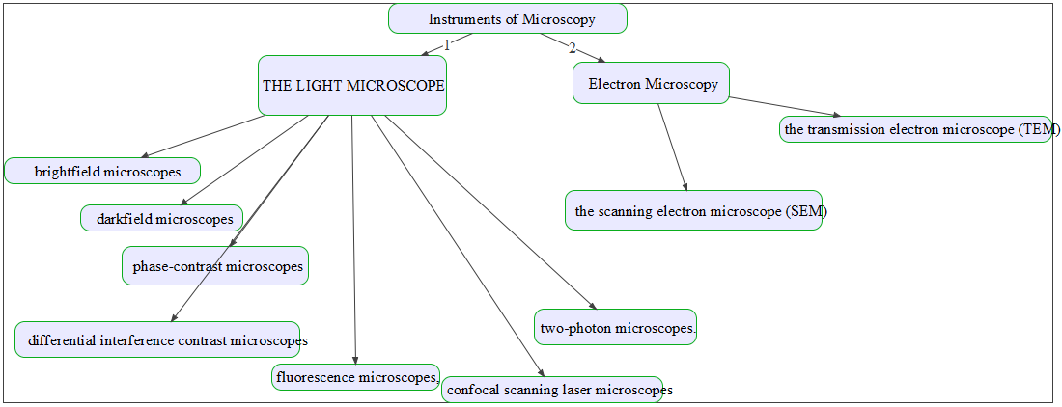
I. Instruments of Microscopy

Slide 8
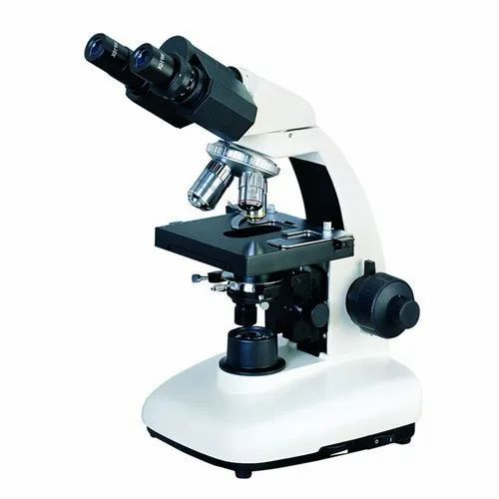
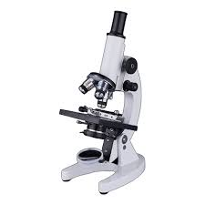
Brightfield Microscopes
The most commonly used type of microscope is the brightfield microscope, which produces a dark image against a bright background.
Some brightfield microscopes are monocular (with a single eyepiece), but most new brightfield microscopes are binocular (with two eyepieces); in both cases, each eyepiece contains a lens called an ocular lens.

Slide 9
ocular lens typically magnify images 10 times
At the other end of the body tube is a set of objective lenses on a rotating nosepiece. The magnification of these objective lenses generally varies from 4 to 100 times, the magnification of each lens being indicated on the metal casing of the lens.
The ocular and objective lenses work together to create a magnified image. The total magnification is the product of the ocular magnification and the objective magnification:
Ocular magnification x objective magnification
For example, if we choose an objective of 40 and an ocular lens of 10 , the total magnification will be as follows:
(40x) (10x) = 400

Slide 10
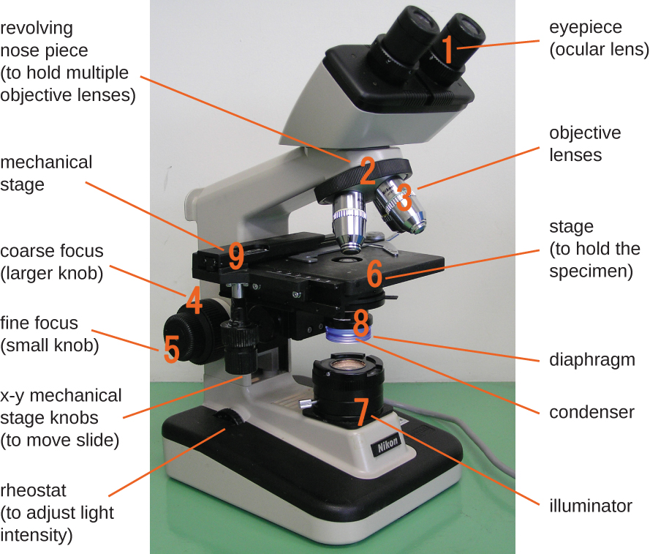
Fig 1: Components of a typical brightfield microscope.

Slide 11
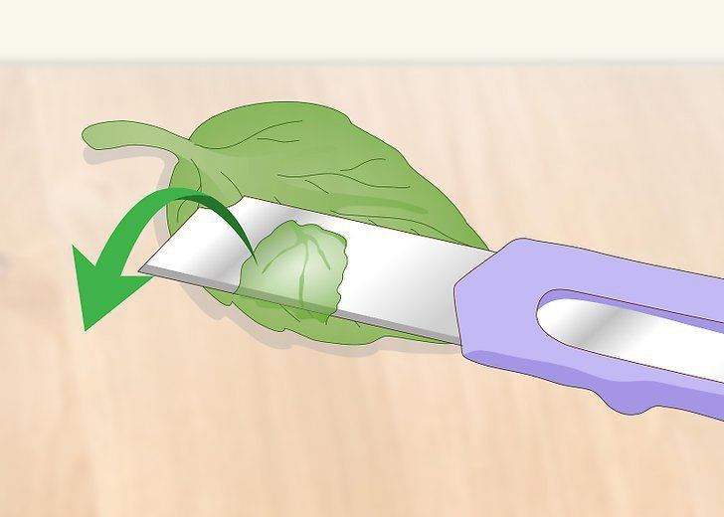
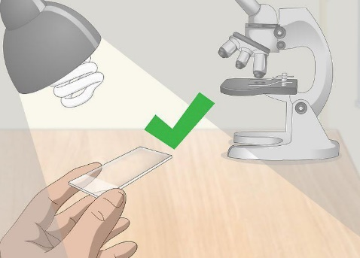

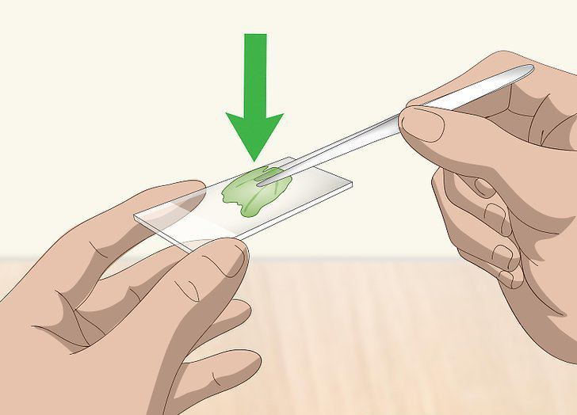
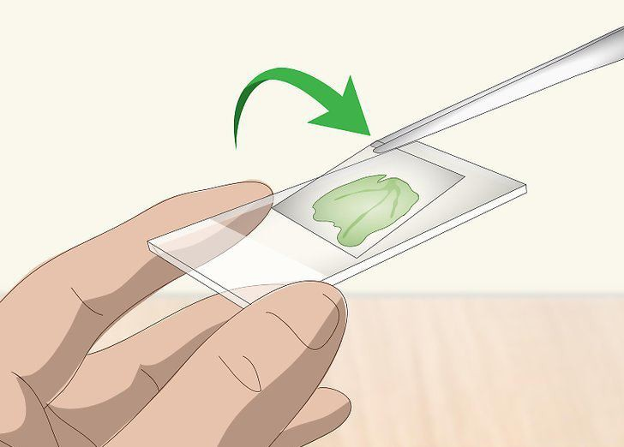
application of microscopy
1, Prepare Microscope Slides
Examine the sample to determine whether sectioning is required.
Slice off a thin piece of the sample specimen.
Choose a clean slide
Slice off a thin piece of the sample specimen.
5. Place the cover glass on the sample.

Slide 12
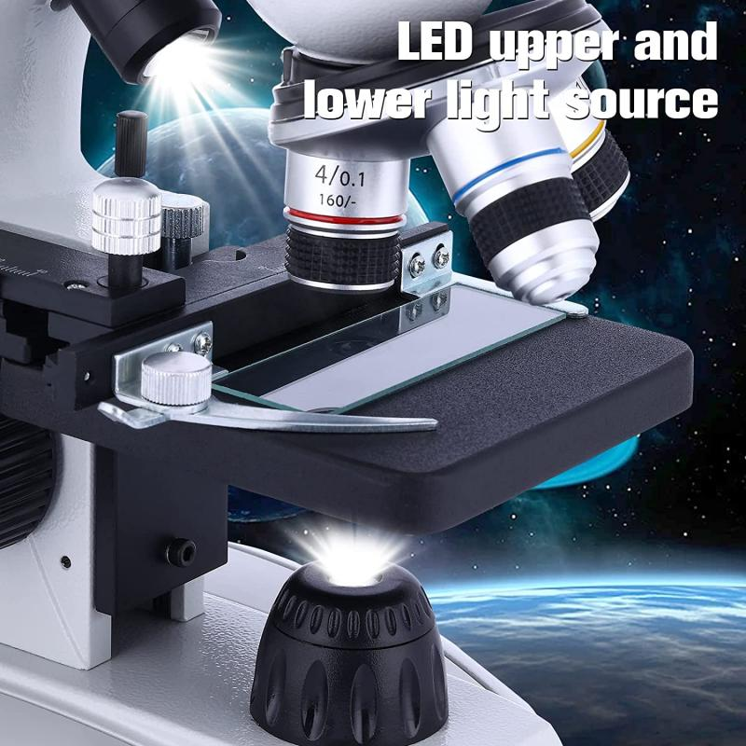
then clipped the slide into place on the stage (a platform) of the microscope

Slide 13
Fig 1: Components of a typical brightfield microscope.

Slide 14
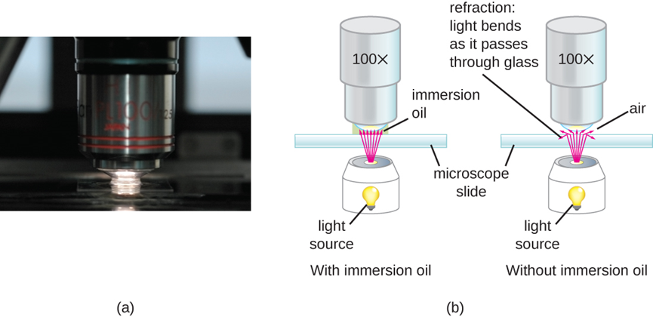
Fig 2: (a) Oil immersion lenses like this one are used to improve resolution. (b) Because immersion oil and glass have very similar refractive indices, there is a minimal amount of refraction before the light reaches the lens. Without immersion oil, light scatters as it passes through the air above the slide, degrading the resolution of the image.

Slide 15
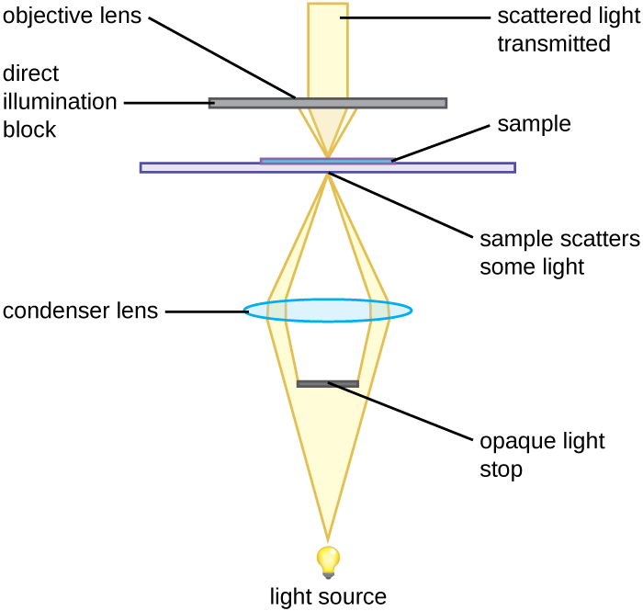
2, Darkfield Microscopy
An opaque light stop inserted into a brightfield microscope is used to produce a darkfield image.
The light stop blocks light traveling directly from the illuminator to the objective lens, allowing only light reflected or refracted off the specimen to reach the eye.

Slide 16
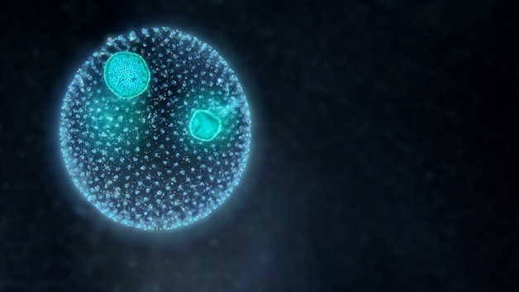
is particularly suitable for observing tiny living aquatic organisms, diatoms, small insects, bones, fibers, hair, unstained bacteria, yeast, tissue culture cells, and protozoa.
Fig 4: A colony of green planktonic algae Volvox under the dark field microscope.

Slide 17
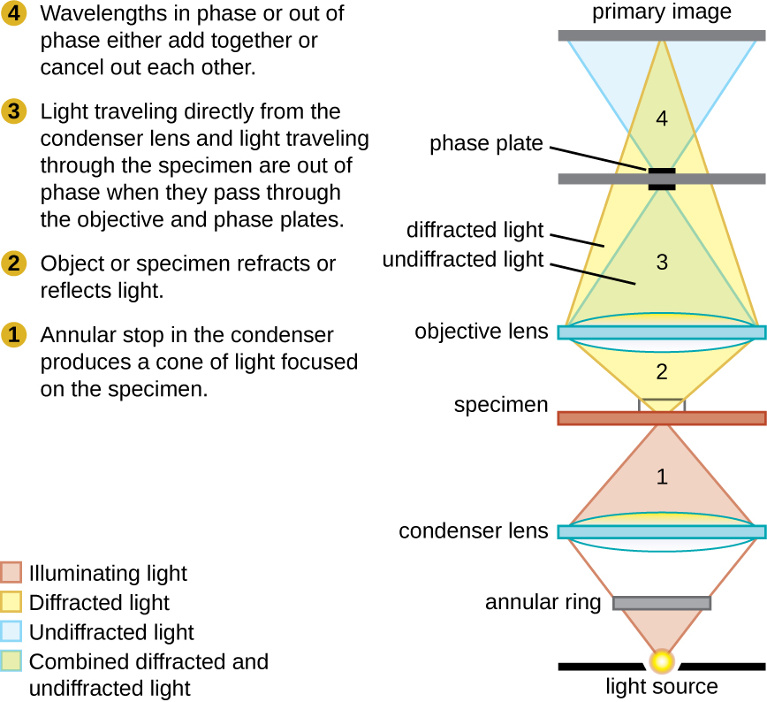
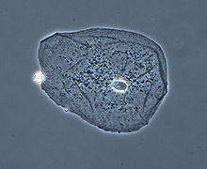
3, Phase-Contrast Microscopes
Phase-contrast microscopes use refraction and interference caused by structures in a specimen to create high-contrast, high-resolution images without staining.
Fig 6: Photographie d'un cellule épithéliale

Slide 18
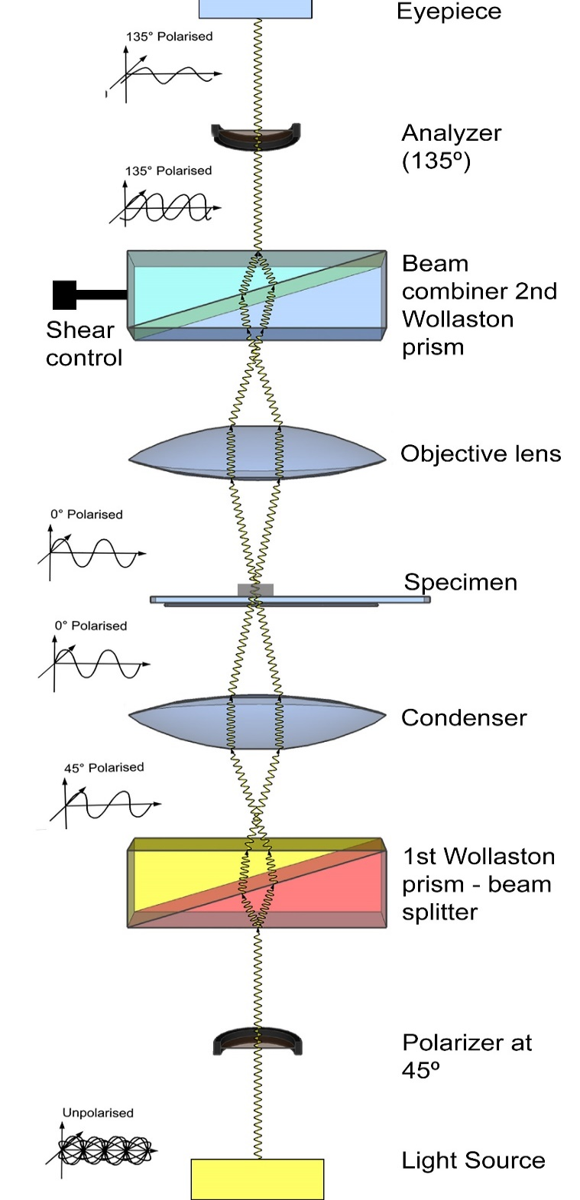
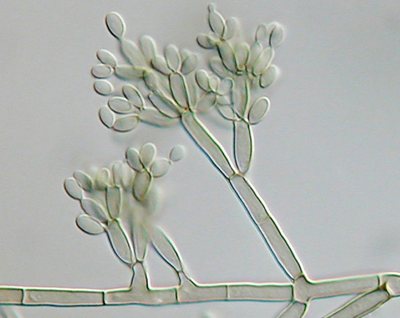
4, Differential Interference Contrast Microscopes
In a Differential Interference Contrast Microscopes, two beams of light are created in which the direction of wave movement (polarization) differs.
Once the beams pass through either the specimen or specimen-free space, they are recombined and effects of the specimens cause differences in the interference patterns generated by the combining of the beams.
This results in high-contrast images of living organisms with a three-dimensional appearance.
These microscopes are especially useful in distinguishing structures within live, unstained specimens,
A DIC image of Fonsecaea pedrosoi grown on modified Leonian’s agar. This fungus causes chromoblastomycosis, a chronic skin infection common in tropical and subtropical climates.

Slide 19
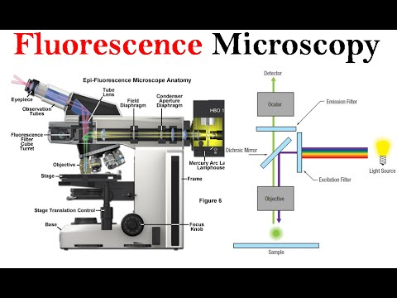
6, Fluorescence Microscopes
A fluorescence microscope uses fluorescent chromophores called fluorochromes, which are capable of absorbing energy from a light source and then emitting this energy as visible light.
The microscope transmits an excitation light, toward the specimen; the chromophores absorb the excitation light and emit visible light with longer wavelengths. The excitation light is then filtered out (in part because ultraviolet light is harmful to the eyes) so that only visible light passes through the ocular lens. This produces an image of the specimen in bright colours against a dark background.

Slide 20
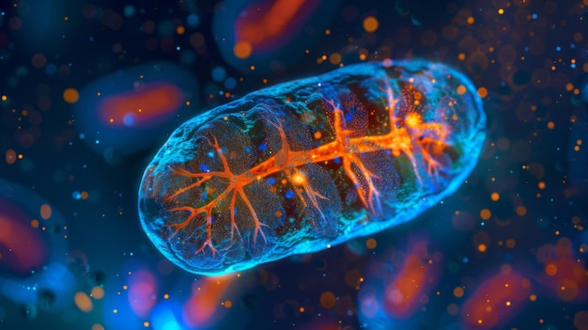
They can be used to:
identify pathogens,
find particular species within an environment,
find the locations of particular molecules and structures within a cell.
Approaches have also been developed to distinguish living from dead cells using fluorescence microscopy based upon whether they take up particular fluorochromes.
Sometimes, multiple fluorochromes are used on the same specimen to show different structures or features.
Fig 6: A fluorescence microscopy image of a mitochondrion.

Slide 21
6, Confocal Microscopes
a confocal microscope uses a laser to scan multiple z-planes successively. This produces numerous two-dimensional, high-resolution images at various depths, which can be constructed into a three-dimensional image by a computer. As with fluorescence microscopes, fluorescent stains are generally used to increase contrast and resolution. Image clarity is further enhanced by a narrow aperture that eliminates any light that is not from the z-plane. Confocal microscopes are thus very useful for examining thick specimens such as biofilms, which can be examined alive and unfixed .

Slide 22
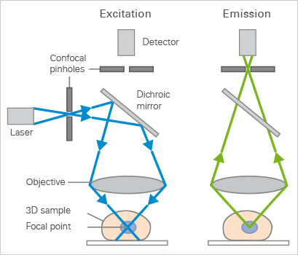
the confocal microscope uses fluorescence optics. Instead of illuminating the whole sample at once, laser light is focused onto a defined spot at a specific depth within the sample. This leads to the emission of fluorescent light at exactly this point. A pinhole inside the optical pathway cuts off signals that are out of focus, thus allowing only the fluorescence signals from the illuminated spot to enter the light detector.
By scanning the specimen in a raster pattern, images of one single optical plane are created. 3D objects can be visualized by scanning several optical planes and stacking them using a suitable microscopy deconvolution software (z-stack

Slide 23
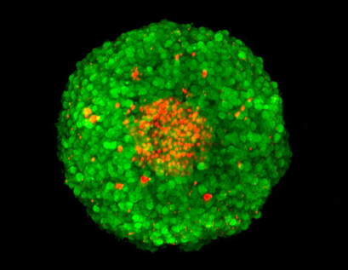
Fig 7 : Z-stack of an FDA/PI-stained MCF-7 spheroid, acquisition by confocal microscopy. Green: FDA-stained living cells. Red: PI-stained dead cells in the necrotic center of the spheroid.

Slide 24
7, Two-Photon Microscopes
the two-photon microscope uses a scanning technique, fluorochromes, and long-wavelength light (such as infrared) to visualize specimens. The low energy associated with the long-wavelength light means that two photons must strike a location at the same time to excite the fluorochrome. The low energy of the excitation light is less damaging to cells, and the long wavelength of the excitation light more easily penetrates deep into thick specimens. This makes the two-photon microscope useful for examining living cells within intact tissues—brain slices, embryos, whole organs, and even entire animals.
Currently, use of two-photon microscopes is limited to advanced clinical and research laboratories because of the high costs of the instruments.

Slide 25
two-photon microscopy is based on fluorophore excitation, which results in the emission of light. In classic fluorescence microscopy, a fluorophore is excited by absorbing one single photon of a certain wavelength. When using two-photon microscopy, two or three photons of a higher wavelength do the work of one: When they hit the fluorophore at the very same time (typically within several femtoseconds), they are absorbed, resulting in fluorophore excitation and emission of light.
In this process, photons combine their energy, which allows low-energy infrared photons to excite standard fluorophores, such as GFP. The infrared light penetrates tissue more deeply than the standard excitation light used in fluorescence microscopy. Due to its low energy level, infrared light is less damaging, and therefore especially useful when working with living samples.
In order to increase the likelihood that two photons hit the fluorophore simultaneously, lasers with very high intensity are needed. Their infrared light only leads to excitation in the focus of the objective, because only in this area, the critical number of photons per time and space is reached. Therefore, all emitted light comes from one focal point in the specimen, strongly reducing background noise. The image is created just as in confocal microscopy: The laser scans across the sample, recording the image intensity point by point.

Slide 26
Microscope Maintenance
proper care of a microscope includes the following:
cleaning the lenses with lens paper
not allowing lenses to contact the slide (e.g., by rapidly changing the focus)
protecting the bulb (if there is one) from breakage
not pushing an objective into a slide
not using the coarse focusing knob when using the 40⨯ or greater objective lenses
only using immersion oil with a specialized oil objective, usually the 100⨯ objective
cleaning oil from immersion lenses after using the microscope
cleaning any oil accidentally transferred from other lenses
covering the microscope or placing it in a cabinet when not in use

