Slide 1
UNIVERSITY CENTER OF MILA
INSTITUTE OF SCIENCE AND TECHNOLOGY
DEPARTMENT OF CIVIL AND HYDRAULIC ENGINEERING
Seismic Engineering
Génie parasismique (Master2 G.C)
Chapter 3: Characteristics of Earthquake Resistant Buildings

Responsible: Dr. GUETTICHE ABDELHEQ

Academic Year 2024- 2025

Slide 2

Principle of seismic design: The shape of buildings and the distribution of the various elements that constitute them have a significant impact on behavior under seismic loads. The designer should aim for simplicity and good regularity in forms, as well as in the distribution of masses and stiffness.“
1. 1,Plan Regularity:Plans that are symmetric along two axes exhibit good behavior under seismic loads. Square or nearly square plans are highly suitable; an ideal construction would have the same stiffness in all directions. Plan symmetry should be associated with structural symmetry to align the center of gravity with the center of rigidity.
Plan Symmetry: Plan symmetry along two axes tends to significantly reduce vertical axis torsion. The torsional stress on buildings shaped like L, T, U, V, or Z is much higher compared to symmetric and compact buildings. For instance, in an L-shaped building, the part of the building with lesser depth is more flexible than the adjacent part and deforms more under the influence of horizontal forces.

Slide 3
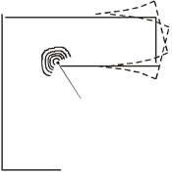
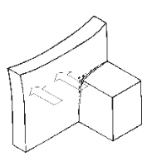
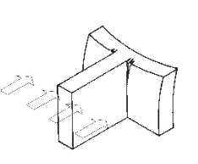
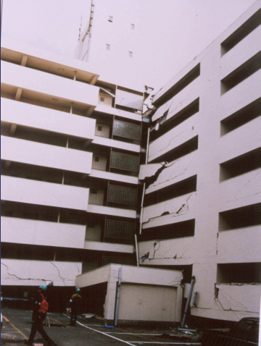
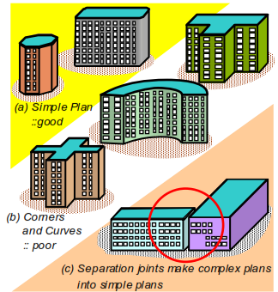
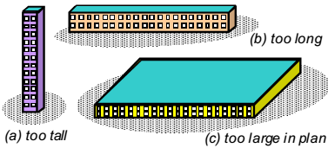
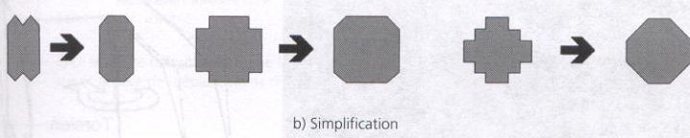
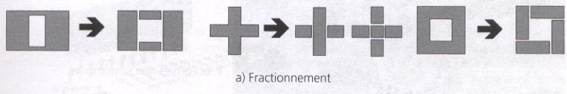
Simplicity of Plan: Buildings with angles are considered irregular. These angles occur at the junction of two parts with different stiffness.
The difference in stiffness leads to differential oscillations, resulting in stress concentrations. To address this situation, three approaches are possible:
- Choose shapes without reentrant angles.
- Divide the building into simple volumes using seismic joints (Fig a).
- Simplify the plan shape (Fig b)
When it comes to plan regularity, two types are identified:

Slide 4

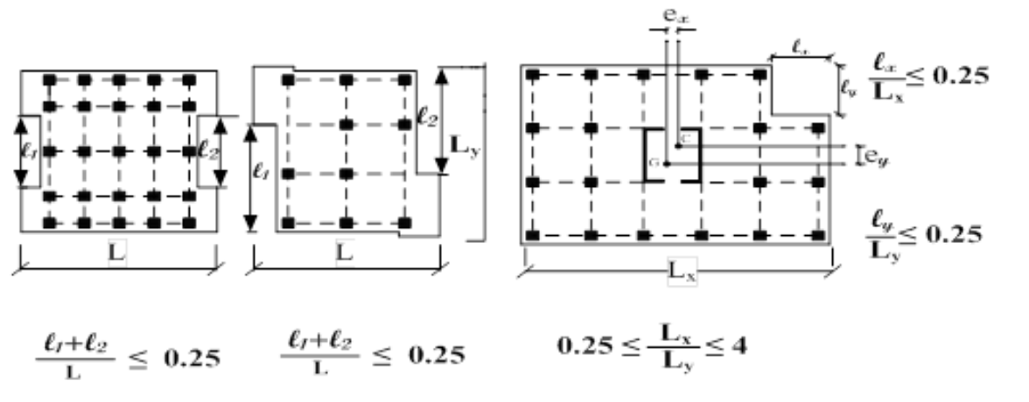
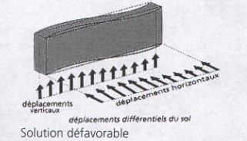
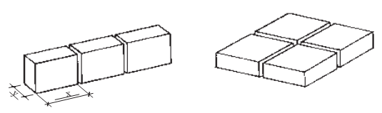

Geometric Plan Regularity:
- According to RPA 2024 Paragraph §3.7.1.a, the shape of the building should be compact, with a length-to-width ratio of the floor plan between:
The sum of the dimensions of the recessed or projecting parts of the building in a given direction must not exceed 25% of the total dimension of the building in that direction..
The advantage of the ratio (Lx/Ly) is to limit the influence of ground deformations on the structure. Therefore, it is desirable not to exceed a ratio of 4 between Lx and Ly or to divide the building using seismic joints.
Limit openings in floor surfaces: RPA 2024, Paragraph §3.7.1.a.4
Examples: stairwells, elevator shafts

Slide 5

"We must therefore seek simple symmetric plans or divide complex symmetric plans with seismic joints. It should be noted that the beneficial effect of architectural geometric symmetry can be entirely negated by asymmetry in the load-bearing system (structural irregularity). In this case, the center of masses will be offset from the center of stiffness, and the construction will be subjected to vertical axis torsion, which will be greater the further apart these two centers are from each other."
Structural Plan Regularity:
According to RPA 2024, Paragraph §3.7.1.a.2: At each level and for each calculation direction, the distance between the center of gravity of masses and the center of stiffness does not exceed 15% of the building's dimension measured perpendicular to the direction of the considered seismic action:
To achieve maximum overall torsional stiffness, elements capable of providing torsional stiffness to the structure should be placed as close as possible to the perimeter of the construction.

Slide 6
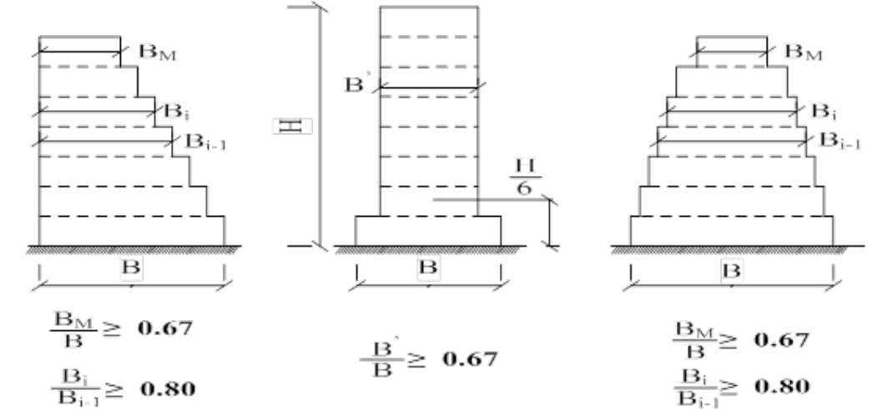


3.2 Elevation Regularity: In elevation, the regularity of shapes, distribution of masses, and stiffness are just as crucial as in the plan. The absence of simplicity or symmetry along two axes is generally more detrimental in elevation than in the plan.
Geometric Elevation Regularity: According to RPA 2024, Paragraph §3.7.1.b.4: In the case of setbacks in elevation, the variation in building dimensions between two successive levels does not exceed 20% in both directions.
Structural Elevation Regularity:
Vertical structural irregularities that can unfavorably affect the seismic resistance of a building:
Soft Story Irregularity: This irregularity occurs when one or more stories are significantly more flexible (subjected to large deformations) than the stories located just above. A soft story is defined as one in which the lateral stiffness is less than 70% of that of the story located just above or lower than 80% of the average lateral stiffness of the three stories immediately above.
Where:

Slide 7
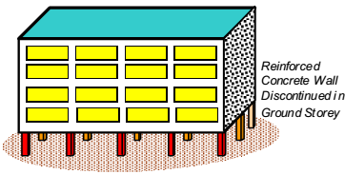
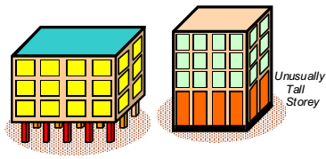
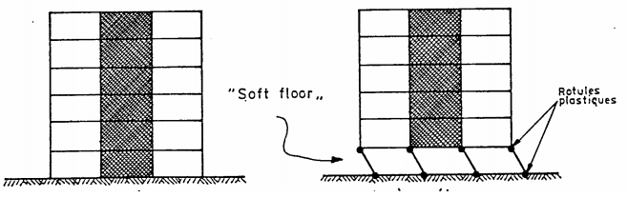
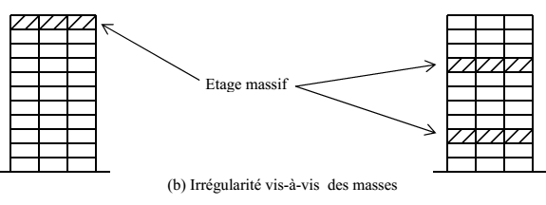
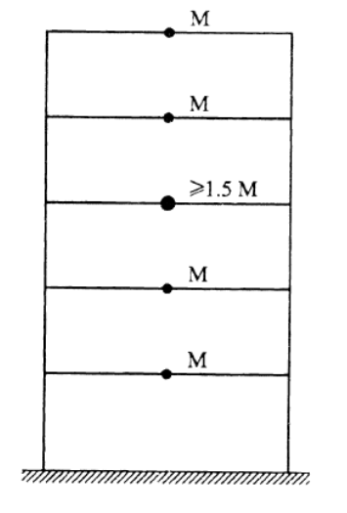
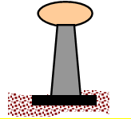
Some of the most illustrative examples are the 'reception' levels or lobbies of large hotels (sparse partitions or, at times, greater height compared to typical floors...) or open floors for functional reasons (computer rooms, special equipment spaces, etc.). These systems are generally to be avoided. Otherwise, besides being penalized by an appropriate behavior coefficient.
2. Weight (Mass) Irregularity:
This irregularity occurs when the effective mass (weight divided by the acceleration due to gravity) of a story is significantly greater (exceeding 150%) than that of the adjacent story. The last story (the roof), which is not as loaded as the story directly below, does not need to be considered

Slide 8
3. Adequate Foundation:
Observations indicate that structures built on easily deformable formations suffer significantly more damage than those resting on compact soils or rock.
Their vulnerability is even greater when their foundation is shallower. These differences in behavior can be explained as follows:
Seismic motion is more intense near the surface of the ground than at depth.
Deformable soils are inherently prone to causing reversible or irreversible differential movements, particularly settlements that are significantly higher than in rigid formations. The amplification of seismic motion itself contributes to exacerbating these effects.
Rocky, homogeneous, and sound soils are by far the best foundation materials. Experience shows that structures built on such soils perform better than the same structures on sandy or clayey soils. When the rock is not uniform, the bearing capacity is determined based on the least resistant parts.
In principle, the construction site and the nature of the foundation soil should ideally be free from various risks (settlement, sliding, liquefaction, surface expression of a fault, etc.) to prevent any kind of hazards.

Slide 9
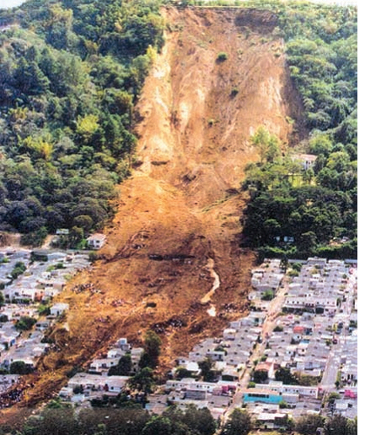
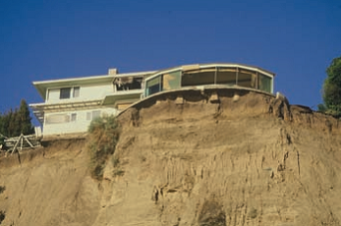
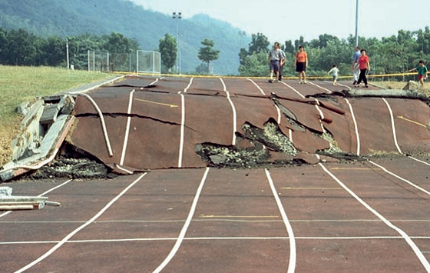
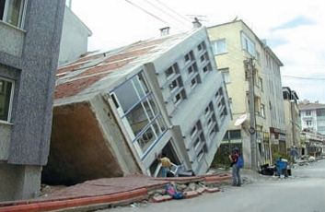
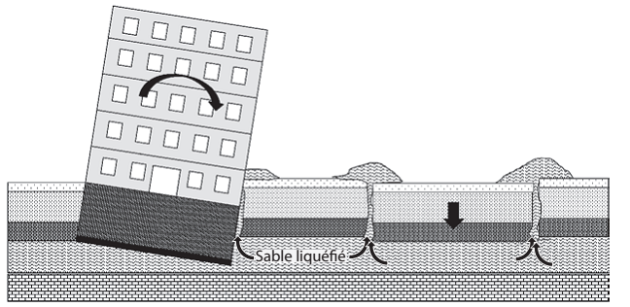
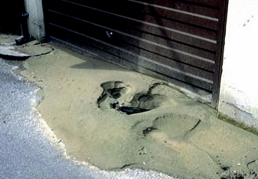
In general, soils not suitable as foundation bases include:
Soils with very low characteristics: mud, peat, loose debris, uncompacted fill
Powdery soils
Swelling soils
Unstable soils: prone to liquefaction, sliding, etc.
Landslides in El Salvador, Las Colinas, 2001
Landslides in California, Northridge, 1994
Surface Rupture of a Fault; Taiwan, 1999
Liquefaction of soil , Kocaeli-Izmit, 1999 ;
Mechanism of Liquefaction
Soil Liquefaction:
Characteristic Sand Uplift
Notes:
Powdery soils = Sols pulvérulents
Swelling soils =Sols gonflants
Sliding = glissement

Slide 10
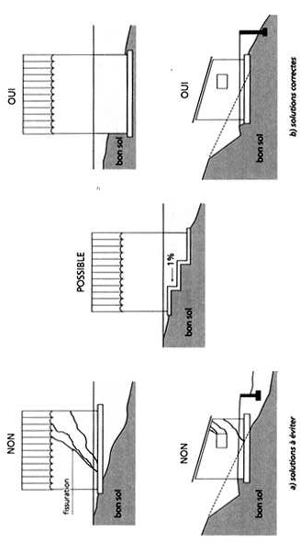
Choice of Foundation Type:
Same criteria as in non-seismic zones
The deepest solution is preferred
Common Dispositions:
- Homogeneous foundation system or division by seismic joints
- Materials resistant to tension: reinforced concrete, steel
- Effective connection between foundations and structure
- Horizontal base or a 1% counter-slope footing
- Foundation on a single type of soil

Slide 11

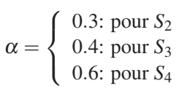
Isolated Footing:In the case of strip footing: Mechanical continuity (connections) between foundations: According to RPA 2024 the support points of the same block must be interconnected by a bidirectional network of tie beam. The minimum dimensions of the cross-sectional section of tie beam are:
25 cm x 30 cm : Category sites S2 et S3
30 cm x 30 cm : Category sites S4
The strip footings or equivalent structure must be designed to withstand tensile forces caused by an action equal to:
With: N average value of vertical loads provided by the solid support
points in a seismic situation. α = coefficient dependent on the seismic zone and site category.
The minimum reinforcement must be 0.6% of the section with stirrups spaced at no more than the minimum of (20 cm or 15φl).
- Tie beams or an equivalent device are always required, except in the case of footings anchored (poured directly into the excavation) in sound, unfractured rock (category S1 sites) and in the case of a category S2 site in zone I.
- In the case of lightweight structures (such as warehouses), the tie beams can be replaced by the slab, which acts in tension or as a strut in the transverse direction.
Notes:
Strip footing =longrin
Withstand = resister
Reinforcement =ferraillage

Slide 12
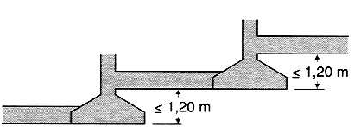
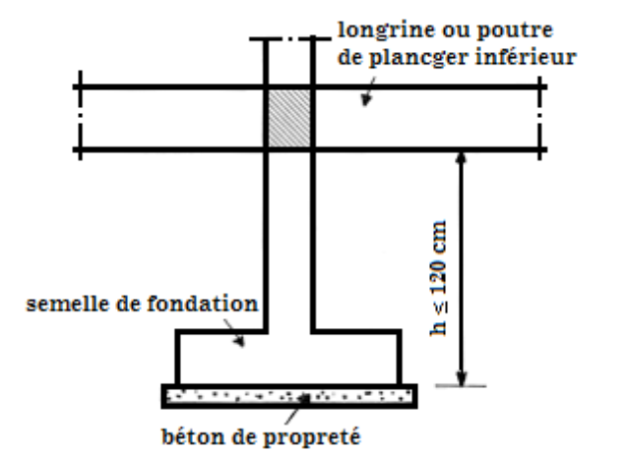
-In the case of heavy structures (such as tall buildings) composed of multiple blocks separated by joints, it is recommended to eliminate the joints at the foundation level if the foundation system and the quality of the foundation soil remain consistent under the different blocks.
- The beams of the lower floor of a structure can only be considered to act as tie beam if they are located at a distance from the underside of the footings or pile caps less than 1.20m. If not, a slab can replace the strip footings as long as it adheres to the above rule.
B- Perimeter Shear Wall: Substructures below the base level, consisting of short columns (e.g., crawl spaces), must include a continuous perimeter shear wall between the foundation level (footings, mat foundation...) and the base level. However, in Zone I,II and III this requirement is optional for individual houses, similar buildings, or any other construction with a height of 10 meters or less above the average ground level. In the case of blocks separated by expansion joints, the perimeter shear wall must encircle each block.
Notes:
crawl spaces =vide sanitaire
Mat foundation = radier
slender columns = poteaux élancées

Slide 13

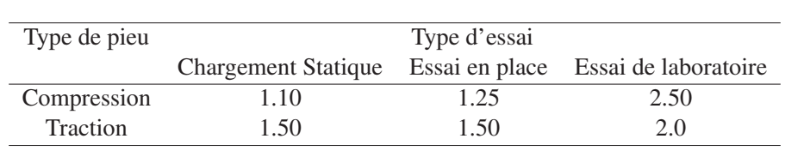

This shear wall must have the following minimum characteristics:
Thickness ≥ 15 cm.
Reinforcement consists of 2 layers.
The minimum of reinforcement is 0.10% in both horizontal and vertical directions.
Openings in this shear wall should not significantly reduce its stiffness.
Verification of Load-Bearing Capacity:
Shallow foundations: The application of a global safety factor of 2.0 to the soil's bearing capacity 𝑄𝑙 (punching shear stress) must be considered. (see DTR BC 2.33).
Deep Foundations: The application of global safety factors, $γ_{R}$ , on the ultimate bearing capacity, 𝑄𝑙, must be considered, which depend on the pile's mode of operation and the method used to determine 𝑄𝑙 (see Table 10.1) (see DTR BC 2.33).
QPl: ultimate point load, Q’sl: ultimate friction load.
the values of safety factors, $γ_{R}$:
Sliding resistance at the base of the shallow foundation:
DTR BC2.33 specifies the details for verifying sliding resistance at the base. A global safety factor of 1.25 must be applied to the sliding resistance.
Notes:
crawl spaces =vide sanitaire
Mat foundation = radier
slender columns = poteaux élancées

Slide 14
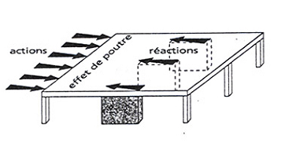
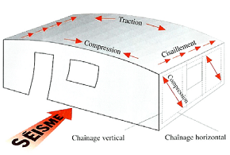
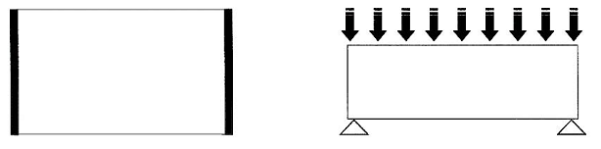
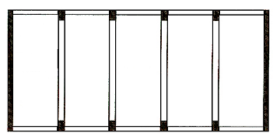
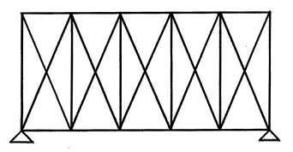
3. Diaphragm:
Definition: Any horizontal (floor) or inclined (roof slope) plane capable of transmitting horizontal loads to vertical bracing elements.
Role:
Transmitting loads to the underlying vertical bracing elements: load transmission occurs by beam action, as the diaphragm behaves like a beam located in the plane of horizontal loads."
Analogous to a solid beam.
Analogy with a truss beam

Slide 15
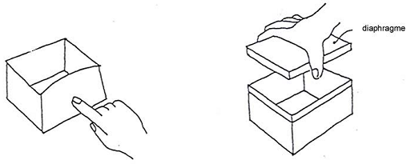
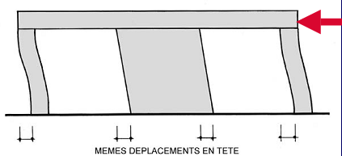
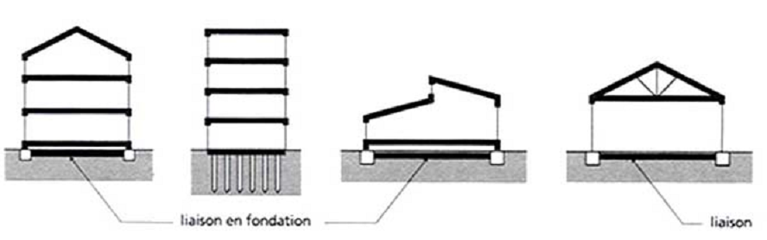
2. Stiffen the level: like the lid of a box. Stiffening aims to prevent the overturning of vertical load-bearing elements
3. Couple the vertical load-bearing elements (same displacement
at the top of elements in a row). Of course, this is applicable if the diaphragm is more rigid than the vertical bracing.
Diaphragm Placement:
- Floors of all levels
- Roof slopes
- Plane of purlins (roof trusses)"Classification des diaphragmes based on their stiffness
Rigid diaphragms: stiffer in their plane than the vertical bracing elements, imposing deformations on them.
-Flexible diaphragms: less stiff in their plane than the vertical bracing elements, they deform between these elements.

Slide 16
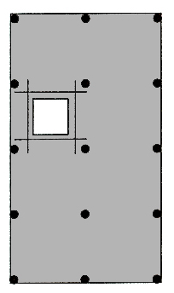
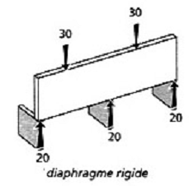
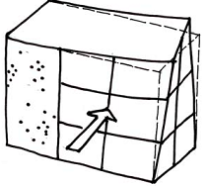
Rigid diaphragms are preferable to flexible diaphragms, as they distribute horizontal loads to vertical elements according to their lateral stiffness
La rigidité des diaphragmes dépend :
-Based on their shape: long and narrow diaphragms are flexible.
Diaphragms with reentrant angles can experience stress concentrations leading to damage
-If the vertical bracing stiffness is significant (masonry walls or concrete shear walls), moderate diaphragm spans are preferable to limit their flexibility.
- Based on their material: Plywood floors on wooden joists behave as relatively rigid diaphragms in a wooden structure, but are flexible in a masonry structure.
- Based on the effectiveness of the solidarity of their constituent elements:
(wood truss diaphragm)“
Based on the significance of openings (voids) which should be minimized. The presence of voids leads to stress concentrations, most notably at reentrant angles. Openings should be kept as small as possible, and their contours reinforced
Notes:
Plywood = contre plaqué
Joists =poutrelle

Slide 17
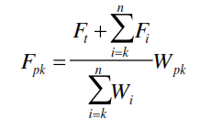
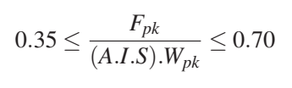
Two arrangements are crucial for satisfactory diaphragm behavior:
- Proper anchoring of diaphragms to the perimeter beams throughout to enable the transfer of horizontal forces to the bracing elements.
- Solidarity among the components forming the diaphragms (reinforcement of openings).
According to RPA 2024 , the horizontal diaphragms or bracings of floors and roofs must be designed to withstand seismic forces determined by the formula:
Wpk = weight of the diaphragm and the elements dependent on level k, including a minimum of operating loads (see Table 4.2: Coefficient ψ)
The seismic force exerted on the diaphragm will be bounded as follows
Diaphragms supporting concrete or masonry walls must have transverse ties connecting edge ties to ensure the distribution of anchoring forces. In diaphragms, intermediate ties can be provided for the creation of sub-diaphragms to transmit anchoring forces to transverse ties.
Notes:
Ties= chainages

Slide 18

4. Adequate Foundation:
4.1. Soil Behavior and Foundation Selection: Soils exhibit complex behavior and often constitute a heterogeneous and anisotropic medium. Under the influence of an external load, interstitial water generates pressure, and the Coulomb equation is then expressed as:$τ=C+\left(σ−μ\right)tgφ$
"Soil Liquefaction: When a pulverulent mass (c=0) saturated with water is subjected to the action of an earthquake, the solid grains tend to compact, leading to the development of interstitial pressure." $μ$": si $μ$ ≥ $σ$ $τ$= 0
4.2 Site Influence on Seismic Spectrum:
Structures built on loose soil experience more significant damage than those situated on rocky ground. The most favorable scenario is a flexible structure on rocky soil. An unfavorable scenario is a flexible structure on loose soil.
4.3 Foundation Design:
Foundations have a crucial impact on the performance of constructions during earthquakes. Experience shows that buildings erected on loose soils suffer more than those founded on stable ground. Reference should be made to the recommended practices outlined in the Algerian Seismic Code 'RPA' for foundation design, proper soil anchoring, settlement and deformation reduction.

Slide 19
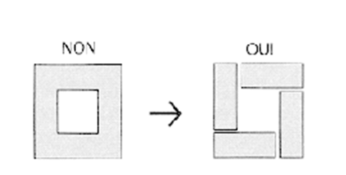
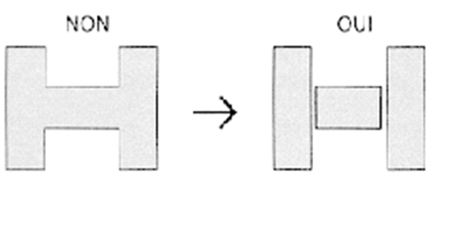
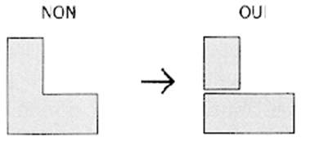
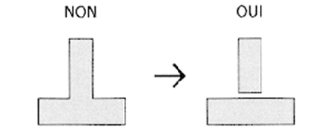
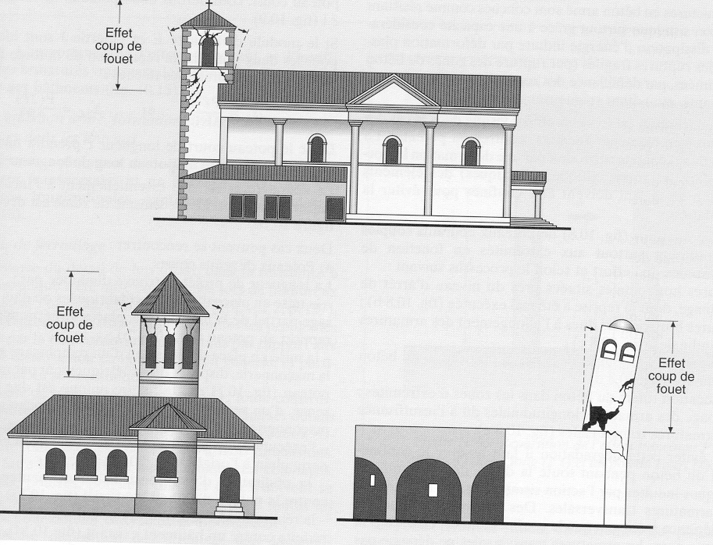
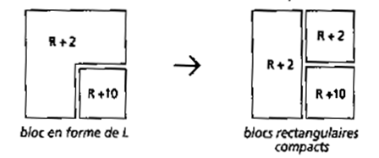
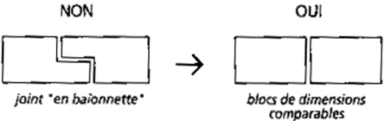

Solution :
Building division through seismic joints.
Example: Whip effect.
When dealing with vibrating machines, solid slabs should be used. It is advised not to allocate balconies for storage purposes (Q = 6 kN/m2).
Buildings with 2 axes of symmetry.
Buildings with 1 axis of symmetry.

Slide 20





It is not recommended to directly place pre-stressed beams on columns.
Avoid 'short' columns
It is not recommended to place slabs directly on columns.
It is advisable to reinforce corner masonry
Failures often occur at corners, which is typical because angles are highly stressed, much more than the regular parts, either due to bending or overall torsion.
It's important to avoid the plastic hinge effect: the 'strong columns - weak beams' principle should be followed. The beam should yield first. Its ultimate strength should be lower than that of the column
Loma Prieta -1989
Japon : Tokachi Oki
Turquie – 1997

Slide 21









Avoid flexible ground floors (lack of infill walls at ground level, transparency at ground level, different ground floor height at upper levels for commercial use).
Avoid flexible upper floors
Avoid partial frame infilling! (Avoid short columns and poor stiffness distribution)

Slide 22






Avoid infilling frames with masonry
For buildings stabilized by shear walls, two slender reinforced concrete shear walls in each principal direction are often sufficient
Avoid stiffness and strength discontinuities! (Avoid short columns and poor stiffness distribution)

Slide 23







Avoid stabilization discontinuities:
Avoid non-symmetric stabilizations.
Buildings exposed to vertical axis torsion during earthquakes can suffer severe damage. The shape of buildings can contribute to torsion when it leads to different horizontal dimensions (depths) within the same building.

Slide 24



Avoid stabilization discontinuities.
Avoid asymmetric stabilizations.
Design appropriate joints between two buildings' facades.

Slide 25





Avoid openings for pipes, ventilation channels in load-bearing walls.
Promote ductile load-bearing structures.
not allowed

