Slide 1
UNIVERSITY CENTER OF MILA
INSTITUTE OF SCIENCE AND TECHNOLOGY
DEPARTMENT OF CIVIL AND HYDRAULIC ENGINEERING
Seismic Engineering
Génie parasismique (Master2 G.C)
Chapter 02: The objectives of seismic protection and the methods of dimensioning

Responsible: Dr. GUETTICHE ABDELHEQ

Academic Year 2023- 2024

Slide 2
Seismic code :
Global seismic codes (RPA, EC8, ATC, UBC etc.) do not have a definitive or scientifically exact character. They are a convention at a given moment in technical and societal evolution.
"The main objective of seismic regulations is to safeguard as many human lives as possible. This involves designing and sizing structures capable of withstanding seismic actions without local or general collapse. Seismic regulations are there to protect us.
Therefore, it is important to understand and, above all, adhere to them. In Algeria, the first regulation was RPA81, which was followed the RPA.81 version of 1983 after the Chlef earthquake on October 10, 1980. The third versbyion, RPA.88, was followed by the RPA99 version.
"The RPA99 code take into account the effects of the Ain Témouchent earthquakes on December 22, 1999. As a result, it introduces 4 soil types instead of the 2 types (soft soil and firm soil) from RPA88. In fact, during the Boumerdes earthquake in 2003, structures built according to the current standards (RPA 99) suffered considerable damage, which indicates the presence of deficiencies and inadequacies in the Algerian regulations. As a result, the Algerian codes were updated in 2003."

Slide 3

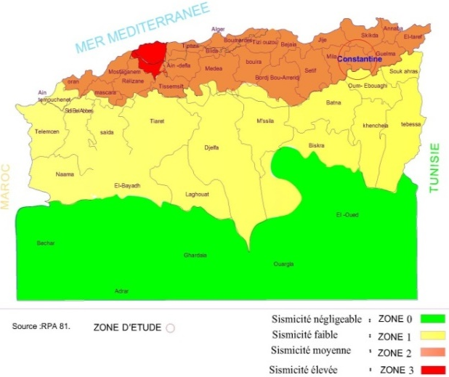
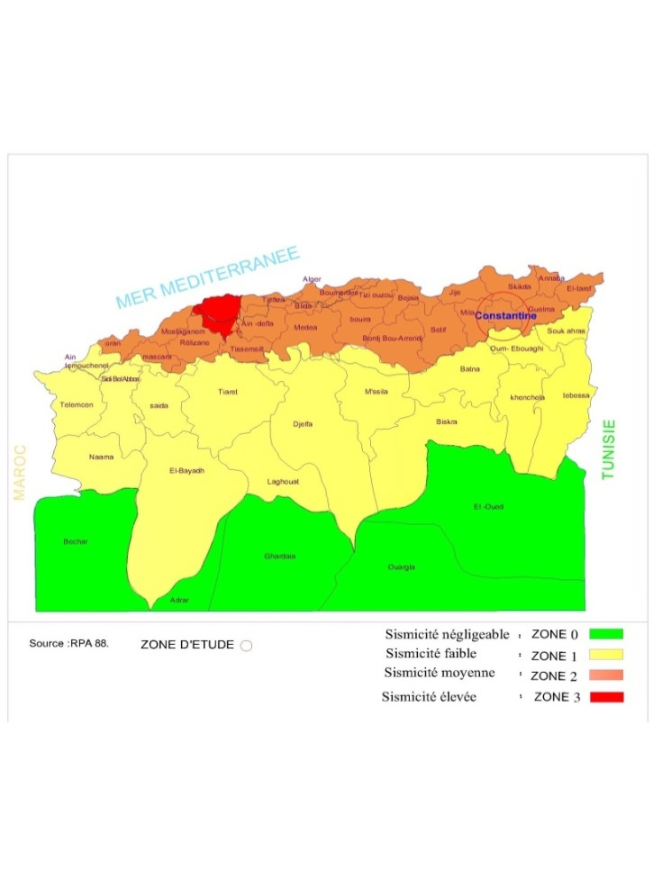
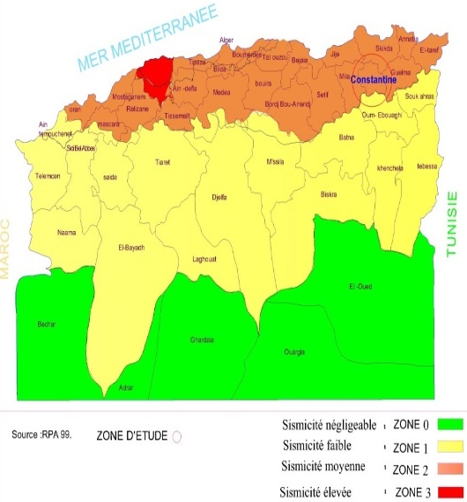
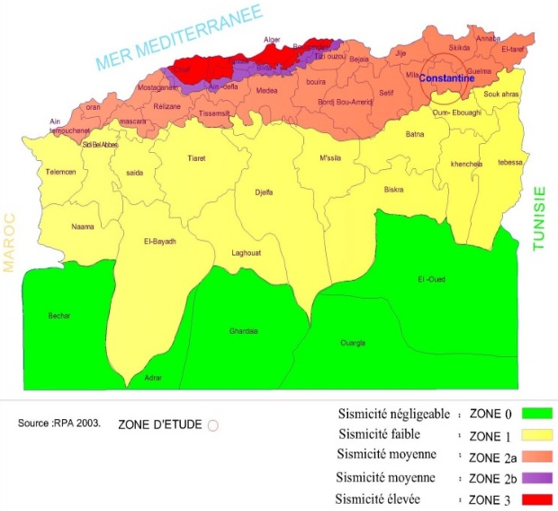
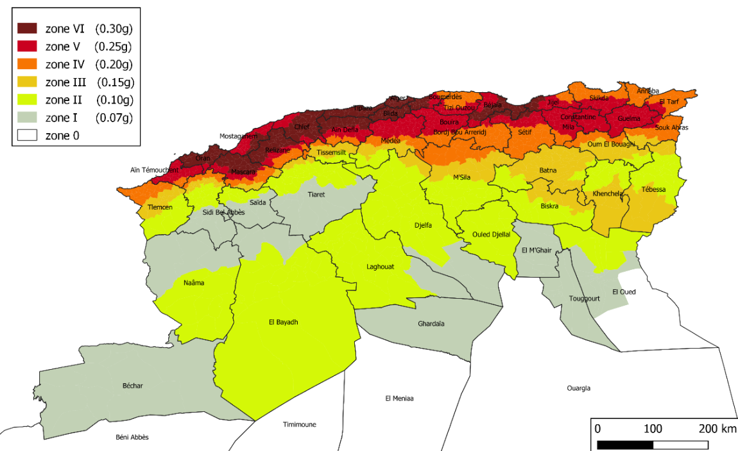
2. The evolution of seismic zones. According RPA: In order to establish design criteria based on seismic occurrence probabilities, a seismic zoning has been established by seismic codes, classifying different zones in Algeria where the seismic regulations (RPA) are applicable.

Slide 4
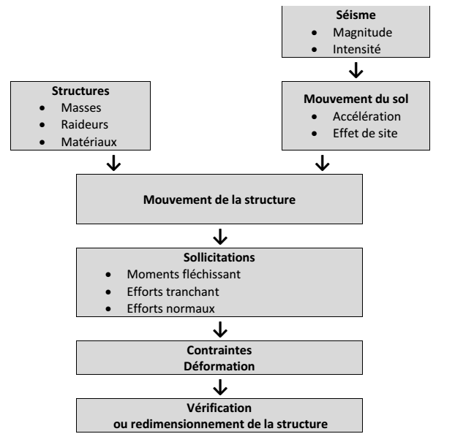
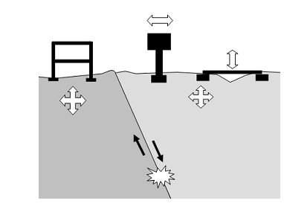
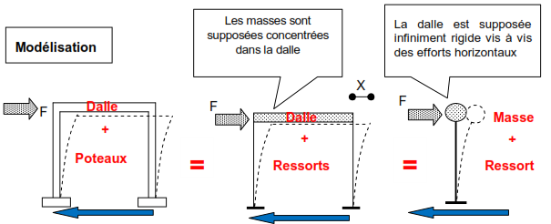
3. Dynamic Behavior of Structures in Seismic Zones: it is also important to note that a building with an absolutely perfect seismic design will only be able to withstand earthquakes if it is constructed correctly.
"Example: A perfectly symmetrical structure consisting of 4 identical columns and a single level of rigid floor, deforming only in translation and in one direction, can be likened to a simple oscillator:"

Slide 5
The principle of calculation is to transform ground movements into a system of equivalent static forces (in the case of horizontal components).“
"Ground acceleration = Imposed displacements.« "Calculation of Fi."
The horizontal force exerted on the structure is of the inertial force (Fi) type:
It is proportional to the mass of the structure (m) and the experienced acceleration (a).
"The deformation of the columns (displacement x) is proportional to the horizontal force experienced (Fi) and inversely proportional to the stiffness of the columns (k):"
To determine the required strength of a simple oscillator-type structure excited by an earthquake, the engineer's calculation must account for its mass, the stiffness of its supports, and the maximum acceleration it experiences in the studied direction. It's this last parameter that is the most challenging to obtain.
The maximum acceleration during earthquake oscillations depends on the earthquake's magnitude, attenuation with the source distance, site effects, and the potential for amplification or attenuation of ground shaking by the structure on that site."

Slide 6
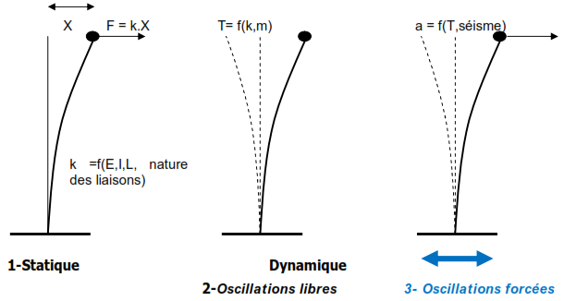
"The parameters for modeling a simple oscillator are as follows:
- F = k.x : There is a proportional relationship between the exerted force F (Fi), the stiffness k of the oscillator, and its measured deformation x.
T = f(k, m) :The period of free oscillations of a simple oscillator is a function dependent on its mass and stiffness. The period is longer when the spring is flexible and the mass is significant.
- a = f (T, earthquake) : The accelerations actually experienced by a simple oscillator, with its base fixed and subjected to earthquake shaking, are not directly those of the oscillating ground. They also depend on the dominant oscillation period of the site and the period of the structure."

Slide 7
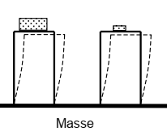
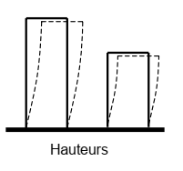
"But buildings are rarely designed as simple oscillators! In reality, they are defined by numerous masses and various stiffness values. It's a multiple oscillator. Since we can't influence the earthquake itself, we can deduce from the above that a seismic construction project requires a thorough understanding of the masses and stiffness of all structural elements, as they influence various dynamics parameters of the structure: deformations, accelerations, period, and thus resonance.
The more complex the architecture, the more intricate the distribution of masses and stiffness becomes. As a result, the engineer's work in the design office becomes more challenging, and the risk of damage increases."
"3.1. Factors Affecting the Period of an Oscillator:
Different Masses: The two models are identical in terms of height of columns,
column cross-sections, column material, and type of connections (fixed supports).
However, the mass attached to the top floor differs."
2. Different Heights: The two models are identical in terms of column
cross-sections, column material, type of connections (fixed supports),
and mass on the floor. However, the length of the columns differs.

Slide 8
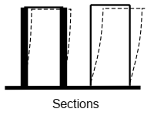
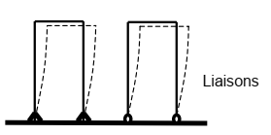
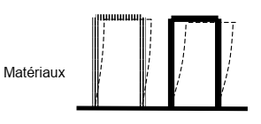
3. Different Sections:
The two models are identical in terms of column height, column material,
type of connections (fixed supports), and mass on the floor. However, the
column sections differ. It is observed that the model with smaller column
sections (lower inertia) is more flexible and has a longer natural oscillation period.
4. Different Support Connections:
The two models are identical in terms of column height, column cross-
sections, column material, and mass on the floor. However, the type of
support connections at the base differs. It is observed that the model with hinged connections is more flexible and has a longer natural oscillation period than the model with fixed base connections.
base Different Materials:
The two models are identical in terms of column height, column cross-
sections, type of connections (fixed supports), and mass on the floor, but the column materials differ. It is observed that the model with column material having a lower "modulus of deformation " is more flexible and has a longer natural oscillation period."

Slide 9
"So, the objective is to raise awareness among building designers about the complexity of phenomena and the necessity of not making any modifications to a building without consulting the engineer who conducted the study. A localized change in mass or stiffness can lead to serious damage that was originally avoided by the initial seismic design.
3.2. Design Methods: To calculate the required strength for a building exposed to seismic hazard, engineers commonly employ 'modal spectral analysis'."
1
Forced oscillations (earthquake), damped
F(inertia) + F(Stiffness) + F(Damping) = F
m.x ’’ + kx + cx’ = f(t)
Mathematical solution
Response spectrum
method
x(t) displacement
x’(t) velocity
x’’(t) acceleration
xmax displacement maxi
x''max acc. maxi

Slide 10
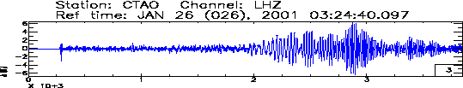
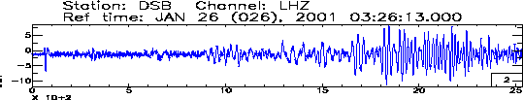
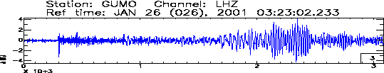
1st phase: Modal analysis seeks characteristic deformations of the structure and the natural period for each deformation 'mode.' These depend on the masses and stiffness of the construction, not the earthquake.
2nd phase: Spectral analysis = finding the structure's response (acceleration, velocity, or displacement) using spectral methods.
3.3. Response Spectrum of Structures: One of the goals of applied seismology is to provide each site with a 'tool,' called a 'response spectrum,' that allows architects and engineers to assess the potential amplification of waves arriving at the site due to the building's presence: structural resonance."
x(t) Displacement response
Maximum displacement
Acceleration of soil
Time
Time
a(t) Acceleration response
Maximum
acceleration
x(t), X’(t), x’’(Structural response)
Time
Time

Slide 11

"The regulatory response spectrum allows the structural engineering firm (BET) to determine the design acceleration of the structure. Knowing the type of soil (geotechnical studies) and the natural periods of the building's oscillation modes (modal analysis), they can read the 'response' of the building from it, which means the potential amplification level of ground shaking due to resonance.
During seismic design of a structure, engineers only focus on the maximum value of the structure's response.
The response spectrum doesn't represent any actual seismic motion but provides the most unfavorable response of the system. It allows for a straightforward estimation of the maximum displacement and, consequently, the maximum force.
Response spectra are defined by the following expressions:"
Relative displacement spectrum: $\left(ω_{D,ξ}\right)=\max_{t}\left|u\left(t,ω_{D},ξ\right)\right|$ (2.1)
Relative velocity spectrum: SV$\left(ω_{D},ξ\right)=\max_{t}\left|\dot{u}\left(t,ω_{D},ξ\right)\right|$ (2.2)
Absolute acceleration spectrum: SA$\left(ω_{D},ξ\right)=\max_{t}\left|\ddot{u}\left(t,ω_{D},ξ\right)\right|$ (2.3)
"For an earthquake, response spectra are functions of frequency and damping. They are depicted as graphs for given damping ratios over a wide frequency range."

Slide 12
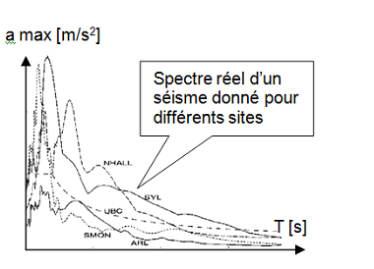
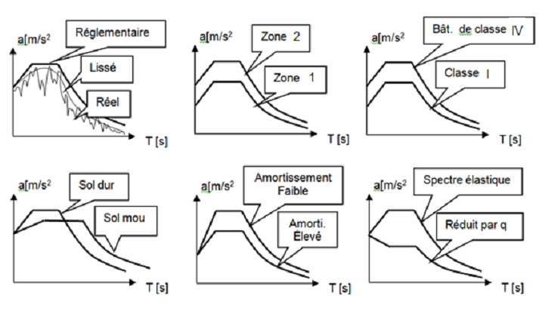
The design spectrum in terms of acceleration depends on the following regulatory factors:
The seismicity zone of the construction site, categorized as Zones I, IIA, IIB, and III.
The risk classification of the structure, which is designated as 1A, 1B, 2, or 3.
The damping coefficient of the structure, denoted as ζ
The soil classification (S1, S2, S3, S4) and the terrain's topography
The material's ability to withstand plastic deformations, indicated by the behavior coefficient.
Therefore, it is necessary to determine a design spectrum that will encompass a set of spectra corresponding to accelerograms suitably recorded at sites comparable to the studied location. The spectra thus obtained are then referred to as normalized spectra, depicted graphically for given damping ratios across a wide frequency range.
1B
2

Slide 13
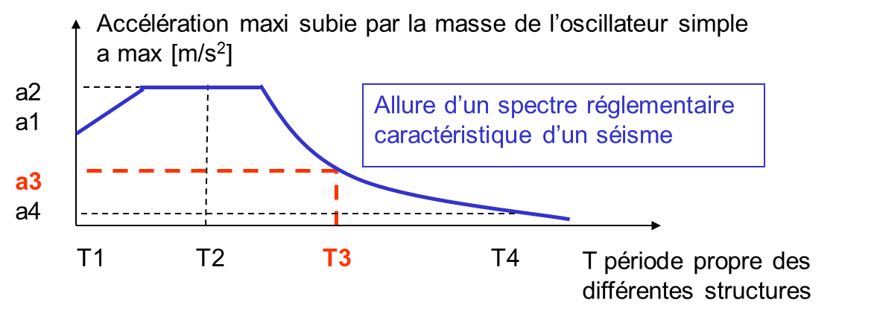
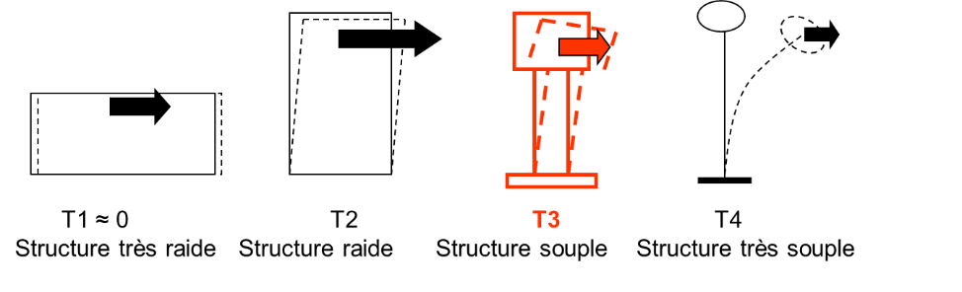
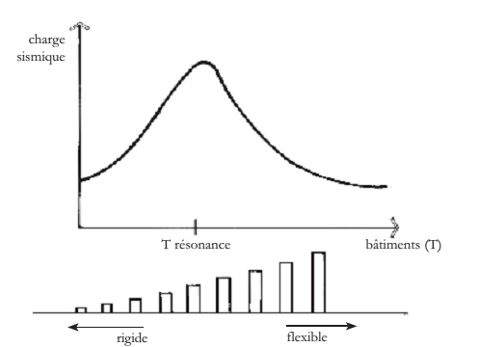
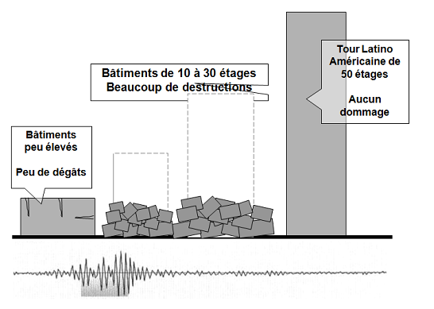
En principe, Chaque séisme est caractérisé par un spectre de réponse en accélération et chaque structure est caractérisée par une période propre T et un facteur d’amortissement ξ. En fonction de son mode de vibration une structure sera soumise à une accélération maximale amax.
For the same earthquake and consequently the same regulatory spectrum, each structure experiences a maximum acceleration depending on its natural period. This is why, in 1985 in Mexico, it was primarily the buildings with 10 to 30 stories that suffered significant damage.

Slide 14
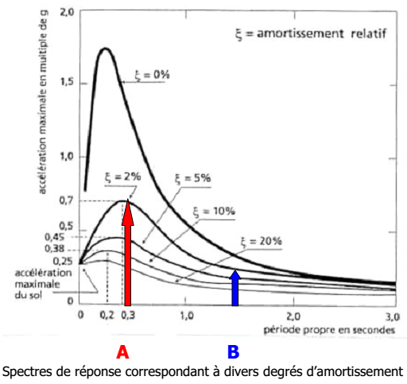
Once the oscillation periods of the structures are determined (modal analysis), the maximum expected response acceleration is read from the spectrum,
considering the amplification of ground motions by the structure
based on its oscillation periods.
Example of amplification and attenuation of accelerations by a
building founded on a specific soil type (in this case, hard soil).
Building A (with a period T = 0.3 s) amplifies the ground
shaking, while building B (with a period T = 1.5 s) attenuates it.
To avoid resonance, it is therefore important to seek, for the planned building, a natural period as distinct as possible from the dominant period of the soil. However, a site-specific response spectrum is seldom available for this purpose.
For an initial approximation, one can consider that on soft soils, rigid structures should be chosen, while on firm or rocky soils, flexible structures are more suitable (such as frame structures without infill walls, for example). However, it is much wiser to compare the periods of the building and the soil, and if they are close, to separate them by adjusting the design of the structure.

Slide 15
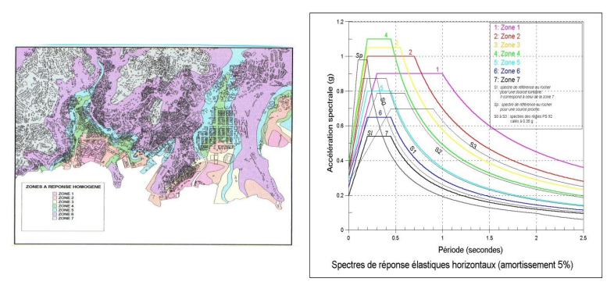
Microzonation: To determine the regulatory spectrum in highly seismic regions, one cannot simply rely on the spectrum that provides the highest maximum acceleration, as it is not evident that it corresponds to the primary risk to the structure.
Earthquakes are not an "external load" like wind actions; they stress buildings through ground movements, in which case there is an inertial force at play.
The displacements of foundations only induce stress based on the response of the structure, meaning its masses, stiffness, and damping characteristics.

Slide 16
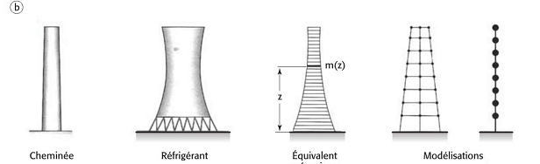
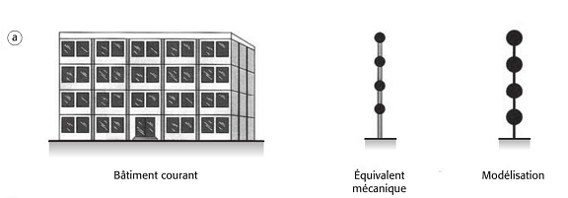
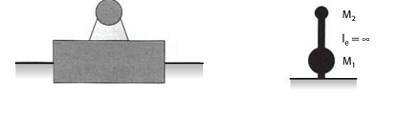
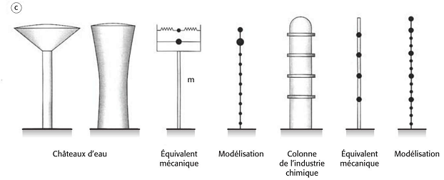
Structure:
5.1. Mass Modeling: In reality, structures are composed of a certain number of oscillating masses, some of which are concentrated at various levels, while others are distributed throughout the height of the structure.
In typical constructions (with a vertical load-bearing system and horizontal floors), most of the total mass is concentrated at the floor levels.
For slender structures like chimneys, cooling towers, pylons, etc., the mass is distributed continuously along the height of the construction. In this case, the structure is divided into a significant number of finite elements, with masses considered concentrated at the nodes.

Slide 17



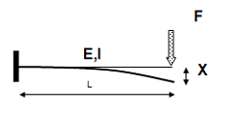
Special Structures: Water towers, chemical industry columns (Photo C): In cases where the support's mass is of a similar magnitude to that of the reservoir and the fluid, one can adopt a model with concentrated masses or even a multitude of concentrated masses. For an overall analysis, considering the water contained in the reservoir as part of the tank's structure is reasonable.
Massive and Highly Rigid Constructions: Monuments, massive foundations, etc. (Photo D): The masses will be treated as concentrated at the center of gravity of each element. In this scenario, the hypothetical connecting bars are massless but infinitely rigid. This modeling approach is also used for structures on seismic isolators.
5.2. Structural Stiffness: Stiffness is defined as the ratio of the applied force to the displacement.
Example: For a cantilever beam, it is known that under a force F, the displacement at point L is: This leads to the determination of the stiffness K:
More generally, one can define the parameters influencing stiffness, which are dependent on the type of loading:

Slide 18
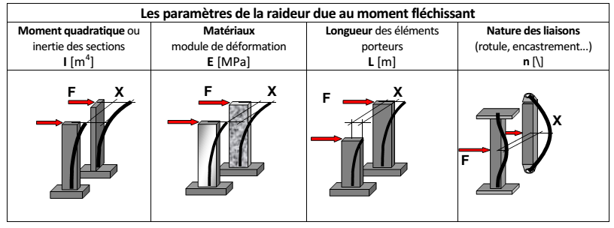
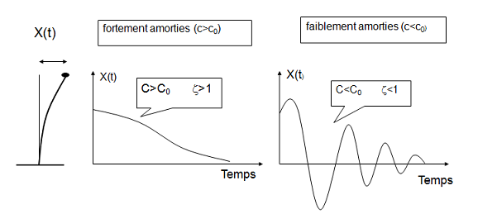
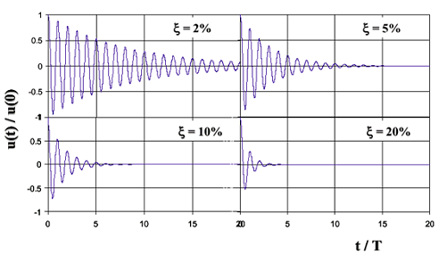
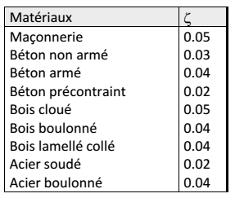
.
5.3. Structural Damping: The damping of a structure characterizes its ability to return to its initial position after displacement. The damping factor ζ helps assess the decay of oscillations over time. It is observed that a higher damping ratio leads to a shorter oscillation duration.
Example of damping factor in relation to the material:

Slide 19





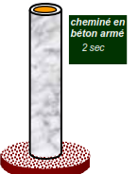
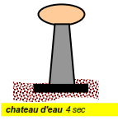

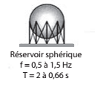
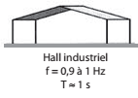
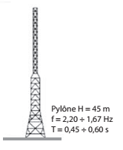
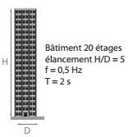
5.4. Period: Free oscillation can be characterized by its period T, which depends on the mode of natural vibration. It can be defined for each structure. Here are a few examples:
It can be observed that earthquakes manifest in the frequency
range of 0.5 to 20 Hz, while structures respond within the range
of 0.1 to 10 Hz. Specifically, building structures
(main structure) can be categorized as follows:
Rigid: T < 0.3 s;
Moderately rigid: T ≈ 0.3 to 0.7 s;
Flexible: T ≈ 0.7 to 1.5 s;
Very flexible: T > 1.5 s;
With seismic isolators: T ≈ 2.0 to 3.0 s.
The natural frequency of the construction depends on its stiffness and mass.
Transamerica pyramid
San Francisco
T = 2,9 s axe E-O etN-S
T = 18.2 s transversely
T = 10.9 s vertically
T = 3.81 s horizontally
T = 4.43 s torsion / bridge axis

Slide 20
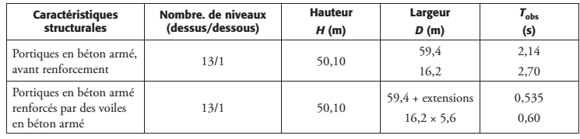
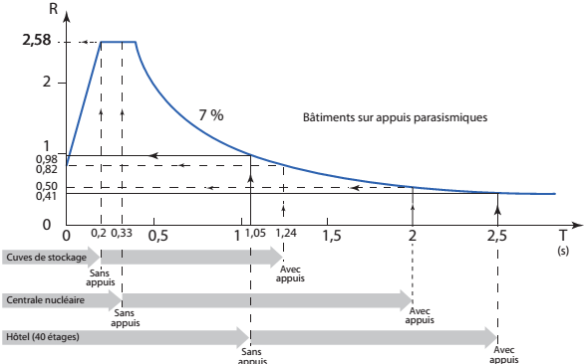
The experimental method of background noise enables the determination of the resonance frequency of the soil and the building frequencies using the recording of seismic background noise at a specific point through a three-component sensor,
The reinforcement of buildings after the1985 Mexico
earthquake, through the introduction of reinforced concrete
walls, led to a reduction in their fundamental periods.
The introduction of seismic isolation systems modifies the response of structures: due to the flexibility of these systems, the resulting setup exhibits a fundamental mode of vibration that involves overall translation relative to the foundation. This mode is characterized by a longer natural period compared to the initial system. Examining the acceleration spectrum reveals that seismic forces acting on the structure are typically
reduced as the period becomes longer.

Slide 21
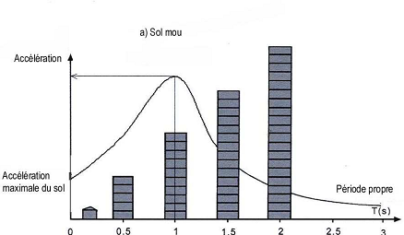
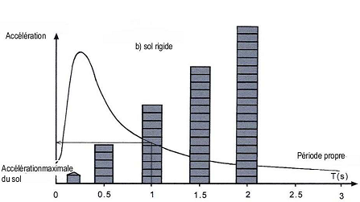
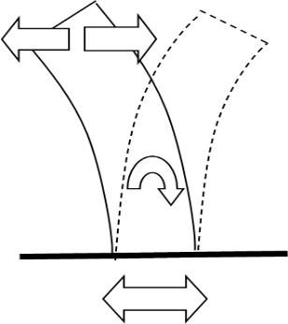
5.5. Design Principles: To create a structure resistant to seismic actions, one must:
1. Minimizing the impact on the structure (inertial forces):
"Minimizing Masses (light structure, non-structural elements, and lightweight equipment) Minimizing Accelerations: moving away from areas prone to significant site effects and avoiding seismic fault zones, or through construction site modifications (soil replacement, trenches filled with absorbing materials)
2. Maximize the structure's response capacity:
prevent resonance with the ground: This situation occurs when: (Tbuilding = Tground) To avoid this risk we must build rigid structures on soft ground and flexible structures on rocky or firm ground.
Increase energy dissipation: Increase damping (plasticization of materials), and ductility.
Bury constructions Prevent collisions with neighboring constructions
3. Increase energy storage: Increase mechanical resistance in the elastic domain.
F= masse× Accélération
Stored mechanical energy (potential and kinetic)
Dissipated energy
Seismic energy

Slide 22
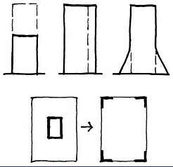
To avoid the resonance phenomenon for an existing structure, we must modify its natural period (increase or reduce the period):
1-Reduce the natural period:
Modify the shape of the building: reduce its height;
reduce its geometric slenderness; flare its base
Increase the stiffness of the structure: brace with shear walls; increase the number of walls, peripheral bracing.
-Reduce the mass: light structure and light non-structural elements.
2. Increase the natural period:
Modify the shape of the building: increase its height; increase its geometric slenderness;
Reduce its stiffness: brace with frames; increase spans (frame structures)
- Use mechanical devices: seismic isolation

