Slide 1
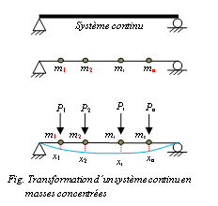
Chapter 03: Multi-Degree-of-Freedom Systems
Introduction :
For 1 DOF we have an equation of motion
For +MDOF We have as many equations of motion (system of equations)
In matrix form N x N
The discrete system with n concentrated masses is an approach for
evaluating the dynamic response of a given continuous system.
At each instant t the position of the beam is determined by x₁(t),
x₂(t), … x_{n}(t). (these are the n degrees of freedom corresponding to
vertical displacements) measured from the static equilibrium position.
Case of a building with N floors:
Generally, for the dynamic analysis of buildings, it is assumed that the mass is concentrated at the level of each floor and only its displacement in the lateral direction is considered.
In this case, the number of degrees of freedom is equal to the number of floors in the building.

Slide 2
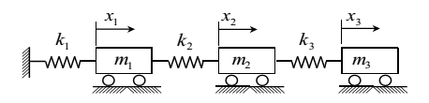

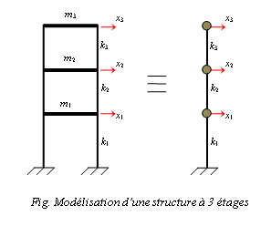

A real system generally comprises several masses connected to each other by elements of spring and damper types.
1.2. Equation of motion:
For each node (mass):
External excitation P_{i}(t)
Inertia force f_{Ii}(t)
Elastic force f_{Ki}(t)
Damping force f_{ai}(t)
Equilibrium equation for node i:
$f_{Ii}+f_{ai}+f_{ki}=P_{i}(t)$ (5.1)
For the other masses:
Node 1 $f_{I1}+f_{a1}+f_{k1}=P_{1}(t)$
Node n $f_{In}+f_{an}+f_{kn}=P_{n}(t)$
Matrix form :
$\left\{f_{I}\right\}+\left\{f_{a}\right\}+\left\{f_{k}\right\}= \left\{P(t)\right\}$ (5.2)

Slide 3
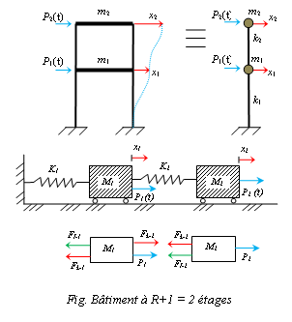

Example: Two-story structure subjected to two external forcesP₁(t), P₂(t) :
building with R+1 = 2 floors . Differential equations of motion: $\begin{aligned}m_{1} \\ m_{2} \end{aligned}\left\{\begin{aligned}f_{I1}+f_{k1}−f_{k2}=P_{1}\left(t\right) \\ f_{I2}+ f_{k2} =P_{2}\left(t\right)\end{aligned} \right\}$
$\left\{ \begin{aligned}m_{1}{\ddot{x}}_{1}+k_{1}x_{1}−k_{2}(x_{2}−x_{1})=P_{1}\left(t\right) \\ m_{2}{\ddot{x}}_{2}+ k_{2}(x_{2}−x_{1}) =P_{2}\left(t\right)\end{aligned} \right\}$
$$\left\{ \begin{aligned}m_{1}{\ddot{x}}_{1}+(k_{1}+k_{2})x_{1}−k_{2}x_{2}=P_{1}\left(t\right) \\ m_{2}{\ddot{x}}_{2}− k_{2}x_{1}+ k_{2}x_{2}=P_{2}\left(t\right)\end{aligned} \right\}$$
$\left[\begin{aligned}m_{1} 0 \\ 0 m_{2}\end{aligned}\right]\left\{\begin{aligned}{\ddot{x}}_{1} \\ {\ddot{x}}_{2}\end{aligned}\right\}+\left[\begin{aligned}k_{1}+k_{2} −k_{2} \\ −k_{2} k_{2}\end{aligned}\right]\left\{\begin{aligned}x_{1} \\ x_{2}\end{aligned}\right\}=\left\{\begin{aligned}P_{1} \\ P_{2}\end{aligned}\right\}$
so : $\left[M\right]\left\{\ddot{X}\right\}+\left[C\right]\left\{\dot{X}\right\}+\left[K\right]\left\{X\right\}=\left\{P\right\}$
with:$\left\{ \begin{aligned}f_{k1}=k_{11}x_{1}+k_{12}x_{2}+ k_{13}x_{3}+…+ k_{1n}x_{n} \\ f_{k2}=k_{21}x_{1}+k_{22}x_{2}+ k_{23}x_{3}+…+ k_{2n}x_{n} \\ . \\ . \\ f_{kn}=k_{n1}x_{1}+k_{n2}x_{2}+ k_{n3}x_{3}+…+ k_{nn}x_{n}\end{aligned} \right\}$ (5.3)
$\left\{f_{k}\right\}=\left[K\right]\left\{X\right\}$ (Stiffness force vector) … (5.4)

Slide 4

$\left\{\begin{aligned}f_{k1} \\ f_{k2} \\ . \\ . \\ f_{kn}\end{aligned}\right\}=\left[\begin{aligned}k_{11} k_{12} k_{13}… k_{1n} \\ k_{21} k_{22} k_{23}… k_{2n} \\ . \\ . \\ k_{n1} k_{n2} k_{n3}… k_{nn}\end{aligned}\right]\left\{\begin{aligned}x_{1} \\ x_{2} \\ . \\ . \\ x_{n}\end{aligned}\right\}$
k_{ij} : Stiffness influence coefficient
f_{ij} : force corresponding to coordinate i produced by a unit displacement of coordinate j
[K] : stiffness matrix of the system.
{X} : Displacement vector representing the displacement of the system. And similarly:
$\left\{\begin{aligned}f_{a1} \\ f_{a2} \\ . \\ . \\ f_{an}\end{aligned}\right\}=\left[\begin{aligned}c_{11} c_{12} c_{13}… c_{1n} \\ c_{21} c_{22} c_{23}… c_{2n} \\ . \\ . \\ c_{n1} c_{n2} c_{n3}… c_{nn}\end{aligned}\right]\left\{\begin{aligned}{\dot{x}}_{1} \\ {\dot{x}}_{2} \\ . \\ . \\ {\dot{x}}_{n}\end{aligned}\right\}$ (5.5)
$\left\{f_{a}\right\}=\left[C\right]\left\{\dot{X}\right\}$ (Damping force vector) … (5.6)
c_{ij} :Damping influence coefficient (viscous damping)
f_{ij} : force corresponding to coordinate i is caused by a unit velocity along coordinate j
[C] : damping matrix of the structure
{$\dot{X}$} : velocity vector of the system

Slide 5
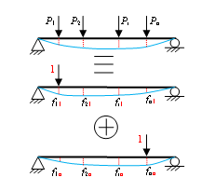

And similarly :$\left\{\begin{aligned}f_{I1} \\ f_{I2} \\ . \\ . \\ f_{In}\end{aligned}\right\}=\left[\begin{aligned}m_{11} m_{12} m_{13}… m_{1n} \\ m_{21} m_{22} m_{23}… m_{2n} \\ . \\ . \\ m_{n1} m_{n2} m_{n3}… m_{nn}\end{aligned}\right]\left\{\begin{aligned}{\ddot{x}}_{1} \\ {\ddot{x}}_{2} \\ . \\ . \\ {\ddot{x}}_{n}\end{aligned}\right\}$ (5.7)
$\left\{f_{I}\right\}=\left[M\right]\left\{\ddot{X}\right\}$ (Inertia force vector) … (5.8)
m_{ij} : Mass influence coefficient.
f_{ij} : The force corresponding to coordinate i is caused by a unit acceleration along coordinate j.
[M] : The mass matrix of the structure . {$\ddot{X}$} : Acceleration vector of the system
$\left[M\right]\left\{\ddot{X}\right\}+\left[C\right]\left\{\dot{X}\right\}+\left[K\right]\left\{X\right\}=\left\{P(t)\right\}$ (5.9)
2. Matrice de flexibilité d’une structure : Consider the following beam which is subjected to the system of forces shown in the diagram below.
By applying the superposition method, we get:
x₁ = f₁₁P₁ + f₁₂P₂ + … + f_{1n}P_{n}
x₂ = f₂₁P₁ + f₂₂P₂ + … + f_{2n}P_{n}
.
.
x_{n} = f_{n1}P₁ + f_{n2}P₂ + … + f_{nn}P_{n}

Slide 6
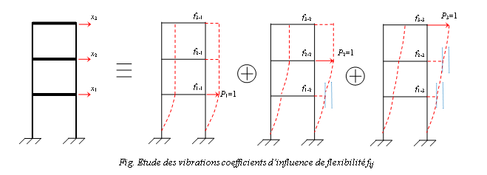

f_{ij} : Flexibility influence coefficient
x_{ij} : The displacement corresponding to degree of freedom i produced by a unit force applied in the direction of degree of freedom j.
$\left\{\begin{aligned}x_{1} \\ x_{2} \\ . \\ . \\ x_{n}\end{aligned}\right\}=\left[\begin{aligned}f_{11} f_{12} f_{13}… f_{1n} \\ f_{21} f_{22} f_{23}… f_{2n} \\ . \\ . \\ f_{n1} f_{n2} f_{n3}… f_{nn}\end{aligned}\right]\left\{\begin{aligned}P_{1} \\ P_{2} \\ . \\ . \\ P_{n}\end{aligned}\right\}$ (5.10)
$\left\{X\right\}=\left[f\right]\left\{P\right\}$ (Displacement vector) … (5.11)
[ f ] : Flexibility matrix or compliance matrix.
Example :Détermination of f_{ij},et k_{ij} for structure :

Slide 7
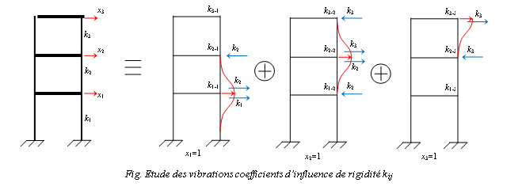
Remark :
If degree of freedom i is a rotation, to determine the flexibility influence coefficients, a unit moment M=1 is applied about degree of freedom i.
[ f ] = [K]⁻¹ or [K] = [ f ]⁻¹ ;
The matrices [ f ] et [K] are symmetric matrices : [K] = [K]^{T} , [ f ] = [ f ]^{T}

Slide 8

3. Undamped free vibrations: : The analysis of a system (structures) with multiple degrees of freedom (MDOF) undergoing undamped free vibration provides the most important dynamic properties of the system, namely the natural frequencies and mode shapes.
In each vibration mode, each point in the structure executes a harmonic motion about its equilibrium position. All points pass through the equilibrium position and maximum amplitude simultaneously.
3.1. Stiffness matrix method: $\left[M\right]\left\{\ddot{X}\right\}+\left[K\right]\left\{X\right\}=0$ (6.1)
For sinusoidal motion of each point in the structure.
x₁ = A₁.sin(ωt+ϕ)
x₂ = A₂.sin(ωt+ϕ) (6.2)
.
x_{n} = A_{n}.sin(ωt+ϕ)
$\left\{x\right\}=\left\{A\right\}sin⁡(ωt+φ)$ (6.3)
$\left\{\ddot{x}\right\}=−\left\{A\right\}ω^{2}sin⁡(ωt+φ)$
By substituting these last two expressions into the first equation, we obtain:
$\left(\left[K\right]−ω^{2}\left[M\right]\right) \left\{A\right\}\sin\left(ωt+φ\right)=0$ (6.5)
Eq (6.5) = 0 ∀t == > For any value of the sin function; We have :
$\left(\left[K\right]−ω^{2}\left[M\right]\right) \left\{A\right\}=0$ (6.6)

Slide 9

$\left.\begin{aligned}ω^{2}=? \\ A_{1}= ? \\ A_{2}= ? \\ . \\ A_{n}= ?\end{aligned}\right\}$ == > Therefore we have a system of (n) equations with (n+1) unknowns
$\left\{\begin{aligned}\left(k_{11}−ω^{2}m_{1}\right)A_{1}+k_{12}A_{2}+…+k_{1n}A_{n}=0 \\ k_{21}A_{1}+\left(k_{22}−ω^{2}m_{2}\right)A_{2}+…+k_{2n}A_{n}=0 \\ . \\ k_{n1}A_{1}+{k_{n2}A}_{1}+…+{\left(k_{nn}−ω^{2}m_{n}\right)A}_{n}=0\end{aligned}\right.$ (6.7)
With :
$\left[K\right]=\left[\begin{matrix}k_{11} & k_{12} & k_{1n} \\ k_{21} & k_{22} & . \\ k_{n1} & . & k_{nn}\end{matrix}\right]$ et $\left[M\right]=\left[\begin{matrix}m_{1} & 0 & 0 \\ 0 & m_{2} & . \\ 0 & . & m_{n}\end{matrix}\right]$
The homogeneous system of equations (6.6) can only admit a non-trivial solution if the determinant of the square matrix is zero.
Characteristic e$q{: ∆}_{ω}=\left|\left(\left[K\right]−ω^{2}\left[M\right]\right)\right|=0$ (6.8)
$∆_{ω}=f\left[{\left(ω^{2}\right)}^{n}+{\left(ω^{2}\right)}^{n−1}+…+{\left(ω^{2}\right)}^{1}+cst\right]$
If we expand the characteristic eq we obtain a polynomial equation of degree‘n’ en ω².
The n solutions for (ω²) are the squares of the natural frequencies of the n possible vibration modes. The 1st vibration mode corresponds to ω₁, it is called the fundamental mode.we have :
ω₁< ω₂ < ω₃< … < ω_{n} ou T₁> T₂ > T₃> … > T_{n}

Slide 10

Therefore, for each natural frequency (ω), we calculate the corresponding mode shape:
$ω=ω_{1}== > \left\{A_{1}\right\}$
$ω=ω_{2}== > \left\{A_{2}\right\}$
...
$ω=ω_{n}== > \left\{A_{n}\right\}$
For $ω=ω_{i}==>\left\{\begin{aligned}\left(k_{11}−{m_{1}ω_{i}}^{2}\right)A_{1}+k_{12}A_{2}+…+k_{1n}A_{n}=0 \\ k_{21}A_{1}+\left(k_{22}−{m_{2}ω_{i}}^{2}\right)A_{2}+…+k_{2n}A_{n}=0 \\ . \\ k_{n1}A_{1}+{k_{n2}A}_{1}+…+{\left(k_{nn}−m_{n}{ω_{i}}^{2}\right)A}_{n}=0\end{aligned}\right.$ (6.9)
The mode shape {A_{j}}^{i} can only be determined up to its form as a ratio of non-zero displacements.
The mode shapes are usually normalized with respect to the largest component, if A₁^{(i)} is this last one.
$φ_{k,i}=\frac{A_{k}^{(i)}}{A_{1}^{(i)}}$ (6.10) == > $\left\{\begin{aligned}A_{1} \\ A_{1} \\ . \\ . \\ A_{n}\end{aligned}\right\}=> \left\{\begin{aligned}1 \\ φ_{1} \\ . \\ . \\ φ_{n−1}\end{aligned}\right\}={\left\{φ\right\}}^{i}$
{φ}^{i} : gives us the shape or form of the natural vibration corresponding to ω_{i}.

Slide 11
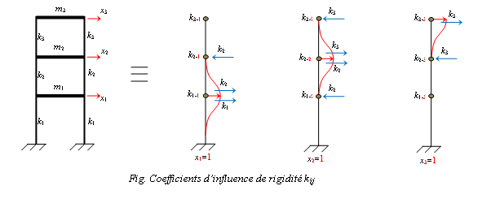

Spectral matrix : $\left[ω^{2}\right]=\left[\begin{matrix}ω_{1}^{2} & 0 & 0 \\ 0 & ω_{2}^{2} & . \\ 0 & . & ω_{n}^{2}\end{matrix}\right]$
modal matrix : $\left[φ\right]=\left[{\left\{φ\right\}}^{1} {\left\{φ\right\}}^{2}… {\left\{φ\right\}}^{n}\right]=\left[\begin{matrix}φ_{11} & φ_{12} & φ_{1n} \\ φ_{21} & φ_{22} & . \\ φ_{n1} & . & φ_{nn}\end{matrix}\right]$
Example : we have three-story structure with :
m₁ = m₂ = 4000 kg , m₃= 2000 kg.
Stiffness for each column:
k₁ = 1,5.10⁶ N/m , k₂ = 1,0.10⁶ N/m , k₃ = 0,75.10⁶ N/m
Determine the modes and natural frequencies of the system?
Solution :

Slide 12

$\left[K\right]=\left[\begin{matrix}k_{1}+k_{2} & −k_{2} & 0 \\ {−k}_{2} & k_{2}+k_{3} & −k_{3} \\ 0 & −k_{3} & k_{3}\end{matrix}\right]=\left[\begin{matrix}2.\left(1,5+1\right).{10}^{6} & −2.\left(1\right).{10}^{6} & 0 \\ −2.\left(1\right).{10}^{6} & 2.\left(1+0,75\right).{10}^{6} & −2.\left(0,75\right).{10}^{6} \\ 0 & −2.\left(0,75\right).{10}^{6} & 2.\left(0,75\right).{10}^{6}\end{matrix}\right]$
$\left[M\right]=\left[\begin{matrix}m_{1} & 0 & 0 \\ 0 & m_{2} & 0 \\ 0 & 0 & m_{3}\end{matrix}\right]=\left[\begin{matrix}4000 & 0 & 0 \\ 0 & 4000 & 0 \\ 0 & 0 & 2000\end{matrix}\right]kg$ $\left[K\right]={10}^{6}\left[\begin{matrix}5 & −2 & 0 \\ −2 & 3,5 & −1,5 \\ 0 & −1,5 & 1,5\end{matrix}\right]N/m$
$\left|\left[K\right]−ω^{2}\left[M\right]\right|=0==>\left[\begin{matrix}5.{10}^{6}−4.{10}^{3}.ω^{2} & −2.{10}^{6} & 0 \\ −2.{10}^{6} & 3,5.{10}^{6}−4.{10}^{3}.ω^{2} & −1,5.{10}^{6} \\ 0 & −1,5.{10}^{6} & 1,5.{10}^{6}−2.{10}^{3}.ω^{2}\end{matrix}\right]$
We put ω² = λ, We will have a cubic equation of the 3rd order:|A.λ³ + B.λ² + C.λ¹ + D| = 0
λ₁ = 164,4 == > ω₁ = 12,82 rad/sec ; λ₂ = 1000,0 == > ω₂ = 31,62 rad/sec
λ₃ = 1710,6 == > ω₃ = 41,35 rad/sec
ω₁, ω₂ et ω₃ These are the natural frequencies of the system.
For each value of ω, are we looking for the values of A? ?
for ω₁= 12.82 rad/sec on a :
$$\left(5.{10}^{6}−4.{10}^{3}.ω_{1}^{2}\right).A_{1}^{(1)} −2.{10}^{6}.A_{2}^{(1)} +0.A_{3}^{(1)}=0$$
${−2.{10}^{6}.A}_{1}^{(1)} +\left(3,5.{10}^{6}−4.{10}^{3}.ω_{1}^{2}\right).A_{2}^{(1)} −1,5.{10}^{6}.A_{3}^{(1)}=0$
$0.A_{1}^{(1)} −1,5.{10}^{6}A_{2}^{(1)} +\left(1,5.{10}^{6}−2.{10}^{3}.ω_{1}^{2}\right).A_{3}^{(1)}=0$
On aura éq à 3 inconnus, il faut fixer un inconnu et on détermine les autres.

Slide 13
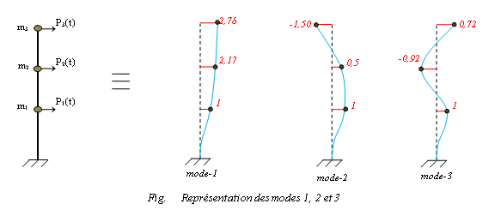


We choose A₁⁽¹⁾ = 1.00 so :$A^{(1)}=\left\{\begin{aligned}A_{1}^{(1)} \\ A_{2}^{(1)} \\ A_{3}^{(1)}\end{aligned}\right\}=\left\{\begin{aligned}1,00 \\ 2,17 \\ 2,78\end{aligned}\right\}$ Similarly, we do the same for ω₂ et ω₃ resulting in:
$A^{(2)}=\left\{\begin{aligned}1,00 \\ 0,50 \\ −1,50\end{aligned}\right\}$ et $A^{(3)}=\left\{\begin{aligned}1,00 \\ −0,92 \\ 0,72\end{aligned}\right\}$
Example :
To calculate the eigenvectors (Ø1,Ø2) nd eigenvalues(ω1,ω2) of the structure below,? :
Calculate by MATLAB :
----------------------------------------------------
% To find the roots of a polynomial:
Y = [A B C D] % The factors of the polynomial
roots(Y)
----------------------------------------------------
% les valeurs propres :
K = [--- ;--- ;---] ; % matrix K
M = [-00 ;0-0 ;00-] ; % matrix M
[d, w] = eig(K,M)
sqrt(w)
---------------------------------------------------

