Slide 1
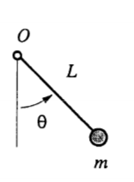
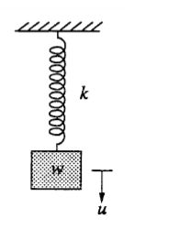
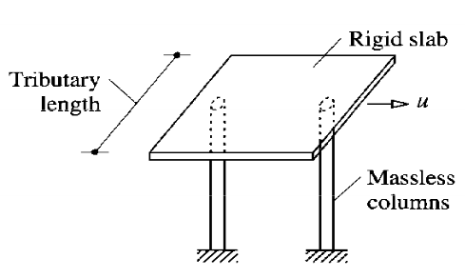
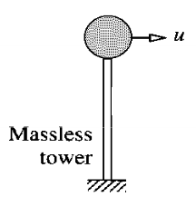
Chapter 02: Single Degree of Freedom Systems (SDOF)
Introduction : A structure is said to have a "single degree of freedom" if its configuration at any time "t" can be determined by a single scalar parameter q(t), called the configuration parameter. So a model with only one possibility of movement (displacement or rotation).
I.1. Why study SDOF Models:
Very useful for modeling more complex civil engineering
structures.
The response of a SDOF is used to solve MDOF systems.
Can be effective in modeling simple systems.
I.2. Example:

Slide 2
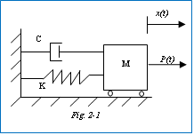

II. Formulation of the Equation of Motion:In structural dynamics, methods to formulate the equation of motion for a single degree of freedom (SDOF) system include: D'Alembert's Principle, Hamilton's Principle, and the Principle of Virtual Displacements.
Generally the equation of motion takes the form:
$$m.\ddot{x}+c.\dot{x}+k.x=P\left(t\right)$$
It is a linear differential equation of second order.
II.1. Modeling: The SDOF system is simply represented by the model:
A system characterized by a single degree of freedom (displacement along x) is called a 1 DOF system.
II.2. D'Alembert's Principle:
a/ Case of external excitation: Newton's second law states: the variation in momentum of a mass m $\left(m.\frac{dx}{dt}\right)$ is proportional to the resultant of the external forces P(t): $\frac{d}{dt}\left(m.\frac{dx}{dt}\right)=P(t)$

Slide 3
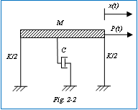
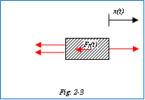
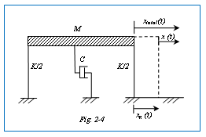

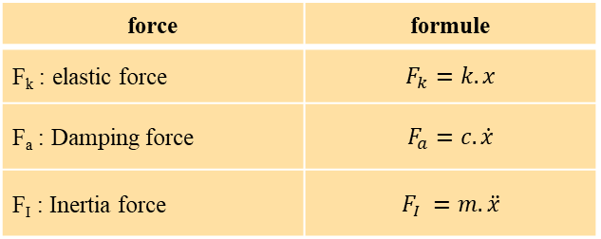
"In dynamics, mass is not a function of time."
$$m.\frac{d^{2}x}{dt^{2}}=m.\ddot{x}=P(t)$$
P$\left(t\right)−m.\ddot{x}=0$
$P\left(t\right)+F_{I}(t)=0$ generally:
${ F}_{I}\left(t\right)+F_{a}\left(t\right)+F_{k}(t)=P(t)$ (2.1)
With :
$m.\ddot{x}+c.\dot{x}+k.x=P\left(t\right)$ (2.2)
Fk(t)
force | formule
F_{k} : elastic force | $$F_{k}=k.x$$
F_{a} : Damping force | $$F_{a}=c.\dot{x}$$
F_{I} : Inertia force | $$F_{I} =m. \ddot{x}$$
Fa(t)

Slide 4
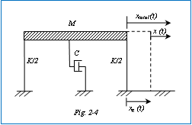
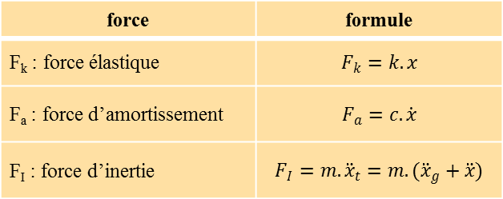
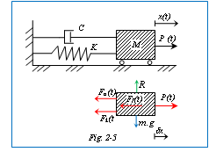

b/ Case of ground motion due to earthquake:In this case the excitation comes from an earthquake which causes ground displacement xg(t) relative to the reference axis.
$m.\left({\ddot{x}}_{g}+\ddot{x}\right)+c.\dot{x}+k.x=0$
$m.\ddot{x}+c.\dot{x}+k.x=−m.{\ddot{x}}_{g}=P(t)$ (2.3)
P(t) :effective force (direct)
II.3. Principle of Virtual Work: From a system in equilibrium: Virtual work of external forces = Virtual work of internal forces
Where the system undergoes an arbitrarily chosen virtual displacement.
$${ F}_{I}\left(t\right).δ_{x}+F_{a}\left(t\right).δ_{x}+F_{k}\left(t\right).δ_{x}−P\left(t\right).δ_{x}=0$$
For (δ_{x} ≠ 0) the equation of motion can be obtained:
$m.\ddot{x}+c.\dot{x}+k.x=P(t)$

Slide 5

III. Free Vibrations of a SDOF System : In the absence of external forces, the mass oscillates freely.
So: $M.\ddot{x}+C.\dot{x}+K.x=P\left(t\right)=0$ (2.5)
The solution takes different forms depending on whether the oscillator is damped or not.
III.1. Undamped free vibration (c=0): For a conservative system:
$M.\ddot{x}+K.x=0$ (2.6)
$\ddot{x}+\frac{K}{M}.x=0$ (2.7) Where: : $ω^{2}=\frac{K}{M}$
The general solution is:$x\left(t\right)=A.cos(ωt)+B.sin\left(ωt\right)$ (2.8)
The maximum amplitude has the value:$x_{max}=\sqrt{A^{2}+B^{2}}$
If we consider for example the following initial conditions:
$\left\{\begin{aligned}x\left(t=0\right)=x_{0} \\ \dot{x}\left(t=0\right)={\dot{x}}_{0}\end{aligned}\right.==>\left\{\begin{aligned}A=x_{0} \\ B=\frac{{\dot{x}}_{0}}{ω}\end{aligned}\right.$
Therefore, the solution becomes: $x\left(t\right)=x_{0}.cos\left(ωt\right)+\frac{{\dot{x}}_{0}}{ω}.sin\left(ωt\right)$ (2.9

Slide 6

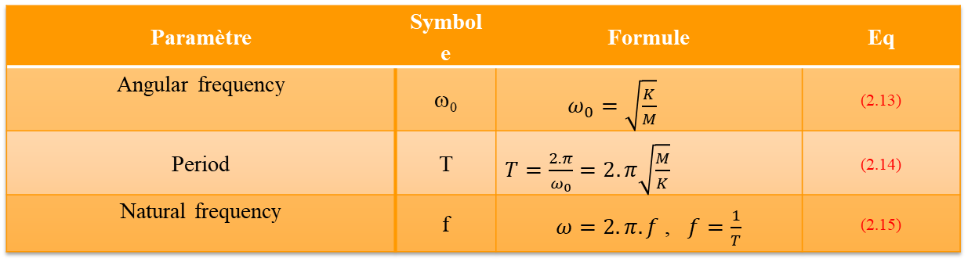
And we write x_{max} as : $x_{max}=ρ=\sqrt{{\left(x_{0}\right)}^{2}+{\left(\frac{{\dot{x}}_{0}}{ω}\right)}^{2}}$ (2.10)
Two other general solutions of the equation [(2.8)] are:
$x\left(t\right)=ρ.cos\left(ωt−α\right)$ et $x\left(t\right)=ρ.sin\left(ωt−β\right)$
Avec : $tg(α)=\frac{{\dot{x}}_{0}}{ω.x_{0}}$ (2.11) et $tg(β)=\frac{ω.x_{0}}{{\dot{x}}_{0}}$ (2.12)
Paramètre | Symbole | Formule | Eq
Angular frequency | ω₀ | $ω_{0}=\sqrt{\frac{K}{M}}$ | (2.13)
Period | T | $T=\frac{2.π}{ω_{0}}=2.π\sqrt{\frac{M}{K}}$ | (2.14)
Natural frequency | f | $ω=2.π.f$ , $f=\frac{1}{T}$ | (2.15)

Slide 7

III.2. Damped free vibration (c≠0):
We have : $M.\ddot{x}+C.\dot{x}+K.x=0$ (2.16)
The form of the solution depends on the damping coefficient c.
The exponential function : $x\left(t\right)=D.e^{q.t}$
The general homogeneous solution is:Eq.[(2.16)] == > $\left(m.q^{2}+c.q+k\right).D.e^{q.t}=0$
We have : (D≠0) et (e^{q.t} ≠0 ) == > $m.q^{2}+c.q+k=0$ (2.17)
This is the characteristic equation.
$x\left(t\right)=D_{1}.e^{q_{1}.t}+D_{2}.t.e^{q_{2}.t}$ (2.19)
The general solution l’éq.[(2.16)] is a superposition of the two possible solutions q1 and q2.. D₁ et D₂ are given by the initial conditions.
$q_{1,2}=−\frac{c}{2.m}±\frac{\sqrt{c^{2}−4.m.k}}{2.m}$ s$o{ q}_{1,2}=−\frac{c}{2.m}±\sqrt{{\left(\frac{c}{2.m}\right)}^{2}−{\left(ω_{0}\right)}^{2}}$ (2.18)
Three types of motion are possible:
${\left(\frac{c}{2.m}\right)}^{2}−{\left(ω_{0}\right)}^{2} \left\{\begin{aligned}>0 :Overdamped: \\ =0 :Critically damped \\ <0 :Under damped:\end{aligned}\right.,$

Slide 8

If we put : $ξ=\frac{c}{2.m.ω_{0}}$ , On peut écrire : $q_{1,2}=−ξ.ω_{0}±ω_{0}\sqrt{{\left(ξ\right)}^{2}−1}$ and we discuss ξ = 1 ; So :
ACritical Damping : ξ=1 or: ${\left(\frac{c}{2.m}\right)}^{2}−{\left(ω_{0}\right)}^{2}=0==> {\left(\frac{c}{2.m}\right)}^{2}−\frac{k}{m}=0$
$C_{cr}=2.\sqrt{k.m}$ (2.20) $et q_{1,2}=q=−ω_{0}$ (2.21)
La solution sera :
$x\left(t\right)=\left(D_{1}+D_{2}.t\right)e^{−ω_{0}.t}$ (2.22)
$\left\{\begin{aligned}x\left(t=0\right)=x_{0} \\ \dot{x}\left(t=0\right)={\dot{x}}_{0}\end{aligned}\right.==>on trouve :x\left(t\right)=\left[x_{0}\left(1+ω_{0}.t\right)+{\dot{x}}_{0}.t\right].e^{−ω_{0}.t}$ (2.23)
B/ Over-damped System : The response of an over-damped system is similar to the motion of a critically damped system, but the return to equilibrium position occurs more slowly since the damping is increased (C > C_{cr}). We define the damping ratio:
$ξ=\frac{C}{C_{cr}}$ (2.24) et $q_{1,2}=−ξ.ω_{0}±ω_{0}\sqrt{{\left(ξ\right)}^{2}−1}$
And we define : $ω_{D}=ω_{0}\sqrt{{\left(ξ\right)}^{2}−1}$ (2.25) $so, q_{1,2}=−ξ.ω_{0}±ω_{D}$ (2.26)
The general solution is:
$x\left(t\right)={D_{1}e}^{q_{1}.t}+{D_{2}e}^{q_{2}.t}$
$x\left(t\right)=e^{−ξ.ω_{0}.t}.\left[{D_{1}e}^{ω_{D}.t}+{D_{2}e}^{{−ω}_{D}.t}\right]$ (2.27)

Slide 9
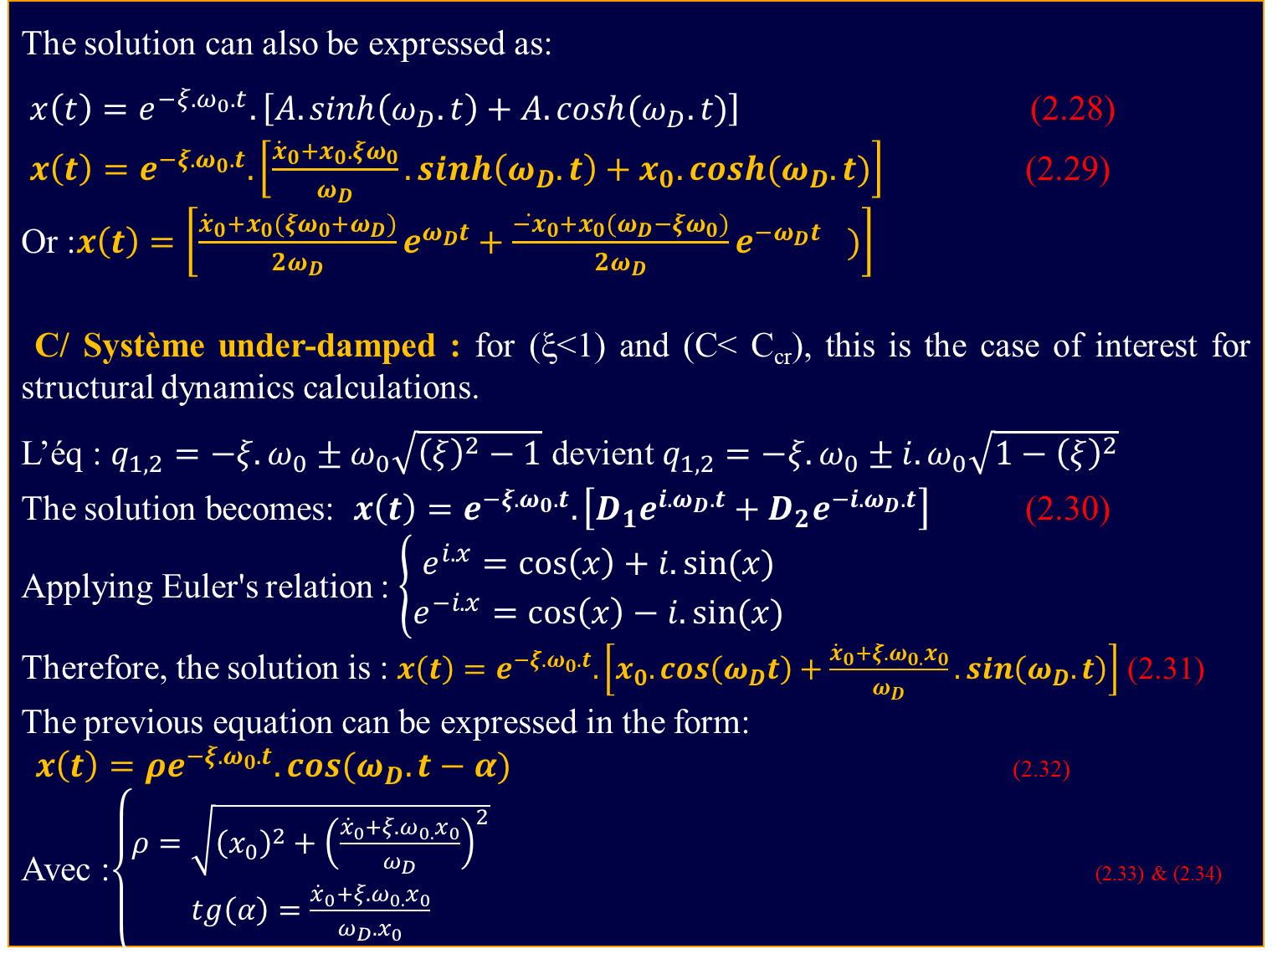
The solution can also be expressed as:
$x\left(t\right)=e^{−ξ.ω_{0}.t}.\left[A.sinh\left(ω_{D}.t\right)+A.cosh(ω_{D}.t)\right]$ (2.28)
$x\left(t\right)=e^{−ξ.ω_{0}.t}.\left[\frac{{\dot{x}}_{0}+x_{0}.ξω_{0}}{ω_{D}}.sinh\left(ω_{D}.t\right)+x_{0}.cosh(ω_{D}.t)\right]$ (2.29)
Or :$x\left(t\right)=\left[\frac{{\dot{x}}_{0}+x_{0}(ξω_{0}+ω_{D})}{{2ω}_{D}}e^{ω_{D}t}+{\frac{{\dot{−x}}_{0}+x_{0}(ω_{D}−ξω_{0})}{{2ω}_{D}}e^{−ω_{D}t}}_{})\right]$
C/ Système under-damped : for (ξ<1) and (C< C_{cr}), this is the case of interest for structural dynamics calculations.
L’éq : $q_{1,2}=−ξ.ω_{0}±ω_{0}\sqrt{{\left(ξ\right)}^{2}−1}$ devient $q_{1,2}=−ξ.ω_{0}±{i.ω}_{0}\sqrt{{1−\left(ξ\right)}^{2}}$
The solution becomes: $x\left(t\right)=e^{−ξ.ω_{0}.t}.\left[{D_{1}e}^{{i.ω}_{D}.t}+{D_{2}e}^{{−i.ω}_{D}.t}\right]$ (2.30)
Applying Euler's relation : $\left\{\begin{aligned}e^{i.x}=\cos\left(x\right)+i.sin⁡(x) \\ e^{−i.x}=\cos\left(x\right)−i.sin⁡(x)\end{aligned}\right.$
Therefore, the solution is : $x\left(t\right)=e^{−ξ.ω_{0}.t}.\left[x_{0}.cos\left(ω_{D}t\right)+\frac{{\dot{x}}_{0}+{ξ{.ω}_{0.}x}_{0}}{ω_{D}}.sin\left(ω_{D}.t\right)\right]$ (2.31)
The previous equation can be expressed in the form:
$x\left(t\right)=ρe^{−ξ.ω_{0}.t}. cos(ω_{D}.t−α)$ (2.32)
Avec :$\left\{\begin{aligned}ρ=\sqrt{{\left(x_{0}\right)}^{2}+{\left(\frac{{\dot{x}}_{0}+{ξ{.ω}_{0.}x}_{0}}{ω_{D}}\right)}^{2}} \\ tg\left(α\right)=\frac{{\dot{x}}_{0}+{ξ{.ω}_{0.}x}_{0}}{ω_{D}.x_{0}}\end{aligned}\right.$ (2.33) & (2.34)

Slide 10
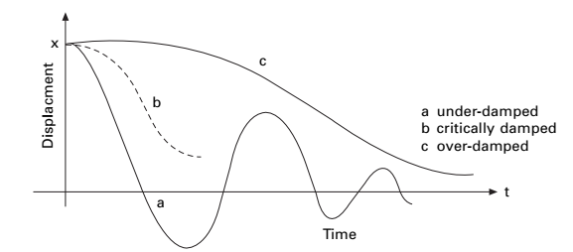
Fig.2.7- Response of critically damped and overdamped systems
Note: It can be observed that the motion is oscillatory but non-harmonic, meaning the vibration amplitude is not constant during the movement.
Logarithmic decrement:
A practical methd for the experimental determination of the damping factor x is the measurement of the decay rate of the amplitude of a damped system in free oscillation. Considering two successive peaks of the response xn and xn+1 and applying eq. [(2.31)]

Slide 11
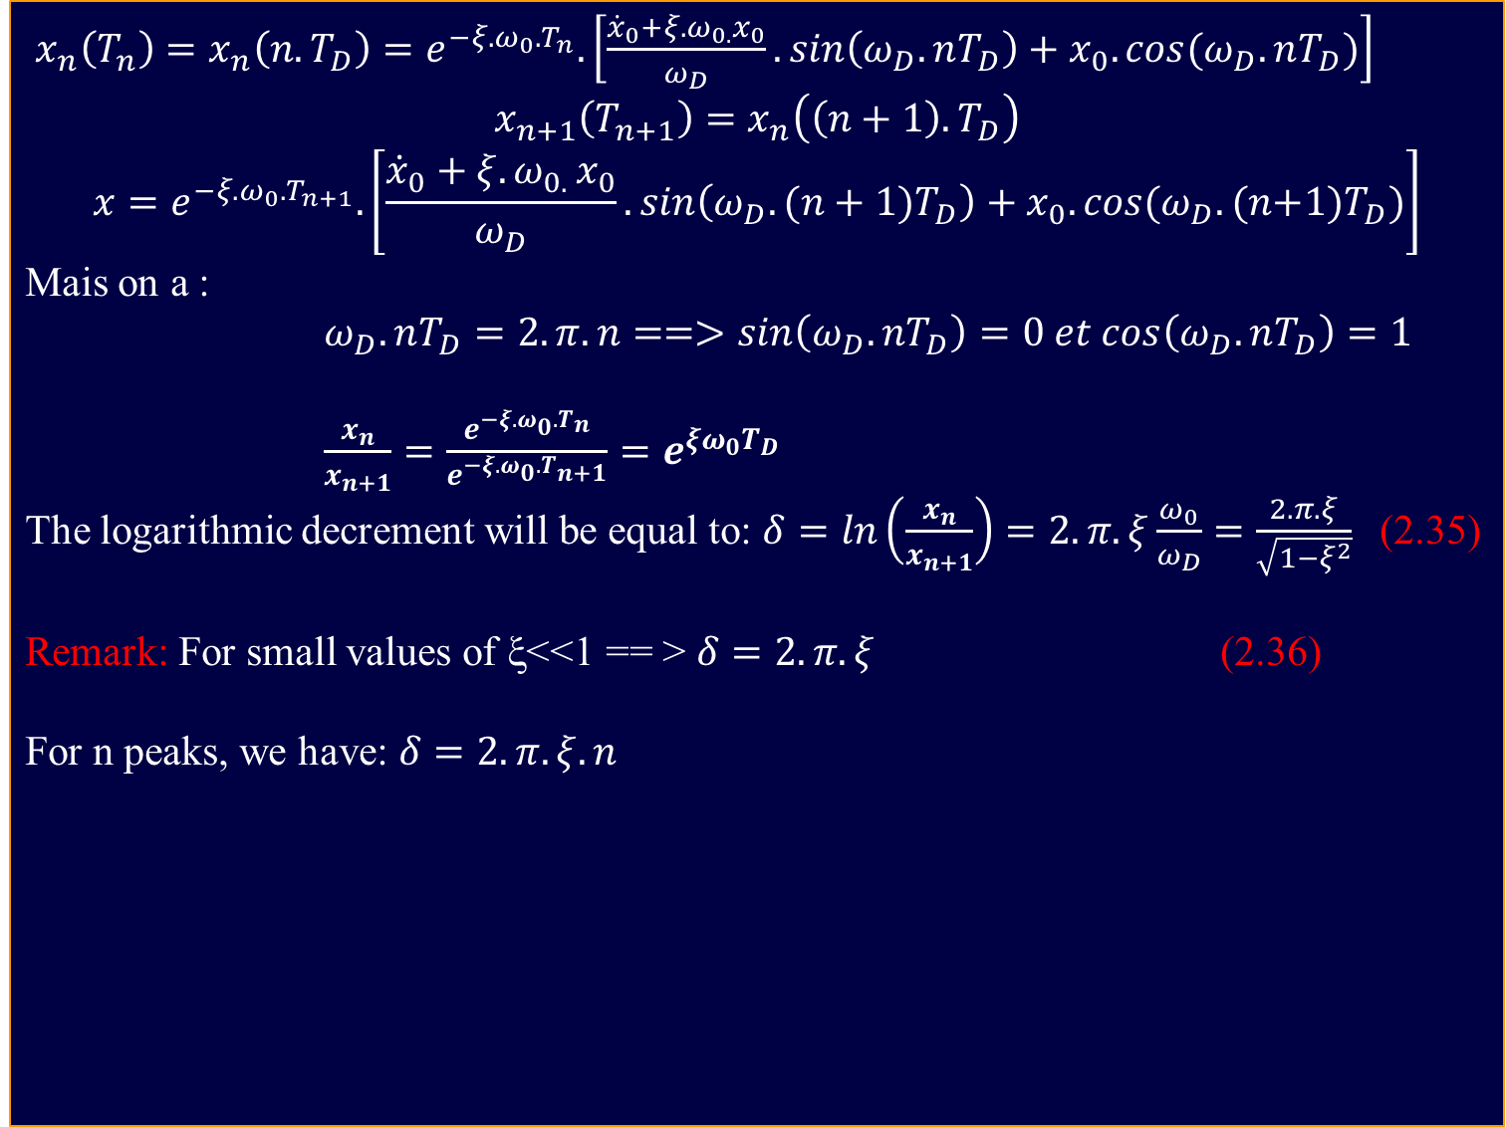
$x_{n}\left(T_{n}\right)=x_{n}\left(n.T_{D}\right)=e^{−ξ.ω_{0}.T_{n}}.\left[\frac{{\dot{x}}_{0}+{ξ{.ω}_{0.}x}_{0}}{ω_{D}}.sin\left(ω_{D}.nT_{D}\right)+x_{0}.cos(ω_{D}.nT_{D})\right]$
$$x_{n+1}\left(T_{n+1}\right)=x_{n}\left(\left(n+1\right).T_{D}\right)$$
$$x=e^{−ξ.ω_{0}.T_{n+1}}.\left[\frac{{\dot{x}}_{0}+{ξ{.ω}_{0.}x}_{0}}{ω_{D}}.sin\left(ω_{D}.(n+1)T_{D}\right)+x_{0}.cos(ω_{D}.(n{+1)T}_{D})\right]$$
Mais on a :
$ω_{D}.nT_{D}=2.π.n==>sin\left(ω_{D}.nT_{D}\right)=0 et cos\left(ω_{D}.nT_{D}\right)=1$
$\frac{x_{n}}{x_{n+1}}=\frac{e^{−ξ.ω_{0}.T_{n}}}{e^{−ξ.ω_{0}.T_{n+1}}}=e^{ξω_{0}T_{D}}$
The logarithmic decrement will be equal to: $δ=ln\left(\frac{x_{n}}{x_{n+1}}\right)=2.π.ξ\frac{ω_{0}}{ω_{D}}=\frac{2.π.ξ}{\sqrt{1−ξ^{2}}}$ (2.35)
Remark: For small values of ξ<<1 == > $δ=2.π.ξ$ (2.36)
For n peaks, we have: $δ=2.π.ξ.n$
Fig.2.8- Representation of an underdamped system

Slide 12
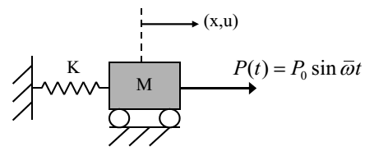
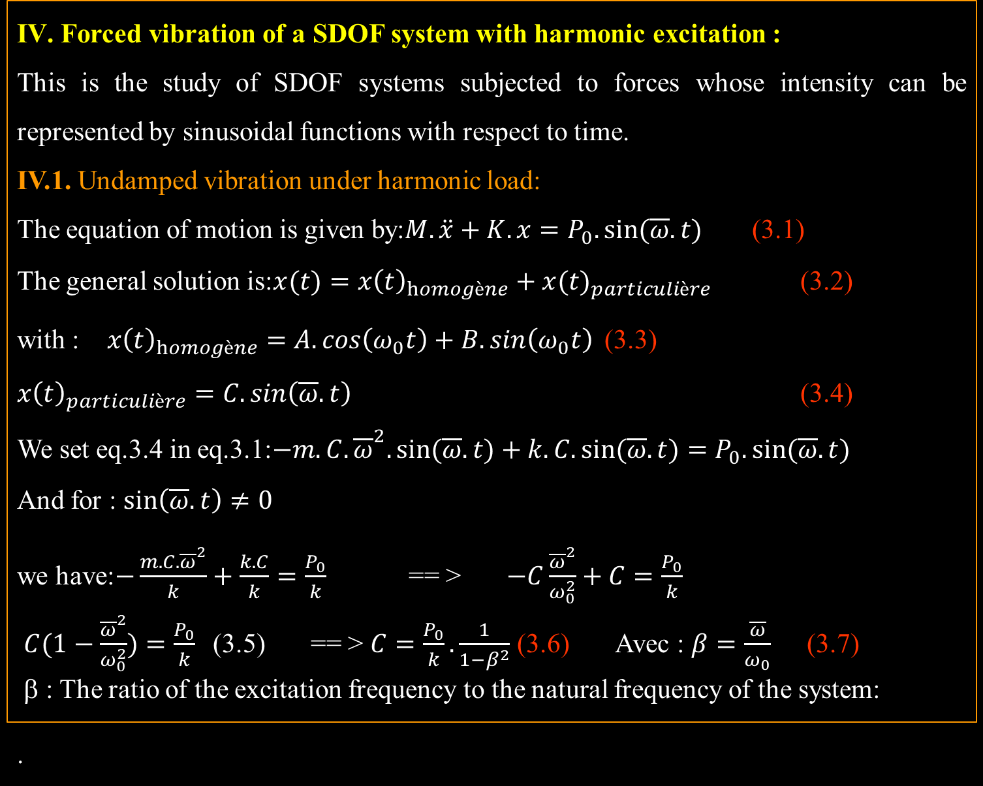
IV. Forced vibration of a SDOF system with harmonic excitation :
This is the study of SDOF systems subjected to forces whose intensity can be represented by sinusoidal functions with respect to time.
IV.1. Undamped vibration under harmonic load:
The equation of motion is given by:$M.\ddot{x}+K.x=P_{0}.sin⁡(\overline{ω}.t)$ (3.1)
The general solution is:$x(t)=x{\left(t\right)}_{homogène}+x{(t)}_{particulière}$ (3.2)
with : $x{\left(t\right)}_{homogène}=A.cos\left(ω_{0}t\right)+ B.sin\left(ω_{0}t\right)$ (3.3)
$x{\left(t\right)}_{particulière}=C.sin\left(\overline{ω}.t\right)$ (3.4)
We set eq.3.4 in eq.3.1:$−m.C.{\overline{ω}}^{2}.sin⁡(\overline{ω}.t)+k.C.sin⁡(\overline{ω}.t)=P_{0}.sin⁡(\overline{ω}.t)$
And for : $\sin\left(\overline{ω}.t\right)≠0$
we have: $−\frac{m.C.{\overline{ω}}^{2}}{k}+\frac{k.C}{k}=\frac{P_{0}}{k}$ == > $−C\frac{{\overline{ω}}^{2}}{ω_{0}^{2}}+C=\frac{P_{0}}{k}$
$C(1−\frac{{\overline{ω}}^{2}}{ω_{0}^{2}})=\frac{P_{0}}{k}$ (3.5) == > $C=\frac{P_{0}}{k}.\frac{1}{1−β^{2}}$ (3.6) Avec : $β=\frac{\overline{ω}}{ω_{0}}$ (3.7)
β : The ratio of the excitation frequency to the natural frequency of the system:
.

Slide 13
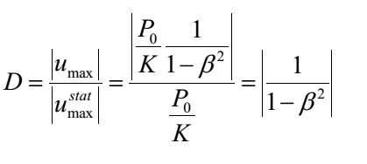

The general solution will be the superposition of two solutions:
$x\left(t\right)=A.cos\left(ω_{0}t\right)+B.sin\left(ω_{0}t\right)+ (\frac{P_{0}}{k}.\frac{1}{1−β^{2}}).sin\left(\overline{ω}.t\right)$ (3.8)
A and B will be given by the initial conditions.
if : $\left\{\begin{aligned}x\left(t=0\right)=0 \\ \dot{x}\left(t=0\right)=0\end{aligned}\right.==>\left\{\begin{aligned}A=0 \\ B=−\frac{P_{0.β}}{k}.\frac{1}{1−β^{2}}\end{aligned}\right.$ , The response is given by:
$x\left(t\right)=\frac{P_{0}}{k}.\frac{1}{1−β^{2}}.\left(sin\left(\overline{ω}.t\right)−β.sin\left(ω_{0}t\right)\right)$ (3.9) where :
$\frac{P_{0}}{k}$ : The static displacement is the displacement that would be produced by the force P0 applied statically:. $\frac{1}{1−β^{2}}$ : Dynamic amplification factor (D); representing the effect of dynamic amplification of the harmonic load.
Transient component depending on the initial conditions :(p(t))=0
Particular solution (steady –state) depending on the applied load

Slide 14

IV.2. Response of damped systems to harmonic loading:
The equation of motion can be written as::$M.\ddot{x}+C.\dot{x}+K.x=P_{0}.sin⁡(\overline{ω}.t)$ (3.10)
the solution takes the form: :$x(t)=x{\left(t\right)}_{homogène}+x{(t)}_{particulière \text{(}\text{3.12}\text{) }}$
as we have : $C_{cr}=2.\sqrt{k.m}=2.m.ω_{0}$ et $ξ=\frac{C}{C_{cr}}$ == > $C=2.m.ω_{0}.ξ$
We devided éq.(3.10) by m :$\ddot{x}+2.ω_{0}.ξ.\dot{x}+ω_{0}^{2}.x=\frac{P_{0}}{m}.sin⁡(\overline{ω}.t)$ (3.11)
$$\left\{\begin{aligned}x_{h}(t)=e^{−ξ.ω_{0}.t}.\left[A.cos⁡(ω_{D}.t)+B.sin\left(ω_{D}.t\right)\right] + (3.12) \\ x_{p}(t)=C_{1}.sin\left(\overline{ω}.t\right)+C_{2}.cos\left(\overline{ω}.t\right) (3.13)\end{aligned}\right.$$
We substitute éq.(3.13) in l’éq.(3.11), we have :
$$\left({−C}_{1}.{\overline{ω}}^{2}.sin\left(\overline{ω}.t\right)−C_{2}.{\overline{ω}}^{2}.cos\left(\overline{ω}.t\right)\right)+2.ω_{0}.ξ\left(C_{1}.\overline{ω}.cos\left(\overline{ω}.t\right)−2.ω_{0}.ξC_{2}.\overline{ω}.sin\left(\overline{ω}.t\right)\right)+ C_{1}.ω_{0}^{2}.sin\left(\overline{ω}.t\right)+C_{2}.ω_{0}^{2}.cos\left(\overline{ω}.t\right)=\frac{P_{0}}{m}.sin⁡(\overline{ω}.t)$$
$sin\left(\overline{ω}.t\right)\left[{−C}_{1}{\overline{ω}}^{2}−2ω_{0}ξC_{2}\overline{ω}+C_{1}.ω_{0}^{2}−\frac{P_{0}}{m}\right]+cos\left(\overline{ω}.t\right)\left[{−C}_{2}{\overline{ω}}^{2}+2ω_{0}ξC_{1}\overline{ω}+{C_{2}ω}_{0}^{2}\right]=0$
This equation is null if : $\left\{\begin{aligned}{−C}_{1}{\overline{ω}}^{2}−2ω_{0}ξC_{2}\overline{ω}+C_{1}.ω_{0}^{2}=\frac{P_{0}}{m} \\ {−C}_{2}{\overline{ω}}^{2}+2ω_{0}ξC_{1}\overline{ω}+{C_{2}ω}_{0}^{2}=0\end{aligned}\right.$
$\left\{\begin{aligned}C_{1}\left(ω_{0}^{2}−{\overline{ω}}^{2}\right)−2{ξω}_{0}\overline{ω}C_{2}=\frac{P_{0}}{m} \\ 2{ξω}_{0}{\overline{ω}C}_{1}+C_{2 }\left(ω_{0}^{2}{−\overline{ω}}^{2}\right)=0\end{aligned}\right. (3.14)$

Slide 15

$\left\{\begin{aligned}C_{1}=\frac{P_{0}}{k}\frac{1−β^{2}}{{\left(1−β^{2}\right)}^{2}+{\left(2ξβ\right)}^{2}} \\ C_{2}=−\frac{P_{0}}{k}\frac{2ξβ}{{\left(1−β^{2}\right)}^{2}+{\left(2ξβ\right)}^{2}} \end{aligned}\right. (3.15)$
Therefore, the solution becomes :$x\left(t\right)=e^{−ξ.ω_{0}.t}.\left[A.cos(ω_{D}.t)+B.sin\left(ω_{D}.t\right)\right]+$ $\frac{P_{0}}{k}\frac{1}{{\left(1−β^{2}\right)}^{2}+{\left(2ξβ\right)}^{2}}\left[(1−β^{2})sin\left(\overline{ω}.t\right)−2ξβcos\left(\overline{ω}.t\right)\right]$ (3.16)
Remark:
The first part represents the transient motion which is a damped motion (presence of ω_{D} means it will disappear rapidly over time).
The permanent motion occurs at the same frequency $\overline{ω}$ as the excitation force but with a phase angle.
Equation (3.16) can be written as follows:
$x\left(t\right)=\frac{e^{−ξ.ω_{0}.t}.\left[A.cos(ω_{D}.t)+B.sin\left(ω_{D}.t\right)\right]}{m^{vt} transitoire}+\frac{ρsin\left(\overline{ω}.t−θ\right)}{m^{vt} permanent}$ (3.17)
$$ρ=\frac{P_{0}}{k}\frac{1}{{\left(1−β^{2}\right)}^{2}+{\left(2ξβ\right)}^{2}}.\sqrt{{\left(1−β^{2}\right)}^{2}+{\left(2ξβ\right)}^{2}}$$
$ρ=\frac{P_{0}}{k}\frac{1}{\sqrt{{\left(1−β^{2}\right)}^{2}+{\left(2ξβ\right)}^{2}}}$ (3.18)
$tg\left(θ\right)=−\frac{2ξβ}{1−β^{2}}$ (we have phase lag$−2ξβ$) (3.19)

Slide 16
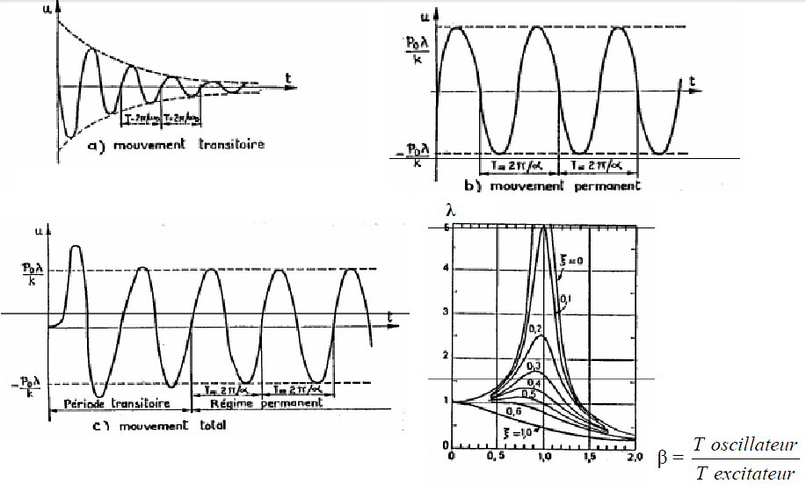

the equation (3.17) : $ρ=\frac{P_{0}}{k}\frac{1}{\sqrt{{\left(1−β^{2}\right)}^{2}+{\left(2ξβ\right)}^{2}}}$ et $tg\left(θ\right)=\frac{2ξβ}{1−β^{2}}$
We put : $λ=\frac{ρ}{\frac{P_{0}}{k}}=\frac{1}{\sqrt{{\left(1−β^{2}\right)}^{2}+{\left(2ξβ\right)}^{2}}}$ (3.20)
The ratio of the amplitude of the permanent state response to the static displacement that would be produced by the force P0 is called the dynamic amplification factor. As can be seen from eq.(3.17), the curve of the total motion can be obtained by summing the product of the transient motion curve with the permanent state motion curve.

Slide 17

IV.4. Résonance :
According to the formula (3.20) : $λ=\frac{1}{\sqrt{{\left(1−β^{2}\right)}^{2}+{\left(2ξβ\right)}^{2}}}$ == > $λ=f(ξ,β)$
The effect of resonance produced in the case: $\frac{\overline{ω}}{ω}=1==> β=1$
So we have: $λ=\frac{1}{2ξ}$ we search: λ_{max} :$\frac{dλ}{dβ}={\left(\frac{1}{\sqrt{{\left(1−β^{2}\right)}^{2}+{\left(2ξβ\right)}^{2}}}\right)}^{′}=0$ == >
$$\frac{dλ}{dβ}={\frac{1}{2}\left(\frac{1}{\sqrt{{\left(1−β^{2}\right)}^{2}+{\left(2ξβ\right)}^{2}}}\right)}^{−3/2}.\left[2\left(1−β^{2}\right)\left(−2β\right)+2\left(2ξβ\right)2ξ\right]=0$$
== > $−4β\left(1−β^{2}\right)+{8\left(ξ\right)}^{2}β=0$ == > $4β\left[2ξ^{2}−\left(1−β^{2}\right)\right]=0$
$\left\{\begin{aligned}β=0 \\ 2ξ^{2}=1−β^{2}\end{aligned}\right.$ == > $\left\{\begin{aligned}β=0 \\ β=\sqrt{1−2ξ^{2}}\end{aligned}\right.$
β Define when : $1−2ξ^{2}>0$ == > $ξ<\frac{1}{\sqrt{2}}=0.707$
Remark : For low damping, there is very little difference between λ_{max} et λ_{Résonance} (β=1).

Slide 18
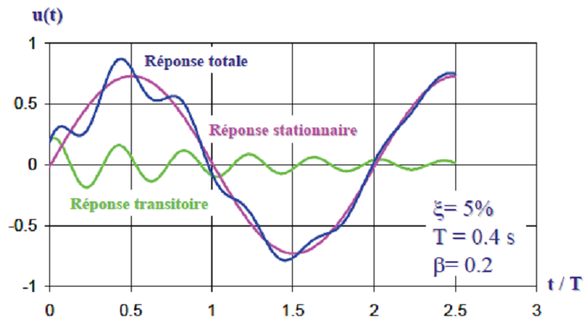
Remark : If the system enters resonance, the consequences can be serious. Two well-known cases are:
On April 18, 1850, in Angers, France, a regiment marching in step (harmonically) across a suspension bridge over the Maine River caused it to collapse.
On November 7, 1940, six months after its inauguration, the Tacoma Narrows Bridge in the United States was destroyed by the effects of gusts of wind that, while not particularly violent (60 km/h), were regular

Slide 19
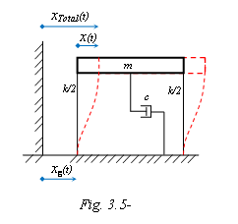

VI.2.3Response of the motion of a base (support) :
x_{g} : Displacement of the support (soil in the case of an earthquake)
x : Relative displacement of the structure.
x_{t} : Total displacement of the structure.
a/ Equation of motion as a function of total displacement :
Alembert's principle :$m.{\ddot{x}}_{t}+c.\left({\dot{x}}_{t}−{\dot{x}}_{g}\right)+k.(x_{t}−x_{g})=0$ (3.21)
$m.{\ddot{x}}_{t}+c.{\dot{x}}_{t}+k.x_{t}=c{.\dot{x}}_{g}+k.x_{g}$ (3.22) Therefore, we represent the excitation of the support as an external harmonic force: $x_{g}\left(t\right)=x_{g0}.sin\left(\overline{ω}.t\right)$ On aura :$m.{\ddot{x}}_{t}+c.{\dot{x}}_{t}+k.x_{t}=c\overline{ω}x_{g0}.cos\left(\overline{ω}.t\right)+$ $k.x_{g0}.sin\left(\overline{ω}.t\right)$ (3.23)
Et comme : $\sin\left(a+b\right)=sin⁡(a).cos⁡(b)+cos⁡(a).sin⁡(b)$
So : $m.{\ddot{x}}_{t}+c.{\dot{x}}_{t}+k.x_{t}=P_{0}.sin\left(\overline{ω}.t+γ\right)$ (3.24)
$tg\left(γ\right)=\frac{c\overline{ω}x_{g0}}{k.x_{g0}}=\frac{c\overline{ω}}{k}=\left(2mω_{0}ξ\right)\frac{\overline{ω}}{k}=2ω_{0}ξ\frac{\overline{ω}}{ω_{0}^{2}}$ == > $tg\left(γ\right)=2ξβ$
$P_{0}=\sqrt{{\left(k.x_{g0}\right)}^{2}+{\left(c\overline{ω}x_{g0}\right)}^{2}}=x_{g0}\sqrt{{\left(k\right)}^{2}+{\left(c\overline{ω}\right)}^{2}}$ == > $P_{0}=x_{g0}\sqrt{1+{\left(2ξβ\right)}^{2}}$
$x_{t}\left(t\right)=\left(Transient response≈0\right)+(Permanent$ response)

Slide 20

The permanent response of the system is given by(3.17) $x_{t.p}(t)=ρ.sin\left(\overline{ω}.t+γ−θ\right)$
$x_{t.p}(t)=\frac{P_{0}}{k.\sqrt{{\left(1−β^{2}\right)}^{2}+{\left(2ξβ\right)}^{2}}}.sin\left(\overline{ω}.t+γ−θ\right)$
so : $x_{t.p}(t)=\frac{x_{g0}\sqrt{1+{\left(2ξβ\right)}^{2}}}{k.\sqrt{{\left(1−β^{2}\right)}^{2}+{\left(2ξβ\right)}^{2}}}.sin\left(\overline{ω}.t+γ−θ\right)$ (3.25)
"The response of a single degree of freedom system subjected to harmonic ground displacement is equivalent to the response of a single degree of freedom system subjected to a force directly applied to the mass.
b/ Equation of motion as a function of relative displacement :
$m.{(\ddot{x}+\ddot{x}}_{g})+c.\dot{x}+k.x=0$ == > $m. \ddot{x}+c.\dot{x}+k.x={−m.\ddot{x}}_{g}$ (3.26)
Assuming : $x_{g}\left(t\right)=x_{g0}.sin\left(\overline{ω}.t\right)$ Donc l’éq.(3.26) devient : $m. \ddot{x}+c.\dot{x}+k.x=m.{\overline{ω}}^{2}x_{g0}.sin\left(\overline{ω}.t\right)$ The steady-state response is given by:
$x_{t.p}(t)=ρ.sin\left(\overline{ω}.t−θ\right)$ Avec : $ρ=\frac{P_{0}}{k}\frac{1}{\sqrt{{\left(1−β^{2}\right)}^{2}+{\left(2ξβ\right)}^{2}}}$ et on a :
$\frac{P_{0}}{k}=\frac{m.{\overline{ω}}^{2}x_{g0}}{k}=\frac{{\overline{ω}}^{2}}{ω_{0}^{2}}x_{g0}$ == > $\frac{P_{0}}{k}=β^{2}x_{g0}$ (3.27)
so : $x_{t.p}(t)=\frac{β^{2}x_{g0}}{.\sqrt{{\left(1−β^{2}\right)}^{2}+{\left(2ξβ\right)}^{2}}}.sin\left(\overline{ω}.t−θ\right)$ (3.28)
$x_{t.p}(t)={λβ}^{2}x_{g0}.sin\left(\overline{ω}.t−θ\right)$ (3.29)
P0

Slide 21
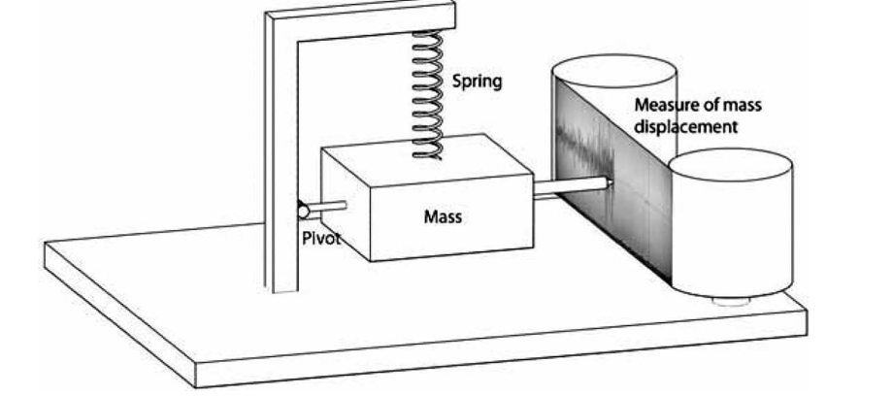

IV.5. Seismic instrumentation :
IV.5.1. Seismograph: The relative displacement between the mass and the support is recorded by an instrument called a seismograph;
this very sensitive instrument is intended to record
the shape, duration, and amplitude of earthquakes
Relative displacement :
$ρ=\frac{β^{2}x_{g0}}{.\sqrt{{\left(1−β^{2}\right)}^{2}+{\left(2ξβ\right)}^{2}}} ==> \frac{ρ}{x_{g0}}=f(β)$
Response of a seismograph to base displacement
Remark : For : $\left\{\begin{aligned}β>1 \\ ξ=0.5\end{aligned} ==> \frac{ρ}{x_{g0}}=1\right.$
In the above figure we see that the amplitude of the response (ρ/x_{g0}) is constant for frequency ratios β>1 and a damping coefficient ξ=0.5, Consequently, the response of this type of properly damped instrument is proportional to the ground motion amplitude for frequencies higher than the support motion.. The application domain of this instrument can be widened by reducing the frequency ω₀ (either k↓ or m↑ with : ω₀² = k/m)

Slide 22
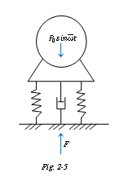

IV.5.2Vibration isolation :There are two types of isolation:
1/ A vibrating machine transmits undesirable vibrations to the supporting structure that can lead to its rupture. This is the case with a poorly balanced motor.
2/ Fragile instruments are supported by a structure that vibrates excessively.
a/ Vibrating (rotating) machine :Taking the case of a poorly balanced rotating machine on a single degree of freedom support of spring-damper type. This machine produces a vertical alternating force: :P(t) = P₀sin (ωt)
Its steady-state displacement is given by Breaking it down :
$x\left(t\right)=\frac{P_{0}}{k}λsin\left(\overline{ω}t−θ\right)$ Avec :$λ=\frac{1}{.\sqrt{{\left(1−β^{2}\right)}^{2}+{\left(2ξβ\right)}^{2}}}$
$F_{k}=k.x\left(t\right)=P_{0}λsin\left(\overline{ω}t−θ\right)$ et $F_{a}=c.\dot{x}\left(t\right)=c\frac{P_{0}}{k}λ\overline{ω}cos\left(\overline{ω}t−θ\right)$ $F_{a}=2ξβP_{0}λcos\left(\overline{ω}t−θ\right) avec : 2ξβ=c\frac{\overline{ω}}{k}$ $Fmax where : Fmax=\sqrt{{\left(F_{k}\right)}^{2}+{\left(F_{a}\right)}^{2}}=\sqrt{{\left(P_{0}λ\right)}^{2}+{\left(2ξβP_{0}λ\right)}^{2}}$
The ratio of the maximum force at the base and the amplitude of the applied force P0, which we call the transmissibility of the support, is given by:
$T_{R}=\frac{F_{max}}{P_{0}}=λ\sqrt{1+{\left(2ξβ\right)}^{2}}=\frac{\sqrt{1+{\left(2ξβ\right)}^{2}}}{\sqrt{{\left(1−β^{2}\right)}^{2}+{\left(2ξβ\right)}^{2}}}$ Avec T_{R} : is a function of β et de ξ.

Slide 23
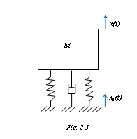

b/ Vibrating support: The mass m to be isolated is supported by a system
(K-C) on a slab subjected to harmonic vertical movements,
Definition: the transmissibility is the ratio of the amplitude of the mass
Movement and the amplitude of the base movement:$T_{R}=\frac{F_{max}}{P_{0}}=λ\sqrt{1+{\left(2ξβ\right)}^{2}}$
Remark: When calculating a vibration isolation system, it is convenient to express its behavior in terms of its effectiveness defined as: 1-T_{R}
The isolation system only works well for : ($β>\sqrt{2}$) .
V. Periodic excitations (special and general):
V.1. Principle of superposition: The principle of superposition can only be applied if the structure varies linearly with respect to the quantity studied (displacement, rotation, etc.). The total displacement due to a number of forces acting simultaneously on a structure is equal to the sum of the displacements due to each force acting separately.$δA= δA_{1}+δA_{2}$
$$P=K.x ==>K=\frac{P}{x} rigidity$$
$x=f.P ==>f=\frac{x}{P} Flexibility$

Slide 24

V.2. Réponse d’un SSDDL à une excitation périodique(anharmonique) : All periodic loading functions encountered in dynamics can be expanded into a series of trigonometric functions (called Fourier series).
Fourier series$: P\left(t\right)= \sum{\left(\sin\left(\overline{ω}t\right)+cos⁡(\overline{ω}t)\right)}$
Fourier demonstrated that a periodic function can be
expressed as the sum of an infinite number of sine and cosine functions.
$P\left(t\right)=a_{0}+a_{1}cos\left(\overline{ω}t\right)+a_{2}\cos\left(2\overline{ω}t\right)+…+a_{n}\cos\left(n\overline{ω}t\right)+b_{1}sin\left(\overline{ω}t\right)+b_{2}sin\left(2\overline{ω}t\right)+…+b_{n}sin\left(n\overline{ω}t\right)$Avec : $\overline{ω}=\frac{2π}{T_{p}} donc :P\left(t\right)=a_{0}+\sum_{n=1}^{∞}{\left[a_{n}\cos\left(n\overline{ω}t\right)+b_{n}\sin\left(n\overline{ω}t\right)\right]}$
The dynamic response of a system to a periodic load is therefore equivalent to the summation of the system's responses to forces of different amplitudes but all varying according to harmonic functions.
$P\left(t\right)=a_{0}+\sum_{n=1}^{∞}{\left[a_{n}\cos\left(\frac{2πn}{T_{p}}t\right)+b_{n}\sin\left(\frac{2πn}{T_{p}}t\right)\right]}$ (4.1) $\left\{\begin{aligned}a_{0}=\frac{1}{T_{p}}\int_{0}^{T_{p}}{P\left(t\right)dt} \\ a_{n}=\frac{2}{T_{p}}\int_{0}^{T_{p}}{P\left(t\right)cos⁡(n\overline{ω}t)dt} \\ b_{n}=\frac{2}{T_{p}}\int_{0}^{T_{p}}{P\left(t\right)sin⁡(n\overline{ω}t)dt}\end{aligned}\right.$ (4.2) $\left\{\begin{aligned}M.\ddot{x}+C.\dot{x}+K.x=a_{0} \\ M.\ddot{x}+C.\dot{x}+K.x=\sum{a_{n}\left(cos⁡(n\overline{ω}t)\right)} \\ M.\ddot{x}+C.\dot{x}+K.x=.=\sum{b_{n}\left(sin⁡(\overline{nω}t)\right)}\end{aligned}\right.$

Slide 25
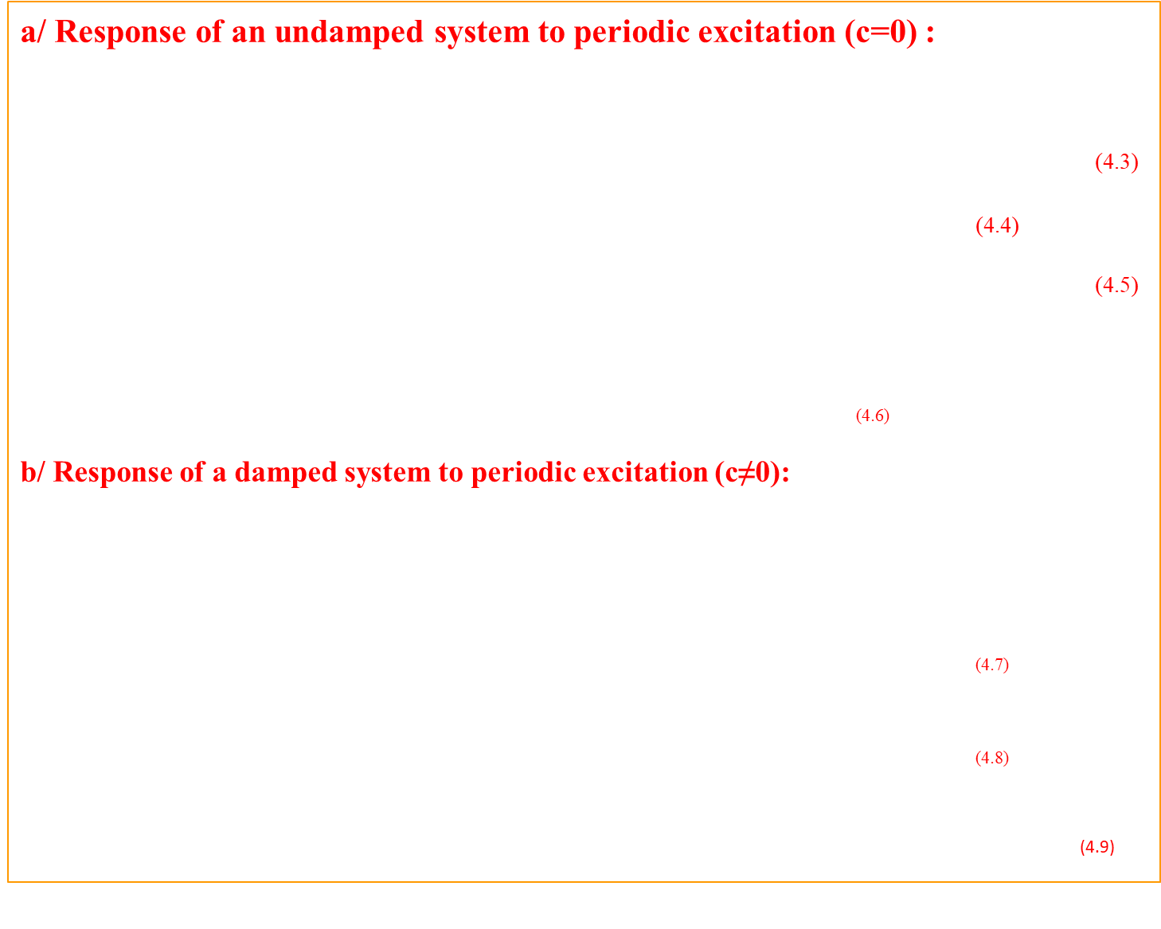
a/ Response of an undamped system to periodic excitation (c=0) :
$x\left(t\right)=A.sin\left(ωt\right)+B.cos\left(ωt\right)+\frac{p_{0}}{k}\frac{1}{1−β^{2}}sin⁡(\overline{ω}t)$
Sinus part : $P\left(t\right)=b_{n}\sin\left(n\overline{ω}t\right)==>x\left(t\right)=\frac{b_{n}}{k}\frac{1}{1−β^{2}}sin⁡(n\overline{ω}t)$ (4.3)
cosinus part: $P\left(t\right)=a_{n}\cos\left(n\overline{ω}t\right)==>x\left(t\right)=\frac{a_{n}}{k}\frac{1}{1−β^{2}}cos⁡(n\overline{ω}t)$ (4.4)
constant part : $P\left(t\right)=a_{0} ==>x\left(t\right)=\frac{a_{0}}{k}$ (4.5)
We put : $β_{n}=n\frac{\overline{ω}}{ω_{0}}=nβ_{1}$ ; The steady state response of a system to periodic excitation is given by:$x\left(t\right)=\frac{1}{k}\left[a_{0}+\sum_{n=1}^{∞}{\frac{1}{1−β_{n}^{2}}\left[a_{n}\cos\left(n\overline{ω}t\right)+b_{n}\sin\left(n\overline{ω}t\right)\right]}\right]$ (4.6)
b/ Response of a damped system to periodic excitation (c≠0):
$P\left(t\right)=a_{0}+\sum_{n=1}^{∞}{\left[a_{n}\cos\left(n\overline{ω}t\right)+b_{n}\sin\left(n\overline{ω}t\right)\right]}$
The total steady state response will be given by the superposition expressed by:
sinus : $x_{n,s}\left(t\right)=\frac{b_{n}}{k}\frac{1}{{\left(1−β_{n}^{2}\right)}^{2}+{\left(2ξβ_{n}\right)}^{2}}\left[\left(1−β_{n}^{2}\right)\sin\left(n\overline{ω}t\right)−2ξβ_{n}cos⁡(n\overline{ω}t)\right]$ (4.7)
cosinus : $x_{n,c}\left(t\right)=\frac{a_{n}}{k}\frac{1}{{\left(1−β_{n}^{2}\right)}^{2}+{\left(2ξβ_{n}\right)}^{2}}\left[\left(1−β_{n}^{2}\right)\cos\left(n\overline{ω}t\right)+2ξβ_{n}sin⁡(n\overline{ω}t)\right]$ (4.8)
$x\left(t\right)=\frac{1}{k}\left[a_{0}+\sum_{n=1}^{∞}{\frac{1}{{\left(1−β_{n}^{2}\right)}^{2}+{\left(2ξβ_{n}\right)}^{2}}\left\{\left[a_{n}2ξβ_{n}+b_{n}\left(1−β_{n}^{2}\right)\right]\sin\left(n\overline{ω}t\right)+ \left[a_{n}\left(1−β_{n}^{2}\right)+b_{n}2ξβ_{n}\right]\cos\left(n\overline{ω}t\right)\right\}}\right]$ (4.9)

Slide 26

V.3. Response of an SSDDL to an impulsive load overlay: non-periodic
Impulse, impact or shock: sudden application of a force F(t) of short duration. A force can be considered impulsive if the duration of application of the force is much less than the natural period of the system. t1<<<T. In practice: 0.001s <t1< 0.01s
Then the impulse can be treated as a sudden change in velocity.
In other words, the system does not have time to react during the
time interval (so the system is considered undamped).
Rectangular pulse force :
Phase I: loading and Phase II: free vibration
Phase I :0 ≤ t ≤ t₁ (loading)
$M\ddot{x}+Kx=P_{0}==>x\left(t\right)=x_{h}(t)+x_{p}(t)$ $\left\{\begin{aligned}x_{h}\left(t\right)=A.cos\left(ω_{0}t\right)+B.sin(ω_{0}t) \\ x_{p}\left(t\right)=\frac{P_{0}}{K}\end{aligned}\right.$
$x\left(t\right)=A.cos\left(ω_{0}t\right)+B.sin\left(ω_{0}t\right)+\frac{P_{0}}{K}$ (4.10); By substituting the initiales Conditions :
$x\left(t=0\right)=0 ; \dot{x}\left(t=0\right)=0$ in 4-10, we obtain: $x\left(t\right)=\frac{P_{0}}{K}\left(1−cos\left(ω_{0}t\right)\right)$
Phase II :The system is in free vibration ; t ≥ t₁ ; on pose : t’ = t - t₁
$x\left(t′\right)=A.cos\left(ω_{0}t′\right)+B.sin\left(ω_{0}t′\right);$ Eq. (4.11) == > $x\left(t\right)=x(t_{1}).cos\left(ω_{0}t′\right)+\frac{\dot{x}(t_{1})}{ω_{0}}.sin\left(ω_{0}t′\right)$ (412) initiales Conditions :$x\left(t=t_{1}\right)=x_{0} ; \dot{x}\left(t=t_{1}\right)={\dot{x}}_{0}$

Slide 27

$x\left(t\right)=x_{0}.cos\left(ω_{0}t′\right)+\frac{{\dot{x}}_{0}}{ω_{0}}.sin\left(ω_{0}t′\right)$ (4.13)
The maximum response will occur in phase I :
if the time (t₁≥T/2), in this case the dynamic amplification factor will be equal to:
$D=\frac{x_{max}}{\frac{P_{0}}{K}}$ avec : $\left(\frac{P_{0}}{K}=x_{statique}\right)$ et $x_{max}=x\left(t=\frac{T}{2}\right)=2\frac{P_{0}}{K} ==>D=2\frac{\frac{P_{0}}{K}}{\frac{P_{0}}{K}} ==>D=2$
if the time (t₁<T/2), == > x_{max} (phase II) : $D=\frac{x_{max}}{x_{statique}}$ avec (éq.(4.12) : $x_{max}=\sqrt{{\left(\frac{\dot{x}(t_{1})}{ω_{0}}\right)}^{2}+{\left(x(t_{1})\right)}^{2}}$
$x\left(t_{1}\right)=\frac{P_{0}}{K}\left(1−cos⁡(ω_{0}t_{1}\right) ; \dot{x}\left(t_{1}\right)=\frac{P_{0}}{K}ω_{0}sin⁡(ω_{0}t_{1})$
$x_{max}=\frac{P_{0}}{K}\sqrt{\sin^{2}\left(ω_{0}t_{1}\right)+1−2cos\left(ω_{0}t_{1}\right)+\cos^{2}\left(ω_{0}t_{1}\right)}$
$x_{max}=\frac{P_{0}}{K}\sqrt{2\left(1−cos\left(ω_{0}t_{1}\right)\right)}$
with : $cos2α=1−2\sin^{2}α ==> 2\sin^{2}α=1−cos2α$
$x_{max}=\frac{P_{0}}{K}\sqrt{4\sin^{2}{\frac{ω_{0}}{2}t_{1}}}=\frac{{2P}_{0}}{K}.sin⁡(\frac{ω_{0}}{2}t_{1})$
$D=\frac{x_{max}}{x_{statique}}=2.\sin\left(\frac{ω_{0}}{2}t_{1}\right)=2.sin⁡(\frac{π}{T}t_{1})$ (4.14)

Slide 28
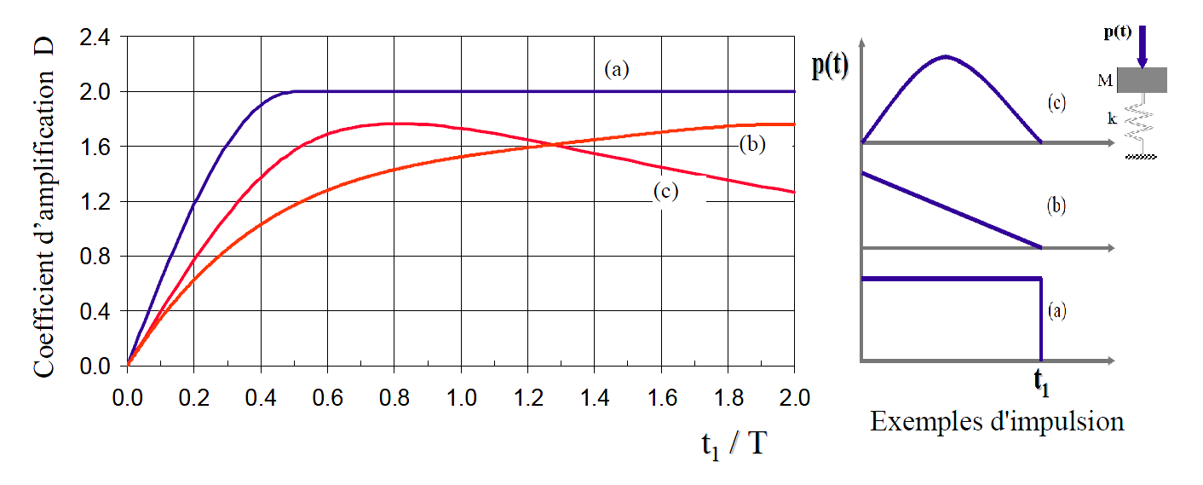

2/Triangular Pulse: $P(t)=P_{0}\left(1−t/{t_{1}}\right)$
Phase I :0 ≤ t ≤ t₁ (loading)
$x\left(t\right)=x_{h}\left(t\right)+x_{p}\left(t\right) et$ $x_{p}\left(t\right)=\frac{P_{0}}{K}\left(1−t/{t_{1}}\right)$
$x\left(t\right)=A.cos\left(ω_{0}t\right)+B.sin\left(ω_{0}t\right)+\frac{P_{0}}{K}\left(1−t/{t_{1}}\right)$
Initial conditions, the system initially at rest: $x\left(t=0\right)=0 ; \dot{x}\left(t=0\right)=0.$By substituting in the equation, we obtain : $x\left(t\right)=\frac{P_{0}}{K}\left(\frac{1}{ω_{0}t_{1}}sin\left(ω_{0}t\right)−cos\left(ω_{0}t\right)−t/{t_{1}}+1\right)$ (4.15)
Phase II :
$x\left(t\right)=x(t_{1}).cos\left(ω_{0}t\right)+\frac{\dot{x}(t_{1})}{ω_{0}}.sin\left(ω_{0}t\right)$ Avec : $x\left(t_{1}\right) et \dot{x}\left(t_{1}\right) suivant éq.(4.15)$
$x\left(t_{1}\right)=\frac{P_{0}}{K}\left(\frac{1}{ω_{0}t_{1}}sin\left(ω_{0}t_{1}\right)−cos\left(ω_{0}t_{1}\right)\right) ;$ $\dot{x}\left(t_{1}\right)=\frac{P_{0}ω_{0}}{K}\left(\frac{1}{ω_{0}t_{1}}cos\left(ω_{0}t_{1}\right)+sin\left(ω_{0}t_{1}\right)−\frac{1}{ω_{0}t_{1}}\right)$
Si : $\frac{t_{1}}{T}≥0.4$ The maximum response is found in phase I. == > $D=\frac{x_{max}}{x_{statique}}=\frac{x_{max}}{{P_{0}}/K}$
Si : $\frac{t_{1}}{T}<0.4$ The maximum response is found in phase II.

Slide 29
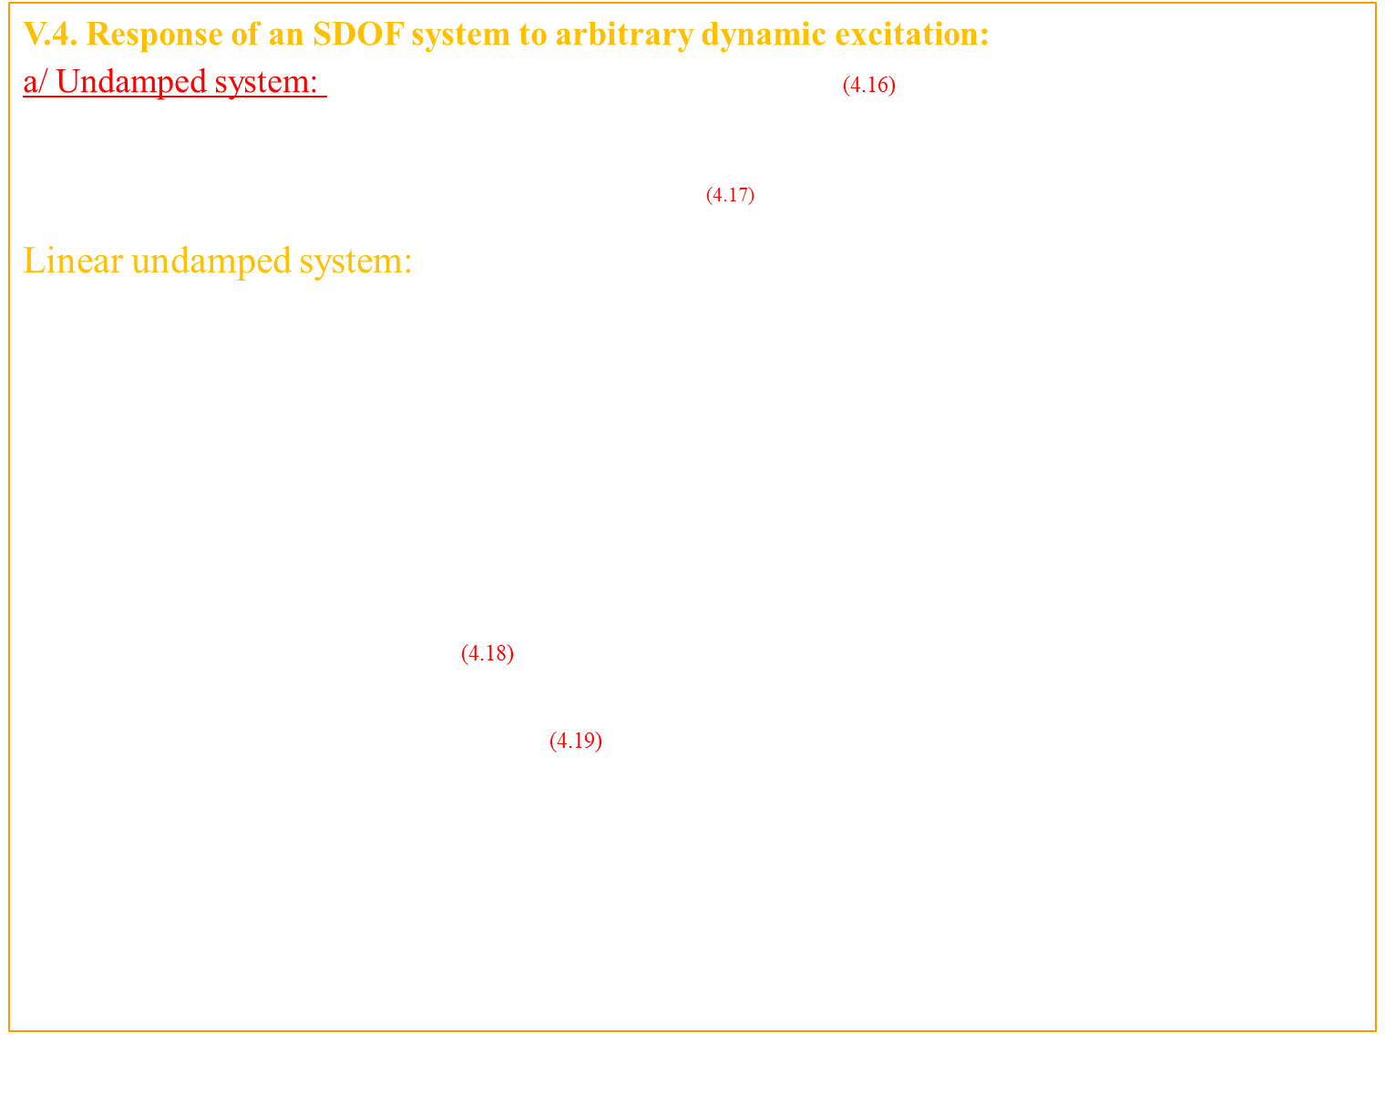
V.4. Response of an SDOF system to arbitrary dynamic excitation:
a/ Undamped system: Impulse = force * time = P(τ)*d(τ) (4.16)
Let's take the case of Newton's Law :$P=m.γ$
$donc P\left(τ\right)=m\frac{d\dot{x}}{dτ} ==> d\dot{x}=\frac{P\left(τ\right)dτ}{m}$ (4.17)
Linear undamped system:We can assume that the
intensity of the impulsive force is very large compared to other forces present, so elastic and damping forces can be neglected. There is no significant loading on displacement during the time of application of the load t1, but only a velocity change $∆\dot{x}$. (dτ << T)
$x\left(t\right)=\frac{{\dot{x}}_{0}}{ω_{0}}sinω_{0}t+x_{0}cosω_{0}t$ Conditions initiales : $x\left(t=τ\right)=0 ; \dot{x}\left(t=τ\right)=d\dot{x}=\frac{P(τ)dτ}{m}$
$dx\left(t\right)=\frac{P\left(τ\right)}{mω_{0}}sinω_{0}\left(t−τ\right)dτ$ (4.18) $donc :x\left(t\right)=\int_{0}^{t}{\frac{P\left(τ\right)}{mω_{0}}sinω_{0}\left(t−τ\right)dτ}$
So: : $x\left(t\right)=\frac{1}{mω_{0}}\int_{0}^{t}{P\left(τ\right)sinω_{0}\left(t−τ\right)dτ}$ (4.19)
This expression is generally known as DUHAMEL's integral for undamped systems. For systems not initially at rest, i.e. x₀ ≠ 0 et ${\dot{x}}_{0}≠0$the general solution is given by:
$x\left(t\right)=\frac{{\dot{x}}_{0}}{ω_{0}}sinω_{0}t+x_{0}cosω_{0}t+ \frac{1}{m.ω_{0}}\int_{0}^{t}{P\left(τ\right)sinω_{0}(t−τ)dτ}$

Slide 30

. b/ Damped system:
éq(2.32) == > $x\left(t\right)=e^{−ξω_{0}t}\left[\frac{{{\dot{x}}_{0}+ξω}_{0}x_{0}}{ω_{D}}sinω_{D}t+x_{0}cosω_{D}t\right]$
$x\left(t\right)=e^{−ξω_{0}t}\left[\frac{P(τ)dτ}{m.ω_{D}}sinω_{D}(t−τ)\right]$ (4.20)
Initial conditions:
$$x\left(t=0\right)=0 ; \dot{x}\left(t=0\right)=dx=\frac{P(τ)dτ}{m}$$
$x\left(t\right)=\frac{1}{m.ω_{D}}\int_{0}^{t}{P\left(τ\right)e^{−ξω_{0}(t−τ)}sinω_{D}(t−τ)dτ}$ (4.21)
If the system is not initially at rest, the general solution will be given by
Where:l’éq.(4.20) +(4.21) : $x\left(t\right)=\frac{1}{m.ω_{D}}\int_{0}^{t}{P\left(τ\right)e^{−ξω_{0}(t−τ)}sinω_{D}(t−τ)dτ}+e^{−ξω_{0}t}\left[\frac{{{\dot{x}}_{0}+ξω}_{0}x_{0}}{ω_{D}}sinω_{D}t+x_{0}cosω_{D}t\right]$ (4.22)

Slide 31
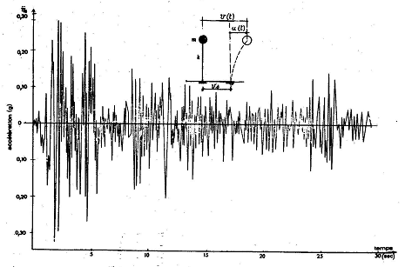
V.5. Response of a system under seismic loading (Notion of response spectrum):
In what preceded we assumed the system in time was defined i.e.: C, K and M were assumed known and by determining the response of the system to a given load.
The problem facing the engineer will be to determine one or more parameters (K, M or C) of a system in order to limit a certain response (limit displacement, stress, etc.). The response spectrum is used to solve this problem.
Consider a simple oscillator connected to the ground characterized by its frequency ω and damping ratio ξ. It is subjected to the effects of an earthquake (El Centro 1940).
Accelerogram of the N-S component of the El Centro 1940 earthquake

Slide 32
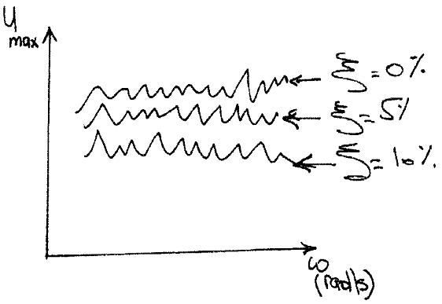

The response spectrum is a plot of the responses (displacement, velocity, acceleration) to a specific excitation for all possible single degree of freedom systems. The x-axis shows the frequency (or period) and the y-axis shows the max response.
The interest of this spectrum is that it allows, by simply reading the plot, to evaluate the maximum displacement of any oscillator, and thus the maximum stresses.
At a time t, the relative displacement u(t) of the mass can be calculated using Duhamel's integral.
"Equation of motion (relative displacement)$\text{ é}\text{q}\text{.}\text{2.3 }\text{: }m\ddot{x}+c\dot{x}+kx=−m{\ddot{x}}_{g}=P_{effectif}$
$$\text{Initial} \text{conditions}\text{:} x\left(t=0\right)=0 ; \dot{x}\left(t=0\right)=0 ,We have Duhamel′s integral:\text{:}$$
$x\left(t\right)=\frac{1}{m.ω_{D}}\int_{0}^{t}{P\left(τ\right)e^{−ξω_{0}(t−τ)}sinω_{D}(t−τ)dτ} \text{, }\text{et} P\left(τ\right)=−m{\ddot{x}}_{g}(τ)$ $\text{so}\text{ :}$
$$x\left(t\right)=\frac{1}{ω_{D}}\int_{0}^{t}{{\ddot{x}}_{g}(τ)e^{−ξω_{0}(t−τ)}sinω_{D}(t−τ)dτ} \text{(}\text{4}\text{.}\text{23}\text{)}$$
Since the function P(τ) is known, the displacement x(t) only
depends on the parameters ξ and ω. Therefore, to determine
the spectra, we fix one of the two parameters (ξ and ω) and
vary the other.

Slide 33

For design purposes, we are generally interested in the maximum value of the response due to an earthquake.
The maximum responses are defined as:
maximum relative displacement: $SD =\left|{x(t)}_{max}\right|$ (4.24.a)
maximum relative velocity : $SV =\left|{\dot{x}(t)}_{max}\right|$ (4.24.b)
maximum relative acceleration : $SA =\left|{\ddot{x}(t)}_{max}\right|$ (4.24.c)
$SD={\left|\frac{1}{ω_{D}}\int_{0}^{t}{{\ddot{x}}_{g}(τ)e^{−ξω_{0}(t−τ)}sinω_{D}(t−τ)dτ}\right|}_{max}$ (4.25)
$SV={\left|−\int_{0}^{t}{{\ddot{x}}_{g}(τ)e^{−ξω_{0}(t−τ)}\left[\cos{ω_{D}(t−τ)}−\frac{ξω_{0}}{ω_{D}}sinω_{D}(t−τ)\right]dτ}\right|}_{max}$ (4.26)
$SA={\left|\int_{0}^{t}{{\ddot{x}}_{g}(τ)e^{−ξω_{0}(t−τ)}\left[\frac{ω_{0}\left(1−{2ξ}^{2}\right)}{\sqrt{1−ξ^{2}}}\sin{ω_{D}(t−τ)}+2ξω_{0}cosω_{D}(t−τ)\right]dτ}\right|}_{max}$ (4.27)
For common buildings (ξ < 20%); Considerable simplifications can be made by noting that:( ω₀ ≈ ω_{D} ).
In common buildings (ξ << 20%), we can assume that the terms in (ξ et ξ² <<< 1).

Slide 34
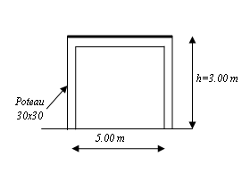

We thus obtain the response spectra:
$PSD(pseudo displacement spectrum)={\left|\frac{1}{ω_{0}}\int_{0}^{t}{{\ddot{x}}_{g}(τ)e^{−ξω_{0}(t−τ)}sinω_{0}(t−τ)dτ}\right|}_{max}$ (4.25.b)
$PSV(\left(pseudo velocity spectrum\right))={\left|−\int_{0}^{t}{{\ddot{x}}_{g}(τ)e^{−ξω_{0}(t−τ)}\left[sinω_{0}(t−τ)\right]dτ}\right|}_{max}$ (4.26.b)
$PSA((pseudo acceleration spectrum)={\left|ω_{0}\int_{0}^{t}{{\ddot{x}}_{g}(τ)e^{−ξω_{0}(t−τ)}\left[sinω_{0}(t−τ)\right]dτ}\right|}_{max}$ (4.27.b)
PSA = ω².PSD = ω.PSV
Application :
Calculate the maximum relative displacement of the building and the corresponding maximum elastic force and overturning moment for the structure shown.
The reinforced concrete structure : E = 3.10⁵ MPa
columns : 30x30 cm ; beams : 30x30 cm
Slab tickness : 15 cm
The total mass of the floor.: m = 18.10³ kg
Utilize the El Centro earthquake spectrum18.05.1940 pour ξ= 5 %

Slide 35
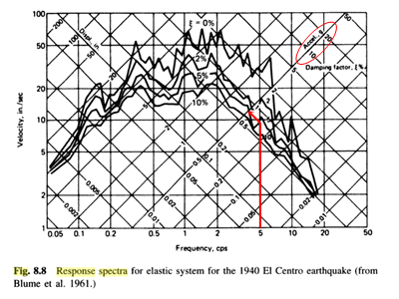
.

Slide 36

Solution : the rigidity : $k_{pot}=\frac{12EI}{h^{3}}$
$${k_{éq}=2 k}_{pot}=2\frac{12EI}{h^{3}}=\frac{2∗12∗300000∗{10}^{6}∗0,675∗{10}^{−3}}{3^{3}}=180.{10}^{6} N/m$$
The natural frequency of vibration is: $ω=\sqrt{\frac{k}{m}}=\sqrt{\frac{18x{10}^{6}}{18x{10}^{3}}}=100 rad/sec$
$T=\frac{2π}{ω}=\frac{2π}{100}=0,0628 sec$ == > $f=\frac{1}{T}=15,92 Hz$ The value of the spectral acceleration PSA, for a damping ratio of ξ= 5 % est : (PSA=0.52g)
The seismic force at the base V0max is given by:
F$=PSA×m=0,52∗18000=93,6 kN$
and : $f_{k max}=K×X=93,6 kN$ . X=F/k=0,52mm
.

