Slide 1
UNIVERSITY CENTER OF MILA
INSTITUTE OF SCIENCE AND TECHNOLOGY
DEPARTMENT OF CIVIL AND HYDRAULIC ENGINEERING
Seismic Engineering
Génie parasismique (Master2 G.C)

Responsible: Dr. GUETTICHE ABDELHEQ

Academic Year 2023- 2024

Slide 2
COURSE PROGRAM:
1.Chapter 01 : Elements of Seismology (1Week)
Causes of Earthquakes,
Seismic Waves,
Seismic Measurement Systems
Seismic Hazards, Case Study Analysis d’un cas pratique.
2. Chapter 02: Objectives of Seismic Protection and Design Methods (1 Week)
Behavior Objectives
Design Methods
Verification Principles
Design Principles
3. "Chapter 03: Characteristics of Earthquake-Resistant Buildings (2 Weeks)
Structural Simplicity
Uniformity, Symmetry, and Redundancy
Strength and Stiffness in Two Directions (Torsional Effects)
Diaphragm Action at Floor Levels
Appropriate Foundations
Structural Regularity Criteria: Plan Regularity Criteria and Elevation Regularity Criteria"

Slide 3
I.1. COURSE PROGRAM:
4. Chapter 4: Classification Criteria (1 Week)
Seismic Zones - Zone-specific Acceleration Coefficient
Structures by Importance Level
Site Locations - Average Dynamic Amplification Factor
Bracing Systems - Global Behavior Coefficient of the Structure"
5. Chapter 05:Calculation Rules for Seismic Force - Equivalent Static Method (3 Weeks)
Application Conditions - Principle – Modeling
Calculation of Total Seismic Force - Distribution of Seismic Force along Height (Floors)
Accidental Torsional Effects
Horizontal Distribution of Seismic Forces to Bracing Elements
Safety Justification - Load Combinations

Slide 4
I.1COURSE PROGRAM:
6,Chapter 06: Modal Spectral Dynamic Method (3 Weeks)
Principle – Modeling - Calculation Response Spectrum - Seismic Force Calculation.
Common Requirements for Both Methods:
Overturning Stability.
Displacement Calculation.
Safety Justification.
7. Chapter 07: Ductility Concept and Construction Arrangements (2 Weeks)
Ductility Concept and Introduction to Capacity-Based Design.
Construction Arrangements
Specific Specifications for Structural Elements
Additional Requirements for Non-Structural Elements."
Evaluation Method:
Continuous exam: 40% ; Exam : 60%.

Slide 5
Chapter 01:
Introduction and General Overview

Slide 6
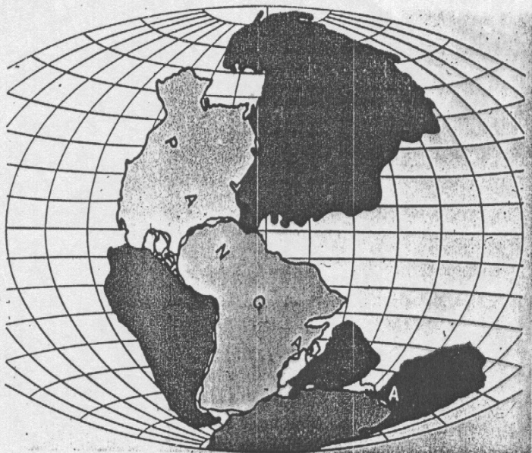


« It is not earthquakes that kill human beings, but rather the collapse of the designs they create »
The term "Seismic Design" refers to any design that is planned and executed in accordance with seismic codes, with the primary goal of preserving human lives. It involves creating structures capable of withstanding a defined level of seismic activity, as determined by codes specific to each seismic zone.
introduction: The Earth is a living entity. Continents come together and break apart, seas emerge and vanish, all on the scale of geological times, of course.
Before: 180 Million Years
Before: 50 Million Years
After: 50 Million Years

Slide 7
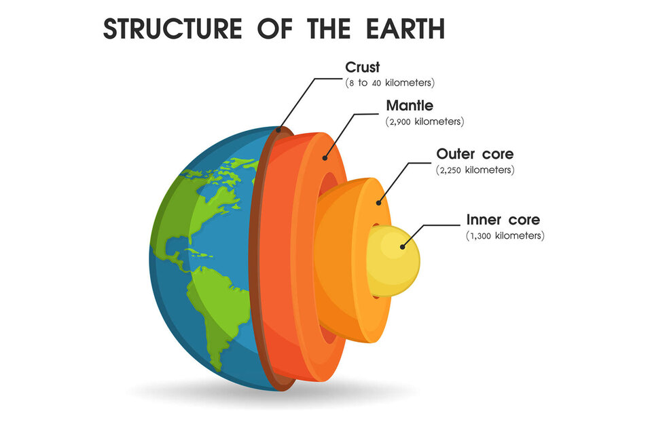
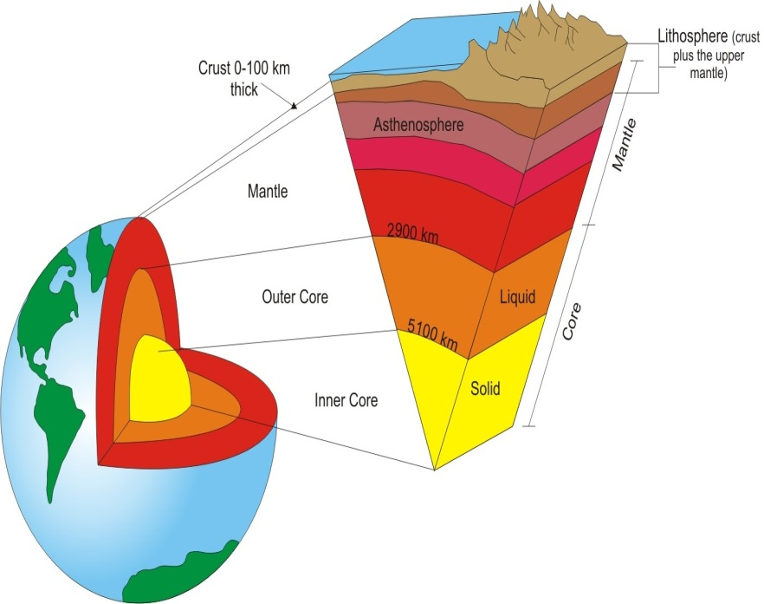
Earth's Structure: : The Earth is composed of a succession of layers with differing chemical composition, density, and temperature.
In the center, the core, presents 17% of the Earth's volume, and is divided into a solid inner core and a viscous outer core.;
Next is the mantle, which makes up the majority of the Earth's volume, 81%, and is divided into a solid lower mantle and an upper mantle that is mainly plastic but has a solid uppermost portion.
Following the mantle is the crust (or outermost layer), accounting for less than 2% of the volume and being solid."

Slide 8

3. Concept of Continental Drift:
The theory of continental drift was proposed in the early 20th century by the physicist-meteorologist Alfred Wegener, who developed the idea of continents shifting on the surface of the planet. His theory is supported by the coincidence of geological features on either side of the southern Atlantic, the similarity of rock sequences, and paleoclimatic indicators, along with other geological agreements.
This theory was later confirmed through studies on the paleomagnetism of ocean floors. The role of oceanic ridges, which generate material under the influence of convection currents in the mantle, was explained. This explanation led to the deduction of the continuous creation of oceanic crust."

Slide 9
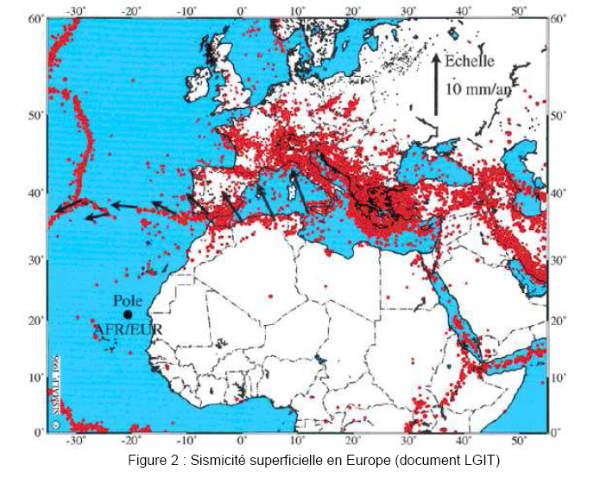
4. Tectonic Plates: Earthquakes are not randomly distributed across the planet's surface but are mostly concentrated along the boundaries of lithospheric plates. Tectonics is the branch of geology that studies the nature and causes of deformations in rock formations, specifically on a large scale within the Earth's lithosphere. This theory was developed in the late 1960s and has had significant implications for all Earth Sciences."

Slide 10
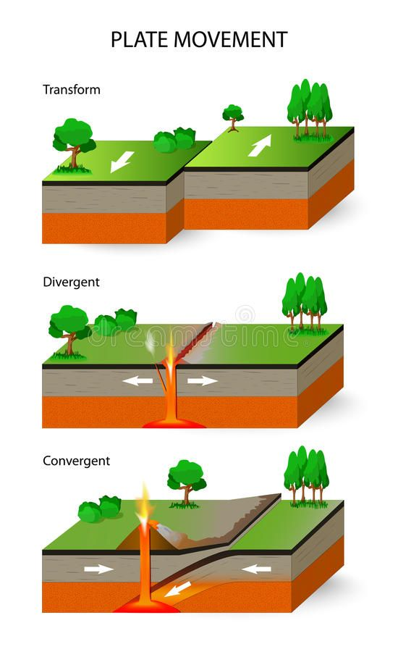
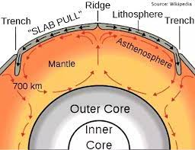
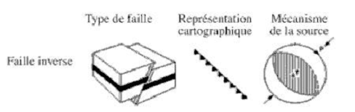

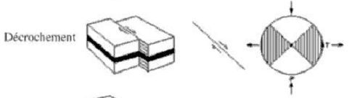
5. Origin of Plate Movements: The Earth's crust rests upon the plastic mantle, which undergoes convective movements that drive the plates. The boundaries between plates are referred to as faults. These faults come in different types depending on the movements of the plates:"
There are three types of faults:
a- Convergent faults. (reverse faults) ; Divergent faults ( normal ); Transform fault
.

Slide 11
6. Seismic Classification: : The classification of earthquakes is based on several criteria. The most important ones are: (1) the depth of the focus; (2) the origin of the earthquake; and (3) the intensity and magnitude of the earthquakes
Based on the depth of the focus, we distinguish:
o Shallow earthquakes: the depth of the focus is less than 60 km..
o Intermediate earthquakes: the focus is located between 60 and 300 km deep.
o Deep earthquakes: the depth of the focus exceeds 300 km.
Based on the origin of the earthquake, we distinguish between tectonic origin earthquakes and non-tectonic origin earthquakes.
Tectonic origin earthquakes are related to the movements of the Earth's crust along faults. These are the most significant (95% of recorded earthquakes).
Non-tectonic origin earthquakes can be triggered (caused) by volcanic eruptions (magma rise and degassing), the collapse of natural underground cavities, or large landslides. Generally, these earthquakes are of low intensity and affect limited areas.
Artificially induced earthquakes are caused by certain human activities such as dams, deep well injections, mining operations, underground or nuclear explosions.

Slide 12
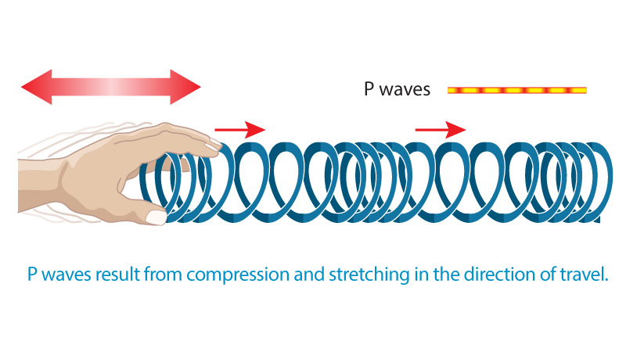
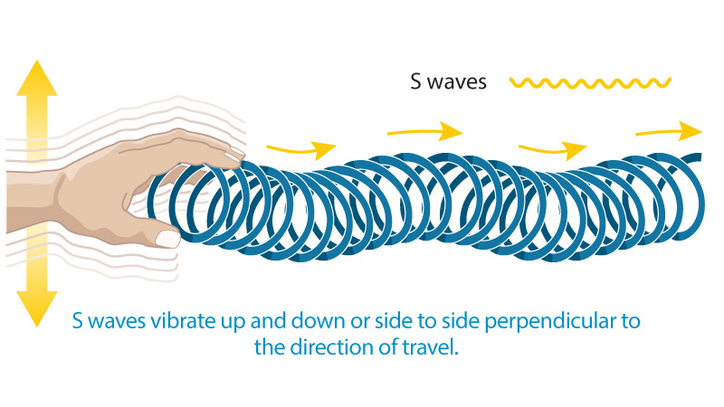
7. Seismic Waves: we have tow types:
7. 1. Volume (body) Waves: Volume waves propagate in two forms:
P-waves (primary waves) or longitudinal waves: These waves propagate through the Earth's crust at a velocity of 6 to 8 km/s and are accompanied by a change in volume (alternate compression and dilation). This type of wave induces vertical movement (pumping) in structures. The movement will be more significant when the structure is located close to the epicenter.
S-waves (secondary waves) or shear waves: These waves propagate through the Earth's crust at a velocity of approximately 3 to 5 km/s and are accompanied by distortion in the plane perpendicular to the direction of propagation, causing shear without a change in volume. It is this type of wave that introduces horizontal movement in structures. Unlike longitudinal waves, transverse waves cannot propagate through liquid or gaseous media due to these mediums' inability to transmit shear forces.

Slide 13








In homogeneous and isotropic solid (such rock substrate), according to the theory of elasticity, we can calculate the propagation velocity of these waves based on the soil's characteristics.
The propagation velocities of the waves are given by the following formulas:
• For P-waves: with : and :
Where: ρ is the density of the material. [kg/m3]
E: is the dynamic elastic modulus (Young's modulus) of the material. [N/m2]
G: dynamic shear modulus [N/m2]
ν is the Poisson's ratio of the material and λ, Lamé's constant.
• For S-waves: With and
The knowledge of the shear wave velocity (VS) s essential for determining the dynamic characteristics of soils(such as E, ν and G) required to consider soil-structure interaction.
The ratio of P-wave and S-wave velocities is given by:
For most soils, ν= 0,18 à 0,40.
P-waves, in granite, 6.0 km/s; in water, 1.5 km/s.
S-waves, in granite, 3.0 km/s; in water, 0 km/s.
By measuring this difference in propagation times, one can infer the distance between the source and the recording point.

Slide 14
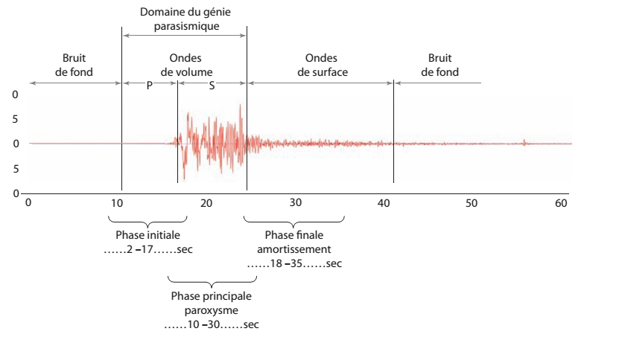
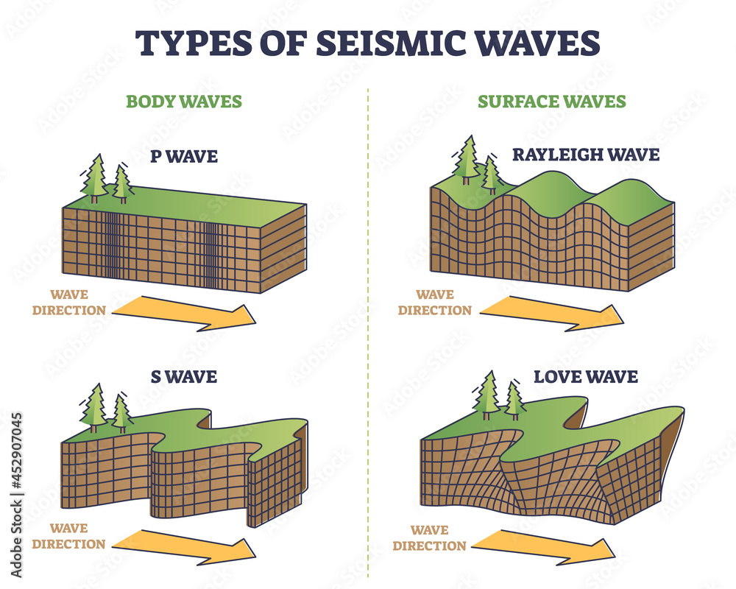
The volume waves that reach the Earth's surface give rise to surface waves that affect the soil only to an extremely shallow depth.
7.2. Surface Waves: The most significant surface waves are as follows:
Rayleigh Waves: These are waves in which points on the ground describe ellipses in the vertical plane in a retrograde motion. This movement is similar to the motion of ocean waves and results in compressions (or tension) as well as shear stresses within the soil.
Love Waves: These are waves in which points on the ground move in a plane tangent to the surface and perpendicular to the direction of propagation. Their "rolling" motion generates only shear stresses.

Slide 15
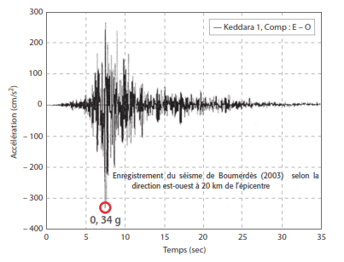
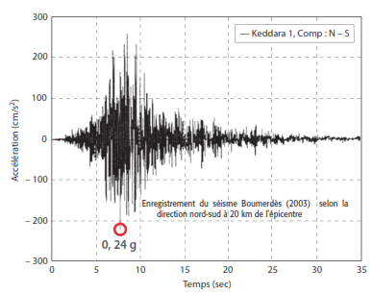
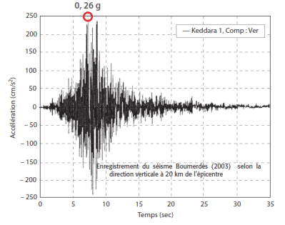


The displacement of a point on the ground during an earthquake is not straightforward, so it must be studied separately along the three principal directions. For each earthquake, recordings (accelerograms) are available in the three directions: North-South, East-West, and Vertical.
•The dimensions of a harmonic wave are expressed in terms of the period T and length L
Wave velocity: Wave frequency:
In seismic engineering, the range of significant frequencies extends from 0.10 to 10 Hz. As a result, wavelengths are a few hundred meters for good soils and can decrease to a few tens of meters in superficial and poor-quality soils.

Slide 16
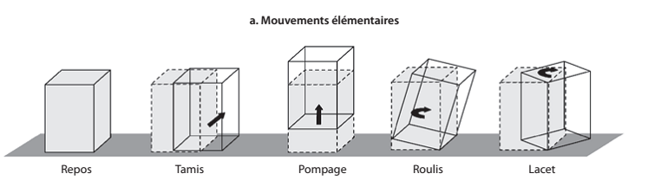
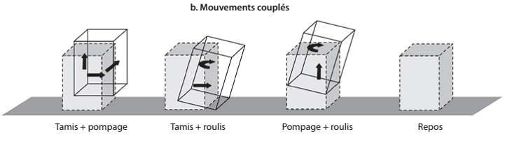
– Longitudinal P-waves with vertical propagation produce a seismic motion of "pumping," resulting in a vertical component.
- Shear S-waves with vertical propagation generate a seismic motion resembling a "sieve( tamis )" leading to horizontal components.
- Surface waves, specifically Rayleigh waves with horizontal propagation, induce a seismic motion characterized by a "rolling" movement.
- Surface waves, specifically Love waves with horizontal propagation, result in a seismic motion characterized by a "swinging" or "yawing (lacet ) " movement.

Slide 17
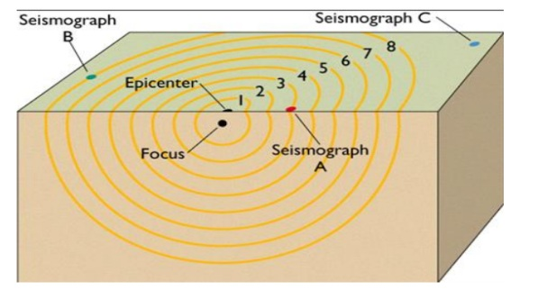

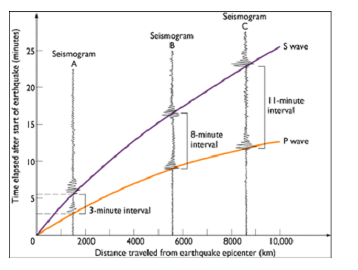


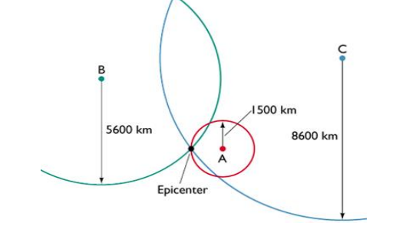
8. Systèmes de mesures des séismes:
The calculation, from a single station, does not allow to determine the direction in which the epicenter is located, but by using simultaneously the recordings from more than three stations, it will be possible to determine its position.
The seismic waves are recorded by stations A, B and C at different 'times'.
This figure shows the time intervals between the arrival of P and S waves at the three stations A, B and C.
Arrival times of P waves:
Arrival times of S waves:
t0: origin time and Vp: velocity of P wave and Vs: velocity of S wave
"The circles represent the geometric locus of the epicenter
for each station. Knowing that this is a single earthquake,
the epicenter is therefore located at the intersection of the
three circles

Slide 18
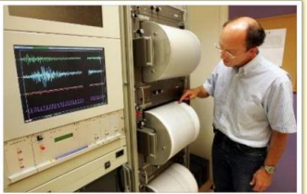
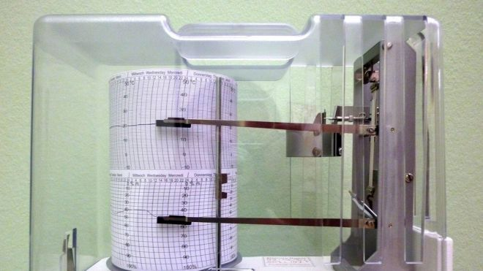
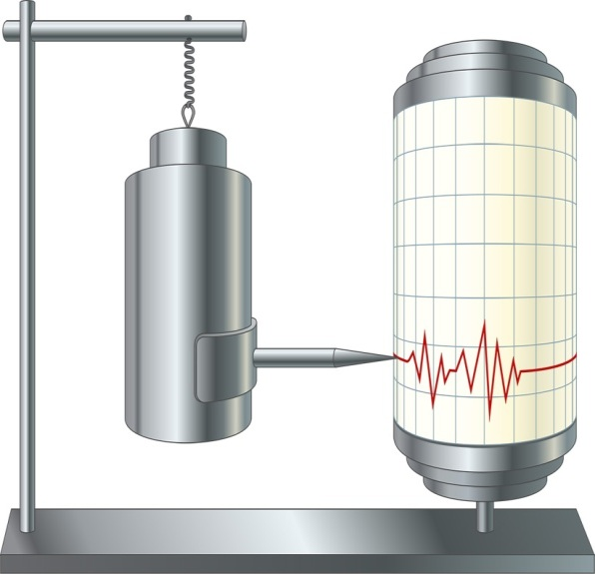
The seismometer:
A seismometer is a sensor designed to detect the waves generated by an earthquake. It can detect either vertical ground vibrations or horizontal vibrations. To fully describe the motion, three seismometers are needed: one vertical and two horizontal ones, usually placed in two perpendicular directions, commonly North-South (N-S) and East-West (E-W).
In general, multiple devices were required to measure such ground activity since older seismometers could only measure a single direction of movement.
Modern seismometers are equipped with advanced technologies to accurately measure Earth's movements.

Slide 19

Characterization of an Earthquake:
9.1. Magnitude: The magnitude of an earthquake (denoted as M) is a dimensionless number that represents the energy released by an earthquake. The calculation of magnitude was developed in 1935 by Charles Richter to characterize locally recorded earthquakes in California. This calculation was based on measuring the amplitude of ground motion recorded on a standardized seismograph
Richter defined magnitude by taking the decimal logarithm of the amplitude in micrometers.
example: An earthquake located 100 km away that produces a maximum amplitude of 2 mm (equivalent to 2000 micrometers) on the seismogram would have a magnitude of 3.3, since the decimal logarithm of 2000 is 3.3.
Conversely, an earthquake with a magnitude of 4.5 generates a seismogram with a maximum amplitude of ${\text{10}}^{\text{4.5}}$= 30 000 micrometers, , or 30 millimeters.
The higher the energy released by the earthquake, the higher the magnitude: an increase of 1 magnitude corresponds to a 30-fold increase in energy and a 10-fold increase in amplitude of movement.

Slide 20


Several types of magnitudes are distinguished:
a- Richter Scale, or local magnitude, ML: The original definition provided by Richter in 1935, now referred to as local magnitude ML, is a simple logarithmic scale of the form:
A: represents the maximum amplitude measured on the seismogram,
A0: is a reference amplitude corresponding to an earthquake of magnitude 0 at 100 km,
∆: is the epicentral distance (in kilometers),
c: is a calibration constant.
Local magnitude ML is used for nearby earthquakes, often referred to as local earthquakes. It is defined based on the maximum amplitude of the P-waves. It is always averaged over several stations, taking local corrections into account.
Duration Magnitude, MD: Used for nearby earthquakes but defined based on the duration of the signal.
Where t is the duration of the signal measured in seconds,
A and c are calibration constants,

Slide 21



Surface Wave Magnitude, MS: Used for distant earthquakes, known as teleseisms, with a depth of less than 80 km.. It is calculated based on the amplitude of the surface waves.
Where:
A: is the amplitude of ground motion in micrometers (µm).
T: is the pseudo-period of the wave measured in seconds (s).
a et c : are calibration constants.
ð : is the distance in kilometers (km).
Body Wave Magnitude, MB: Defined for all teleseisms and especially for deep earthquakes, as these events often do not generate significant surface waves. It is calculated based on the amplitude of the P-wave that arrives at the beginning of the seismogram.
e- Moment Magnitude or Kanamori MW: Better suited for very large earthquakes. It is calculated based on a physical model of the seismic source and is related to the seismic moment m0

Slide 22
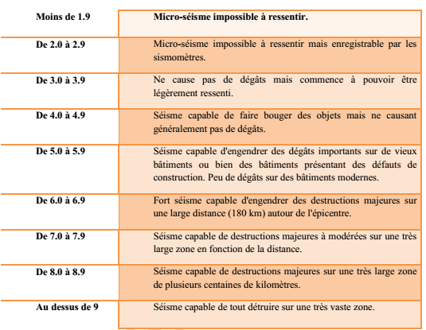
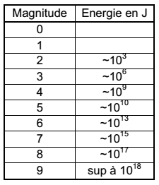
There is no direct relationship between magnitude and intensity. Thus, two earthquakes of the same magnitude can result in different intensities at the surface. Conversely, two earthquakes with the same intensity at a location can have different magnitudes.

Slide 23
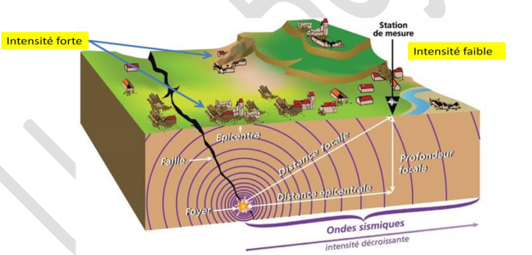
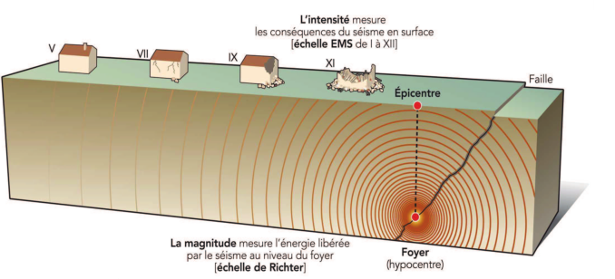
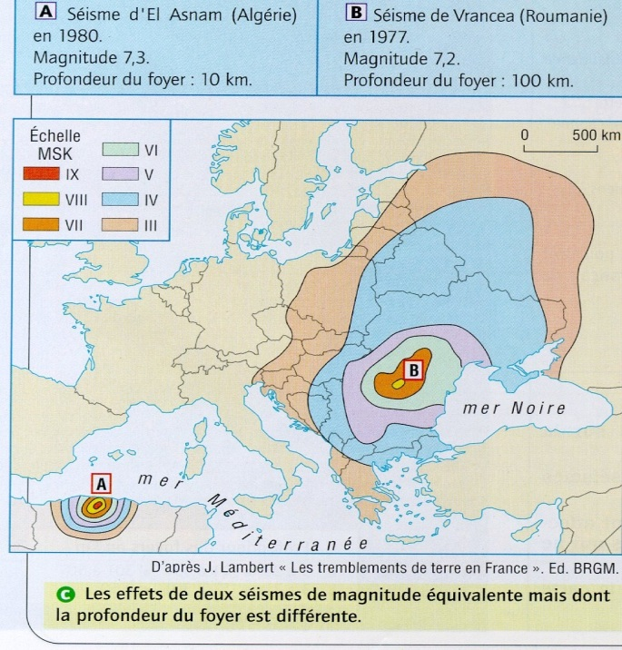
9.2. Intensity:
Seismic intensity measures the strength of an earthquake and its impact on a given region, including objects, humans, and infrastructure. It can describe the probable distribution of damage and is then referred to as macroseismic intensity.. In general, intensity decreases with distance, but specific conditions such as site effects or directivity effects related to the position and orientation of the seismic source can sometimes create anomalies in intensity maps

Slide 24
Often, each country uses its preferred intensity scale due to historical reasons or continuity in macroseismic catalogs. Different scales provide valuable information about the impact of earthquakes on the ground and structures, aiding in assessing damage, disaster management, and engineering designs.
The United States uses the Modified Mercalli Scale.
JAPAN uses the Japan Meteorological Agency (JMA) Intensity Scale.
Algeria ses the Medvedev-Sponheuer-Karnik (MSK-64) macroseismic scale, which is more precise and takes into account building type and the percentage of affected buildings.
Italy often uses the Mercalli-Cancani-Sieberg (MCS, 1912, Sieberg 1932) scale.
In Europe, the EMS-98 scale has replaced the MSK scale since the year 2000.
Each of these scales reflects the seismic intensity experienced in different regions and considers various factors such as building vulnerability, damage assessment, and local conditions. These scales help provide a standardized way of describing the impact of earthquakes in various parts of the world.

Slide 25
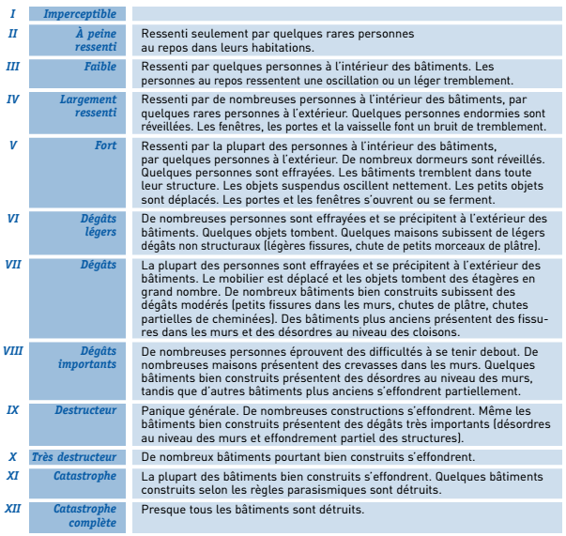
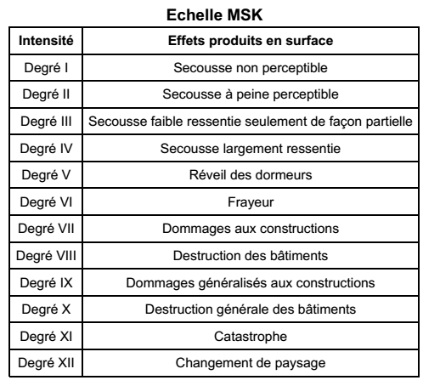
Intensity, expressed in Roman numerals to clearly differentiate it from magnitude, is used to describe the effects produced by an earthquake at a specific location.
EMS 98

Slide 26
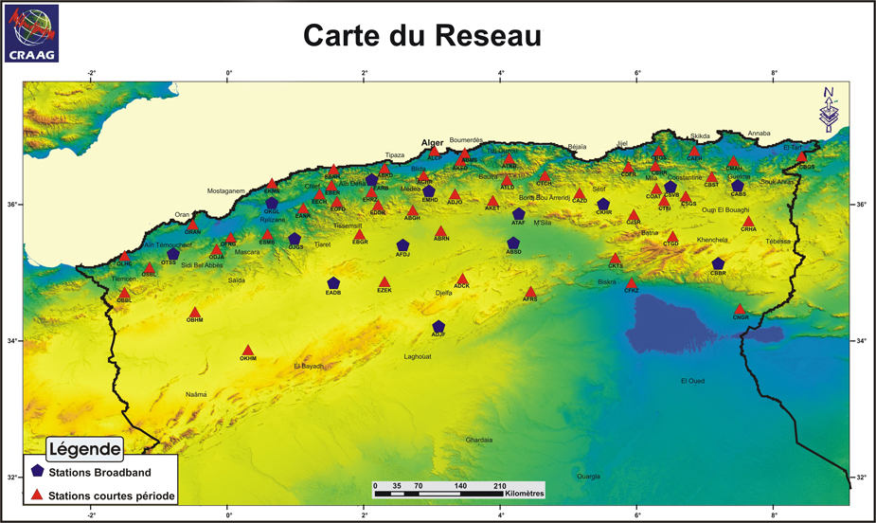
10. The Algerian Seismic Monitoring and Alert Network:
Seismic monitoring in Algeria began in 1910 when the first seismic station was installed in Bouzaréah. Currently, the Algerian seismic monitoring network consists of 35 telemetry stations and 45 recently acquired digital stations. This network now covers a significant portion of the northern region of the country, where the highest seismic activity occurs. There is also coverage in the Tamanrasset region, where a station is located at the Tamanrasset Observatory. The network plays a crucial role in monitoring and assessing seismic activity across the country, providing valuable data for earthquake research, early warning systems, and disaster preparedness.

Slide 27
Seismic Hazard:
Seismic risk is expressed as the combination of seismic hazard, building vulnerability, and exposed value (the overall impact in terms of human, economic, and environmental damages). This can be formulated as follows:
Seismic hazard is defined as the probability of the occurrence of a destructive event of a given intensity based on a macroseismic scale, over a specific period. It's important to note here that seismic hazard can be locally modified in smaller areas where ground or topographic conditions are particularly unfavorable (site effects).
Risk = Seismic Hazard x vulnérability x exposed value
Conséquences
Hazard
Damage degree
exposed value

Slide 28
10. Case Study of Seismic Hazard (Constantine-Mila Basin):
In Algeria, the northern part of the country is considered a zone with a moderate to high estimated seismic hazard. According to the Center for Research in Astronomy, Astrophysics, and Geophysics (GRAAG), there are around thirty micro tremors each month in general, which are usually not felt by the population.
The Constantine basin is situated at a higher elevation.
This area is limited by:
To the East, it is bordered by the Guelma basin (specifically, by the Temolouka fault that separates the two basins),
To the North, by the abnormal contact that separates the internal zone of Petite Kabylie, which corresponds to a significant oriented feature known as the "North Constantine Fault" or the "M'cid Aicha-Debar fault";
To the South, the area is limited by the Batna zone through the Sigus East-West fault.
To the West, it is adjacent to the Sétif region.

Slide 29
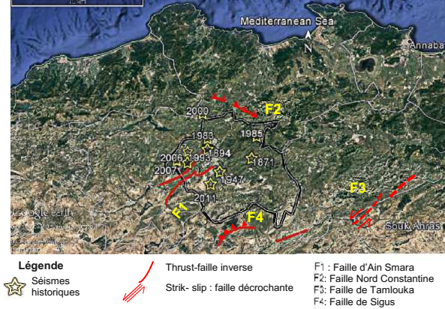
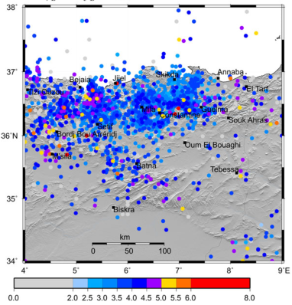
Within this area, there are three significant neotectonic faults that affect the plio-quaternary deposits:
The Ain Smara fault, recognized as active during the Constantine earthquake of October 27, 1985, extends for nearly 30 km.
The North Constantine Fault (M’cid Aicha-Debar fault), extending for over 80 km.
The Sigus fault, oriented in an east-west direction and with a length of approximately 30 km.

Slide 30
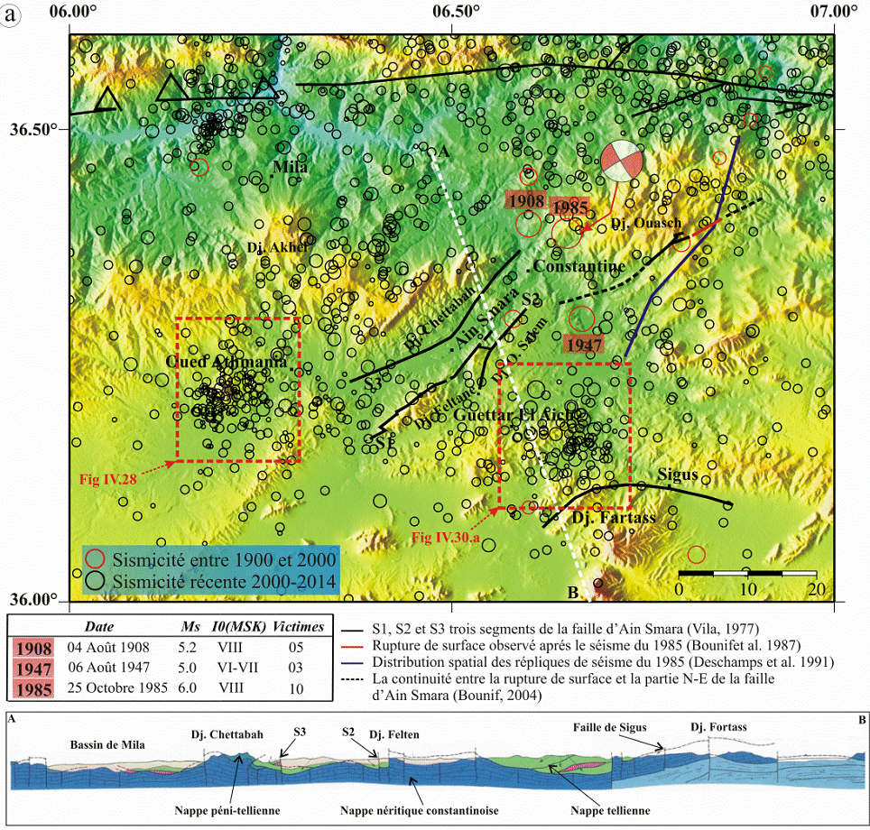
In this area, there have been three historical earthquakes with a return period of 39 years. These earthquakes are as follows:
The earthquake on August 4, 1908, with a magnitude of Ms=5.2.
The earthquake on August 6, 1947, with a magnitude of Ms=5.0.
The earthquake on October 27, 1985, with a magnitude of Ms=6.0.

Slide 31
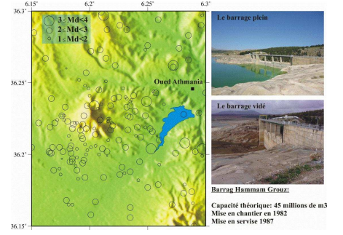
Recent Seismic Activity in the Mila Region: Analysis of seismic activity in this area has revealed that it is concentrated at the following levels:
The region around the Hammam Grouz Dam (Mila Basin): Seismic activity is concentrated to the west of the dam. This dam, initially with a capacity of 45 million cubic meters, experienced degradation starting from the year 2003, leading to significant water leakage exceeding 200 liters per second.
The seismic activity in this zone could be considered
of low magnitude, with Md ≤ 3.5. It might be related to
the leakage at the Grouz Dam. It was observed that
the first event was detected in 2003 with a magnitude
of 1.7, coinciding with the initial leakages. The number
of events then notably increased from the year 2007.
The northern region of Constantine: This zone of faults extends for more than 80 km, from Djebel M’cid Aicha in the west to Djebel Debar in the north of Guelma. The seismic activity around this fault is characterized by low magnitudes. To the west of this fault lies the largest dam in Algeria, the Beni Haroun Dam.

Slide 32
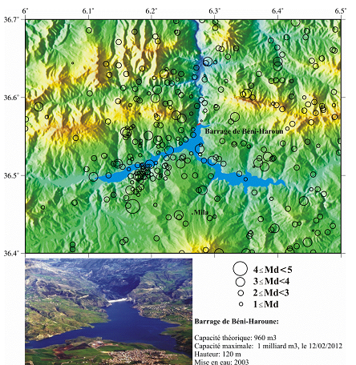
The dam, standing at a height of 120 meters, is the largest in terms of its capacity of nearly one billion cubic meters. With its large pumping station, boasting a power of 180 MW, the dam supplies drinking water to several neighboring regions of the Mila province, including the provinces of Constantine, Oum el Bouaghi, Batna, and Khenchela.
The seismicity around the Beni Haroun Dam was studied over
a period of 5 months, from December 2011 to April 2012
This period corresponds to when the dam was filled to its
maximum capacity for the first time on February 12, 2012.
A CBHR station was installed beneath the dam.
Two seismic crises were recorded:
the first at the beginning of January 2012, during which the
station recorded 266 events over 3 days from January 2nd
to January 4th, 2012, with 175 events recorded on January
2nd.

Slide 33
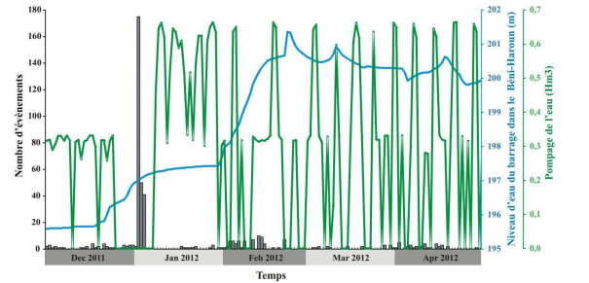
This seismic activity coincides precisely with the abrupt change in the water level of the dam, which increased by 7 meters in height.
The second activity, marked by 63 events, including 10 recorded on February 3, 2012, occurred shortly after the dam reached a historic peak of 1 billion cubic meters on February 12, 2012, with a 3-meter increase in height over 15 days.
Therefore, this seismicity in the area is considered induced and is linked to the filling of the Beni Haroun Dam. The rise in the dam's water level leads to an overload of the area and destabilizes the balance of masses. The rebalancing of the Beni Haroun Dam is also subject to a second major risk, which is that of landslides.

Slide 34
August 7, 2020 Earthquake: According to the Center for Astronomy, Astrophysics, and Geophysics Research (CRAAG), a seismic tremor with a magnitude of 4.9 was recorded at 7:15 AM in the province of Mila. Its epicenter was located 2 km southeast of Hammala.
Around 12:13 PM, an equally strong aftershock was felt by the residents of Mila and neighboring provinces. According to CRAAG, it had a magnitude of 4.5 on the Richter scale. The epicenter of this second tremor was situated 3 km south of Hammala. The result was widespread panic and significant damage to many buildings.
According to the Civil Protection, three structures collapsed completely, while others had their pillars cracked. Specifically, two residences in the old town and a 4-story building in the El Kherba neighborhood were affected. Ultimately, the local authorities declared the El Kherba area a red zone, indicating a high level of damage and potential danger.Chronologies des secouses sismiques :
- Le 17/07/2020/: 9h 12min ; M= 4.5 - Le 20/07/2020/: 5h 56min ; M= 3.2
- Le 17/07/2020/: 10h 45min ; M= 3.2 - Le 01/08/2020/: 5h 56min ; M= 3.2
- Le 17/07/2020/: 10h 49min ; M= 3.4 - Le 07/08/2020/: 7h 15min ; M= 4.9
- Le 17/07/2020/: 11h 17min ; M= 3.4
- Le 17/07/2020/: 13h48min ; M= 3.4

Slide 35
