Slide 1
UNIVERSITY CENTER OF MILA
INSTITUTE OF SCIENCE AND TECHNOLOGY
DEPARTMENT OF CIVIL AND HYDRAULIC ENGINEERING
Dynamics of structures 1(DDS1)
Dynamique des structures (Master1 G.C)

Responsible: Dr. GUETTICHE ABDELHEQ

Academic Year 2023- 2024

Slide 2
I.1. PROGRAMME DU COURS :
3. Chapter 03: Multi-degree-of-freedom systems:
Formulation of the equations of motion
Evaluation of the matrices [M], [K], [C] and force vector {P}
Stiffness matrix [K], Mass matrix [M], Damping matrix [C], External force vector {P})
Evaluation method:
Continuous assessment: 40%; Exam: 60%.

Slide 3
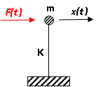

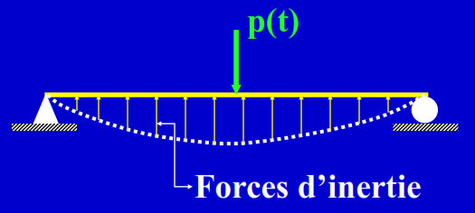
Chapitre 01 : Introduction et généralités
1. Dynamic loading: : Actions that evolve over time (in direction, intensity and/or position). [Reminder: quasi-static load = negligible inertial forces]
2. Dynamic actions in civil engineering:
- Vibrations caused by traffic (trains, trucks) mobile loads of constant or non-constant intensity (assumption to be made);
- Vibrations caused by humans: walking, jumping, dancing...
- Vibrations caused by machines (rotating machines...)
- Explosions and impacts
Statics: single value
Dynamics: variable over time
response: unique (deformation)
response: variable

Slide 4
Wind: average static component + turbulent dynamic component
Earthquakes: excitation by imposed acceleration of structure foundations (vertical and horizontal components)
Waves: case of coastal and offshore structures + ships
3. Analysis of the dynamic behavior of structures: Before presenting the methods of dynamic analysis of structures, some concepts need to be clarified:
3.1. Steps of a dynamic problem:
Characterization of the actions acting on the system
Modeling of the system
Equation formulation
Resolution of equations

Slide 5
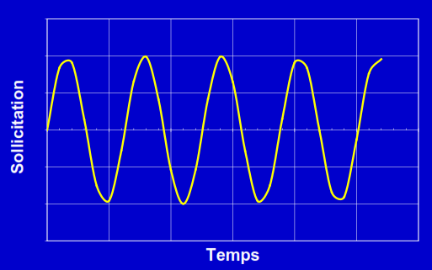


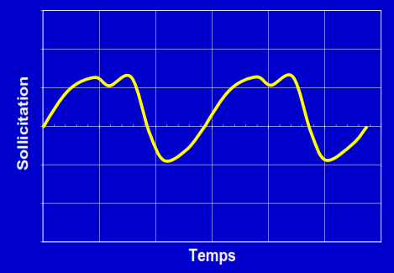

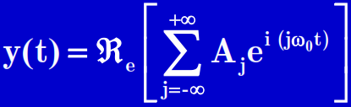
3.2. Characterization of actions:
a) Periodic: Harmonic, anharmonic.
Harmonic (sinusoidal function): describes an oscillatory motion around a stable equilibrium position (rotating machine, mass-spring system).
Defined by: Amplitude (A) and pulsation (ω)
Anharmonic:
Defined by: Amplitude (A) and pulsation (ω) and the Fourier transform is used to solve the equation of motion
Notes:
D’après l’analyse de Fourier, ce chargement peut être exprimé comme une somme de chargements harmoniques
caractérisés chacun par une amplitude A
j
et une pulsation ω
j
. Un tel
chargement s'écrit sous la forme d'une somme d'harmoniques

Slide 6

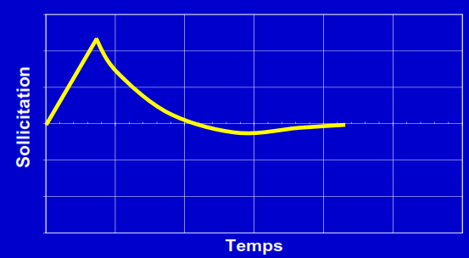

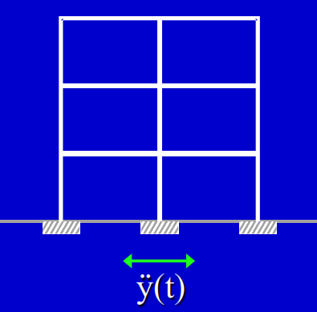
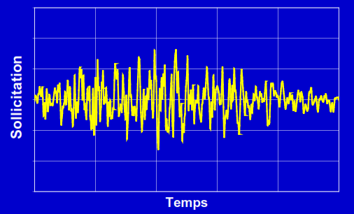
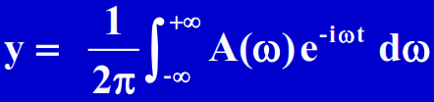
b) Non-periodic: loads that do not change with time. These loads can be either like a pulse spread over a short period (impulsive) like charges resulting from the explosion, or a pulse spread over a relatively long period like earthquakes.
Explosion in the air
Time diagram:
Shock spectrum
Simplified representation: Maximum response
earthquake
Time diagram:
Fourier Transform:
Simplified representation: Maximum response
Oscillator response spectrum

Slide 7
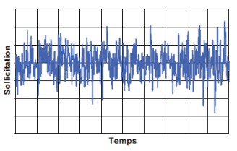
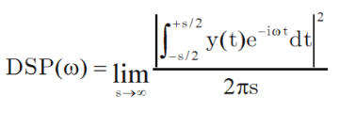
C) Random action:
Many of the loads acting on structures (Mechanical or Civil Engineering) cannot be defined deterministically by an equation of the form .
they are generally only known by their average value. These are typically the vibratory motions generated by rail or road traffic, wind, etc. The stress is said to be random and is represented by its power spectral density. We then speak of stochastic dynamics.
.
Random loading

Slide 8
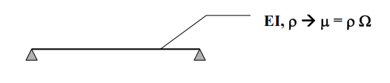


4. Notion Degree of freedom: the number of coordinates required to define the position of all the mass particles of a system
Assumption 1:Stiffness and mass uniformly distributed over the length + deformed= fct(x) continuous system
Assumption 2: Finite element model system with N degrees of freedom
Assumption 3: Vibratory deformation supposed known and defined by its amplitude system described by a single parameter (1 degree of freedom)

Slide 9

So to make a calculation diagram two assumptions are used:
The mass concentration approach.
The generalized displacement approach.
4.1- The mass concentration approach:
4.2 The generalized displacement approach:This method is based on the assumption that the deformed shape of a simple beam is represented in trigonometric series (Fourier series). $v\left(x\right)=\sum_{n=1}^{∞}{b_{n}sin\left(\frac{n.π.x}{L}\right).}$
v(x)
x
l
b₁sin(π.x/l)
b₂sin(2π.x/l)
b₃sin(3π.x/l)

Slide 10

5. Vibration theory (kinematic aspect): The displacement of any simple oscillatory system is expressed by the following trigonometric function:
$x\left(t\right)=x_{0}.sin\left(ω.t+φ\right)$ (I.1)
x(t) : displacement measured from the initial position
$x$0 : Amplitude (maximum value of x(t))
ω : Pulsation (rad/s)
φ : Phase shift (angle of the initial phase for t=0)
The minimum time T to complete a full cycle is called the vibration period. A complete cycle corresponds to the value: ω.t = 360°
In this case T = t == > ω.T = 2.π == > $T=\frac{2π}{ω}$ (I.2)
The number of complete oscillations occurring per second characterizes the frequency F of the vibration. F therefore represents the number of cycles per second in Hertz $f=\frac{1}{T}=\frac{ω}{2π}$ (I.3)
Knowing the equation (I.1), we can deduce:
The velocity : $v\left(t\right)=\frac{d\left(x(t)\right)}{dt}=\dot{x}\left(t\right)=x_{0}.ω.cos\left(ω.t+φ\right)$ (I.4)
The acceleration: : $a\left(t\right)=\frac{d^{2}\left(x(t)\right)}{dt^{2}}=\ddot{x}\left(t\right)=−x_{0}.ω^{2}.sin\left(ω.t+φ\right)$ (I.5)

Slide 11
In DDS, we classify dynamic problems according to degrees of freedom and according to the type of system (dissipative or conservative) and whether forced or free
Single degree of freedom system (1 DOF)
Multiple degree of freedom system (MDOF)
Number of DOF
SDOF (1 DOF)
MDOF (MDOF)
Dissipative system
Damped vibration
C ≠ 0
If any energy is lost in friction or other resistance during oscillation.
Dissipative or
conservative system
If no energy is lost in friction or other resistance during oscillation.
Undamped vibration C = 0
Conservative system

Slide 12
If a system, after an initial disturbance (excitation) is left to vibrate alone, the following vibration is known as free vibration. No external force acts on the system. The best example of a free vibration is the pendulum.
Free vibration
Causes producing vibration
Forced vibration
If a system is subjected to an external force (often a repetitive force).
If all the basic components of a vibratory system (the spring, mass, and damper) behave linearly, therefore the superposition principle applies.
Linear vibration
Linear or nonlinear vibration
If all the basic components of a vibratory system (the spring, mass, and damper) behave nonlinearly, therefore the superposition principle does not apply.
Nonlinear vibration
Not part of the program

