Slide 1

"PROTECTING OUR PLANET: A JOURNEY TOWARDS CLEAN AND SUSTAINABLE WATER"
EXPLORE NOW

Slide 2
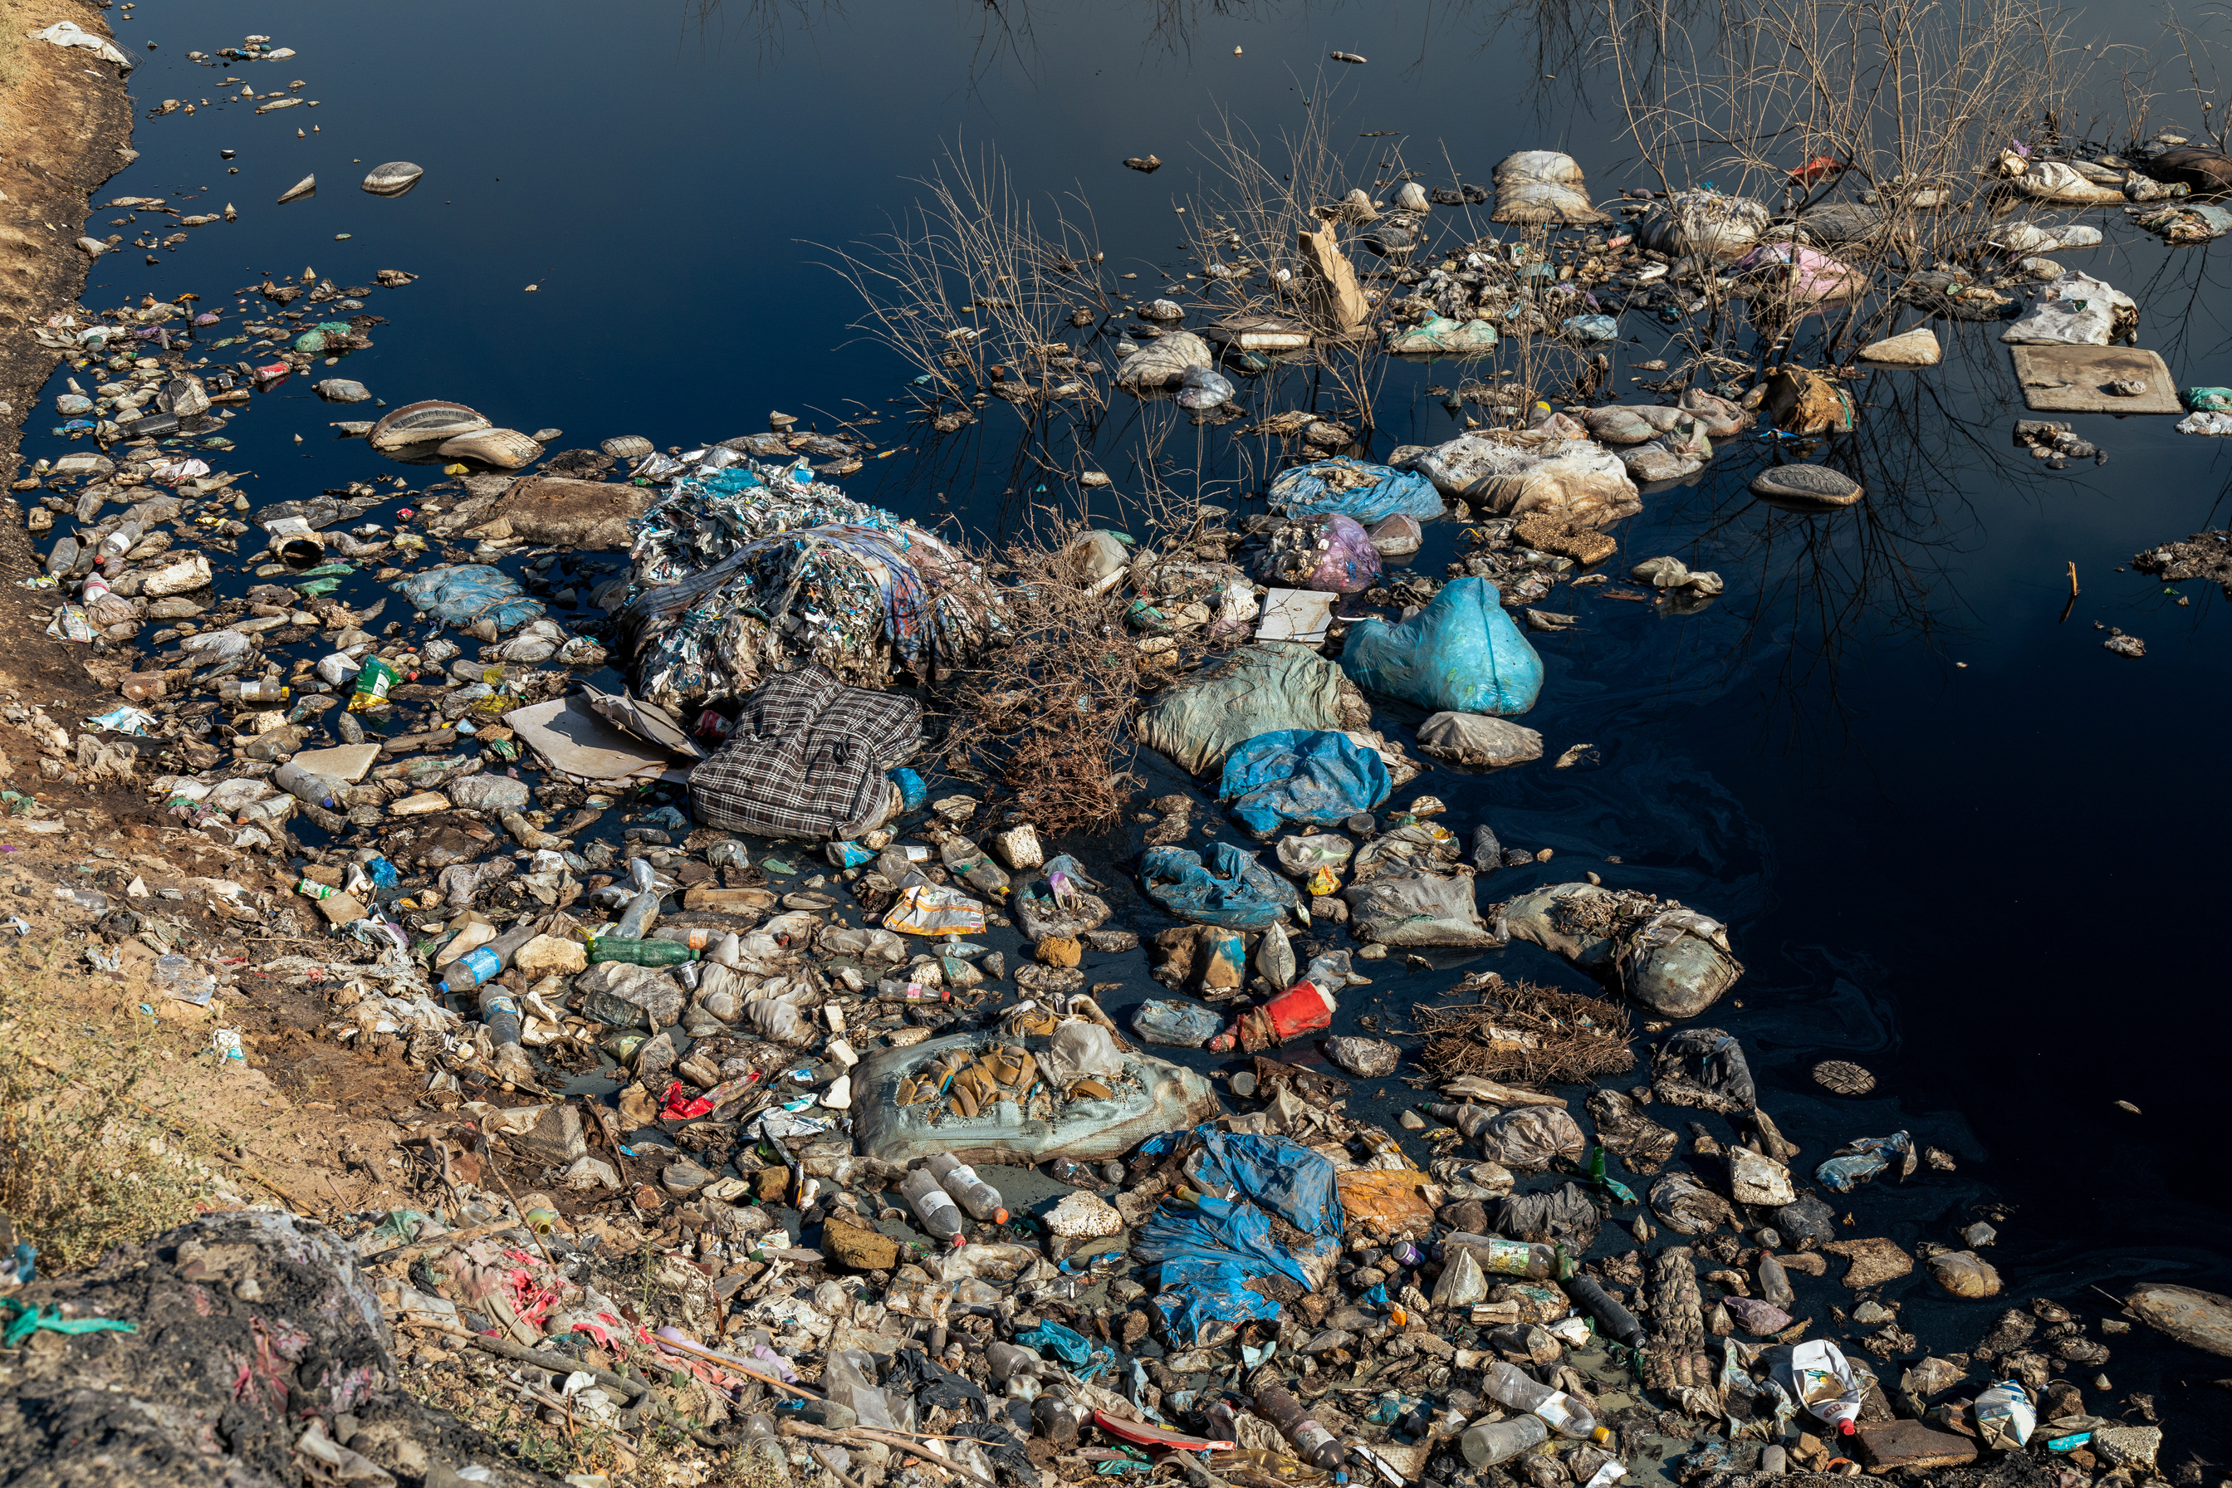
CAUSES OF WATER POLLUTION
Water pollution is the contamination of water bodies due to harmful substances or pollutants, such as chemicals, waste, and pesticides

Slide 3
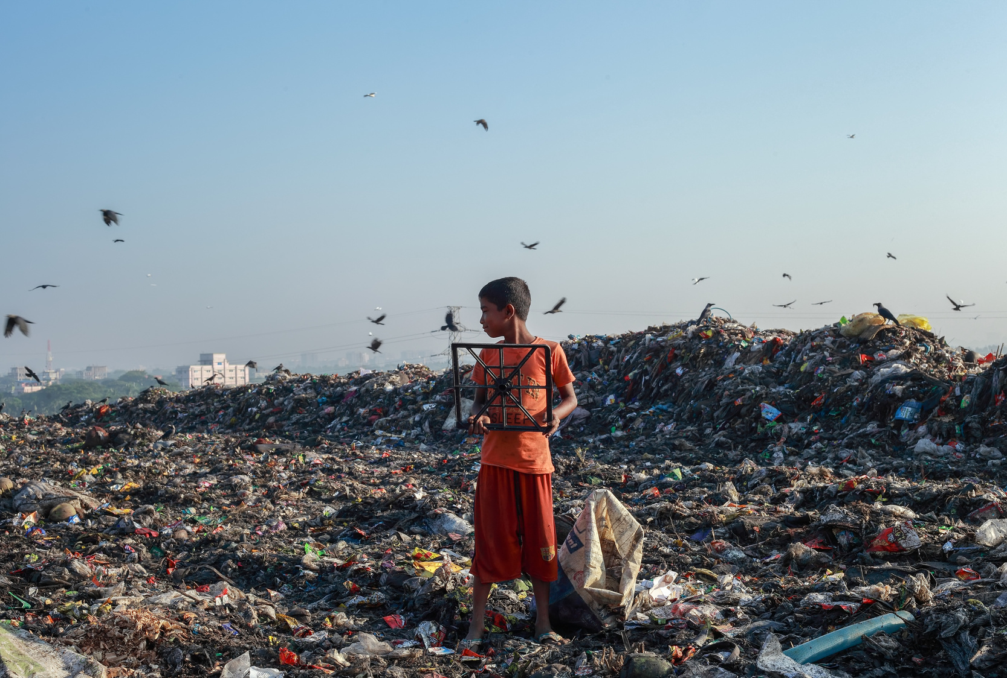
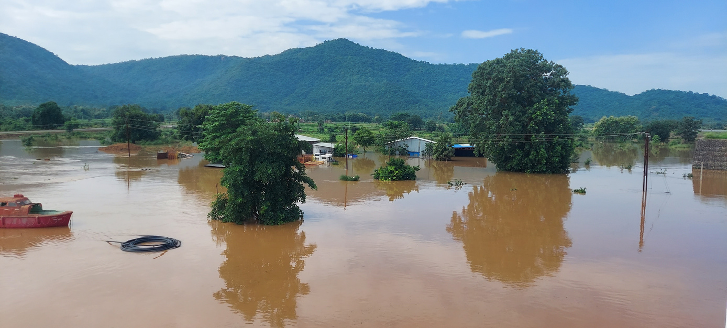
Human activities significantly contribute to water pollution. The most notable of these activities include:
1.1 Agriculture and Pesticide Use
1.2 Industrial Processes and Waste
HUMAN ACTIVITIES
Some natural phenomena also contribute to water pollution:
1.1 Flooding
1.2 Groundwater Pollution
NATURAL CAUSES

Slide 4
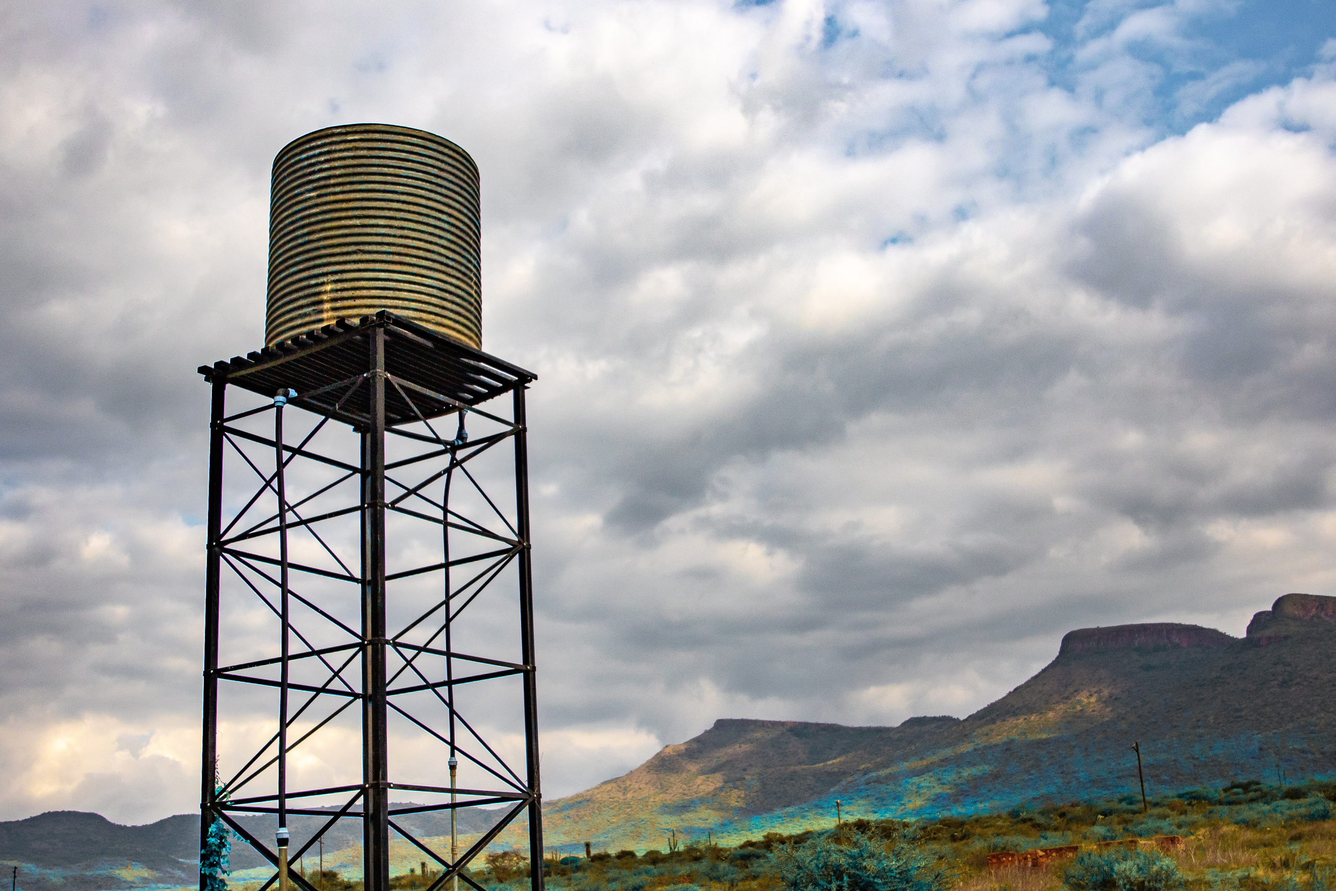
Water pollution negatively affects marine life and human health, necessitating actions to reduce it and preserve clean water sources.
METHODS OF WATER TREATMENT
We will discuss two techniques.

Slide 5
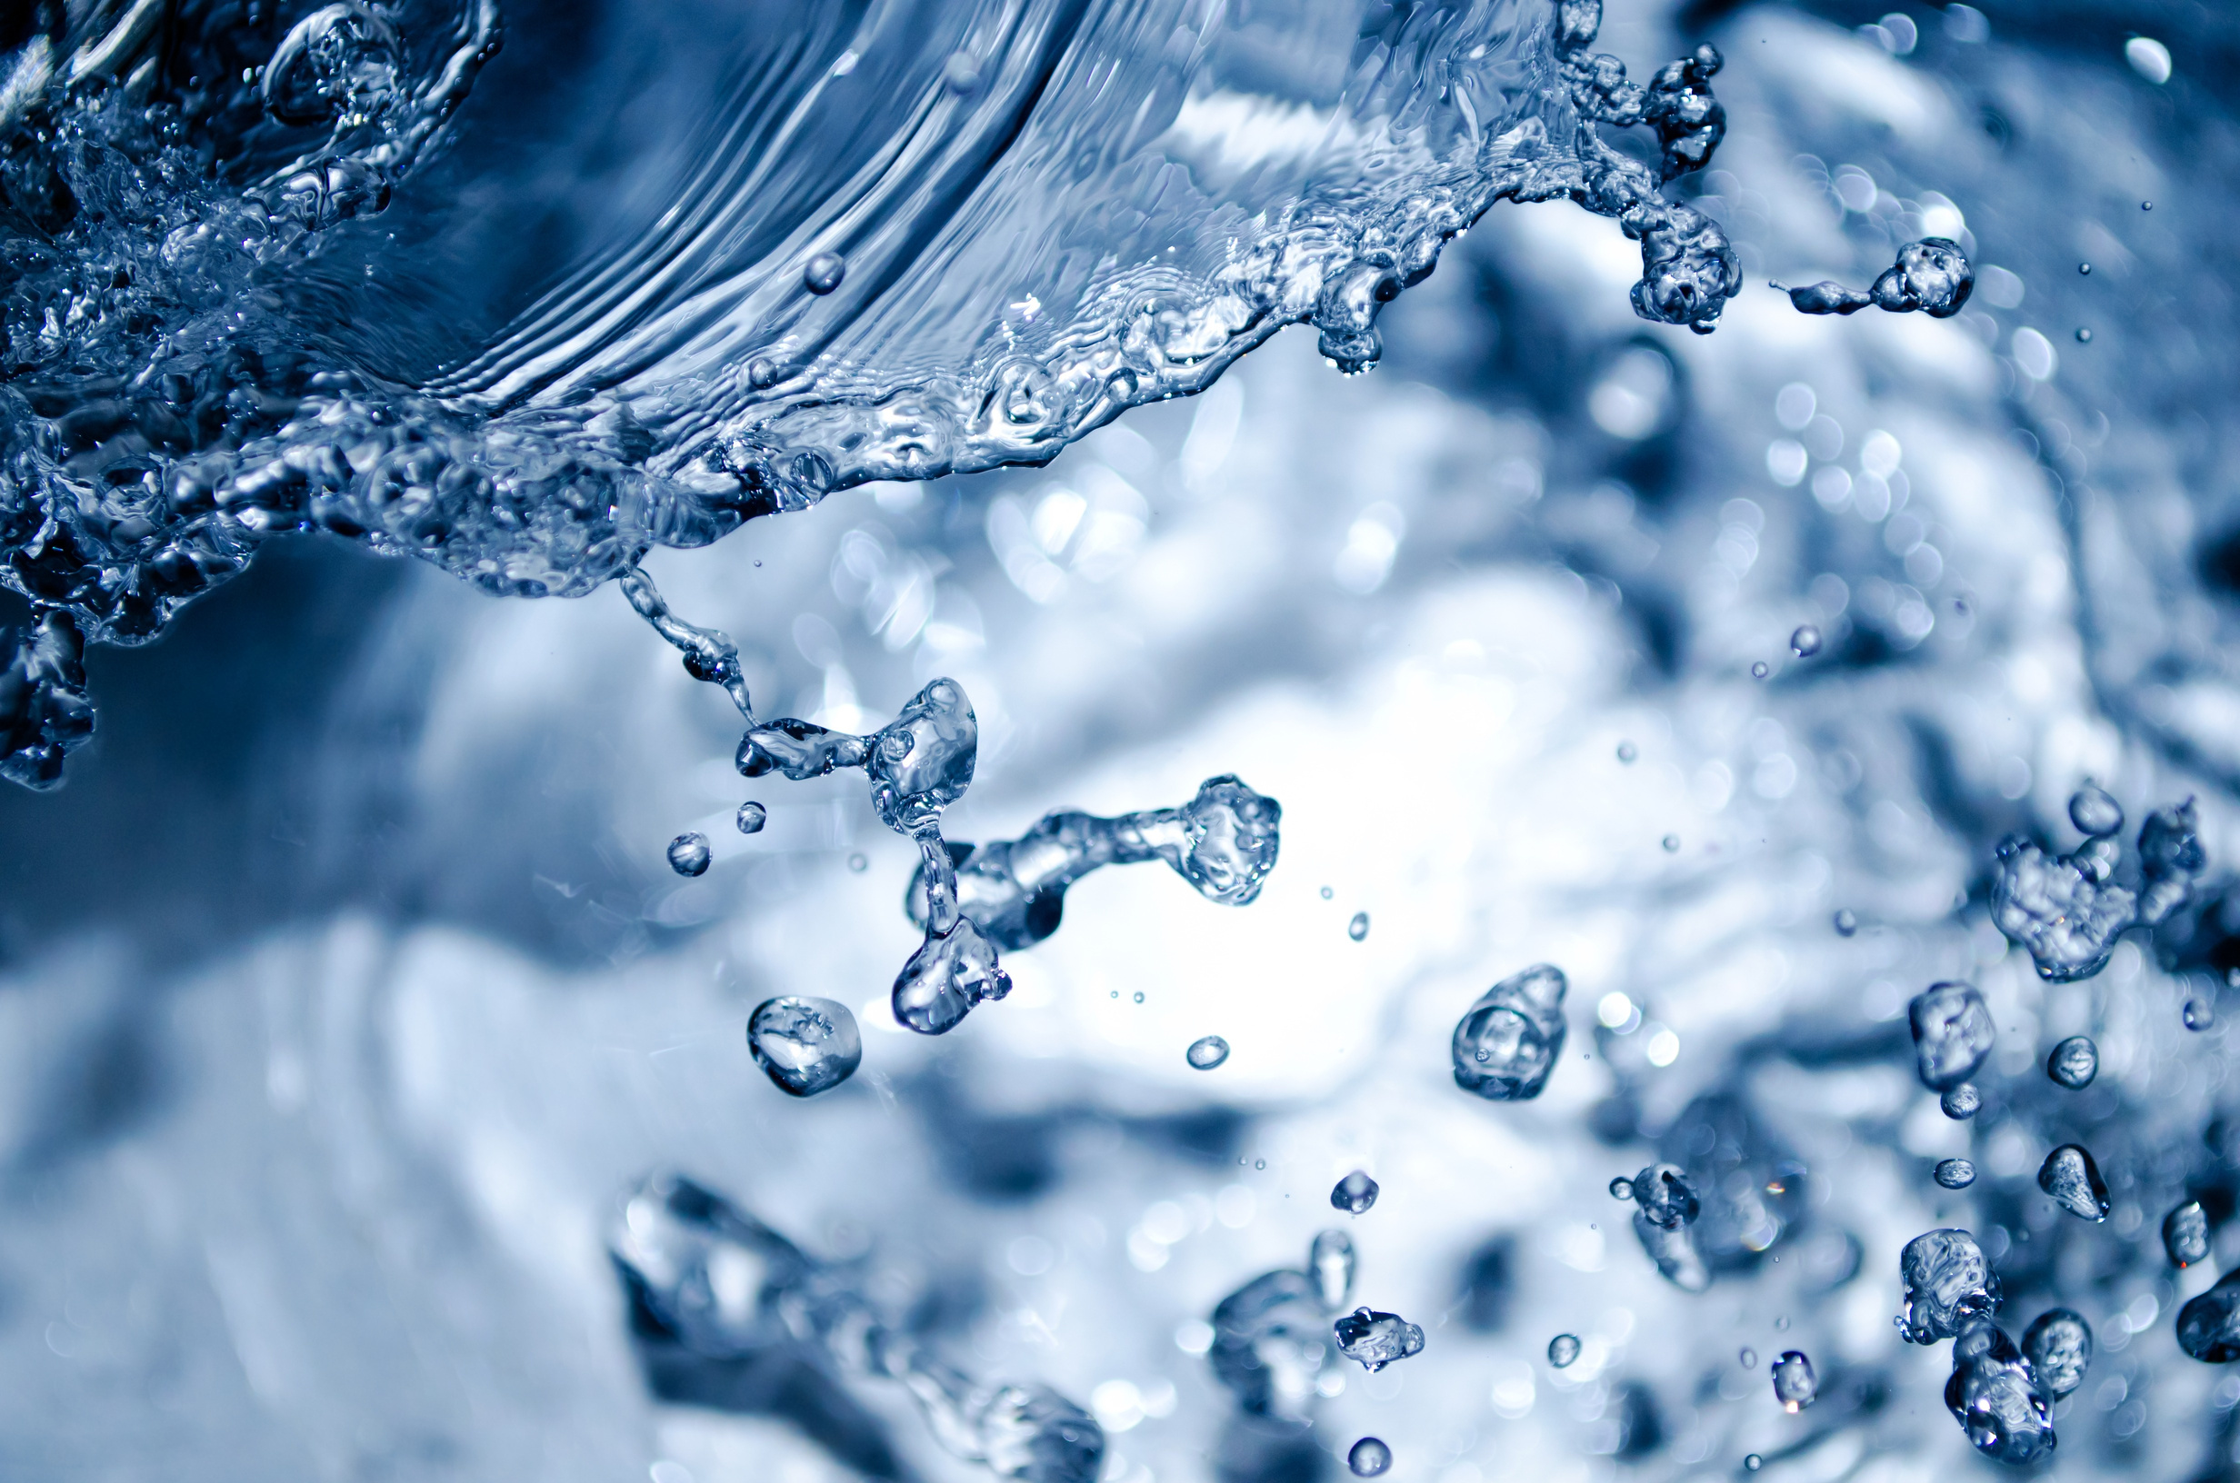
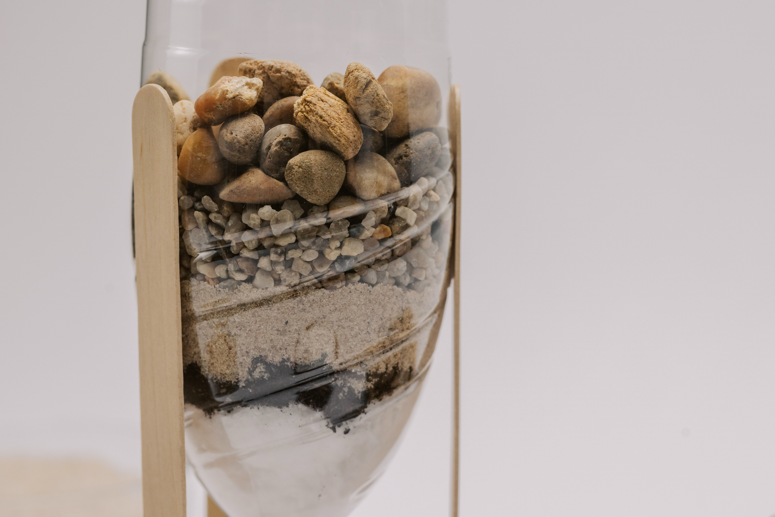
TRADITIONAL TECHNIQUES
2.2 CHEMICAL OXIDATION
2.1 SAND FILTRATION
  Process: Chemicals like chlorine or ozone react with pollutants, breaking them down into less harmful substances.
  Applications: Used in drinking water treatment and wastewater management.
  Mechanism: Water is passed through layers of sand to remove suspended particles and impurities.
  Effectiveness: This method is simple and effective in reducing water pollution.

Slide 6
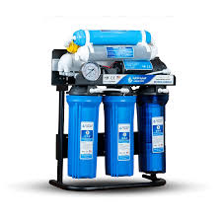
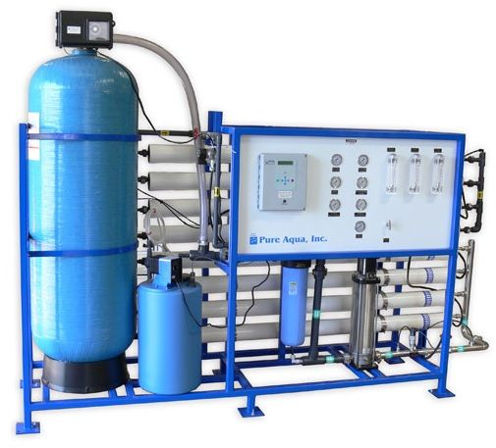
MODERN
TECHNIQUES
2.1 NANO FILTERS
2.2 REVERSE OSMOSIS
  Technology: Uses nanomaterials for water filtration, allowing the removal of fine particles and pollutants.
  Features: Increases purification efficiency while reducing the footprint of the equipment.
  Process: Utilizes a thin membrane to pass water, effectively removing salts and contaminants.
  Uses: Widely used in desalination and improving drinking water quality

Slide 7
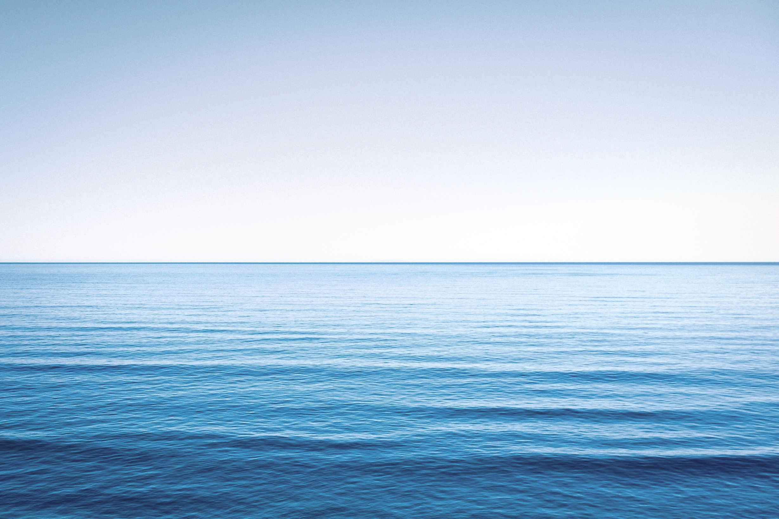
Water Resource Management
SUSTAINABILITY OF WATER RESOURCES
  Planning: Involves assessing available sources and ensuring fair distribution.
  Monitoring Systems: Techniques to track water levels and contaminants.

Slide 8
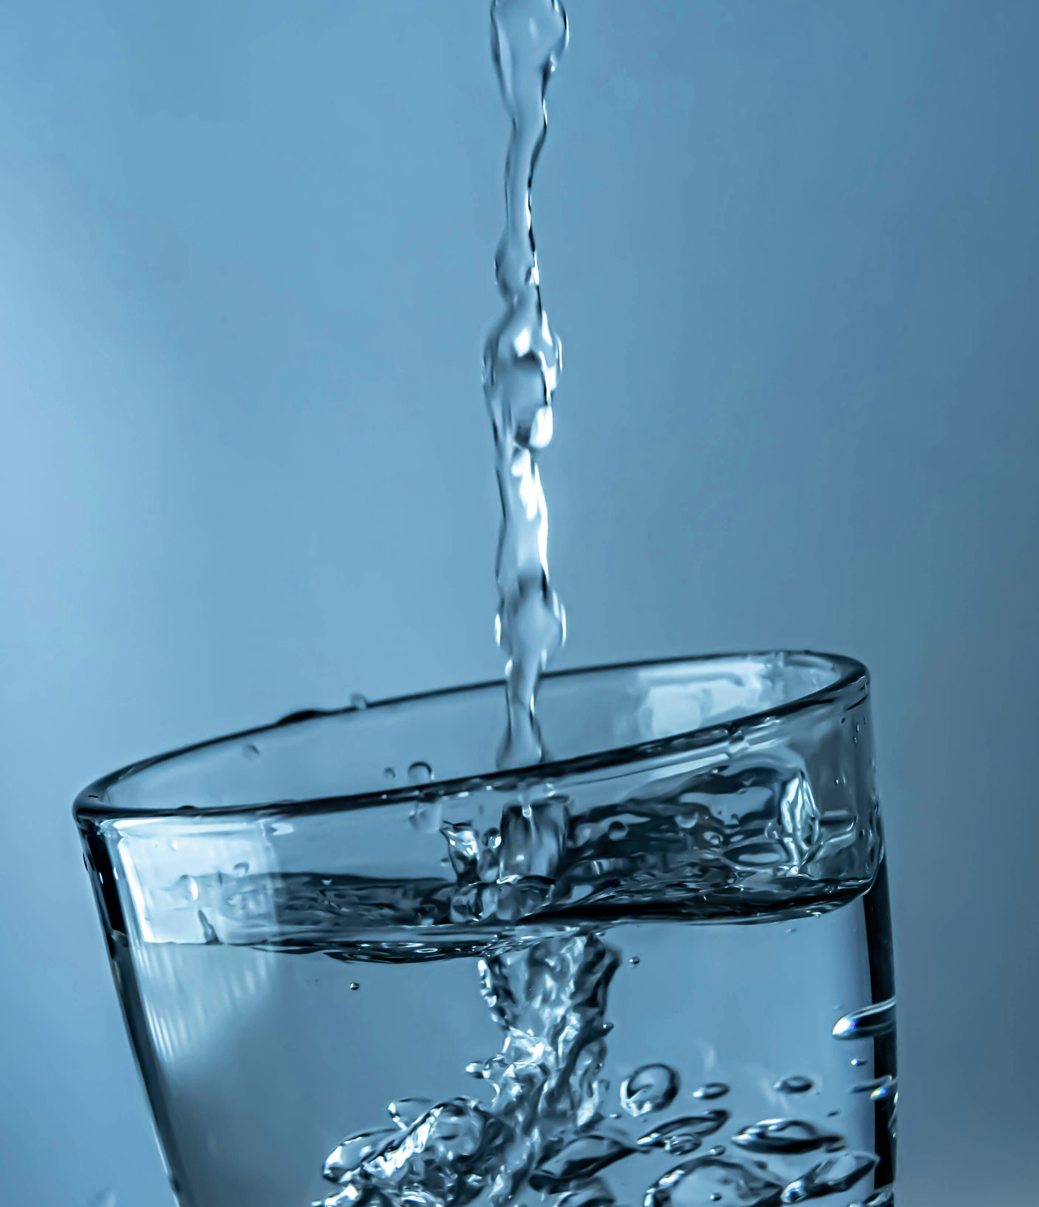
HOW YOU CAN HELP ??
WATER CONSERVATION
  Community Awareness and Conservation Methods
Awareness Campaigns: Organizing community programs to educate people about the importance of water and conservation techniques.
Daily Practices: Encouraging wise water use in daily activities such as washing and bathing.

Slide 9
RIMAH BERCH
BENHOUMER NOUR EL HOUDA
THANK YOU!
Let's embrace the wonders of nature and commit to its preservation.

