Slide 1


Chapter 4
Presentation of a manuscript (or written work)
Dr: Baatouche .S

Slide 2


A DEFENSE
CHAPTER 4
PRESENTATION OF A MANUSCRIPT
Definition:
The act of presenting an intellectual work to obtain a degree (Bachelor's, Master's, Doctorate, etc.) before a jury responsible for assessing its merit and capable of awarding the degreeIt is characterized by :
Is not a summary of the work, especially not a reading of the completed work.
Does not cover everything contained within the work.
Does not develop the full argument and analysis of the research.
Communicates scientific facts and the corresponding argument.
Convinces the audience.
Must be scientifically interesting and capture the audience's attention.

Slide 3





CHAPTER 4
PRESENTATION OF A MANUSCRIPT
Introduction
The oral presentation consists of three parts
Development
or
discussion
Conclusion

Slide 4

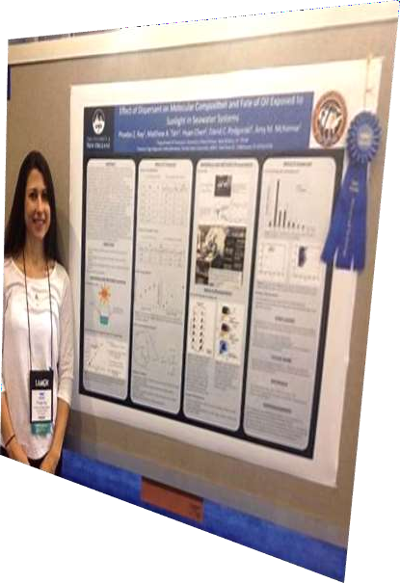
scientific poster
CHAPTER 4
PRESENTATION OF A MANUSCRIPT
A scientific poster is a presentation or display that allows you to present scientific work to other researchers or doctoral students at scientific meetings or conferences. Its purpose is to bring together, on a single page, all the information about the study being presented.

Slide 5
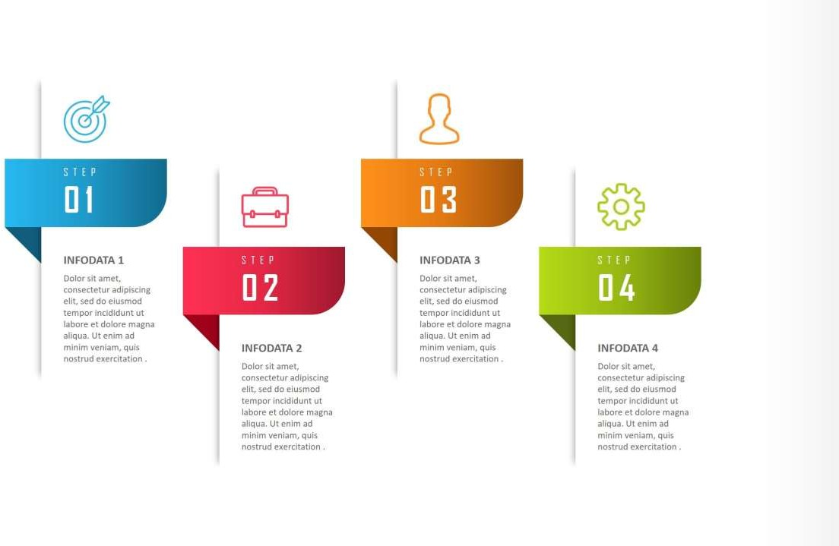



Basic steps to prepare a poster
CHAPTER 4
PRESENTATION OF A MANUSCRIPT
Define the main theme
Choose the
structure
Choose the
medium
Construct
the frames
You must identify the poster's main
message, the
key idea.
This involves choosing the reading direction, natural or
explicit, of
the poster
An A₀-sized PowerPoint slide (95 cm wide – 105 cm high)
in portrait or
landscape mode.
summary;
introduction
Materials and methods;
results;
analysis of results;
Conclusion

Slide 6










CHAPTER 4
PRESENTATION OF A MANUSCRIPT
Title
Authors and Affiliations
References
Poster
Composition
Conclusion
Introduction
Materials and methods
Results

Slide 7


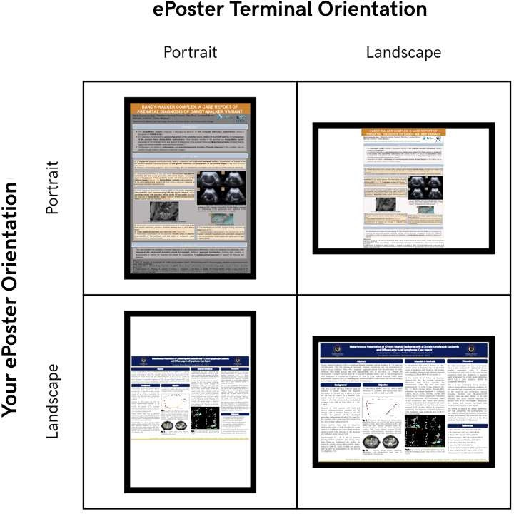
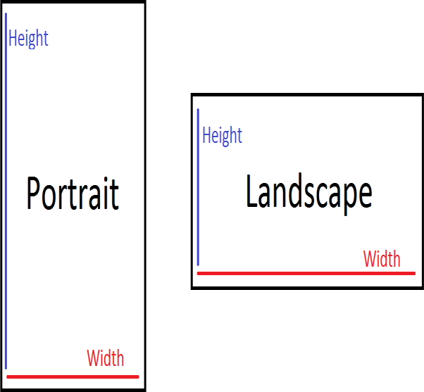
Designing the Poster Format
CHAPTER 4
PRESENTATION OF A MANUSCRIPT
Poster format
There are two main types of scientific poster forms:

Slide 8


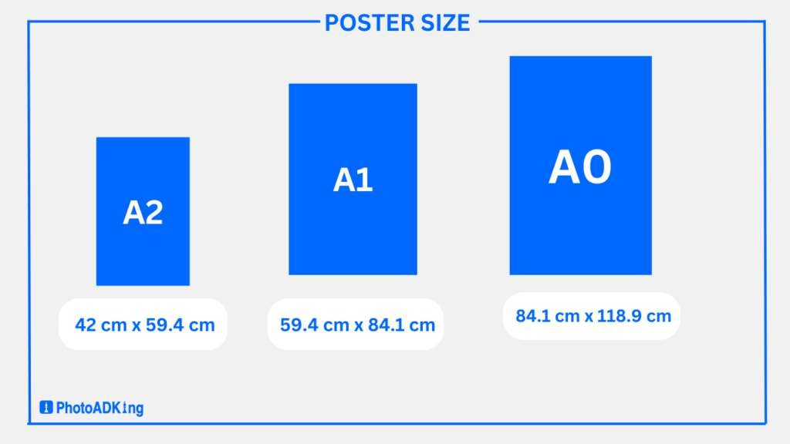
Designing the Poster Format
CHAPTER 4
PRESENTATION OF A MANUSCRIPT
Poster format

Slide 9
CHAPTER 4
PRESENTATION OF A MANUSCRIPT
Designing the Poster Format
Poster format
To control the shape of the poster we go to in PowerPoint
conception
Slide size
Custom slide size

Slide 10



Designing the Poster Format
CHAPTER 4
PRESENTATION OF A MANUSCRIPT
Formatting
84
36
24

Slide 11



Designing the Poster Format
CHAPTER 4
PRESENTATION OF A MANUSCRIPT
Formatting

Slide 12

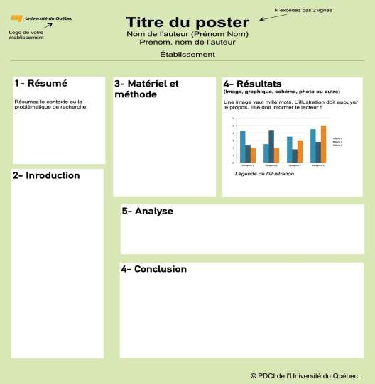
Designing the Poster Format
CHAPTER 4
PRESENTATION OF A MANUSCRIPT
Formatting

Slide 13


CHAPTER 4
PRESENTATION OF A MANUSCRIPT
Designing the Poster Format
Colors
Use a maximum of two to three main colors, preferably pastels. Therefore, favor contrasting colors between the text and the background, for example, dark text on a light background.

Slide 14

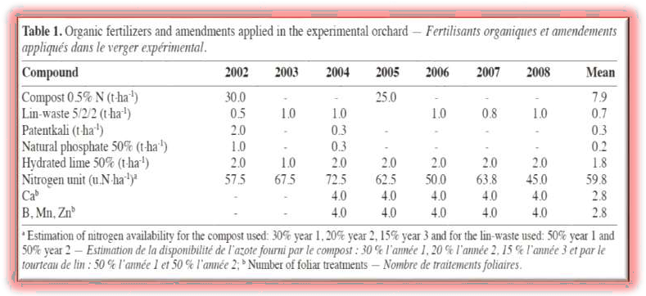

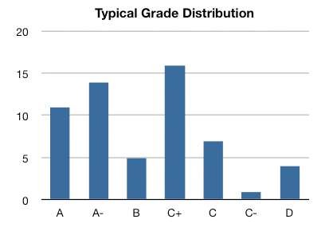
Designing the Poster Format
CHAPTER 4
PRESENTATION OF A MANUSCRIPT
Illustrations
Illustrations (tables, graphs, diagrams) must be contained: a title, numbered reference them in the text

Slide 15

CHAPTER 4
PRESENTATION OF A MANUSCRIPT
A poster must be:
Attractive : to capture attention: The title must attract the reader, and the information must be as graphic as possible
Structured: to facilitate reading: The reader must be guided through their reading. To do this:
Identify the different parts of the poster (by titles, section numbers, colors, etc.).
Or adopt a natural or explicit direction of movement through the poster.
Concise : to focus communication on the message :
The text must be clear and precise, the sentences short, and the font appropriate (not in capital
letters, etc.).
White spaces are important. Ideally, a mix of 30% text, 40% illustrations, and 30% empty
space is recommended. Avoid overusing colors, which impair readability.

Slide 16


Basic steps to design a scientific poster
CHAPTER 4
PRESENTATION OF A MANUSCRIPT
Choose one of the available programs for designing scientific posters
PowerPoint Publisher
Some sites to design scientific posters for free
PhD posters
posteres presentations
makesigns scientific posters

Slide 17

Poster objectives
CHAPTER 4
PRESENTATION OF A MANUSCRIPT
The purpose of the poster is to present your research work to uninitiated readers; it's a kind of scientific business card. You need to put yourself in the shoes of the person who will read it:
The problem and vocabulary must, therefore, be simple.
The poster must attract attention ; it's a visual communication tool.
The poster serves to convey a message : it's to inform.
The poster must make the reader want to delve deeper into the subject: it's to convince.
The poster must be educational, present a logical sequence, and not be too dense. Important : the poster must be self-contained, meaning it can be understood even if you're not there to explain it.

