Slide 1
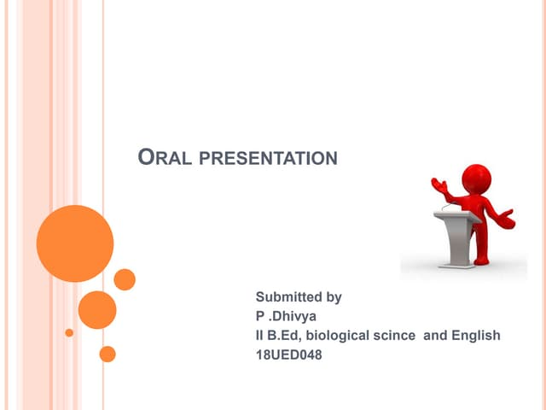
PRESENTATION OF AN ORAL PRESENTATION
Chapter
2
Dr: Baatouche .S

Slide 2
Chapter2 presentation of an oral presentation
Introduction :
Each student, regardless of their field of study or level, is required to make presentations on various topics, either suggested or assigned. In order for this offer to be successful, the following stages must be adhered to :
Comprehensive preparation of the “content” to be conveyed, which includes collecting, selecting and organizing relevant information based on the topic of presentation and the audience in question.
Comfortable with public speaking, which involves oral and physical expression skills and requires adaptation to the specific communication situation.

Slide 3

Chapter2 presentation of an oral presentation
ORAL PRESENTATION PROCESS
  The process of collecting, organizing, and preparing data and information.
  Presenting information to others.
  Evaluating and critiquing performance during the presentation.

Slide 4
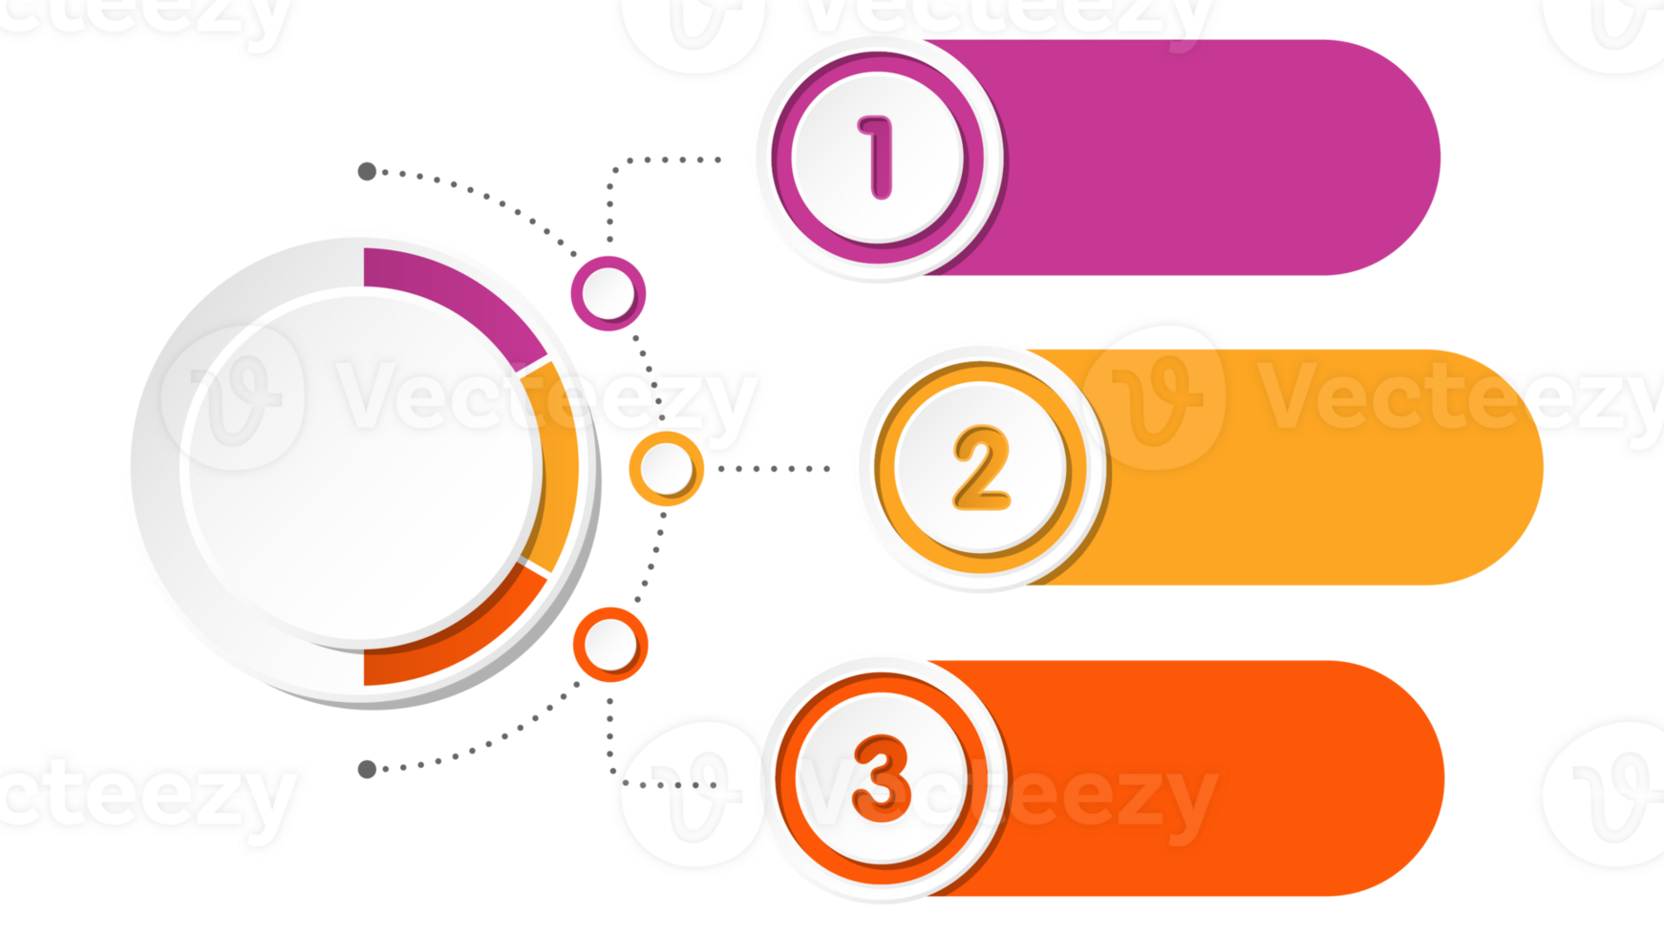
Chapter2 presentation of an oral presentation
Short presentation
(5 to 10 minutes),
Types of
Oral Presentations
Intermediate
presentation
(15 to 20 minutes),
Long presentation
(around 45 minutes).

Slide 5
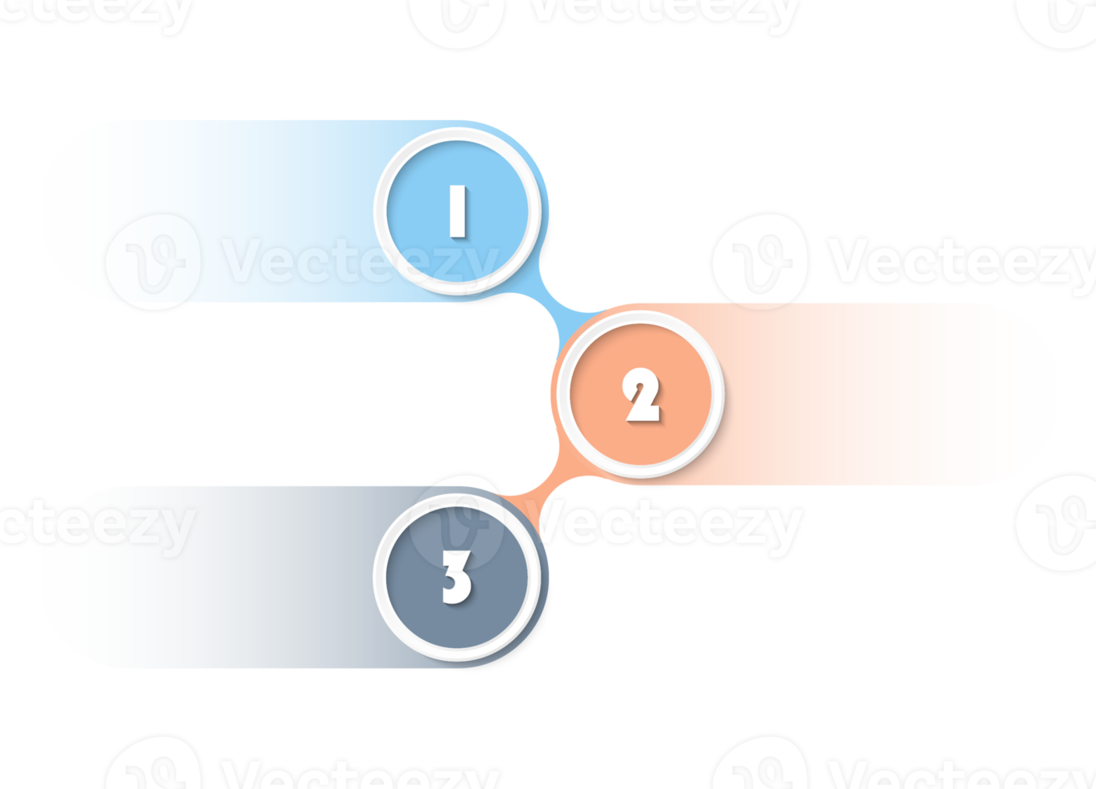
Chapter2 presentation of an oral presentation
The Typical Structure of a Presentation
INTRODUCTION
BODY (DEVELOPMENT)
CONCLUSION

Slide 6


Slide 7
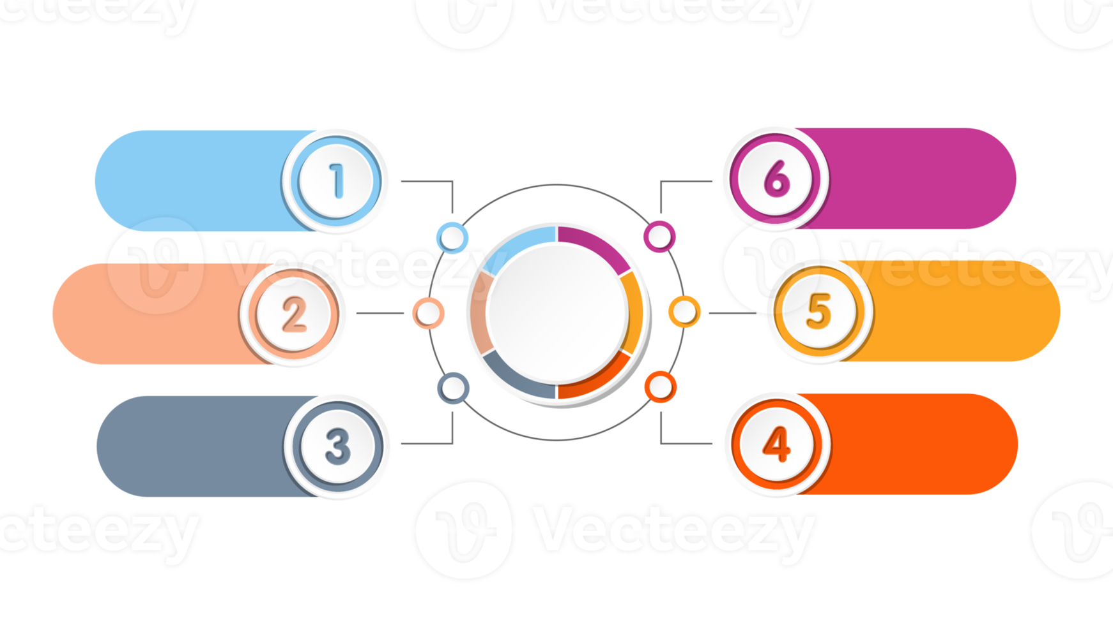
Chapter2 presentation of an oral presentation
PRESENTATION
OF AN ORAL PRESENTATION
PROPER
PLANNING
Adapting the
Speech to the Audience
STRESS
MANAGEMENT
ARGUMENTATION
FOCUS
LANGUAGE

Slide 8
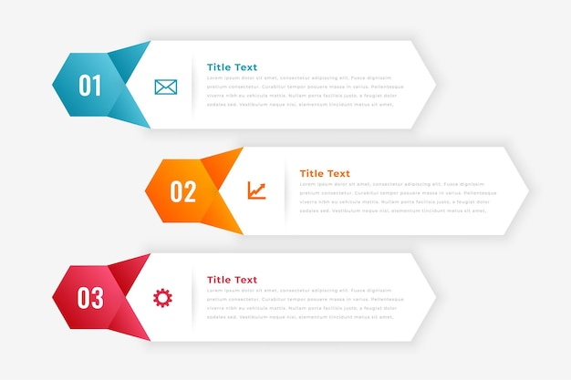
Chapter2 presentation of an oral presentation
THE VOICE
ADAPTING THE
SPEECH TO
THE AUDIENCE
VERBAL EXPRESSION
NON-VERBAL EXPRESSION

Slide 9
Chapter2 presentation of an oral presentation
VERBAL EXPRESSION
INTRODUCTION
Mr. President, gentlemen members of the jury, gentlemen attendeesالسلام عليكم ورحمة الله و بركاته I am honored to present to you my work entitled...under the direction of Mr. Cover page).
"The topic of my presentation is...« (Cover page). "This presentation will cover...« ( plan)
"First of all, let me give you an overview of...« (introduction )
"I will start by introduction..."(introduction )
"Let’s begin with introduce ..."(introduction )

Slide 10
Chapter2 presentation of an oral presentation
VERBAL EXPRESSION
DEVELOPMENT
"Moving on to the next point...""الانتقال إلى النقطة التالية ..."
"In addition to that...« بالإضافة إلى ذلك ...« "Now that we’ve covered [topic], let’s move on to... " or "Let’s shift our focus to...""الآن بعد أن غطينا [الموضوع] ، دعنا ننتقل إلى ... " أو "دعنا نحول تركيزنا إلى ...
"Now, I’d like to turn to...""الآن ، أود أن أنتقل إلى ..."
"One of the key points I’d like to highlight is..."إحدى النقاط الرئيسية التي أود تسليط الضوء عليها هي .
"It is important to note that...""من المهم ملاحظة أن ..."
"This leads us to the next important point, which is..."هذا يقودنا إلى النقطة المهمة التالية ، وهي ..."
« i can give you an example..."أستطيع أن أعطيك مثالا ...
"This can be seen in...""يمكن رؤية هذا في ..."

Slide 11
Chapter2 presentation of an oral presentation
VERBAL EXPRESSION
CONCLUSION
"To conclude, I’d like to summarize the main points..."في الختام ، أود أن ألخص النقاط الرئيسية ..."
"In conclusion, we can see that..."في الختام ، يمكننا أن نرى أن ..."
"To wrap up, I believe..."في الختام ، أعتقد ..."
"Finally, I want to leave you with this thought...""أخيرا ، أريد أن أترككم مع هذه الفكرة ..

Slide 12
Chapter2 presentation of an oral presentation
VERBAL EXPRESSION
Questions/Answers
"I’d be happy to take any questions now.""سأكون سعيدا بالرد على أي أسئلة الآن."
"If you have any questions, feel free to ask.""إذا كان لديك أي أسئلة ، فلا تتردد في طرحها."
"Thank you for your attention. Any questions ?""شكرا لك على اهتمامك. أي أسئلة؟
"Does anyone have any questions about this?""هل لدى أي شخص أي أسئلة حول هذا؟"

Slide 13
Chapter2 presentation of an oral presentation
VERBAL EXPRESSION
Strengthen an argument
"It’s clear that...""من الواضح أن ..."
"This clearly shows that..."هذا يدل بوضوح على أن ..."
"The evidence supports the idea that..."تدعم الأدلة فكرة أن ..."

Slide 14
Chapter2 presentation of an oral presentation
VERBAL EXPRESSION
Express a doubt or reservation
"It’s possible that...""من الممكن أن ..."
"Some may argue that...""قد يجادل البعض بأن ..."
"There might be another perspective, but...""قد يكون هناك منظور آخر ، لكن ..."

