Slide 1


Methodology of presentation
Dr: Baatouche .S

Slide 2
Module content : mothodology of presentation
Chapitre 1
The oral presentation
Chapter 3
Plagiarism and Intellectual Property
Chapter 2
Presenting an Oral Presentation
Chapter 4
Presenting Written Work

Slide 3

Chapter 1
Dr: Baatouche .S

Slide 4
Chapter1 Oral presentation
Definition of oral communication
Oral communication is the transfer of information from sender to receiver by verbal and visual means in the presence of the both. The main feature of oral communication is its richness, as it is considered a means of rapid and direct communication. As is the case in speeches, discussions, etc..

Slide 5
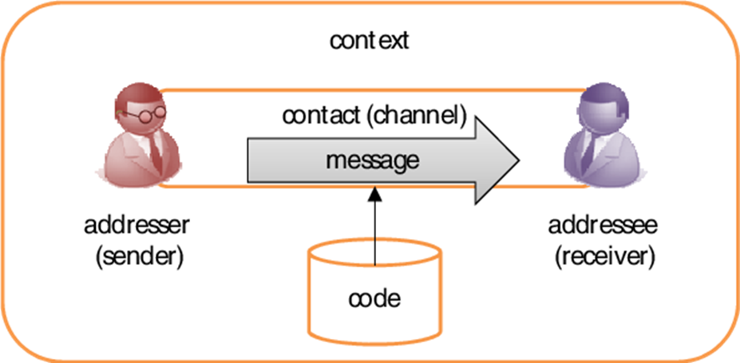
Chapter1 Oral presentation
Oral communication system
Diagram 1: the oral communication system according to Jakobson

Slide 6
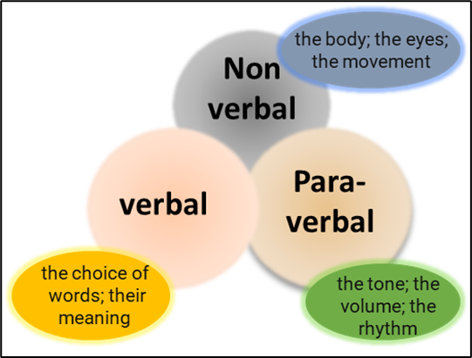
Chapter1 Oral presentation
Types of Oral Communication
Diagram 2 : the types of oral communication.

Slide 7

Chapter1 Oral presentation
The objectives of using oral communication
Oral communication is used to :
convey opinions
emotions.
ideas, beliefs and other information in many everyday situations.

Slide 8

Chapter1 Oral presentation
Advantages of Oral Communication
This method of communication is a fast and direct.
It also saves a lot of time and effort.
This method of communication allows for immediate feedback and is therefore a form in which two-way communication can be activated..
The other main advantage of this method of communication is that it helps in conveying the message with the desired pitch and tone of the message.
This communication associated with an appropriate type of verbal communication, oral forms can create trust and loyalty from the sender to the receiver's side.

Slide 9
Chapter1 Oral presentation
Disadvantages of Oral Communication
This method of communication can be misinterpreted very easily.
The listener cannot retain verbal messages in his memory for a long time.
Oral communications are often considered informal.
Effective oral communication requires good speaking skills. Less confident people may find it difficult to express their ideas clearly, which prevents effective communication.

Slide 10
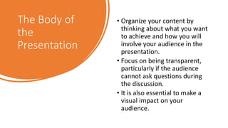
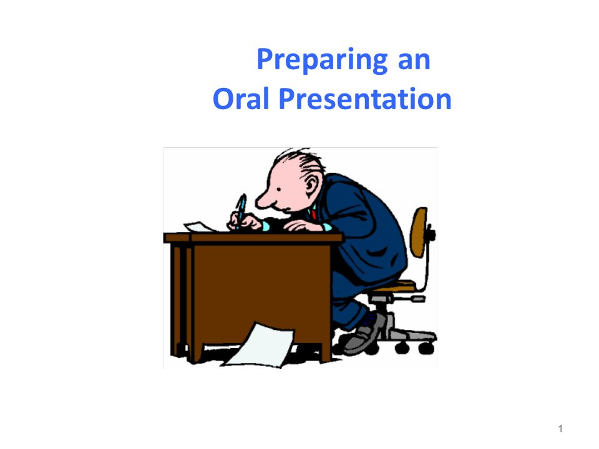
PREPARING
AN
ORAL
PRESENTATION

Slide 11
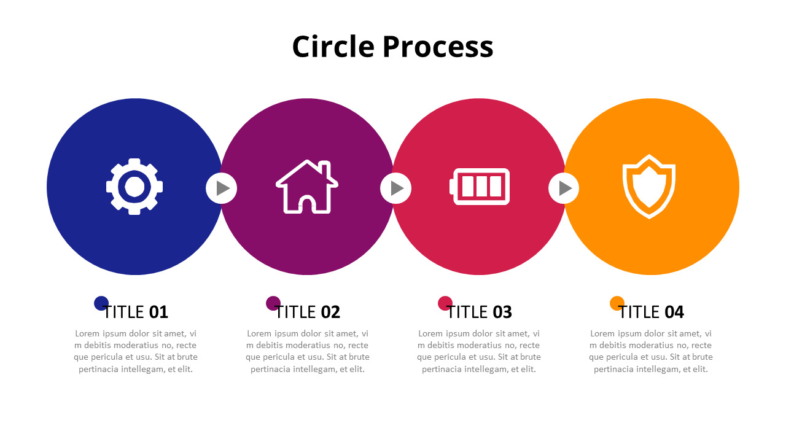

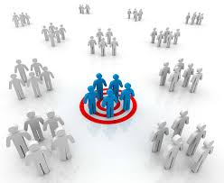
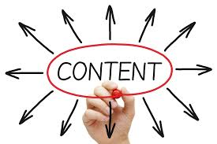
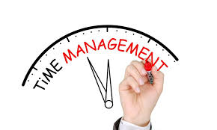
PREPARING AN ORAL PRESENTATION
CONTENT
PLANNING
AND
STRUCTURE
TARGET AUDIENCE
TIME
MANAGEMENT

Slide 12
Chapter1 Oral presentation
Preparing an oral presentation
Planning and Structure :
Gather the key information from the thesis and organize it in a way that is suitable for the presentation
Make sure they are coherent and in a logical sequence.
Make sure that the presentation you are preparing contains their essential elements: an introduction, a main body, and a conclusion.
Write down the main headings included in the presentation, so that each heading appears on a separate sheet of paper.
After preparing the entire text, you can access your preferred program and start preparing the presentation.

Slide 13
Chapter1 Oral presentation
Preparing an oral presentation
Planning and Structure :
It is preferable to use audiovisual media to animate the presentation (PowerPoint presentation or documentary, Google Slides……. ).
Choose a simple template that fits the theme of the note and avoid bright colors and busy designs.
Prefer index cards over papers; One index card for each title and business plan, one or two index cards at most for the introduction and conclusion, and between 10 and 30 index cards for the presentation, which is enough for a 15-20 minute presentation.

Slide 14
Chapter1 Oral presentation
Preparing an oral presentation
Planning and Structure :
Use appropriate visuals and visual effects to illustrate important points and make the presentation more interesting. Add transitions between slides to improve the flow of your presentation.
Use headings, paragraphs, bullet points, or charts to make the information easier to understand.
Use images, illustrations, and charts to add value and clarify the information.

Slide 15
Chapter1 Oral presentation
Preparing an oral presentation
Target Audience
Make sure to use short text and key points in your slides rather than writing long sentences. This helps to focus the audience and make the presentation easier to follow.
Make sure the information provided in the presentation is understandable and easy to digest

Slide 16
Chapter1 Oral presentation
Preparing an oral presentation
Content
Be concise and precise: Provide relevant information and support it with concrete examples or evidence.
The written presentation accompanying the oral presentation should include an introduction, a body and a conclusion according to a simple plan.
Avoid the urge to say everything, but rather three or four basic ideas are enough and stick to the initial plan applied during Research.

Slide 17
Chapter1 Oral presentation
Preparing an oral presentation
Content :
References are written at the bottom of the document.
You write the main ideas on each document, while the secondary ideas are presented orally.
Organize the ideas into headings.
All visuals and graphics should be simple, professional, precise and clear.
Revise the plan and visuals if necessary.

Slide 18
Chapter1 Oral presentation
Preparing an oral presentation
Time management :
Stick to the time allotted for your presentation.

Slide 19
Chapter1 Oral presentation
Different types of plans
Definition
An outline is an essential step that follows the research and reading of all necessary documentation for preparing your oral presentation. The outline consists of an introduction, a body (development), and a conclusion. It will help you organize your content.

Slide 20
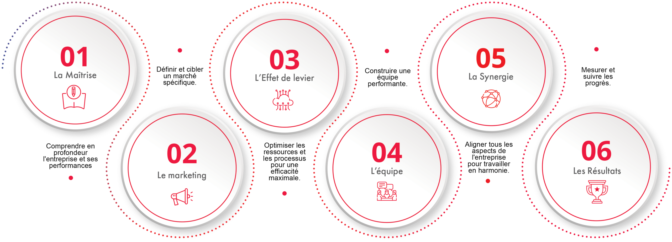


Chapter1 Oral presentation
Different types of plans
Different types of plans are possible
The chronological plan
2
4
From general
to specific
The dialectical
plan
6
The comparative
The reasoning-
based (logical)
plan
The categorical
plan
1
3
5

Slide 21
Chapter1 Oral presentation
Different types of plans
The chronological plan
This plan consists of following the progression of a phenomenon over time: before, now, and in the future. It can take several forms:
Progressive: (in the past, today, tomorrow)
Regressive: (today, recent past, more distant past)
"Out of order": the parts differ in their relation to time, but are not presented in chronological order. This type of plan can be used in writing (for a report or a summary), but it is difficult to make it clear in an oral presentation
Example
Topic: The evolution of distance learning
Past: Learning by correspondence via mail, VHS tapes, or televised courses
Present: Interactive platforms like Zoom, Google Classroom, and Moodle
Future: Fully virtual classrooms using AI and virtual reality technology

Slide 22
Chapter1 Oral presentation
Different types of plans
The comparative plans
This plan is based on contrast or opposition:
Advantages vs. Disadvantages (positive aspects vs. negative aspects, pros vs. cons)
Current situation vs. Past situation
True vs. False
It is essential to highlight your point of view in the conclusion
Example
Topic: Pros and cons of distance learning
Advantages:
  Flexible schedules and learning locations
  Reduced commuting and costs
  Access to a variety of online resources
Disadvantages:
  Social isolation and lack of peer interaction
  Weaker student-teacher engagement
  Challenges in accurately assessing student performance
Conclusion: A blended approach combining in-person and online learning may be the most effective solution.

Slide 23
Chapter1 Oral presentation
Different types of plans
From General to Specific
This plan can be developed in two ways:
General issue → specific issue → analysis of a concrete example
typical example → first generalization → second generalization
Example:
Topic: The role of technology in education
General idea: Technology is transforming all sectors, including education.
Specific focus: Distance learning as a key example of educational transformation
Concrete example: The shift to online classes during the COVID-19 pandemic and how schools adapted

Slide 24
Chapter1 Oral presentation
Different types of plans
The Categorical plan
This involves considering several possible aspects of a problem. These aspects are not necessarily “positive” and “negative” (as in the comparative outline); they are simply “different”.
Example
Topic: Aspects of distance learning
Technical aspect : Internet access, platform usability, device compatibility
Pedagogical aspect: Teaching methods, digital content quality, student engagement
Psychological aspect: Student motivation, mental health, sense of isolation

Slide 25
Chapter1 Oral presentation
Different types of plans
The Dialectical plan
This is the most “classic” structure: thesis – antithesis – synthesis.
Example
Topic: Can distance learning replace traditional education?
Thesis: Yes, it can be an efficient and modern alternative
Antithesis: No, it lacks the essential human interaction and classroom dynamics
Synthesis: Distance learning is a valuable supplement but cannot fully replace traditional teaching

Slide 26
Chapter1 Oral presentation
Different types of plans
The Reasoning-Based (Logical) plan This is a specific case of the previous outline:
Presentation of the situation
Explanation of the causes of this situation
Explanation of the consequences
Possible solution
Example
Topic: Challenges students face in distance learning
Situation: Many students struggle to adapt to online education
Causes: Lack of structure, poor internet access, unsuitable home environments
Consequences: Decline in academic performance, low motivation, digital fatigue
Possible solutions : Provide technical support, train teachers and students, promote hybrid models
.

