Slide 1
Process Simulation in Chemical Engineering
HysysAspen , Aspen+

Slide 2
Courses Index :
Chapter 1: “ processes simulation and modeling”
(2 weeks)
1- Introduction of processes simulation, Mathematical modeling
2- Commercial simulators
3- presentation of HYSYS, Aspen.

Slide 3
Unless the user-designer has some knowledge of what specific computer program can accomplish, on what specific heat transfer equations and concepts the program is based, on which of these concepts has been incorporated into program “ The user designer can be flying blind regarding the results

Slide 4
What's a modeling ?
Modeling : is the act of building (create) a model which represents a system of interest with its all or subset of properties.

Slide 5
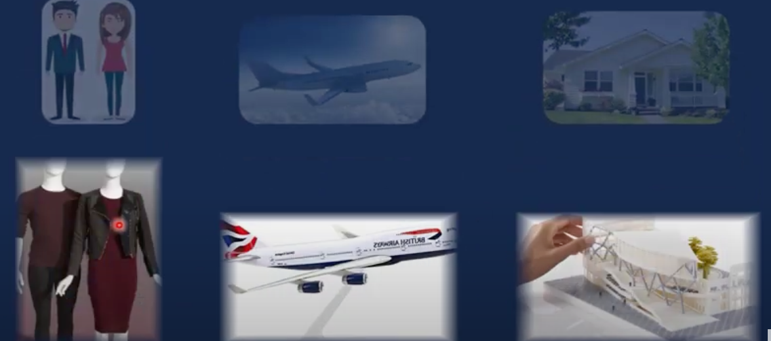
There are two types of model
1- physical model
2-Mathematical model

Slide 6
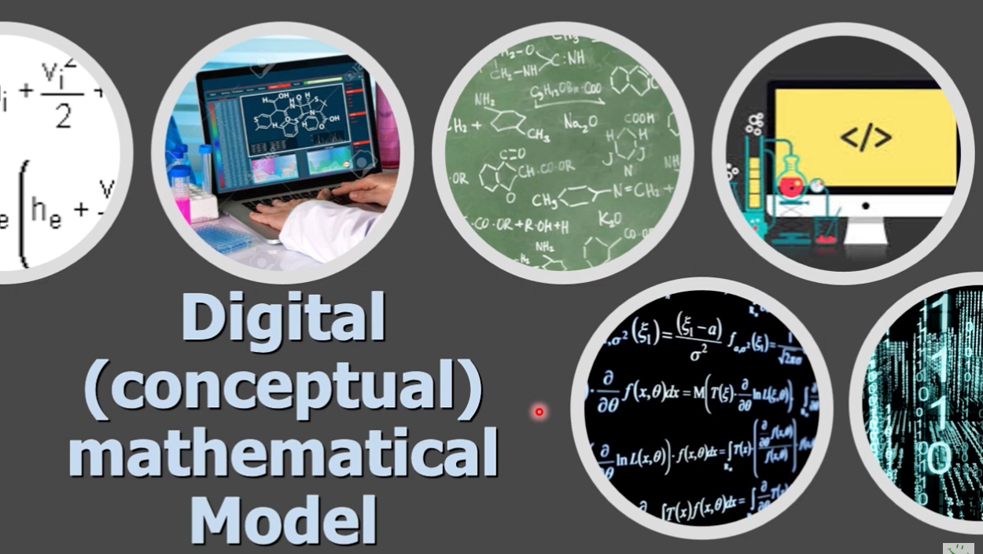
Digital Model (Mathematical Model)

Slide 7
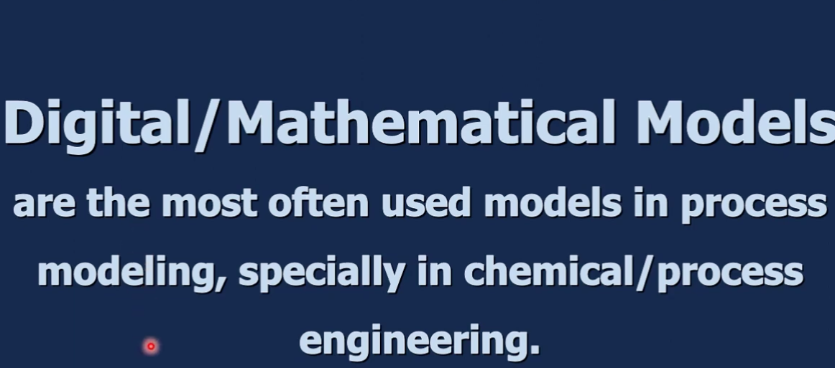
Digital Model (Mathematical Model)

Slide 8
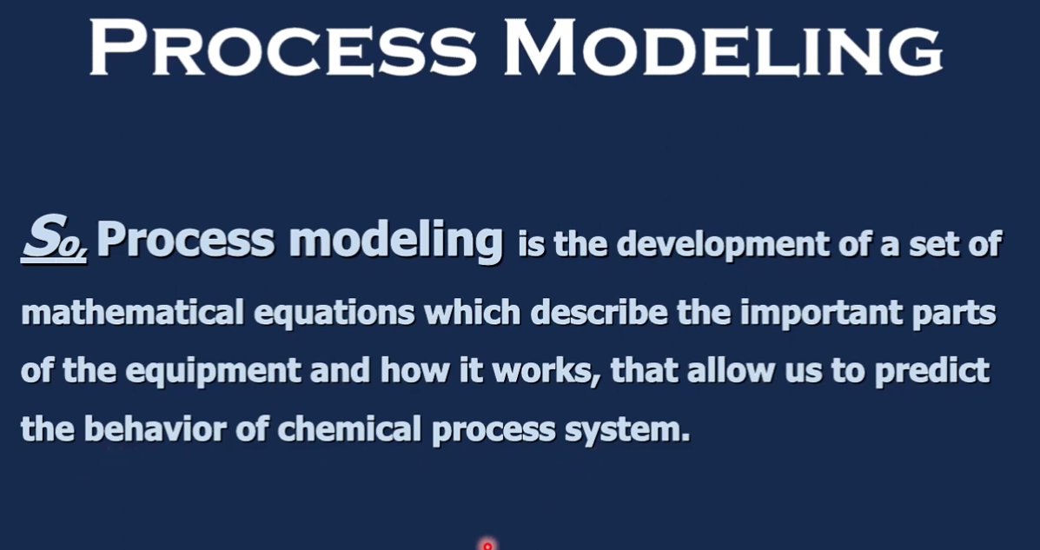

Slide 9
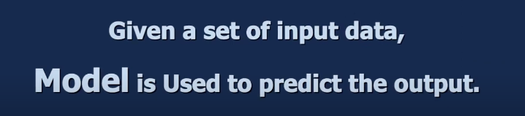
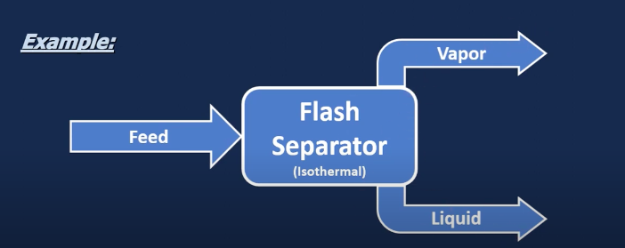
Feed
Vapor
Liquid
Volum
Y molar
L
X

Slide 10

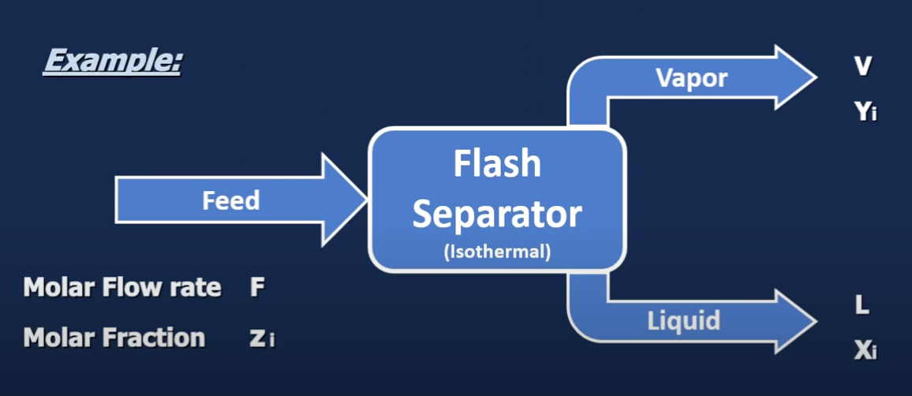

Slide 11
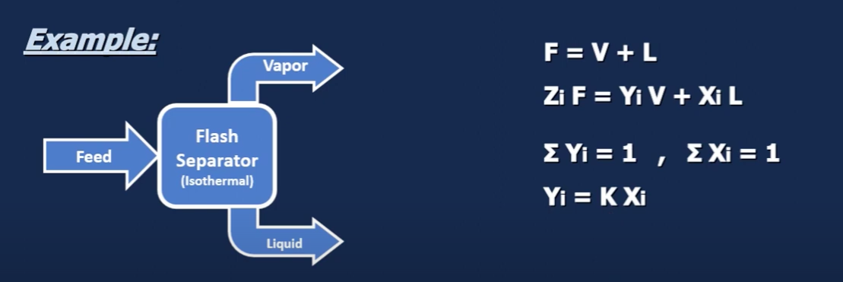
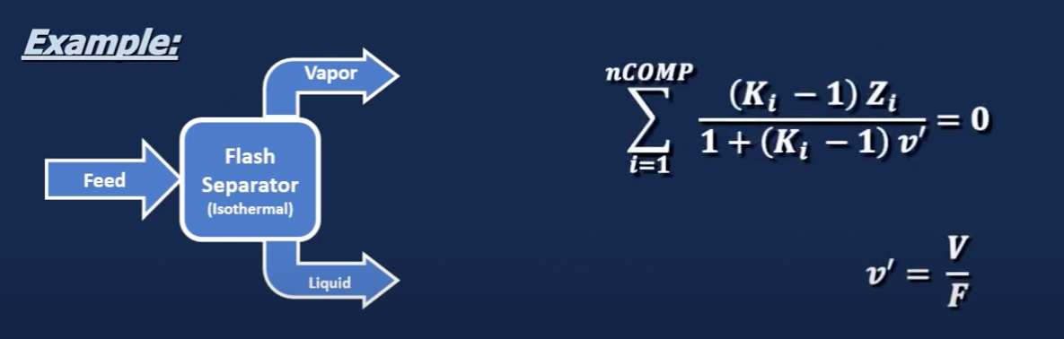

Slide 12
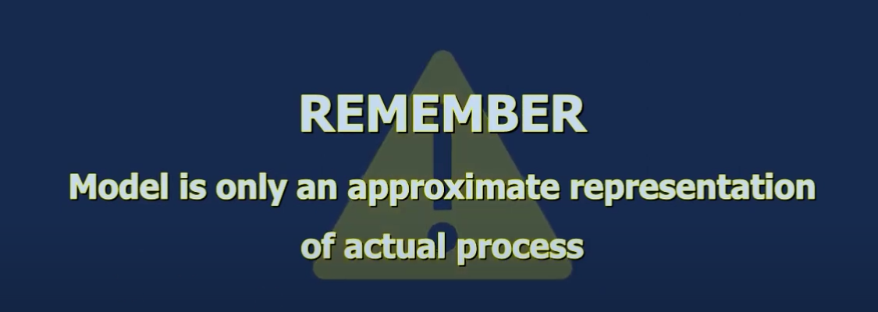

Slide 13
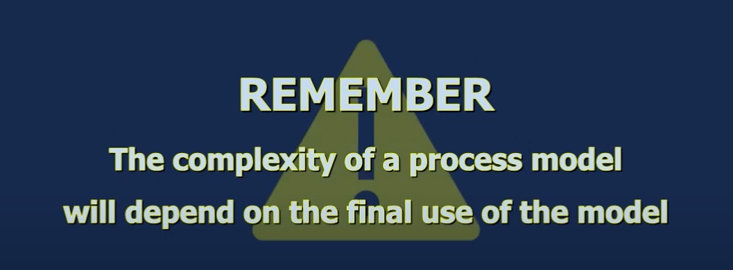

Slide 14
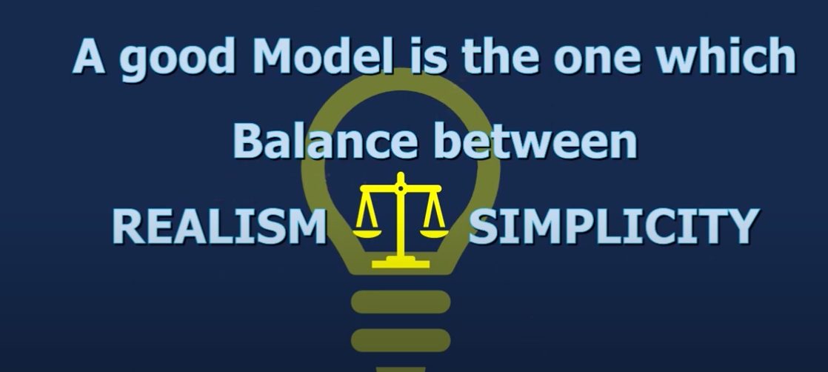

Slide 15
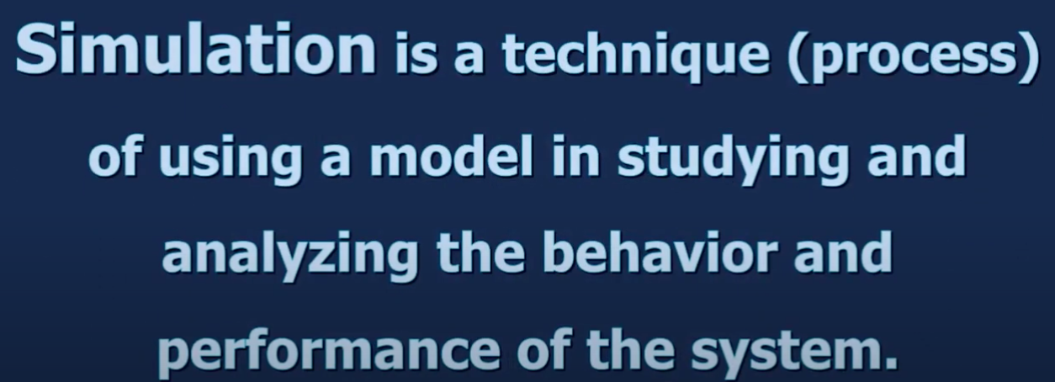

Slide 16
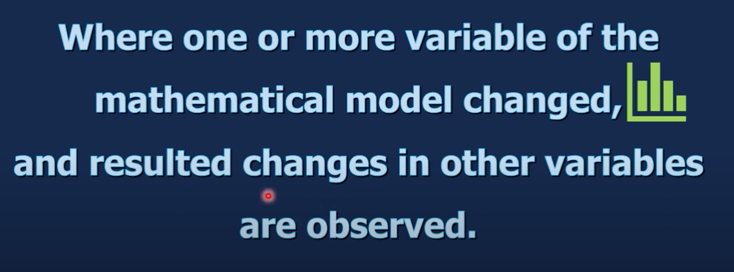

Slide 17
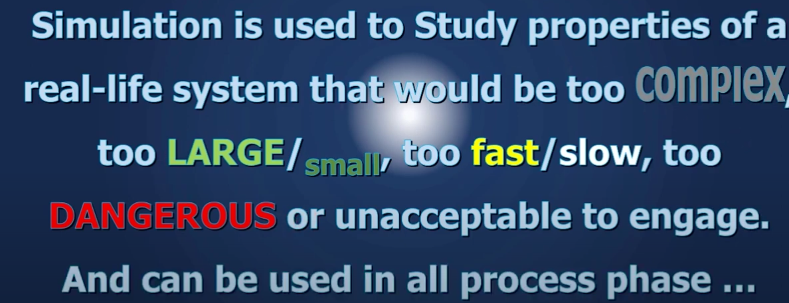

Slide 18
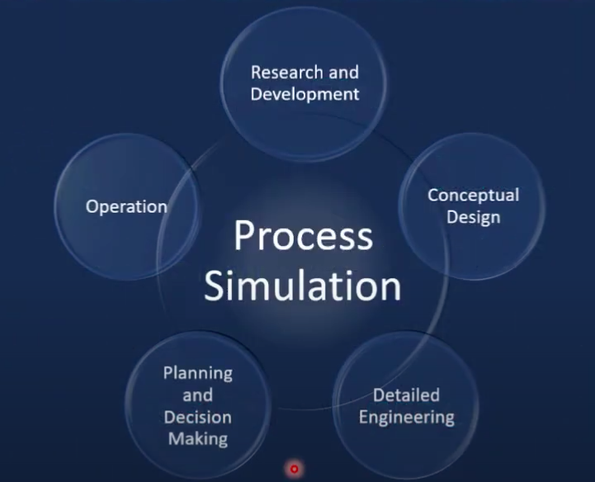

Slide 19
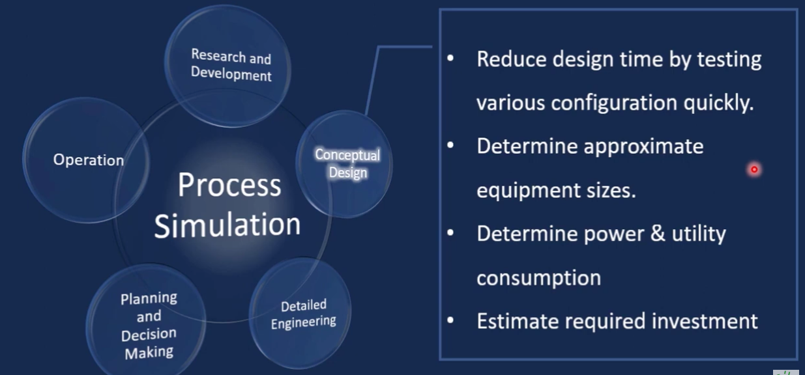

Slide 20
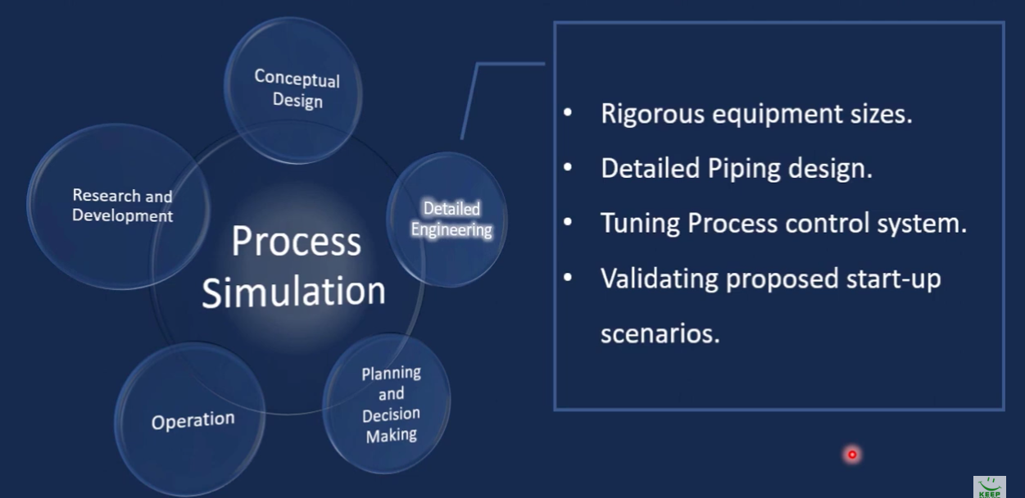
Notes:
1- we can rigorous equipment size
2- we can provide a detailed piping design
3-نظام التحكم في عملية الاختبار
4-التحقق من صحة سيناريوهات البدء المقترحة

Slide 21
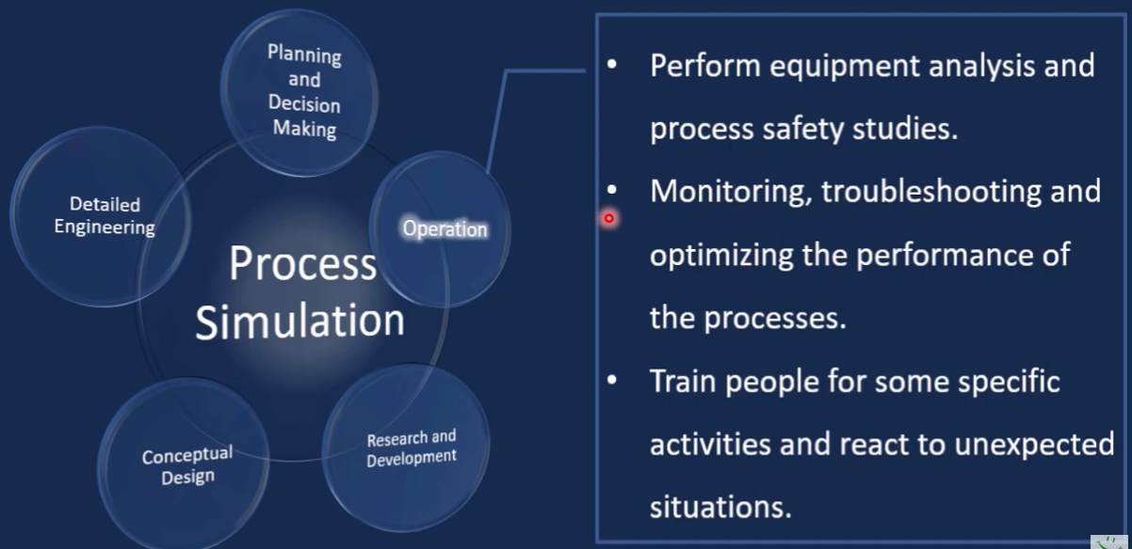

Slide 22
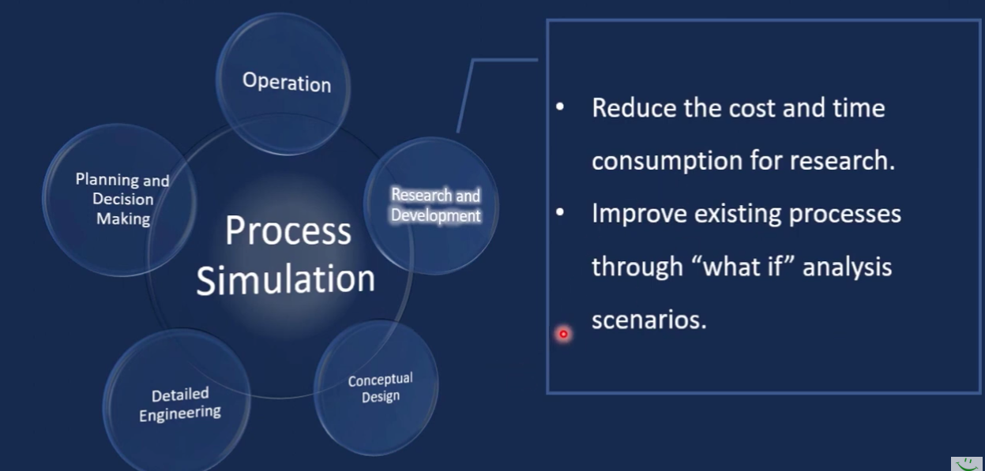

Slide 23
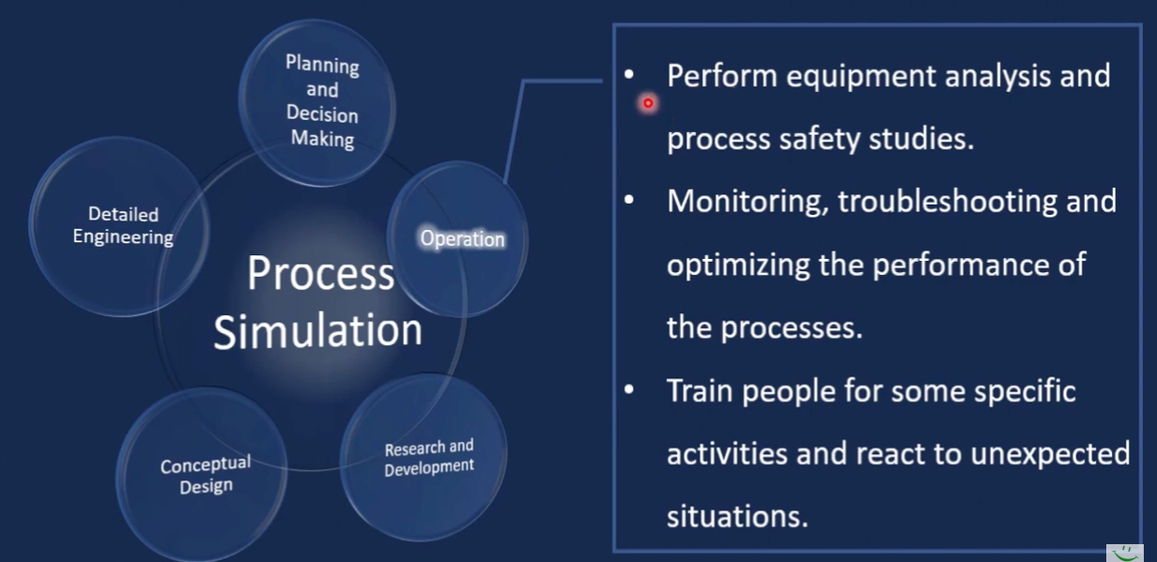

Slide 24
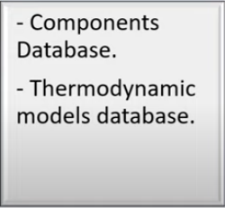
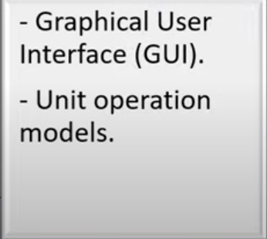
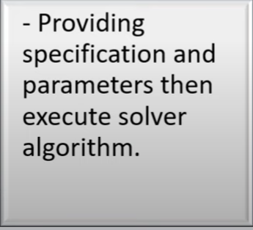
Basic Information Libraries
Flowsheet Construction
Flowsheet Solver

Slide 25

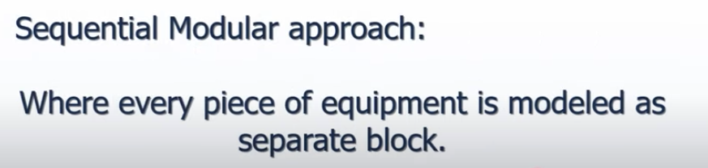

Slide 26
Sequential Modular approach:
Inside each block is embedded the model equation, which attempted to solve if sufficient information is available from user input and/or upstream/downstream blocks.

Slide 27

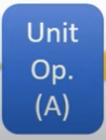
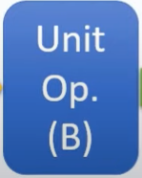





Slide 28

01
Aspen HYSYS PLUS
(AspenTech)
Comprehensive Process Modeling
Dynamic Simulation
User-Friendly Interface
02
PRO/II and DYNSIM
(SimSci)
Dynamic Simulation
Visualization and Analysis
Real-Time Optimization (RTO)
03
Plant Performance Monitoring
Customization
Process Optimization
UniSim
(Honeywell)
04
CHEMCAD
(Chemstations )
Thermodynamic Analysis
Heat and Mass Balance Calculations:
Chemical Reaction Modeling
05
VMGSim
(Virtual Materials Group)
Chemical Reaction Modeling
Heat and Mass Balance Calculations
Integration

Slide 29
Steady State
Assume stable and average conditions without considering time dependencies.
Dynamic State
Time is a variable in the process, each snapshot resembling one different steady state.

Slide 30
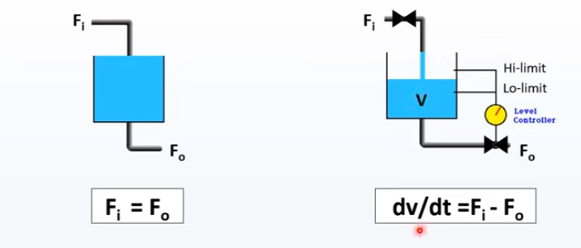
-there is no accumulation or holdup factor.
-Equipment sizes in general not needed.
-Amount of information required is small to medium.
-Consider holdup and accumulation
- Equipment sizes needed
-Amount of information required is medium to large.

Slide 31

-Finishing process design.
-process analysis.
-process optimization and the economics of the overall process.
-Design /analysis of control schemes
-Operator Training.
-Hazard and safety studies.
-Design/analysis of startup & shutdown

Slide 32
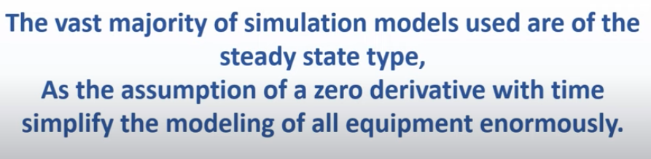
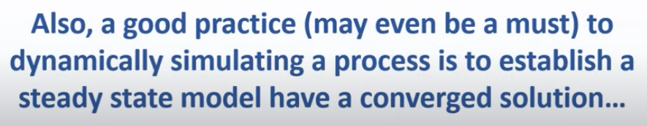

Slide 33

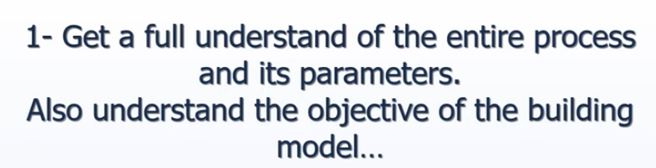
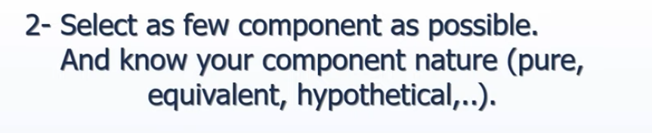

Slide 34
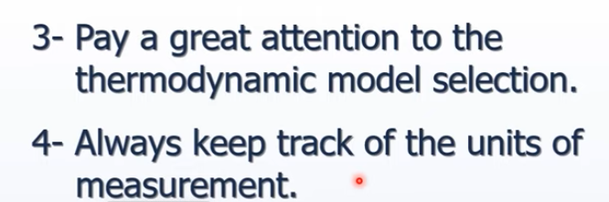
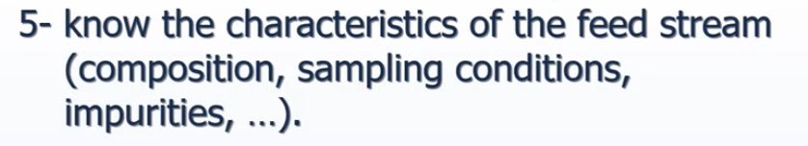
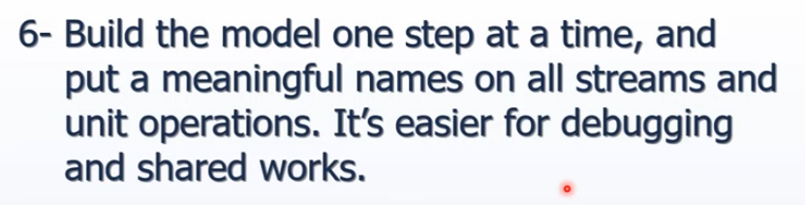

Slide 35
