Slide 1
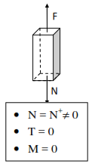
Centre universitaire de Mila
Cours : béton armé
Chapitre 05: Design of sections subjected to centered forces:
Simple tension
Definition
If it is a normal tensile force N+, it is referred to as tension; this is the case for tie rods. N: the normal force T : l’effort tranchant et M : le moment fléchissant
Pièce soumise à la traction
Reinforced concrete elements subjected to simple tension are rare; they are generally found in truss frames, dome rings, water pipelines, reservoirs, and tie rods in arched structures.

Slide 2


II. Calculation Assumptions
The tensile strength of concrete is not taken into account;
The entire tensile force is balanced by the steel;
The reinforcement and the concrete section share the same centroid;
For Ultimate Limit State (ULS) verification, the steel undergoes an elongation of εₛₜ = 10 ‰ (pivot A);
For Serviceability Limit State (SLS) verification, the stress in the steel is limited by cracking conditions.
III. Determination of Longitudinal Reinforcement:
Since the tensile strength of the concrete is considered null, the tensile force is entirely balanced by the reinforcement.
III.1. Case of Slightly Detrimental Cracking In this case, the dimensions are based solely on the ultimate limit state:
with :
Amin: minimum section, obtained from the non-brittleness condition
Nu: normal tensile force at ULS

Slide 3




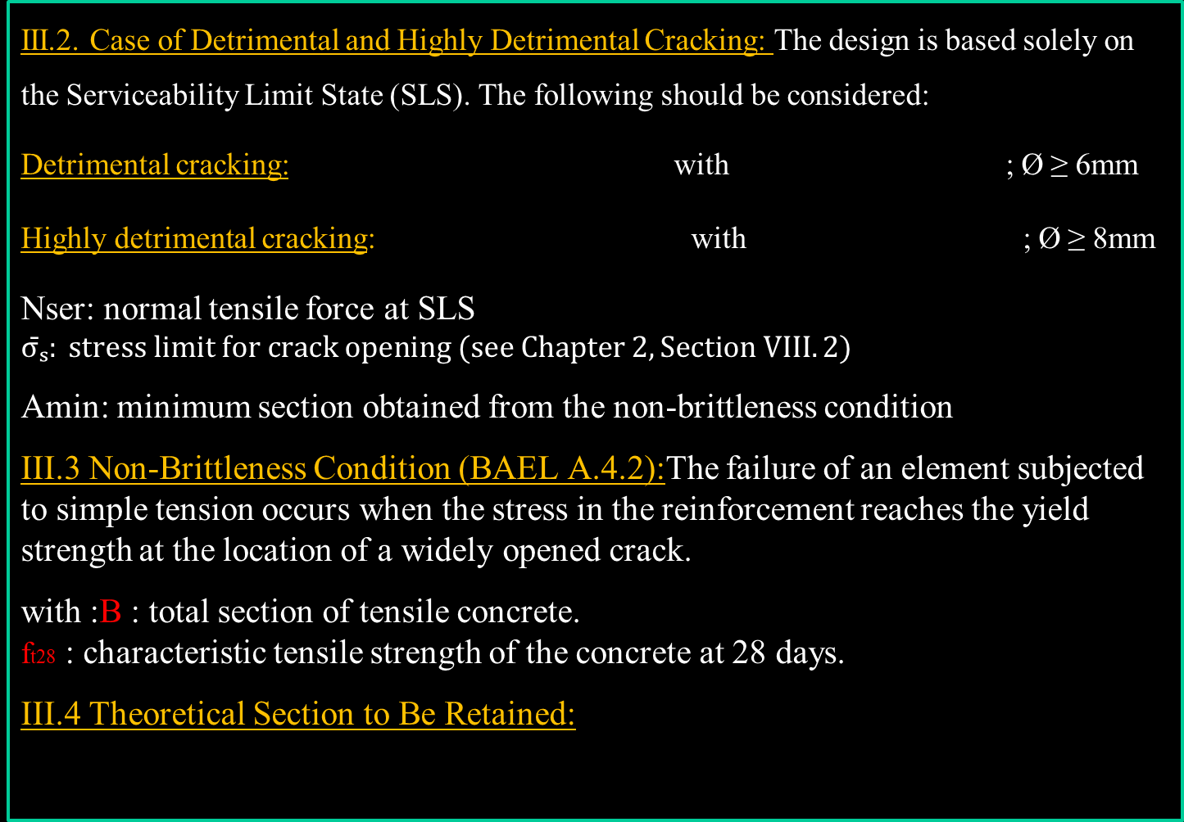
III.2. Case of Detrimental and Highly Detrimental Cracking: The design is based solely on the Serviceability Limit State (SLS). The following should be considered:
Detrimental cracking: with ; Ø ≥ 6mm
Highly detrimental cracking: with ; Ø ≥ 8mm
Nser: normal tensile force at SLS
$$σ̄ₛ: stress limit for crack opening (see Chapter 2, Section VIII.2)$$
Amin: minimum section obtained from the non-brittleness condition
III.3 Non-Brittleness Condition (BAEL A.4.2):The failure of an element subjected to simple tension occurs when the stress in the reinforcement reaches the yield strength at the location of a widely opened crack.
with :B : total section of tensile concrete.
ft28 : characteristic tensile strength of the concrete at 28 days.
III.4 Theoretical Section to Be Retained:

Slide 4

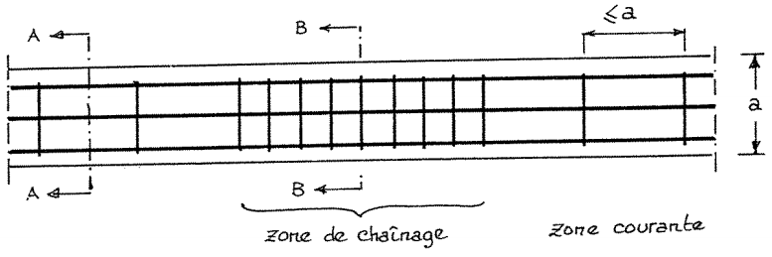


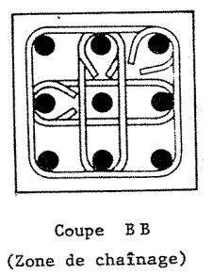
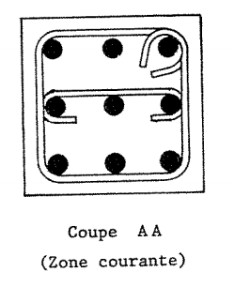

IV. Transverse Reinforcement of Tie Rods:
a)Diameter Øt: If these transverse reinforcements are:
Plain round bars or high-adherence bars (HA)
b) Spacing st:
In the regular zone:
$st≤a$, where a is the shorter side of the section
In the overlap zone: stitching reinforcements
- Overlap Length
$∑A_{t}=nA_{t} with n:A_{t}:$cross-section of one strand
A: cross-section of longitudinal steel
fe: grade of longitudinal steel
fet: grade of transverse steel
$$S_{t}=\frac{L_{s}}{n}$$

Slide 5
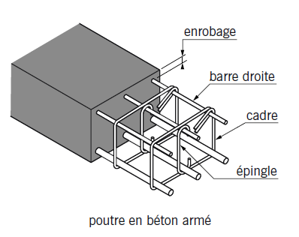
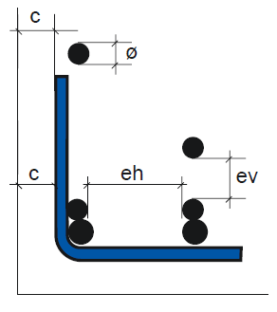
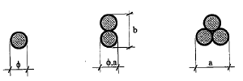

Steel Cover Conditions:
The cover c of any reinforcement must be at least:
•5 cm: for structures exposed to sea conditions
•3 cm: in environments exposed to aggressive actions
•3 cm: in environments exposed to weather, liquids, or condensation
▪ Possibilities for Proper Concreting:
$φ_{t}≤min\left(h/35; φ; b_{0}/10\right)$
$e_{v}≥max\left(c_{g}; φ\right)$
$e_{h}≥max\left(1.5c_{g}; φ\right)$
$C_{t}≥φ$
Diameters and Spacings
Case of Detrimental Cracking:
Tensioned longitudinal bars: $φ≥6$ mm
Spacing between bars: $e_{h}≤4φ$ if $φ≥20$ mm
Case of Highly Detrimental Cracking:
Tensioned bars: $φ≥8$ mm
Spacing between bars: $e_{h}≤3φ$ if $φ≥20$ mm
IV. Minimum Regulatory Provisions:

