Slide 1
Structure machine 2
Ch3. Sequential logic
(Part 3-4)

Slide 2
Presentation plan of chapter 3
Part 3-4
1. Bistable
2. Flip-flops triggered by a positive or negative edge
3. Toggle applications
4. Counters
4.1. How the asynchronous counter works
4.2. How the synchronous counter workse

Slide 3
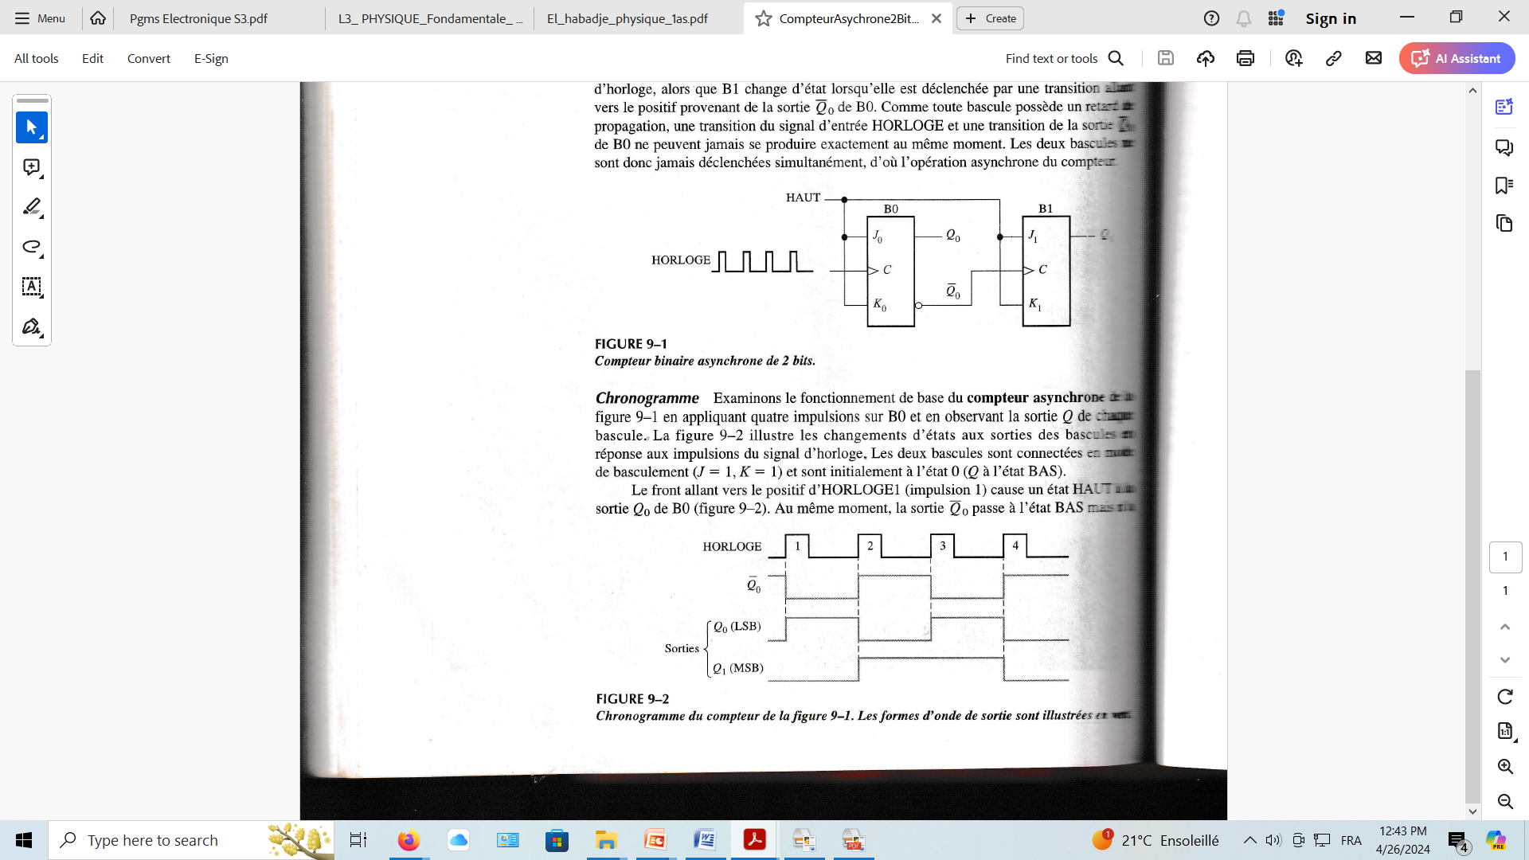
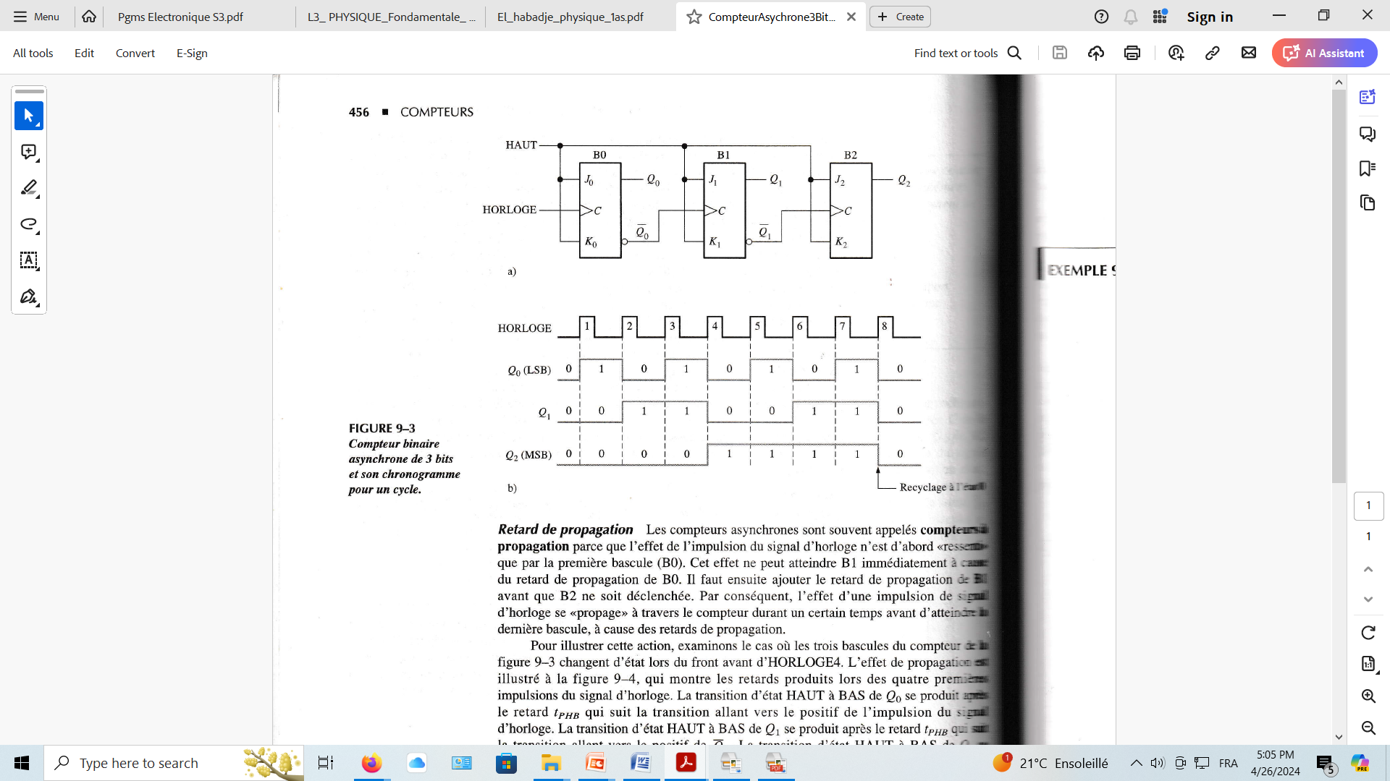
4. Counters
4.1. How the asynchronous counter works
Asynchronous 2-bit binary counter
and its diagram
MODULO 4
Asynchronous 3-bit binary counter
and its diagram
MODULO 8

Slide 4
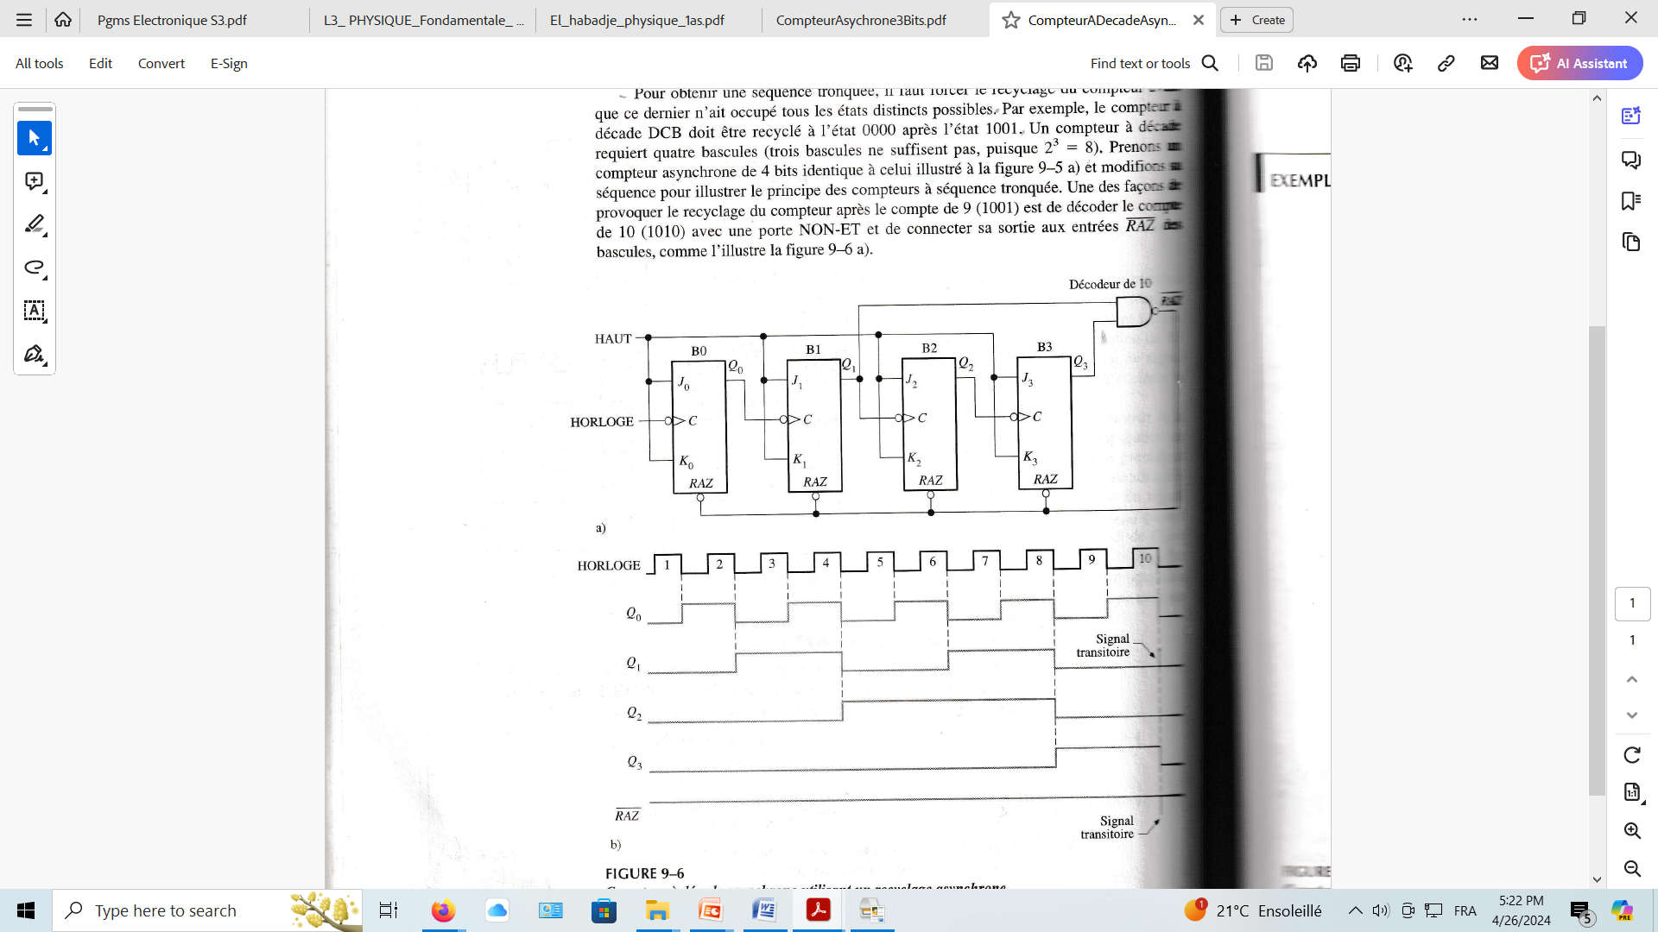
4.1. How the asynchronous counter works (following)
RAZ
Asynchronous decade counter
MODULO 10

Slide 5
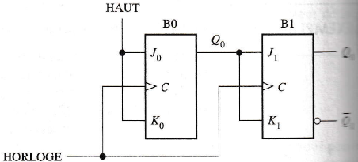
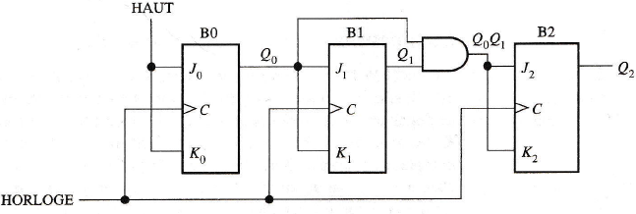
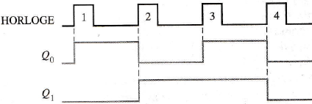
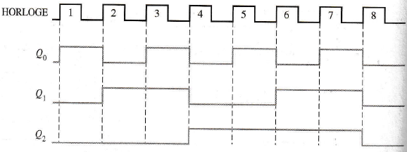
4. Counters
4.2. How the synchronous counter works
Synchronous 2-bit binary counter
and its diagram
MODULO 4
Asynchronous 3-bit binary counter
and its diagram
MODULO 8

Slide 6
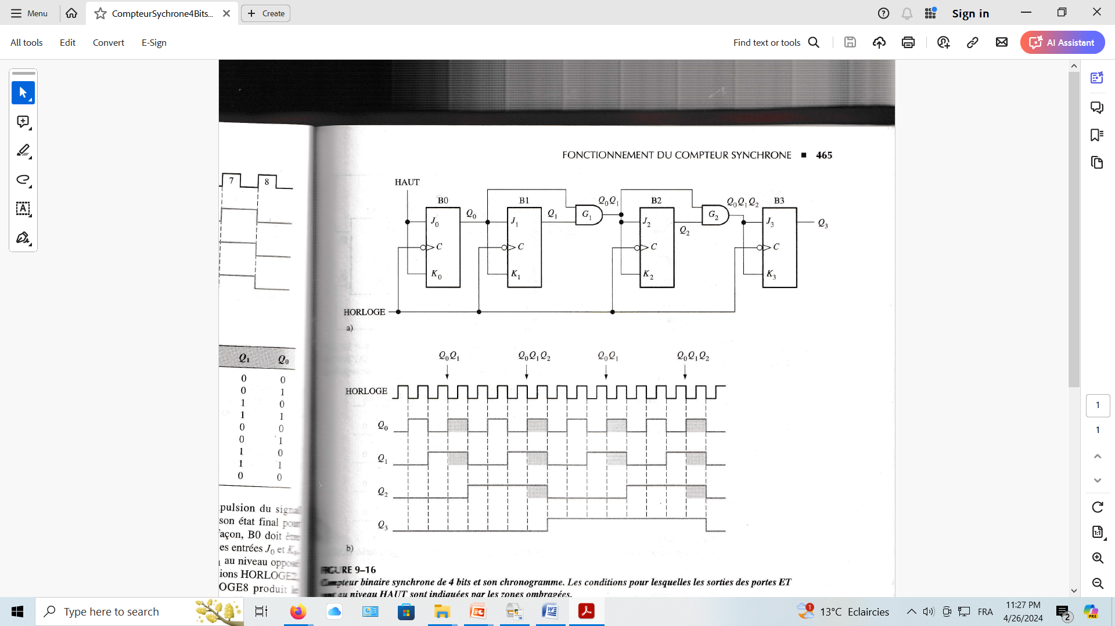
4.2. How the synchronous counter works (following)
4-bit synchronous binary counter
and its diagram
MODULO 16

Slide 7
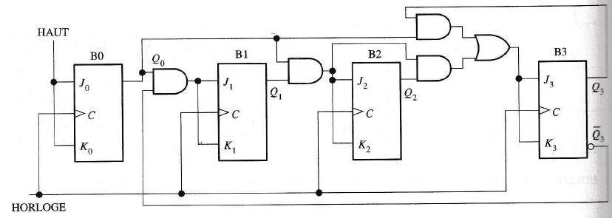
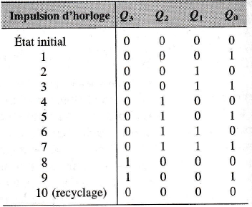

4.2. How the synchronous counter works (following)
Synchronous decade counter
MODULO 10

