Slide 1
Structure machine 2
Ch3. Sequential logic
(Part 3-2)

Slide 2
Presentation plan of chapter 3
1. Bistable
2. Flip-flops triggered by a positive or negative edge
2.1. Introduction to Clock-Triggered Flip-Flops
2.2. S-R Clock-triggered flip-flop
2.3. D Clock-triggered flip-flop
2.4. J-K Clock-triggered flip-flop
2.5. Asynchronous inputs
3. Toggle applications

Slide 3
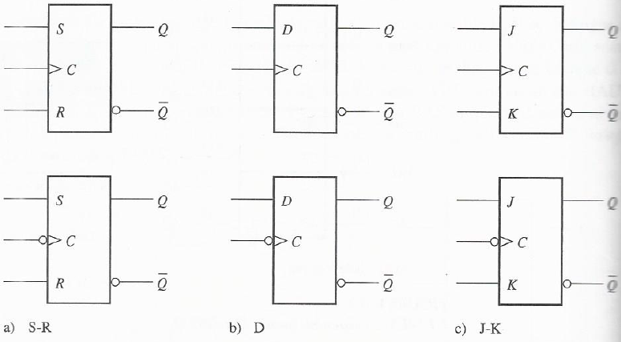
2. Flip-flops triggered by a positive or negative edge
2.1. Introduction to Clock-Triggered Flip-Flops
Positive or negative edge of the clock signal ➔ Control input (C) of a flip-flop ➔ The output of flip-flop changes state (Outputs flip-flop changes are therefore synchronized by clock signal) ➔ The flip-flop is a synchronous bistable multivibrator element.

Slide 4
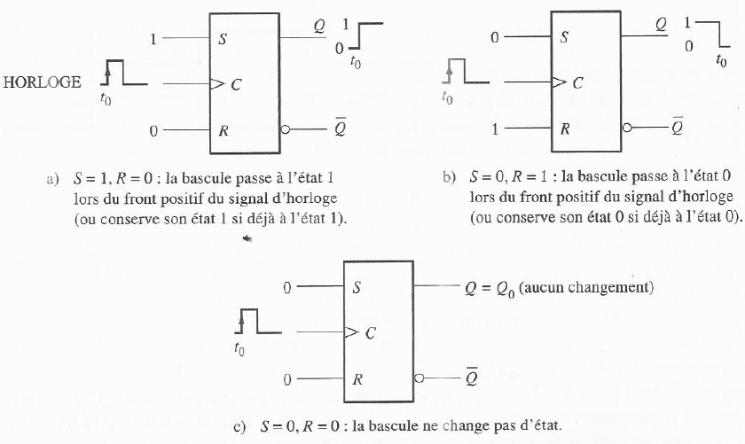
2. Flip-flops triggered by a positive or negative edge (following)
2.2. Clock-triggered S-R flip-flop
2.2.1. Operation of a positive edge triggered S-R flip-flop
Invalid condition

Slide 5
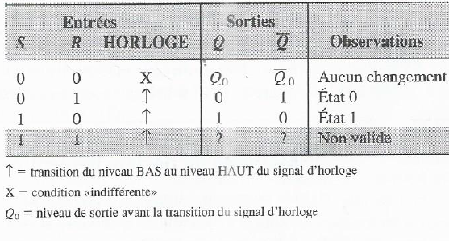
2. Flip-flops triggered by a positive or negative edge (following)
2.2. Clock-triggered S-R flip-flop
2.2.2. Truth table of a positive edge-triggered S-R flip-flop

Slide 6
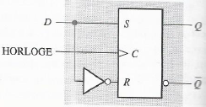
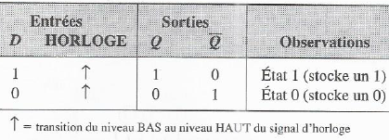
2. Flip-flops triggered by a positive or negative edge (following)
2.3. Clock-triggered D flip-flop
Clock-triggered D flip-flop =
Clock-triggered S-R flip-flop
+
Inverter
Truth table of a positive edge-triggered D flip-flop

Slide 7
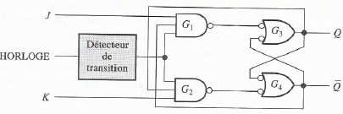

2. Flip-flops triggered by a positive or negative edge (following)
2.4. Clock-triggered J-K flip-flop
Simplified logic diagram of a positive edge-triggered J-K flip-flop
Toggle mode of
J-K flip-flop
occurs when J = 1 et K = 1
Toggle mode (change to the opposite state for each new positive or negative edge of clock signal)

Slide 8
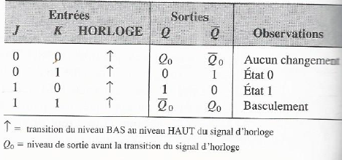
2. Flip-flops triggered by a positive or negative edge (following)
2.4. Clock-triggered J-K flip-flop (following)
Truth table of J-K flip-flop triggerred by a positive edge

Slide 9
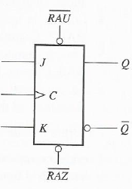

2. Flip-flops triggered by a positive or negative edge (following)
2.5. Asynchronous inputs
Asynchronous inputs allow the state of the flip-flop to be affected independently
of the clock signal.
  RAU or SET or PRESET or S_{D} for set to 1
  RAZ or RESET or CLEAR ou R_{D} for reset to 0
Logic diagram of a J-K flip-flop with asynchronous inputs of LOW valid level
asynchronous operation

