Slide 1
Structure machine 2
Ch3. Sequential logic
(Part 3-1)

Slide 2
Presentation plan of chapter 3
1. Bistable
1.1. S-R bistable
1.2. S-R bistable with validation input
1.3. D bistable
2. Flip-flops triggered by a positive or negative edge
2.1. Horloge temps réel ou RTC (Real Time Clock) (rappels)
2.2. Introduction to Clock-Triggered Flip-Flops
2.3. S-R Clock-triggered flip-flop
2.4. D Clock-triggered flip-flop
2.5. J-K Clock-triggered flip-flop
2.6. Asynchronous inputs
3. Toggle applications

Slide 3
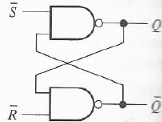
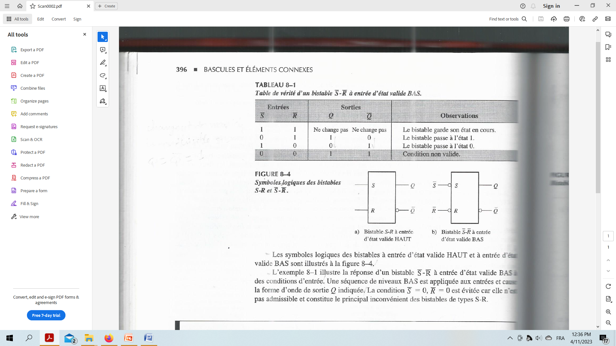
1. Bistables
1.1. S-R bistable
Truth table of bistable with LOW valid state input
Q = 1 (output that corresponds to ) ⬅➔ The bistable is in state 1 (SET)
bistable with LOW valid state input
Q = 0 (output that corresponds to ) ⬅➔ The bistable is in state 0 (RESET)

Slide 4
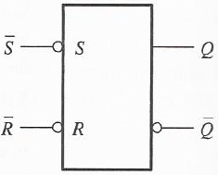
1.1. S-R bistable (following)
Logic symbol of bistable with LOW valid state input

Slide 5
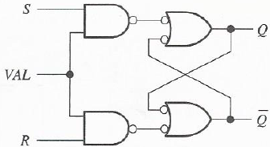
1.2. S-R bistable with validation input
VAL | S | R | Q_{n} | Q̅_{n}
0 | X | X | Q_{n-1} | Q̅_{n-1}
1 | 0 | 0 | Q_{n-1} | Q̅_{n-1}
1 | 0 | 1 | 0 | 1
1 | 1 | 0 | 1 | 0
1 | 1 | 1
Condition non valide
Truth table of
S-R bistable with validation input
Logic diagram of
S-R bistable with validation input
S-R bistable with validation input
  VAL = 1 ➔ Q = f(S,R) et Q̅ = f(S,R) as in a S-R bistable with a valid HIGH state input
  VAL = 0 ➔ Q and Q̅ do not change

Slide 6

1.2. S-R bistable with validation input (following)
Logic symbol of S-R bistable with validation input

Slide 7
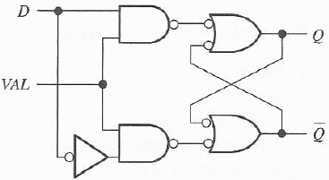
1.3. D Bistable
D bistable is a type of bistable with validation input.
VAL | D | Q_{n} | Q̅_{n}
0 | X | Q_{n-1} | Q̅_{n-1}
1 | 0 | 0 | 1
1 | 1 | 1 | 0
Truth table of D bistable
Logic diagram of D bistable (D for data)
Bistable D
  VAL = 1 ➔ Q = D (Q follows D input)
  VAL = 0 ➔ Q et Q̅ do not change

Slide 8

1.3. D Bistable (following)
Logic symbol of D bistable

