Slide 1
Structure machine 2
Ch2. Combinatorial Logic
(Part 1-2)

Slide 2
Presentation plan
1. Logic gates
1.1. Inverter (NOT circuit)
1.2. AND gate
1.3. OR gate
1.4. NAND gate
1.5. NOR gate
1.6. EXCLUSIVE OR and NOT EXCLUSIVE OR gate

Slide 3
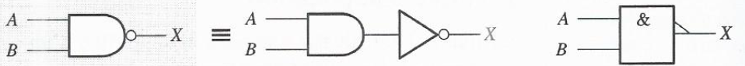
1.4. NAND gate
Logical function AND + complementation ➔ NAND logic function ➔ NAND
gate
Standard NAND Gate Logic Symbols
1.4.1. Logical operation of NAND gate
Logical operation of NAND gate
  All inputs are at HIGH levels ➔ Output at LOW level
  One input at low level ➔ Output at HIGH level

Slide 4
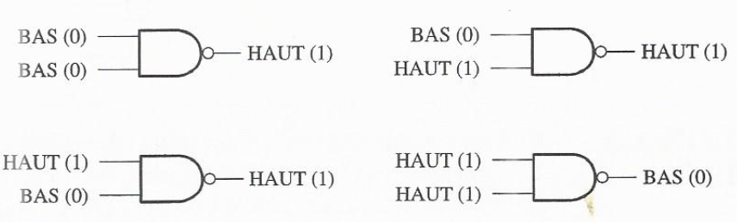
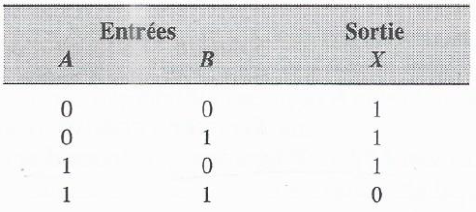
1.4. NAND gate (continued)
1.4.1. Logical operation of NAND gate (continued)
Logical operation of 2-input NAND gate
1.4.2. Truth table of NAND gate

Slide 5
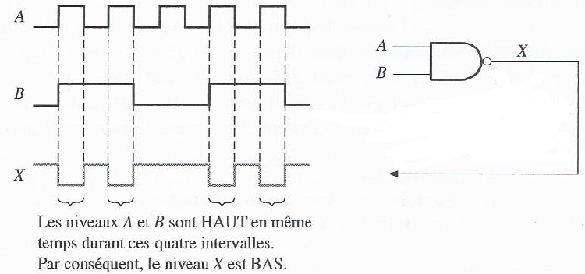
1.4. NAND gate (continued)
1.4.3. Operation with pulse waves

Slide 6
1.4. NAND gate (continued)
1.4.4. Logical expression of NAND gate
Boolean (logical) expression of 2-input AND gate, X = AB
Logical function AND + Complementation ➔ NAND logic function ➔ NAND
Gate

Slide 7
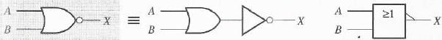
1.5. NOR Gate
Logical function OR + complementation ➔ NOR logic function ➔ Gate
NOR
Standard NOR Gate Logic Symbols
2.5.1. Logical operation of NOR gate
Logical operation of NOR gate
  At least one input at HIGH level ➔ Output at LOW level
  All inputs are at LOW levels ➔ Output at HIGH level

Slide 8
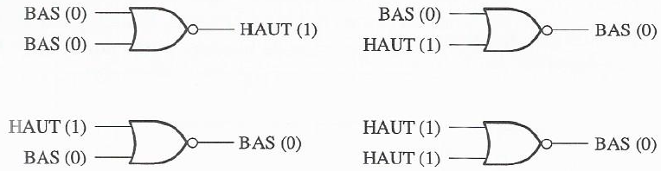
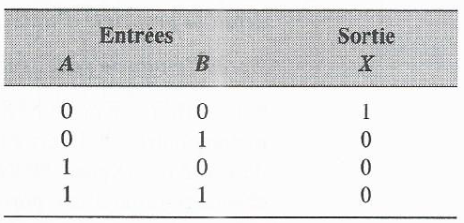
1.5. NOR Gate (continued)
1.5.1. Logical operation of NOR gate (continued)
Logical operation of 2-input NOR gate
1.5.2. Truth table of NOR gate

Slide 9
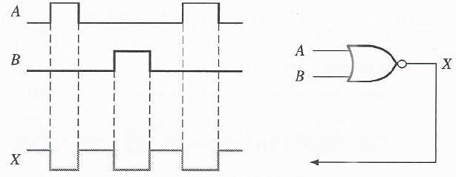
1.5. NOR Gate (continued)
1.5.3. Operation with pulse waves

Slide 10
1.5. NOR Gate (continued)
1.5.4. Logical expressions of NOR gate
Boolean (logical) expression of 2-input OR gate, X = A + B
Logical function OR + Complementation ➔ NAND logic function ➔ Porte
NON-OU

Slide 11
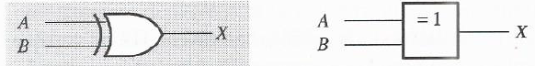
1.6. EXCLUSIVE OR and NOT EXCLUSIVE OR gate
1.6.1. EXCLUSIVE OR gate
Standard Logic Symbols of Exclusive OR Gate
1.6.2. Logical operation of exclusive OR gate
Logical operation of exclusive OR gate
  The two inputs are at opposite logic levels ➔ Output at HIGH level
  Both inputs are the same ➔ Output at LOW level

Slide 12
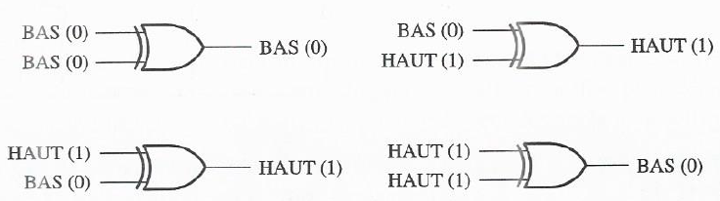
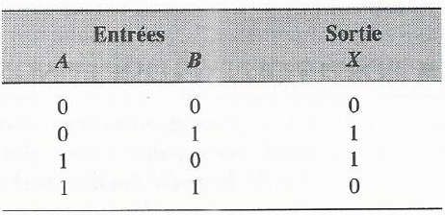
1.6. EXCLUSIVE OR and NOT EXCLUSIVE OR gate (continued)
1.6.2. Logical operation of exclusive OR gate
Opération logique de la porte OU exclusif à 2 entrées
1.6.3. Truth table of exclusive OR gate

Slide 13
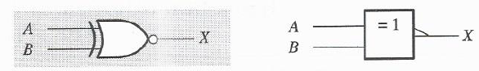
1.6. EXCLUSIVE OR and NOT EXCLUSIVE OR gate (continued)
1.6.4. NOT EXCLUSIVE OR gate
Standard Not Exclusive OR Gate Logic Symbols
1.6.5. Logical operation of not exclusive NOR gate
Logical operation of the exclusive NOR gate
  The two inputs are at opposite logic levels ➔ Output at LOW level
  Both inputs are the same ➔ Output at HIGH level

Slide 14
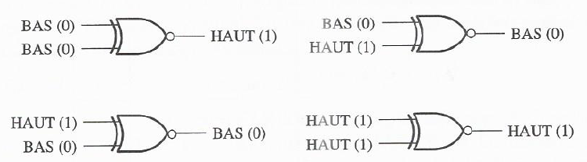
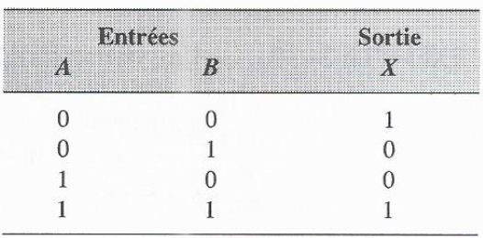
1.6. EXCLUSIVE OR and NOT EXCLUSIVE OR gate (continued)
1.6.5. Logical operation of not exclusive OR gate
Opération logique de la porte NON-OU exclusif à 2 entrées
1.6.6. Truth table of not exclusive OR gate

Slide 15
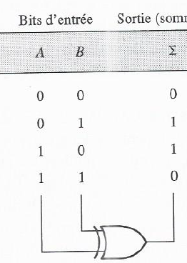
1.6. EXCLUSIVE OR and NOT EXCLUSIVE OR gate (continued)
1.6.7. Example
Exclusive OR Gate ➔ Two-bit adder

