Slide 1
Structure machine 2
Ch2. Combinatorial Logic
(Part 1-1)

Slide 2
Presentation plan
1. Logic gates
1.1. Inverter (NOT circuit)
1.2. AND gate
1.3. OR gate
1.4. NAND gate
1.5. NOR gate
1.6. EXCLUSIVE OR and NOT EXCLUSIVE OR gate

Slide 3
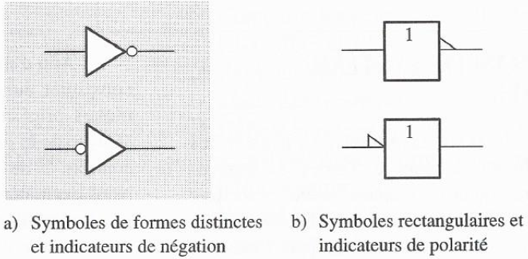
1. Logic gate
1.1. Inverter (NOT circuit)
Inversion or complementation (operation) ➔ Inverter or NOT circuit
Standard logic symbols of inverter
Standard logic symbols of inverter

Slide 4
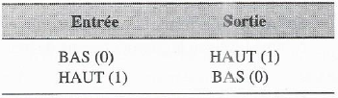

1.1. Inverter (NOT circuit) (continued)
1.1.1. Truth table of Inverter
1.1.2. Inverter operation
Inverter response to an input pulse

Slide 5
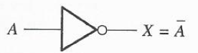
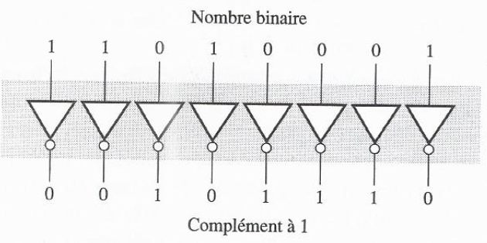
1.1. Inverter (NOT circuit) (continued)
1.1.3. Logical expression of Inverter
Boolean algebra (mathematics logic circuits)
Logical expression of Inverter (Inverse of A or not A or Complement of a variable or complemented variable)
Inverter complements an input variable
1.1.4. Example
Circuit producing the first complement of 8-bit binary number

Slide 6
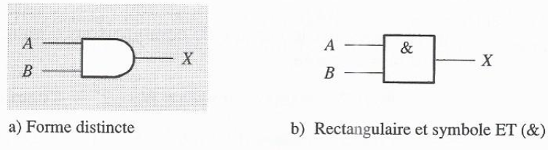
1.2. AND gate
Logical multiplication (operation) ➔ Logic gate AND
Standard logic symbols of and gate
1.2.1. Logical operation of AND gate
Logical operation of AND gate
  All inputs are at HIGH levels ➔ Output at HIGH level
  One or more inputs at LOW level ➔ Output at LOW level

Slide 7
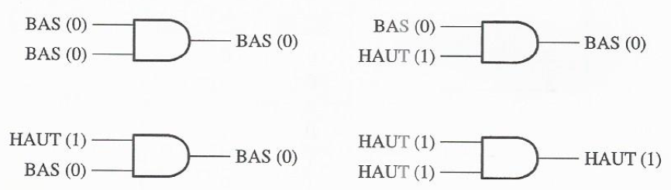
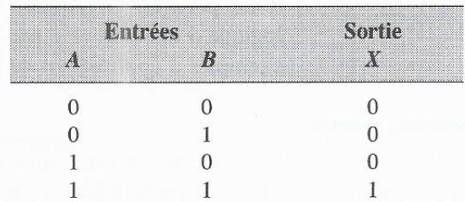
1.2. AND gate (continued)
1.2.1. Logical operation of AND gate (continued)
Logical operation of 2-input AND gate
1.2.2. Truth table of AND gate
The number of binary input combinations for a logic gate, N = 2^{n}
n denotes the number of input variables.

Slide 8
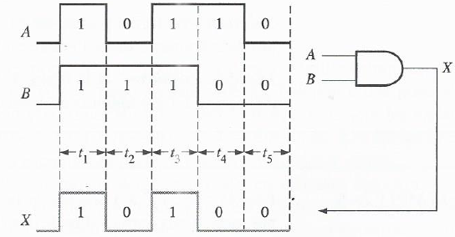
1.2. AND gate (continued)
1.2.3. Operation with pulse waves (timing diagram)

Slide 9
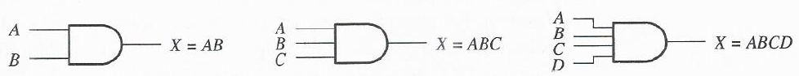
1.2. AND gate (continued)
1.2.4. Logical expression of AND gate
Boolean Algebra ➔ Combination of two variables A and B by logical operation AND ➔ (boolean multiplication)
Boolean multiplication ≡ binary multiplication ➔ Boolean (logical) expression of 2-input AND gate, X = AB
Boolean expression of 2-input AND gates
Boolean expression of 3-input AND gates
Boolean expression of 4-input AND gates

Slide 10
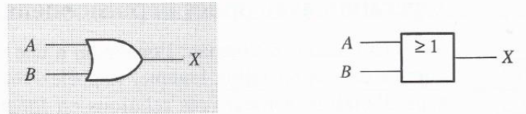
1.3. OR Gate
Logical addition (operation) ➔ OR logic gate
Standard OR Gate Logic Symbols
1.3.1. Logical operation of OR gate
Logical operation of the OR gate
  At least one input is HIGH ➔ Output at HIGH level
  One or more inputs at LOW level ➔ Output at LOW level

Slide 11
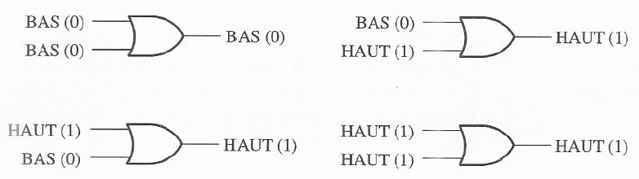
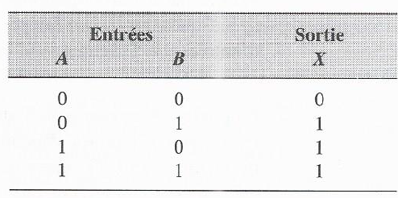
1.3. OR Gate (continued)
1.3.1. Logical operation OR gate (continued)
Logical operation of 2-input OR gate
1.3.2. Truth table of OR gate

Slide 12
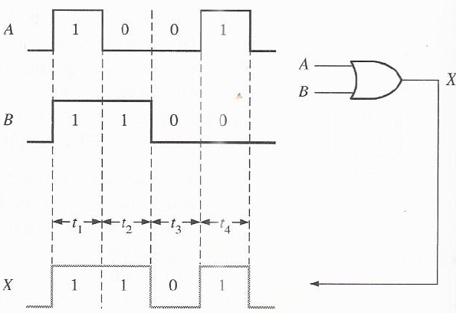
1.3. OR Gate (continued)
1.3.3. Operation with pulse waves (timing diagram)

Slide 13
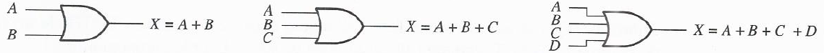
1.3. OR Gate (continued)
1.3.4. Logical expressions of OR gate
Boolean Algebra ➔ Combination of two variables A and B by logical operation OR ➔ (boolean addition ≡ OR function)
Boolean addition ≠ (not the same as) binary addition
(boolean addition ≡ OR function) ➔ Boolean (logical) expression of 2-
input OR gate, X = A + B
Boolean expression of 2-input OR gates
Boolean expression of 3-input AND gates
Boolean expression of 4-input AND gates

