Slide 1
Structure machine 2
Ch2. Combinatorial Logic
(Part 2-2)

Slide 2
Presentation plan (following)
2. Combinational Logic Functions (Common Combinational Circuits)
2.1. Adders
2.2. Comparators
2.3. Decoder
2.4. Encoder
2.5. Multiplexers (data selectors)
2.6. Demultiplexers

Slide 3
2. Combinational Logic Functions (Common Combinational Circuits)
2.4. Encoder
:
Encoder ➔ coding
  Valid level at one of its inputs representing a digit (decimal or octal)
  ➔ binary code or BCD
  Symbol or alphabet character ➔ code
2.4.1. Decimal-DCB encoder
Decimal-DCB encoder (decimal digit ➔ DCB code)
Decimal-DCB encoder or 10-line input, 4-line output encoder

Slide 4
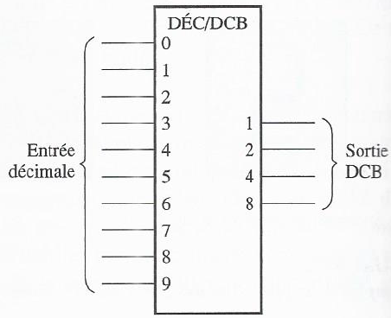
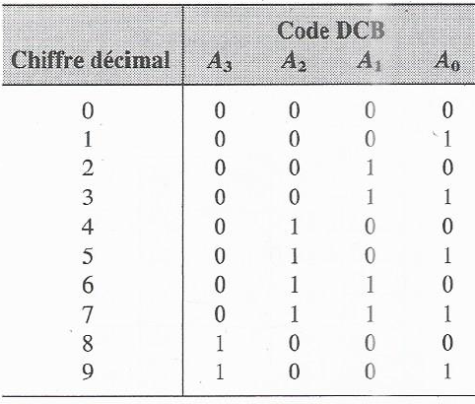
2. Combinational Logic Functions (Common Combinational Circuits)
2.4.1. Decimal-DCB encoder (following)
:
Logical symbol of a
decimal-DCB encoder
Truth table of a decimal-DCB decoder

Slide 5
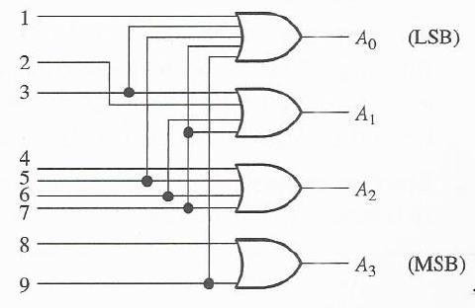
2. Combinational Logic Functions (Common Combinational Circuits)
2.4.1. Decimal-DCB encoder (following)
➔ Logic diagram of the decimal-DCB encoder
2.4.2. MSI 8-line input 3-line output encoder
74F148 (MSI 8-line input 3-line output encoder) (octal ➔ binary)

Slide 6
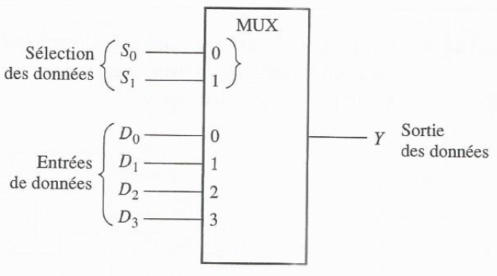
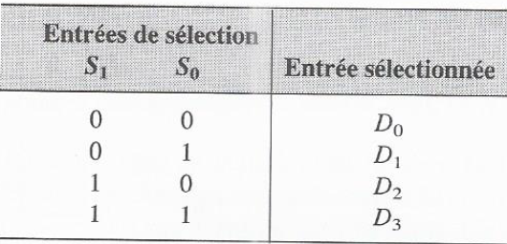
2. Combinational Logic Functions (Common Combinational Circuits)
2.5. Multiplexers (data selectors)
2.5.1. 4-input multiplexer (MUX)
Multiplexer (MUX) (multiple lines of digital information ➔ a line)
Logic symbol of a 4-input multiplexer (MUX)(1 of 4 multiplexer/data selector)

Slide 7
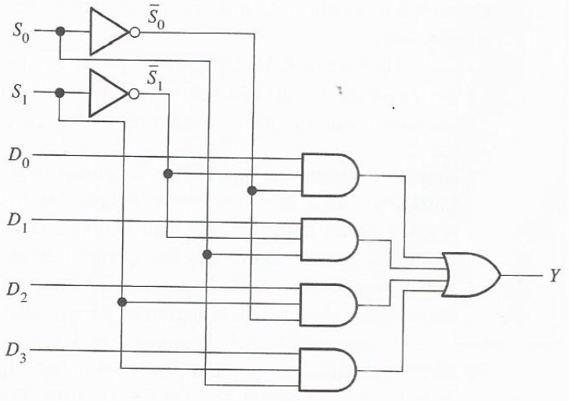
2. Combinational Logic Functions (Common Combinational Circuits)
2.5.1. 4-input multiplexer (MUX)
➔ Logic diagram of a 4-input multiplexer

Slide 8
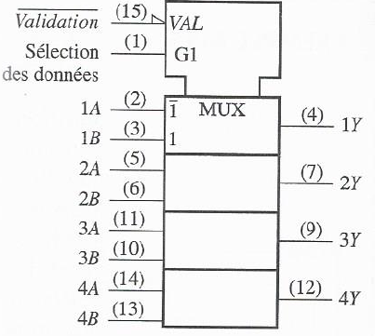
2. Combinational Logic Functions (Common Combinational Circuits)
7.5.2. MSI 2-input quadruple data multiplexer/selector
4 x 2-input multiplexers)
A data selection entry
(common to 4 multiplexers)
  Validation input (common to all 4 multiplexers)
  ➔ MUX operational
  ➔ Blocks data passage
Logic symbol of 74HC157A 2 input quadruple multiplexer
➔ Input selection A
➔ Input selection B

Slide 9
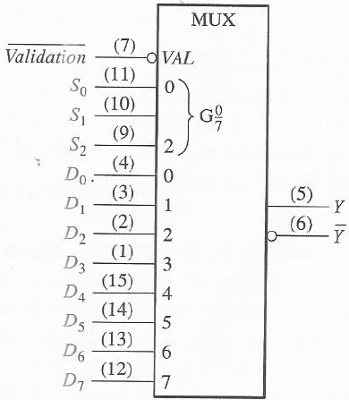
2. Combinational Logic Functions (Common Combinational Circuits)
2.5.3. MSI 8-Input Data Multiplexer/Selector
Logic symbol of
8-input multiplexer 74HC151

Slide 10
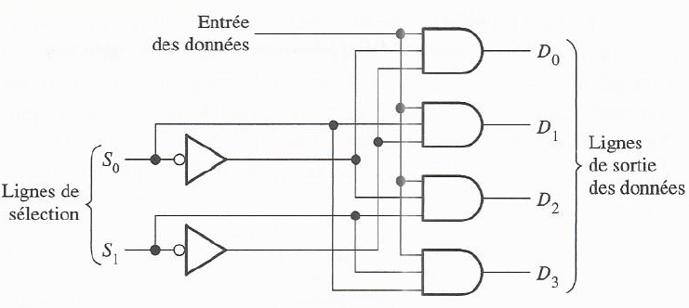
2. Combinational Logic Functions (Common Combinational Circuits)
2.6. Demultiplexers
Demultiplexer (DEMUX) (Data received on a single line ➔ (distribution on) Given number of output lines ➔ Data distributor
7.6.1. Single input, four output demultiplexer
Logic diagram of demultiplexer
one input and four data outputs

Slide 11
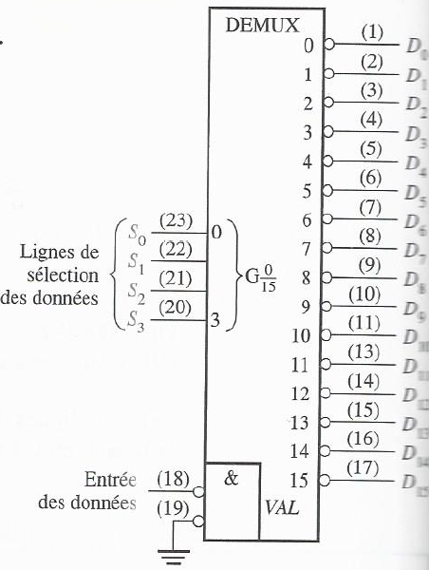
2. Combinational Logic Functions (Common Combinational Circuits)
7.6.2. MSI Demultiplexer
74HC154 Decoder ➔ Demultiplexer
Logic symbol of 74HC154 decoder used as demultiplexer

