Slide 1
Structure machine 2
Ch2. Combinatorial Logic
(Part 2-1)

Slide 2
Presentation plan (following)
2. Combinational Logic Functions (Common Combinational Circuits)
2.1. Adders
2.2. Comparators
2.3. Decoder
2.4. Encoder
2.5. Multiplexers (data selectors)
2.6. Demultiplexers

Slide 3
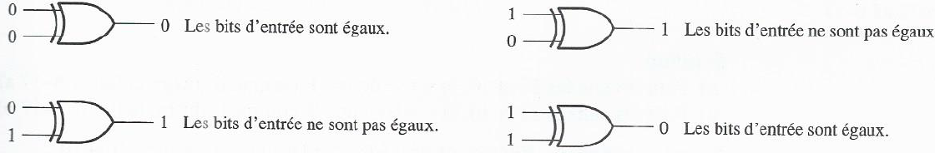
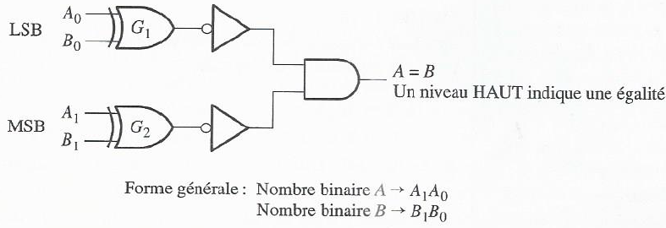
2. Combinational Logic Functions (Common Combinational Circuits)
2.2. Comparators
:
2.2.1. Equality
OR exclusive (XOR) ➔ Basic comparator
Equality comparator for two 2-bit numbers using OR exclusive (XOR)
Logic diagram of equality comparator for two
using XOR

Slide 4
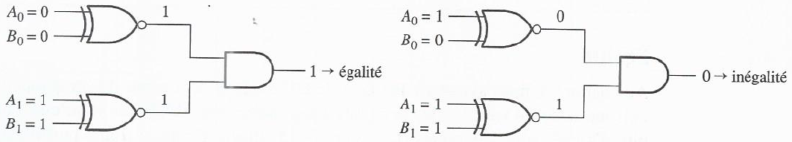
2. Combinational Logic Functions (Common Combinational Circuits)
2.2. Comparators
:
2.2.1. Equality (following)
Equality comparator for two 2-bit numbers using NOT exclusive OR
Equality comparator for two 2-bit numbers using NOT exclusive OR

Slide 5
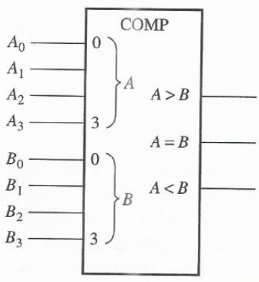
2. Combinational Logic Functions (Common Combinational Circuits)
2.2. Comparators
:
2.2.2. Inequality (continued)
  A = B ➔ 1
  A ≠ B ➔ 0
  A > B ➔ 1
  A < B ➔ 0
Logic symbol of 4-bit comparator with inequality indications (additional outputs indicating which number is greater)

Slide 6
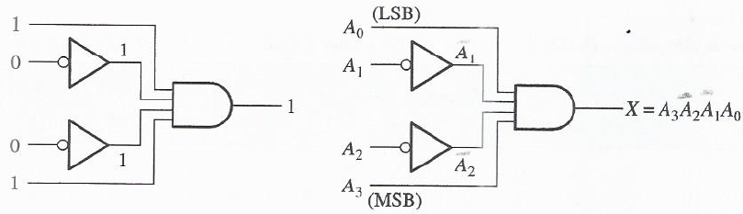
2. Combinational Logic Functions (Common Combinational Circuits)
2.3. Decoder
:
2.3.1. Basic Binary Decoder
Binary decoder logic of 1001
with valid status output HIGH
For valid status output LOW, a NAND gate can be used.

Slide 7
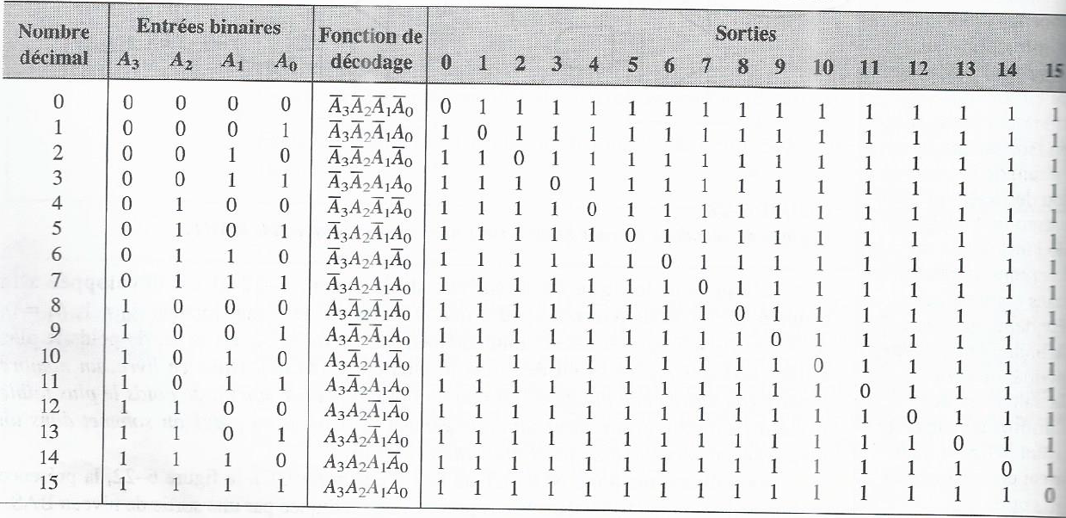
2. Combinational Logic Functions (Common Combinational Circuits)
2.3. Decoder
:
Decoding functions and truth table of a 4-input, 16-output decoder with valid status output low (using a NAND gate)
2.3.2. 4-bit decoder

Slide 8
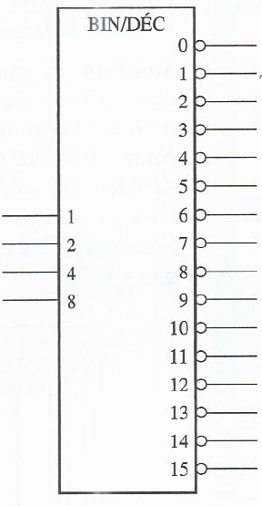
2. Combinational Logic Functions (Common Combinational Circuits)
2.3. Decoder
:
2.3.2. 4-bit decoder (continued)
8, 4, 2 et 1 ➔ Binary weights of the input bits
Logic symbol of a 4-input, 16-output decoder with valid status output low

Slide 9
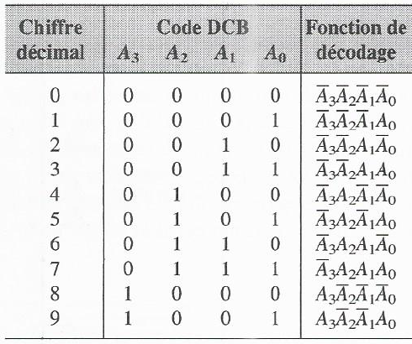
2. Combinational Logic Functions (Common Combinational Circuits)
2.3. Decoder
:
2.3.3. DCB-decimal decoder
DCB-decimal decoder ➔ (DCB code ➔ decimal digit)
DCB-decimal decoder or 4-line input 10-line output decoder or 1 of 10 decoder
Decoding functions and truth table of DCB-decimal decoder ➔
AND gate ➔ Valid status output HIGH
NAND gate ➔ Valid status output LOW

Slide 10
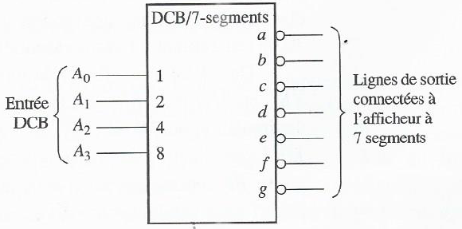
2. Combinational Logic Functions (Common Combinational Circuits)
2.3. Decoder
:
2.3.4. DCB-7 segment decoder
DCB code ➔ (inputs) DCB-7 segment decoder ➔ outputs capable of driving 7-segment displays (➔ a decimal display)
Logic symbol of a DCB-7 segment decoder (It drives 7-segment displays with valid status output LOW)

