Slide 1
Structure machine 2
Ch2. Combinatorial Logic
(Part 2-1)

Slide 2
Presentation plan (following)
2. Combinational Logic Functions (Common Combinational Circuits)
2.1. Adders
2.2. Comparators
2.3. Decoder
2.4. Encoder
2.5. Multiplexers (data selectors)
2.6. Demultiplexers

Slide 3
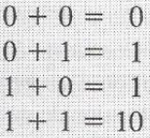
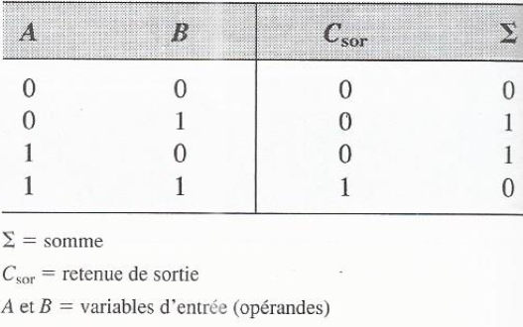
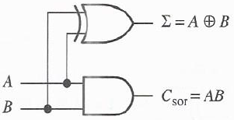
2. Combinational Logic Functions (Common Combinational Circuits)
2.1. Adders
:
2.1.1. Half adder
Binary addition ➔ Half adder (circuit)
Truth table of half adder
output holdback
Logic diagram of half adder

Slide 4
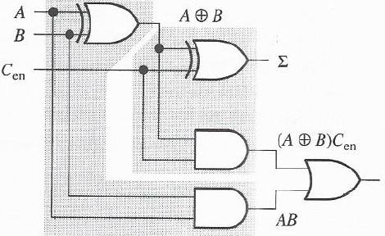
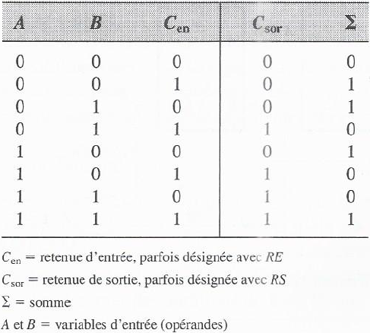
2. Combinational Logic Functions (Common Combinational Circuits)
:
2.1.2. Full adder
Truth table of full adder
Logic diagram of full adder

Slide 5
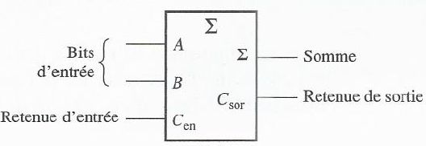
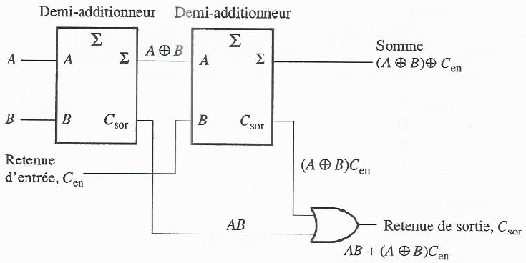
2. Combinational Logic Functions (Common Combinational Circuits)
2.1.2. Full adder (following)
:
Logic symbol of full adder ➔
Two interconnected half adders ➔ Full adder
input hold

Slide 6
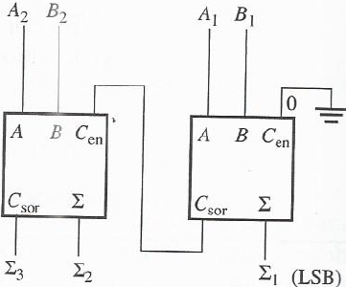
2. Combinational Logic Functions (Common Combinational Circuits)
2.1.3. 2-bit parallel adder
:
Additionneur complet ou demi-additionneur + additionneur complet ➔ 2-bit parallel adder
LSB (Least Signifiant Bit)
MSB (Most Significant Bit)
(MSB)

Slide 7
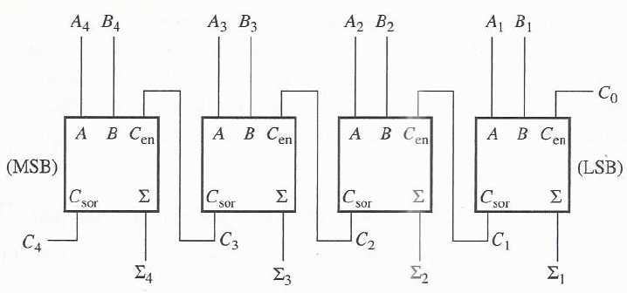
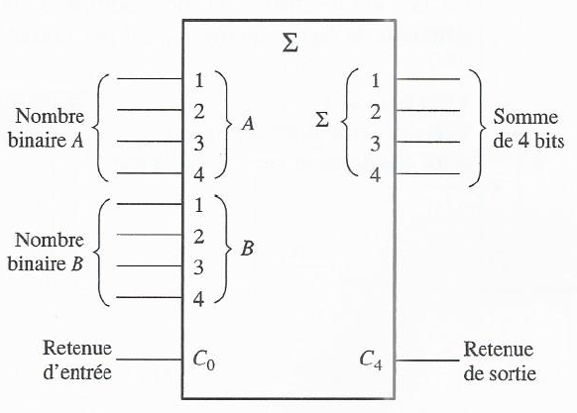
2. Combinational Logic Functions (Common Combinational Circuits)
2.1.4. 4-bit parallel adder
:
Diagramme logique
Symbole logique d’un additionneur
parallèle de 4 bits

