Slide 1
Structure machine
Ch1. Introduction to digital systems

Slide 2
Presentation plan
1. Basic Logical Operations
2. Basic Logic Functions
3. Integrated circuits (IC)
3.1. Integrated circuit (CI)
3.2. IC packages (classification according to the principle of mounting on printed circuit board)
3.3. Pin numbering
3.4. IC Complexity Classification (continued)
3.5. IC Technologies

Slide 3
1. Basic Logical Operations
A proposition and the conditions
If "The bulb is not burned out" and "The switch is on" ➔ "The light is on"
A proposition can be true or false.
Logic (the field of human reasoning that determines whether a given proposition is true or false (when certain conditions are true))
Combination of several propositions ➔ A logical function
George Boole (1850) ➔ Boolean Algebra

Slide 4
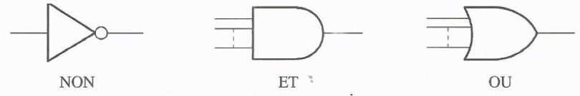
1. Basic Logical Operations (continued)
Digital circuit used in the implementation of logic functions ➔ Logic circuit
Logic circuits ➔ Digital system (computer)
Basic Logical Operations (⬅➔ logical function)
  NOT
  AND
  OR
Standard symbols for basic logical operations

Slide 5
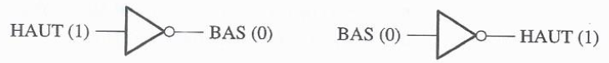
1. Basic Logical Operations (continued)
Circuit that performs a specific logical operation ➔ Logic gate (NOT gate,
AND gate, OR gate)
  True Input (True Condition) ⬅➔ HIGH level
  False input (false condition) ⬅➔ LOW level
Logical operation NOT ➔ Inverter (logic gate)

Slide 6
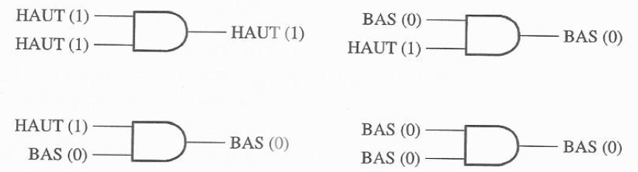
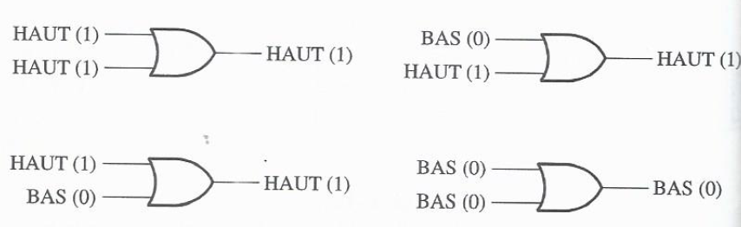
1. Basic Logical Operations (continued)
Logical operation AND ➔ AND gate (logic gate)
Logical OR operation ➔ OR gate (logic gate)

Slide 7
2. Basic Logic Functions
Combination of logic gates ➔ Complex logic circuit
Combination of basic logical operations (⬅➔ Logic Function)
Basic Logic Functions
  Comparison
  Arithmetic
  Code conversion
  Coding
  Decoding
  Data selection
  Storage
  Counting

Slide 8
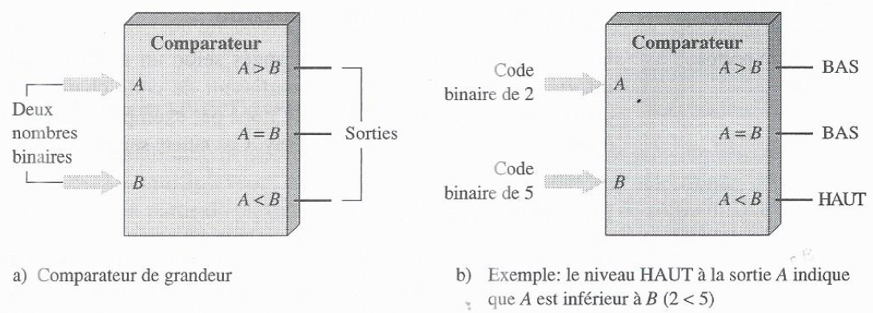
2. Basic Logic Functions (Comparison)
Comparison ➔ Comparator

Slide 9
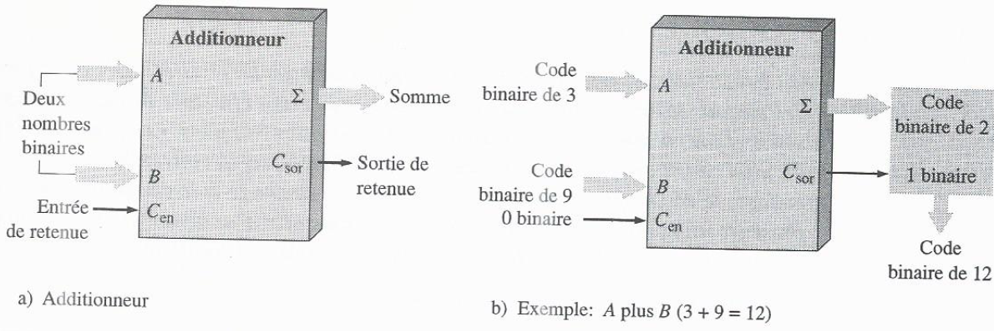
2. Basic Logic Functions (Arithmetic functions)
Addition➔ Adder

Slide 10
2. Basic Logic Functions (Arithmetic functions) (continued)
Subtraction ➔ Subtractor
Nombre binaire
A
Différence
Nombre binaire
B
Entrée d’emprunt
Sortie d’emprunt

Slide 11
2. Basic Logic Functions (Arithmetic functions) (continued)
Multiplication ➔ Multiplier
Binary number
A
Product
Binary number
B
Multiplication = Addition + Product Position Shift ➔ Multiplication can be done
by an adder + other circuits
Division ➔ Divisor (2 inputs and 2 outputs (quotient + remainder))
Division = Subtraction + Comparison + Shift ➔ Division can be performed by a subtractor + other circuits

Slide 12
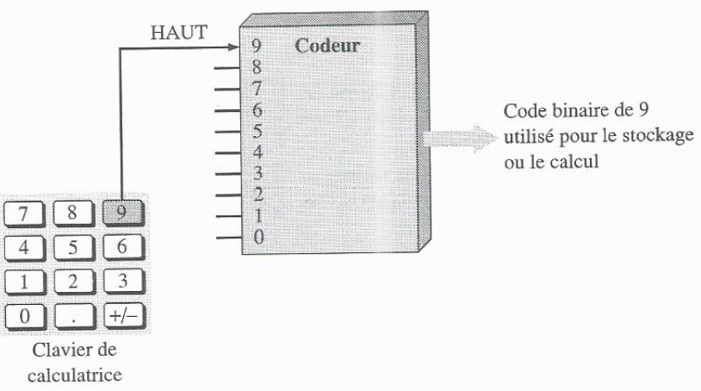
2. Basic Logic Functions (Coding)
Coding (conversion of information (decimal number or alphabet character) into coded form (binary)) ➔ Encoder

Slide 13
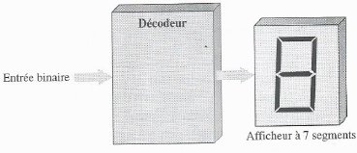
2. Basic logic functions (decoding)
Decoding ➔ decoder (conversion of coded (binary) information into uncoded form)
Decoder performing the conversion of a binary code on a seven-segment display

Slide 14
2. Basic Logical Functions (Data Selection)
Data selection ➔ Multiplexer and demultiplexer
Multiplexer (multiple inputs ➔ output) (like an electronic switch sequentially connecting each of the input lines to the output line)
Demultiplexer (one input ➔ multiple output lines according to a specific timeline)
Multiplexer and demultiplexer ➔Remote data transmission

Slide 15
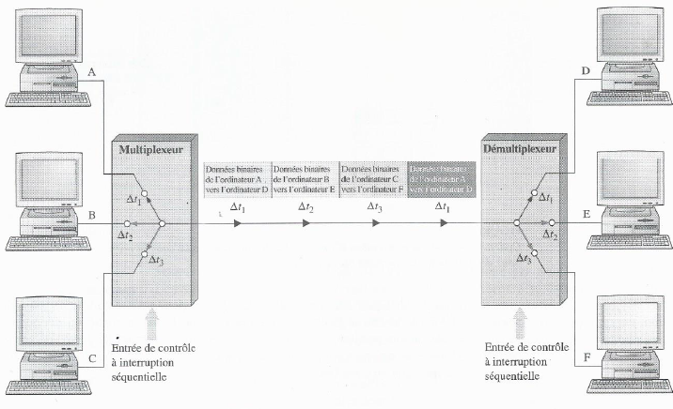
2. Basic Logical Functions (Data Selection) (continued)
Time Division Multiplexing

Slide 16
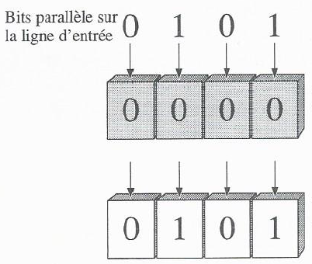
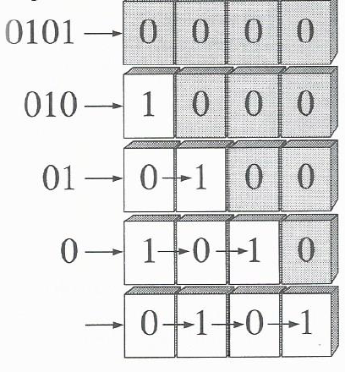
2. Basic Logical Functions (Data Storage)
Storage ➔ storage unit
Flip-flop (bistable logic circuit whose output indicates which bit is currently stored)
(Shift) Register (Flip-Flops Combinations) ➔ Storing a group of bits
Shifting bits (from one position to another)
(Shift) Register (Flip-Flops Combinations) ➔ Shifting bits (from one position to another)
Serial Shift Register
Parallel shift register

Slide 17
4. Basic Logical Functions (Data Storage (continued))
Semiconductor memories (storage of large quantities of bits) Mémoire morte (ROM)
  Random Access Memory (RAM)
  Cache memory (cache or buffer memory)
  Semiconductor flip-flop
  Register that consists of semiconductor flip-flops
Magnetic memories ➔ Mass storage of binary data
  Hard disk
  Optical disc (It uses laser beams to store and retrieve data)
  Magnetic tape

Slide 18
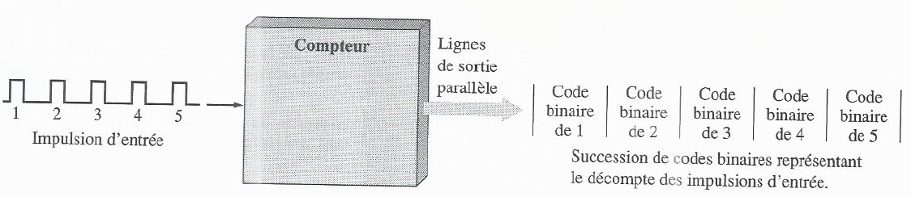
2. Basic Logic Functions (Counting)
Counting ➔ Counter (count events)
A counter is composed of a memory (based on flip-flops)

Slide 19
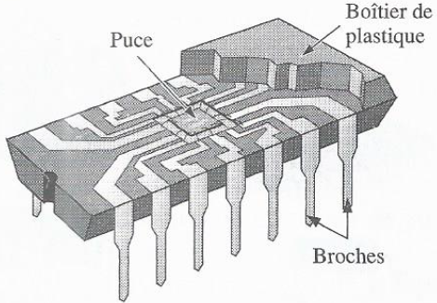
3. Integrated circuits (IC)
3.1. Integrated circuit (IC)
Integrated circuit (IC) (electronic circuit built entirely on a single Si chip)
IC (advantages)
  Size
  Reliability
  Cost
  Consumption (electrical)
Cutaway view of a typical IC package
showing the chip mounting
and connections to the input and output pins

Slide 20
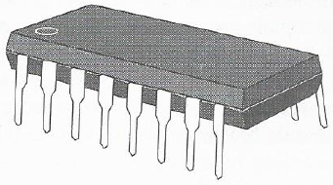
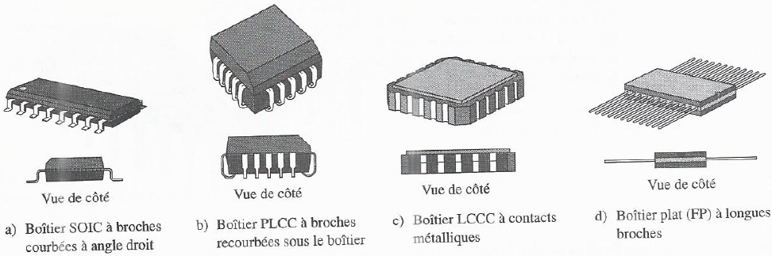
3. Integrated circuits (IC) (continued)
3.2. IC packages (classification according to the principle of mounting on printed circuit board)
Insertion Mount Integrated Circuits
Dual In-Line Package (DIP)
Surface-Mount Technology (SMT) Integrated Circuits

Slide 21
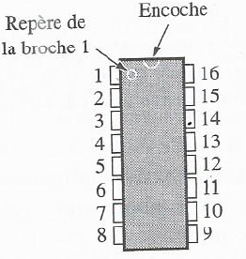
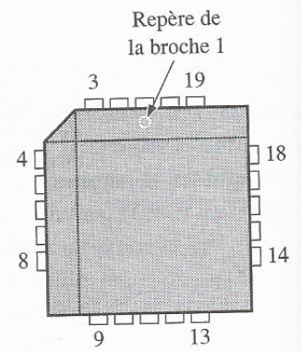
3. Integrated circuits (IC) (continued)
3.3. Pin numbering
DIP + SOIC + FP
PLCC + LCCC

Slide 22
3. Integrated circuits (IC) (continued)
3.4. IC complexity classification
Small Scale Integration (SSI) (number of equivalent logic gates < 12)
  Basic Logic Gates
  Toggles
Medium-scale integration (MSI) (12 ≤ number of equivalent logic gates ≤ 99)
  Coders
  Decoders
  Counters
  Registers
  Multiplexer
  Arithmetic circuits
  Little memories

Slide 23
3. Integrated circuits (IC) (continued)
3.4. IC complexity classification (continued)
Large Scale Integration (LSI) (100 ≤ number of equivalent logic gates ≤ 9999)
  Memories
Very Large Scale Integration (Very LSI (VLSI)) (10000 ≤ number of equivalent logic gates ≤ 99999)
Ultra-large scale integration (Ultra LSI) (number of equivalent logic gates ≥ 100000)
  Very large memory
  Powerful microprocessors

Slide 24
3. Integrated circuits (IC) (continued)
3.5. IC Technologies
Bipolar Transistor Based IC Technologies
  TTL (Transistor-Transistor Logic)
  ECL (Emitter Coupled Logic)
SC-Metal-Oxide Field-Effect Transistor (MOSFET) Technology
  CMOS (complementary MOS)
  NMOS (MOS) N channel
TTL Technology ➔ SSI and MSI
CMOS or NMOS ➔ SSI and MSI and LSI and VLSI and ULSI

