Slide 1
In the concrete + steel association, the concrete resists compression forces, and the steel resists tensile forces and possibly compression forces if the concrete is not sufficient to take all the existing compression forces.
Concrete Compression (Strength :20 MPa to 40MPa)
(Tensile Strength: 2 MPa à 4MPa)
Steel Tension or compression (200 MPa to 500 MPa) ·
A construction is called reinforced concrete if both materials contribute to the overall resistance.
There is no chemical reaction between steel and concrete, and additionally, concrete protects steel from corrosion.
The expansion coefficient of both materials is practically the same.
Chapter 03: Steel-Concrete Bond: 1. Generalities:
Steel
Conctrete

Slide 2
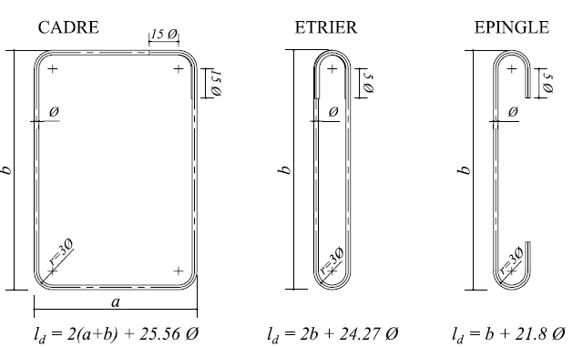
1.1- Longitudinal Reinforcements: High-adherence reinforcement with diameters ≥12 mm is generally used in the tensioned part of the beam to withstand tensile forces (main reinforcements). In the compressed part, mounting bars can potentially take on part of the compressive forces when the concrete alone is insufficient.
1.2.- Transverse Reinforcements:They have a diameter of less than 10 mm. There are three types of transverse reinforcements:
• Transverse reinforcements are placed along the beam and are very closely spaced near the supports because the shear force is at its maximum.
• Transverse reinforcements are attached to the longitudinal bars to maintain their spacing.
stirrup cage
stirrup
U-bar(hairpin bar)

Slide 3

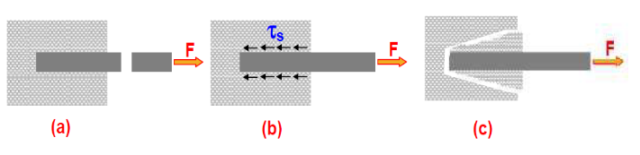

2. Steel-Concrete Bond: The term bond refers to the interfacial forces that prevent the slippage of reinforcement bars relative to the surrounding concrete. This bond is crucial in ensuring one of the fundamental assumptions in reinforced concrete design, which states that there is no relative displacement between steel bars and concrete (ξb = ξs).
This property allows for the transfer of stresses from the concrete to the reinforcement bars, ensuring structural integrity. The bond between reinforcement and concrete is quantified by the bond stress (τs).
$\frac{dF}{dx}$ : is the variation per unit length of the axial force exerted on the reinforcement. U: the effective perimeter of the reinforcement.
The efficiency of a bar in terms of bond is characterized by its anchorage coefficient 𝜓ψ, which is taken as unity for smooth round bars as-rolled and as the value specified in the identification sheet for other types of reinforcement.

Slide 4

The steel-concrete bond is influenced by several factors, namely:
Surface condition of the bars (smooth surface, rough surface).
Shape of the bars.
Grouping of reinforcements.
Concrete strength.
Transverse compression (clamping).
Concrete thickness.
2.1. Bond Strength Limit: To ensure proper anchorage, meaning to prevent the slippage of reinforcement within the concrete shear the surrounding it, the bond stress must be limited to the value:
ftj is expressed in MPa.; ψs : is the anchorage coefficient relative to the steel, depending on whether it is smooth or high-adherence (HA) steel. ψ s= 1 for smooth steel bars. ψs = 1,5 for high-adherence (HA) steel.

Slide 5
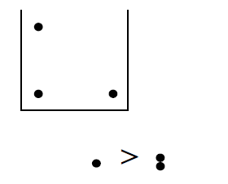
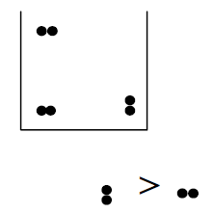
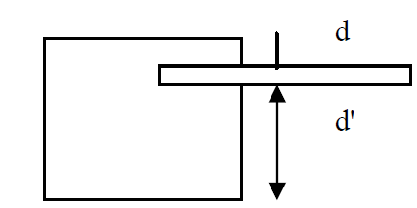
2.2Factors Affecting Bond Strength:
Surface condition of the bars: Rough surfaces increase friction between concrete and steel, thereby enhancing the bond.
b. Shape of the bars : Circular (round) reinforcement provides better adhesion compared to bars with other shapes.
c. Grouping of reinforcements:
The bond strength of an individual bar is greater than that of two grouped bars.
The bond strength of two vertically grouped bars is greater than that of two horizontally grouped bars..
d. Concrete strength:Bond strength increases with the increase in the compressive strength of concrete.
e. Concrete thickness: The thicker the element, the better the bond, as the concrete thickness prevents cracking and splitting.

Slide 6
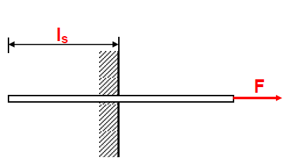
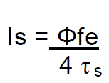
3. Reinforcement Anchorage:
3.1. Straight Anchorage: A reinforcement bar is well anchored when the tensile force exerted on it is fully balanced by the adhesion between steel and concrete within the anchorage zone.
The straight anchorage length 𝑙𝑠 s​ is defined as the length of a bar of diameter capable of balancing, with a bond stress 𝜏𝑠u​ , the force causing a tensile stress in this bar equal to the steel's yield strength 𝑓𝑒.Therefore:
Tensile Force = Bond Force
In the absence of a precise calculation, the following standard values are adopted:
40 φ for FeE 400 steel (ψs ≥ 1.5).
50 φ for FeE 500 steel (ψs ≥ 1.5).
For smooth steel bars (FeE 215 and FeE 235): ψs = 1.

Slide 7
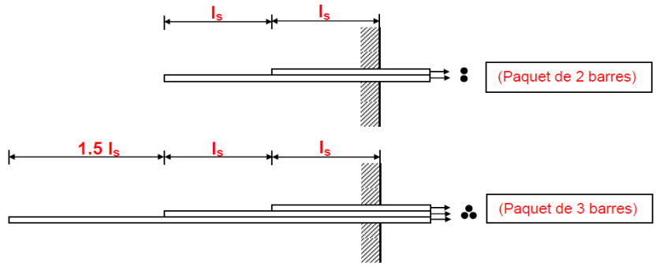
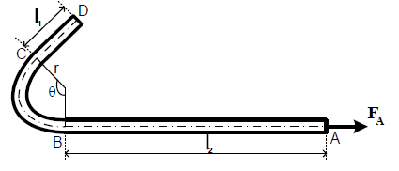
3.2. Straight Anchorage Length for a Bundle of Bars: A bar must always be anchored individually.
3.3 Curved Anchorage: When the dimensions
of the element are insufficient to allow a straight
anchorage of length 𝑙𝑠 , we use curved
anchorage (Extreme support of beams).
3.3.1 Minimum Bending Radii:
According to BAEL, curved anchorages must be executed according to the following minimum radii:
Smooth round steel bars::- Hook bending: r ≥ 3 ϕ
Frames, stirrups, U-bar(hairpin bar) : r ≥ 2 ϕ
High-adherence steel bars:- Hook bending: r ≥ 5.5 ϕ
- Frames, stirrups, U-bar(hairpin bar) 𝑟 ≥2𝜙: r ≥ 2 ϕ in general

Slide 8
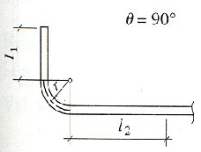
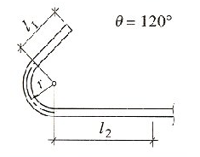
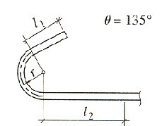
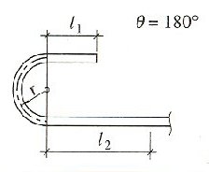
3.3.2 Characteristics of Common Hooks:The most commonly used types of hooks are:
L’angle θ = 90°: L’angle θ = 120°: L’angle θ = 135° L’angle θ = 180°
ls = 1.87 l1 + l2 + 2.19 r ls = 2.31 l1 + l2 + 3.28 r ls= 2.57 l1 + l2 + 3.92 r ls= 3.51 l1 + l2 + 6.28 r
3.4. Anchorage of Frames, Stirrups, and U-bar(hairpin bar) :
According to BAEL, it is assumed that the anchorage of the ends of bars shaped into frames, stirrups, and U-bar(hairpin bar) is ensured by curvature following the minimum radius, provided that the curved parts are extended by straight segments of length (l₁) at least equal to:
- 15ϕ for a 90° circular arc.
10 ϕ for a 135° circular arc.
5 ϕ for a 180° circular arc.

Slide 9
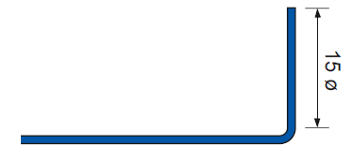
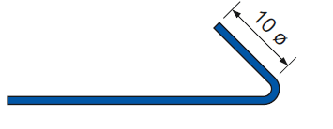
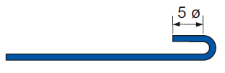
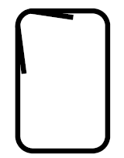

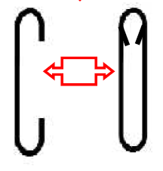
4. Overlapping (Splicing):
Due to the limited length of commercially available bars, some large structural elements require the use of multiple bars to ensure continuity of reinforcement, and therefore, continuity in the transmission of forces. To achieve this function, a lap splice must be created between two identical bars over a certain length called "lap length 𝑙𝑟".
Frames
Frames
U-bar
Stirrups

Slide 10
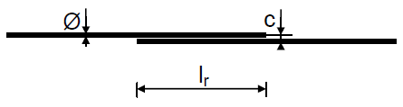
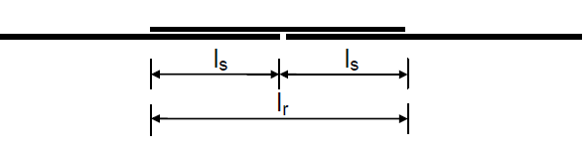

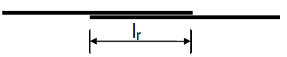
4.1. Straight Bars Without Hooks:
4.1.1 Tensioned Bars:
Continuity by Simple Overlapping:
if : c ≤ 5ϕ => lr = ls.
if : c > 5Ø => lr = ls + c
with :
c : Distance between the axes of the two bars
ls : Anchorage length
b. Overlapping with Cover Joint:
lr = 2 ls
4.1.2. Compressed Bars
Continuity by Simple Overlapping:

Slide 11
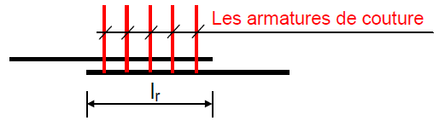

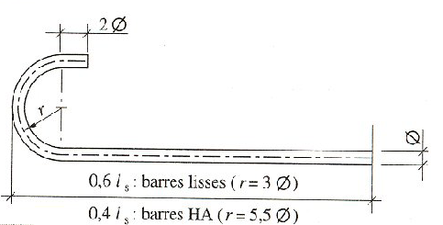
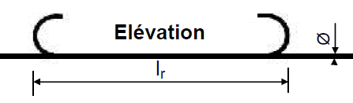
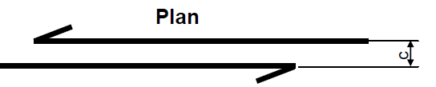

4.1.3 Stitching of Joints: In the case of an overlap joint between two parallel bars, the resistance of the stitching reinforcement (frames, stirrups) must be at least equal to the resistance of each of the bars to be anchored.
The diameter of the stitching reinforcement must be chosen small
enough to ensure good distribution along the joint.
4.2 Straight Bars with Standard Hooks: The shaping of the standard hook is done according to the model shown in the figure.
a. Smooth Round Bars
• lr= 0.6 ls= 30 Ø
b. High-Adherence Steel (HA)
Lr = 0.4 ls with : - FeE400 ⇒ lr = 16 Ø et - FeE500 ⇒ lr = 20 Ø
(In cases where overlapping bars are terminated with standard hooks.)
If c ≤ 5 ϕ :Lr = 0.6 ls ou lr = 0.4 ls
if c >5 ϕ :lr= 0.6 ls + c ou lr = 0.4 ls + c
Stitching of Joints:

Slide 12
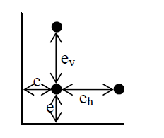
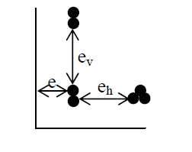
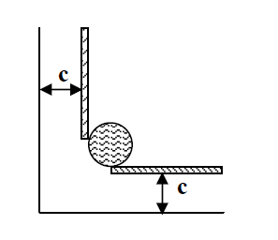
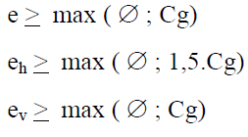
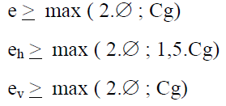
5- General Construction Provisions:
5.1- Reinforcement Protection:his protection is called "cover" (c). The cover of any reinforcement must be at least 5 cm for marine structures or structures exposed to highly aggressive environments.
5 cm: For structures subjected to aggressive actions (e.g., aggressive soils) and structures exposed to weather conditions (rain, snow) or in contact with liquids (e.g., bridges).
3 cm : For superstructures.
b- Distance Between Bars:
-Isolated bars: - grouped des bars :
Cg : Maximum aggregate diameter.

Slide 13
Exercise :
Determine the straight anchorage length of a bar with diameter Ø in FeE 215, 235, 400, and 500 steel for concrete with a compressive strength :
fc28 = 20, 25, 30 et 40 Mpa

