Slide 1

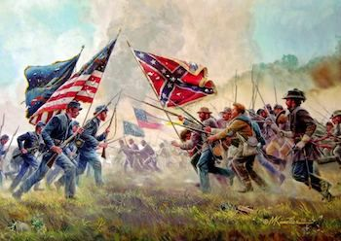
American Civil War Causes and Effects
The teacher
Boudjerida Messaouda

Slide 2

Plan
Introduaction
Causes
Effects
Conclusion

Slide 3


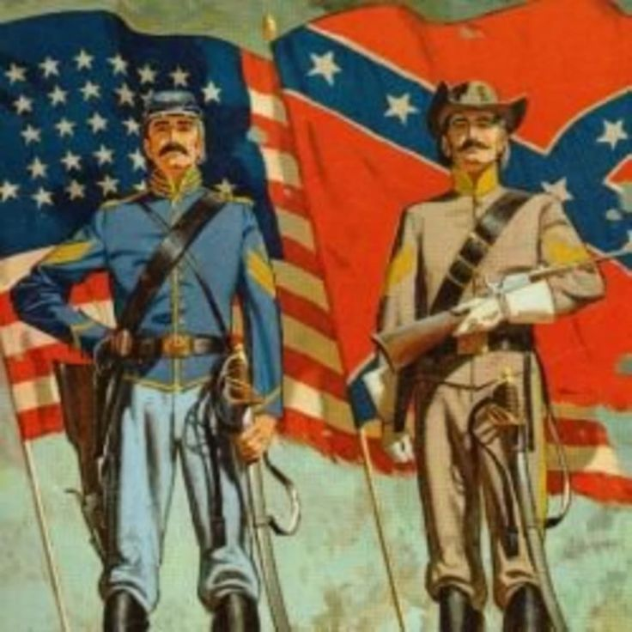
Introduaction
The American Civil War was a significant conflict fought in th United States from 1861 to 1865, between the Northern states which called the Union and the Southern states which called the Confederacy, primarily over issues such as slavery which is the main cause of civil war, it is also known as the War Between the States.

Slide 4
Causes
Slavery and it's expansion into new territories : this was a major cause of the American civil war . The main issue was wether slavery should be allowed in the new territories, this created a deep divide between the northern states which were against slavery and southern states which relied on slave labour . This disagreement led to the beginning of the war.
The economic differences between the industrialized north and the agricultural south : the northern states relied more on industry and manufacturing while the southern states focused on agriculture particularly cotton production using slave labor, this differences led to disagreements over issues such as tariffs ,taxation and the expansion of slavery and this led indirectly to the war.
States rights versus federal authority : which basically means the question of how much power the states should have compared to the government , the southern states believed in the concept of state's

Slide 5
rights which meant they believed individual states should have the power to make decisions and laws for themselves and the government should have limited authority over them , they can disagree with the laws that are not suitable for there way of living. On the other hand , the northern states believed in a stronger central government with more authority over the states , this disagreement over the balance of power between the states and the government led to the outbreak of war.
Sectionalism and regional tensions : which means there were a lot of economic, social and cultural differences between the northern states and the southern states , this made each side have it's own interests and goals which make them disagree in mostly all the issues , this led to a deep regional tensions that contributed into the outbreak of the civil war.
The political differences Between the northern states and southern states : both of the sides had different contrasting political ideologies and priorities , the northern states focused more on industrialization , urbanization and strong federal government , they supported policies that promoted economic growth and modernization while the southern states valued state's rights and agrarian society,they were concerned in the interference of the government in their ways of life particularly in the slavery deal. These political differences led to the war.

Slide 6
The issue of slavery :the northern states got influenced by abolitionist movements which viewed slavery as morally wrong, they believed in the equality of all individuals regardless of their race . In contrast, southern states believed that slavery is essential to their ways of life, this conflict led to the outbreak of the war.
The election of Abraham Lincoln as a president in 1860 : Abraham Lincoln won the elections without receiving any votes from the southern states , his election was seen as a threat to the institution of slavery as he opposed and refused the expansion into the new territories .they saw his presidency as a direct challenge to their ways of life and they feared he would take actions against slavery. This increased the tensions that led to the war.
The supreme court's decision in the Dred Scott case : in this case , the court rules that the African American were not considered as citizens and they had no right in the constitution . This decision deepened the divide between the north and the south and this led to the war .
The secession of southern states from the union : after the election of Abraham Lincoln as president , several southern states decided to leave the United States and form their own

Slide 7
government because they believed that their rights were threatened specially in the issue of slavery , this secession led to the formation of the confederate states of American and to the outbreak of the war .
The attack of Fort Sumter : which marked the beginning of the war , in april 1861 confederate forces attacked the union-held Fort Sumter in south Carolina . This event was the first military engagement of the civil war.

Slide 8
Effects
The American Civil War, which lasted from 1861 to 1865, was a pivotal event in U.S. history with numerous effects that reshaped the nation. Here's an explanation of the 20 significant effects listed:
1. *Abolition of Slavery*: The Civil War led to the abolition of slavery with the passage of the 13th Amendment to the U.S. Constitution in 1865, ending centuries of legalized slavery in America.
2. *Preservation of Union*: The war ensured the survival of the United States as a single, unified country, preventing the secession of the Confederate states.
3. *Reconstruction Era*: Following the war, the Reconstruction Era (1865-1877) aimed to rebuild the South and integrate newly freed slaves into society, though it faced challenges and ultimately ended without fully achieving its goals.
4. *Loss of Life and Destruction*: The Civil War resulted in a devastating loss of life, with an estimated 620,000 soldiers killed, along with widespread destruction of property and infrastructure.

Slide 9
5. *Expansion of Federal Power*: The war led to an increase in the power of the federal government over the states, as seen in the passage of laws such as the 14th and 15th Amendments.
6. *Racial and Social Changes*: The end of slavery and the Reconstruction period brought about significant changes in race relations and social structures in the United States.
7. *Economic Transformation*: The war had profound effects on the economy, leading to changes in agriculture, industry, and labor systems, and paving the way for economic growth in the post-war years.
8. *Advances in Medicine*: The Civil War spurred advancements in medical practices and techniques, particularly in field medicine and surgery.
9. *Redefinition of Citizenship*: The 14th Amendment redefined citizenship to include all persons born or naturalized in the United States, including former slaves.
10. *Impact on Women's Rights*: The war had implications for women's rights, as women took on new roles and responsibilities during the conflict, contributing to the early women's rights movement.
11. *Military Innovations*: The Civil War saw the use of new military technologies and tactics, including rifled muskets, ironclad warships, and trench warfare.

Slide 10
12. *National Identity*: The war played a significant role in shaping American national identity and ideals, including notions of freedom, democracy, and equality.
13. *Rise of Industrialization*: The demands of the war effort accelerated industrialization in the North, laying the foundation for the country's industrial growth in the late 19th century.
14. *Changes in Labor Systems*: The end of slavery led to changes in labor systems, including the rise of sharecropping and other forms of agricultural tenancy in the South.
15. *Political Realignment*: The war led to a realignment of political parties, with the Republican Party emerging as a dominant force in national politics.
16. *Westward Expansion*: The war contributed to the settlement of the western frontier, as returning soldiers and freed slaves moved west in search of new opportunities.
17. *Impact on Native Americans*: The war had significant effects on Native American tribes, as they were forced to choose sides and faced increased pressure to cede land to the expanding United States.
18. *Rise of National Cemeteries*: The Civil War led to the establishment of national cemeteries to honor the soldiers who died in battle, such as Arlington National Cemetery.

Slide 11
19. *Transformation of Southern Society*: The war and Reconstruction period brought about profound social and economic changes in the South, including the end of the plantation system and the rise of a new social order.
20. *Long-term Economic and Social Divide*: The effects of the Civil War created a lasting economic and social divide between the North and South, impacting regional development and politics for generations.
These effects illustrate the far-reaching impact of the Civil War on American society, politics, and culture, shaping the course of the nation's history in profound ways.

Slide 12
Conclusion
In conclusion, the American Civil War stands as a pivotal chapter in the nation's history, driven by deep-rooted tensions over slavery, economics, and political power. Its effects were profound, leading to the abolition of slavery, reshaping the economy, and transforming American society. Despite the war's conclusion, its legacy persists in ongoing debates over race, politics, and national identity, underscoring the enduring significance of this conflict in shaping the trajectory of the United States.

