Slide 1
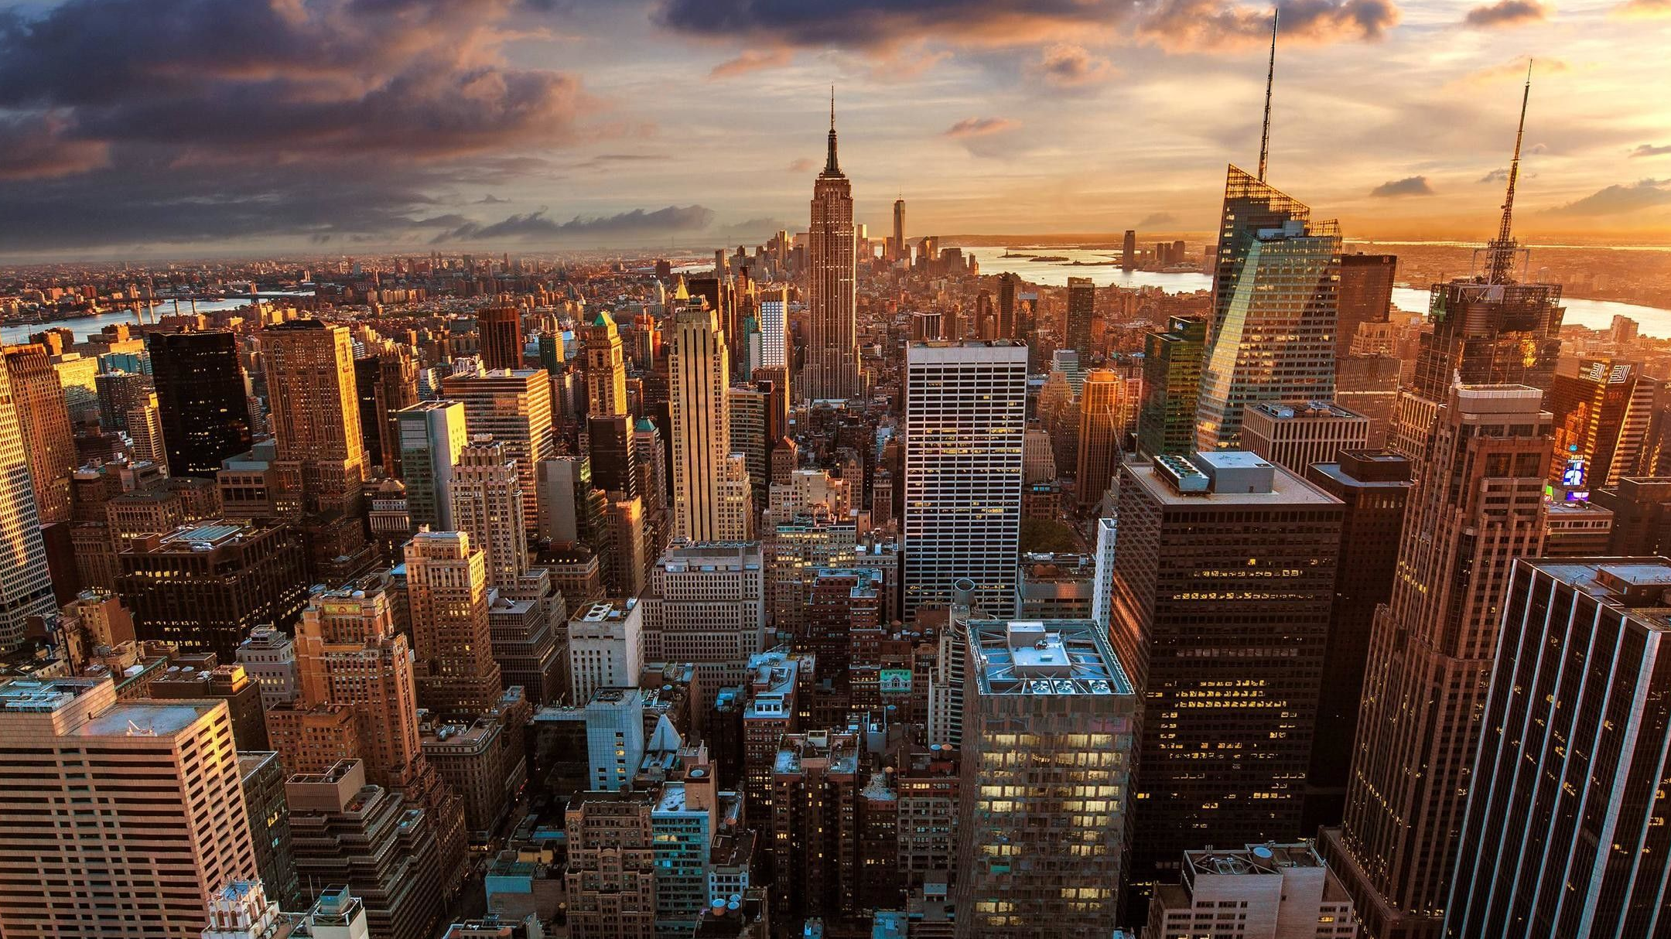
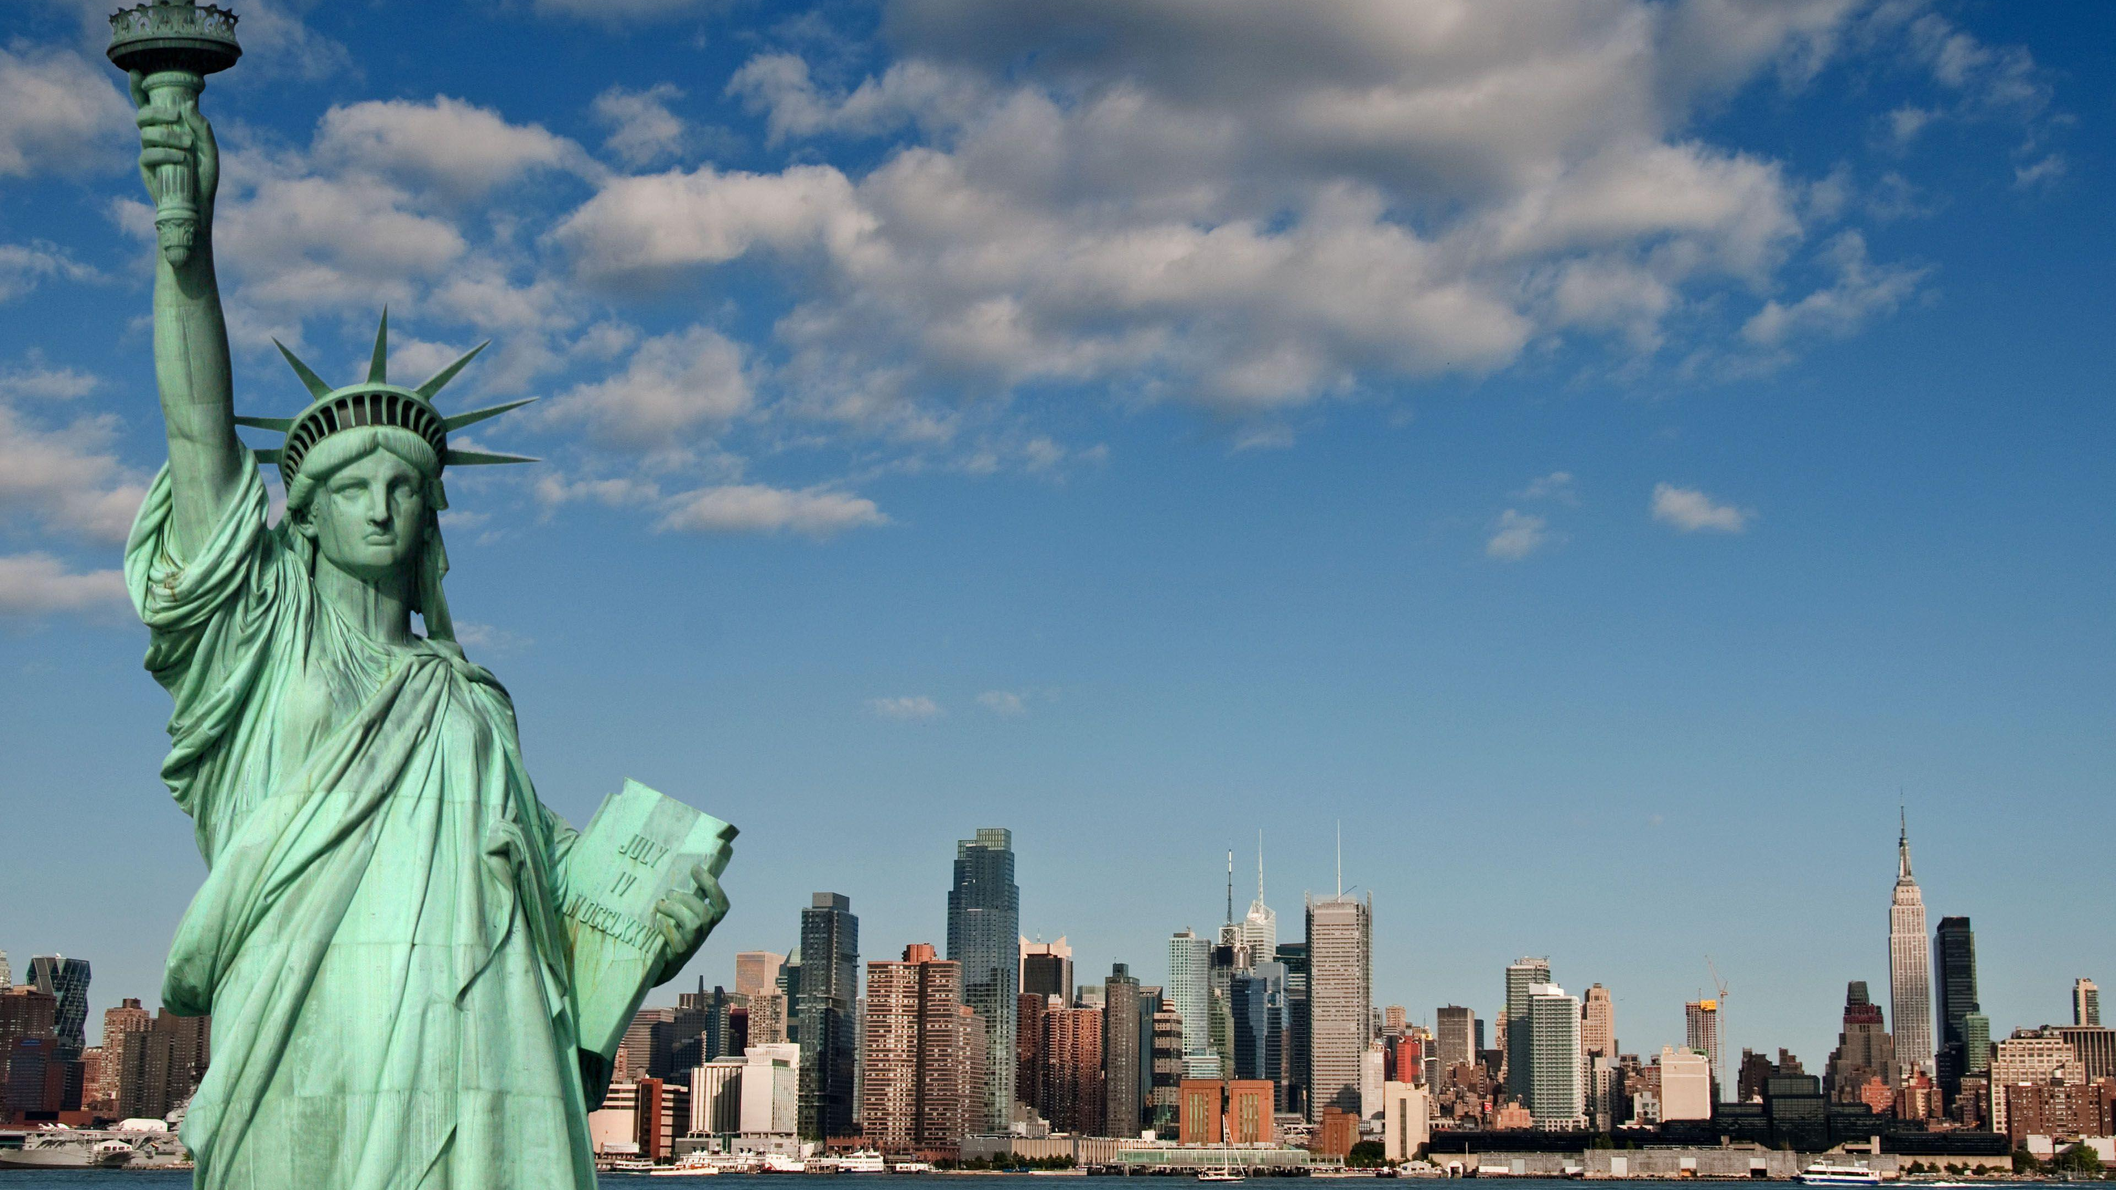

Slide 2
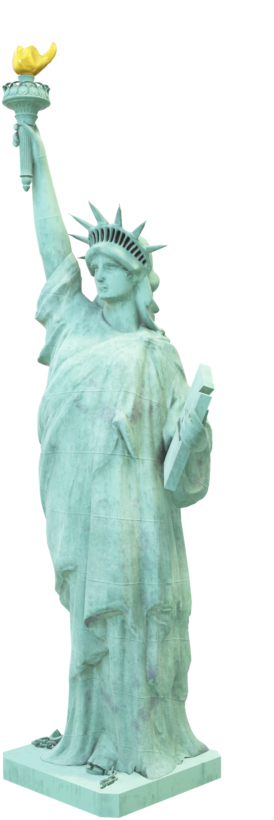
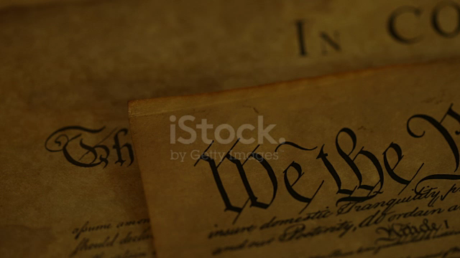


Slide 3
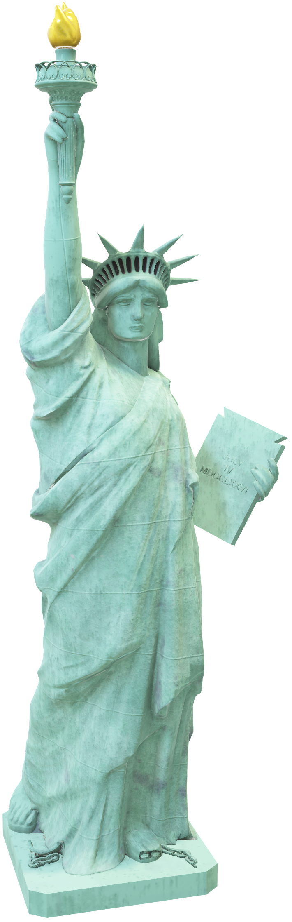
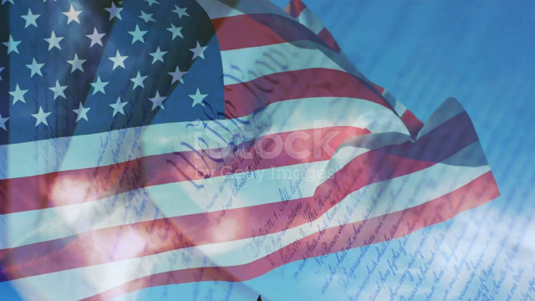
Introduction
In the tapestry of American governance, the Bill of Rights stands as a luminous thread, woven with the aspirations of a fledgling nation determined to guard against the encroachment of tyranny and secure the inalienable rights of its citizens. As we embark on an exploration of this foundational document, we peel back the layers of history to reveal the profound motivations that led to its creation.
TEAM
RAHMA BOUDEN
BOUAROUDJ YASSAMINE
BOULBASSIR SAFIA
IKRAM BAGHI

Slide 4
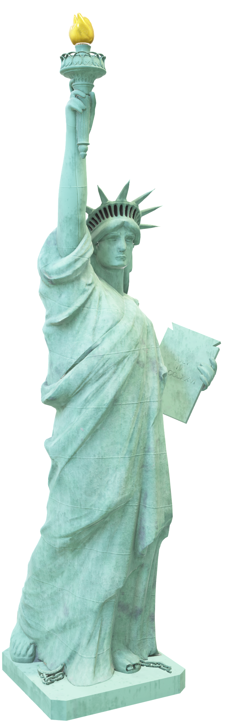

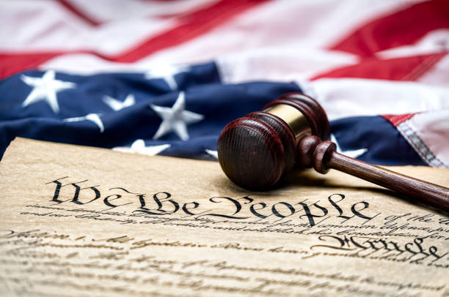
Definition
The Bill of Rights is a set of ten amendments added to the United States Constitution in 1791. It was influenced by the American Revolutionary War and the desire to protect individual freedoms. The amendments guarantee rights such as freedom of speech, religion, and the press, the right to bear arms, the right to a fair trial, and protection against unreasonable searches and seizures. The Bill of Rights was ratified by the states and has since played a crucial role in safeguarding individual liberties and shaping American democracy. It remains an essential document that continues to influence the principles and values of the United States.

Slide 5
Definition
The Bill of Rights is a set of ten amendments added to the United States Constitution in 1791. It was influenced by the American Revolutionary War and the desire to protect individual freedoms. The amendments guarantee rights such as freedom of speech, religion, and the press, the right to bear arms, the right to a fair trial, and protection against unreasonable searches and seizures. The Bill of Rights was ratified by the states and has since played a crucial role in safeguarding individual liberties and shaping American democracy. It remains an essential document that continues to influence the principles and values of the United States.

Slide 6
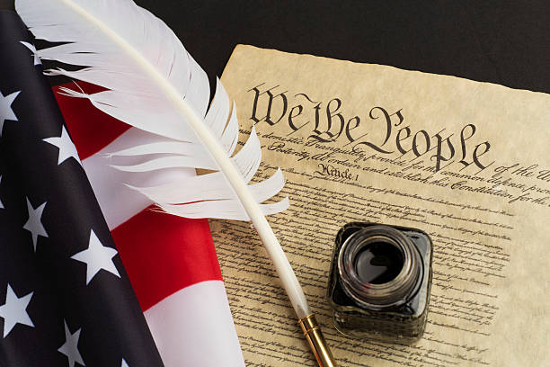


Slide 7

FIRST AMENDMENT
Freedom of Speech: This clause protects the right of individuals to express their thoughts, ideas, and opinions without government censorship or retaliation.
- Freedom of Religion: The First Amendment ensures the freedom to practice any religion or none at all.
- Freedom of the Press: This protects the right of the press to publish information without government interference.
- Right to Assemble: The First Amendment grants the right of individuals to peacefully assemble in groups for various purposes.
- Right to Petition: This guarantees the right of individuals to petition the government for redress of grievances, allowing citizens to address their concerns and seek remedies

Slide 9

SECOND AMENDMENT : Right to Keep and Bear Arms
The Second Amendment is a basic right in American culture, founded on the notion that people have the right to defend themselves and their relatives. This freedom has been restored and interpreted in many ways throughout the years, sparking continuous discussions over gun control and legislation. Ultimately, the Second Amendment is a foundation of American democracy, guaranteeing that individuals have the ability to defend themselves and their freedoms.

Slide 11

THIRD AMENDMENT : Protection from Quartering of Troops*
The Third Amendment addresses issues that arose from British policies prior to the American Revolution. It prevents the government from quartering, or lodging, soldiers in private residences without the owner's permission, save in times of war as allowed by statute. This amendment illustrates the Founders' determination to preserve personal privacy and property rights against future military excesses.

Slide 13

THE FORTH AMENDEMENT :
Prohibits the united state government from conducting unreasonable search and seizures .in general this means police Can not search a person on their property warrant or probable cause .it also aplies to arrests and the collection of evidence .however what is reasonable is the question the supreme court has grappled with for more than two hundred years.

Slide 15

THE FIFTH AMENDMENT:
Was added to the constitution in 1791. It break down Into five Rights or protections :
1_the right to jury trail when you re charged with a crime .
2_protections against double
Jeopardy
3_self incrimination
4_ the Right to fair trail
5_protection the constitution taking of property by the government without compensation.

Slide 17

THE SIXTH AMENDEMENT:
sets forth Rights that related to criminal prosecutions .it was ratified. In 1791as part of untied states bill of right .
lt Provides additional protections to people accused of crime such as the Right to Speedy and public trial )trail by an impartial jury in criminal cases and to be informed of criminal charges.
Witnesses must face the accused and the accused is allow his or her own Witnesses and to be represent by a lawyer.

Slide 19

THE SEVENTH AMENDMENT : Rights in a Civil Trial.
A civil case is brought by a person to get back property, to have a contract enforced, or to
protect a person’s rights. The Seventh Amendment allows a civil case to be decided by a jury
trial when the amount of money involved is over $20

Slide 21
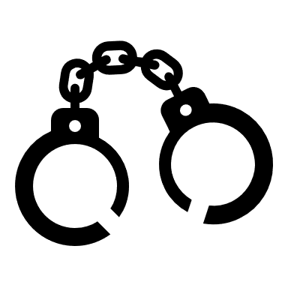
THE EIGHTH AMENDMENT: Bail, Fines and Punishment.
The Eighth Amendment does not allow for unfair bail or fines and the use of cruel or unusual
punishments. The framers wanted to eliminate the use of torture on suspected criminals or as
a punishment for a crime.

Slide 23

THE NINTH AMENDEMENT :
of the United States Constitution, part of the Bill of Rights, acknowledges that individuals have rights beyond those specifically listed in the Constitution. It ensures that these unenumerated rights are protected and that the government cannot deny or diminish them. In essence, the Ninth Amendment safeguards the notion that individuals possess a broader range of rights that are not explicitly outlined in the Constitution.

Slide 25

THE TENTH AMENDEMENT :
of the United States Constitution, part of the Bill of Rights, establishes the principle of federalism and defines the division of powers between the federal government and the states. It states that any powers not granted to the federal government or prohibited to the states by the Constitution are reserved for the states or the people. In simple terms, the Tenth Amendment ensures that the states have authority over certain matters and that the federal government's powers are limited to those explicitly granted by the Constitution.

Slide 26
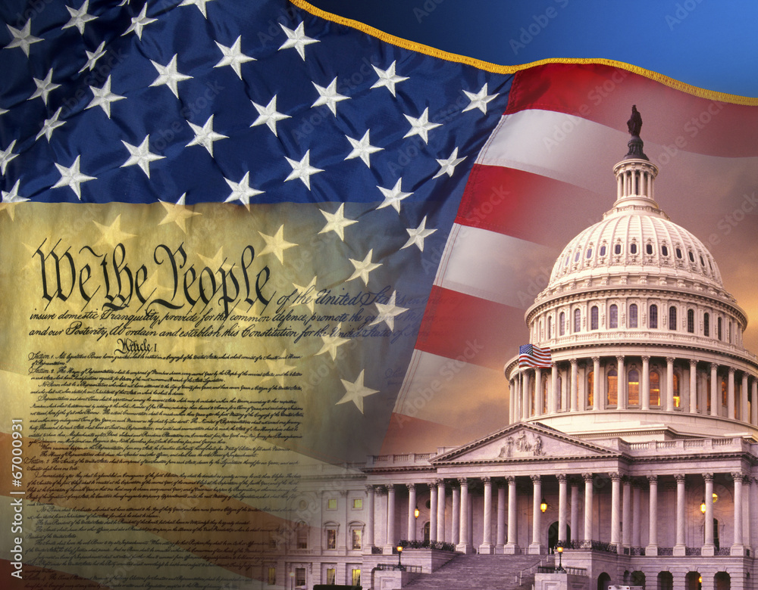
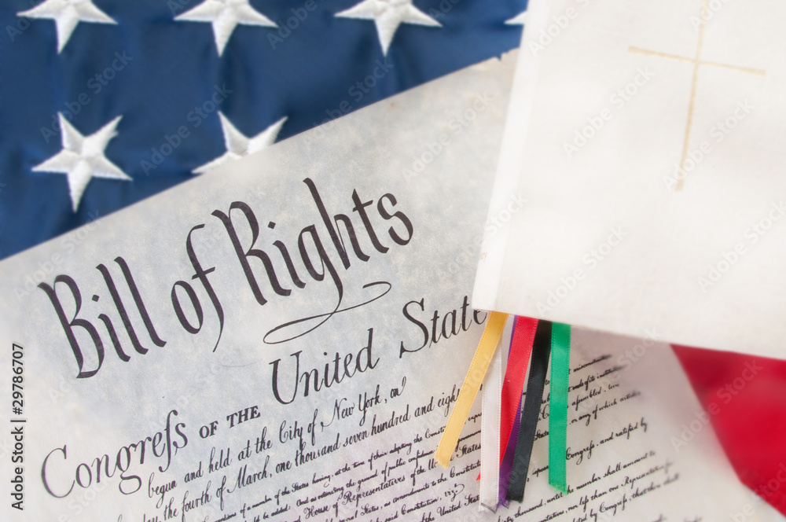
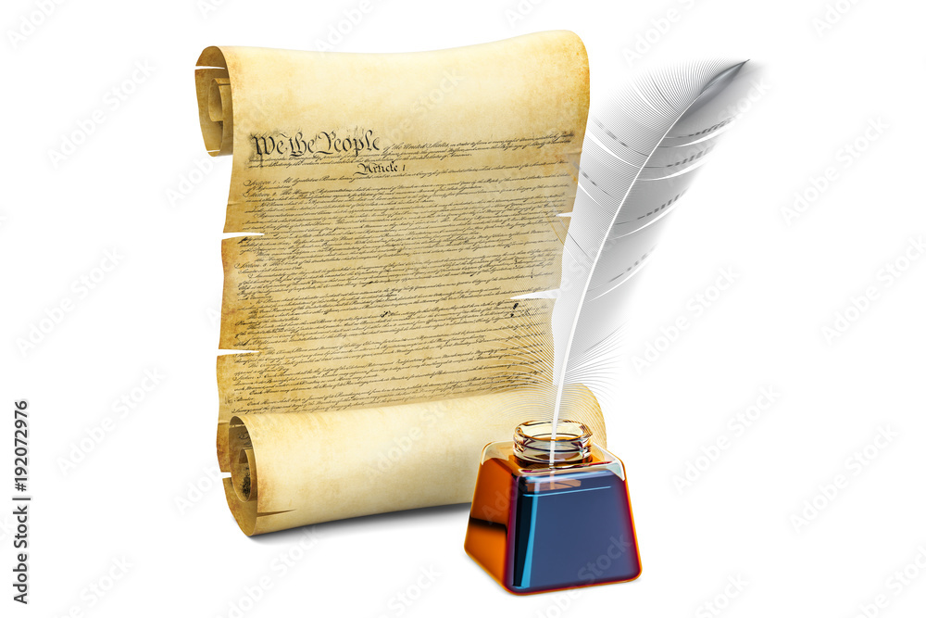
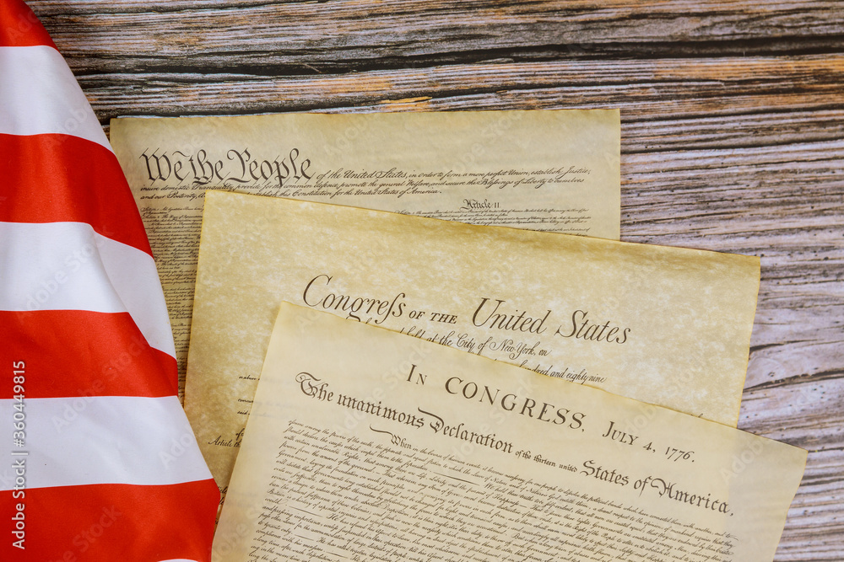
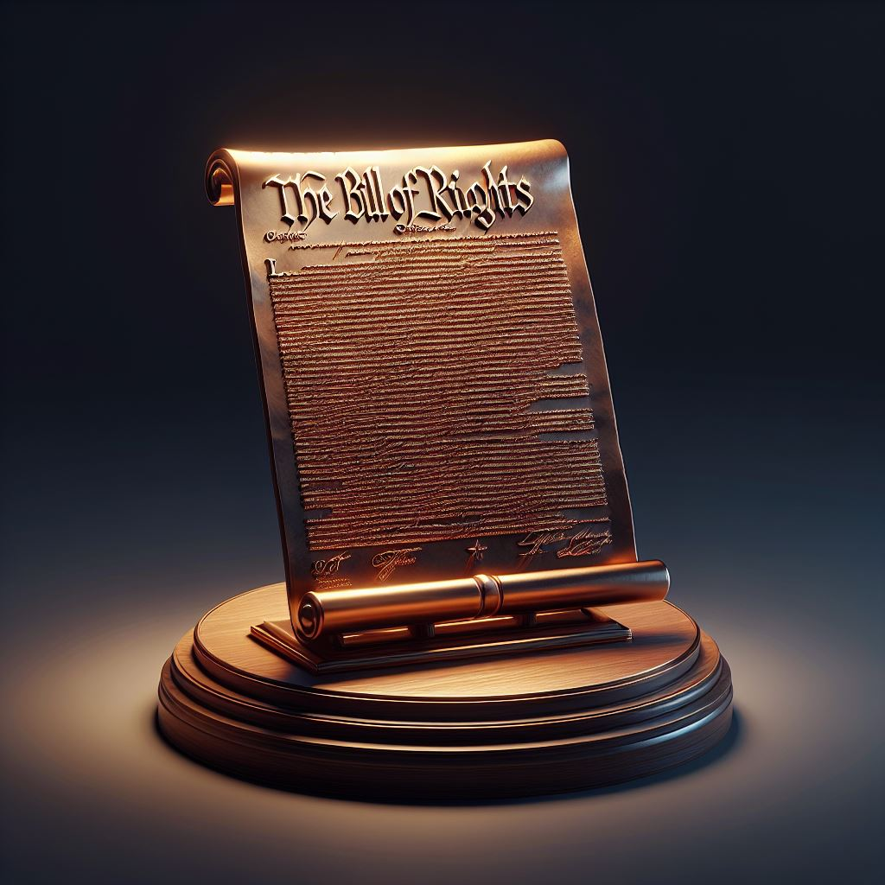
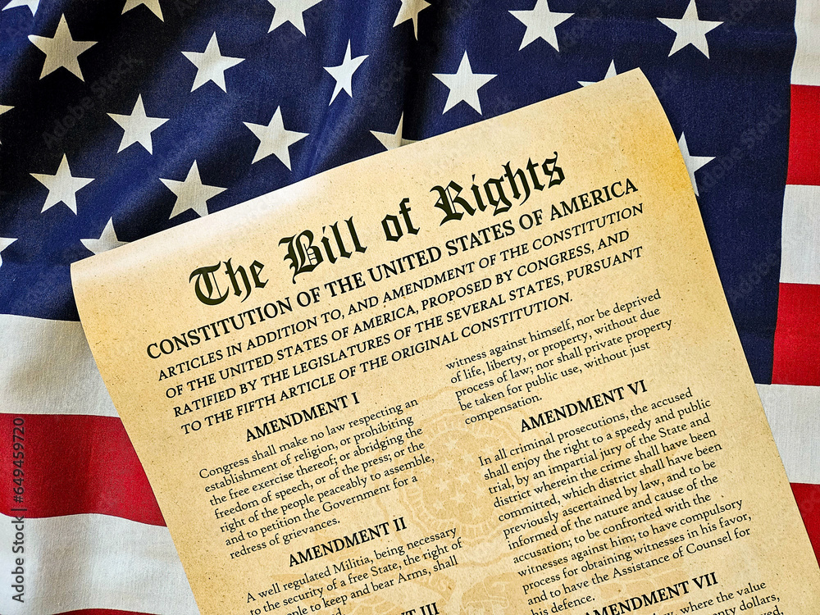
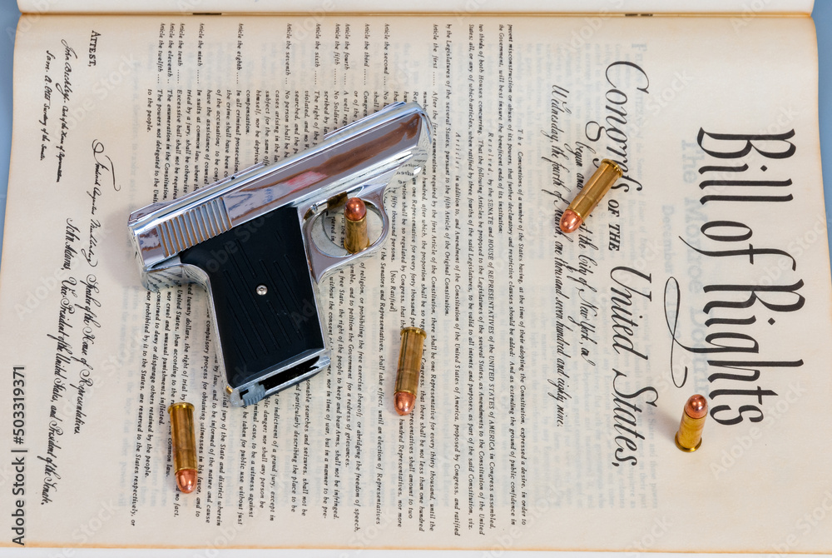

Slide 33
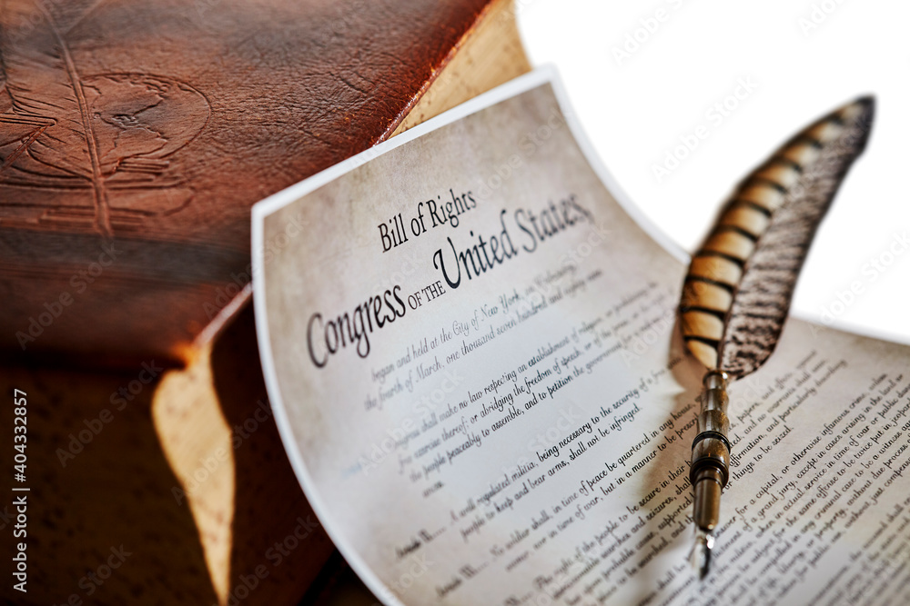

As you can see, the bill of right's whole point is to give the American citizens the right to have a fair life with rights, without it we would not be living in the world we do today.
It guarantees civil rights and liberties to the individual like freedom of speech, press of law and reserves all powers not delegated to the federal government to the people or the states, America would
completely crumble and it would be a disaster. Thankfully, these things cannot legally
happen because of the Bill of Rights, that is why the Bill of Rights is important. It
makes America truly, “The land of the free.”
Conclusion

Slide 34
As you can see, the bill of right's whole point is to give the American citizens the right to have a fair life with rights, without it we would not be living in the world we do today.
It guarantees civil rights and liberties to the individual like freedom of speech, press of law and reserves all powers not delegated to the federal government to the people or the states, America would
completely crumble and it would be a disaster. Thankfully, these things cannot legally
happen because of the Bill of Rights, that is why the Bill of Rights is important. It
makes America truly, “The land of the free.”
Conclusion

