Slide 1





I. Advantages and Disadvantages of Reinforced Concrete
A- Avantages :
- Economic Interest:
More cost-effective.
Maintenance Economy:
Requires no maintenance better than ( steel and wood constructions)
Durability:
Resists water and air exposure
Insulating Material:
Provides acoustic and thermal insulation.
B- Disadvantages:
Execution: Requires formwork and reinforcement preparation.
Le poids : Les ouvrages en B.A sont plus lourds .
Material Quality Control: Needs rigorous inspection.
Modification Challenges: Difficult to alter once built.
Chapter 2: Regulatory Provisions

Slide 2

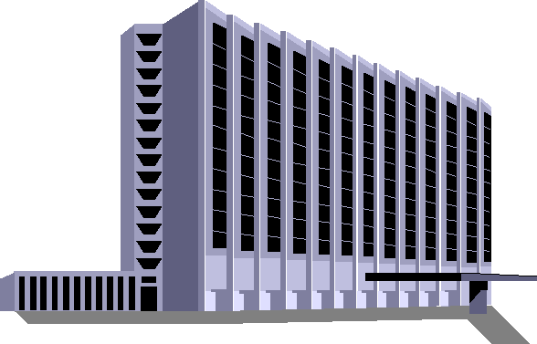
II. Actions and Loads Applied to Structures
1. Dead Loads (G):
Self-weight: ex: ( concrete weight: 2.5 t/m³).
2. Variable Loads: (Q, S, W):
Live loads (Q), climatic loads (e.g., snow: 35-56 kg/m² and wind)
Temperature and shrinkage.
3. Accidental Loads: Earthquake, Fire, Impact.
4.- . Internal Forces: :Normal forces, shear forces, bending moments.
vertical Actions
Load distribution
Strenth of each element
Horizontale Action
Bracing
Stresses due to the most unfavorable load combinations
  Soil

Slide 3
A limit state is a specific condition beyond which a structure no longer fulfills the functions for which it was designed. A limit state is thus reached when a required condition for a construction (such as lack of stability, failure, etc.) is no longer met. We distinguish between two limit states:
III-1 Ultimate Limit State (ULS - ELU):
Max load capacity, exceeding leads to failure.
III-2. Serviceability Limit State (SLS - ELS):
Ensures service conditions without failure.
III-3 Algerian Regulations: : (C.B.A.93)-(R.P.A.2024)
It is the Algerian technical codes that replace the accepted practice of B.A.E.L (Reinforced Concrete at Limit States), providing specific recommendations for Algeria in the field of seismic design through the R.P.A (Algerian Seismic Code).
III- Concept of Limit States:

Slide 4
We will determine the combination or combinations that generate the most unfavorable loads in the structural elements of the construction.
Gmax: Set of unfavorable permanent actions.
Gmin: Set of favorable permanent actions.
Q 1 : basic variable action
Qi : accompanying variable action
IV.1 Action combinations to be considered for ULS :
-Fundamental combinations·:
1,35 Gmax + Gmin + γQ1. Q1 +∑ 1,3ψ0i.Qi
γQ1 = 1,5 In general case.
γQ1 = 1,35 for temperature, operational loads
General the combinaison will be: 1,35 G + 1,5 Q
IV-2 Action combinations to be considered for SLS
We have the rare combination:
Gmax + Gmin + Q1 + ∑ ψ0i .Qi
In general the combinaition is :G + Q
IV. Load Combinations:

Slide 5





V. Action combinations in practice:
V.1. Columns & Foundations: 1,35. G + 1,5. Q.
V.2. Slabs & Beams:
a. Case of a single span without `cantilever The combination to be considered at ultimate limit states (ULS.) is: 1,35.G + 1,5 .Q.
The combination to be considered at ultimate limit states (SLS.) is: G + Q
b. Case of a beam resting on two supports, extended by a cantilever:
b.1 ultimate limit states (ULS.) :

Slide 6
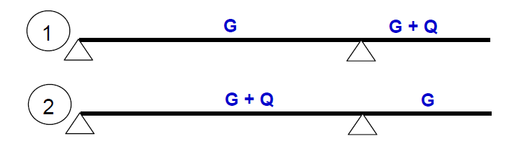
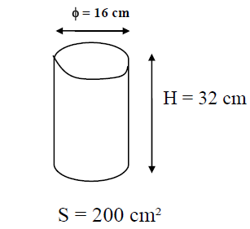
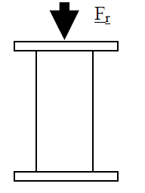

b.2 ULS:
VI. Mechanical characteristic of concrete
VI-1. Compressive strength of concrete:
a- Compression test: the test is performed on concrete cylinders as follows:

Slide 7
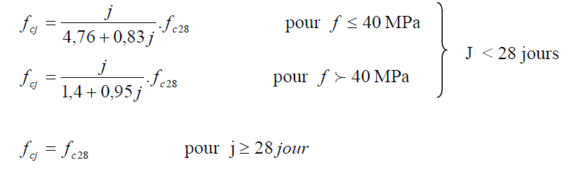
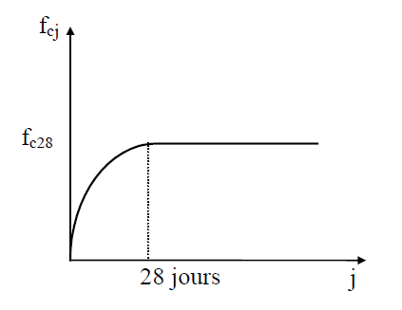
b- Evolution of compressive strength with the age of concrete:
The compressive strength varies over time according to the following law:
fcj : the compressive strength at j days.
fc28 : The compressive strength at 28 days; It is also called the characteristic strength of concrete.
VI-2 Characteristic tensile strength of concrete:
ftj = 0,6 + 0,06 . Fcj si : fc28 ≤ 60MPA
fcj : the compressive strength at j days
ftj : the tensile strength at j days

Slide 8
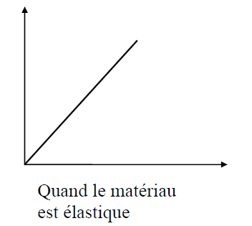
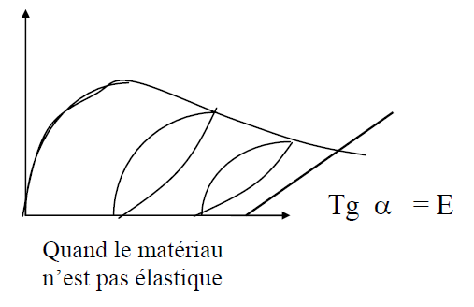


Instantaneous deformation modulus: :Concrete is not an elastic material; during the unloading of the specimen, it is observed that the unloading curve is shifted compared to the loading curve.
The following relationship is assumed under loads with an application duration of less than 24 hours.
i: instantaneous; j: day
-Delayed deformation modulus: > 24 H.(long application duration) :
it is taken as equal to:
(delayed ≠ instantaneous) .

Slide 9
Hygrometric shrinkage: After its production (manufacturing), concrete contains excess water. If hardening occurs in open air, the water will evaporate. This evaporation is automatically accompanied by a reduction in volume, which is called shrinkage. In standard constructions, the effects due to temperature variations and shrinkage will be negligible if expansion joints are planned every 20 to 30 meters. Expansion joints are typically 1 to 2 cm wide.
Exemple d’application1:The crushing tests of a series of concrete specimens taken from a construction site gave the following results: 𝑓𝑐𝑗= 18, 20, 21, 22, 19, 21, 18, 25, 24, 22, 21, 20, 19, 23, 23, 25 [MPA] (j=28 days). The following calculations are required:
1/ The compressive strength fc28 and at j = 90 days
2/ The tensile strength ft28.
3/ The deformation moduli 𝐸𝑖𝑗 and 𝐸𝜗𝑗
Shrinkage | Situation
1.5 × 10⁻⁴ | In very humid climates
2 × 10⁻⁴ | Humid climate
3× 10⁻⁴ | Dry temperate climate
4 × 10⁻⁴ | Hot climate
5 × 10⁻⁴ | Very dry or desert climate

Slide 10
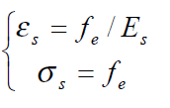
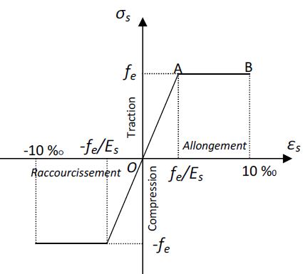
Horizontal AB with ordinate 𝜎ₛ = 𝑓ₑ (plastic domain)
VII. Steel:
The mechanical characteristic used as the basis for justifications is the guaranteed yield strength, designated as fe. It varies depending on the type of steel.
The longitudinal modulus of elasticity Es is practically constant regardless of the steel used and is taken as: Es = 200,000 MPa.
The conventional stress-strain diagram for tension and compression has the shape presented in the figure below, noting that the yield strength values are the same in both tension and compression.
VII.1. Case of Tension:
Line OA (elastic domain)
- Proportionnalité ε-σ
Coordinates of point A
Horizontal AB with ordinate 𝜎ₛ = 𝑓ₑ (plastic domain)
The position of point B corresponds to an elongation of 10 ‰.
II.2. Cas de la compression
The corresponding diagram is symmetrical to that of tension with respect to O.

Slide 11
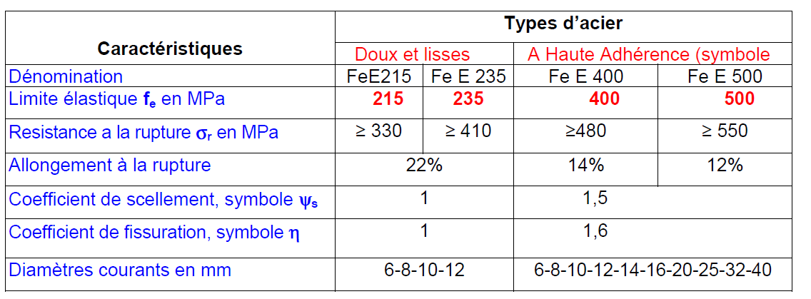
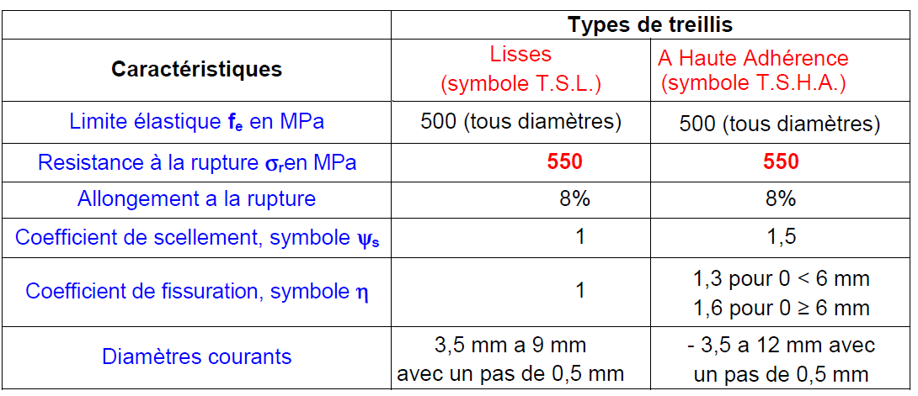
VII.3 Steel Grades:There are 4 main grades that correspond to different yield strength and resistance qualities; see the tables below.
Reinforcing Bars:
Welded Mesh:

Slide 12
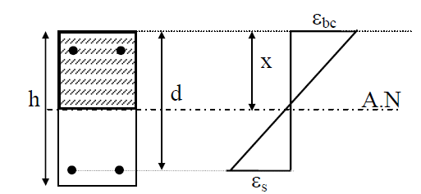
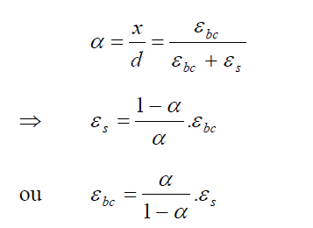
VIII Deformations and Calculation Stresses:
VIII.1 Ultimate Limit State of Resistance: U.L.S
Calculation Assumptions: To apply the rules of strength of materials (SOM) for homogeneous bodies to reinforced concrete, which is a heterogeneous material, it is necessary to homogenize the reinforced concrete section. Therefore, certain assumptions must be applied:
The cross-sections remain plane, and there is no relative slip between the reinforcements and the concrete (deformations are the same for both materials, concrete and steel).
-The tensile strength of concrete is neglected.
Section deformations are limited to a unit elongation of steel of 10 ‰, a unit shortening of concrete of 3.5 ‰ in bending, and 2 ‰ in simple compression.compression simple .

Slide 13
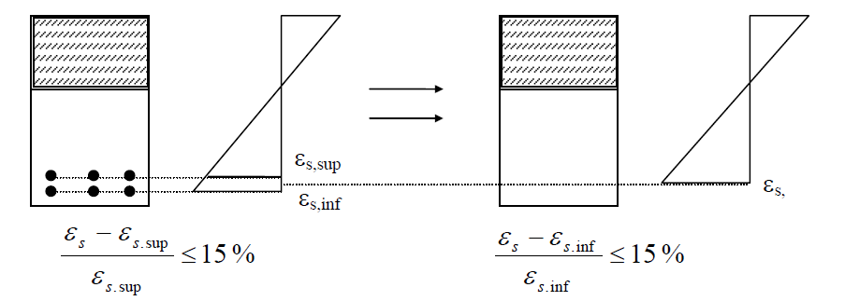
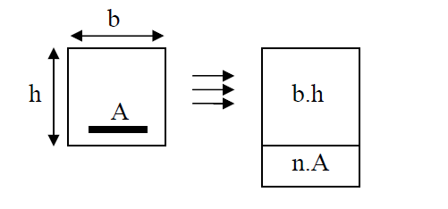
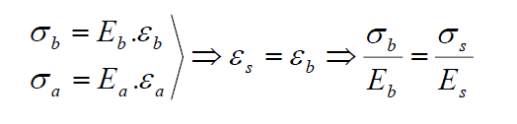

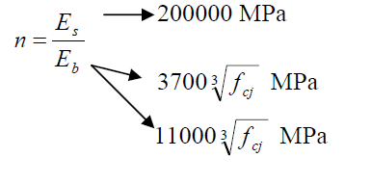
The section of a group of multiple tensioned or compressed bars is assumed to be concentrated at their center of gravity, provided that the error in unit deformations does not exceed 15%.
-It will be necessary to homogenize the reinforced concrete section. A steel section works n times more than the same concrete section. Therefore, a steel section ⇔ n times a concrete section.
Concrete and steel will be considered as linear elastic
materials, so Hooke's law is applied to them ⇔ σ = E . ε.

Slide 14
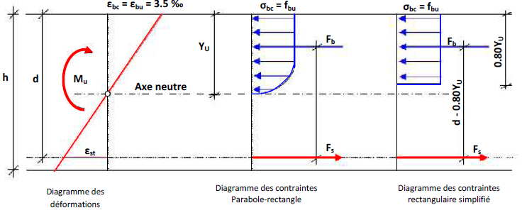
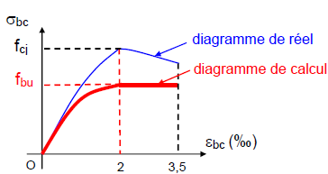
b. Concrete Stress-Strain Diagrams: Two types of diagrams are distinguished: the parabola-rectangle diagram and the simplified rectangular diagram. The rectangular diagram can replace the parabola-rectangle diagram if the considered section is not entirely compressed (case of simple bending).
h : total height of the section.
d : effective height in simple bending.
yu : position of the neutral fiber.
σbc : concrete compression stress.
fbu : ultimate conventional compressive strength.
εbc : concrete strain in compression.
Parabola-Rectangle Diagram

Slide 15
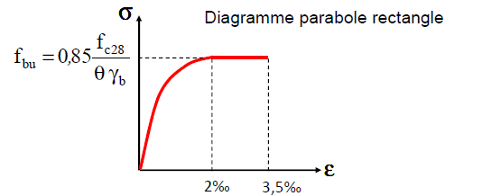
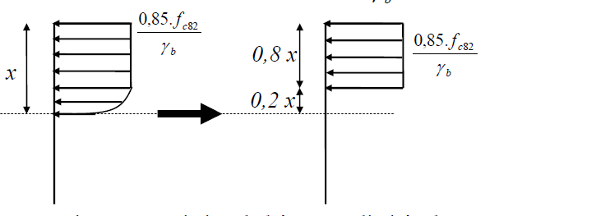

The value of fbu for the design stress corresponding to a strain between 2 ‰ and 3.5 ‰ is:
- ${ γ}_{b}$=1,5 in the general case
$γ_{b}$=1,15 For accidental load combinations.
θ: depends on the duration of load application.
θ = 1: when the probable duration of the applied loads is greater than 24 hours.
θ = 0,9 : when this duration is between 1 hour and 24 hours.
θ = 0,85 : when it is less than 1 hour.

Slide 16
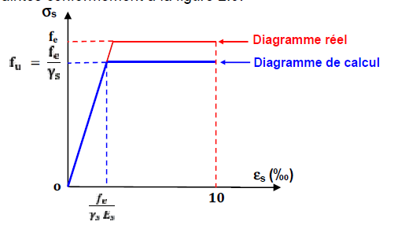

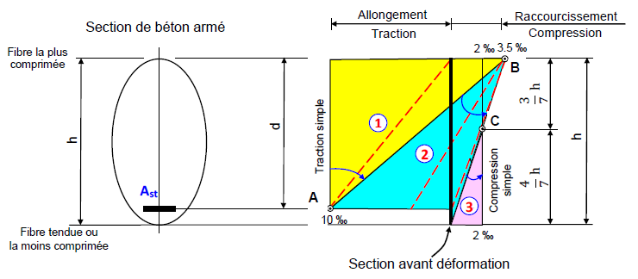
C. Steel Stress-Strain Diagrams:
• fe : Guaranteed yield strength.
• γs : Common cases: γs = 1,15
- Accidental combinations: γs = 1
• Longitudinal modulus of elasticity: Es =200 000MPa
D. Rules of the Three Pivots:
The design at U.L.S is conducted assuming that the strain diagram passes through one of the three pivots A, B, or C, as defined in the figure.
Pivot A (Domain 1):
Elongation of the most tensioned steel: εst = 10‰
Members subjected to simple tension or simple or
combined bending.
Pivot B (Domain 2):
Shortening of the most compressed concrete fiber:
εbc = 3.5‰;
Members subjected to simple or combined bending
(partially compressed concrete).
Pivot C (Domain 3):
Shortening of compressed concrete εbc = 2‰ for yu = (3/7)h
Members subjected to simple compression (if the deformation line is parallel to the representative line of the section before deformation) or combined bending.

Slide 17


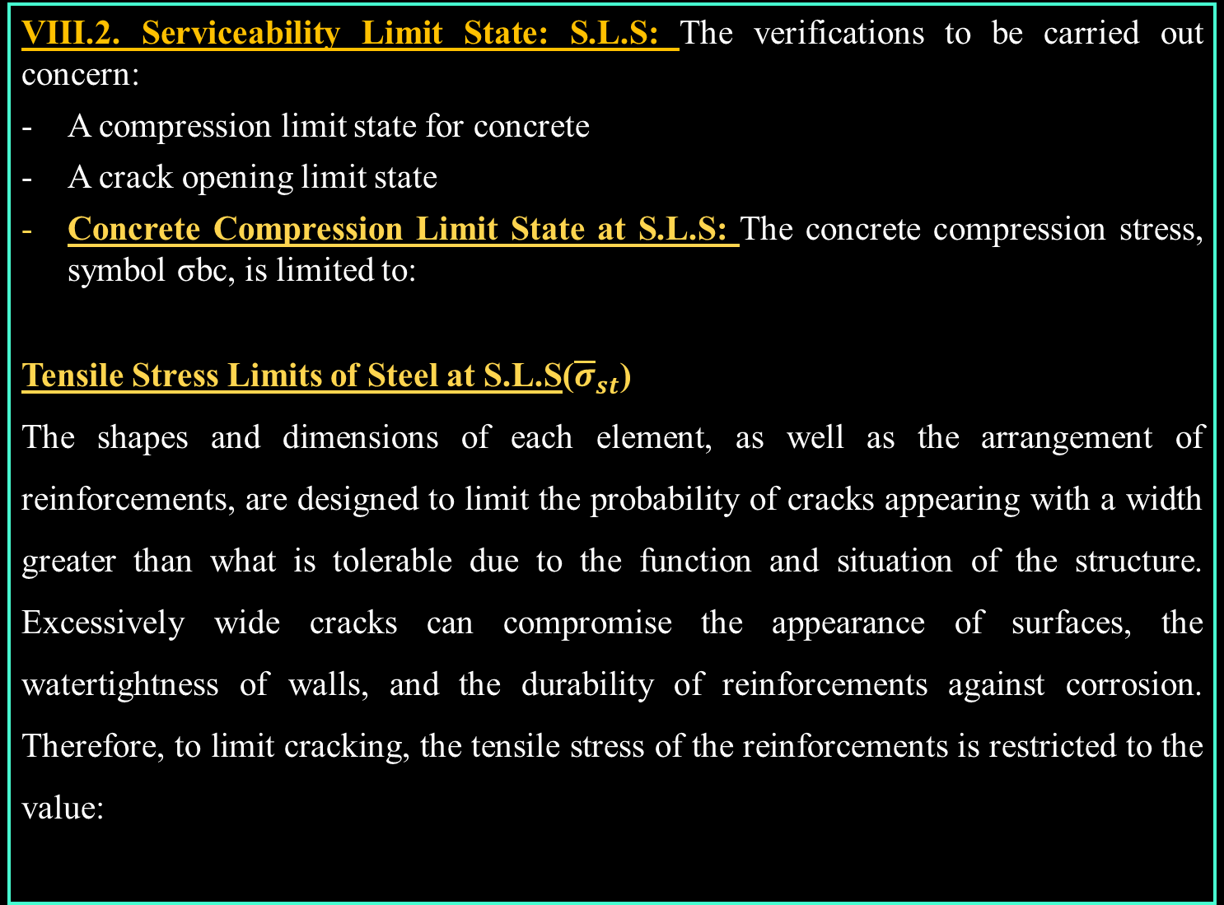
VIII.2. Serviceability Limit State: S.L.S: The verifications to be carried out concern:
A compression limit state for concrete
A crack opening limit state
Concrete Compression Limit State at S.L.S: The concrete compression stress, symbol σbc, is limited to:
Tensile Stress Limits of Steel at S.L.S(${\overline{σ}}_{st}$)
The shapes and dimensions of each element, as well as the arrangement of reinforcements, are designed to limit the probability of cracks appearing with a width greater than what is tolerable due to the function and situation of the structure. Excessively wide cracks can compromise the appearance of surfaces, the watertightness of walls, and the durability of reinforcements against corrosion. Therefore, to limit cracking, the tensile stress of the reinforcements is restricted to the value:

Slide 18



VIII.2. Serviceability Limit State: S.L.S: The verifications to be carried out concern:
A compression limit state for concrete
A crack opening limit state
Case where cracking is considered slightly detrimental: (covered and enclosed spaces not subject to condensation).
Case where cracking is considered detrimental: Elements exposed to weather conditions (rain, snow, wind, etc.) or in contact with water.
• fe : Elastic limit.
• η : Cracking coefficient, with:
- η = 1 for smooth round bars
η = 1,6 for H.A. (diameters ≥ 6 mm)
• ftj: Concrete tensile stress at j days.
- Case where cracking is considered highly detrimental: The element is exposed to an aggressive environment.

Slide 19
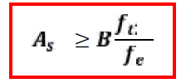
IX. Non-Fragility Condition: A section is considered non-fragile when the stresses causing concrete cracking are lower than the elastic limit of the steel fe.
A minimum section of longitudinal reinforcements is mandated by regulations. This section must balance the cracking stress of unreinforced concrete.
For members subjected to simple tension: The non-fragility condition is expressed by the following requirement:
Avec :fe : Elastic limit of steel.
B : Total section of the tensile concrete.
ft28 : Characteristic tensile strength of concrete at 28 days.
In the case of rectangular sections subjected to simple bending:
b and d: Dimensions of the section.
ft28
As
B
fe
ft28
As
≥ b.d
fe

