Slide 1
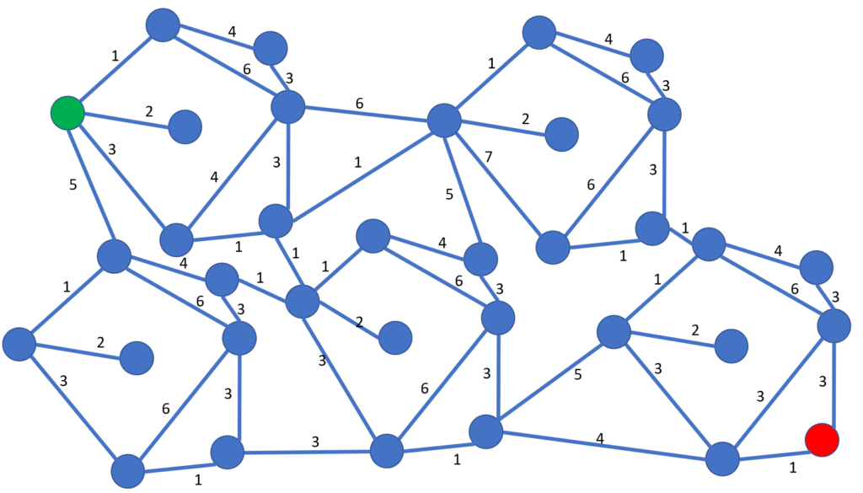
Module Supervisor:
Mr Merabet Adil
Email : a.merabet@centre-univ-mila.dz
https://elearning.centre-univ-mila.dz/a2024/course/view.php?id=331
Network Flows

Slide 2
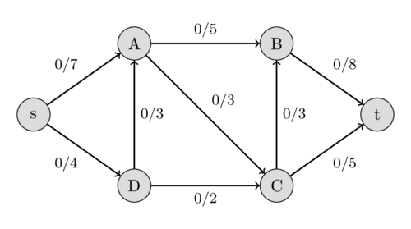
Network Flows
Origin of the problem
Graphs are used to model situations where a product is transported from one location to another
A flow network is a digraph where each edge has a capacity and each edge receives a flow.
The amount of flow on an edge cannot exceed the capacity of the edge.

Slide 3
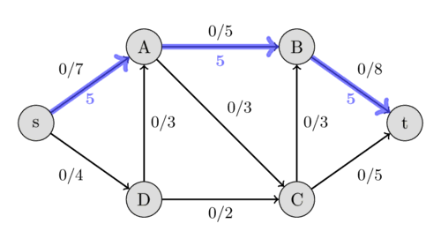

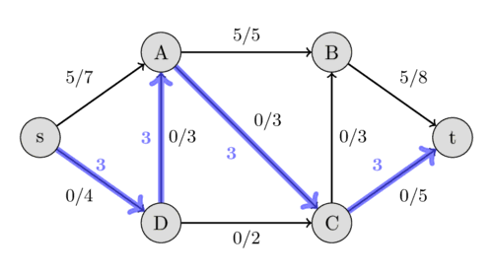

Network Flows
Origin of the problem

Slide 4
Network Flows
Applications of Flow Networks:
A product is transported from one location to another (In airlines, we can interpret passengers as commodities to be transported).
Highway systems can be thought of as transporting cars.
Water supply, where the pipelines are edges, vertices represent water users or pipe pumps.
Communication networks and routing data packets.
…

Slide 5
Network Flows
Definitions
Source: The vertex where the flow originates.
Sink: The vertex where the flow terminates.
Network N(G, s, t, c) is:
    A digraph G= (V, E) with no self-loops and no parallel edges. (Self-loops are useless in this context, and parallel edges can be replaced with one edge whose capacity is the sum of the capacities of the parallel edges).
    With a source s and a sink t.
    a capacity function, c : E → R+. c(e) ≥ 0 is the capacity of edge e.
    a flow function, f : E → R. 0 ≤ f(e) ≤ c(e)

Slide 6
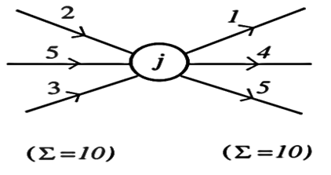
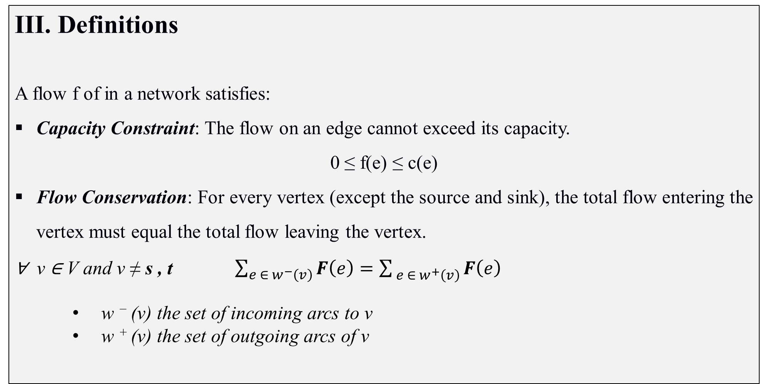
Network Flows
Definitions
A flow f of in a network satisfies:
Capacity Constraint: The flow on an edge cannot exceed its capacity.
0 ≤ f(e) ≤ c(e)
Flow Conservation: For every vertex (except the source and sink), the total flow entering the vertex must equal the total flow leaving the vertex.
∀ v ∈ V and v ≠ s , t $\sum_{{e ∈ w}^{−}\left(v\right)}{F\left(e\right)}=\sum_{{ e ∈ w}^{+}\left(v\right)}{F\left(e\right)}$
    w ⁻ (v) the set of incoming arcs to v
    w ⁺ (v) the set of outgoing arcs of v

Slide 7
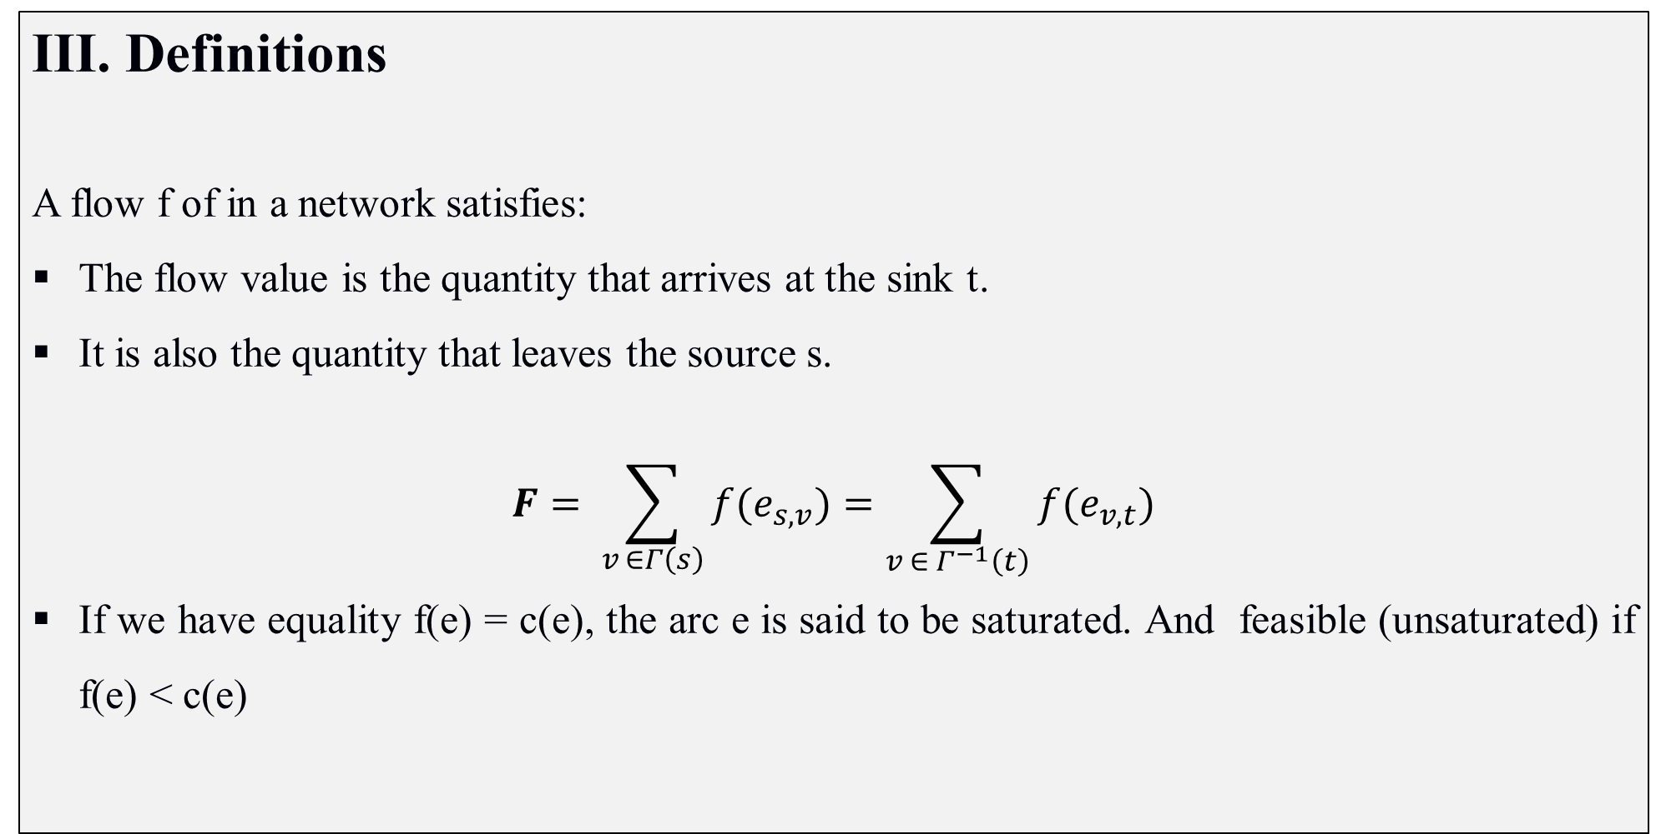
Network Flows
Definitions
A flow f of in a network satisfies:
The flow value is the quantity that arrives at the sink t.
It is also the quantity that leaves the source s.
$$F= \sum_{v_{ }∈Γ\left(s\right)}{f(e_{s,v})}=\sum_{v ∈ Γ^{−1}\left(t\right)}{f(e_{v, t})}$$
If we have equality f(e) = c(e), the arc e is said to be saturated. And feasible (unsaturated) if f(e) < c(e)

Slide 8
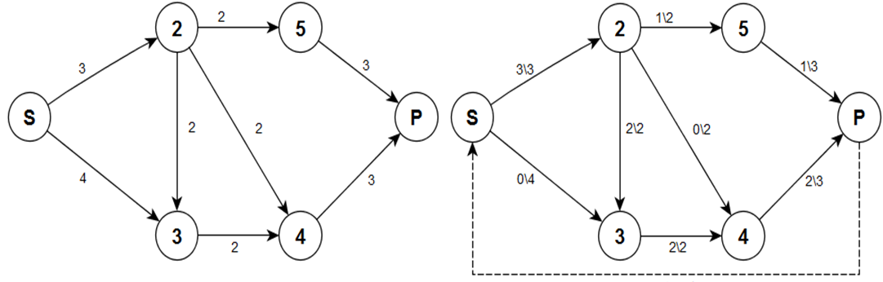
Network Flows
Definitions
Example:
In the example, we see a flow of 3. We can check:
At each vertex (except S and P) flow conservation is guaranteed,
All the flow that comes out of the source s arrives at the sink t.
All capacities are respected.

Slide 9
Network Flows
Flow problems in transportation networks
The maximum flow problem consists of transporting the maximum possible quantity from an origin (source) to a destination (sink), without exceeding the capacities of the arcs.

Slide 10


Network Flows
Flow problems in transportation networks
Augmenting paths:
An augmenting path is a simple path from the source to the sink.
Path 1 : +1
Path 2 : +0
  An arc is saturated if f(e) = c(e).
  A path is saturated if it contains a saturated arc.
  An unsaturated path from s to t is called an augmenting path.

Slide 11


Network Flows
Flow problems in transportation networks
Augmenting paths:
Every edge or arc along the path has positive capacity, meaning:
there is room to send more flow or reverse the existing flow.
Path 3 : +2
Path 4 : +2
Forward Arcs: Edges traversed in the forward direction must be unsaturated:
𝑓(e)<𝑐(e)
Reverse Arcs: Edges traversed in the reverse direction must have a strictly positive flow:
𝑓(e)>0

Slide 12
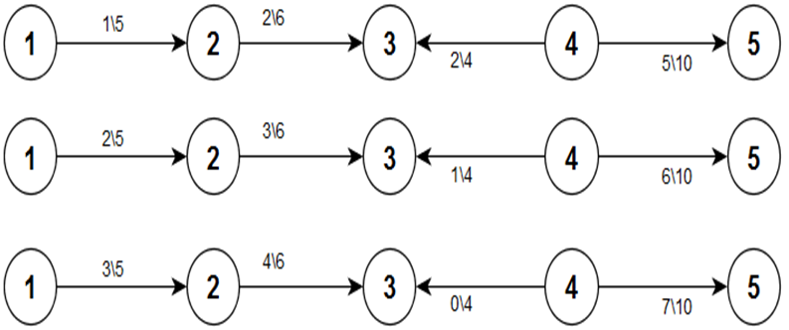
Network Flows
Flow problems in transportation networks
Augmenting paths:
Example: can be increased by at most 2

Slide 13
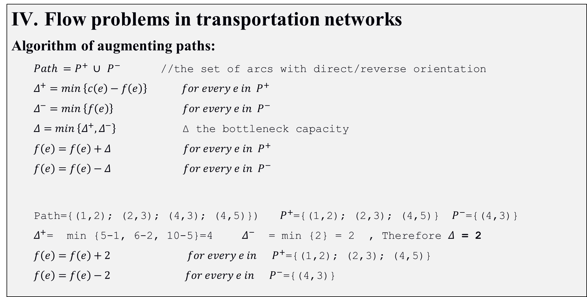
Network Flows
Flow problems in transportation networks
Algorithm of augmenting paths:
  $Path =P^{+} ∪$ $P^{−}$ //the set of arcs with direct/reverse orientation
  $$Δ^{+}=min \left\{c\left(e\right)−f\left(e\right)\right\} for every e in P^{+}$$
  $$Δ^{−}=min \left\{f\left(e\right)\right\} for every e in P^{−}$$
  $Δ=min \left\{Δ^{+},Δ^{−}\right\}$ Δ the bottleneck capacity
  $$f\left(e\right)=f\left(e\right)+Δ for every e in P^{+}$$
  $$f\left(e\right)=f\left(e\right)−Δ for every e in P^{−}$$
  Path={(1,2); (2,3); (4,3); (4,5)}) $P^{+}$={(1,2); (2,3); (4,5)}$P^{−}$={(4,3)}
  $Δ^{+}$= min {5-1, 6-2, 10-5}=4 $Δ^{−}$ = min {2} = 2 , Therefore $Δ$ = 2
  $$f\left(e\right)=f\left(e\right)+2 for every e in P^{+}\text{=\{(1,2); (2,3); (4,5)\}}$$
  $$f\left(e\right)=f\left(e\right)−2 for every e in P^{−}\text{=\{(4,3)\}}$$

Slide 14
Network Flows
Ford-Fulkerson Algorithm
Several algorithms can be used to solve these flow problems, including Ford-Fulkerson Algorithm
A classic algorithm for finding the maximum flow in a network.

Slide 15
Network Flows
Ford-Fulkerson Algorithm
Begin
  Initialize flow in all edges to 0.
  Repeat
    Find an Augmenting Path from s to t in the network,
    Augment Flow:
      Compute Δ the bottleneck capacity of the augmenting path:
      Update the flow along the augmenting path: Add Δ to the flow on forward edges, and subtract Δ from the flow on reverse edges.
  Until ( no more augmenting paths exist )
  4. The current flow is the maximum flow,
end

Slide 16
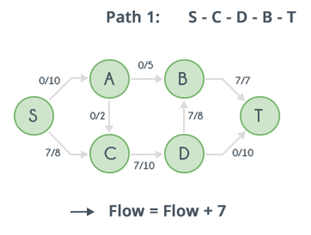
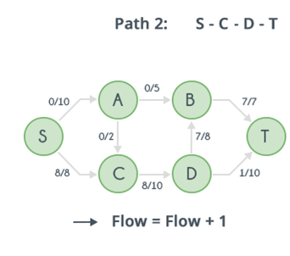
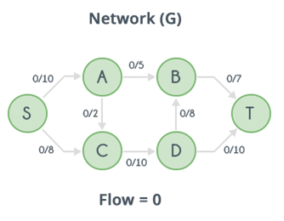
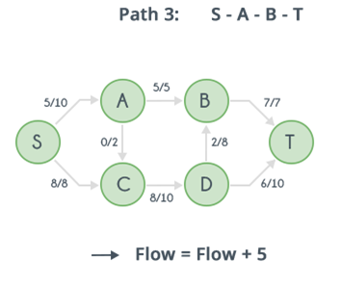
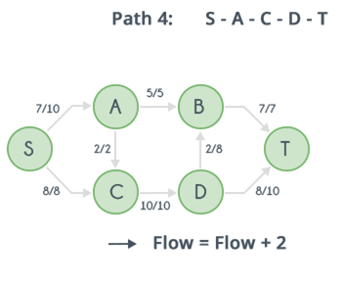
Network Flows
Ford-Fulkerson Algorithm

