Slide 1


Slide 2
Introduction
Whenever someone travels overseas they are like "a fish out of water." Like the fish, they have been swimming in their own culture all their lives. A fish doesn't think about what water it is in. Likewise, we often do not think too much about the culture we are raised in. Our culture helps to shape our identity. Many of the cues of interpersonal communication (body language, words, facial expressions, tone of voice, idioms, slang) are different in different cultures. One of the reasons that we feel like a fish out of water when we enter a new culture, is that we do not know all of the cues that are used in the new culture.

Slide 3
What is Culture Shock?
The term “culture shock” was introduced in the mid 1950s, with Cora DuBois and Kalervo Oberg playing an important role in its recognition and explanation.
It refers to the feelings and fears that are experienced after a move to a foreign environment, where the known behaviours and norms no longer apply.
K. Oberg (1960) Popularized the term culture shock as the “anxiety that results from losing all of our familiar signs and symbols of social intercourse”

Slide 4
These signs or cues include the thousand and one ways in which we orient ourselves to the situations of daily life: when to shake hands and what to say when we meet people, when and how to give tips, how to give orders to servants, how to make purchases, when to accept and when to refuse invitations, when to take statements seriously and when not.

Slide 5
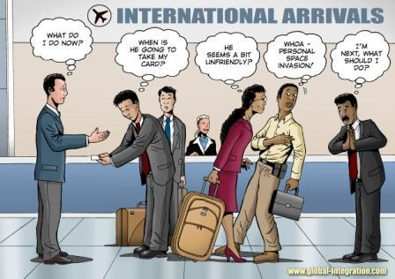

Slide 6
Who is at risk of Culture Shcock?
(Types of inter-cultural contact)
Tourists: less than 6 months period
- Volentary relocation.
- Recreational purposes.
- Superficial contact with the hosting culture.
Sojourners: 6 months to 5 years period.
    - Volentary relocation.
    - For academic or professional Purposes.
    - Includes foreign exchange students & international buisness people.

Slide 7
Immigrants: Relatively permanant residence
- Volentary relocation.
- Economical/political reasons.
- Include legal & illegal immigrants.
Refugies: Relatively permanant residence
    - Involentary relocation.
    - Caused by: pre-migration trauma including civil war, genocide, famine, imprisonment.
    - May be permanant or temporary.

Slide 8
Where does Culture shock Occure?
Types of Intercultural Contact
Inter-society Contact:
Occures among the residents of a culturally diverse nation or society. E.g. a US residence may experience culture shock just by visiting China Town.
Intra-Society Contact:
Takes place when a person from one society travels to another country with a particular objective in mind; for example, to work, play, study, exploit, convert, or provide assistance.

Slide 9
Stages of Cultural Adjustment
STAGE 1: “The Honeymoon Stage” Initial Euphoria/Excitement
Excitement with new sounds, sights, smells.
Superficial involvement in the host culture (like a tourist).
Intrigue with both similarities and differences between the new culture and your home culture.
Lots of interest in learning, very motivated and cooperative.
You feel as if you will be able to handle anything—“I am not going to have any problems adjusting!”

Slide 10
STAGE 2: “Culture Shock”—Irritation/Hostility
Focus on the differences between the new culture and your culture (Small differences feel like major catastrophes).
You become overly concerned with and stressed out by problems and feel helpless and frustrated (the elevator in your dorm is constantly broken; you do not have hot water in the morning; you cannot access e-mail from your apartment, etc.).
Stereotypes and prejudices surface: you feel as if the host nationals are cold, unhelpful, snobbish.
You search out same-culture friends.
You are homesick.

Slide 11
STAGE 3: Gradual Adjustment
You are becoming more familiar with the new culture and its “logic” and values & cultural cues become easier to read.
You feel more comfortable and less isolated, and you even begin to prefer some aspects of the new culture to your home culture.
You are able to laugh at certain ways of doing things that previously just annoyed you.
you can now enter a stage of “deeper learning.” You begin to see a multitude of approaches to your life abroad and to question some of your assumptions about the world. This can be both exciting and unnerving.

Slide 12
STAGE 4: “Feeling at Home”—Adaptation and Biculturalism
The “new” culture is no longer new; instead, the “foreign” country you live in now feels like another home.
The aspects of the culture that are different from your own no longer affect you in a negative way. You are able to live and work to your full potential.
Just like your home culture, you appreciate certain aspects of the foreign culture and are critical of others

Slide 13
Reverse/Re-entry Culture Shock
“Culture shock is the expected confrontation with the unfamiliar. Reentry shock is the unexpected confrontation with the familiar.” – M. Paige
Reverse culture shock, also called re-entry shock, is the term used to describe the disorientation and adaptation that occur when one is trying to readjust to his/her own culture after spending an extended period of time in a different culture. Usually occurs because:
People and places in your home country have changed or You have changed and see things differently now.

Slide 14
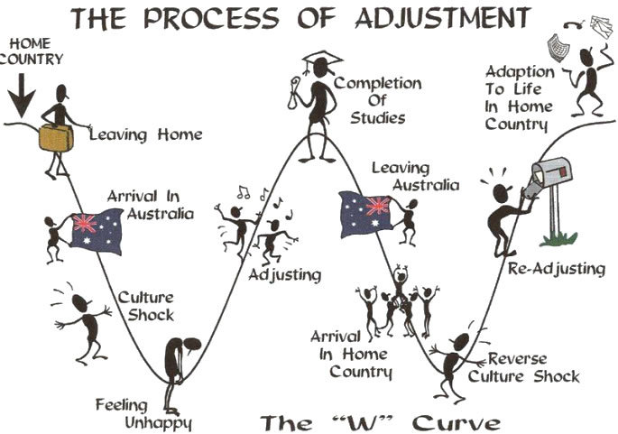

Slide 15
Explanations for Cross-Cultural Maladjustment
The Similarity-Attraction Hypothesis (Byrne, 1969)
The Culture-Distance Hypothesis.
Social Categorization (Abrams and Hogg, 1990)
Primary Socialization (Deaux, 1976)
Cultural Syndromes.
Ethnocentrism

Slide 16
Common Symptoms of Culture Shock:
▪ Feeling very angry over minor inconveniences.
▪ Withdrawal from people who are different from you.
▪ Extreme homesickness.
▪ Sudden intense feeling of loyalty to own culture.
▪ Overeating or loss of appetite.
▪ Boredom.
▪ Excessive amounts of sleep, or inability to sleep.
▪ Headaches, Upset stomach, Physical pain, Sadness, loneliness, depression.
▪ Loss of ability to work or study effectively.
▪ Exaggerated cleanliness.

Slide 17
Strategies for Coping with Cultural Stress
Personal Supports.
Social Supports.
Physical Supports.

Slide 18
Personal Supports:
(Ways of Thinking and Feeling )
Understand the stages of cultural adjustment.
Analyze your situations and reactions; be flexible; tolerate ambiguity; expect things to be different.
Be patient; don’t try to understand everything immediately.
identify what helps you manage stress.
Identify ways of thinking positively; foster your sense of humor; don’t take things too seriously; give yourself permission to fail.

Slide 19
Social Supports :
Identify your sources of support (program staff, other participants, friends and family at home, academic advisers, etc.) and the types of support that each can best offer.
Plan in advance how you will keep in contact with family and friends at home.
Don’t isolate yourself! Seek out friends and groups that share your interests and can facilitate your participation in social circles.

Slide 20
Physical Supports :
- Eat in a healthy way and get plenty of rest.
- Identify any problems (e.g. excessive consumption of alcohol, binge eating) and make plans to manage them.
Find safe and fun ways to exercise on a regular basis.
Bring a sufficient supply of necessary medications from home.
- Don’t forget to bring your “can’t live without items”!

Slide 21
Conclusion
Though the stages of culture shock that have been presented in the U curve and the W curve have been widely used and accepted for the last five decades, they were most commonly criticized on two regards:
The lack of empirical research to back it.
The rigidness of the timeline and stages provided ( no room for diversity).

Slide 22
Culture Shock Instances
A student in my class told us the story of his family's first night in America. They were from China, and moved into a house on October 31st, more commonly known as Halloween. They had never heard of this American holiday. The entire evening there were people dressed up in crazy costumes coming to their door and ringing the door bell, and the family had no idea why. He said they spent much of the night huddled together under a table with all the lights off in the house, completely terrified.

Slide 23
My uncle had just immigrated to upstate NY in the late 70's. He and some other Turkish friends were desperately homesick, and longing for his halla's famous Sarma (stuffed grape leaves). They were driving down the road on some back roads and they saw an abandoned winery and a field of grape leaves! They immediately pulled over and started gathering as many leaves as they could so they could make sarma that night. Not 15 minutes later multiple squad cars pulled up and cops came rushing out with guns drawn. Turns out an old lady had reported that a bunch of mexicans were in a field off of the road harvesting marijuana plants. Apparently the cops were nearly crying with laughter once they figured out what was actually going on. My uncle and his friends... not so much.

