Slide 1



Slide 2

Research Methodology
Meaning of Research
Research seeks the answer of certain questions which have not been answered so far, and the answers depend upon human efforts. it refers to a search for knowledge
Research Methodology refers to the systematic and scientific approach used to conduct research, investigate problems, and gather data and information for a specific purpose.
It involves the techniques and procedures used to identify, collect, analyze, and interpret data to answer research questions or solve research problems.

Slide 3




Research Methodology
Research: Re+ search ‘Re’ means again and again and ‘search’ means to find out something
Observes
Collection of data
Person Phenomena Conclusions
Again and again
Analysis of data
Therefore, research means to observe the phenomena again and again from different dimensions. It is a process of which a person observes the phenomena again and again and collects data on the basis of data s/he draws some conclusions.

Slide 4

Objectives of research
The purpose of research is to discover answers to questions through the application of scientific procedures.
The main aim of research is to find out the truth which is hidden and which has not been discovered yet.
Each research study has its own specific purposes
To gain familiarity with a phenomenon or to achieve new insights into it. Studies with this object in view are termed as exploratory or formulative research studies
To portray accurately the characteristics of a particular individual, situation or a group.
Studies with this object in view are known as descriptive research studies.
To determine the frequency with which something occurs or with which it is associated
with something else.
Studies with this object in view are known as diagnostic research studies.

Slide 5
Objectives of research
Each research study has its own specific purposes
To gain familiarity with a phenomenon or to achieve new insights into it. Studies with this object in view are termed as exploratory or formulative research studies
To portray accurately the characteristics of a particular individual, situation or a group.
Studies with this object in view are known as descriptive research studies.
To determine the frequency with which something occurs or with which it is associated
with something else.
Studies with this object in view are known as diagnostic research studies.
To test a hypothesis of a causal relationship between variables. Studies with this object
are known as hypothesis-testing research studies.

Slide 6
Research Methodology
Other research classification according to the objective
Theoretical Objectives
Those researches whose objectives are theoretical aim to formulate new theories, principles, or laws. Such type of research is exploratory because it explains the relationships of certain variables. The researches contribute some basic knowledge to the science .
Factual Objectives
These researches whose objectives are factual aim to find out new facts. This objective by nature is descriptive. These researches describe facts or events which happened previously. Such type of research is done in history.
Application objectives
The research having application objectives does not contribute a new knowledge in the field of human knowledge but suggests new applications. By application, we mean improvement and modification.

Slide 7


Motivation in research
What makes people to undertake research is a question of fundamental importance ?
The possible motives for doing research may be either one or more of the following: • Desire to get a research degree with its consequential benefits;
• Desire to face challenge in solving unsolved problems;
• Desire to get intellectual joy of doing more creative work;
• Desire to be of service to society.
directives of government,
Employment conditions;
Curiosity about new things;
Desire to understand causal relationships,
Social thinking and awakening,
Try to improve the conditions of human life by solving problems like disease or environmental problems, ….etc

Slide 8
General Characteristics of Research
The following characteristics may be gathered from the definitions of “research”:
It gathers new knowledge or data from primary or first-hand sources.
It places emphasis upon the discovery of general principles.
It is an extent systematic and accurate investigation.
It uses certain valid data gathering devices.
It is logical and exact.
The researcher eliminates personal feelings and preferences.
Research is patient and unhurried activity
Research is carefully recorded and reported

Slide 9
Criteria of a Good Research
Whatever may be research is, one can state the qualities of good research should be as under:
• Good research is systematic:
It means that research is structured with specified steps to be taken in specified sequence in accordance with the well-defined set of rules. Systematic characteristic of the research does not rule out creative thinking but certainly does reject the use of guessing in arriving at conclusions.

Slide 10
Criteria of a Good Research
Good research is logical
This implies that research is guided by the rules of logical reasoning and the logical process of induction and deduction are of great value in carrying out research. Introduction is the process of reasoning from a part to the whole; whereas, deduction is the process of reasoning from some premise. In fact, logical reasoning makes research more meaningful in the context of decision making.
Good research is replicable
This characteristic allows research results to be verified by replicating the study and thereby building a sound basis for decisions.

Slide 11

Types of Research
Description Vs. Analytical
The major aim of descriptive research is description of the state of affairs as it exits at present. In analytical research, on the other hand, researcher has to use facts or information already available, and analyze these to make a critical evaluation of the materials.

Slide 12
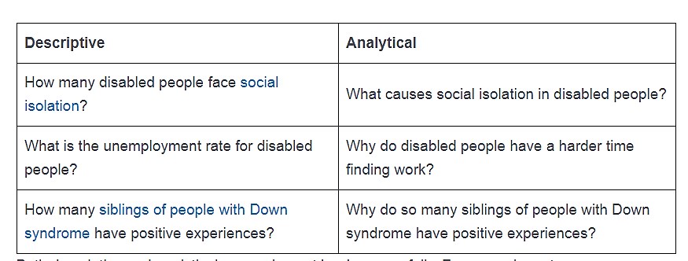
Types of Research
Examples
A researcher who wishes to classify the sea animals into different species will collect samples from various search stations, then classify them accordingly.
A researcher who wishes to find the reason why the number of some sea species is decreasing year after year .

Slide 13
Types of Research
Applied Vs. Fundamental
Applied research aims at finding a solution for an immediate problem facing a society or an organization;
Fundamental research, is a type of investigation focused on improving the understanding of a particular phenomenon, study or law of nature. This type of research examines data to find the unknown and fulfill a sense of curiosity.
Fundamental
Understanding living systems and living processes
A study to discover the components making up human DNA
Applied
It's a type of research method for applying natural sciences to real life to improve the human condition.
A study on how to prevent mosquito bites from itching

Slide 14
Types of Research
Conceptual Vs. Empirical
Conceptual research is that related to some abstract idea(s) or theory. It is generally used by philosophers and thinkers to develop new concepts or reinterpret new ideas. On the other hand, empirical research relies on experience or observation alone, often without due regard for system or theory
Empirical
Pharmaceutical companies use empirical research to try out a specific drug on controlled groups or random groups to study the effect and cause.
Conceptual
The most famous example of a conceptual research is Sir Issac Newton. He observed his surroundings to conceptualize and develop theories about gravitation and motion.

Slide 15


Meaning of Literature Review
The phrase ‘review of literature’ consists of two words 'review' and 'literature'
Traditionally the word ‘’literature’’ is used with reference to the language, e.g. Hindi Literature, English Literature…
It includes a subject content: prose, poetry, dramas, novels, stories, etc.
In research methodology, the term literature refers to the knowledge of a particular area of investigation of any discipline which includes theoretical, practical, and its research studies
The term ‘review’ means to organize the knowledge of the specific area of research to evolve an edifice of knowledge to show that this study would be an addition to this field.
The task of review of literature is highly creative because the research has to synthesize the available knowledge of the field in a unique way to provide the rationale for his/her study.

Slide 16
Need of Review of Literature
The review of literature is essential due to the following:
One of the early steps in planning a research work is to review a research done previously in the particular area of interest.
It is very essential for every researcher to be up-to-date in his/her information about the literature related to his/her own problem already done by others.
It avoids the replication of the study of findings to take an advantage from similar or related literature.
It provides as source of problem of study.

Slide 17
Objectives of Review of Literature
The review of literature serves the following purposes in conducting research work:
• It provides theories, ideas, explanations or hypotheses which may prove useful in the formulation of a new problem.
• It avoids replication when it indicates whether the evidence already available solves the problem adequately without requiring further investigation.
• It provides the sources for hypothesis. The researcher can formulate research hypothesis on the basis of available studies.
• It suggests method, procedure, sources of data appropriate to the solution of the problem. • The conclusions drawn in the related studies may be significantly compared and maybe used as the subject for the findings of the study.

Slide 18






Sources of Literature
here are various sources of literature which may be used for this purpose. Examples of these are:
Scientific articles
Books and textbooks material;
Periodicals publications ;
Abstracts;
Encyclopedias;
Handbooks and Guides;
Special Dictionaries;
Dissertations and Theses;
The Internet.

Slide 19








