Slide 1

Scientific text
Summarizing a Scientific Text:
Summarizing a short scientiﬁc text in one paragraph;
A summary is a shortened version of a longer piece of writing.
It captures all the most important parts (main ideas) of the original, but expresses them in a shorter way.
Then, it should be expressed--as far as possible--in your own words.

Slide 2
Scientific text
Summarizing a Scientific Text:
To have a coherent summary of a scientific text, you should follow some reading strategies;
Reading strategies :
Read the original quickly, and try to understand its main subject or purpose.
Read it again to understand it in more detail, identify keywords and highlight the essential information.
Look up any technical words or concepts you don’t know.

Slide 3
Scientific text
After a good reading, you should then:
A/ Identifying the main sections:
- Work through the text to identify its main sections. A main section can be made up of one or various paragraphs. (Number each different section.)
- Write a one or two-sentence account of each section you identify.
- Focus your attention on the main point and leave out any illustrative examples.
B/ The starting point:
- Write a sentence which states the central idea of the original text.
- Complete the paragraph by including one or two sentences per main point or important part.

Slide 4
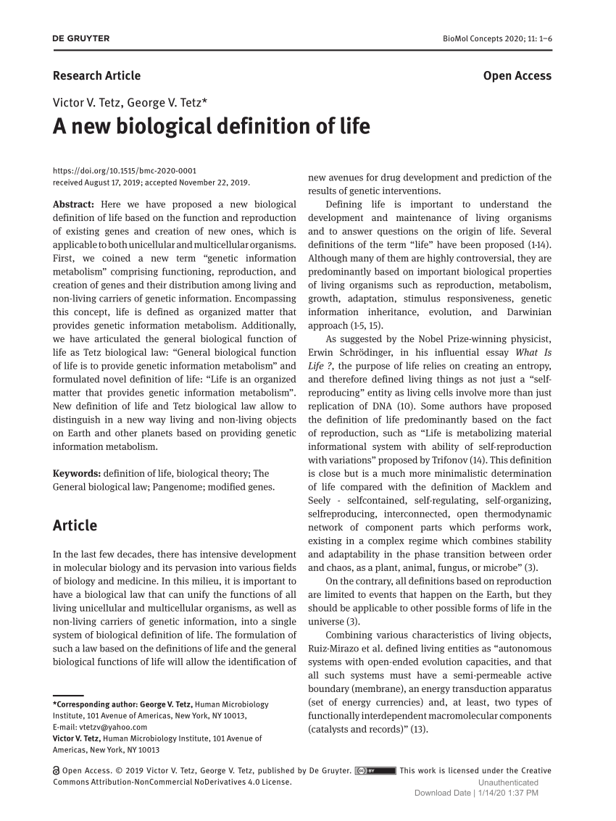
Scientific text
Structure of scientific texts
This type of text has a complex structure that can easily vary according to the subject matter, area and particular needs of the author to present the information.
Let’s see the general structure ;
Title of the text
In this first part it is necessary to place the title, which reflects the topic to be presented in the scientific text

Slide 5
Scientific text
Let’s see the general structure ;
Abstract
This provides a summary of the article.
Usually 150-250 words long,
Preferably written in one paragraph ,
Covers the following about the article:
The problem /issue/question addressed by the article
Method(s) used
The main results
The main conclusions

Slide 6
Scientific text
Let’s see the general structure ;
Abstract
An abstract should not contain
lengthy background information,
references to other literature,
elliptical (i.e., ending with ...) or incomplete sentences,
abbreviations or terms that may be confusing to readers,
any sort of illustration, figure, or table, or references to them.

Slide 7
Scientific text
Abstract
Three soil types with different physicochemical properties were selected to evaluate their effect on lead and cadmium bioavailability and toxicity in the land snail Helix aspersa.
In 28-day ecotoxicity tests, H. aspersa juveniles were exposed to increasing concentrations of Pb or Cd. EC50s, concentrations reducing snail growth by 50%, differed between the soils and so did Cd and Pb uptake in the snails. For lead, EC50s were 2397–6357 mg Pb/kg dry soil, while they ranged between 327 and 910 mg Cd/kg dry soil for cadmium.
Toxicity and metal uptake were highest on the soil with the lowest pH, organic matter content and Cation Exchange Capacity (CEC). Growth reduction was correlated with metal accumulation levels in the snails’ soft body, and differences in toxicity between the soils decreased when EC50s were expressed on the basis of internal metal concentrations in the snails. These results confirm the effect of soil properties; pH, CEC, OM content, on the uptake and growth effect of Pb and Cd in H. aspersa, indicating the importance of properly characterizing soils when assessing the environmental risk of metal contaminated sites.

Slide 8
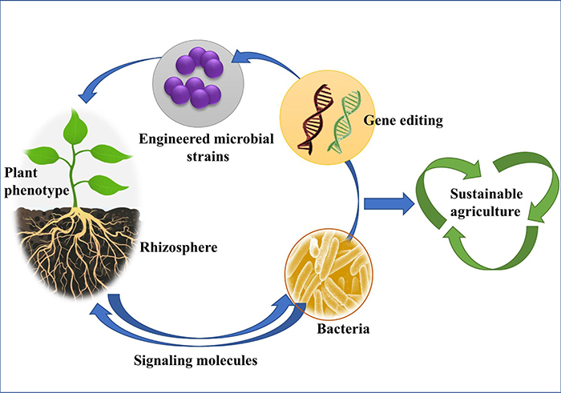
Graphical Abstract
A graphical abstract is a visual representation of a research project. The goal of the abstract is to create a clear story of your scientific method and results that is quickly understood by your audience.

Slide 9
Scientific text
Let’s see the general structure ;
Keywords
6-8 keywords are given immediately after the abstract in the article.
They should be words or phrases the reader searching for the article in question would use in their search
They could be single words or phrases
They should be descriptive
They should represent key concept

Slide 10
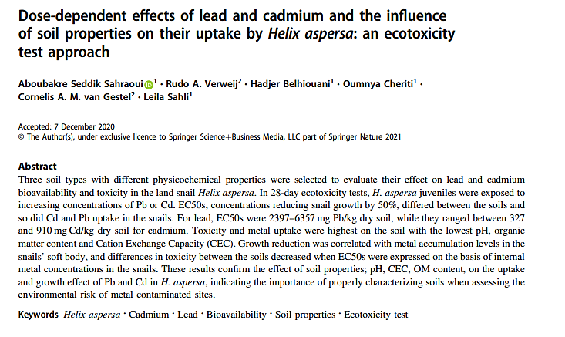

Slide 11
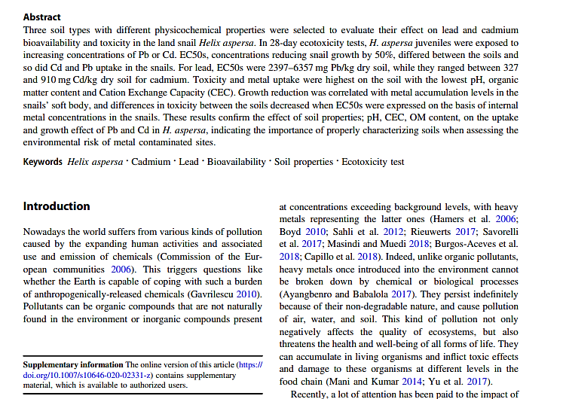
Scientific text
Introduction
Gives background information or the necessary context for the problem/question/issue to be addressed
Describes what emerges from this context as the problem/question/issue that needs to be addressed including what the author intends to do with it.
In other words, through it the author gives a scenario within which he/she identifies what he/she sees as the problem/question/issue and what he/she intends to do with it.

Slide 12

Scientific text
Material and Methods
Explain clearly how the author proceeded methodologically when addressing the problem/question/issue at hand.
Mention some of the material used in the experiments.
Contain some initial information about the material or the living organisms used in the research.
May also include how the author organized or structured the article.

Slide 13
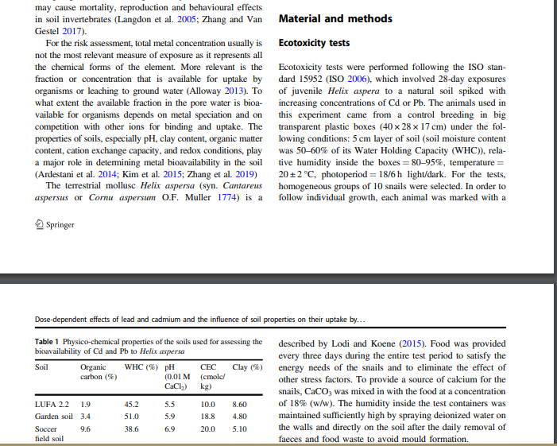

Slide 14


Scientific text
Results
Reports the findings of the study .
Contain graphs, tables , diagrams, maps, pictures …etc
Provides statistical documentation to demonstrate whether the results are valid and reliable.

Slide 15
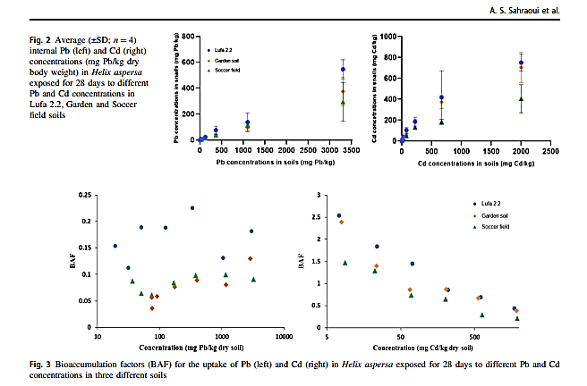
Scatter plot

Slide 16
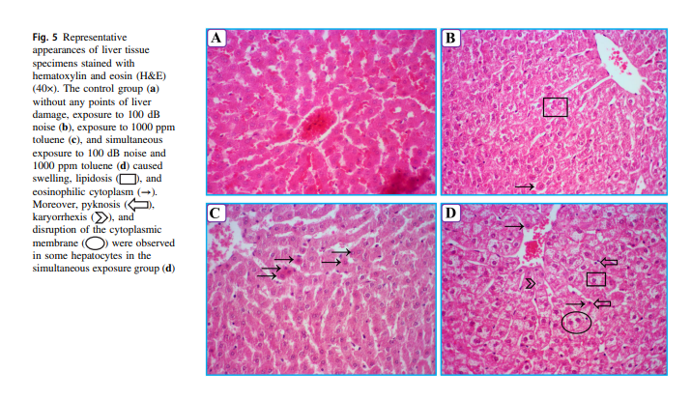
Pictures

Slide 17
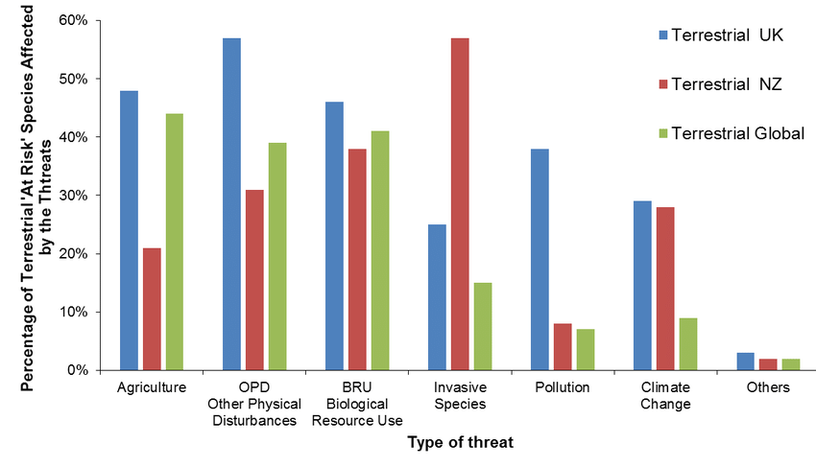
Bar chart

Slide 18
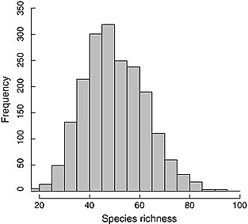
Histogram chart

Slide 19
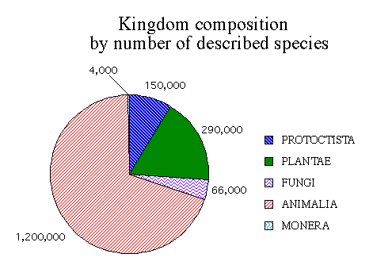
Pie chart

Slide 20
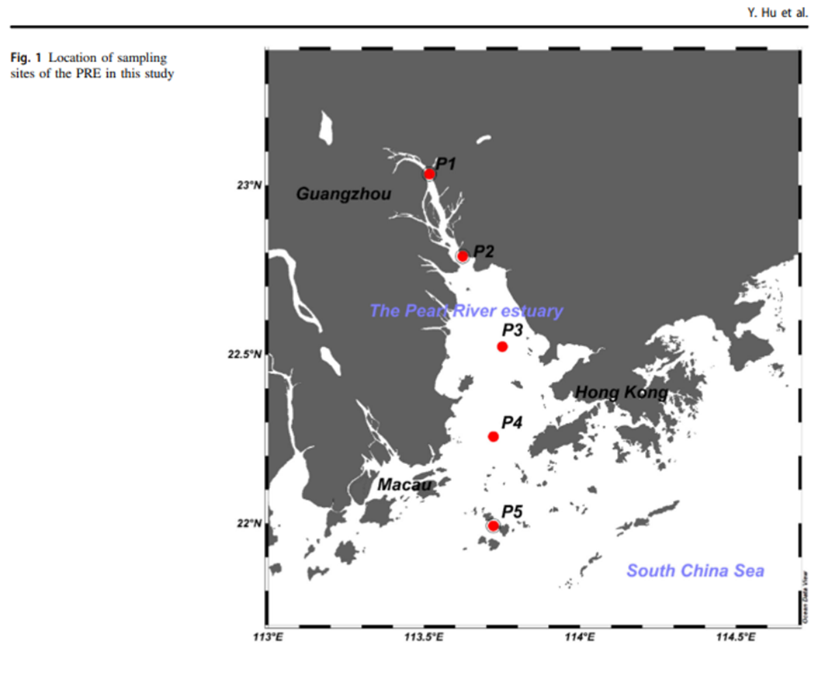
Map chart

Slide 21
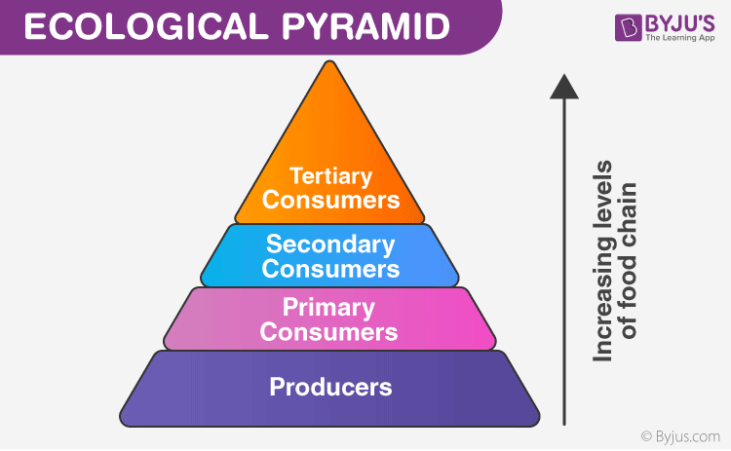

Slide 22
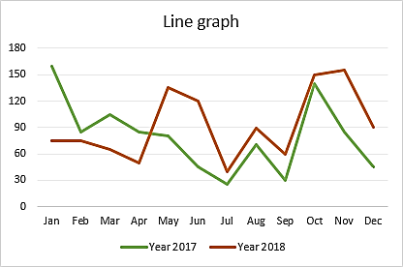

Slide 23

Scientific text
Discussion
Describes what the findings mean.
Relates the findings back to the problem/question stated in the introduction and to the findings of other scholars as reflected in the literature review.
Explains how results contribute to the existing body of scientific knowledge.

Slide 24

Scientific text
Conclusion
After the discussion section, comes the conclusion of the article.
Summarizes the results and discussion
Describes limitations of the study and suggests areas for further research/action.

