Slide 1
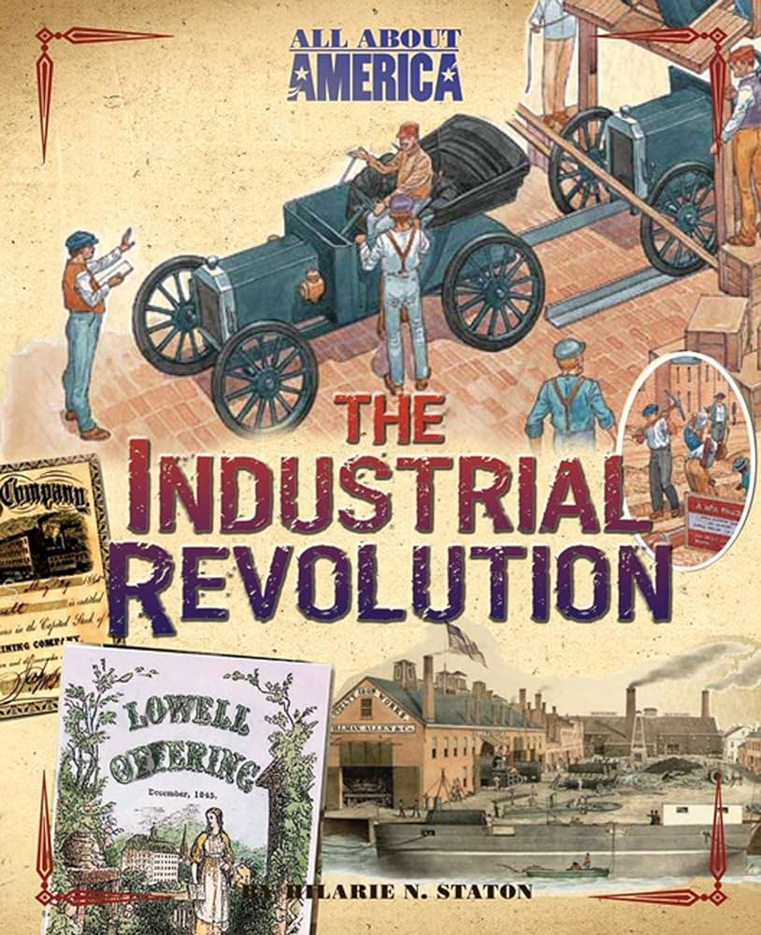
THE INDUSTRIAL REVOLUTION IN AMERICA
(effects)

Slide 2
Plan : Introduction/Development /conclusion
    What is the industrial revolution in America.
    What are the effects of IR.
    Conclusion .

Slide 4
What was the Industrial Revolution?
The Industrial Revolution in America, which began in the late 18th century and continued into the 19th century, was a period of profound economic, technological, and social transformation that laid the foundation for the modern industrial society. While it brought about unprecedented economic prosperity and technological advancement, it also raised concerns about labor rights, social inequality, and environmental sustainability.

Slide 5
It marked a transformative period in the nation's history, characterized by profound economic, technological, and social changes. Beginning in the late 18th century and extending into the 19th century, the Industrial Revolution revolutionized the way goods were produced, leading to a shift from agrarian-based economies to industrialized societies.

Slide 6
  The Industrial Revolution changed American life because it connected the nation. The railroad industry build railways across the United States which connected the coasts. It also improved the transportation of materials, manufactured goods, and people. It also changed American work life. Factory life expanded as industries grew. Americans who worked in factories experienced long work days for very little pay.

Slide 7
EFFECTS OF THE INDUSTRIAL REVOLUTION:
1. Urbanization.
2. Economic Transformation.
3. Technological Advancements.
4. Labor Exploitation and Poor Working Conditions.
5. Environmental Impact.
6. Social Inequalities.
7. Rise of Labor Movements and Reforms.
8. Cultural Shifts.
9.Class Divide.
10. Immigration and Diversity.
11. Women in the Workforce.
12. Impact on Family Structure.
Notes:
S
The last three of these advantages (commercial power, colonies, and government support of transport improvements) can be credited in part to the relatively calm political situation in England. The European continent, on the other hand, suffered volatile political conditions that impeded innovation.

Slide 8
1. Urbanization: • The shift from rural to urban areas was driven by the promise of employment in factories and industries concentrated in cities.
• Urban centers experienced rapid population growth, leading to challenges such as overcrowding, inadequate housing, and strained infrastructure.
• The rise of cities like New York, Chicago, and Philadelphia as industrial powerhouses reshaped the demographic landscape of America.

Slide 9
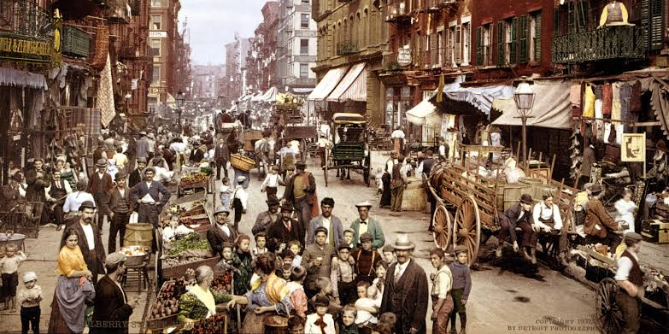

Slide 10
  2. Economic Transformation: • The Industrial Revolution marked a transition from manual labor and small-scale production to mechanized manufacturing on a larger scale.
  • Industries such as textiles, steel, coal mining, and manufacturing experienced unprecedented growth, driving economic expansion and wealth accumulation.
  • This period saw the rise of entrepreneurs and industrialists like Andrew Carnegie, John D. Rockefeller, and J.P. Morgan, who amassed vast fortunes through their business ventures.

Slide 11
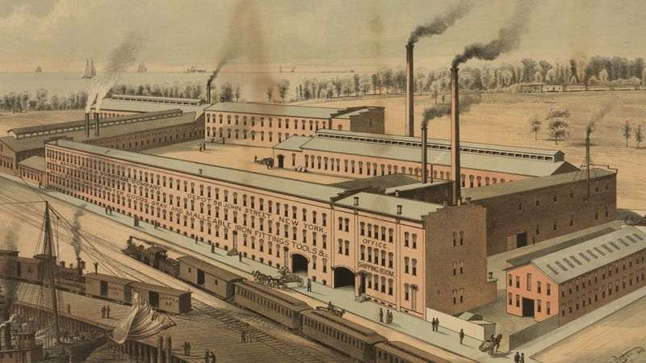

Slide 12
3. Technological Advancements:
• Innovations in machinery and technology revolutionized production processes, increasing efficiency and output.
• The steam engine, patented by James Watt, powered factories, steamboats, and locomotives, facilitating transportation and industrial growth.
• Advances in communication, such as the telegraph, facilitated long-distance communication and coordination of economic activities.

Slide 13
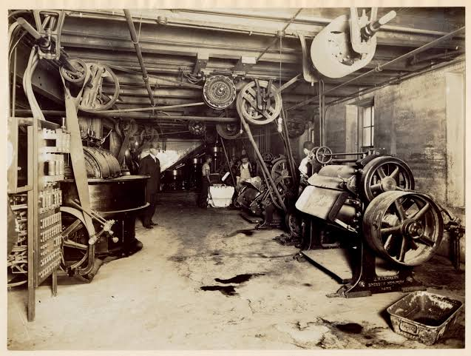

Slide 14
4. Labor Exploitation and Poor Working Conditions:
• Factory workers faced grueling conditions, including long hours, low wages, and unsafe working environments.
• Child labor was widespread, with children as young as five or six working in factories, mines, and mills.
• Labor exploitation and lack of worker protections led to labor unrest, strikes, and protests demanding reforms and better working conditions.

Slide 15
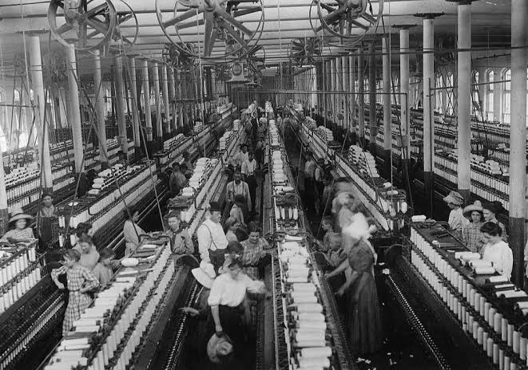

Slide 16
5. Environmental Impact:
• Industrialization brought about pollution from factories, including air and water pollution, as well as soil degradation.
• Deforestation and urban expansion led to habitat loss and environmental degradation.
• The Industrial Revolution marked the beginning of heightened awareness of environmental issues and eventually paved the way for environmental conservation movements.

Slide 17
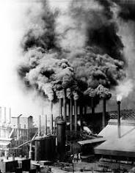

Slide 18
6. Social Inequalities:
• The wealth generated by industrialization was concentrated in the hands of a few industrialists and entrepreneurs, leading to widening income inequality.
• Working-class individuals faced economic insecurity, limited social mobility, and inadequate access to education and healthcare.
• Social divisions based on class, ethnicity, and gender became more pronounced, sparking debates about social justice and equity.

Slide 19
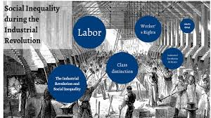

Slide 20
7. Rise of Labor Movements and Reforms:
• Labor unions emerged to advocate for workers’ rights, collective bargaining, and better wages and working conditions.
• The labor movement gained momentum with events like the Haymarket Affair and the Pullman Strike, which highlighted the struggles of workers against corporate power.
• Progressive Era reforms, including the establishment of child labor laws, minimum wage legislation, and workplace safety regulations, aimed to address the social and economic challenges of industrialization.

Slide 21
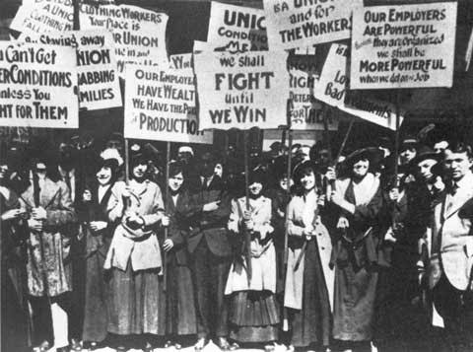

Slide 22
8. Cultural Shifts:
• Industrialization brought about changes in lifestyle, values, and social norms, as people adapted to urban living and industrial work.
• The rise of consumer culture, mass production, and advertising reshaped patterns of consumption and leisure activities.
• Artists, writers, and intellectuals reflected on the impact of industrialization on society and culture, giving rise to movements such as realism and naturalism in literature and the visual arts.

Slide 23
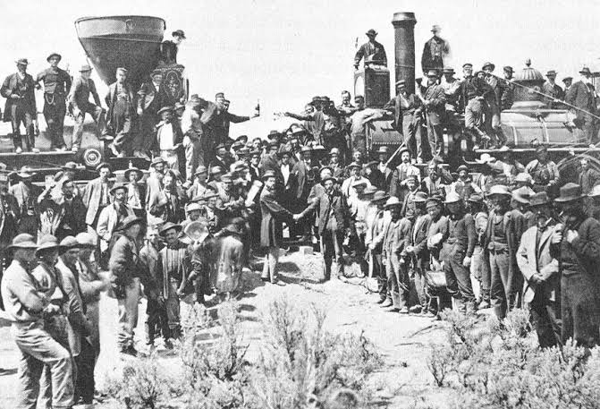

Slide 24
9.Class Divide:
Industrialization widened the gap between the wealthy industrialists and the working-class laborers, leading to increased social stratification.
10. Immigration and Diversity:
The Industrial Revolution attracted immigrants from various countries seeking economic opportunities, contributing to the cultural and ethnic diversity of urban areas.

Slide 25
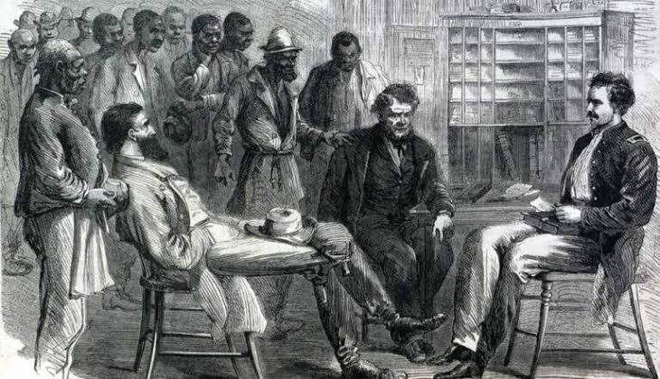

Slide 26
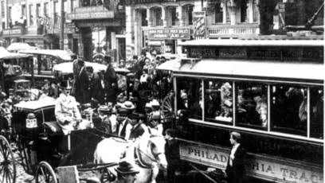

Slide 27
11. Women in the Workforce: Industrialization created new employment opportunities for women in factories and textile mills, challenging traditional gender roles and contributing to the emergence of the women's rights movement.
12. Impact on Family Structure: Industrialization disrupted traditional family structures as families moved to urban areas in search of employment, leading to changes in household dynamics and the role of women in the family economy.

Slide 28
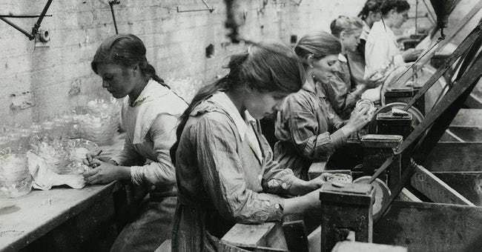

Slide 29
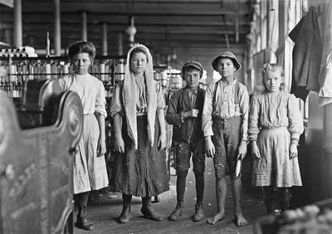

Slide 30
Inventors :
Inventions :

Slide 31
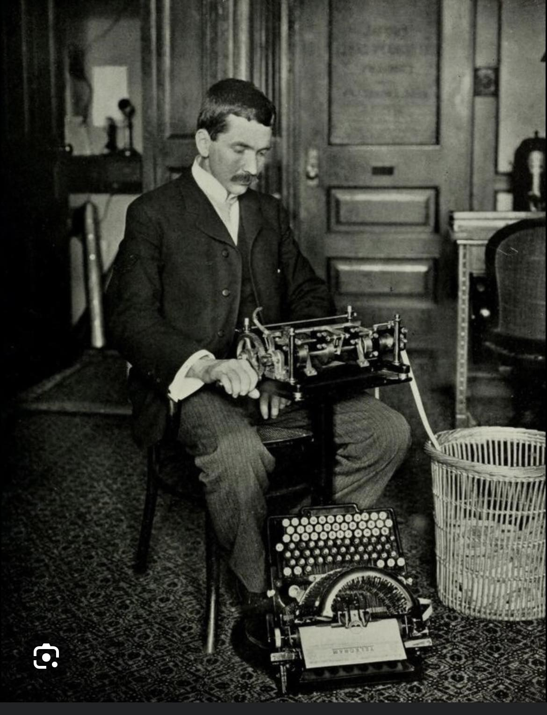
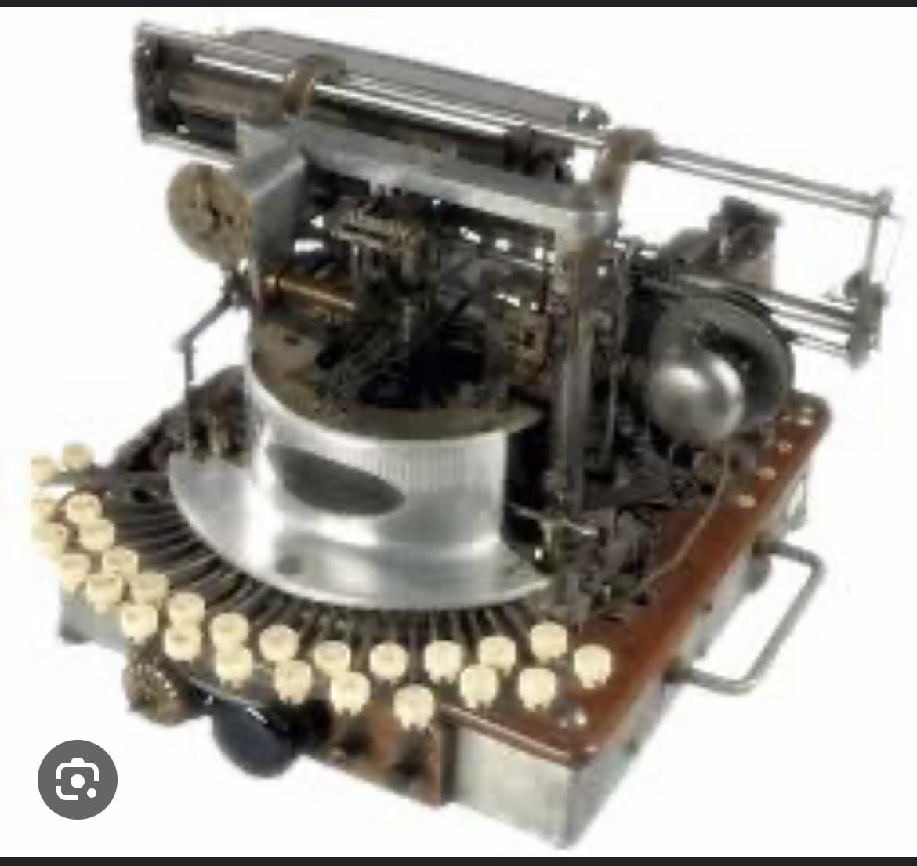
Christopher Latham Scholes
Telegraphic Typewriter

Slide 32
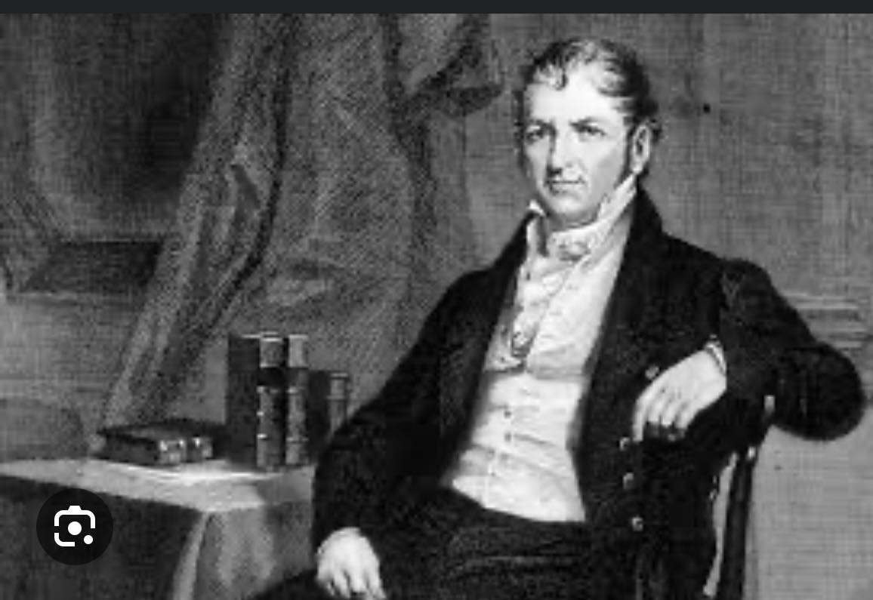
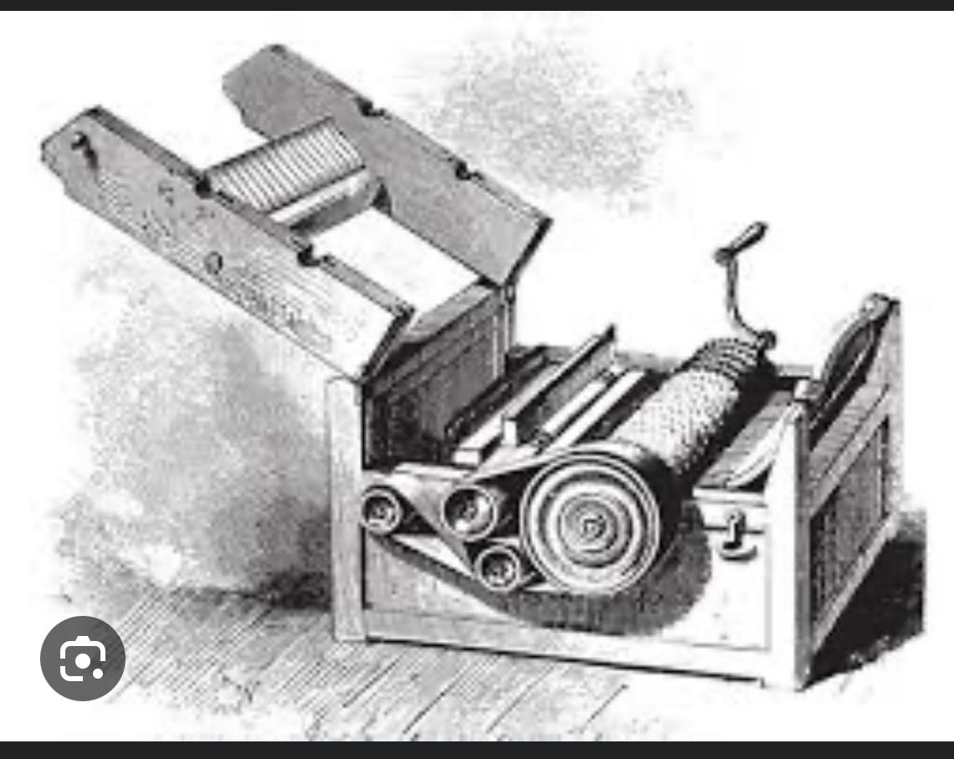
Eli Whitney
Cotton gin

Slide 33
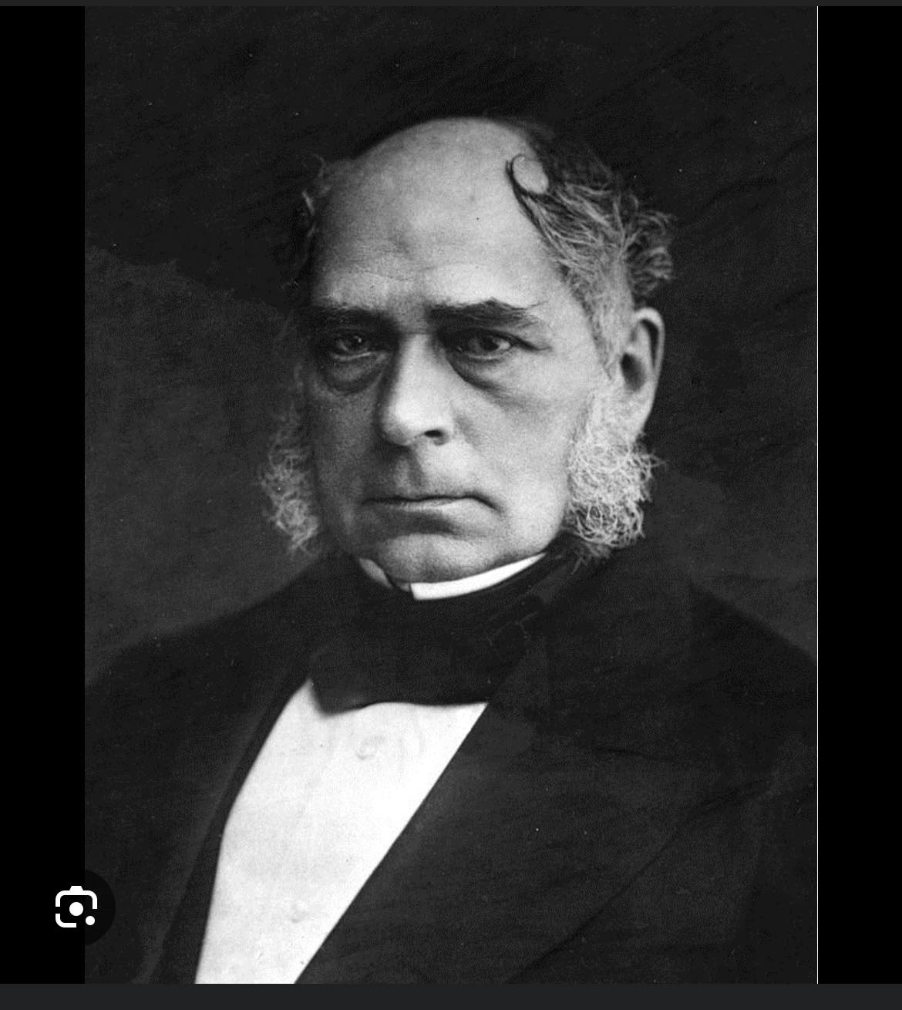
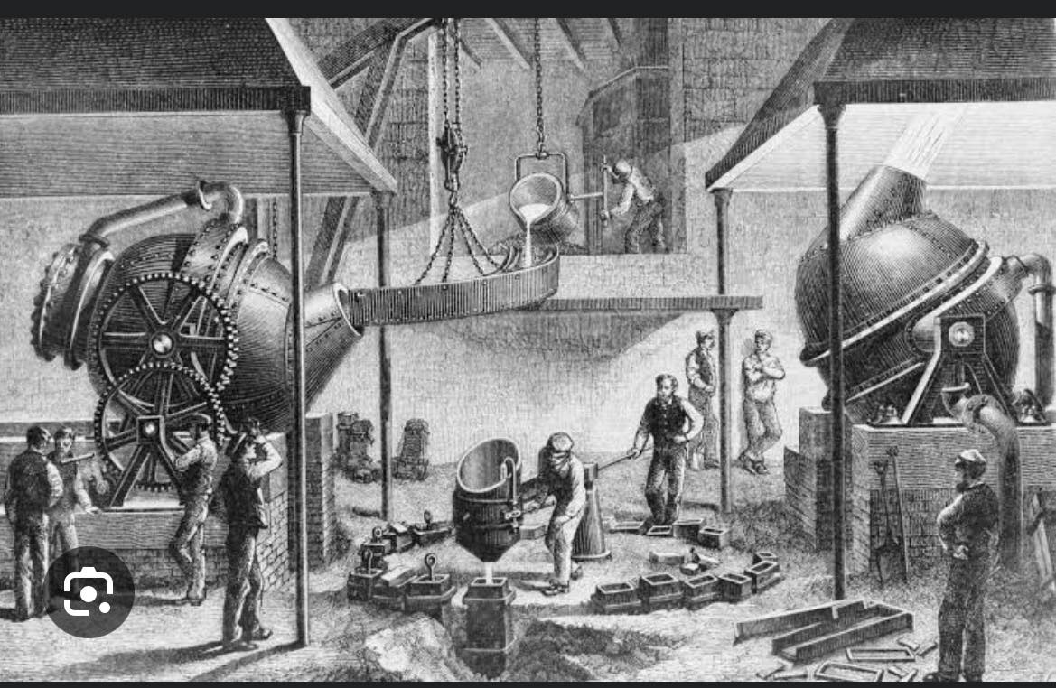
Henry Bessemer
Bessemer process

Slide 34
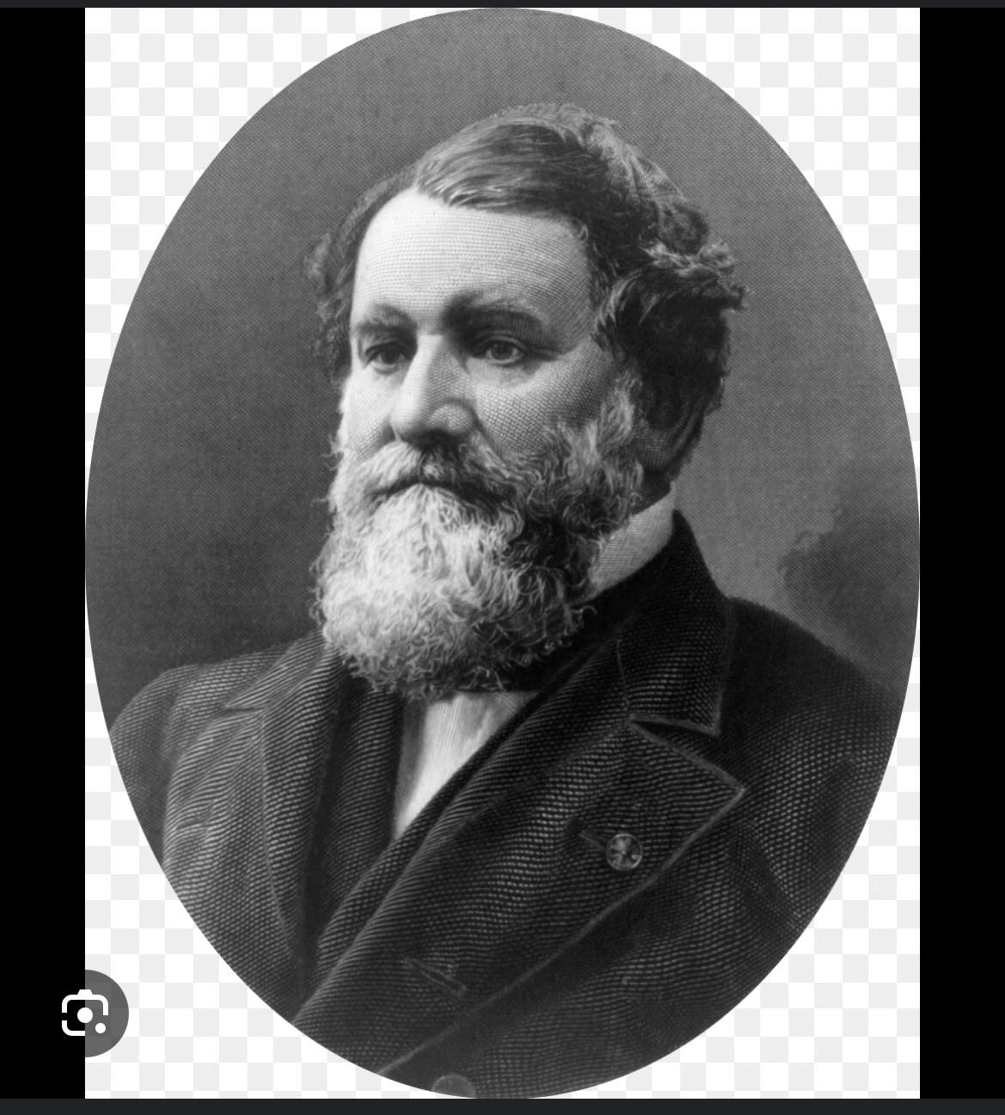
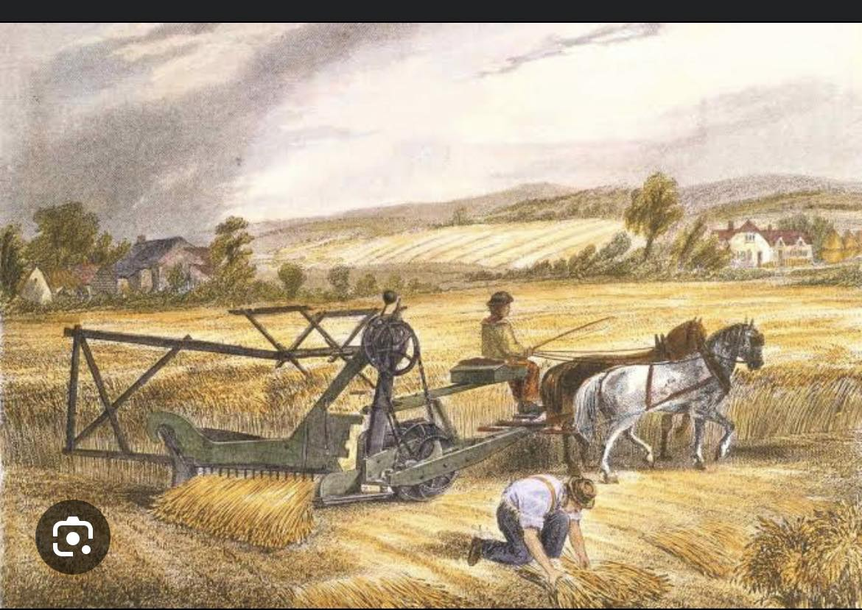
Cyrus Mccormick
Machanical Reaper

Slide 35
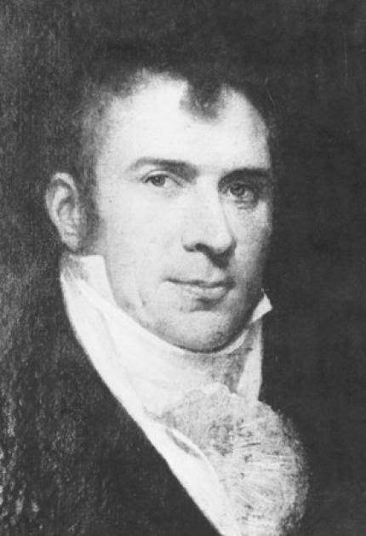
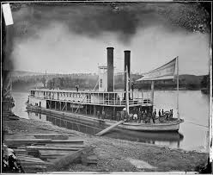
Robert Fulton
Steamboat

Slide 36
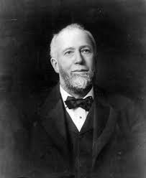
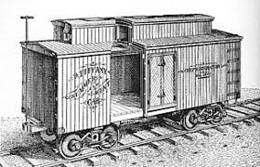
Gustavus Swift
Refrigerated Rail road

Slide 37
CONCLUSION :
The Industrial Revolution in America was a transformative period characterized by profound social, economic, and technological changes. It accelerated urbanization, drove economic growth, and spurred technological innovation. However, it also brought about significant challenges, including labor exploitation, environmental degradation, and widening social inequalities. Despite these challenges, the Industrial Revolution laid the groundwork for modern industrialized society, shaping the trajectory of American development and setting the stage for ongoing debates about labor rights, environmental sustainability, and social justice. As we continue to grapple with the legacies of industrialization, it serves as a reminder of the complex interplay between progress and its consequences, urging us to strive for serves as a reminder of the complex interplay between progress and its consequences, urging us to strive for inclusive, sustainable, and equitable forms of development in the present and future.

