Slide 1
Chapter 4 :
Queue

Slide 2
Introduction to C++ Programming
Definition
Static Queues
Dynamic Queues

Slide 3
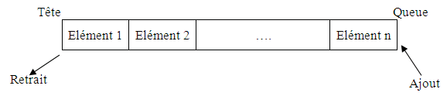
1. Definition
The queue is a data structure that allows elements to be stored in a given order and removed in the same order, i.e. according to the FIFO “First In First Out” protocol.
"We always add an element at the end and remove the one at the front“.
Front
Rear
Remove
Add

Slide 4
1. Definition
Depending on the type of implementation, two types of queues are distinguished:
Static Queue: Implementation by an array.
Dynamic queue: Implementation by a linkedd list.

Slide 5
1. Primitive operation
In the queue data structure, the primary or "primitive" operations are:
Enqueue: Adds an element to the end of the queue.
Dequeue: Removes an element from the front of the queue.
Front (or Peek): Retrieves the front element without removing it.
IsEmpty: Checks if the queue is empty.
Size: returns the numbers of elements in the queue

Slide 6
2. Static Queues
Implementation by an array.
The definition of the Queue (static) type is as follows:
Type Structure Queue
Begin
Tab: Array[MAX] of Elements;
Head: integer; // index of the first in the Queue.
Tail: integer; // index of the last element inserted into the Queue.
END
F
Tab:
Head : 1
Tail: 4
10 | 20 | 14 | 7

Slide 7
2. Static Queues
Implementing static Queues can be done in two ways:
  By shifting: using an array with a fixed head, always at 1, and a variable tail.
  By flow: It can also be done by flow using a circular array where the head and tail are both variables.

Slide 8
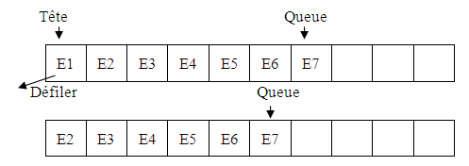
2. Static Queues
Implementation by shifting
Fixed Head and Variable Tail.
The queue is empty if Tail= 0
The queue is full if Tail= Max
It suffers from the shifting problem with each dequeue operation.

Slide 9
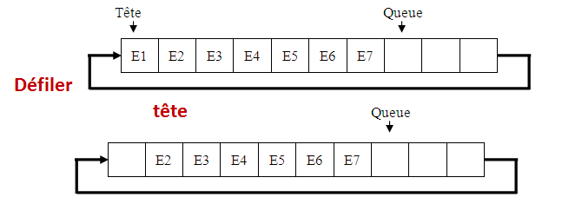
2. Static Queues
Implementation by a circular Array
Variable Head and Variable Tail
The queue is empty if Head = Tail
The queue is full if (Queue + 1) mod Max = Head

Slide 10
3. Dynamic queues
It is a linked list where dequeuing occurs only at the head, and enqueuing occurs only at the tail of the list.
Head
1
@2
8
@3
5
@4
11
NULL
Tail
@4

Slide 11
3. Dynamic queues
  Dynamic Queue Type Definition
The definition of the Queue (dynamic) type is as follows:
Type Structure Node
Ele : typeq ;
next: * Node ;
END
Type Structure Queue
Begin
Head: *Node; // Keeps the address of the head of the queue.
Tail: *Node; // Holds the address of the last element in the queue.
END

Slide 12
3. Dynamic queues
  The structure of a dynamic queue
  F
1
@2
8
@3
11
NULL
Head :
Tail:
@1
@3

Slide 13
3. Dynamic Queues (Primitive Operations )
1. Initialize : Initializes the Head and Tail variables of the queue to NULL.
Procedure Initialise(var F: Queue)
Begin
F.Head ← NULL;
F.Tail ← NULL;
END
F
Head :
Tail:
NULL
NULL

Slide 14
3. Dynamic Queues (Primitive Operations )
2. Is_empty : returns true if the queue is empty otherwise returns false.
Function is_empty (F: Queue): boolean
Begin
Returns (F. Head = NULL);
END
F
Head :
Tail:
NULL
NULL

Slide 15
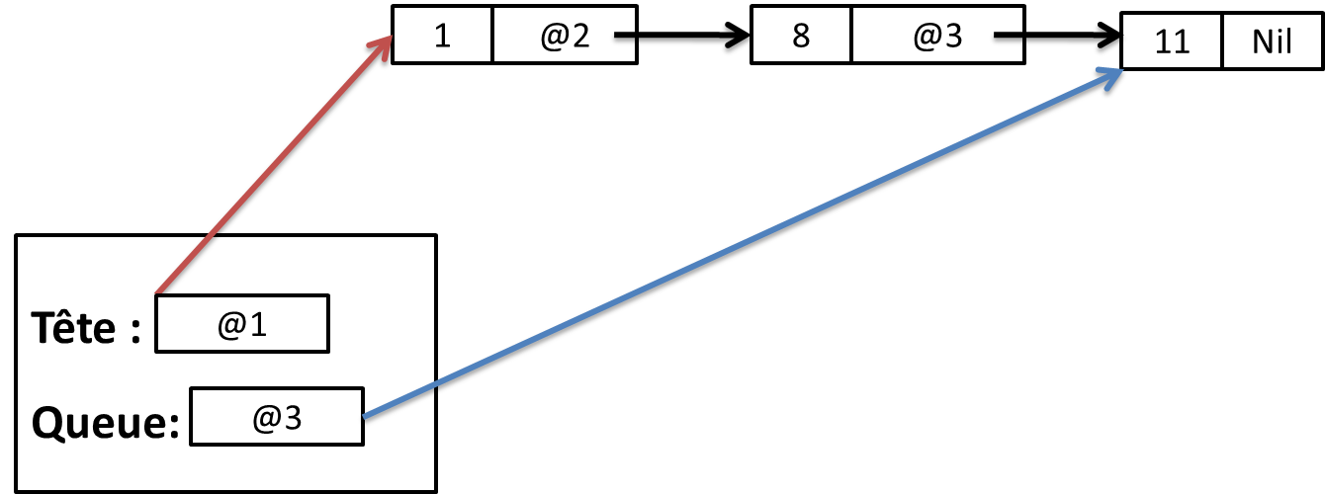
3. Dynamic queues
3. Head : Returns the element that exists in the header of the Queue (The first element threaded).
function Head ( F: Queue ): integer
Begin
Returns ( F.Head -> Ele );
END
F.Head -> Ele = 1
F

Slide 16
3. Dynamic Stacks
Enqueue : Adds an element to the tail of the queue.
Procedure Enqueue (var F: Queue, x: typeq )
P: *Node
Begin
P ← create_Node (x);
If (is_empty(F)) then
F.Head ← P
F.Tail ← P;
Else
F. Head-> next ← P;
F.Tail← P;
End if
END

Slide 17
3. Dynamic Stacks
Dequeue: Removes the first element (the Front) from the queue.
Procedure Dequeue (var F: Queue)
P: *Node
Begin
If( ! is_empty (f))
P ← F.head ;
F.Head ← f.Head -> next;
Desallocate (p);
If ( F.Head =NULL)
F.Tail ← NULL;
End if
Endif
END

Slide 18
3. Dynamic Stacks
The size function : returns the number of elements already enqueue into the queue.
Function Size (F: Queue): integer
Current: *Node
Nb: integer;
Begin
Current ← F.Head; Nb ←0 ;
While (current != NULL)
Nb ← Nb +1;
Current ← Current->next ;
Endwhile
Return Nb;
END

Slide 19
4. Queue usage examples:
Queues are widely used in various applications where data needs to be processed in a First-In-First-Out (FIFO) order such as:
Task Scheduling in Operating Systems:
  Queues manage tasks, processes, or threads that need CPU time, ensuring that the first task to enter is the first one to be executed.
  Print queues also work similarly, where documents are printed in the order they are submitted.
  Breadth-First Search (BFS) in Graph Algorithms: Queues are essential in BFS to keep track of nodes to visit next, allowing each level of nodes to be processed sequentially.

Slide 20
4. Queue usage examples:
Handling Requests in Web Servers: When multiple users make requests to a server, requests are stored in a queue, ensuring they are processed in the order received.
Data Buffers: Queues are used in buffering for streaming or real-time applications, like video streaming, where data needs to be processed in the order it arrives.
Messaging Systems: Messaging queues (like those used in RabbitMQ) store messages for distributed systems, ensuring messages are processed in the order they were received.
Customer Service Systems: Call centers and help desks use queues to manage customers waiting for assistance, where customers are served in the order they called.

Slide 21
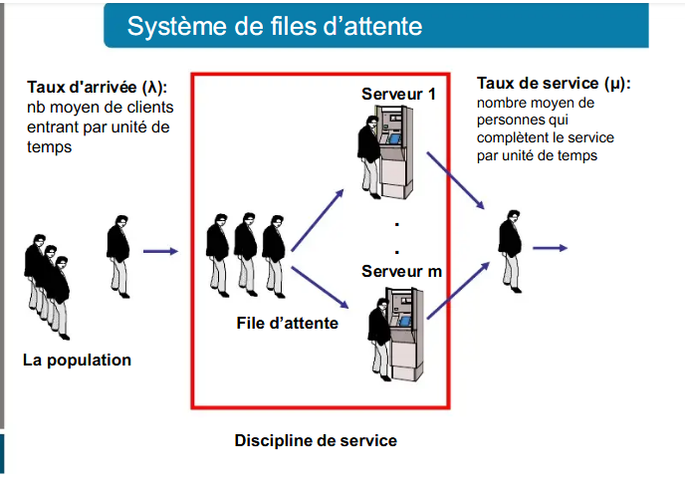
4. Queue usage examples:

