Slide 1
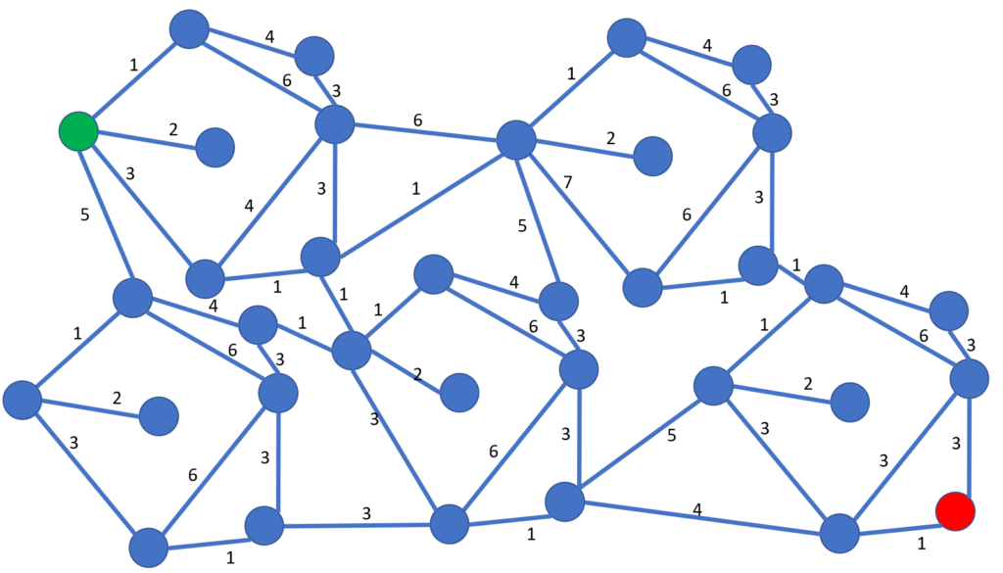
Module Supervisor:
Mr Merabet Adil
Email : a.merabet@centre-univ-mila.dz
https://elearning.centre-univ-mila.dz/a2024/course/view.php?id=331
Shortest Path

Slide 2
Shortest Path
Introduction
To remind:
A walk in a graph is a continuous sequence of edges connecting two vertices.
A walk is a path if any vertex is visited at most once.
The length of a walk or path is the total number of times it traverses edges.
We refer to a weighted graph when the connection between a pair of vertices has a capacity or weight.
  The weight assigned to an edge represents a numerical value that signifies:
  Cost, Distance, Time, Capacity, …

Slide 3
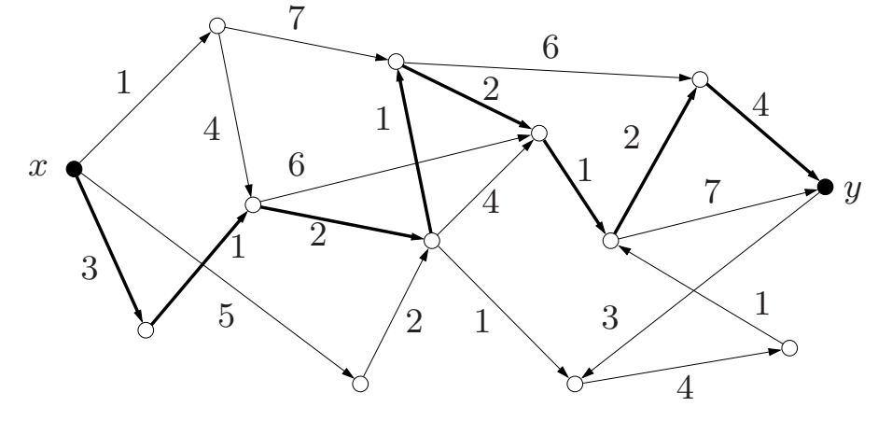
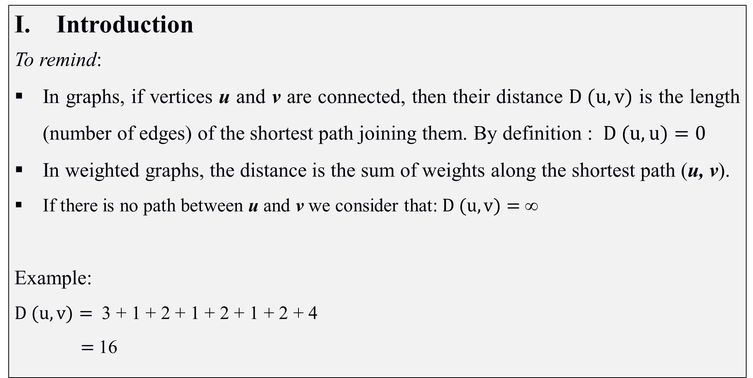
Shortest Path
Introduction
To remind:
In graphs, if vertices u and v are connected, then their distance $D (u,v)$ is the length (number of edges) of the shortest path joining them. By definition : $D (u,u)=0$
In weighted graphs, the distance is the sum of weights along the shortest path (u, v).
If there is no path between u and v we consider that:$D (u,v)=$∞
Example:
$D (u,v)=$ 3 + 1 + 2 + 1 + 2 + 1 + 2 + 4
$=$16

Slide 4
Shortest Path
Definition of the problem
In many applications, it is desirable to know the path of minimum total weight between two vertices.
This is usually called the shortest path problem,
The shortest path problem is widely studied and efficiently solvable for most cases, the longest path problem is much harder in general graphs, especially due to its NP-hard nature (This means there is no known polynomial-time algorithm for it, making it computationally expensive as the graph size increases).

Slide 5
Shortest Path
Definition of the problem
The shortest path problem has numerous real-world applications:
Transportation Networks: Finding the shortest route between two locations, such as in GPS navigation systems.
Computer Networks: Routing packets in networks to minimize latency and congestion.
Logistics: Optimizing delivery routes to reduce travel time and costs.
Robotics: Planning robot paths to reach a goal efficiently.

Slide 6
Shortest Path
Definition of the problem
Several algorithms are used to solve the shortest path problem:
Dijkstra Algorithm
Bellman-Ford Algorithm
Bellman-Kalaba algorithm
Other Algorithms: Floyd-Warshall, A* Search

Slide 7
Shortest Path
Dijkstra Algorithm
Description:
Dijkstra’s algorithm uses a greedy approach to iteratively select the nearest unvisited node and update its neighbors' distances.
Efficient for finding the shortest path from a single source vertex to all other vertices in a graph with non-negative edge weights.
We assume that we do not have any loops or parallel edges. Otherwise, we simply remove the loops and choose the edge with the lowest weight out of the parallel edges.
In undirected graphs, each edge is treated as two arcs with the same weight in opposite directions.

Slide 8
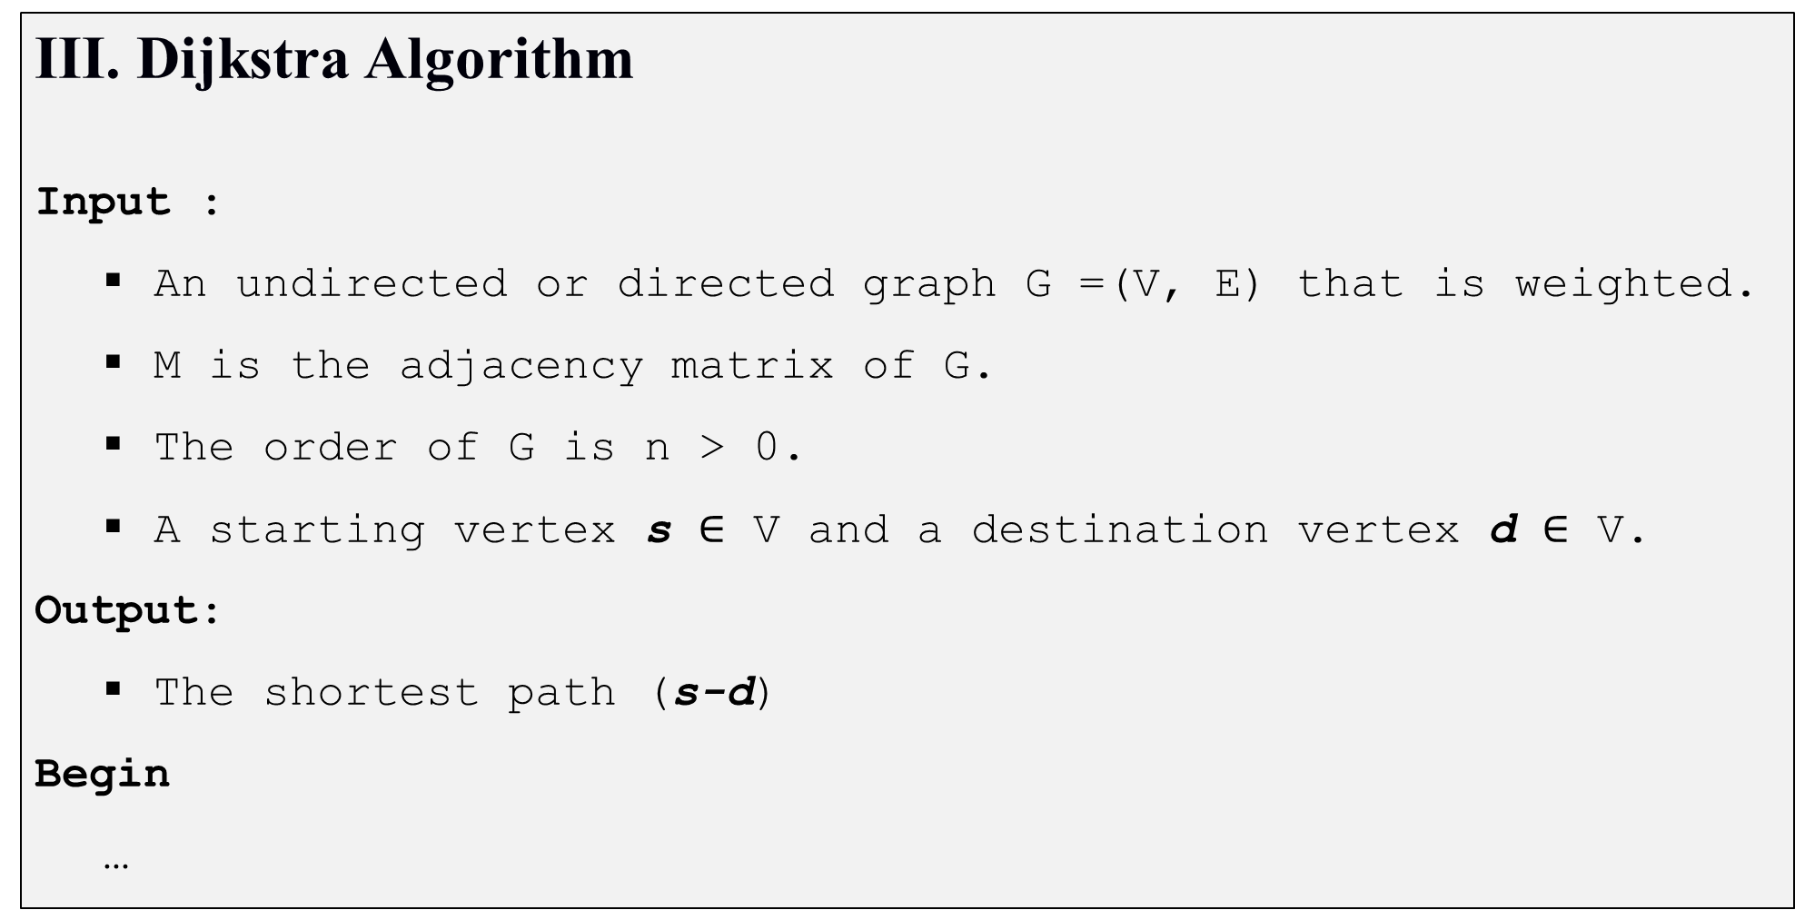
Shortest Path
Dijkstra Algorithm
Input :
  An undirected or directed graph G =(V, E) that is weighted.
  M is the adjacency matrix of G.
  The order of G is n > 0.
  A starting vertex s $∈$ V and a destination vertex d $∈$ V.
Output:
  The shortest path (s-d)
Begin
  …

Slide 9
Shortest Path
Dijkstra Algorithm
Create a matrix L, and a path table P (each column is a vertex).
Set L(s) ← 0 and For all other vertices 𝑥, set L(𝑥) ← ∞
Initially, all vertices are “unmarked”.
While (d is not marked) do
  Select and mark the unmarked vertex 𝑥 with the smallest distance in 𝐿.
  For each unmarked vertex y neighbor of 𝑥 do
    Current_Distance = L( y ), New_Distance = L( x ) + M( x , y )
    L( y ) = min { L( y ), L( x ) + M( x , y ) }
    If (New_Distance < Current_Distance) then update the path in P
  EndFor
EndWhile

Slide 10
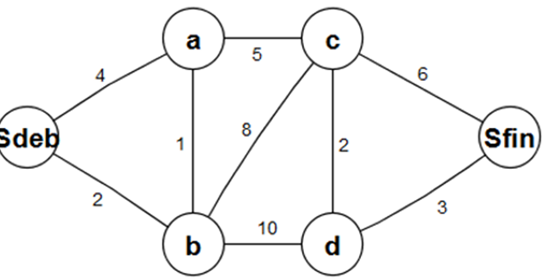
Shortest Path
Dijkstra Algorithm
Create a matrix L, and a path table P (each column is a vertex).
Set L(s) ← 0 and For all other vertices 𝑥, set L(𝑥) ← ∞
Initially, all vertices are “unmarked”.
While (d is not marked) do
  Select and mark the unmarked vertex 𝑥 with the smallest distance in 𝐿.
  For each unmarked vertex y neighbor of 𝑥 do
    Current_Distance = L( y ), New_Distance = L( x ) + M( x , y )
    L( y ) = min {L(y), L(x) + M(x,y)}
    If (New_Distance < Current_Distance) then
      update the path in P
  EndFor
EndWhile

Slide 11
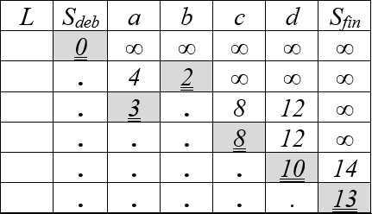
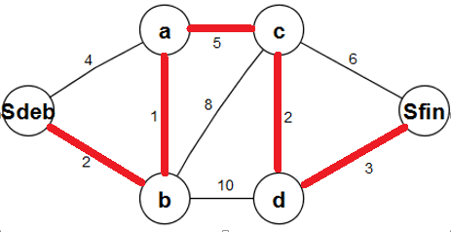
Shortest Path
Dijkstra Algorithm
The shortest path is:
Vertices | Sdeb | a | b | c | d | Sfin
Path

Slide 12
Shortest Path
Bellman-Kalaba Algorithm
Description:
Bellman-Kalaba algorithm uses an iterative approach to compute the shortest path from a fixed vertex to all other vertices in a graph.
It is particularly used when the destination vertex is unknown
In weighted graphs, the weight of a circuit is the sum of the weights of the arcs it contains. If this weight is negative, we speak of an absorbing circuit.
If there is a negative length circuit in the graph, the search for a shortest path is useless. The circuit can be used an infinite number of times.

Slide 13
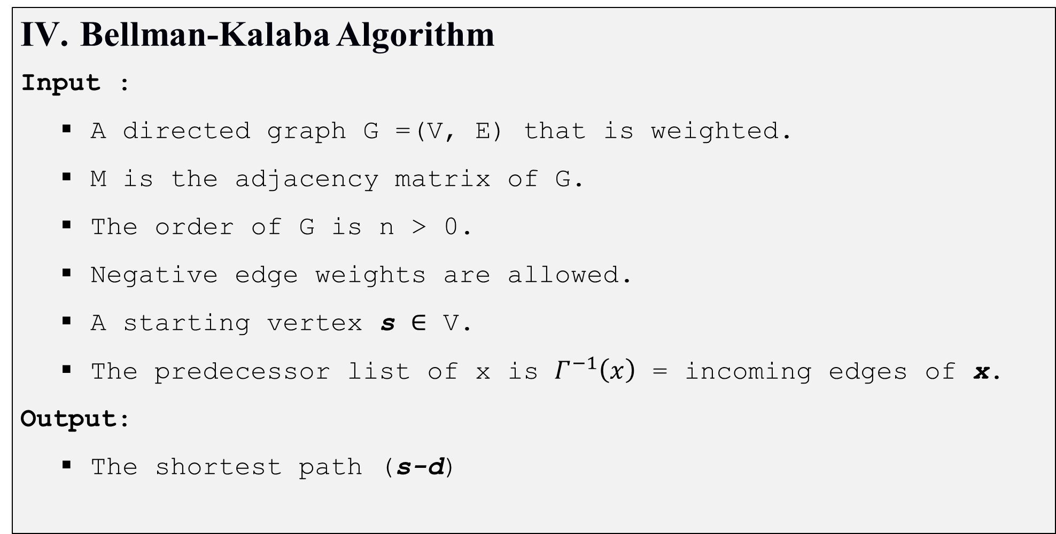
Shortest Path
Bellman-Kalaba Algorithm
Input :
  A directed graph G =(V, E) that is weighted.
  M is the adjacency matrix of G.
  The order of G is n > 0.
  Negative edge weights are allowed.
  A starting vertex s $∈$ V.
  The predecessor list of x is $Γ^{−1}\left(x\right)$ = incoming edges of x.
Output:
  The shortest path (s-d)

Slide 14
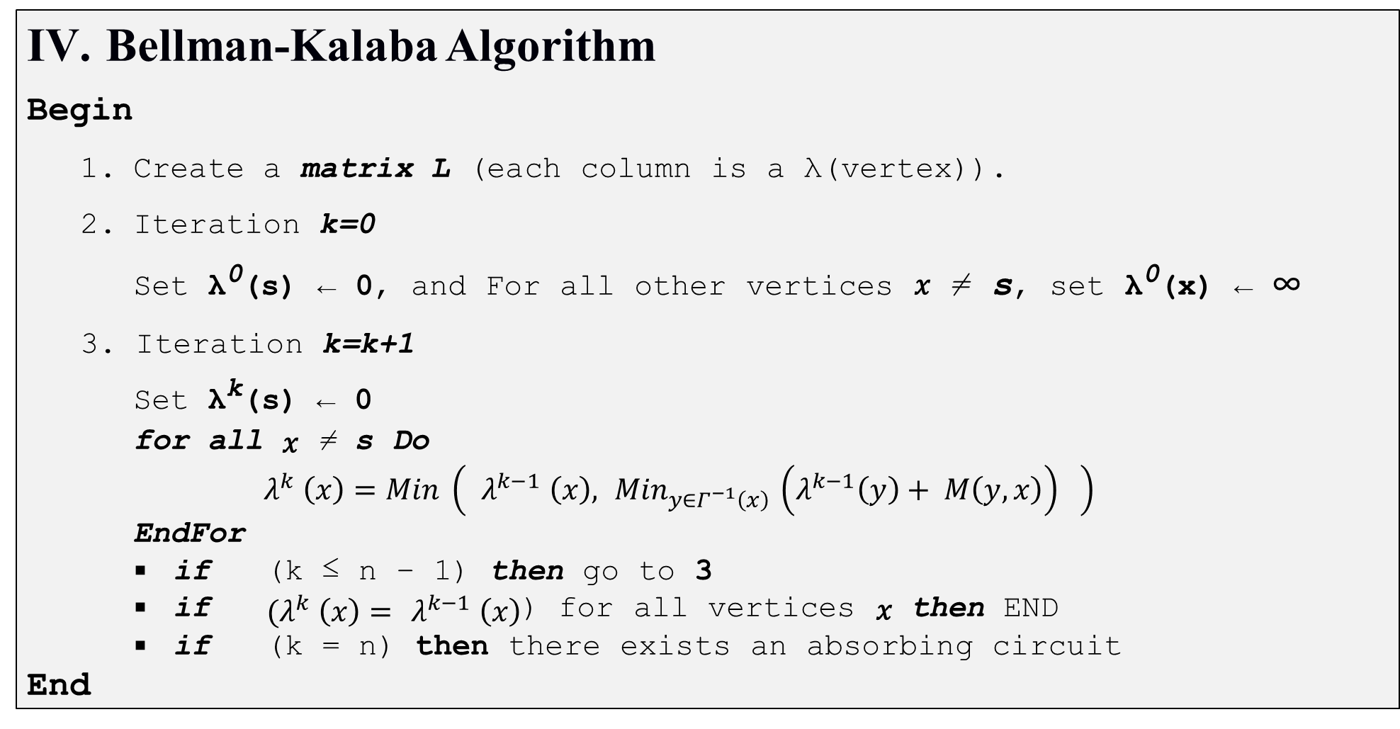
Shortest Path
Bellman-Kalaba Algorithm
Begin
  Create a matrix L (each column is a λ(vertex)).
  Iteration k=0
    Set λ⁰(s) ← 0, and For all other vertices 𝑥 ≠ s, set λ⁰(x) ← ∞
  3. Iteration k=k+1
    Set λ^{k}(s) ← 0
    for all 𝑥 ≠ s Do
    $λ^{k} \left(x\right)=Min \left( λ^{k−1} \left(x\right), { Min}_{y∈Γ^{−1}\left(x\right)} \left(λ^{k−1}\left(y\right)+ M\left(y, x\right)\right) \right)$
    EndFor
    if (k ≤ n − 1) then go to 3
    if ${(λ}^{k} \left(x\right)=$ $λ^{k−1} \left(x\right)$) for all vertices 𝑥 then END
    if (k = n) then there exists an absorbing circuit
End

Slide 15
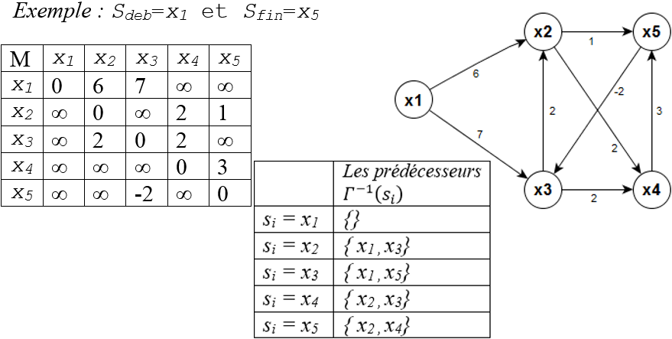
Shortest Path
Bellman-Kalaba Algorithm

Slide 16
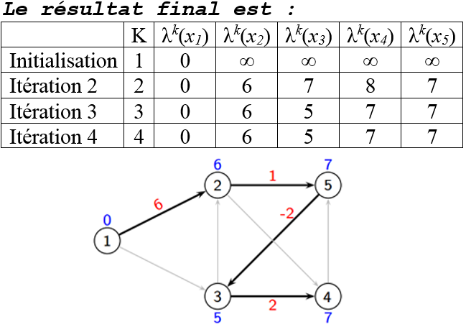
Shortest Path
Bellman-Kalaba Algorithm

