Slide 1
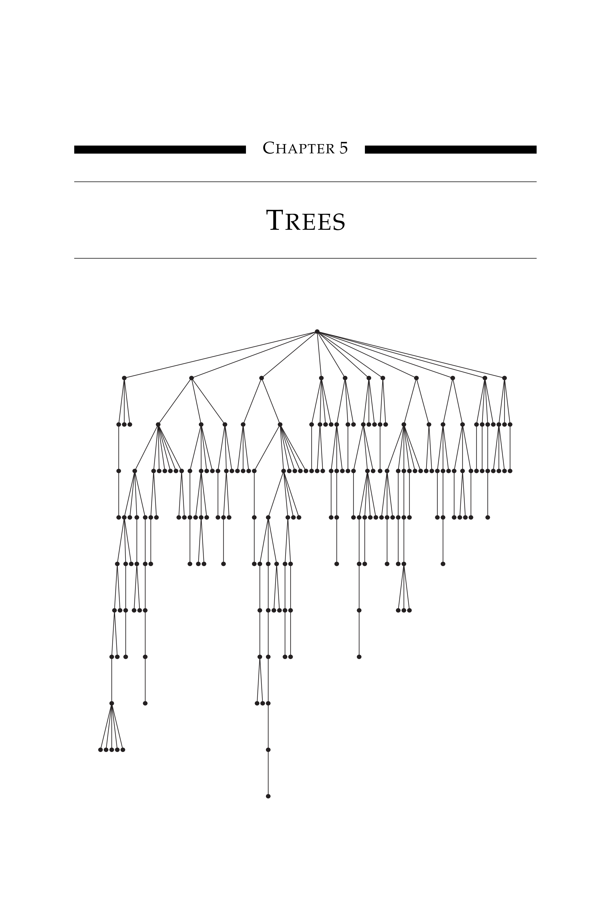
Module Supervisor:
Mr Merabet Adil
Email : a.merabet@centre-univ-mila.dz
https://elearning.centre-univ-mila.dz/a2024/course/view.php?id=331
Trees and Forests

Slide 2
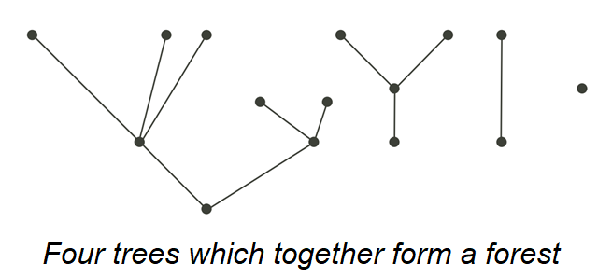
Trees and Forests
Introduction
To remind:
  A graph G is a pair of sets (V, E), G = (V , E).
  A circuit in a graph is a closed path that starts and ends at the same vertex.
  A graph is considered circuitless or acyclic if it contains no circuits.
Definitions:
  A forest is a circuitless graph.
  A tree is a connected forest.
  Each connected component of a forest is a tree
  The word "leaf" is used to refer to a vertex of degree 1 in a tree

Slide 3
Trees and Forests
Introduction
  If the graph G has n vertices and m edges, then G is a tree if:
  G is connected,
  G is circuitless,
  If we add any new edge to G, then we will get one and only one circuit,
  If you remove an edge from a tree, you break the connectivity.
  m = n − 1,
  G has no loops,
  There is exactly one path between any two vertices in G.

Slide 4
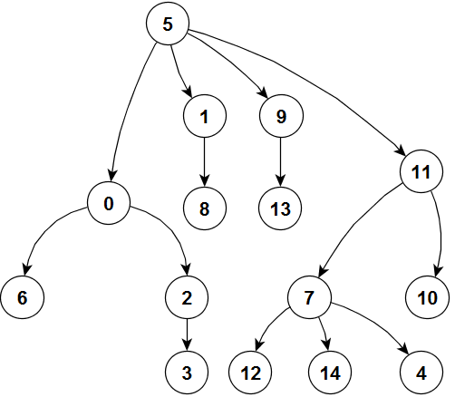
Trees and Forests
Directed Trees
A digraph G(V, E) has a root r if r ∈ V and every vertex v ∈ V is reachable from r ( There is a unique directed path that starts from r to v).
A digraph is called a directed tree if it has a root and its undirected graph is a tree.
Root: The vertex with no incoming edges.
Parent: A vertex that directly precedes another vertex in a path.
Child: A vertex that directly follows another vertex in a path.
Leaf: A vertex with no outgoing edges.
Level: The number of edges between a vertex and the root.

Slide 5
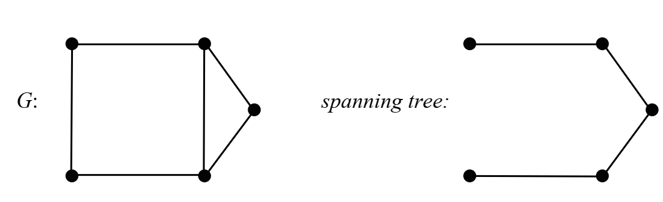
Trees and Forests
Spanning Tree
Let G be a connected graph, and let T be a subgraph of G.
T (𝑉1, 𝐸1) is said to be a subgraph of a graph 𝐺(𝑉, 𝐸) if 𝑉1 ⊆ 𝑉 and 𝐸1 ⊆ 𝐸.
If (T is a tree that contains all the vertices of G) then
T is called a spanning tree of G.
Or,
If (T is a tree and 𝑉1 = 𝑉 and 𝐸1 ⊆ E) then
T is called a spanning tree of G.

Slide 6
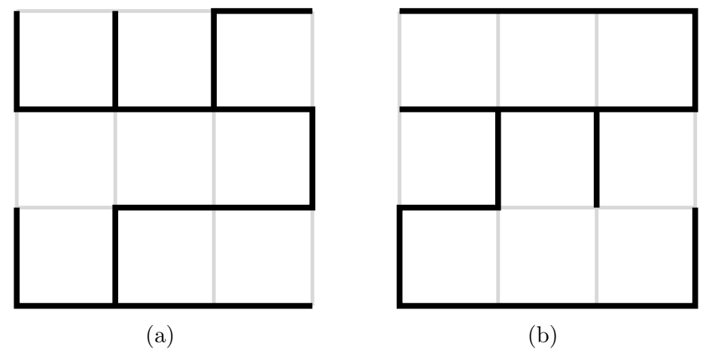
Trees and Forests
Spanning Tree
Two spanning trees for the 4 × 4 grid graph.

Slide 7
Trees and Forests
Spanning Tree
Example:
Suppose we're installing a power line to connect several houses
If these houses represent the vertices of a graph and a wire connecting two houses
represents an edge of the graph, then:
For economical reasons, we will want to connect the houses using the least amount of wire.
The problem essentially becomes about :
finding a minimum spanning tree in the graph containing these vertices

Slide 8
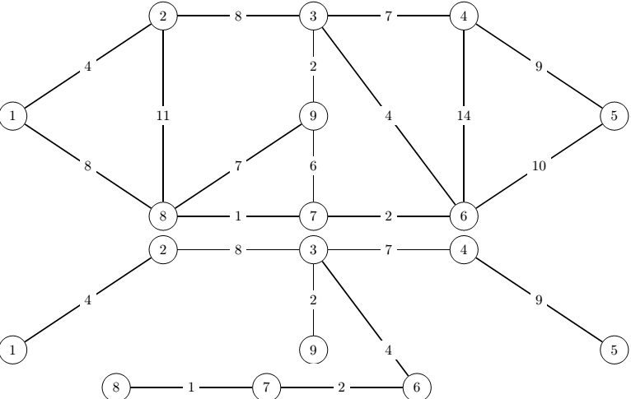
Trees and Forests
Minimum Spanning Trees (MST)
Problem:
We have to find the spanning tree with the lowest weight of a connected graph.
The weight of a tree is the sum of all the weights of the branches.
There are several known algorithms for constructing an MST. We describe here:
Prim, Kruskal, and Sollin algorithms

Slide 9
Trees and Forests
Minimum Spanning Trees : Kruskal’s algorithm
Kruskal’s algorithm belongs to the class of greedy algorithms.
Given a weighted nontrivial graph G = (V, E) that is connected,
let w: E ➔ R be the weight function of G.
The first stage is creating a skeleton of the tree T that is initially set to be a graph without edges. T = (V, Eˈ). Eˈ = {}
The next stage involves sorting the edges of G by weights in increasing order.
In other words, we label the edges of G as follows: E = {e₁, …, e_{m}}
where m = |E| and w(e₁) ≤ w(e₂) ≤ · · · ≤ w(e_{m})
We add e_{i} to the edge set of T if that e_{i} does not result in T having a cycle.

Slide 10
Trees and Forests
Minimum Spanning Trees : Kruskal’s algorithm
Algorithm 6: A minimum spanning tree of G
Inputs : Graph G=(V, E), Output : Tree T= (V, E')
Begin
  Delete all loops.
  Delete all parallel edges between two vertices except the edge with minimum weight.
  Sort E = {e₁, …, e_{m}} by weights so that w(e₁) ≤ w(e₂) ≤ · · · ≤ w(e_{m}) and store them in a list L.
  E' ← {} and create the skeleton of the tree T (draw all vertices)
  … …
END

Slide 11
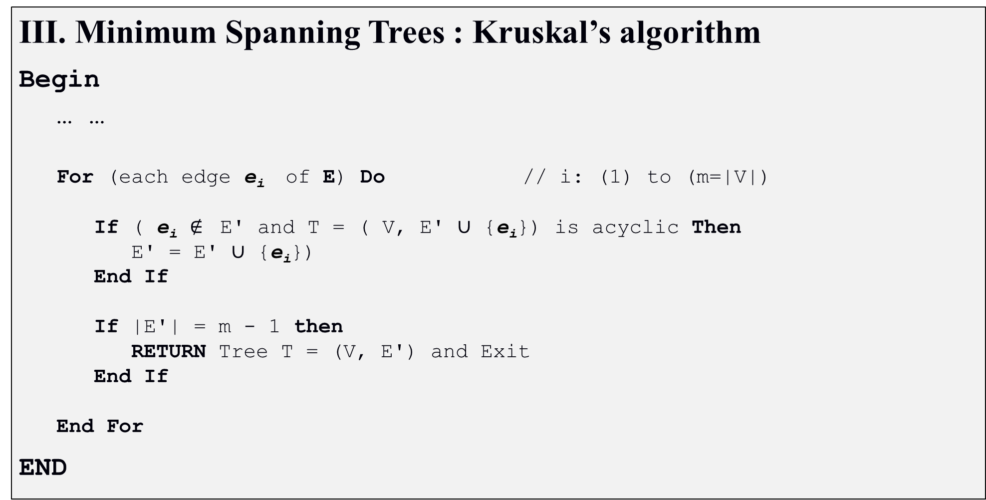
Trees and Forests
Minimum Spanning Trees : Kruskal’s algorithm
Begin
  … …
  For (each edge e_{i} of E) Do // i: (1) to (m=|V|)
    If ( e_{i} $∉$ E' and T = ( V, E' ∪ {e_{i}}) is acyclic Then
      E' = E' ∪ {e_{i}})
    End If
    If |E'| = m - 1 then
      RETURN Tree T = (V, E') and Exit
    End If
  End For
END

Slide 12
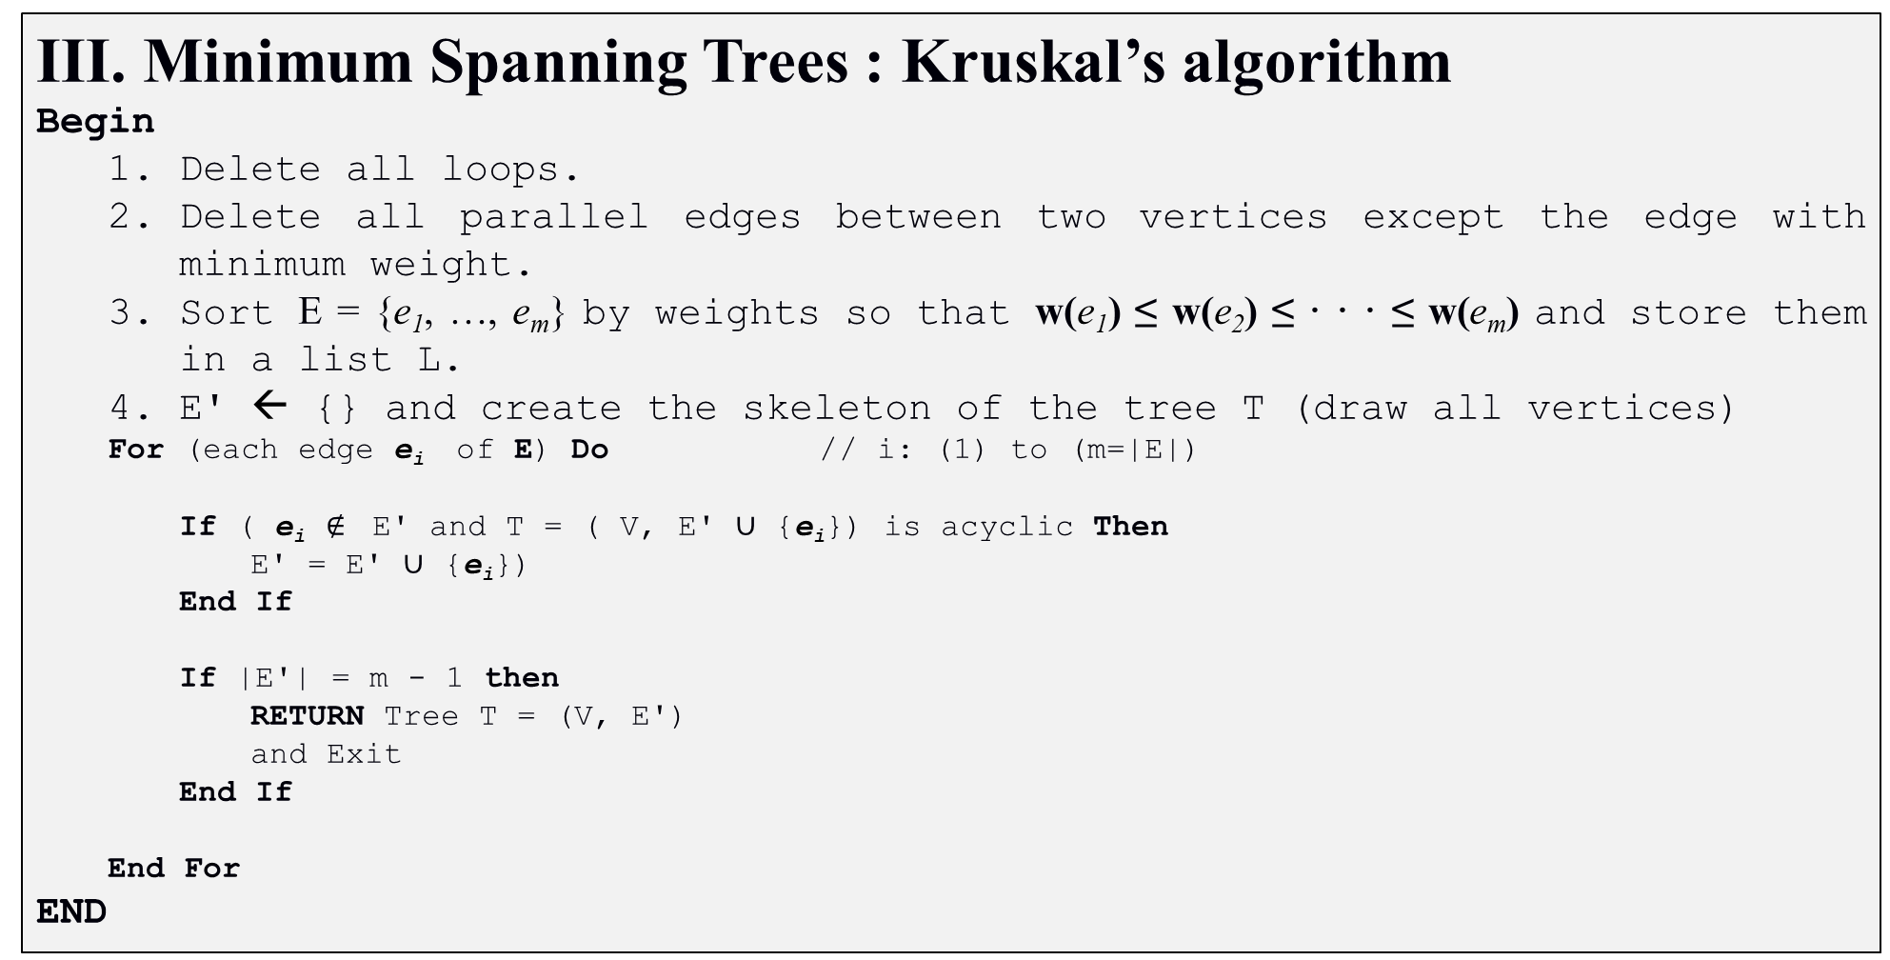
Trees and Forests
Minimum Spanning Trees : Kruskal’s algorithm
Begin
  Delete all loops.
  Delete all parallel edges between two vertices except the edge with minimum weight.
  Sort E = {e₁, …, e_{m}} by weights so that w(e₁) ≤ w(e₂) ≤ · · · ≤ w(e_{m}) and store them in a list L.
  E' ← {} and create the skeleton of the tree T (draw all vertices)
  For (each edge e_{i} of E) Do // i: (1) to (m=|E|)
    If ( e_{i} $∉$ E' and T = ( V, E' ∪ {e_{i}}) is acyclic Then
      E' = E' ∪ {e_{i}})
    End If
    If |E'| = m - 1 then
      RETURN Tree T = (V, E')
      and Exit
    End If
  End For
END

Slide 13
Trees and Forests
Minimum Spanning Trees : Prims’s algorithm
Like Kruskal’s algorithm, Prim’s algorithm uses a greedy approach.
The idea of the algorithm is to grow T, by starting a tree with one vertex s, and in each step adding a new leaf v to T, until all vertices have joined it
v is chosen in such a way that the edge connecting it to T is minimum.

Slide 14
Trees and Forests
Minimum Spanning Trees : Prims’s algorithm
Algorithm 7: A minimum spanning tree of G
Inputs : Graph G=(V, E), Output : Tree T= (V, E')
Begin
  Delete all loops.
  Delete all parallel edges between two vertices except the edge with minimum weight.
  E' ← {}, V' ← {} and create the skeleton of T (draw all vertices)
  … …
END

Slide 15
Trees and Forests
Minimum Spanning Trees : Prims’s algorithm
Begin
  … …
  Choose an unprocessed vertex s ∈ V and add it to V': V' ← V' + {s}
  Examine all edges connected to tree T =(V', E') and choose the edge e_{i} with the lowest weight.
  Add this edge e_{i} to the tree T: E' ← E' + e_{i}
  If (all vertices are examined: V' = V) then
    Return Tree T = (V, E')
  Else
    Go to 4
  End If
END

Slide 16
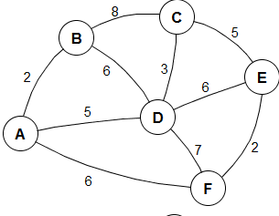
Trees and Forests
Minimum Spanning Trees : Prims’s algorithm
Begin
  Delete all loops.
  Delete all parallel edges between two vertices except the edge with minimum weight.
  E' ← {}, V' ← {} and create the skeleton of T (draw all vertices)
  Choose an unprocessed vertex s ∈ V and add it to V': V' ← V' + {s}
  Examine all edges connected to tree T =(V', E') and choose the edge e_{i} with the lowest weight.
  Add this edge e_{i} to the tree T: E' ← E' + e_{i}
  If (all vertices are examined: V' = V) then
    Return Tree T = (V, E')
  Else
    Go to 4
  End If
END

Slide 17
Trees and Forests
Minimum Spanning Trees : Sollin’s algorithm
Sollin's algorithm is a parallel algorithm for finding the MST
Sollin considers each vertex in the graph to be the root of an empty tree.
Then, select for each tree the minimum cost edge that connects to a vertex in that tree.

Slide 18
Trees and Forests
Minimum Spanning Trees : Sollin’s algorithm
Algorithm 8: A minimum spanning tree of G
Inputs : Graph G=(V, E), Output : Tree T= (V, E')
Begin
  E' ← {}, and create the skeleton of T (draw all vertices)
  Repeat
    V' ← V,
    Delete all loops.
    Delete all parallel edges between two vertices except the edge with minimum weight.
    … …
  Until (G is reduced to a single vertex)
  Return Tree T = (V, E')
END

Slide 19
Trees and Forests
Minimum Spanning Trees : Sollin’s algorithm
Begin
  E' ← {}, and create the skeleton of T (draw all vertices)
  Repeat
    … …
    While (V' ≠ ∅) do
      Choose an unprocessed vertex s ∈ V'
      Examine all edges connected to vertex s and choose the edge e_{i} with the lowest weight.
      Add this edge to the tree T: E' ← E' + e_{i}
      Remove from V' the ends of e_{i}
    End While
    4. Merge vertices of the same component into one vertex
  Until (G is reduced to a single vertex)
  Return Tree T = (V, E')
END

Slide 20
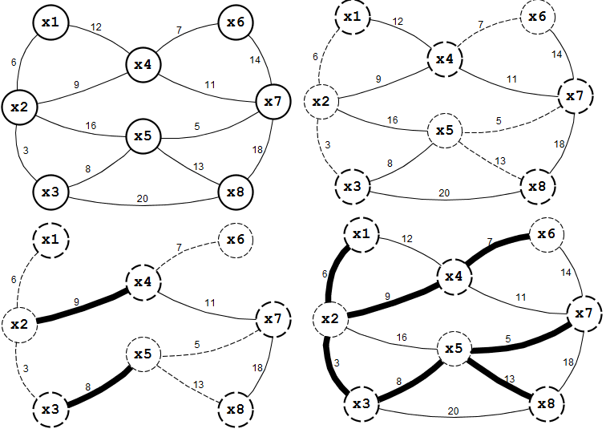
Trees and Forests
Minimum Spanning Trees : Sollin’s algorithm
Begin
  E' ← {}, and create the skeleton of T (draw all vertices)
  Repeat
    V' ← V, Delete all loops and all parallel edges between two vertices except the minimum edge.
    While (V' ≠ ∅) do
      Choose an unprocessed vertex s ∈ V'
      Examine all edges connected to vertex s and choose the edge e_{i} with the lowest weight.
      Add this edge to the tree T: E' ← E' + e_{i}
      Remove from V' the ends of e_{i}
    End While
    4. Merge vertices of the same component into one vertex
  Until (G is reduced to a single vertex)
  Return Tree T = (V, E')
END

