Slide 1
Cours 5: Water Bath

Slide 2
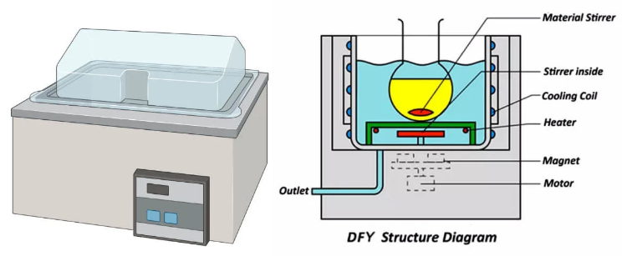
Definition
A water bath is a piece of scientific equipment used to maintain a steady temperature for a prolonged time when incubating samples. A water bath is preferred over an open flame when heating flammable substances. It is employed to enable some chemical reactions at high temperatures

Slide 3
Principle of Water Bath
The sensor converts the temperature of the water into a resistance value, which is then amplified and compared by an integrated amplifier. This produces the control signal, which effectively regulates the average heating power of the electric heating tube and keeps the water at a constant temperature

Slide 4
Parts of Water Bath
Container
A laboratory water bath’s container comprises an insulated metal, like stainless steel. Test samples are maintained in hot water for a lengthy time in a container.
Container lid
It is mainly constructed of insulated metal or heat-resistant glass. The lid keeps the container covered, preventing water evaporation.
• Heater
Temperature sensors are used as a heater in a laboratory water bath to help create heat.

Slide 5
Thermometer
It helps gauge the water bath’s temperature. It may be integrated or added on its own.
Thermostat or regulator
It aids in maintaining a steady temperature in a water bath.
Propeller or stirrer device
It is found in circulating water baths which promotes water circulation inside it.
Outlet
It aids in removing the water from the container.
Indicator light
It should be present in every water bath. The water bath is warming up while the light is on. The light will be turned off to maintain the desired temperature if the water bath achieves it.

Slide 6
Use of Water Bath
Ensure the equipment is clean and the temperature indicator is calibrated by the due date.
Plug in the power source.
Make sure the water in the bath has enough depth for the heating element to be poured in.
Turn “ON” the instrument’s main power source.
In order to set the desired temperature, press the SET key. The temperature can be changed by pressing any or both of these buttons.
Use a calibrated thermometer to confirm the temperature.
The temperature sensor will retain the set temperature whenever a water bath is used.
After use, turn “OFF” the main power source and the instrument’s mains.
After usage, completely dry the instrument and then replace the lid.

Slide 7
Precautions of Water Bath
▪ Make sure the bath is seemingly electrically safe before its use.
▪ Before turning on, make sure your hands are dry.
▪ cover your device when operating at temperatures exceeding “hand hot” (>50°C).
▪ Make that the water level is kept at the proper level, especially when operating at higher temperatures, and only distilled water should be used to fill them.
▪ Use an appropriate algicide, fungicide, or bactericide if the bath will be used constantly for a long time, such as >24 hours, to prevent the growth of undesired
▪ Ensure to thoroughly clean the bath after usage,

Slide 8
Laboratory water Distillers
Definition
A water distiller is a machine that purifies water by removing more than 99.9% of contaminants, including chemicals, heavy metals, microorganisms and sediment.

Slide 9
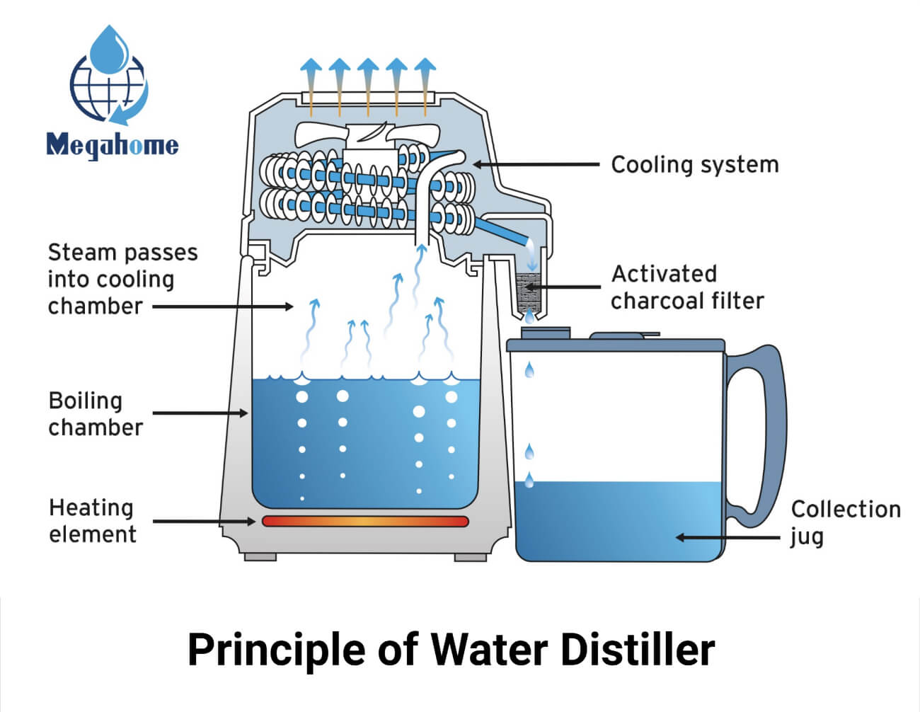
Water Distiller Work
Distillation is a fairly simple scientific process.
Water is added to the boiling chamber, and the machine is plugged into a power source and switched on. The boiling chamber will then heat up to water’s boiling point.
Water evaporates into steam and rises up into the cooling system. Here, it passes down a sloping corridor, where it condenses and drips into a clean container.
The majority of contaminants do not have the same boiling point as water. That means that when water is heated in the boiling chamber, the contaminants cannot evaporate alongside the H20 particles.
They are left behind in the boiling chamber, and once the distillation process has finished, they are cleared away when the chamber is washed out.

Slide 10
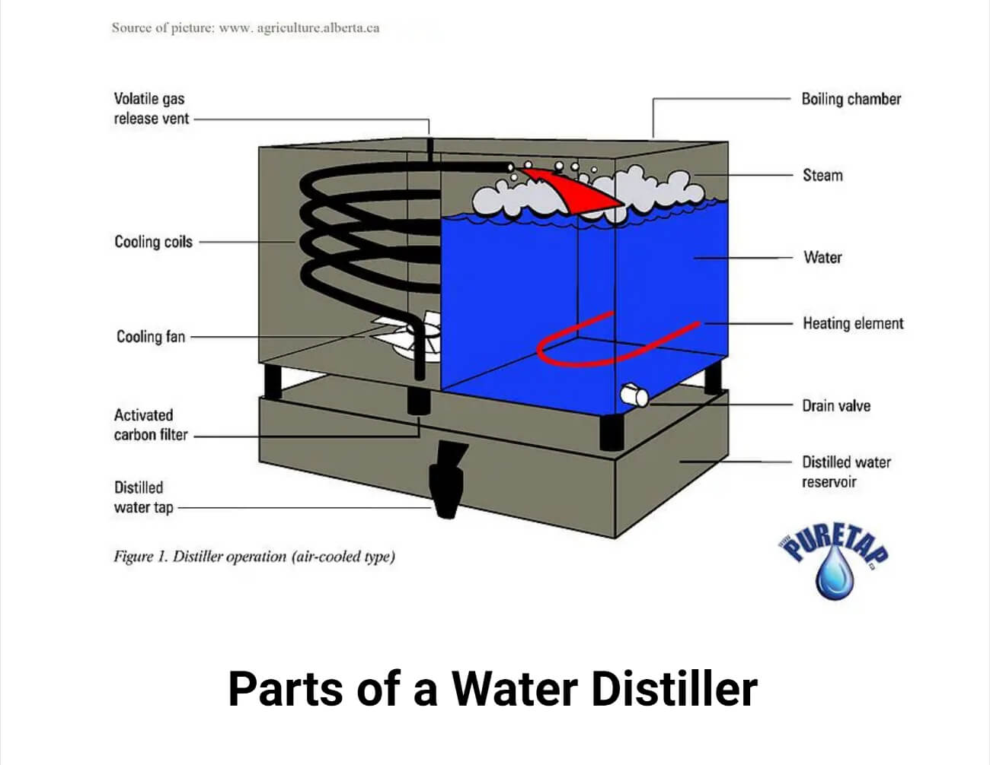
Parts of a Water Distiller
Vapour generator/Boiling tank
Small-volume water distillers are made of glass, while larger-volume machines are made of stainless steel with copper, tin, or titanium coverings. It is designed to store the water to be distilled.
Water Level Gauge
It facilitates the regulation of the quantity of water in the vapor generator. The device enables the amount of liquid that has evaporated to be recovered when the amount of water in the liquid phase in the boiling tank drops.
Control valve
It is a device that allows water flow toward the vapor generator tank to be controlled mechanically or electromechanically.

Slide 12
Immersion resistors
When an electrical current passes through them, it produces heat. These are sealed off by a ceramic cover and shielded from the external environment by a metal plate.
Refrigerator water outlet It is a line utilized for condensing the water vapor (cooling).
Condenser The device cools and returns the vapor to its liquid phase after losing thermal energy. The process is sped up by forced convection, which involves circulating low-temperature fluids (such as water or air) around the line where the vapor flows.
Filter Activated carbon filters are found in water distillers near the condenser or collector exit. As the vapor is being condensed, these remove any flavors or particles that could be there.
Distilled water container
It is the container where the liquid that has undergone distillation is collected. Ionic contamination must be prevented by storing distilled water in designated plastic containers. Containers made of polytetrafluoroethylene, polyethylene, or polypropylene are typically used.

Slide 13
Maintain a Water Distiller
it is important to clean the system regularly and replace the activated carbon filter when necessary
Continuous supervision is required to ensure an adequate supply of cooling water, that the boiling flask doesn’t run dry (sometimes automatic protection is offered), and that the receiver isn’t overfilled.

