Slide 1

Ethics and Deontology
الاخلاقيات و الاداب الحامعية

Slide 2
Course Contents:
Chapter 01.Fundamental concept
Definition
Distinction between the different concepts
Chapter 02.University franchise
Concept of university franchises
Actors of Campus University
Chapter03 University Charter of Ethics and Deontology
Right of student
Duties of student
Teacher’s rights
Obligation of the research professor
Obligation of administrative and technical staff
Chapter 04.University values
Social values
Community values
Professional values

Slide 3
Chaptre 2
university franchise

Slide 4
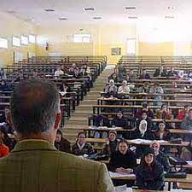
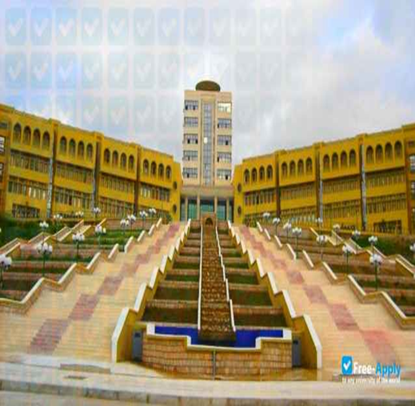
Introduction
What is a university?
A university is an organization that provides higher learning to individuals and promotes knowledge and discovery.

Slide 5
What is franchise University?
A university franchise is a concept that expresses the strengths of a university, and in which the security forces cannot interfere without prior approval from those responsible. This position is saved in law or custom,
This concept expresses the sacred character of the university and respect for science and knowledge
the concept of university franchises assumes that the university president is qualified and authorised to maintain order and security at the university.
.

Slide 6
What is the meaning of university campus? الحرم الجامعي
A campus university is a British term for a university situated on one site, with student accommodation, teaching and research facilities, and leisure activities all together. It is derived from the Latin term campus, meaning "a flat expanse of land, plain, field

Slide 7
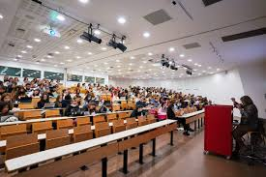

Definition: A campus refers to the physical grounds and buildings of a university or college. It includes
Building for teaching events
Libraries and learning centers:
Administration building
Sports and recreation facilities
Dining Hall and Cafeterias

Slide 8
University campus actors الجهات الفاعلة في الحرم الجامعي
The Rector of the University and the management staff رئيس الجامعة والطاقم
الإداري
vice-Presidents, Secretary General of the University, Deans of the Faculties, Directors of the Institutes, Vice-Deans, Vice-Directors, Secretaries General of the Faculties and Institutes, Heads of Departments, Deputy Heads of Departments
The Board of Directors مجلس الإدارة
Comprises representatives of the State and elected officials from the university family and the major employment sectors.
University Ethics Council مجلس أخلاقيات الجامعة
It is a special body made up of senior members of the teaching staff with a reputation for good behaviour and ethical standards. It guarantees compliance with university ethics and deontology,

Slide 9
Disciplinary council المجلس التأديبي
These bodies ensure that students comply with the general rules of discipline and that order is maintained on the premises of the University.
Joint Commission اللجنة المشتركة
These are committees responsible for considering all individual employee matters.

Slide 10


Cultural and sporting activities الأنشطة الثقافية والرياضية
Scientific Club النادي العلمي
for practising scientific and cultural activities organised by students within the Institution
Cultural and sports associations الجمعيات الثقافية والرياضية
Social partners شركاء اجتماعيو
Workers' unions النقابة العمالية
Student unions الاتحادات الطلابية :

