Slide 1
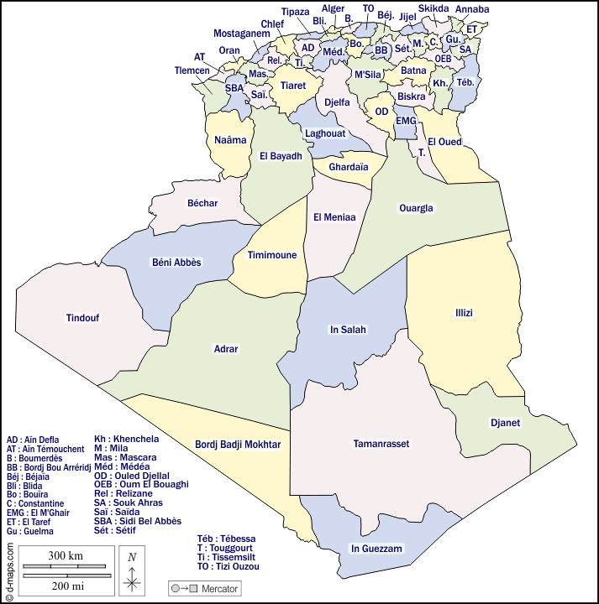
Graph Coloring
Introduction
  Have you ever wondered about the minimum number of colors required to color the map of Algeria so that adjacent cities (with a common boundary) have two different colors?
  This problem of finding the minimum number of colors is called the map coloring problem.

Slide 2
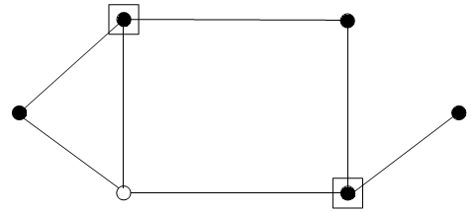
Graph Coloring
Definition
  A vertex coloring of a graph G is an assignment of colors to vertices of G in such a way that no two adjacent vertices have the same color.
  Examples:
  Scheduling: Assigning resources (e.g., classrooms, time slots) without conflicts.
  Mapping: Coloring maps to avoid adjacent regions with the same color.
  …

Slide 3
Graph Coloring
Definition
  A graph is called k-colorable if it has a vertex coloring of k colors.
  The minimum number of colors required to color a graph G is called the chromatic number of G, usually denoted as X(G).
  If G has a subgraph H : X(H) ≤ X(G).
  The Four-Color Theorem: any planar graph can be colored with at most four colors.
  If D is the maximum degree in a graph, the chromatic number X(G) ≤ D + 1

Slide 4
Graph Coloring
Definition
  The subsets C₁,…, C_{k} are called the color classes if :
  C_{i} = { v in V / v is assigned the color i }, for 1 ≤ i ≤ k
  C_{i}∩C_{j}=φ , for every i ≠ j,
  V = C_{i} ∪...∪ C_{k}
  Each color class in a graph coloring is a stable set.
  Graph coloring can be defined as partitioning a graph into stable sets.

Slide 5
Graph Coloring
Definition
  The chromatic number of the complete graph K_{n} is : ?
  The chromatic number of a bipartite graph with a non-empty edge set is : ?
  Let C_{n} a cycle of length n :
      if n is even then: X(C_{n}) = ?
      and if n is odd then: X(C_{n}) = ?

Slide 6
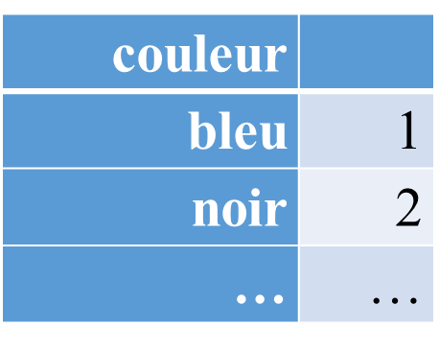
Graph Coloring
Welsh-Powell Algorithm for Graph Coloring
  The Welsh-Powell algorithm is a simple and efficient heuristic for coloring a graph
  In some cases, it may produce a suboptimal solution. However, it's often a good choice for graph coloring problems.
Entries : G=(X ; U) a graph, Output : a colored graph
Intermediate variables: L , V : two lists of vertices, s : a vertex
Begin
L = list of vertices sorted in decreasing order
current color = 0

Slide 7
Graph Coloring
Welsh-Powell Algorithm for Graph Coloring
Begin
L = list of vertices sorted in decreasing order
current color = 0
  while L ≠ ∅ do
    Increment current color
    Color the 1st​ vertex s of L with the current color.
    Remove s from L
    V = list of neighbors of s
    For each x in L do
IF x ∉ V then
        Color x with the current color
        add the neighbors of x to V
EndIf
    EndFor
    Remove colored vertices from L
  EndWhile
END

Slide 8
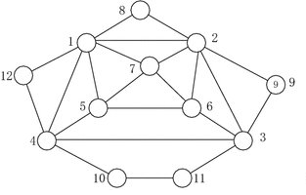
Graph Coloring
Welsh-Powell Algorithm for Graph Coloring
  Example:

