Slide 1
Democratic and Popular Republic of Algeria
Ministry of Higher Education and Scientific Research
Mila University
Institute of Mathematics and Computer Science - Computer Science Department
2nd Year Computer Science - Semester 3
Basics of Graph Theory
Module Supervisor:
Mr Merabet Adil
Email : a.merabet@centre-univ-mila.dz
https://elearning.centre-univ-mila.dz/a2024/course/view.php?id=331

Slide 2
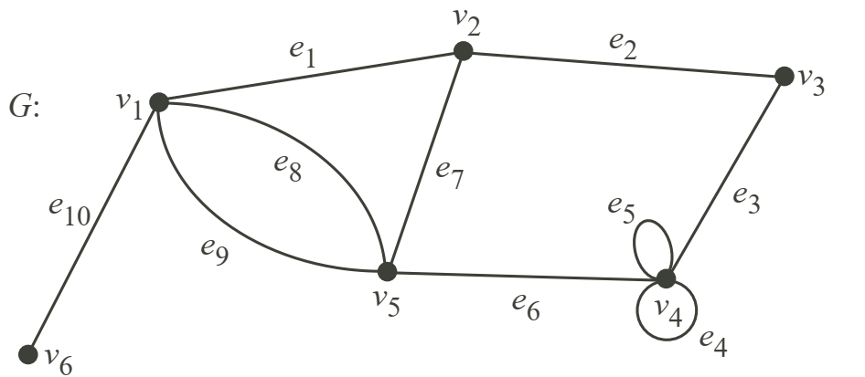
Basics of Graph Theory
Walks, Trails, Paths, Circuits
1. Walks
A walk in the graph G = (V, E) is a continuous sequence of edges connecting two vertices. It is allowed to visit a vertex or go through an edge more than once. k is the length of the walk
Example: v2, e7, v5, e8, v1, e8, v5, e6, v4, e5, v4, e5, v4 is a walk.
2. Trails
A walk is a trail if any edge is traversed at most once.
Example: v1, e8, v5, e9, v1, e1, v2, e7, v5, e6, v4, e5, v4, e4, v4 is a trail
3. Paths
A trail is a path if any vertex is visited at most once (except possibly the initial and terminal vertices when they are the same).
Example: v2, e7, v5, e6, v4, e3, v3 is a path
4. Circuits
A closed path is a circuit (not empty, the initial vertex = the terminal vertex)
Example: v2, e7, v5, e6, v4, e3, v3, e2, v2 is a circuit

Slide 3
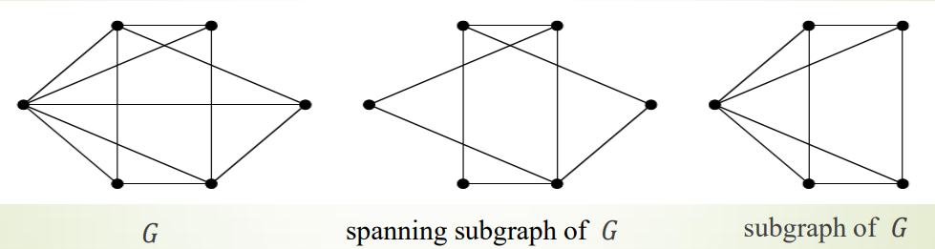
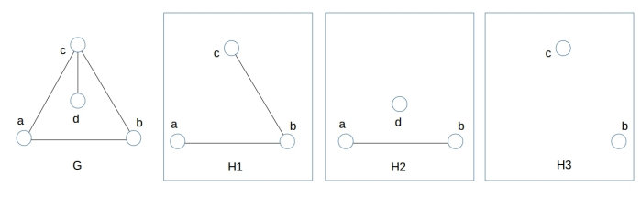
Basics of Graph Theory
Subgraphs, Spanning Subgraph, Induced Subgraph
1. Subgraphs
A graph 𝐻(𝑉1, 𝐸1) is said to be a subgraph of a graph 𝐺(𝑉, 𝐸) if 𝑉1 ⊆ 𝑉 and 𝐸1 ⊆ 𝐸.
2. Spanning Subgraph
A graph 𝐻(𝑉1, 𝐸1) is said to be a spanning subgraph of a graph 𝐺(𝑉, 𝐸) if 𝑉1 = 𝑉 and 𝐸1 ⊆ E.
3. Induced Subgraph
A subgraph that contains every allowable edge between its vertices is called an induced subgraph
Which subgraph is an induced subgraph?

Slide 4
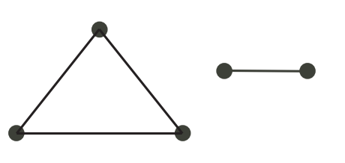
Basics of Graph Theory
Connection, Components (Undirected Graph)
1. Connection
The walk starting at u and ending at v is called an (u,v) walk.
u and v are connected if there is a (u,v) walk in the graph.
If u and v are connected and v and w are connected, then u and w are also connected
If there is a (u,v) walk and a (v,w) walk, then there is also a (u,w) walk.
A graph is connected if all the vertices are connected to each other
Example. This graph is not connected.

Slide 5
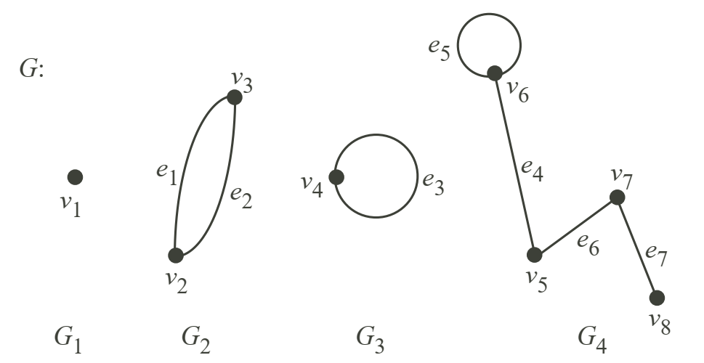
Basics of Graph Theory
Connection, Components (Undirected Graph)
2. Components
The subgraph G1 (not a null graph) of the graph G is a component of G if:
G1 is connected,
G1 is trivial (one single isolated vertex of G)
G1 is not trivial and G1 is the subgraph induced by those edges of G that have one end vertex in G1.
Different components of the same graph do not have any common vertices
Example: The components of G are G1, G2, G3 and G4.

Slide 6
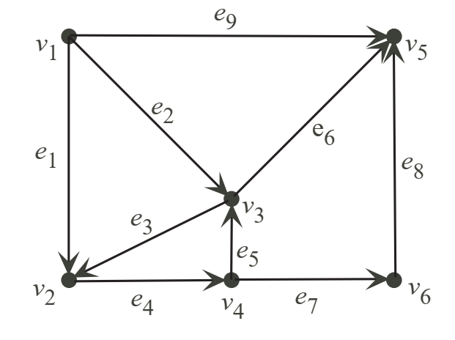
Basics of Graph Theory
Connection, Components (Directed Graph or digraph)
a digraph is formed by vertices connected by arcs (directed edges )
3. Connection
Vertices u and v are strongly connected if there is a directed (u,v) path and also a directed (v,u) path in G
Digraph G is strongly connected if every pair of vertices is strongly connected. By convention, the trivial graph is strongly connected.

Slide 7
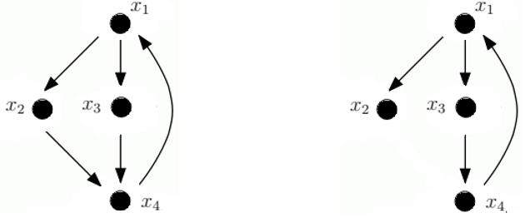
Basics of Graph Theory
Connection, Components (Directed Graph or digraph)
a digraph is formed by vertices connected by arcs (directed edges )
4. Components
A strongly connected component H of the digraph G is a directed subgraph of G such that H is strongly connected, but if we add any vertices or arcs to it, then it is not strongly connected anymore
Example: strongly connected or not?

Slide 8
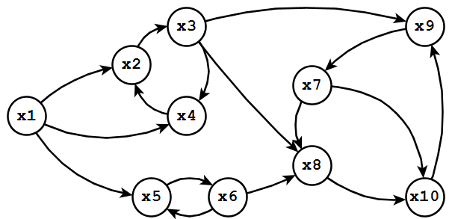
Basics of Graph Theory
Connection, Components (Directed Graph or digraph)
4. Components
The strongly connected components are:
  ({v1}, ∅),
  ({v2, v3, v4}, {e3, e4, e5}),
  ({v5}, ∅) and
  ({v6}, ∅).
Example: find the strongly connected components of:

Slide 9
Basics of Graph Theory
Finding the Strong Components of a Digraph
1. Example of use
When designing a communication network, knowing whether the chosen configuration allows communication from any point to any other may be interesting.
One way to check this is to represent the network as a graph and verify if it is strongly connected.

Slide 10
Basics of Graph Theory
Finding the Strong Components of a Digraph
2. Finding a strongly connected component from a vertex v :
Step 1: Traverse the graph from a vertex v in the direct direction:
Create the first set X1 (groups the vertices accessible from v)
Step 2: Traverse the graph from a vertex v in the indirect direction:
Create the second set X2 (groups the vertices they can reach v)
Step 3: The intersection of the two sets gives the vertices that both can reach v and are reachable from v
This intersection X= X1 ∩X2 is therefore the strongly connected component that contains v

Slide 11
Basics of Graph Theory
Finding the Strong Components of a Digraph
2. Finding a strongly connected component from a vertex v :
Algorithm 1
Begin
    Mark v by +/-
    On all vertices not marked by +/− :
        X1 = Mark by + any vertex successor of a vertex marked by +
        X2 = Mark by − any vertex predecessor of a vertex marked by –
    X = any vertex marked by +/−
END

Slide 12
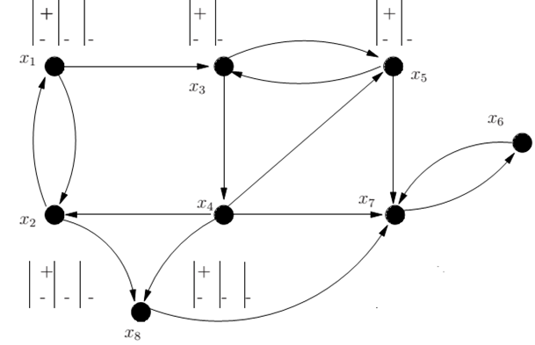
Basics of Graph Theory
Finding the Strong Components of a Digraph
3. Example of finding a strongly connected component from a vertex v :
Beginning
Mark v by +/-
On all vertices not marked by +/− :
    X1 = Mark by + any vertex successor of a vertex marked by +
    X2 = Mark by − any vertex predecessor of a vertex marked by –
X = any vertex marked by +/−
END

Slide 13
Basics of Graph Theory
Finding the Strong Components of a Digraph
4. Finding all strongly connected components :
Step 1: randomly choose a vertex v and determine, using the previous algorithm, the strongly connected component that contains v.
We obtain the first strongly connected component C1.
Step 2: among the vertices not part of C1, we randomly take another vertex x to determine the strongly connected component that contains x.
We obtain the second strongly connected component C2.
Step 3: we repeat until all vertices belong to a strongly connected component.

Slide 14
Basics of Graph Theory
Finding the Strong Components of a Digraph
4. Finding all strongly connected components :
Algorithm 2
Input: G=(V, E) a graph. Output: C={ C1,…,CN } a set of strongly connected components.
Intermediate variables : X': a subset of vertices, x : a vertex, i an integer .
Begin
  X' ← X ; i ← 1 ;
  While ( X'≠ ∅ ) do
    choose x in X' ;
    Ci ← algo1_StronglyConnectedComponent(G,x );
    X' ← X' – Ci ;
    i ← i + 1 ;
  EndWhile
End

Slide 15
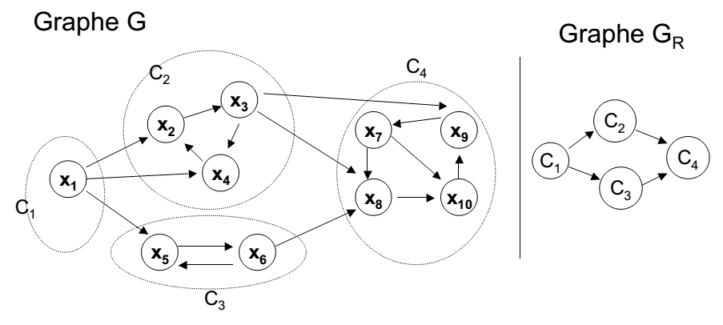
Basics of Graph Theory
Finding the Strong Components of a Digraph
5. Example of finding all strongly connected components :

Slide 16
Basics of Graph Theory
Finding the Strong Components of a Digraph
6. The condensed graph :
The condensed graph Gc of the digraph G is obtained by contracting all the arcs in every strongly connected component.
Each component strongly connected of G is replaced by a vertex

