Slide 1
Democratic and Popular Republic of Algeria
Ministry of Higher Education and Scientific Research
Mila University
Institute of Mathematics and Computer Science - Computer Science Department
2nd Year Computer Science - Semester 3
Théorie des Graphes
Module Supervisor:
Mr Merabet Adil
Email : a.merabet@centre-univ-mila.dz
https://elearning.centre-univ-mila.dz/a2024/course/view.php?id=331

Slide 2
Basics of Graph Theory
Introduction
  Graph theory is a vast field, constantly evolving.
  This theory allows us to represent a complex set of objects by expressing the relationships between the elements.
the relationship
Object 1
Object 2

Slide 3

Basics of Graph Theory
Introduction
  Graphs (and therefore graph theory) are used in many fields.
  Some examples:
  Data transport networks :
      fixed telephone network,
      GSM,
      3G, 4G
      wi-fi ..

Slide 4
Basics of Graph Theory
Introduction
  Graphs (and therefore graph theory) are used in many fields.
  Some examples:
  Data transport networks :
  Road transport networks,

Slide 5
Basics of Graph Theory
Introduction
  Graphs (and therefore graph theory) are used in many fields.
  Some examples:
  Data transport networks :
  Road transport networks,
  Electronic circuits,

Slide 6
Basics of Graph Theory
  Example 1: The road transport problem
  How can we get from city A to a city G as quickly as possible? Knowing the duration of the following trips:
  Users take 4 hours to travel from city A to city N.
  It takes users 9 hours to travel from city A to city M.
  It takes users 12 hours to travel from city A to city L.
  Traveling from city M to city G takes users 4 hours 30 minutes.
  It takes users 4 hours and 30 minutes to travel from City C to City G.
  Users take 1 hour and 15 minutes to travel from city L to city G.
  Traveling from city M to city L takes users 2 hours and 30 minutes.
  Users take 2 hours to travel from city N to city D.
  It takes users 7 hours to travel from city N to city L.
  Users take 1 hour to travel from city D to city C.

Slide 7
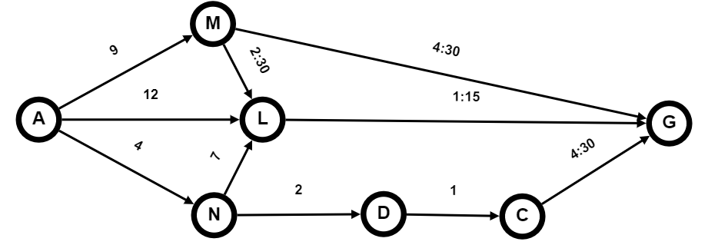
Basics of Graph Theory
  Example 1: The road transport problem
  How do you get from city A to city G as quickly as possible?
  It is easier to explain the problem using a graph,
  A good picture is worth a thousand words (Un bon dessin vaut mieux qu’un bon discours)

Slide 8
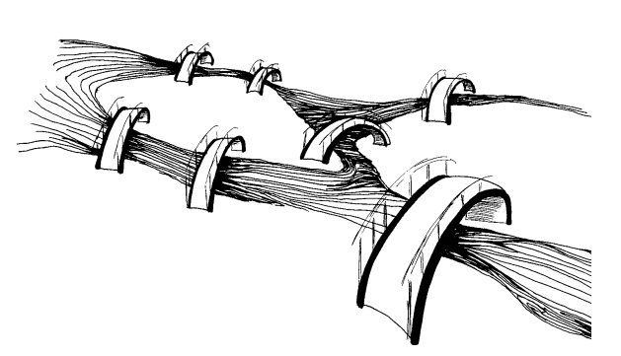
Basics of Graph Theory
  Example 2: The Königsberg bridge problem (Euler)
  The question is: Can someone follow a route such that he crosses each bridge once and only once?

Slide 9
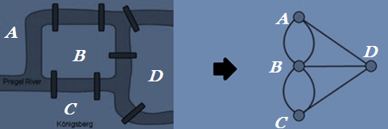
Basics of Graph Theory
  Example 2 : The Königsberg bridge problem (Euler)
  The question is : Can someone follow a route such that he crosses each bridge once and only once?

Slide 10
Basics of Graph Theory
  Graphs therefore constitute a way of thinking.
  which makes it possible to model and solve a wide variety of problems.

Slide 11
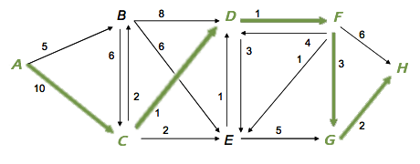
Basics of Graph Theory
  Solutions to some problems:

Slide 12
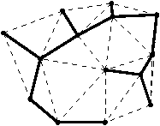
Basics of Graph Theory
  Solutions to some problems:

Slide 13
Basics of Graph Theory
  Solutions to some problems:

Slide 14


Basics of Graph Theory
  Solutions to some problems:

Slide 15
Basics of Graph Theory
  Basic concepts and definitions

Slide 16
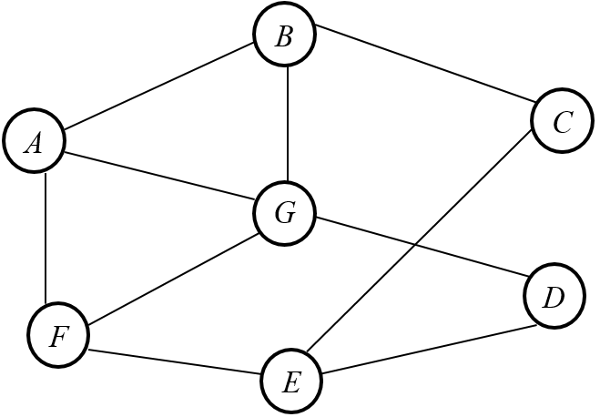
Basics of Graph Theory
Basic concepts
1. Definitions
a graph is formed by:
vertices and,
edges connecting the vertices.

Slide 17
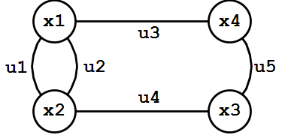
Basics of Graph Theory
Basic concepts
1. Definitions
Mathematically,
a graph is a pair of sets (V, E), where V is the set of vertices and E is the set of edges, formed by pairs of vertices.
  G = ( X ; U ) where
  X = { x ₁ , x ₂ , x ₃ , … , x _{n} } is the set of vertices
  U = { u ₁ , u ₂ , u ₃ , … , u _{m} } is the set of arcs.

Slide 18
Basics of Graph Theory
Basic concepts
1. Definitions
A graph contains two types of information:
    The information given by the summits.
    The information given by the edges between the vertices.

Slide 19
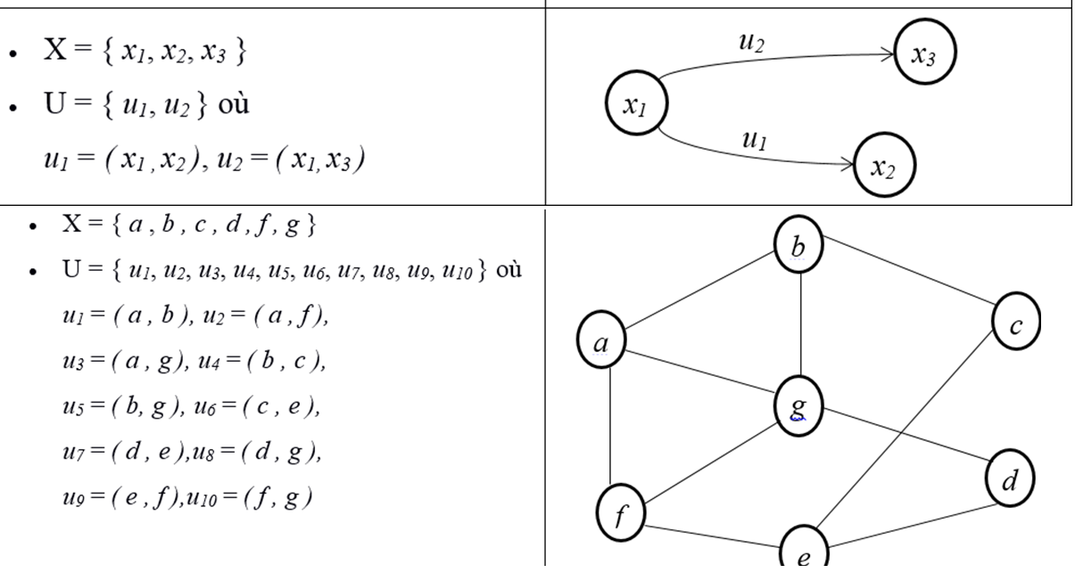
Basics of Graph Theory
Basic concepts
  Mathematically Representation Graphic Representation

Slide 20


Basics of Graph Theory
Basic concepts
Arcs and Edges
  u₁ in a graph is a pair u₁ = ( x₁, x₂ )
u₁ is an edge, if x₁ is related to x₂ and x₂ is related to x₁ . The order of x₁ and x₂ is not important in the couple ( x₁, x₂ ). Thus, ( x₁, x₂ ) = ( x₂, x₁ )
u₁ is an arc (oriented edge), if an object x₁ can be in relation with x₂ without x₂ necessarily being in relation with x₁ . The order of x₁ and x₂ is important in the couple ( x₁, x₂ ). Thus, ( x₁, x₂ ) ≠ ( x₂, x₁ )

Slide 21
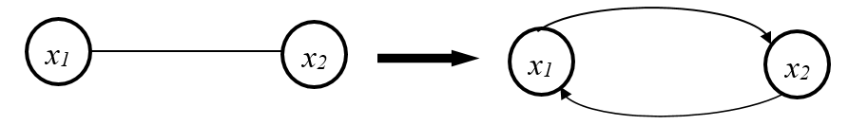
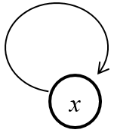
Basics of Graph Theory
Basic concepts
Arcs and Edges
An edge can always be transformed into arcs
For an arc u = ( x₁, x₂ ), x₁ is the initial vertex end, x₂ the terminal vertex (or origin and destination). The arc u starts from x₁ and arrives at x₂
A loop is an arc whose : initial vertex is equal to its terminal vertex . For example: ( x , x ) is a loop.

Slide 22
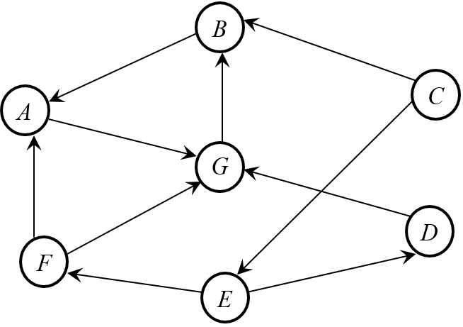
Basics of Graph Theory
Basic concepts
3. Directed Graph and Undirected Graph :

Slide 23
Basics of Graph Theory
Representations of a graph
      The adjacency matrix
      The incidence matrix
      The adjacency list

Slide 24
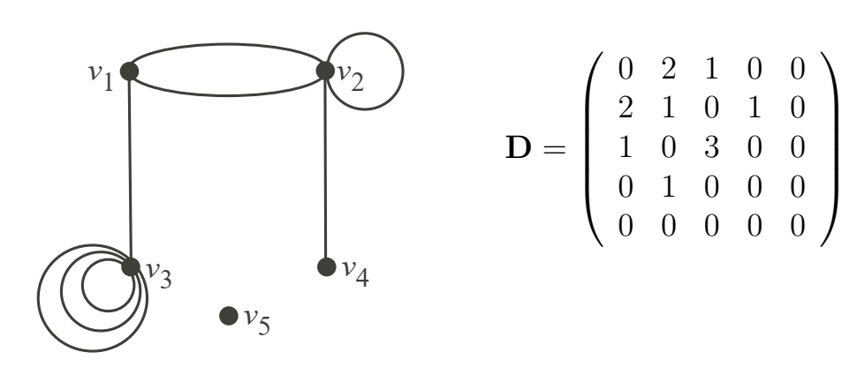
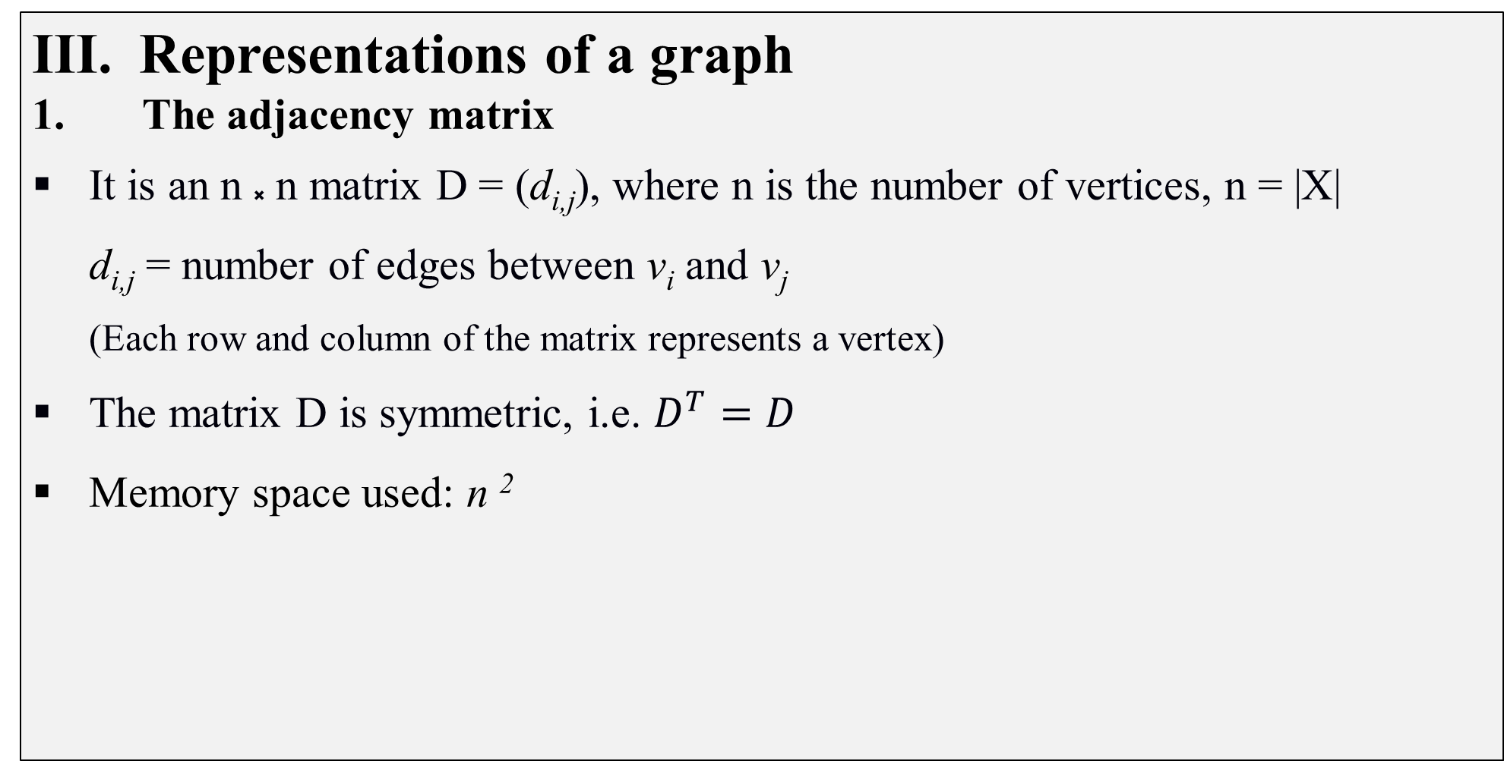
Basics of Graph Theory
Representations of a graph
1. The adjacency matrix
It is an n ⸼ n matrix D = (d_{i,j}), where n is the number of vertices, n = |X|
  d_{i,j} = number of edges between v_{i} and v_{j}
  (Each row and column of the matrix represents a vertex)
The matrix D is symmetric, i.e. $D^{T}=D$
Memory space used: n ²

Slide 25
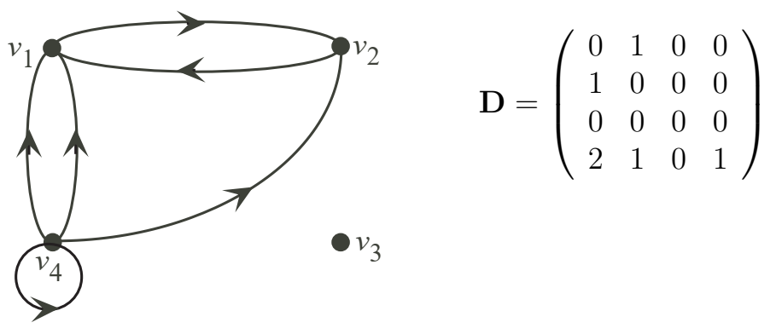
Basics of Graph Theory
Representations of a graph
1. The adjacency matrix
The adjacency matrix of a directed graph G is D = (d_{i,j}),
where d_{i,j} = number of arcs that come out of vertex v_{i} and go into vertex v_{j}

Slide 26
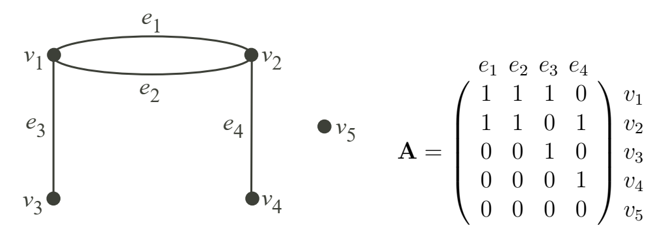
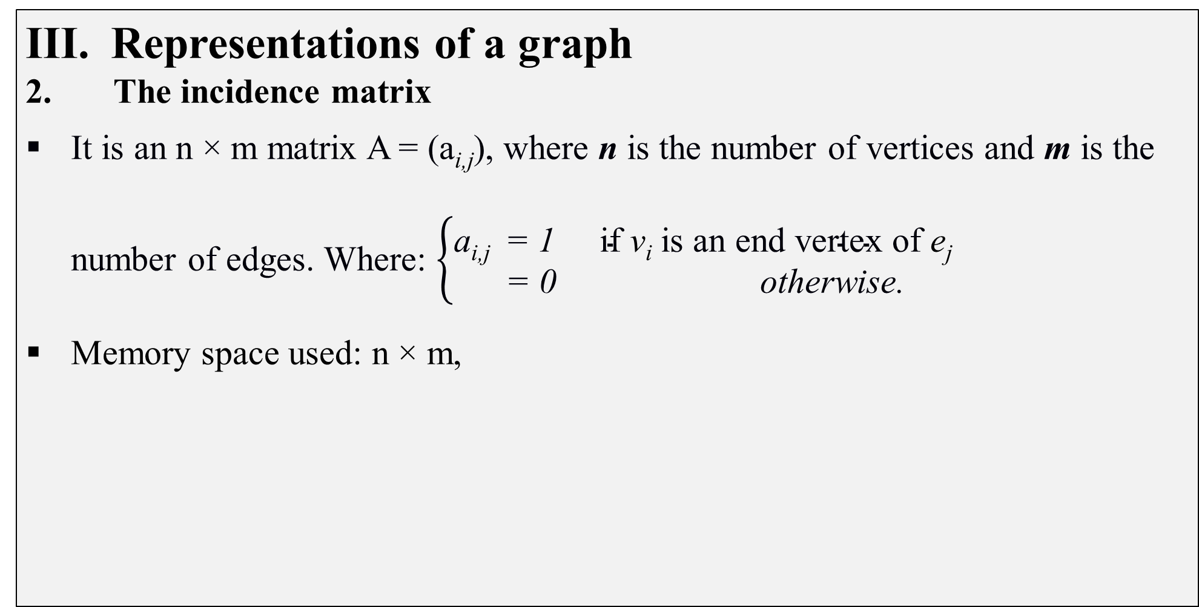
Basics of Graph Theory
Representations of a graph
2. The incidence matrix
It is an n × m matrix A = (a_{i,j}), where n is the number of vertices and m is the number of edges. Where: $\left\{\begin{aligned}\text{a}\text{i}\text{,}\text{j} \text{ = }\text{1 }\text{if} \text{v}\text{i} \text{is} \text{an} \text{end} \text{vertex} \text{of} \text{e}\text{j} \\ \text{= 0 } \text{otherwise}\text{.}\end{aligned}\right.$
Memory space used: n × m,

Slide 27
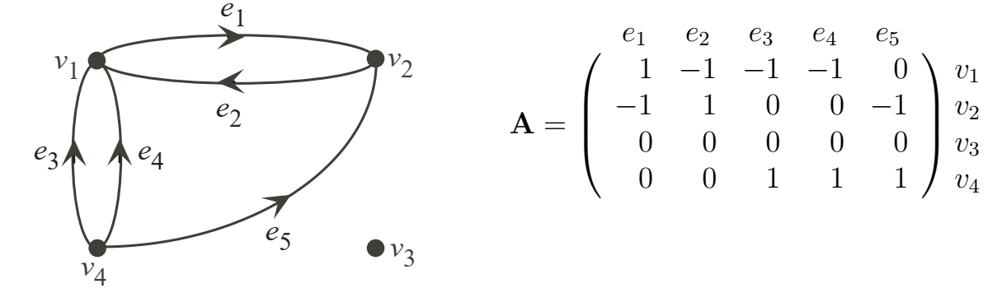

Basics of Graph Theory
Representations of a graph
2. The incidence matrix
The adjacency matrix of a directed graph G is A = (a_{i,j}),
Where: $\left\{\begin{aligned}\text{a}\text{i}\text{,}\text{j} \text{ = } \text{1 } \text{if} \text{v}\text{i} \text{is} \text{the} \text{initial} \text{vertex} \text{of} \text{e}\text{j} \\ \text{a}\text{i}\text{,}\text{j} \text{ = }\text{−}\text{1 }\text{if} \text{v}\text{i} \text{is} \text{the} \text{terminal} \text{vertex} \text{of} \text{e}\text{j} \\ \text{a}\text{i}\text{,}\text{j} \text{ = } 0 otherwise \end{aligned}\right.$

Slide 28
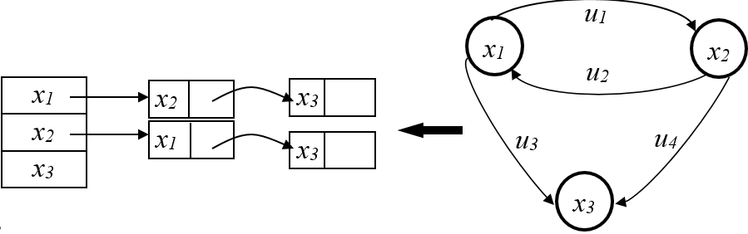
Basics of Graph Theory
Representations of a graph
3. The adjacency list
Each vertex is associated with a list of its adjacent vertices, it is a list of lists or an array of lists.
Each cell i pointing to the linked list of neighbors
It is significantly more efficient in terms of memory occupied than the previous representations (we only code the arcs actually present in the graph).
Easy to add or remove vertices and edges,

Slide 29
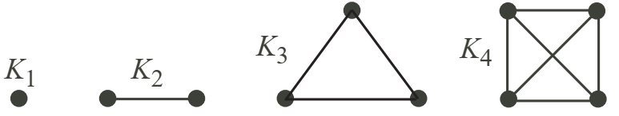
Basics of Graph Theory
We have the following terminologies:
The two vertices u and v are end vertices of the edge (u, v)
Edges that have the same end vertices are parallel.
An edge of the form (v, v) is a loop.
A graph with no edges (i.e. E is empty) is empty.
A graph with no vetices (i.e. V and E are empty) is a null graph.
A graph with only one vertex is trivial.
A that contains every possible edge between all the vertices is called a complete graph. A complete graph with n vertices is denoted as K_{n}

Slide 30
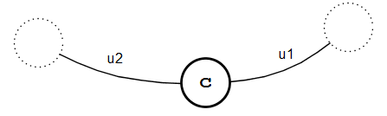


Basics of Graph Theory
We have the following terminologies:
Edges are adjacent if they share a common end vertex.
Two vertices $\text{v}\text{1}$ and $\text{v}\text{2}$ are adjacent if they are connected by an edge
The order of a graph is the number of vertices in that graph.

Slide 31
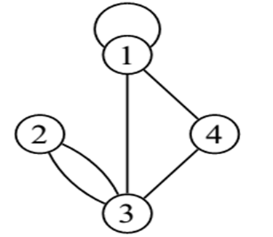
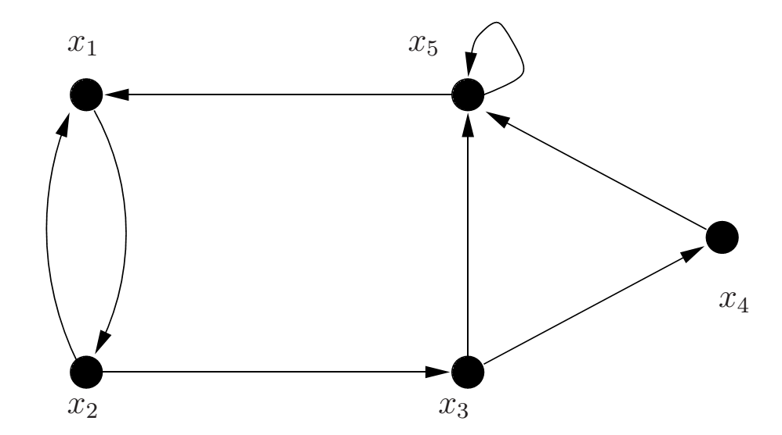
Basics of Graph Theory
We have the following terminologies:
The degree of a vertex v, d(v), is the number of edges with v as an end vertex.
  (by convention, we count a loop twice and parallel edges contribute separately)
The degree of a vertex v in a directed graph,
d(v) = d⁺ (v) + d⁻ (v)
d⁺ (v) : Out-degree: (the number of edges that point from the vertex v).
d⁻ (v) : In-degree (the number of edges that point to the vertex v)
  Example:
d⁺( x₂ ) = 2, d⁻( x₂ ) = 1, d ( x₂ ) = 3
d⁺( x₅ ) = 2, d⁻( x₅ ) = 3, d ( x₅ ) = 5

Slide 32
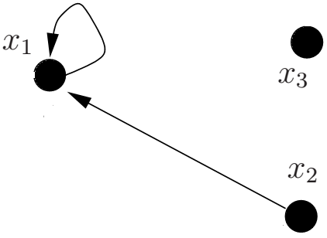
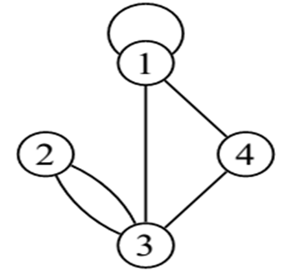
Basics of Graph Theory
We have the following terminologies:
A pendant vertex is a vertex whose degree is 1.
An edge that has a pendant vertex as an end vertex is a pendant edge.
An isolated vertex is a vertex whose degree is 0
The degree of a graph is the maximum degree of all its vertices.
A graph is simple if it has no parallel edges or loops.
In contrast to a simple graph, a multigraph is a graph that allows multiple edges between the same pair of vertices, or contains loops.

