Slide 1
Electronics and system components
Chapter 2. Components of a computer

Slide 2
Presentation plan
1. Computer definition
2. The Personal Computer
3. Von Neumann Architecture
4. Composition of a Personal Computer
5. General diagram of a computer system or General diagram of a computer operation
6. The shapes of the computer

Slide 3
1. Computer definition
Computer definition (see chapter 1.2.2. Computer science)
2. The Personal Computer
IBM (Internal Business Machines) in 1981 ➔ (marketing) of a computer for personal use ➔ PC (Personal Computer)

Slide 4
3. Von Neumann Architecture
John Von Neumann (1903-1957) ➔ A model describing the principles operating of a computer (Von Neumann architecture) (theory)
Memory Unit
Central Processing Unit (CPU)
Control unit (CU)
Arithmetic and Logic Unit (ALU)
Outputs
Inputs

Slide 5
3. Von Neumann Architecture (following)
Von Neumann Architecture
  Central Processing Unit (CPU)
    The Arithmetic and Logic Unit (ALU)
      UAL performs operations on bits 0 and 1 (arithmetic functions and
      comparison functions)
    The control unit (CU)
      Sequence the instructions executed by the UAL, i.e. determine the order
      in which the instructions are executed by the UAL.

Slide 6
3. Von Neumann Architecture (following)
Von Neumann Architecture
  Input devices
    Communication with the outside world
      Data reading
      Programmes reading
  Output devices
    Communication with the outside world
      Provide the results (calculation for example) directly to the user
  Mémoire centrale
    Programmes

Slide 7
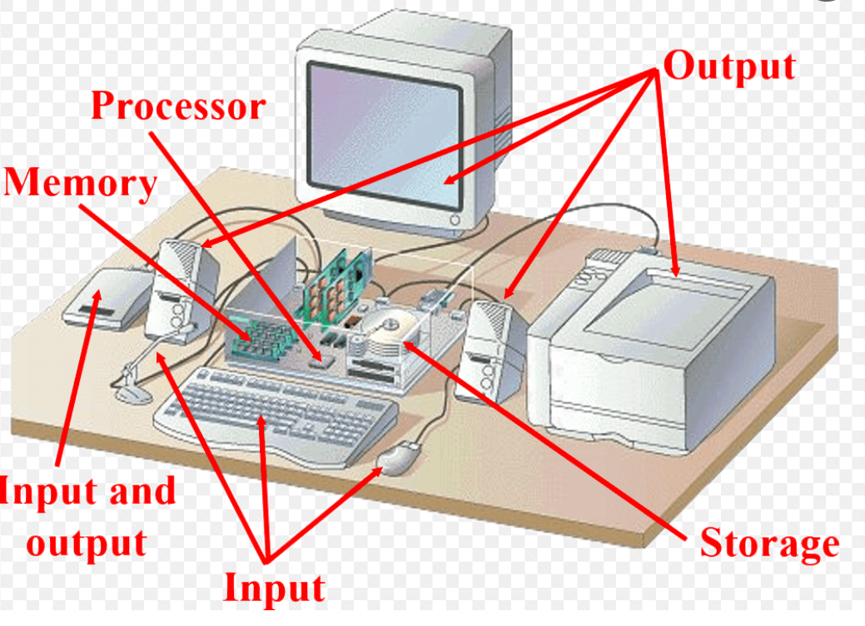
4. Composition of a Personal Computer

Slide 8
4. Composition of a Personal Computer (following)
  Central unit
    Power supply
    Motherboard
      Processor or microprocessor or CPU (Central Processing Unit)
        The Arithmetic and Logic Unit (ALU) (See 3. Von Neumann Architecture)
        The control unit (CU) (See 3. Von Neumann Architecture)
      Memory Unit
      Connectors
    Random Access Memory (RAM)
    Interface cards
      Graphic card
      Soundcard
      Network card
    Hard disk
    Drive CD/DVD

Slide 9
4. Composition of a Personal Computer (following)
  Input devices (information flow in one direction only)
    Keyboard
    Mouse
    Microphone
    Scanner
    Joystick
  Output devices (information flow in one direction only)
    Monitor (screen)
    Printer
    Speaker
  Input /Output devices (information flow in both directions)
    Hard disk drive
    CD-ROM
    Modem (acronym for modulator-demodulator)

Slide 10
4. Composition of a Personal Computer (following)
Summary
Central unit processes and stores information
Peripherals allow communication with the outside world

Slide 11





5. General diagram showing how a computer works (role of its components)
Data input
Processing
Restitution
Data
Instructions
CU
Results
Input devices
Output devices
Auxiliary memories
Joystick
Scanner
Micro
Ecran
Modem
mouse
Floppy disk or USB stick
CD-ROM
Modem
Camera
Hard disk
Keyboard
Speaker
Printer

Slide 12
5. General diagram showing how a computer works (role of its components)
(following)
  Processor ➔ Digital information processing
  Central memory ➔ The processor uses it to store and memorize data and the
  processing results
  Peripherals allow communication with the outside world
  (2.4. Composition of a Personal Computer)
  Bus ➔ Lines linking the different motherboard components to allow the data
  exchange between them

Slide 13
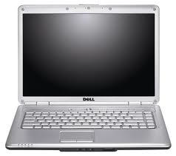
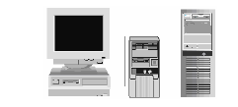

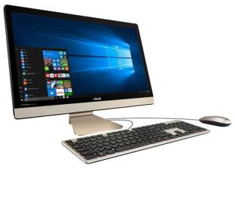
6. Types of the computer
  Mini-tour
  Tour
  Laptop
Desktop
Smartphone
Tablet
All in one

