Slide 1
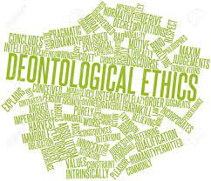
University of Abdelhafid Boussouf Mila
University Ethics and Deontology
الاخلاقيات و الاداب الحامعية

Slide 2
COURSE DESCRIPTION
University of Abdelhafid Boussouf Mila
Teacher: Mrs samira kennouche
Subject: Ethics and Deontology
Grade: 1st year common core science and technology
SEMESTER: 1st
Description of the Content: Theoretical.
Credits: 01 Coefficient: 01
ACADEMIC YEAR: 2024/2025
Department of Science and Technology.

Slide 3
Course Contents:
Chapter 01.Fundamental concept
Definition
Distinction between the different concepts
Chapter 02.University franchise
Concept of university franchises
Actors of Campus University
Chapter03 University Charter of Ethics and Deontology
Right of student
Duties of student
Teacher’s rights
Obligation of the research professor
Obligation of administrative and technical staff
Chapter 04.University values
Social values
Community values
Professional values

Slide 4
Ministry of Higher Education and Scientific Research (Algeria) (MESRS)
The history of higher education in Algeria can be divided into two main periods: before and after Algerian independence in 1962. The first university in Algeria was the University of Algiers, founded in 1910. In 1962, higher education in Algeria was limited to the University of Algiers and two annexes in Oran and Constantine..
in 2022
The university network comprises over 114 university
More than 62,000 teacher
Over 1.5 million student
LMD

Slide 5
Who are the members of the university?
teacher researcher
University Committee
Administrative Staffs
student

Slide 6
introduction
In our everyday conversations, we often refer to current events, we often use certain expressions heard on the news or used by different specialists in the field. We use the words like ethics, morals, or deontology, without always knowing what's behind these words which, in some cases, may seem synonymous. In order to clarify these terms, we have to go through the definition stage
Charter of University Ethics and deontology

Slide 7
Chapter 1
Definition
Concepts
Morality الاخلاق
Ethics علم الاخلاق
Deontology أخلاقيات المهنة

Slide 8
What definition of morality?
moralityالاخلاق
Morality from the Latin moralis meaning customs or manners . Morality is a set of values, beliefs, and principles that guide an individual’s behavior and decisions. It is a code of conduct that is commonly accepted in a particular society or culture
It refers to the distinction between right and wrong, and is usually based on an individual’s personal beliefs and values.
What is a moral person?
Speak the truth

Slide 9
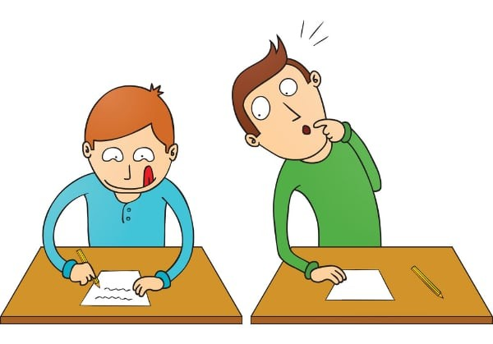
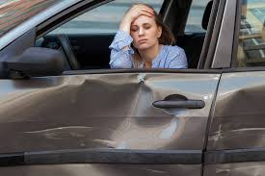
Immoral: Describes someone who purposely commits an offensive act, even though they know the difference between what is right and wrong
Example when student is cheating in exam
a student look someone else's answers or use hidden note during a test
Immoral ≠ moral
Amoral: Describes someone who acknowledges the difference between right and wrong, but who is not concerned with morality
Example driving drunk is amoral behavior

Slide 10












- religions
Conscience
virtue
Sources of morality
Justice
sense of duty
sense of respect

Slide 11
1. La religion: الدين
often involve norms that are supposed to govern behavior(coran)
2conscience:الوعي
It is my conscience that tells me what is good or bad.
3. The sense of duty الاحساس بالواجب: Accomplishing good or seeking it is, above all, a duty.
4. The sense of respect الشعور بالاحترام: Interpersonal relationships should be governed by respect;
5. Justice العدالة: We are all born equal before the law, in other words, there is only one rule that applies to everyone.
6. Virtue الفضيلة: Virtue is specific to a person's character, their identity. A good person, a virtuous person, will accomplish good things.

Slide 12
2. Ethics علم الاخلاق
The word "ethics" is derived from the Greek word ethos (character), and from the Latin word mores الأعراف (customs)
Ethics is the policy of living in the society. It is a way of living which nurtures the order in society
one of the greatest philosophers in modern history, Immanuel Kant (1724–1804),said
Do not do to others what you don't want to be done to you
« Ne fais pas aux autres ce que tu ne voudrais pas que l’on te fasse».

Slide 13
Deontology أخلاقيات المهنة
The word deontology derives from the Greek words for* deon* duty واجب

Slide 14


What is deontology?
Deontology is an ethical theory that says actions are good or bad according to a clear set of rules
focuses on the ethical obligations and responsibilities of professionals within their respective fields
What is an example of deontology in medical practice?
In the principle of deontology, you have moral obligation to treat your patient irrespective of the expected outcome.

Slide 15
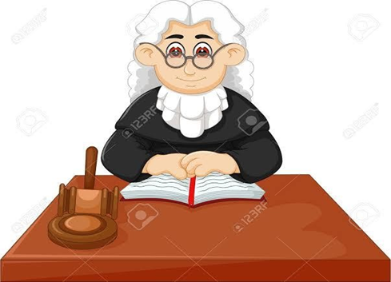
4 Law قانون
The law is a set of rules put in place in order to protect citizens’ rights. These laws are created by legislatures, or elected government officials, and, although the fundamental criminal acts are often the same, they can vary from one country to another. Laws are usually broken down into two key categories: criminal law and civil law

Slide 16
What is the difference between ethics and the law ?
One of the most fundamental differences between ethics and the law is how they are created. While ethics are built up by society over time, and learned from one generation to the next, laws are defined by a ruling government, and can therefore change over time.

Slide 17
2.Distinction between deontology and ethics
Can ethics and deontology be considered synonymous?
invites professionals to reflect on the values that motivate their actions
Values
ethics
Obligations
deontology

Slide 18
To summarise
Morality: what society deems good
Ethics: what I consider good
Deontology: what the profession requires of me
Law: what the law defines as permitted or prohibited

